Slide 1
Update on
Academic Sustainability Programs
Dr. Nanette Chadwick
Director of Academic Sustainability Programs
Office of the Provost
and
Associate Professor
Department of Biological Sciences
Planet
Prosperity
People

Slide 2
What is Sustainability?
“Meeting the needs of the present generation without compromising the ability of future generations to meet their own needs.”
United Nations Commission on Sustainable Development (1987)
Meeting human needs now and in the future in a fair, equitable, and socially just manner, and in a way that protects and maintains healthy ecosystems in perpetuity.
AU Office of Sustainability (2012)

Slide 3
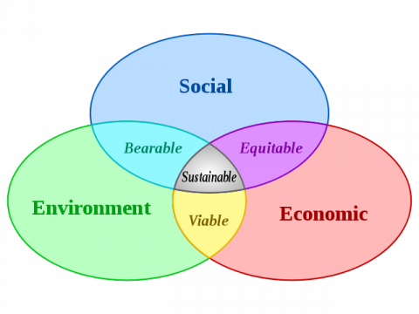
Sustainability as 3 interacting systems

Slide 4
The sustainability compass

Slide 5
Why sustainability?
Preparing students for The Great Transition:
-- population peak of 9 billion before 2100
-- end of ever-expanding, fossil fuel-based economy
-- changing global climate and rising sea levels
-- consequences of the Sixth Extinction
Auburn University’s 2013-2018 Strategic Plan:
“Over the next five years, we will…enhance the commitment to sustainability in our educational programs, research operations, engagement and innovation.”

Slide 6
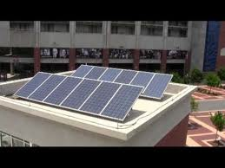
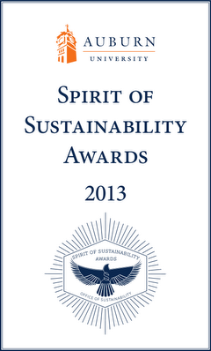
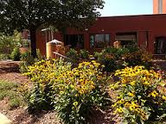

Office of Sustainability:
Campus facilities and operations
Pilot projects (solar energy, water use)
Waste Reduction and Recycling Dept.
Climate Action Plan
Spirit of Sustainability awards
Student internships, Newsletter
http://wp.auburn.edu/sustainability/

Slide 7






Sustainability-Related Student Organizations
https://auburn.collegiatelink.net/organizations
Sustainability Coalition
http://www.auburn.edu/administration/facilities/organization/building-services/recycling/Sustainability-Coalition/

Slide 8
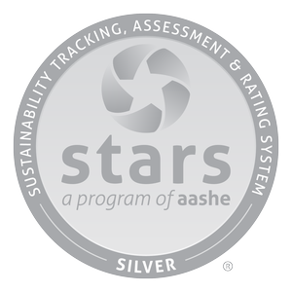

Academic Sustainability Programs
Office of the Provost (teaching & research)/
Faculty development
-- Faculty mixers; opportunities to interact across colleges
-- Online research Inventory (STARS), >70 faculty members listed
-- Research in 8 colleges, cross-college collaborations
-- AU Research Week: Sustainability keywords and sessions
-- Faculty research colloquium series planned
“Greenest College in Alabama”

Slide 9
Minor in Sustainability Studies (one of few in USA)
Established 2008, rapid growth
Diverse students: from 45 majors in 8 colleges
100+ graduated so far + ~60 current
90 in intro courses this year

Slide 10
Faculty opportunities in the
Minor in Sustainability Studies
  Required courses
    Introduction to Sustainability [faculty paid extra to co-teach]
    Senior Capstone [ditto]
    Rails with Trails project outreach: http://www.railwithtrail.com
  Electives in 3 areas (9 hours)
    Society and Markets; Environment; Social Justice
    42 elective courses in 24 departments (changes each year)
      Examples: [faculty can apply for elective status]
        Food, Agriculture and Society
        Sustainable Design and LEED Accreditation
        Political Ecology
        Renewable Energy Resources
        Sociology of Natural Resources and the Environment

Slide 11
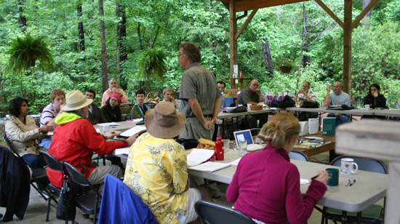
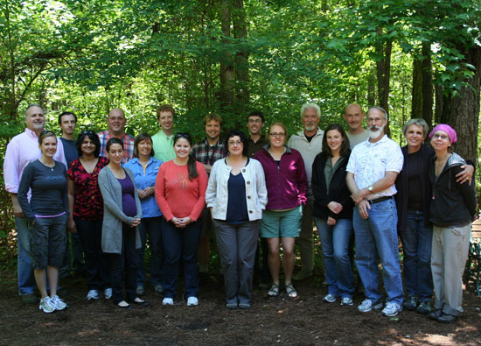
Faculty Development
Workshop and Awards Program
-- $500 for new/revised course syllabus
-- Annual 2-day workshop at Forest Ecology Preserve
~ 80 faculty trained, ~20 each year (from > 30 departments)
40 courses revised to incorporate sustainability
Most rewarding aspect: Interaction with faculty from across campus
http://www.auburn.edu/academic/provost/undergrad_studies/academic_sustainability/general_info.html

Slide 12
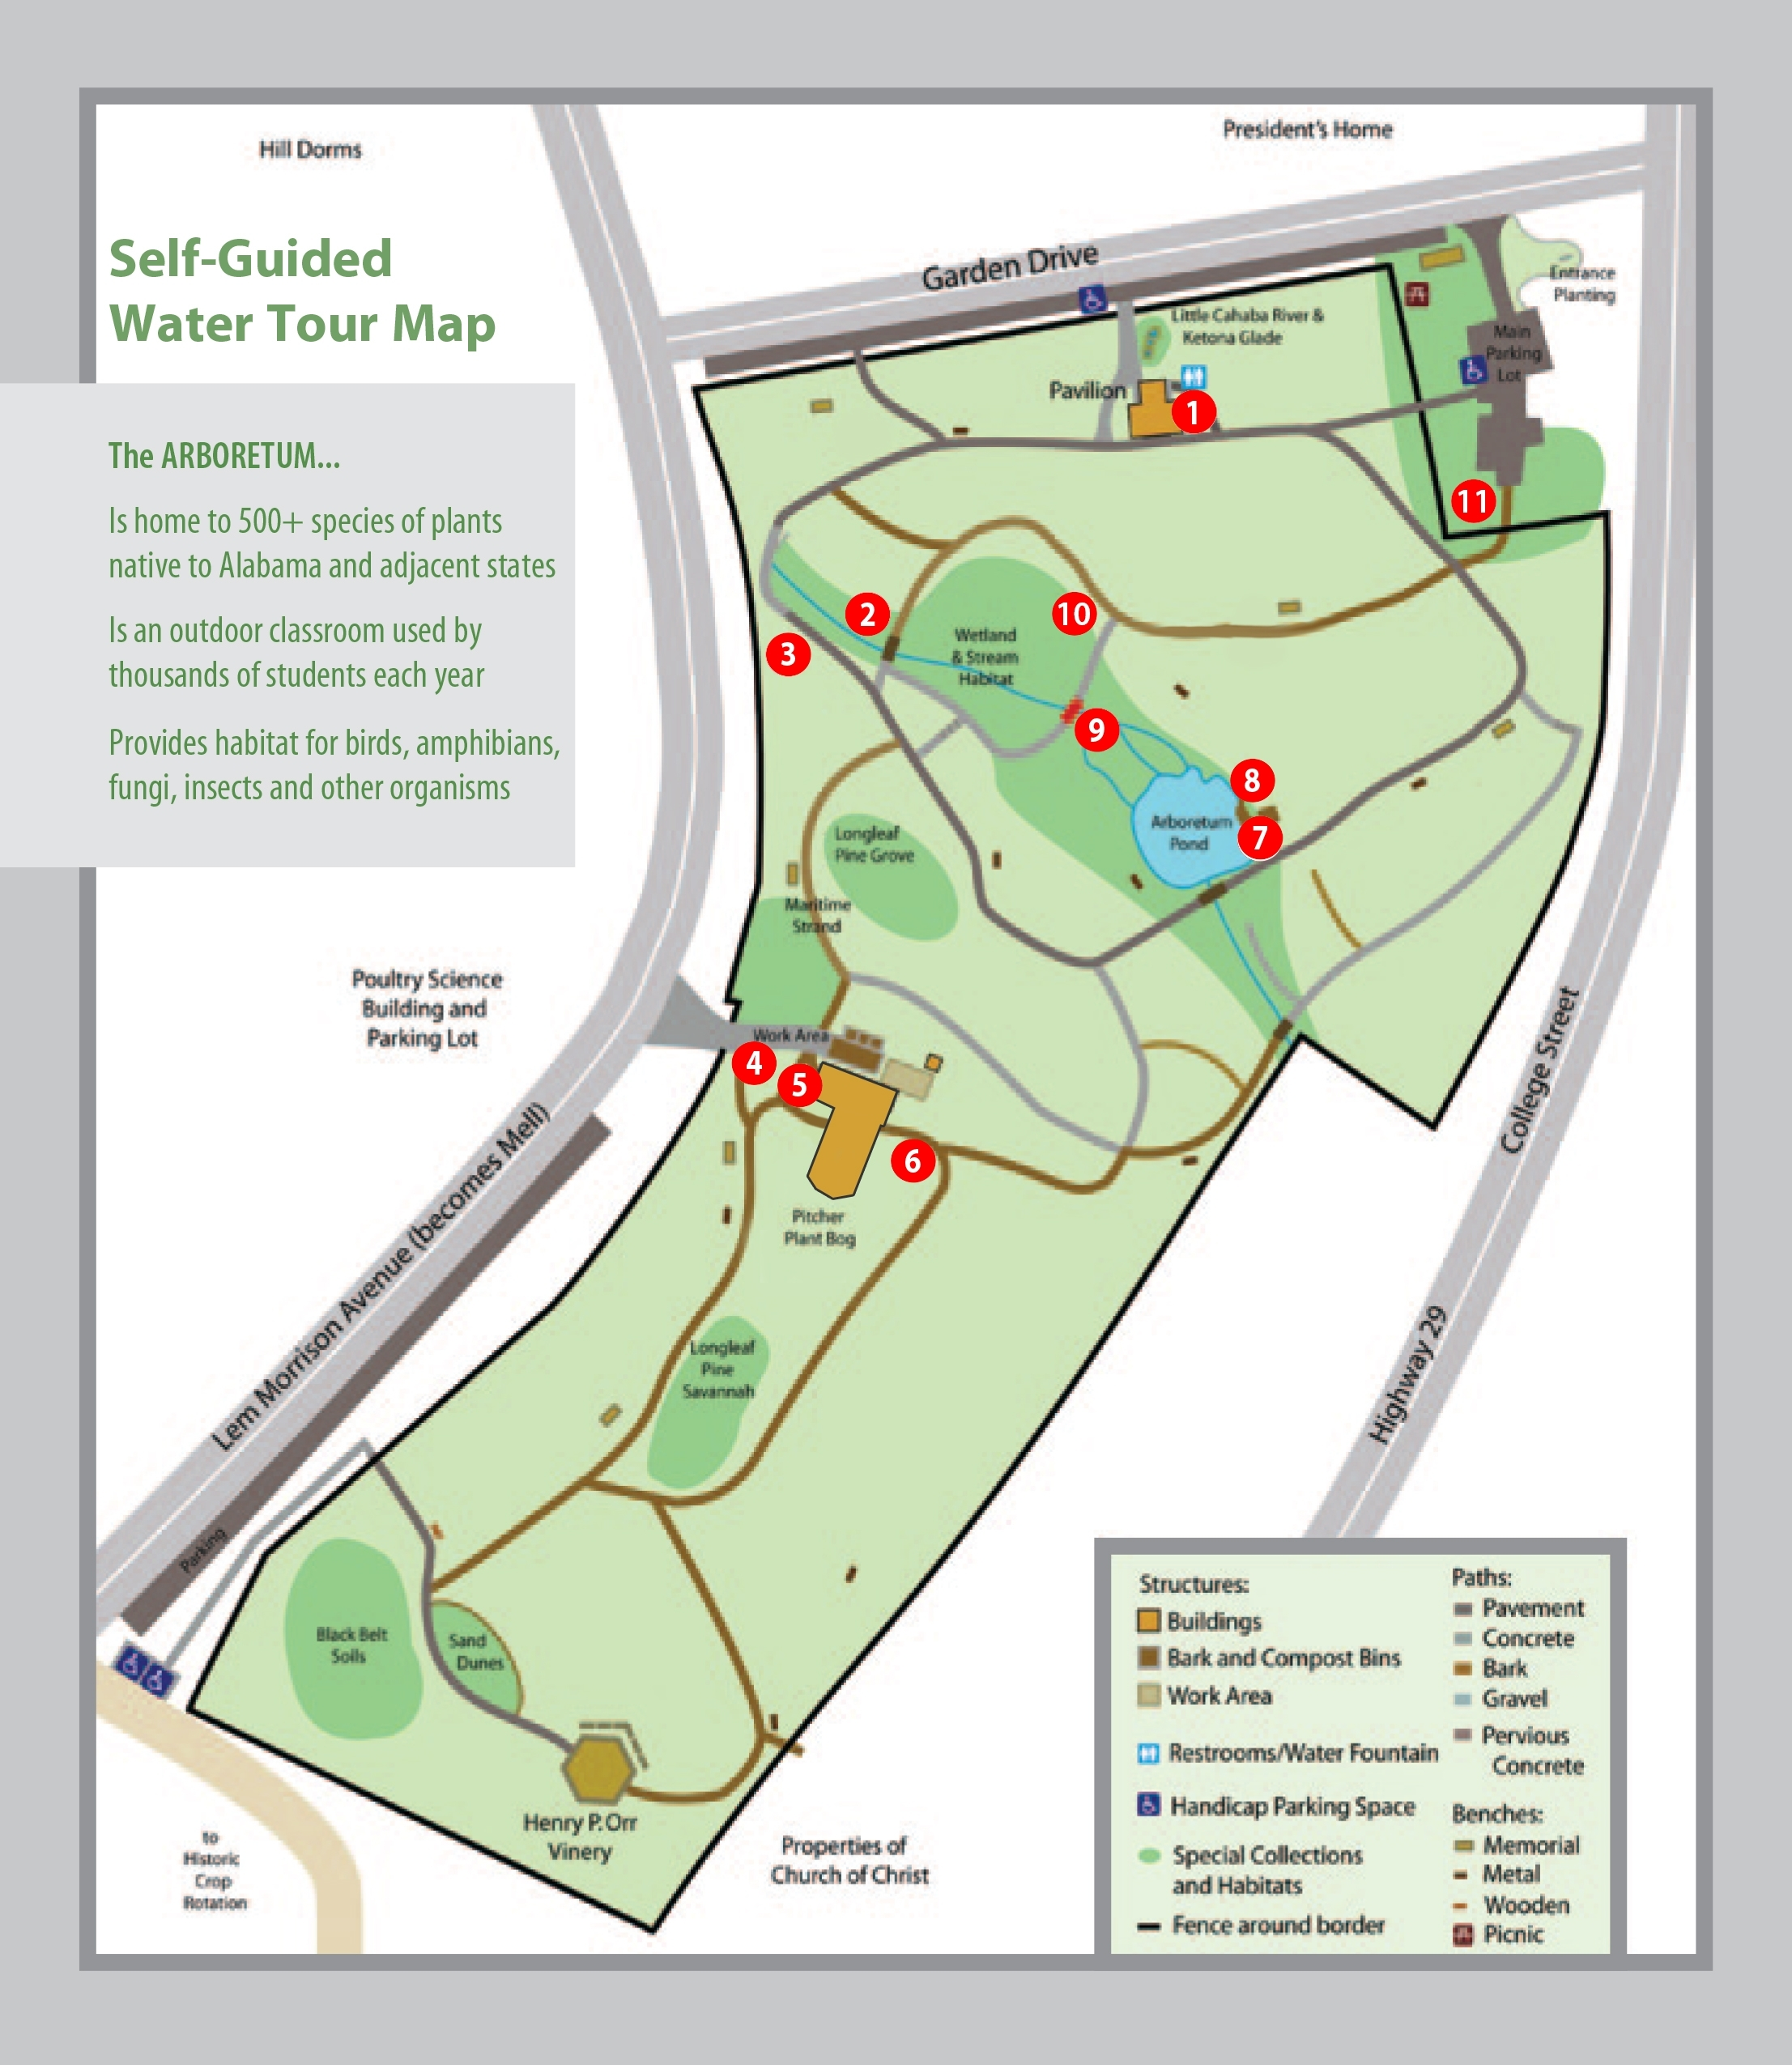
Using Campus
as a Living Laboratory
Course tours available:
Water
Food
Energy
Consumption and Waste
Walkability

Slide 13
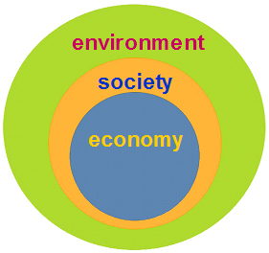
Academic Sustainability
http://www.auburn.edu/academic/provost/undergrad_studies/academic_sustainability/index.html

