Slide 1
IGP Subcommittee report
General Faculty meeting
October 28, 2014

Slide 2
IGP Subcommittee
Faculty research committee
  Dr. Cova Arias, chair (College of Agriculture)
  Dr. Paula Backsheider (College of Liberal Arts)
  Dr. Kevin Huggins (College of Human Sciences)
  Dr. Ya-Xiong Tao (College of Veterinary Medicine)
Task
  Provide a comprehensive assessment of the Intramural Grants Program
Methods
  Qualtrics survey
  2010-2013 IGP recipients

Slide 3
Survey
Regarding your IGP grant, indicate what level did you receive(1, 2, 3 or 4)
Enter funds received from the OVPR office as well as matching funds received from your College, Department or other sources.
List the graduate/undergraduate students whose work has been directly funded (through assistantships, research supplies, or additional learning experiences) by your IGP grant.
List scholarly outputs (i.e. publications, presentations at meetings, performances, invited seminars, etc..) that have been partially/fully funded by your IGP grant.
  Peer-review publication
    Book_____
    Book chapter_____
    Journal article_____
  Proceedings_____
  Meeting presentations_____
  Recitals______
  Exhibits______
  Seminars_____
  Others (explain)_______

Slide 4
Survey cont.
Specify what forms of interdisciplinary collaboration have been made possible through your IGP grant (e.g., publications, applications, membership on thesis/dissertation committees).
  Were you a co-investigator on the IGP grant?
  If yes, which option best describes your work on the project:
    More than proposed
    About as proposed
    Less than proposed
    None at all
  Which best describes the likelihood that there will be a joint proposal for extramural funding:
    A proposal has been submitted
    A proposal is planned in the next 12 months
    Probably
    Highly unlikely
Did the IGP lead you to new research venues? These may include but are not restricted to: grant applications, publications, collaborations with other researchers, implementation on new research methods, etc…. Please, be as detailed as possible.
Only for level 4 recipients: how is the equipment purchased with IGP funds being utilized? How many users are benefiting form this equipment? How have you made the equipment available to other investigators?
From your experience as PI, what areas of the IGP need improvement?

Slide 5
Results
Survey was sent to 133 recipients
82 respondents (62% participation)

Slide 6
174 IGP grants awarded in the last four years

Slide 7
Results
Students funded (directly or indirectly) by IGP

Slide 8
Results
Scholarly outputs

Slide 9
Interdisciplinary collaboration
Forms of interdisciplinary collaboration derived from IGP

Slide 10
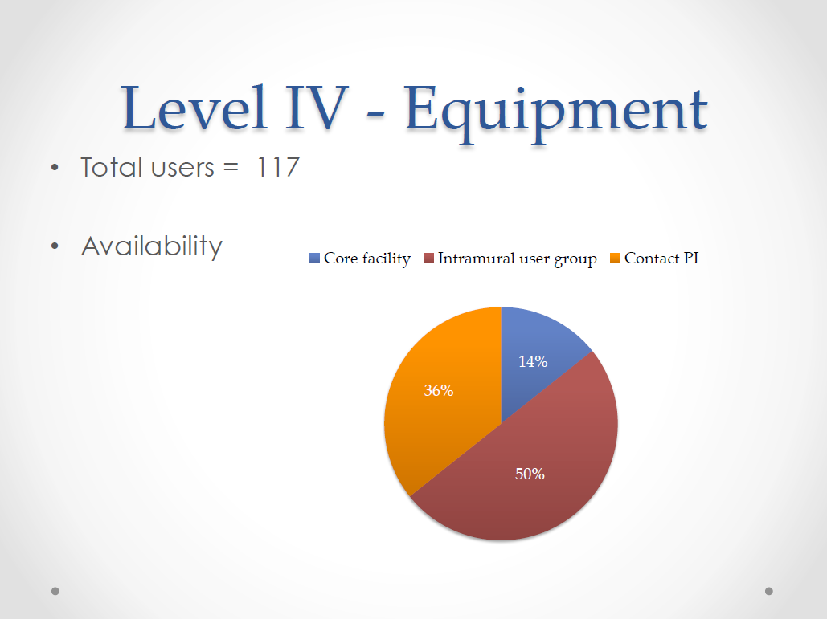

Slide 11
Extramural funding
Likelihood of developing a joint proposal for extramural funding

Slide 12
New research areas
Did the IGP lead you to new research venues?

Slide 13
Areas for improvement

