Slide 1

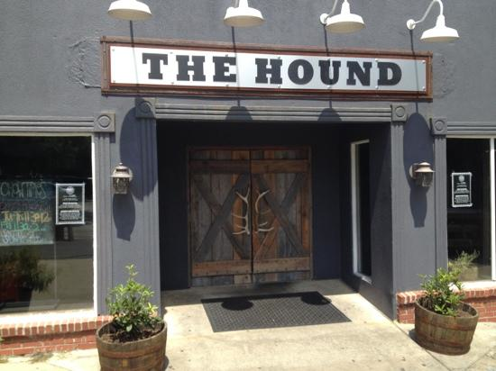
Fall Semester
Faculty Sustainability Mixer
TODAY 4-6pm
The Hound, 124 Tichenor Avenue
Appetizer buffet
Cash Bar available
All faculty invited
Drop-ins after 5pm welcome
Sponsored by
Academic Sustainability Programs

