Slide 1

Capital Projects Plan
Academic Buildings
2015-2020

Slide 2
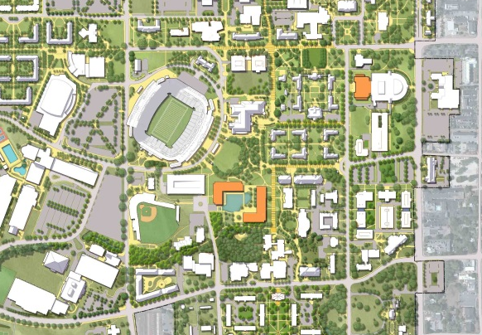
Capital Projects Academic Building Locations
A
B
C
A: Mell Classroom Building
B: Roosevelt Classroom Building
C: Sciences and Mathematics Success Building

Slide 3
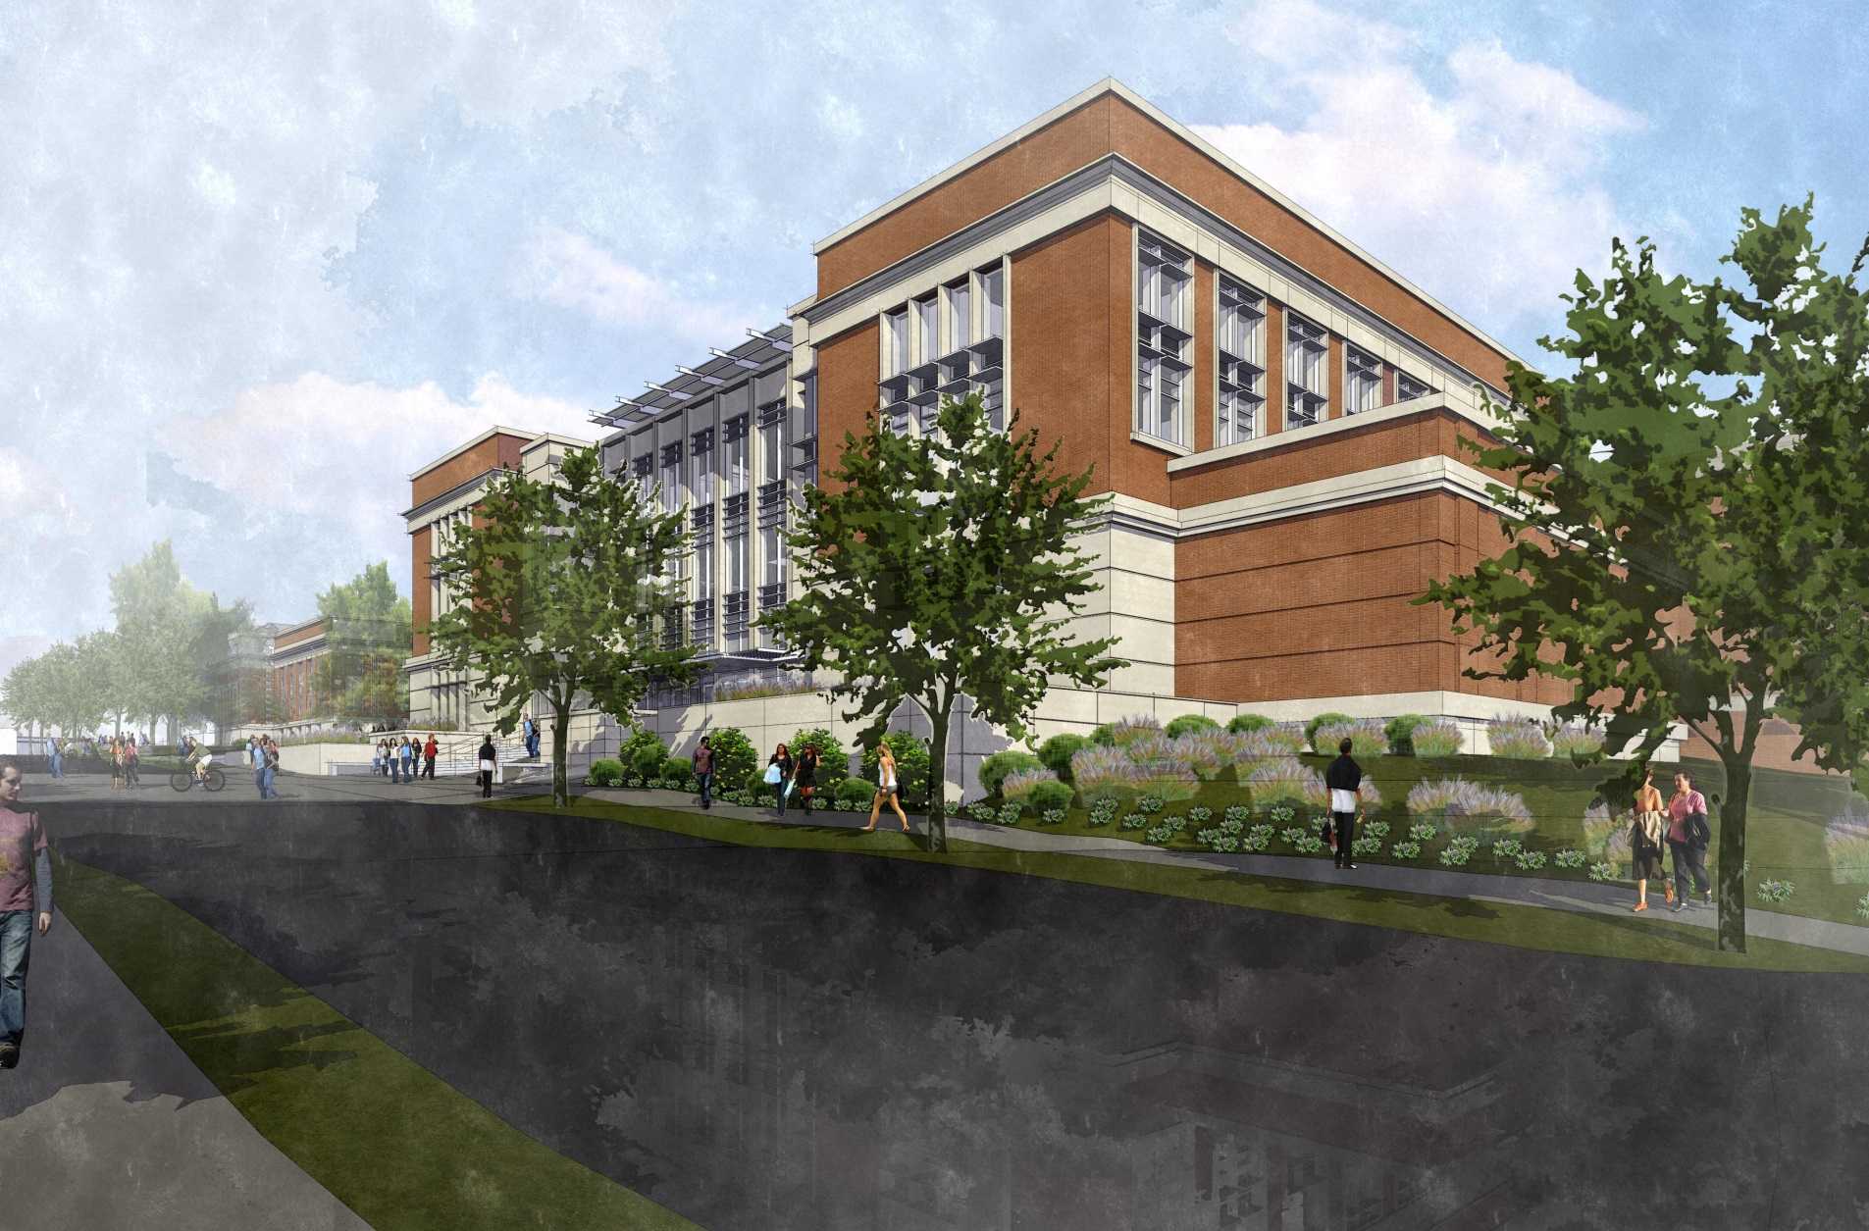
Mell Classroom Building
Mell Street View from South

Slide 4
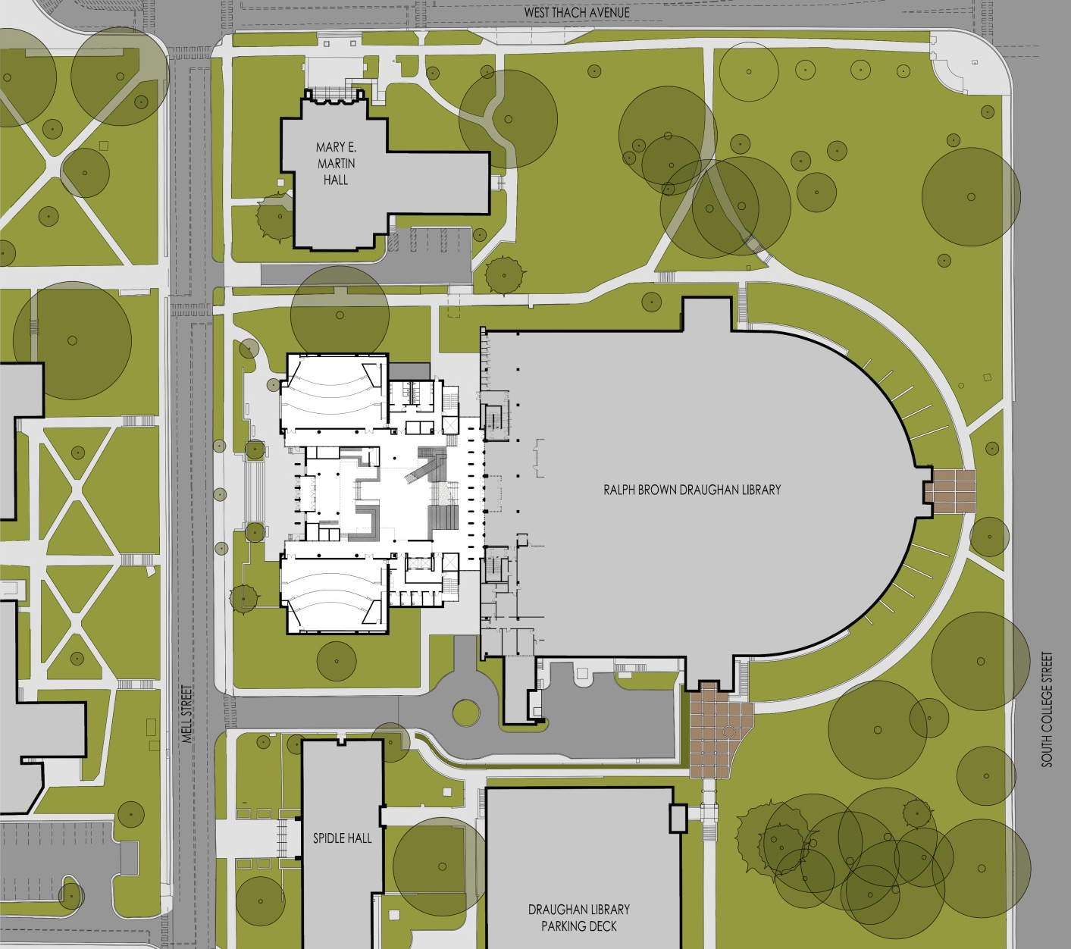
Mell Classroom Building
Site Plan

Slide 5
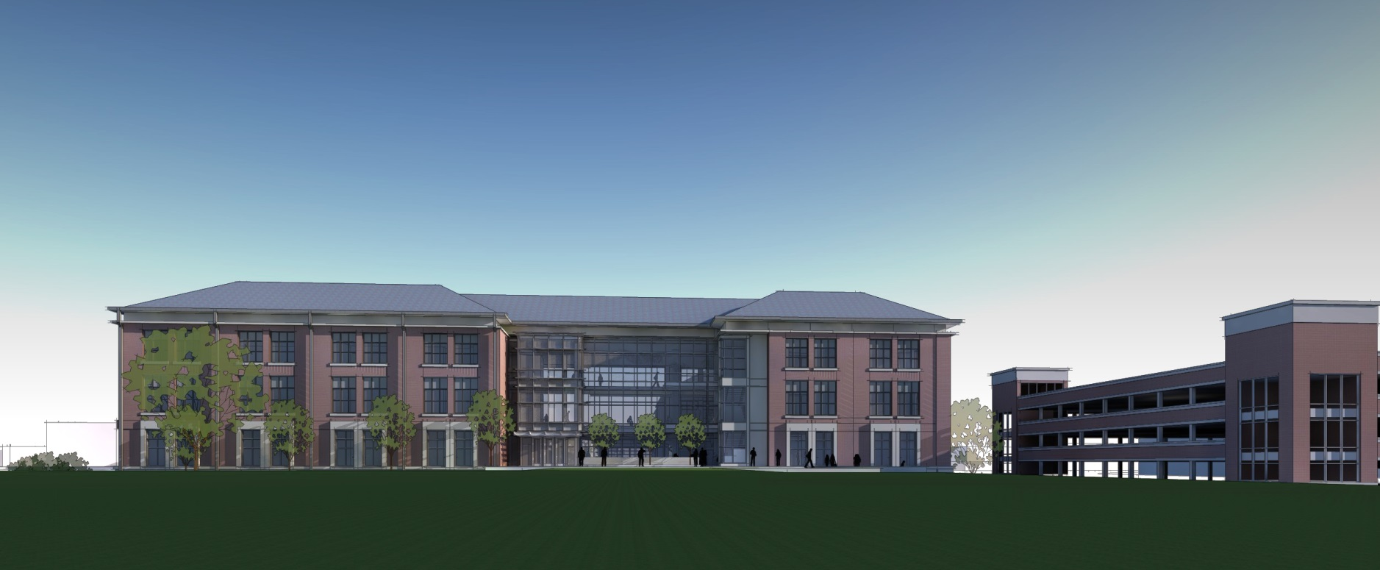
Roosevelt Classroom Building
View South from Campus Green, with Stadium Deck to the West

Slide 6
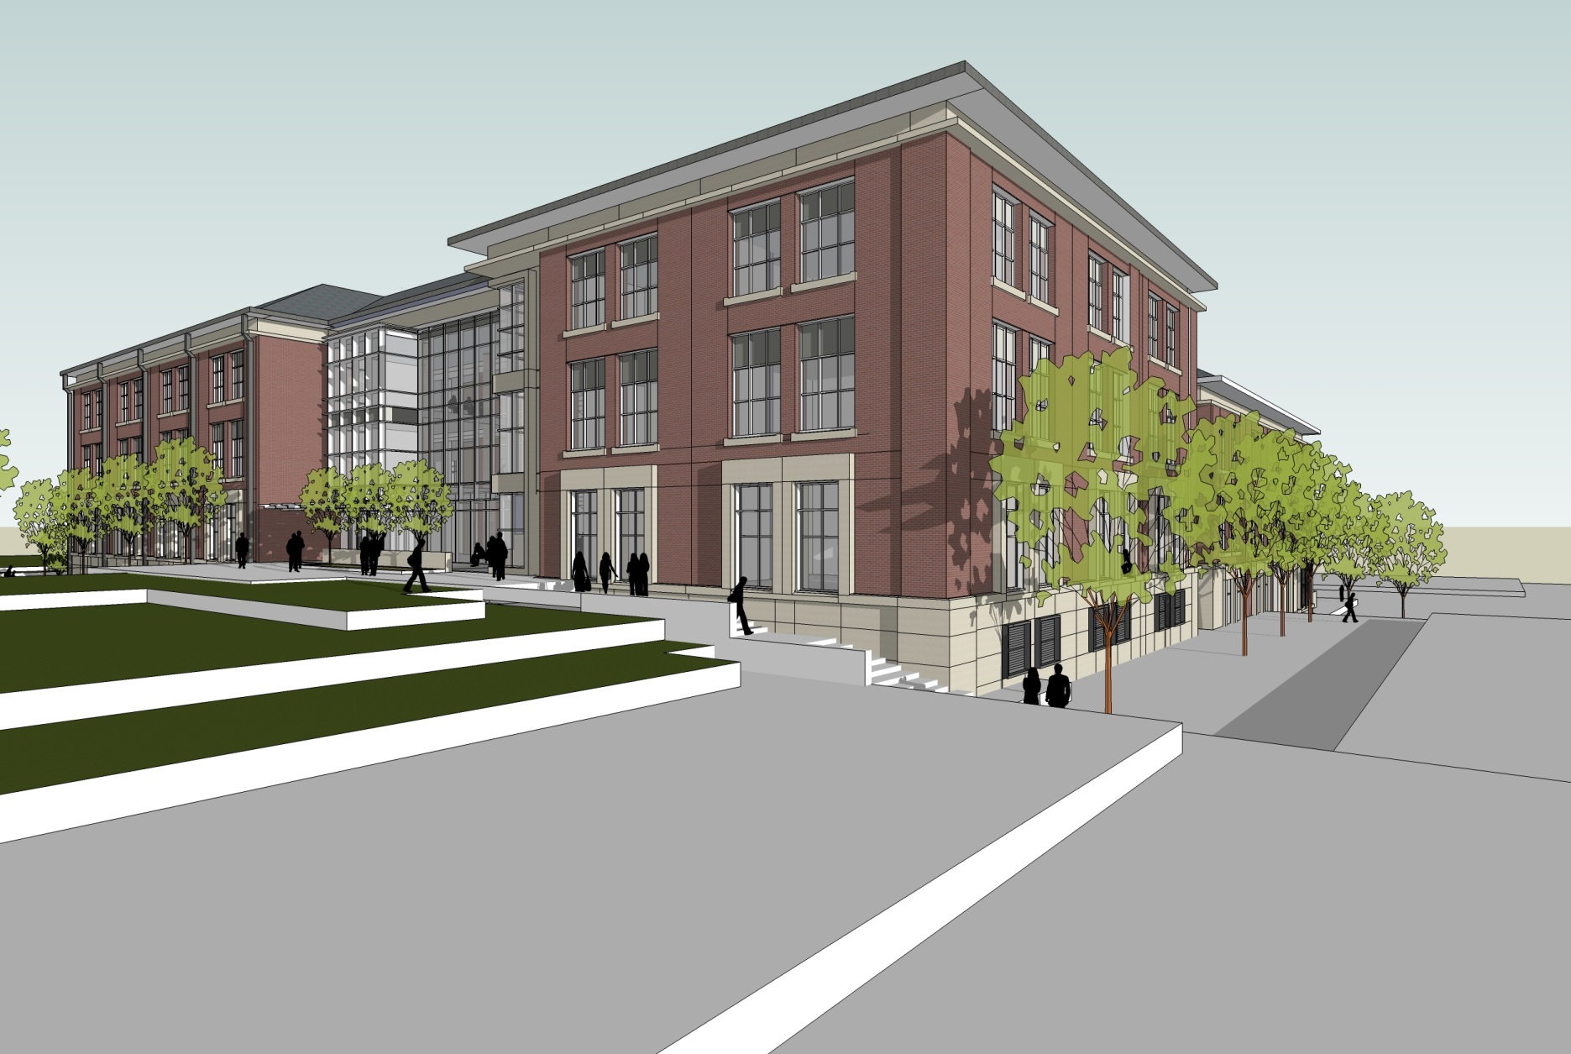
Roosevelt Classroom Building
View Southeast from Campus Green

Slide 7
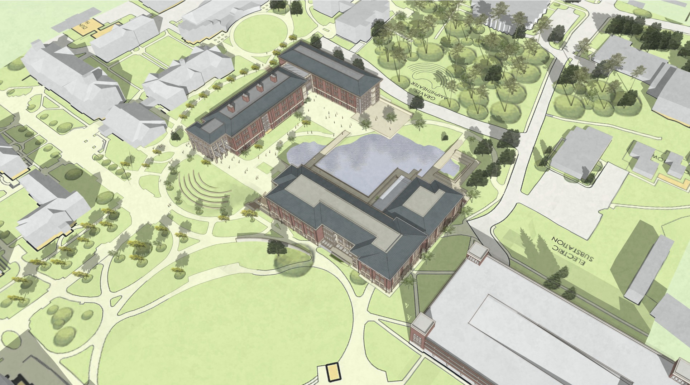
Sciences and Mathematics Success Building
Aerial View Southeast

Slide 8
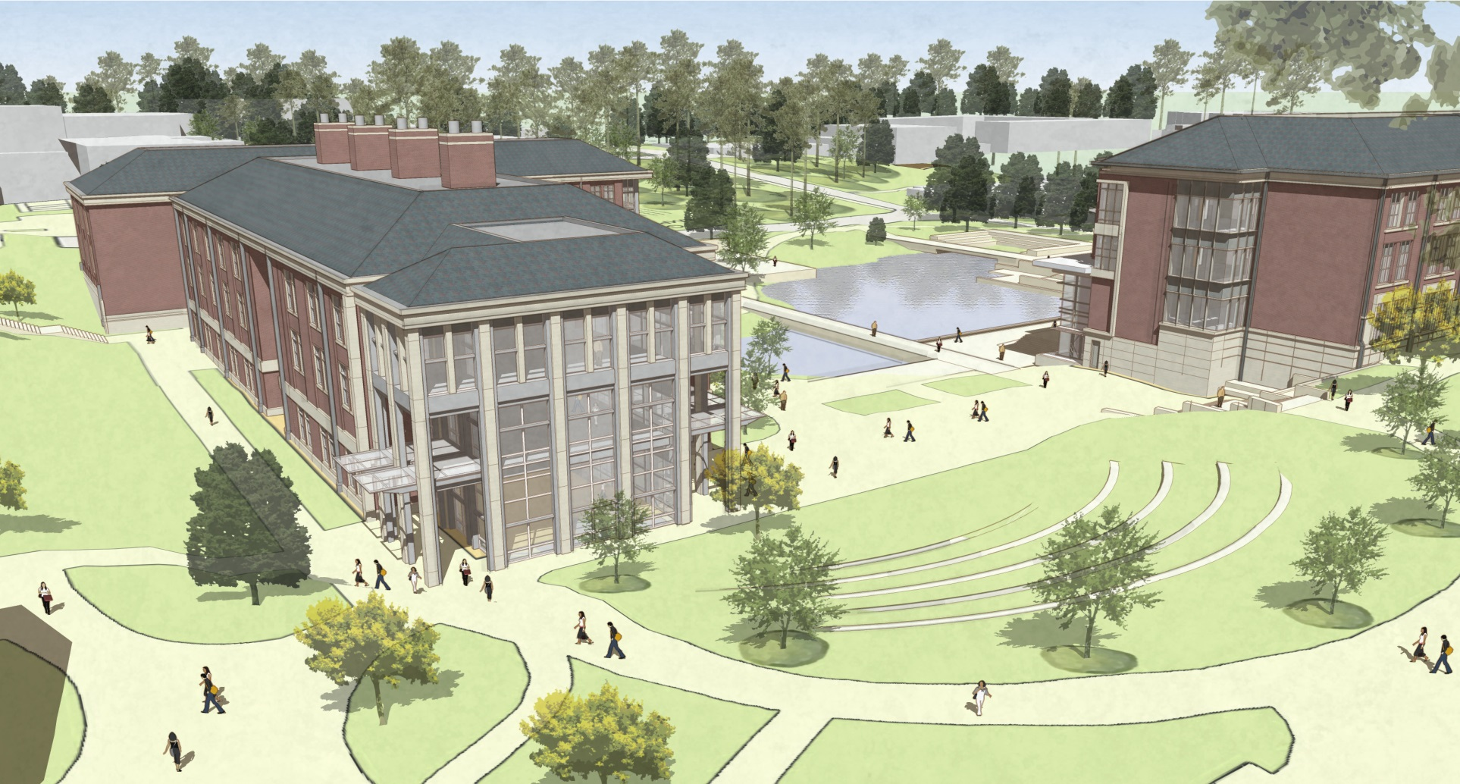
Sciences and Mathematics Success Building
View Southwest from Campus Green

Slide 9
Classroom Facility Committee Members
J. Emmett Winn, Chair | Provost’s Office
Julie Huff | Provost’s Office
Constance Relihan | Provost’s Office
Betty Lou Whitford | Education
Larry Wit | COSAM
Victor Villanueva | Liberal Arts
Robin Jaffe | Liberal Arts
Teresa Gore | Nursing (Clinical)
Ramesh Jeganathan | Human Sciences
Cheryl Seals | Engineering
John Helms | Information Technology
Rusty Presley | Alabama Cooperative Extension System
Vanessa Tarpos | SGA
Owen Parrish | SGA
Kirby Turnage | SGA
Brittny Mathies | Graduate Student Council
Jim Carroll | Facilities
Susan Bannon | Education
Marcia Boosinger | Library
Wiebke Kuhn | Liberal Arts
Greg Parsons | University Architect
John Gober | Information Technology
William Stocks | SGA
Mark Aderholt | Facilities
Scott Fuller | Facilities

