Slide 1
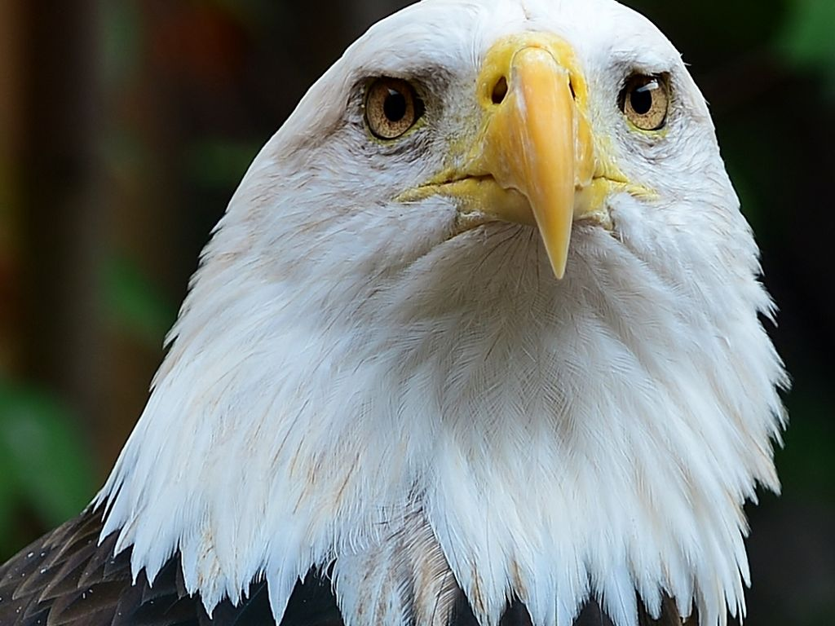


Envisioning the Future
Long-term Outcomes & Goals
Photo by robertkillmer - Creative Commons Attribution-NonCommercial-ShareAlike License https://www.flickr.com/photos/122495188@N08
Created with Haiku Deck

Slide 2
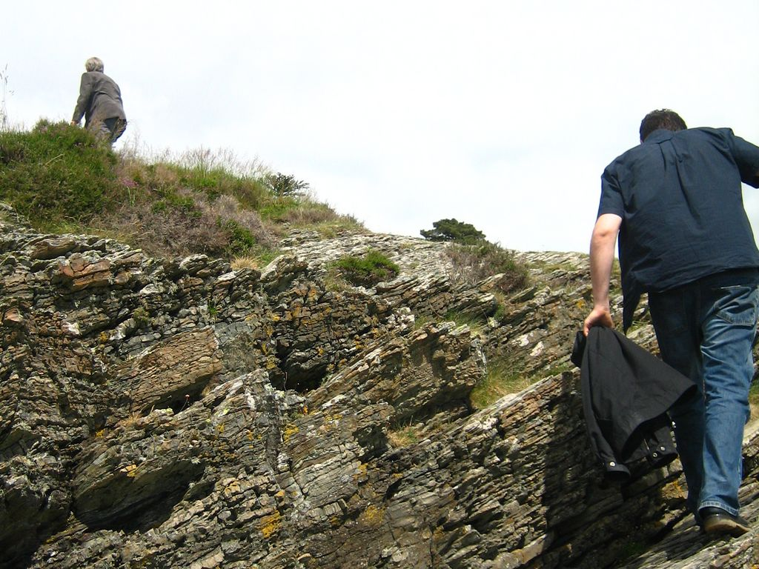
Auburn has made significant commitments
to sustainability
Sustainability Policy
American College and University Presidents Climate Commitment
University Strategic Plans 2008-2012, 2013-2018
Campus Master Plan
Campus Landscape Master Plan
Energy Reduction Strategy
Sustainability Minor
Faculty training and curriculum development
Research
Outreach
Photo by jessie owen - Creative Commons Attribution-NonCommercial-ShareAlike License https://www.flickr.com/photos/9556128@N08
Created with Haiku Deck

Slide 3
What does it mean to fulfill these commitments?
What does success look like?
Photo by jessie owen - Creative Commons Attribution-NonCommercial-ShareAlike License https://www.flickr.com/photos/9556128@N08
Created with Haiku Deck

Slide 4

Photo by gothormr - Creative Commons Attribution-NonCommercial-ShareAlike License https://www.flickr.com/photos/31888628@N08
Created with Haiku Deck

Slide 5

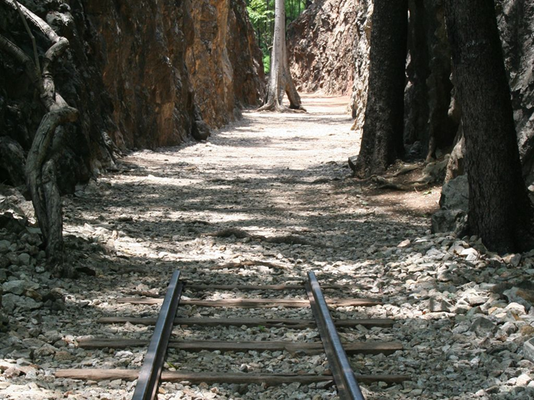
Photo by cathredfern - Creative Commons Attribution-NonCommercial License https://www.flickr.com/photos/43499845@N00
Created with Haiku Deck

Slide 6

Sustainability
A First Principle of Sustainability
Think Long Term
Auburn has made significant commitments to sustainability
• Sustainability Policy
• American College and University Presidents Climate Commitment
• University Strategic Plans 2008-2012, 2013-2018
• Campus Master Plan
• Campus Landscape Master Plan
• Energy Reduction Strategy
• Sustainability Minor
• Faculty training and curriculum development
Read trends
Analyze data
Strategize
Plan for preferred outcomes

Slide 7
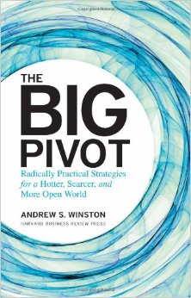
Sustainability
A First Principle of Sustainability
Think Long Term
Auburn has made significant commitments to sustainability
• Sustainability Policy
• American College and University Presidents Climate Commitment
• University Strategic Plans 2008-2012, 2013-2018
• Campus Master Plan
• Campus Landscape Master Plan
• Energy Reduction Strategy
• Sustainability Minor
• Faculty training and curriculum development
Read trends
Analyze data
Strategize
Plan for preferred outcomes

Slide 8

Preferred outcomes?
Photo by Scott McLeod - Creative Commons Attribution License https://www.flickr.com/photos/93393982@N00
Created with Haiku Deck

Slide 9
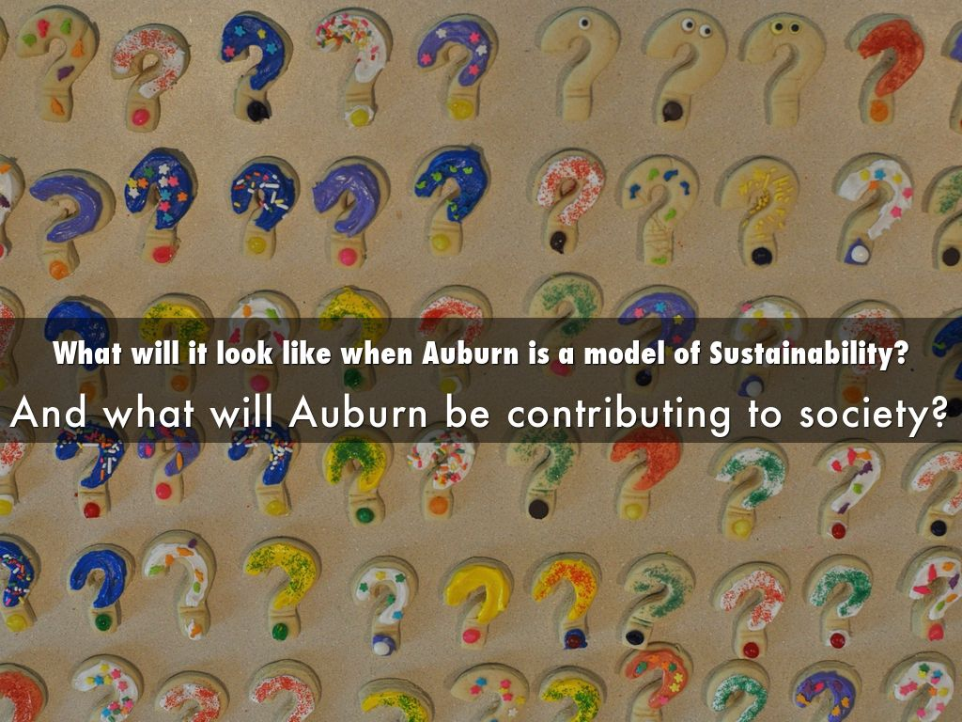
Photo by Scott McLeod - Creative Commons Attribution License https://www.flickr.com/photos/93393982@N00
Created with Haiku Deck

Slide 10
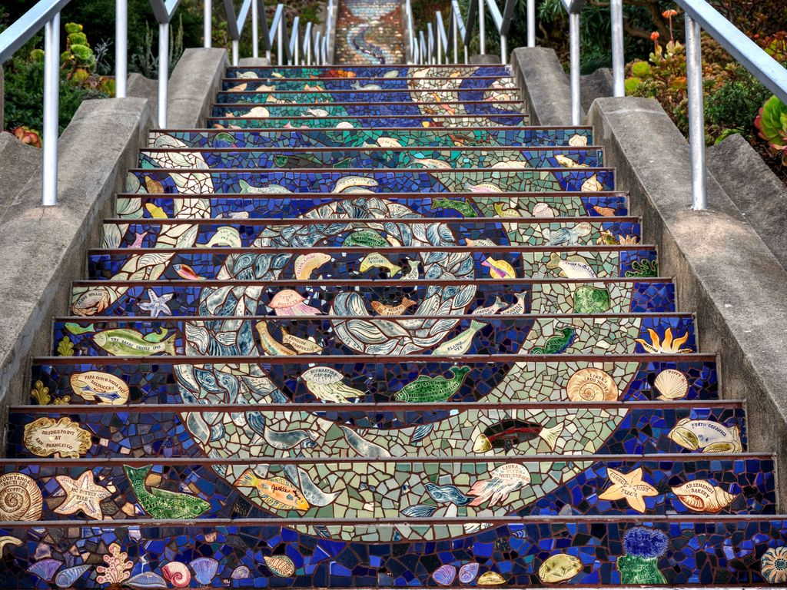
Photo by PeterThoeny - Creative Commons Attribution-NonCommercial-ShareAlike License https://www.flickr.com/photos/98786299@N00
Created with Haiku Deck

Slide 11
“Great teams do both – they have a big vision, but they also get there by hitting short-term milestones.”
Tom Falk, Kimberly-Clark CEO
Photo by PeterThoeny - Creative Commons Attribution-NonCommercial-ShareAlike License https://www.flickr.com/photos/98786299@N00
Created with Haiku Deck

Slide 12

3 interdependent processes:
Vision → Long-term Goals → Next Steps
Photo by FlickrJunkie - Creative Commons Attribution-NonCommercial-ShareAlike License https://www.flickr.com/photos/89035753@N00
Created with Haiku Deck

Slide 13
“Auburn will establish specific goals for sustainability based on national metrics.”
Photo by FlickrJunkie - Creative Commons Attribution-NonCommercial-ShareAlike License https://www.flickr.com/photos/89035753@N00
Created with Haiku Deck

Slide 14

STARS National Metrics
  Curriculum * Research * Campus Engagement
  Public Engagement * Air & Climate
  Buildings * Dining Services/Food * Energy
  Grounds * Purchasing * Transportation
  Waste * Water * Diversity & Affordability
  Health, Wellbeing & Work * Investment
  Other
Photo by FlickrJunkie - Creative Commons Attribution-NonCommercial-ShareAlike License https://www.flickr.com/photos/89035753@N00
Created with Haiku Deck

Slide 15
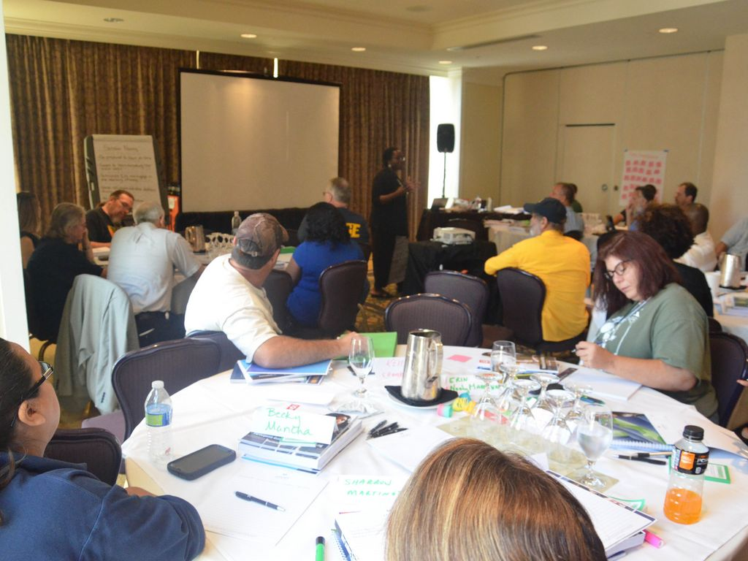
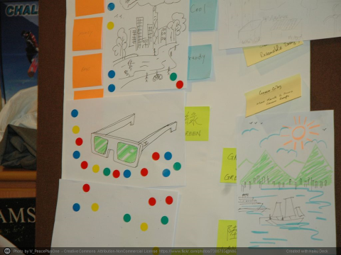
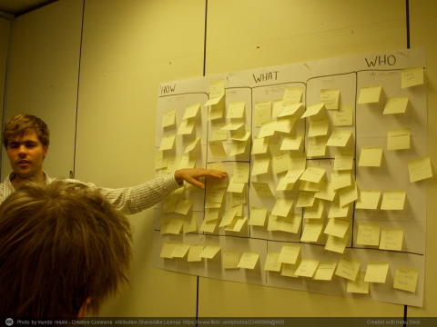
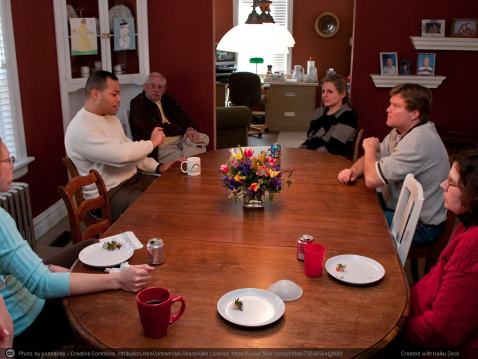
The Process
Photo by AFGE - Creative Commons Attribution License https://www.flickr.com/photos/79684288@N00
Created with Haiku Deck

Slide 16
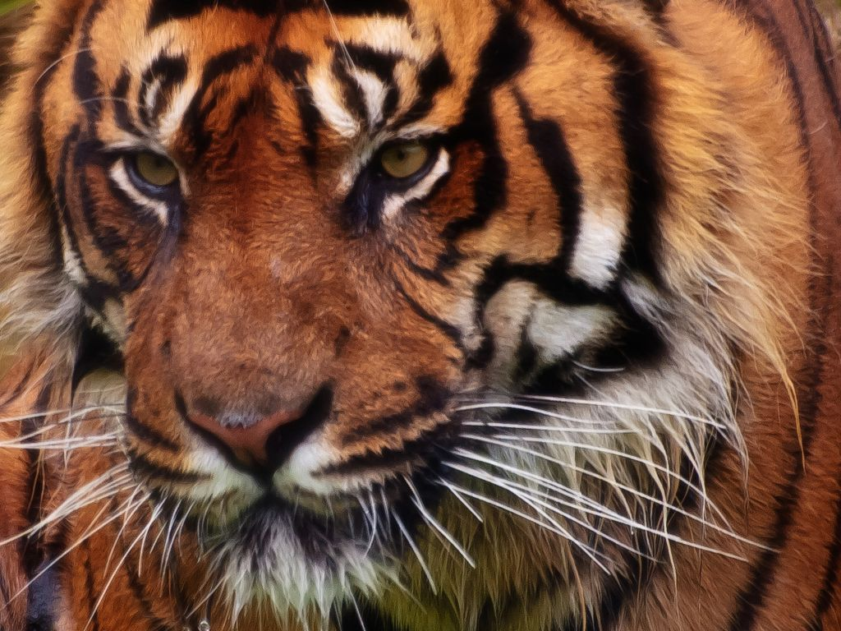
Why do this?
Photo by Digimist - Creative Commons Attribution-NonCommercial License https://www.flickr.com/photos/30898814@N03
Created with Haiku Deck

Slide 17
“We made these commitments…”
“In service to our Land Grant Mission…”
“A necessary response to the world we live in.”
“We need a picture of what we really want.”
Photo by Digimist - Creative Commons Attribution-NonCommercial License https://www.flickr.com/photos/30898814@N03
Created with Haiku Deck

Slide 18
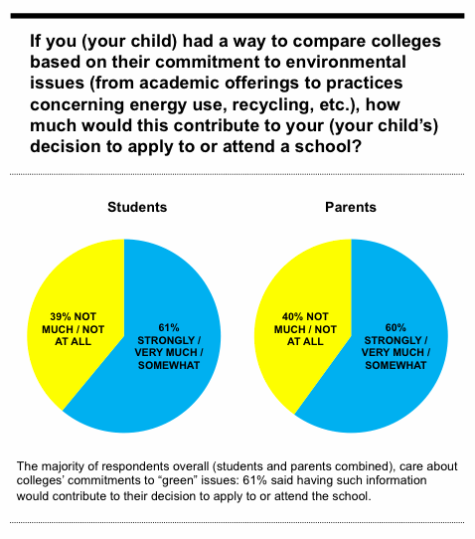



Slide 19




Slide 20

STARS 2.0
“This credit recognizes institutions that have developed comprehensive plans to move toward sustainability.”
“…clarify its vision”
“…provides a road map to help guide decision-making”
“… measurable goals and objectives…”

Slide 21
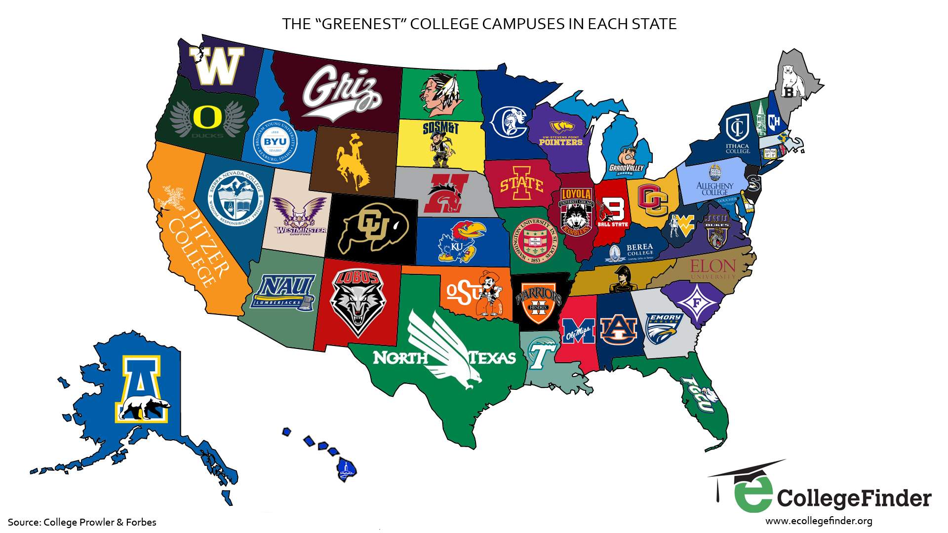

Slide 22



NCAA Top 25 Football pre-season rankings
These universities may perform well on the football field, but how well do they "go green"?

Slide 23
NCAA Top 25 Football pre-season rankings
Criteria
Stadium sustainability efforts
Number of active green organizations
Waste diversion rate
Percentage of budget spent on locally grown or organic foods
Level of Environmental Studies degrees offered
LEED buildings

Slide 24
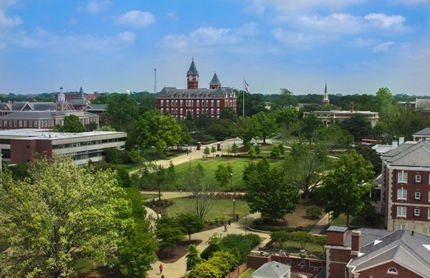
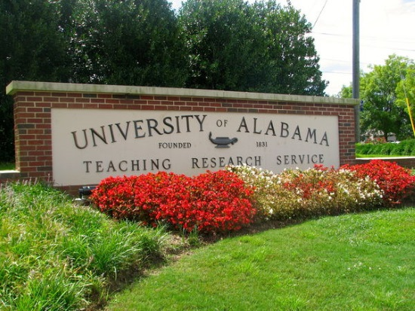
NCAA Top 25 Football pre-season rankings
Auburn’s rank: #22
Alabama’s rank:
#25 “Although Alabama may rank at the top of the AP preseason rankings, they need to ramp up their sustainability efforts.”

Slide 25
“…sustainability…will be… integrated into the day-to-day practices of firms of all sizes in all industries.
…sustainability will touch every function, every business line, every employee.
…firms with a clear vision and the execution capabilities to navigate the megatrend will come out ahead. Those that don’t will be left by the wayside.”
Dan Esty,
Former Yale law professor and Director of Connecticut Dept. of Energy and the Environment
Photo by Digimist - Creative Commons Attribution-NonCommercial License https://www.flickr.com/photos/30898814@N03
Created with Haiku Deck

Slide 26
Photo by Digimist - Creative Commons Attribution-NonCommercial License https://www.flickr.com/photos/30898814@N03
Created with Haiku Deck

Slide 27




Moving forward from here:
What does a sustainable Auburn University look like, and what will Auburn be contributing to society?
Establish Long-term sustainability goals
  “Auburn will establish specific goals for sustainability…”
2012

Slide 28



Sustainability Compass
Nature
Wellbeing
Economy
Society

Slide 29

Photo by Ecotrust - Creative Commons Attribution License https://www.flickr.com/photos/35349370@N08
Created with Haiku Deck

Slide 30
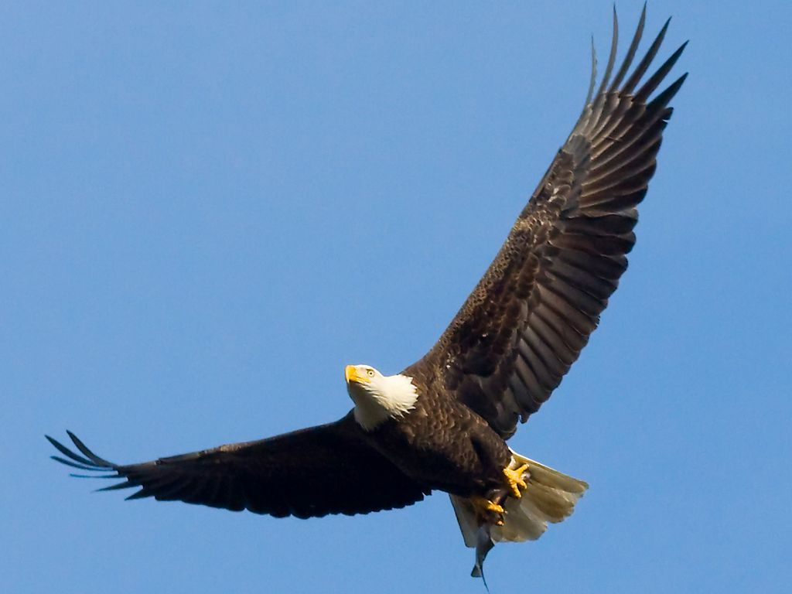
Photo by U. S. Fish and Wildlife Service - Northeast Region - Creative Commons Attribution License https://www.flickr.com/photos/43322816@N08
Created with Haiku Deck

Slide 31
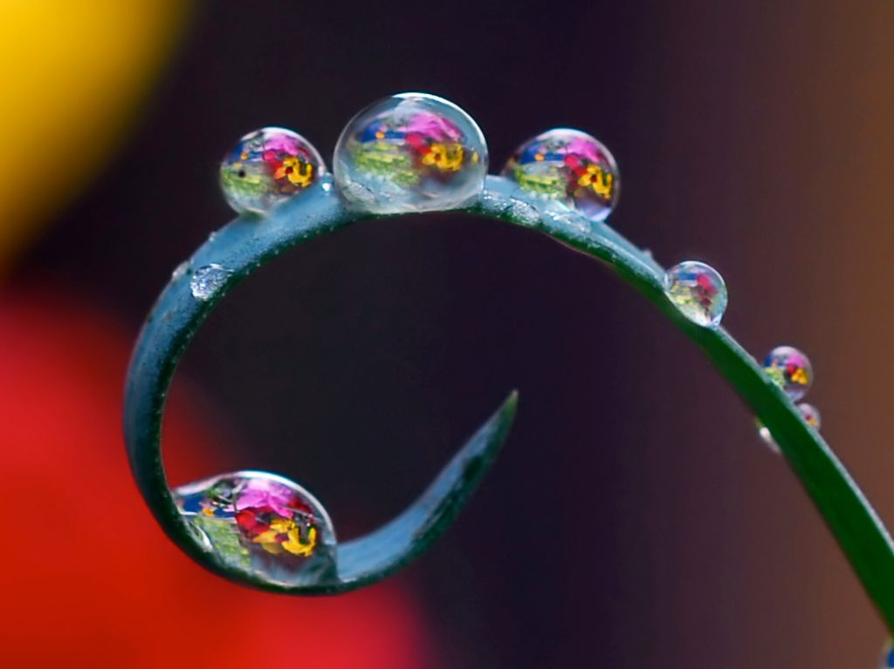
Photo by Steve took it - Creative Commons Attribution-NonCommercial-ShareAlike License https://www.flickr.com/photos/61779926@N00
Created with Haiku Deck

Slide 32

Photo by SergioTudela - Creative Commons Attribution License https://www.flickr.com/photos/27983776@N03
Created with Haiku Deck

