Slide 1

Salary Savings Program
9-month employees have option to have salary paid over 12 months
Through Auburn University Federal Credit Union
Thursday: Email to AU and AUM
Next week: Letter mailed inter-office; calculator available online
Convenient, flexible, free of charge
Employees have control of their money

Slide 2

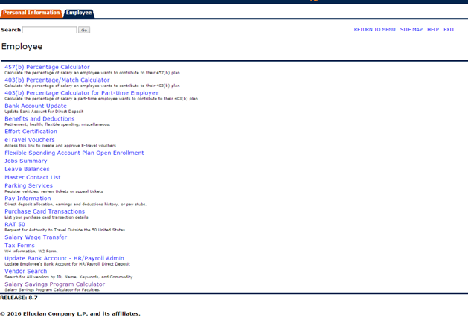
Salary Savings Program

Slide 3
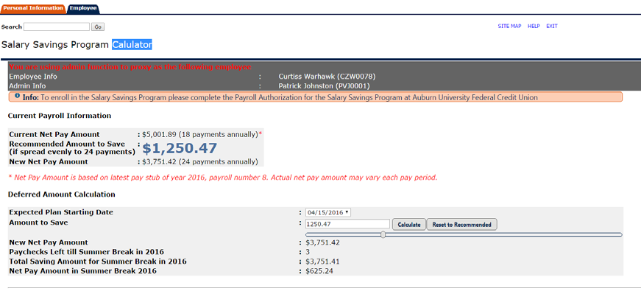
Salary Savings Program

