Slide 1
Use of Copyrighted Materials
Ad hoc Copyright Policy Revision Committee
Sara Wolf/Jan Thornton
Nick Backscheider
Betsy Gilbertson
Bruce Kuerten
Don Mulvaney
Robert Norton
Andrew Wohrley

Slide 2
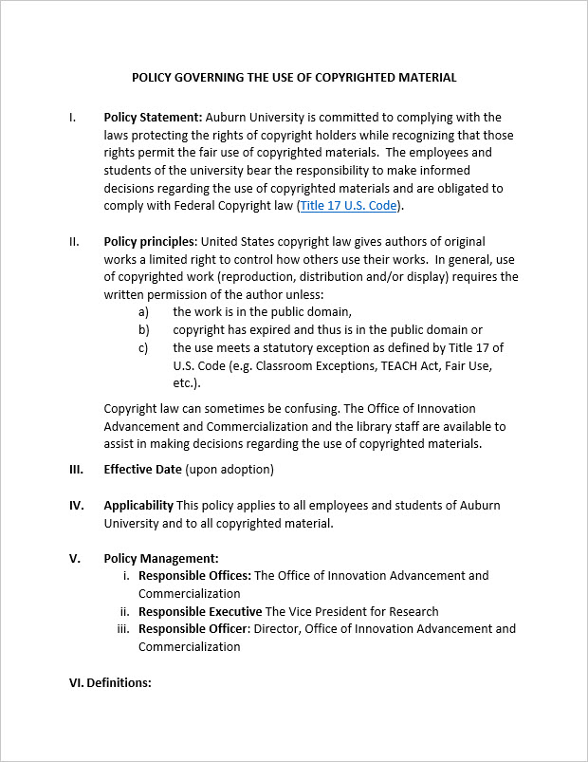
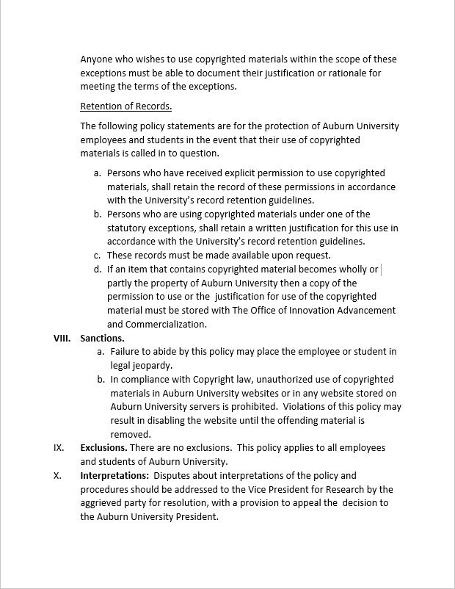
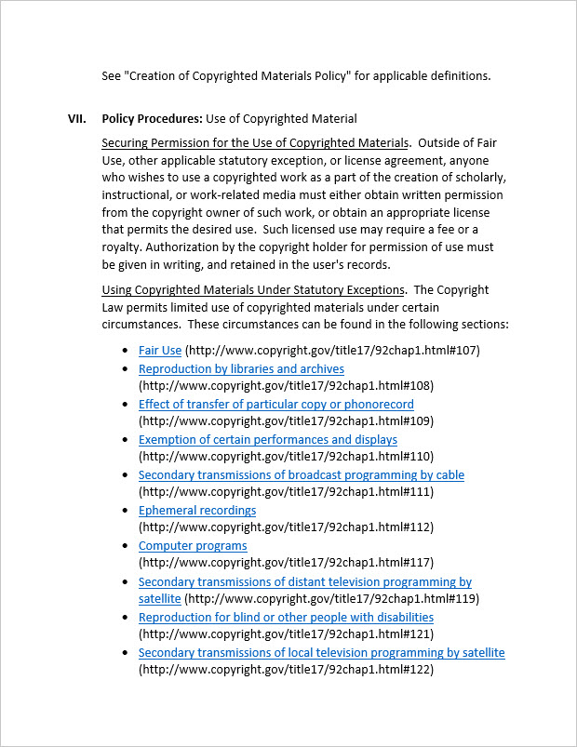
We could read it to you…
http://www.auburn.edu/administration/governance/senate/website/minutes/2015-2016/Current_2015-16.html

Slide 3
In a Nutshell…
Auburn University is committed to complying with the laws regarding copyright. AND
Expects employees and students to comply with the laws regarding copyright. BY…
Making informed decisions regarding the use of copyrighted materials AND
Keeping a record of how those decisions were made.

Slide 4
On a Day-to-Day Basis…
If you are using copyrighted materials in
  Teaching
  Research / Publication
  Learning Activities (students)
You must have permission to use those works, UNLESS
  The item is in the public domain
  The copyright for that item has expired (thus being in the public domain)
  Your use meets one of several exceptions written into copyright law
http://www.copyright.gov/title17/92chap1.html

Slide 5
Fair Use – a Statutory Exception
http://www.copyright.gov/title17/92chap1.html#107
…the fair use of a copyrighted work, including such use by reproduction in copies or phonorecords or by any other means specified by that section, for purposes such as criticism, comment, news reporting, teaching (including multiple copies for classroom use), scholarship, or research, is not an infringement of copyright. In determining whether the use made of a work in any particular case is a fair use the factors to be considered shall include—
the purpose and character of the use, including whether such use is of a commercial nature or is for nonprofit educational purposes;
the nature of the copyrighted work;
the amount and substantiality of the portion used in relation to the copyrighted work as a whole; and
the effect of the use upon the potential market for or value of the copyrighted work.
The fact that a work is unpublished shall not itself bar a finding of fair use if such finding is made upon consideration of all the above factors.

Slide 6
Other Exceptions…
“Certain performances and displays”
  Classroom use of video
  TEACH Act – Distance Education efforts
Several others, such as…
  Libraries
  Computer Programs
  Reproduction for blind or other people with disabilities
http://www.copyright.gov/title17/92chap1.html

Slide 7
Employee/Student Responsibility…
Make informed decisions
  Office of Innovation Advancement and Commercialization
  AU Library (resources, not legal advice)
  Website (To be developed)
“Anyone who wishes to use copyrighted materials within the scope of these exceptions must be able to document their justification or rationale for meeting the terms of the exceptions.”
Retain record of justification/rationale according to University record retention policy (3-7 years, depending on the type of document)
  IAC Office will assist with record retention for materials that are owned by the University

Slide 8
Sanctions
  Failure to abide by this policy may place the employee or student in legal jeopardy.
  In compliance with Copyright law, unauthorized use of copyrighted materials in Auburn University websites or in any website stored on Auburn University servers is prohibited. Violations of this policy may result in disabling the website until the offending material is removed.

Slide 9
Next Steps for Our Committee
Tentatively Finished
“…institutes policies regarding copyright,
[Provide] informational materials to faculty, students, and relevant staff members that accurately describe, and promote compliance with, the laws of the United States relating to copyright…”
Website Purpose:
  Provide guidelines to University community for making informed decisions
  Provide templates for permission requests, recording of use justifications, etc.
  Provide information regarding interpretation of copyright law
  Not construed as legal advice!
Begin Summer 2016
http://www.copyright.gov/title17/92chap1.html#110 (2)(D)(i)

Slide 10
Questions?

