Slide 1
Administrator Evaluation
A quick update

Slide 2
Committee Charter
The committee shall oversee and/or conduct a periodic evaluation of University administrators involved in the University's teaching, research, and extension programs and provide a report of aggregate data to the Senate.
http://www.auburn.edu/administration/governance/senate/website/committees/administrator_evaluation.html

Slide 3
Committee Members
Academic Year 2014-2015
Yasser Gowayed, Polymer and Fiber Engineering – 2017 (Chair)
James Shelley, Philosophy – 2015
William Kelly, Political Science – 2016
Xing Ping Hu, Entomology and Plant Pathology – 2016
Valentina Hartarska, Agricultural Economics and Rural Sociology – 2016
Jose Llanes, EFLT – 2017
Tammy Williams, Staff Representative – 2017
Cathy Pate, A&P Representative – 2017
Jackson Pruett, non-voting student representative – 2015
Academic Year 2015-2016
Yasser Gowayed, Mechanical Engineering – 2017 (Chair)
William Kelly, Political Science – 2016
Hulya Kirkici, Electrical and Computer Engineering – 2016
Valentina Hartarska, Agricultural Economics and Rural Sociology – 2016
Jose Llanes, EFLT – 2017
Jodie Kenney, Forestry and Wildlife Sciences – 2018
Tammy Williams, Staff Representative – 2017
Cathy Pate, A&P Representative – 2017
Ivy Sibley, non-voting student representative – 2016
http://www.auburn.edu/administration/governance/senate/website/committees/administrator_evaluation.html

Slide 4
Proposed Guidelines
The procedure and survey outlined below are intended to be used for the evaluation of deans and department chairs/heads:
1. The survey* will be conducted annually by the Office of Institutional Research and Assessment (OIRA).
2. The survey will be conducted during the month of February of each year to allow for its utilization for annual review of administrators by their direct supervisors. It will not be conducted during the year the administrator is being evaluated within the 3-5 year cycle.
*Survey adopted with permission from University of Arkansas, Agriculture Experiment Station (as Revised 2004) and modified

Slide 5
Full time employees working under the administrator or in direct interaction with him/her will be invited by email to answer the survey questionnaire. The email will have a personalized link to the site that will contain an on-line version of the questionnaire along with a deadline for completion.
The survey will include a section for comments and responders will be warned not to include personal information or identifying events to maintain anonymity.
5. Data, including comments, will be provided to the Chair of the Administrator Evaluation Committee, the Chair of the University Senate and the Provost. In case of the surveys for department chairs/head, the Provost will disseminate the information to the deans.

Slide 6
Administrator Evaluation Survey
On a scale of 1 to 5, rate this administrator’s performance (E=Excellent, VG=Very Good, S=Satisfactory, P=Poor, VP= Very Poor). Use CJ (Cannot Judge) if you do not have enough information for rating.
Mark here if you did not have direct interactions with this administrator … O
E VG G P VP CJ
General Administration
Personnel Management
Budget and Resource Management
Academic Program Management
Comments (specific strengths, weaknesses and suggestions for improvement). Do not include personal information or events that may reduce the level of your anonymity

Slide 7
Before February 2016
Today
Utilize campus resources to optimize survey
Communicate with Office of Institutional Research and Assessment (OIRA)
Consulted with Professor Joni Lakin, Department of Educational Foundations, Leadership, and Technology and optimized survey
Met with OIRA and expect to start the survey during the month of February

Slide 8
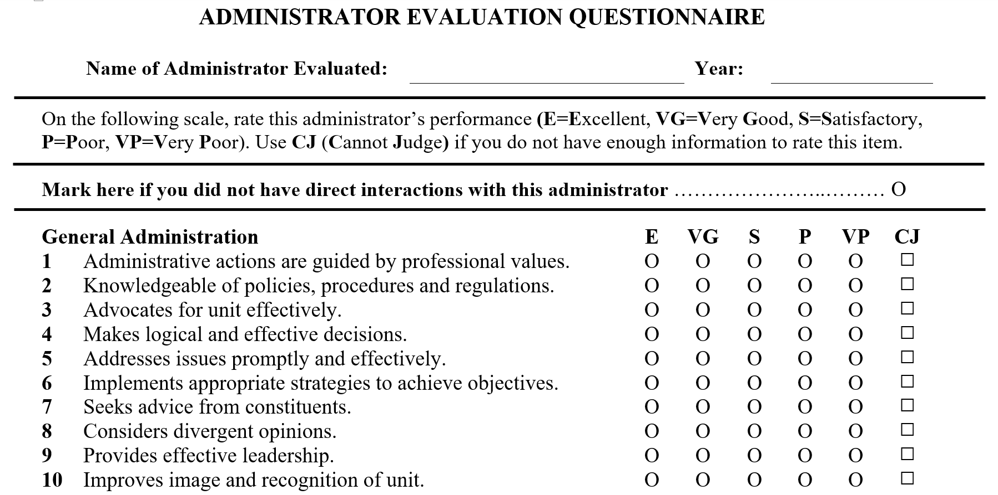

Slide 9
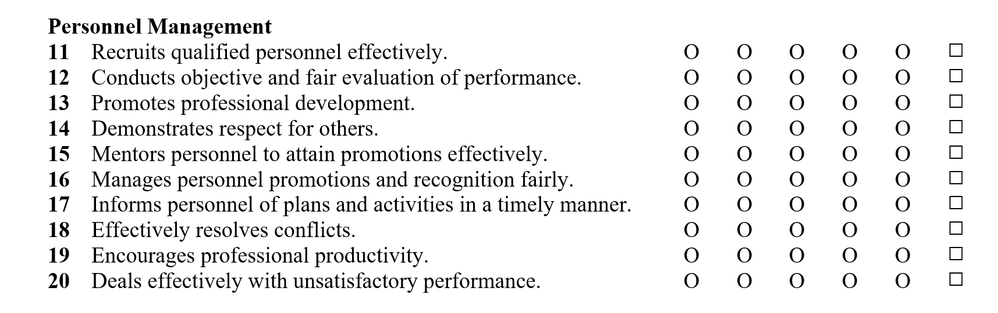

Slide 10
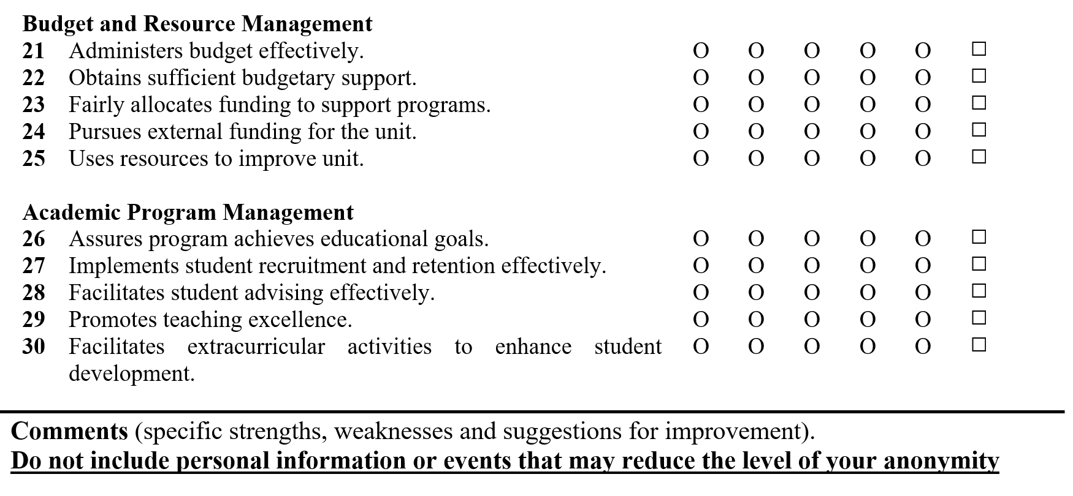

Slide 11
Questions?

