Slide 1

Hopper
The next step in High Performance Computing at Auburn University
February 16, 2016

Slide 2
Hopper? – Named for groundbreaking computer scientist Grace Hopper.
Cluster? – A collection of computers configured to work together.
Community? – A joint effort funded with investments by:
    Office of the Provost
    Office of Information Technology
    College of Science and Mathematics
    Samuel Ginn College of Engineering
    Roughly 25 Researchers and Research Groups

Slide 3
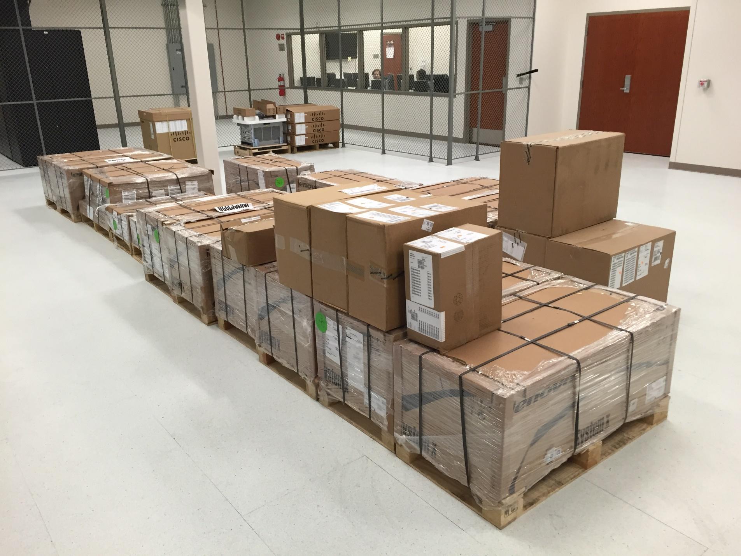

Slide 4
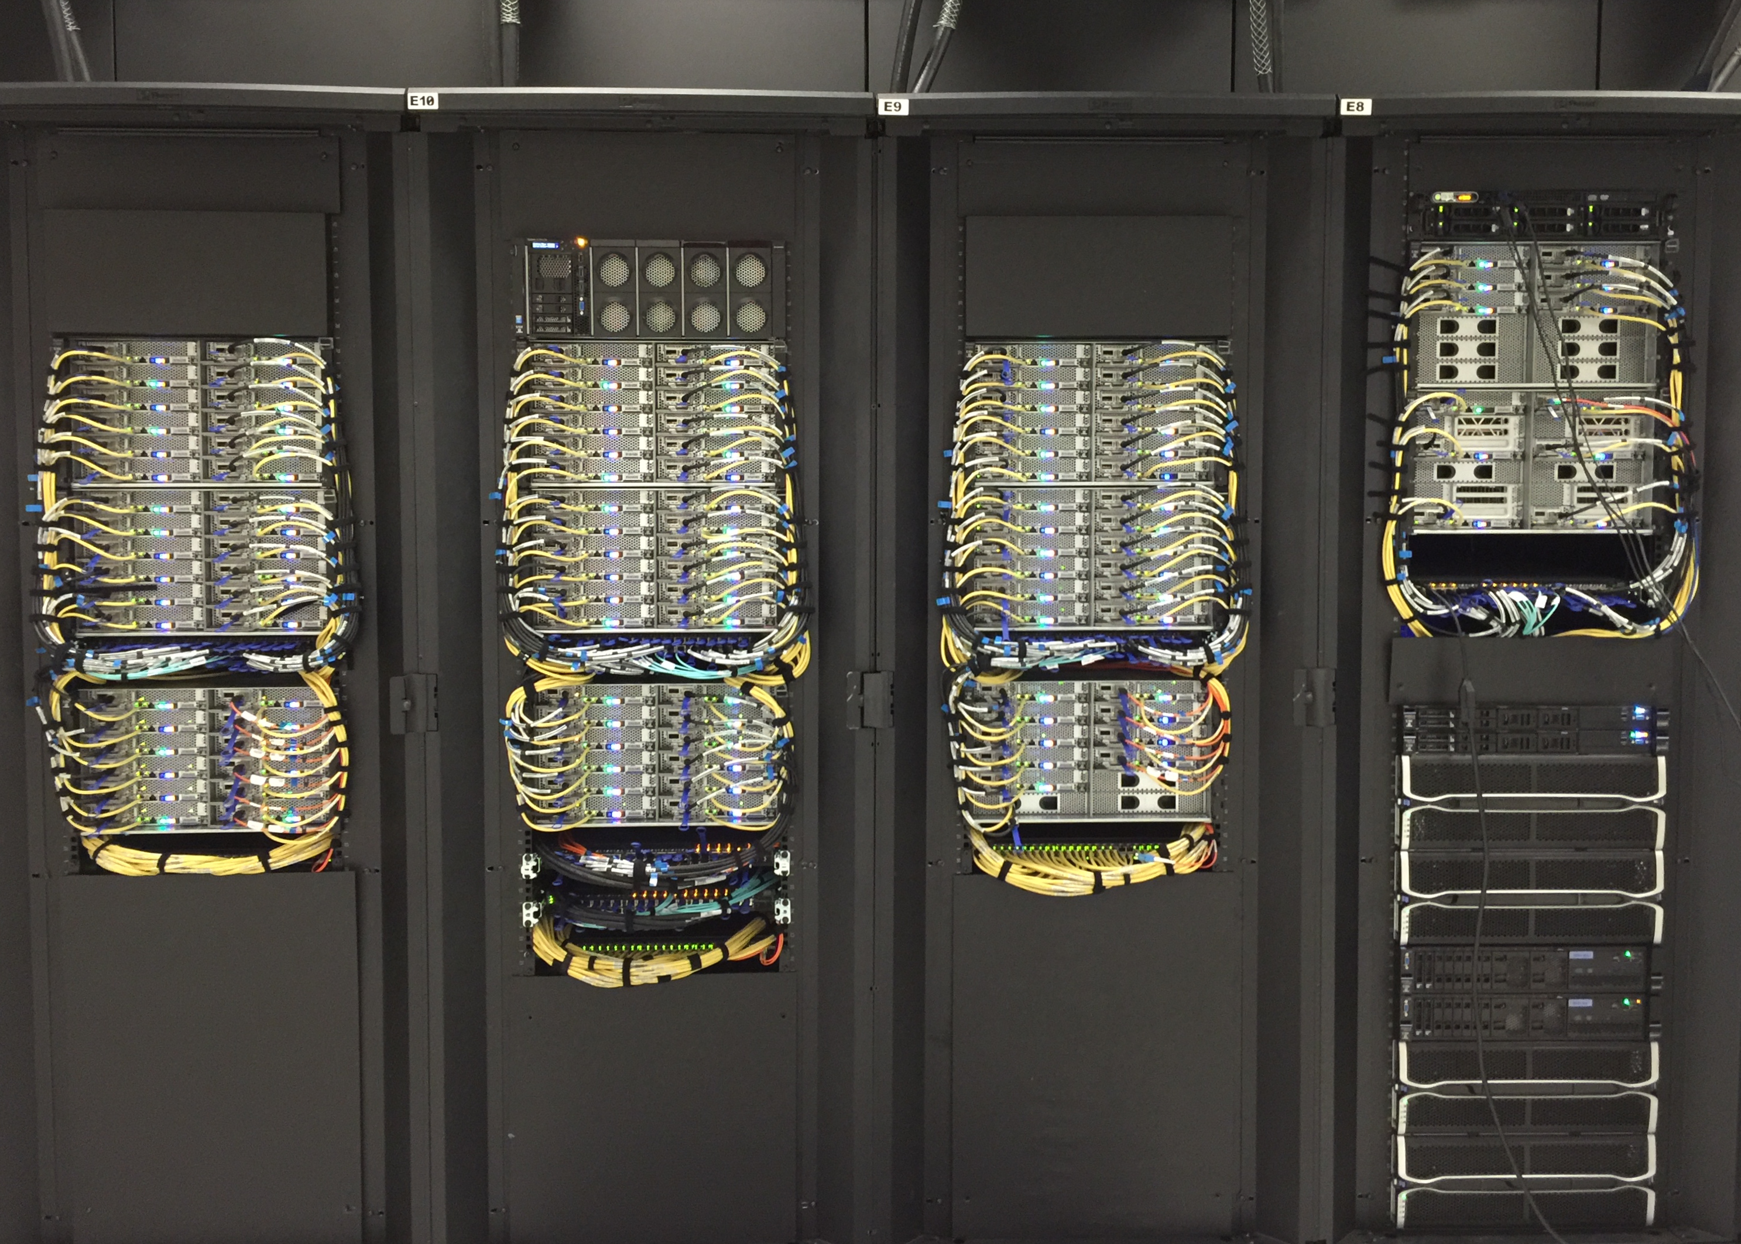
?

Slide 5
Speeds and Feeds
120 Nodes
2,000 cores
15 Terabytes of Memory
1.4 Petabytes of Disk Storage
Infiniband Storage Network
102 Teraflops of compute capacity
Bonus:
  Two nVidia Tesla K80 nodes
  Two Intel Xeon Phi 7120P nodes

Slide 6
The Real Strength of Hopper…
    Central Technical Support
    Infrastructure In Place
    Room to Grow
    Support from the Administration
    Researchers Define Usage Policies
    Researchers Pooling Resources

Slide 7
?
hpcportal.auburn.edu

