Slide 1

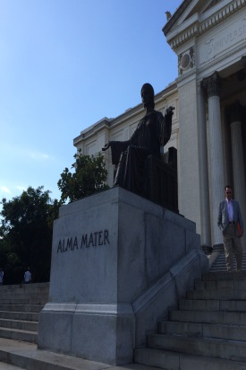
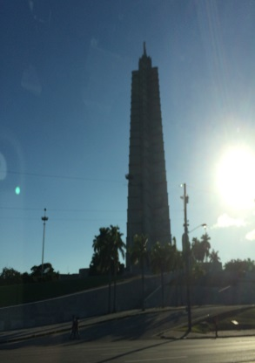
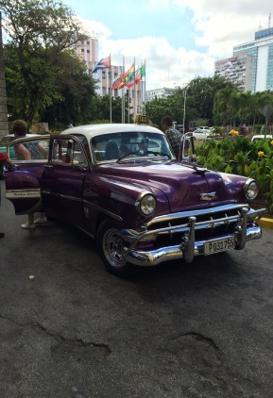
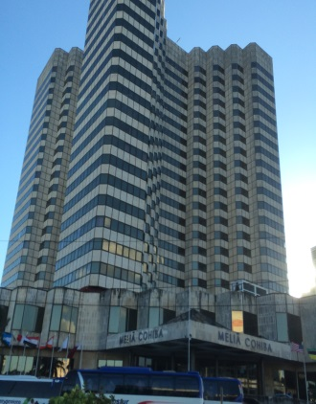
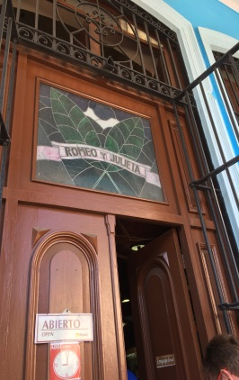
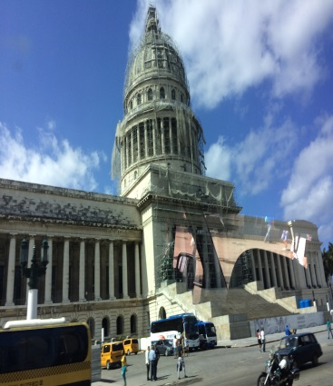
Educational and Cultural Engagement in Cuba
University Senate
Dr. Chippewa Thomas
January, 19, 2016

Slide 2
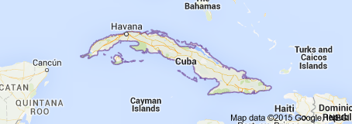
Notes:
Cuba, a large Caribbean island nation under communist rule, is known for its white-sand beaches, rolling mountains, cigars and rum. Its colorful capital, Havana, features well-preserved Spanish colonial architecture within its 16th-century core, Old Havana, loomed over by the pre-revolutionary Capitolio. Salsa emanates from the city's dance clubs and cabaret shows are performed at the famed Tropicana

Slide 3
Place
Capital: Havana
Founded in 1519
Became capital in 1607
Havana in the 1920s. Many Spanish colonial buildings still stand in old Havana
Population: 2.1 million
Population in Cuba: 11.27 million
2013 World Bank

Slide 4
TRAVELING TO CUBA
Office of Foreign Assets Control (OFAC) required People-to-people license
Copies of passport and a confirmation email are needed
Dual Currency System: Cuban convertible peso (CUC) and the Cuban peso
Cuba has a low crime rate and is generally welcoming
Weather is tropical (mid-80’s during the day to mid’60’s at night with possible rain) so warm weather dress causal and sturdy walking shoes are recommended
Drinking bottled water is recommended
Cuisine includes seafood and other delicacies
Cell phone usage is limited

Slide 5
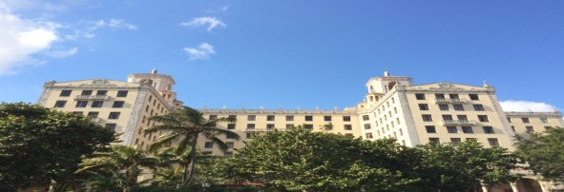
ENGAGMENTS & SITES
Educational sessions and meetings with educators, key officials and professionals
City land and seascapes
Paladars (restaurants and eatery's)
Cuban monuments, fortresses, architecture, and art centers
Buildings (the capital, national theater, residential buildings and places of worship)
Historic venues (e.g., Hemingway Estate and the Hotel Nacional)
Periodic automobiles
University of Havana
Cigar and Rum factory
Cemetery (the largest and the most historical in the city of Havana)

Slide 6
UPCOMING ENGAGEMENTS
March 13-20, 2016
  College of Human Sciences
April 24-29, 2016
  University Outreach and Harrison School of Pharmacy
June 12-17, 2016
  University Outreach
October 23-28, 2016
  University Outreach

Slide 7
FOR MORE INFORMATION
See more at:
http://www.auburn.edu/outreach/facultyengagement/au-cuba-tours.htm
Contact University Outreach at 334-844-5700 or email us at
au2cuba@auburn.edu for more information

