Slide 1


University Faculty Senate Presentation
January 19, 2016
Jennifer Kerpelman, Ph.D.
Professor of Human Development and Family Studies
Associate Dean for Research and Graduate Studies
College of Human Sciences
Lorraine Wolf, Ph.D.
Director of Undergraduate Research
Professor of Geosciences
College of Sciences and Mathematics
Notes:
We are members of the This is Research Steering Committee. We are here to tell you about the 2016 Symposia.

Slide 2

This is Research 2016
Student Symposium April 12/13; Awards April 18
Faculty Symposium September 15/16
Notes:
As we did in 2015, This is Research in 2016 will feature a student symposium this April and a faculty symposium in September. The main day for the student symposium is April 13 (events run from approximately 8:30 am to 6:00 pm); there may be some afternoon events on April 12. The Awards Ceremony is the evening of April 18 in the early evening. The main day for the Faculty Symposium is September 16 (events run from approximately 8:30 to 6:00); there will be some afternoon events on September 15 (from approximately 1:00-5:00 pm). We also will have the Creative Scholarship Showcase during September 2016 (we will share more about that shortly).

Slide 3
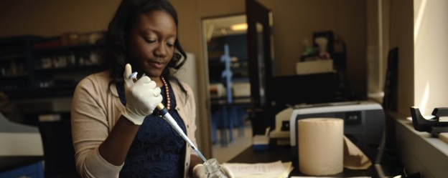
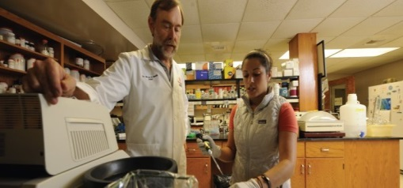
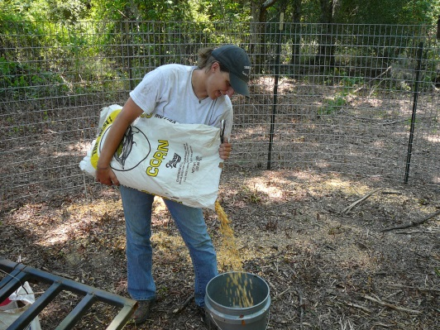
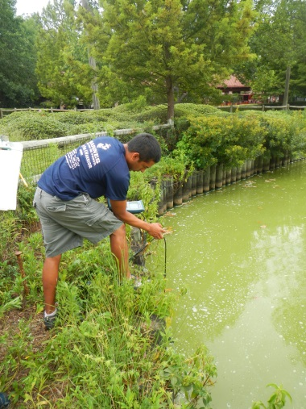
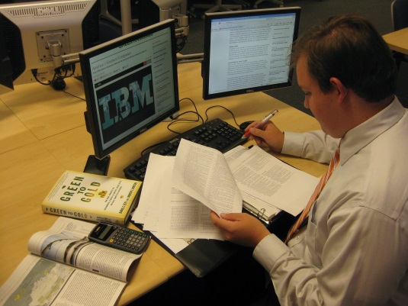
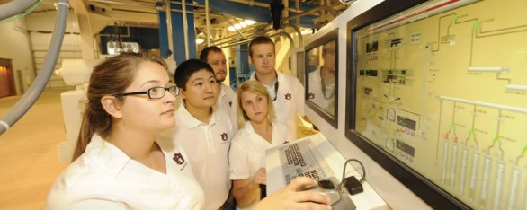
Auburn University
This is Research 2016
Student Symposium
Registration: January 14 - February 23
Graduate and Undergraduate Students welcome
Oral and Poster Presentations: Abstracts accepted January 14-February 23, 2016
Judging and Awards
Visibility of student research to internal and external audiences
Held in the STUDENT CENTER
Notes:
For students, the purpose of This is Research is to provide professional experience presenting research and interacting with various audiences (other students, faculty, potential employers). Students also compete for awards that can add to their accomplishments on their resumes/CVs.
The 2016 Student Symposium will feature undergraduate and graduate students presenting their research via oral papers, posters and creative scholarship presentations.
Middle and high school students will be coming to see some of the presentations
Employers with an interest in hiring professionals with research experience also will be invited to attend
The Symposium and Awards Ceremony will all take place in the Student Center
Registration is now open. Please encourage students (and ask faculty to encourage students) to submit abstracts prior to the February 23 deadline
PLEASE GO TO THE THIS IS RESEARCH WEBSITE (WILL SHOW LINK AT THE END OF THIS PRESENTATION) FOR MORE INFORMATION ON THE STUDENT SYMPOSIUM, THE REGISTRATION FORM, AND THE AWARDS FOR UNDERGRADUATE AND GRADUATE STUDENTS.

Slide 4

Judges Needed!
Our biggest challenge each year is recruiting enough judges for the student symposium.
Having enough judges is one of the most important ways to support our students.
We ask that senators encourage your faculty to sign up to judge student presentations. An online sign-up link will be sent soon.
Notes:
We will be reaching out for help in the recruitment of judges. As senators for your departments, we ask you to help us encourage your faculty to participate. Serving as a judge is the best way faculty can support students participating in the symposium.

Slide 5


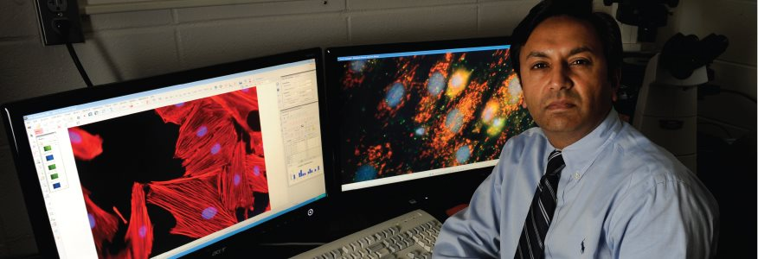

Auburn University
This is Research 2016
Faculty Symposium September 2016
Visibility and Connection
  Auburn Talks
  Interactive Poster Session
  Creative Scholarship Showcase
  Lightning Sessions
  Round Tables
  Reception for Cluster Hires
  Highlighting Research Resources on Campus
  Visibility of research to internal and external audiences
Held in the AUBURN UNIVESITY HOTEL AND DIXON CONFERENCE CENTER
Notes:
The new format for This is Research used in 2015 went well – our post event survey suggested we should do something similar in 2016. We will be building on last year to feature events that build connection among our faculty and help increase the visibility of research and creative scholarship.
In September 2016 we will learn about the work of some of our most successful researchers, and we will recognize the work of some of our newer scholars.
We will strongly encourage faculty, students, staff and administrators to attend the symposium, and we will increase our efforts to attract external audiences. In 2015 some faculty and students thought that students should not attend the faculty symposium – but this is not the case. We strongly encourage students to come to this event.
The 2016 Creative Scholarship Showcase will have featured events on the dates of the symposium, but will continue to have activities during the month of September at different venues on campus. We have a creative scholarship subcommittee who will be planning the showcase. Information will be posted soon on the This is Research website under the Creative Scholarship Showcase tab.

Slide 6
Auburn University
This is Research 2016
Student Symposium: April 12 & 13
Faculty Symposium: September 15 & 16
Questions?
Dr. Jennifer Kerpelman
This is Research 2016 Steering Committee Chair
Contact: jkerpelman@auburn.edu
Dr. Lorraine Wolf
Undergraduate Research
Contact: wolflor@auburn.edu

