Slide 1
Changes in Faculty Parking for 2016-2017
Don Andrae

Slide 2
Current Parking
A and B zone parking enforced from 7:00 am to 5:00 pm, Monday – Friday
Spaces are available to any vehicle, with or without a permit, for all other days and times

Slide 3
Proposed Parking
Change the zoning on A and B spaces in the following locations to be 7:00 am to 6:00 pm enforcement
10 spaces in Lowder Lot
10 spaces behind Tichenor
10 spaces in Library Deck
10 spaces in Comer Lot
10 spaces in Upchurch
10 spaces in New Chemistry/Swingle Hall Area

Slide 4
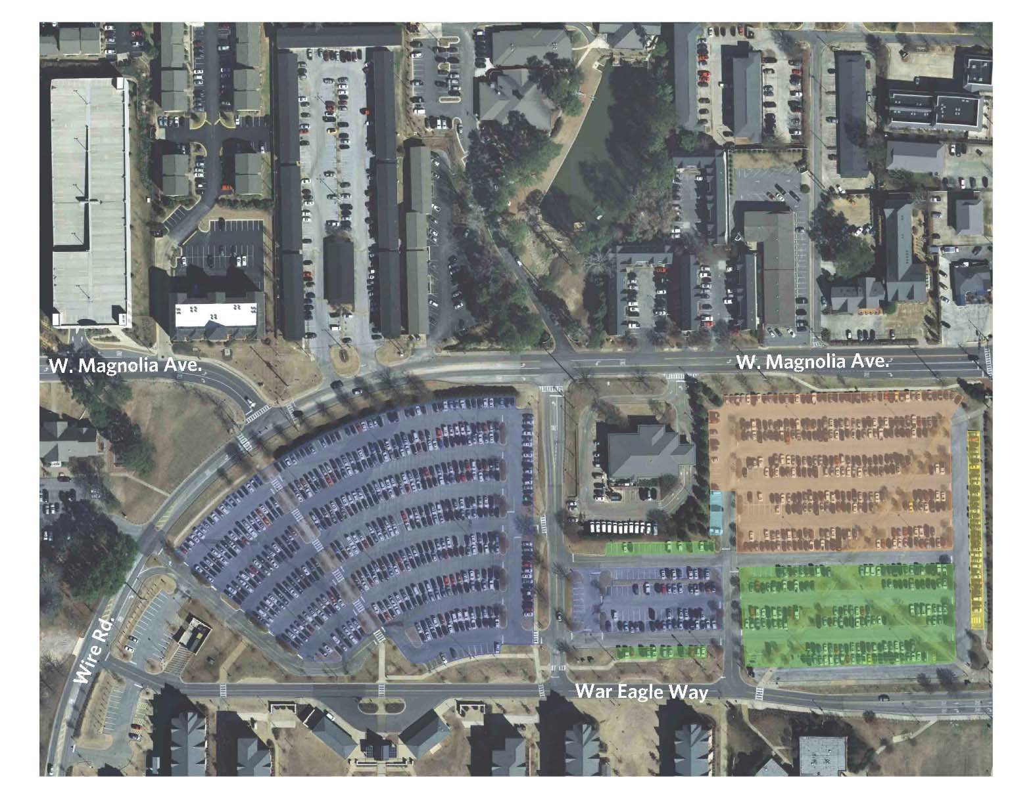
Current Parking Layout

Slide 5
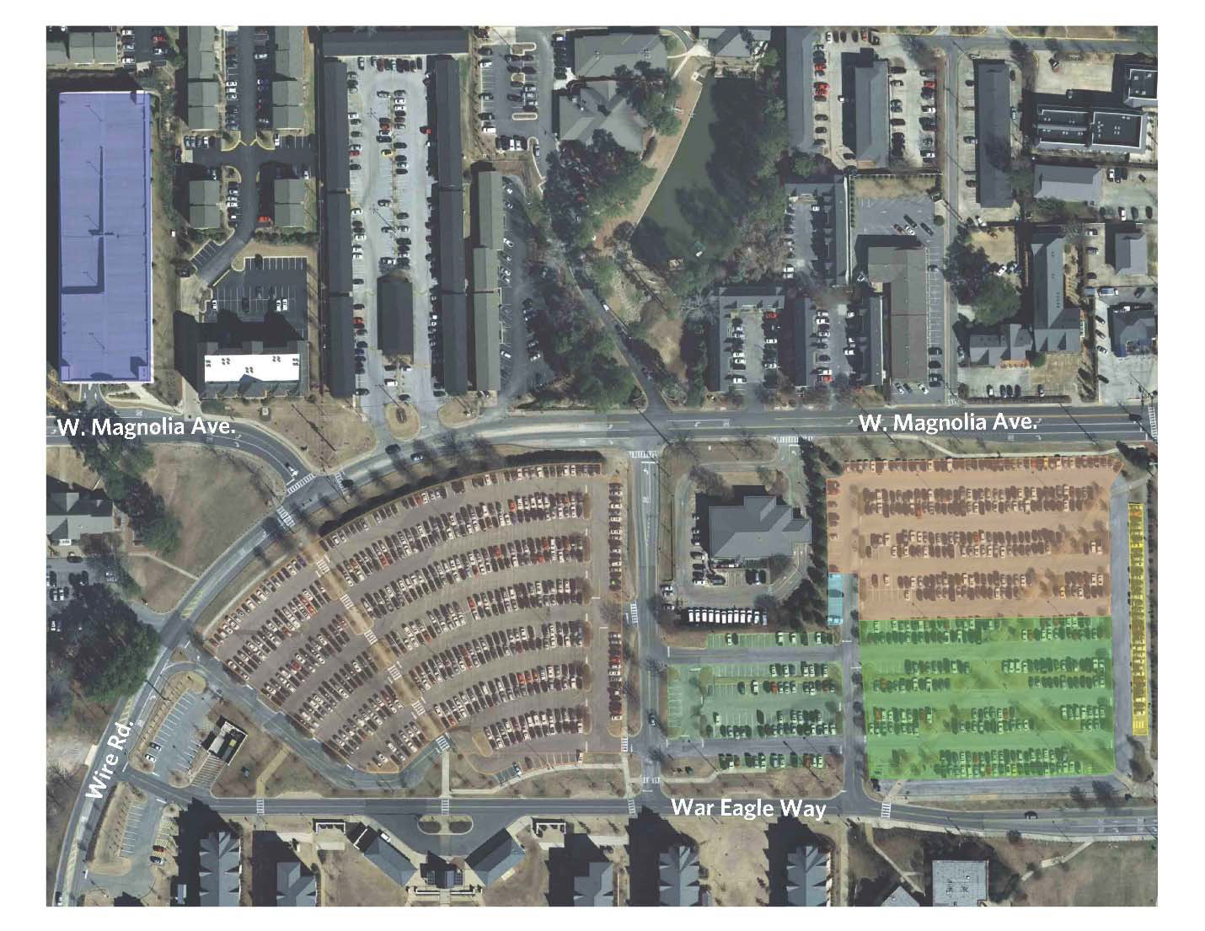
New Parking Layout

Slide 6
Current Spaces
Lot | A Zone | B Zone | PC3 | PC4 | Village Resident | Total
Magnolia/Donahue | 33 | 148 | 313 | 0 | 0 | 494
Public Safety | 0 | 56 | 0 | 0 | 65 | 121
Magnolia/Wire | 0 | 0 | 0 | 0 | 550 | 550
N Park Garage | 0 | 0 | 0 | 0 | 0 | 0
Total | 33 | 204 | 313 | 0 | 615 | 1165

Slide 7
New Spaces
Lot | A Zone | B Zone | PC3 | PC4 | Village Resident | Total
Magnolia/Donahue | 33 | 227 | 234 | 0 | 0 | 494
Public Safety | 0 | 121 | 0 | 0 | 0 | 121
Magnolia/Wire | 0 | 0 | 0 | 550 | 0 | 550
N Park Garage | 0 | 0 | 0 | 0 | 920 | 920
Total | 33 | 348 | 234 | 550 | 920 | 2085

Slide 8
Changes for Faculty/Staff
These changes would create an additional 144 B zone parking spaces in the Lowder/Shelby/Nichols area.
In addition, we have leased 44 spaces in the lot behind Chick-Fil-A and Dominos. Entrance is off of Genelda and will expand to 100 spaces in July.
We have lost the 100 leased spaces on Wright Street.
We have designated 75 spaces on the front side of the Cambridge to be A zone spaces beginning this Fall.

Slide 9
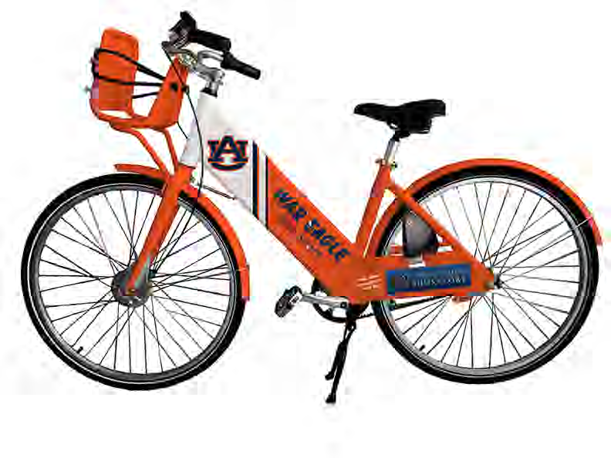

Slide 10
War Eagle Bike Share
  Go to your app store/market place and search for “Social Bicycles” or go to au.gotchabike.com and sign up on-line.
  When installing, you will need to agree to allow the app to access your location and send notifications.
  Once in the app, and when prompted after the instructions, select “Register” and then select “War Eagle Bike Share” network.
  You must enter payment information in case you exceed the free two-hour rental period.
  Keep in mind the PIN code you select when registering will be your PIN for accessing bicycles at the hub locations.
  To activate your registration, you must confirm via the link in the email you will receive from socialbicycles.com.
  Once your registration is activated, you’re ready to ride!

Slide 11
War Eagle Bike Share (Continued)
To use a bike without making a reservation in advance, go to a War Eagle Bike Share hub and enter your account number and PIN code. The bike will unlock – remove the yellow U-bar and place it in the holster rings on the left side of the bike while riding.
To reserve a bike, go to the Social Bicycles app on your smart phone or visit au.gotchabike.com. Select a bike from the map that you would like to reserve. After clicking or tapping on the bike, press the “CONFIRM” button. A screen will pop up informing you which bicycle you have reserved and give you the opportunity to cancel the reservation. You can then go to the War Eagle hub location, find the bicycle you reserved and enter your PIN code to unlock the U-bar.
If a rider would like to make a quick stop, they can press the “HOLD” button on the keypad interface and lock the bike to a nearby rack to temporarily pause the rental. Any maintenance issues encountered can also be reported directly on the keypad.
When your ride is complete, you must return the bicycle to any War Eagle Bike Share hub to end the ride and not be charged additional fees. Be sure to lock the bike securely to the bicycle rack by securing the U-bar around the rack and insert into the designated holes at the rear of the bike.

Slide 12
War Eagle Bike Share Hubs
Student Center on Heisman
Roosevelt Concourse by Sciences Center Classroom
Terrell Dining in the north courtyard
Wellness Kitchen
Lowder by Starbucks
West Thach by Hemlock
Village Dining on Thach Concourse
Cambridge by College
South Quad Parking Deck by Duncan
College of Veterinary Medicine by Greene Hall

Slide 13
Contact Information
Don Andrae – Manager of Parking Services
Telephone #: 334/844-4143
Email: dza0015@auburn.edu

