Slide 1


Mell Classroom Building
&
Offsite Library Archive Facility (OLAF)
BDean of Libraries
Dean of Auburn University Libraries
Bonnie MacEwan

Slide 2
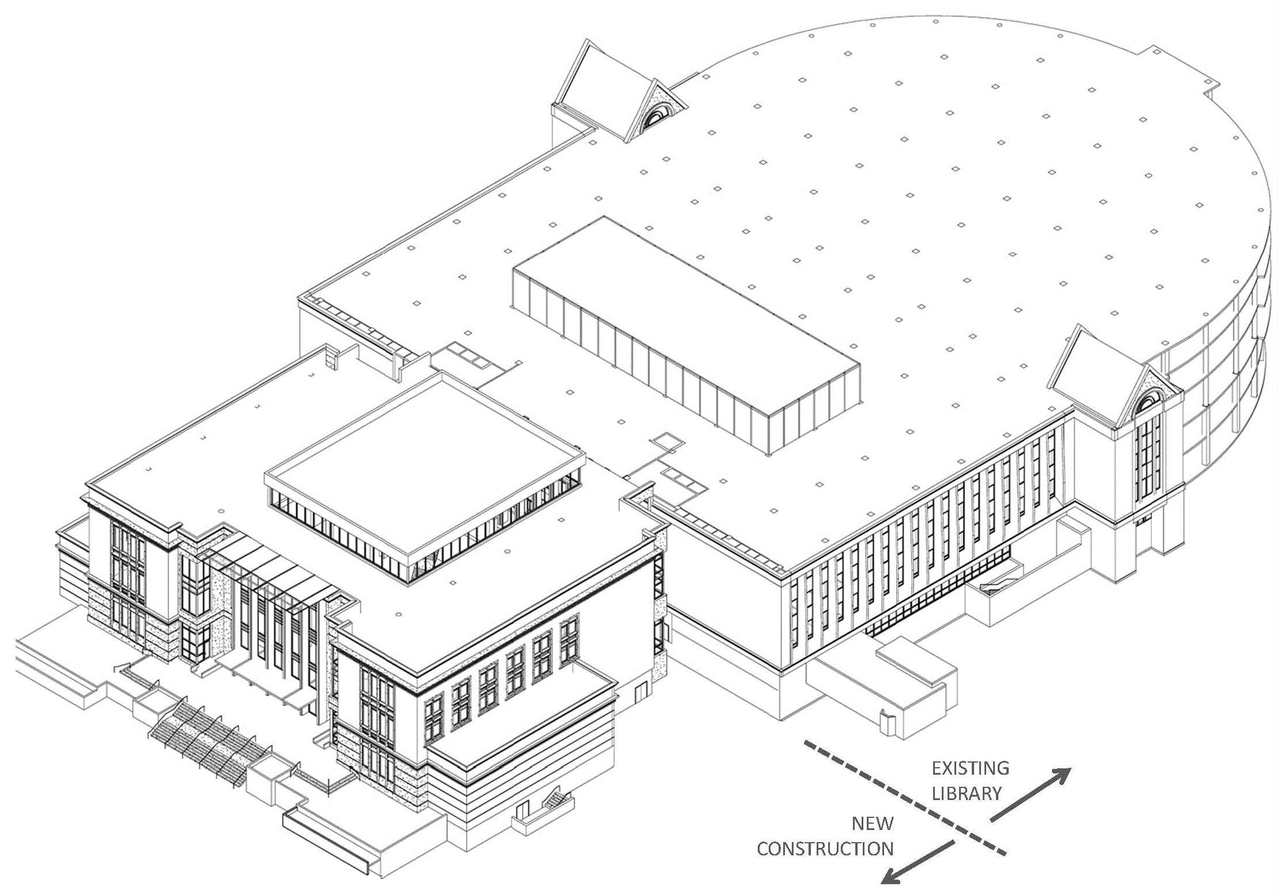
MCB Project Quick Facts
Construction Dates - 12/2015 to 8/2017
^{Primary Use - Classrooms}
107,000 Total SqFt. - 69,000 in Mell Classroom Building and 38,000 in the RBD Library
^{Classrooms Added – 26 active-}
^{learning classrooms,}
^{two lecture halls}

Slide 3
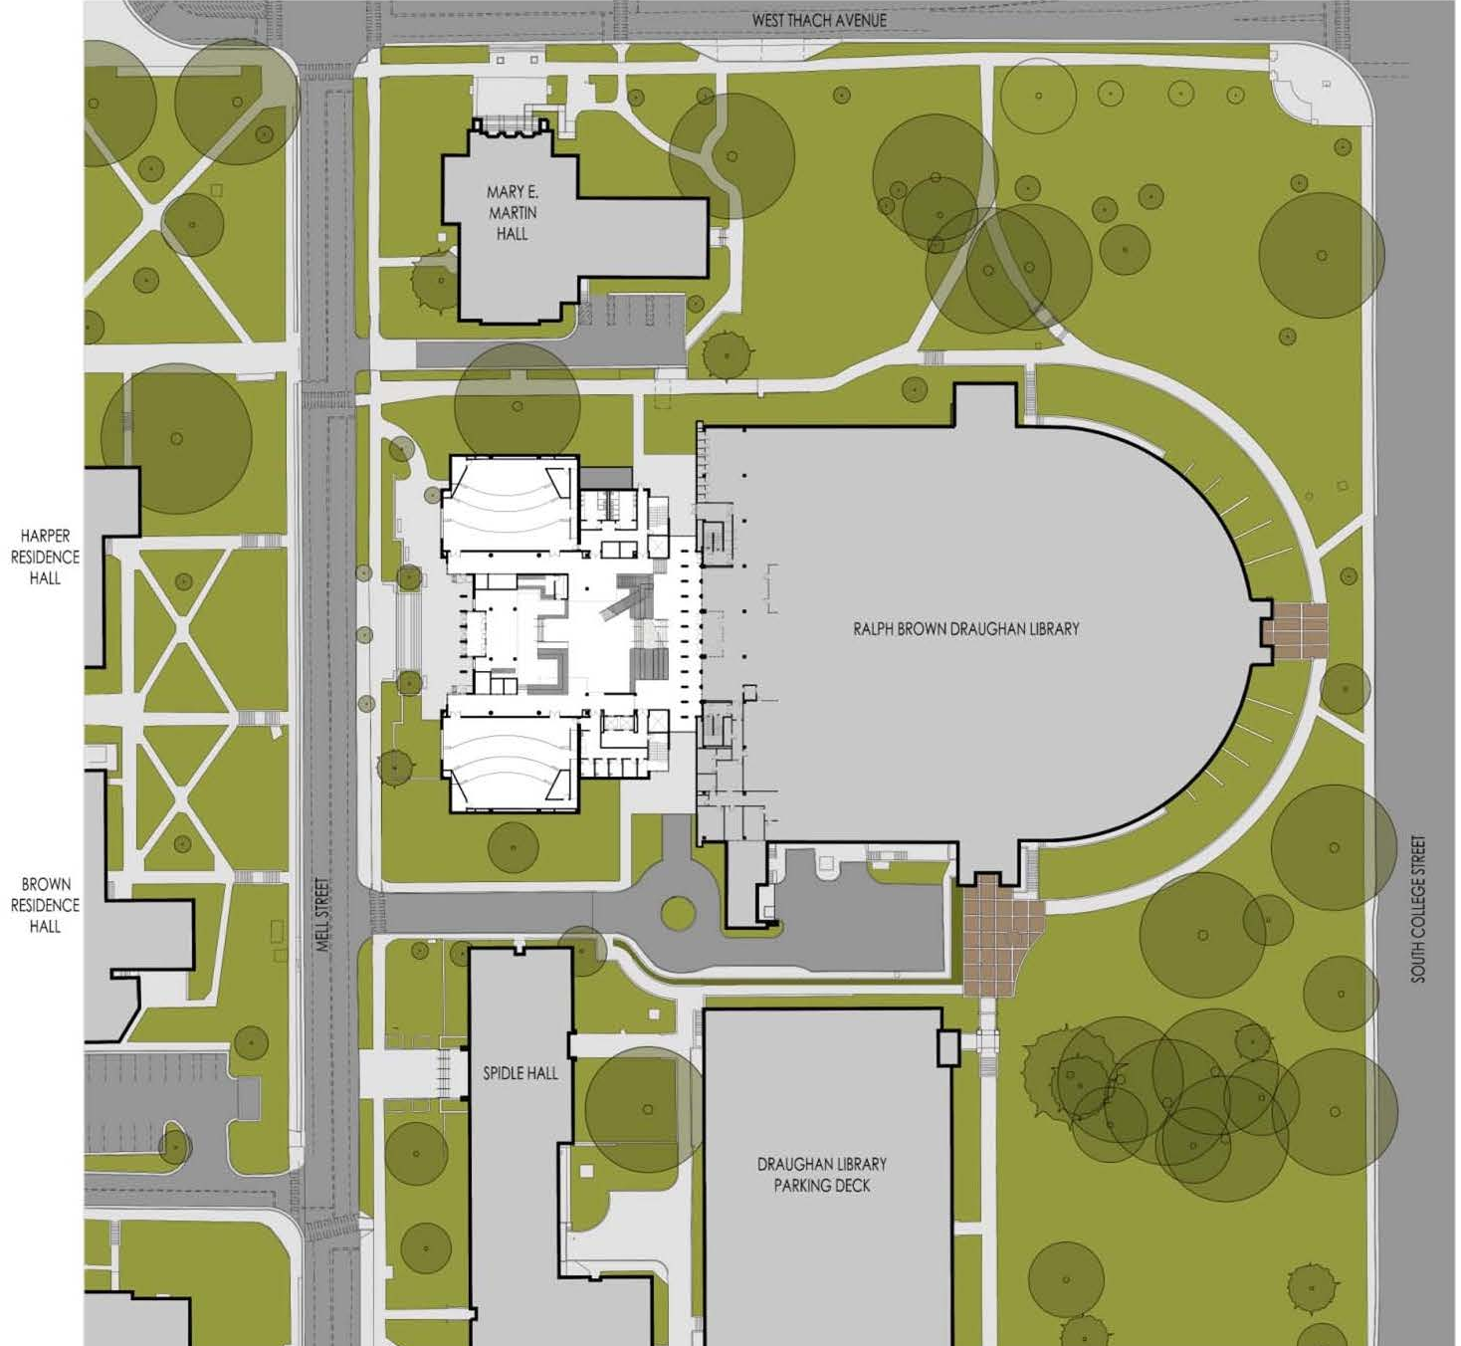
3

Slide 4
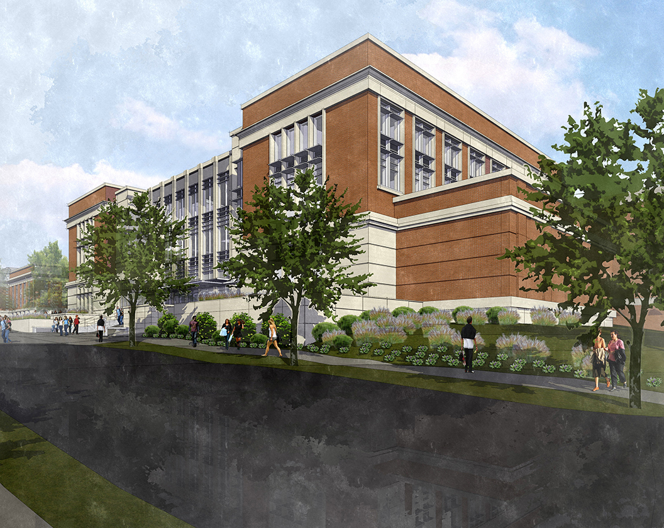
4

Slide 5
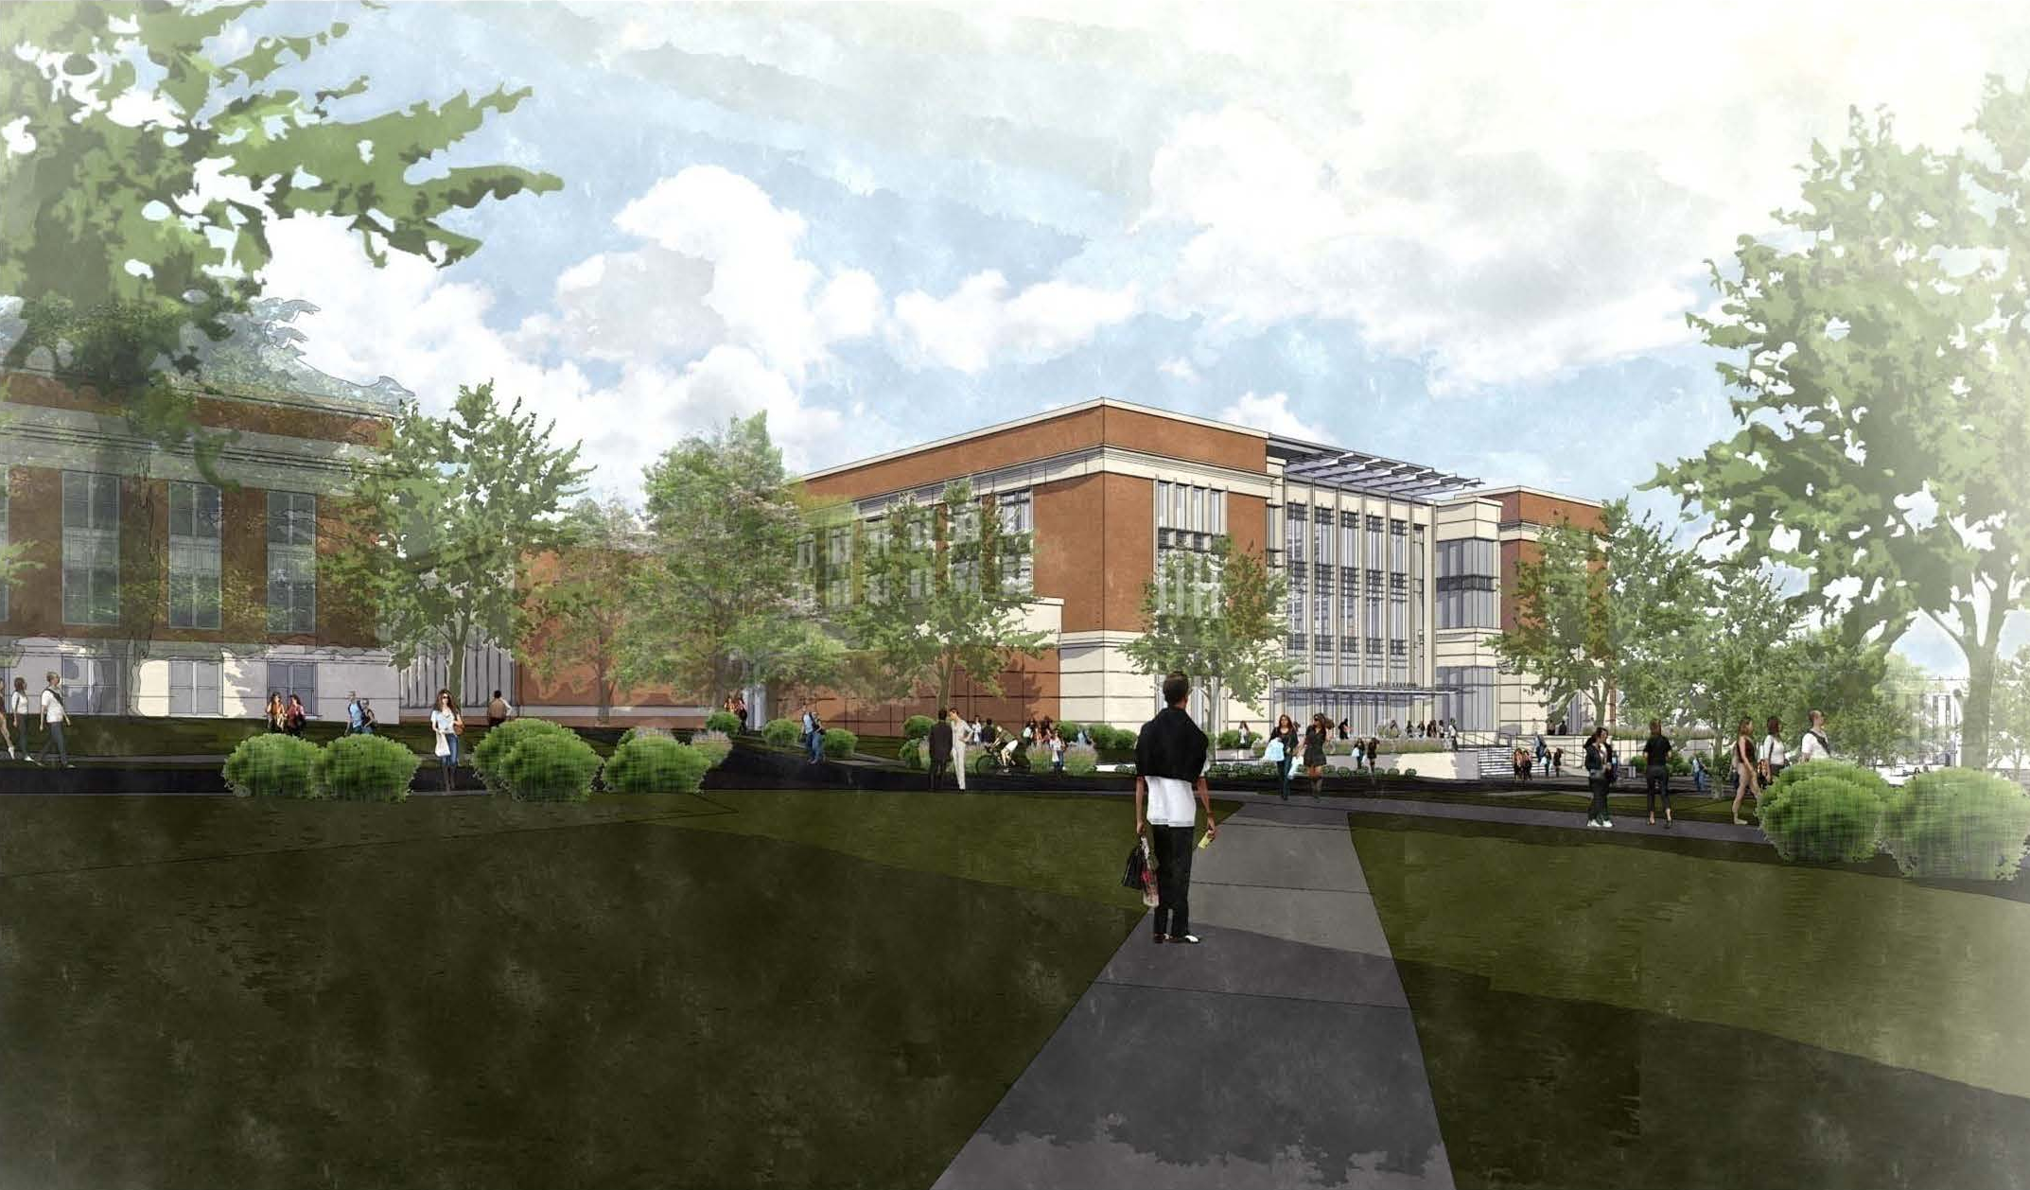
5

Slide 6
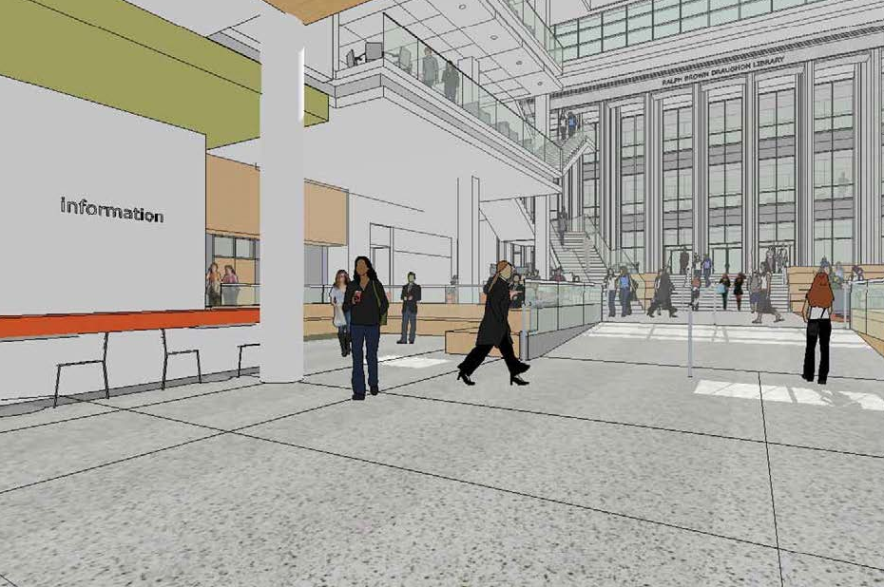
6

Slide 7
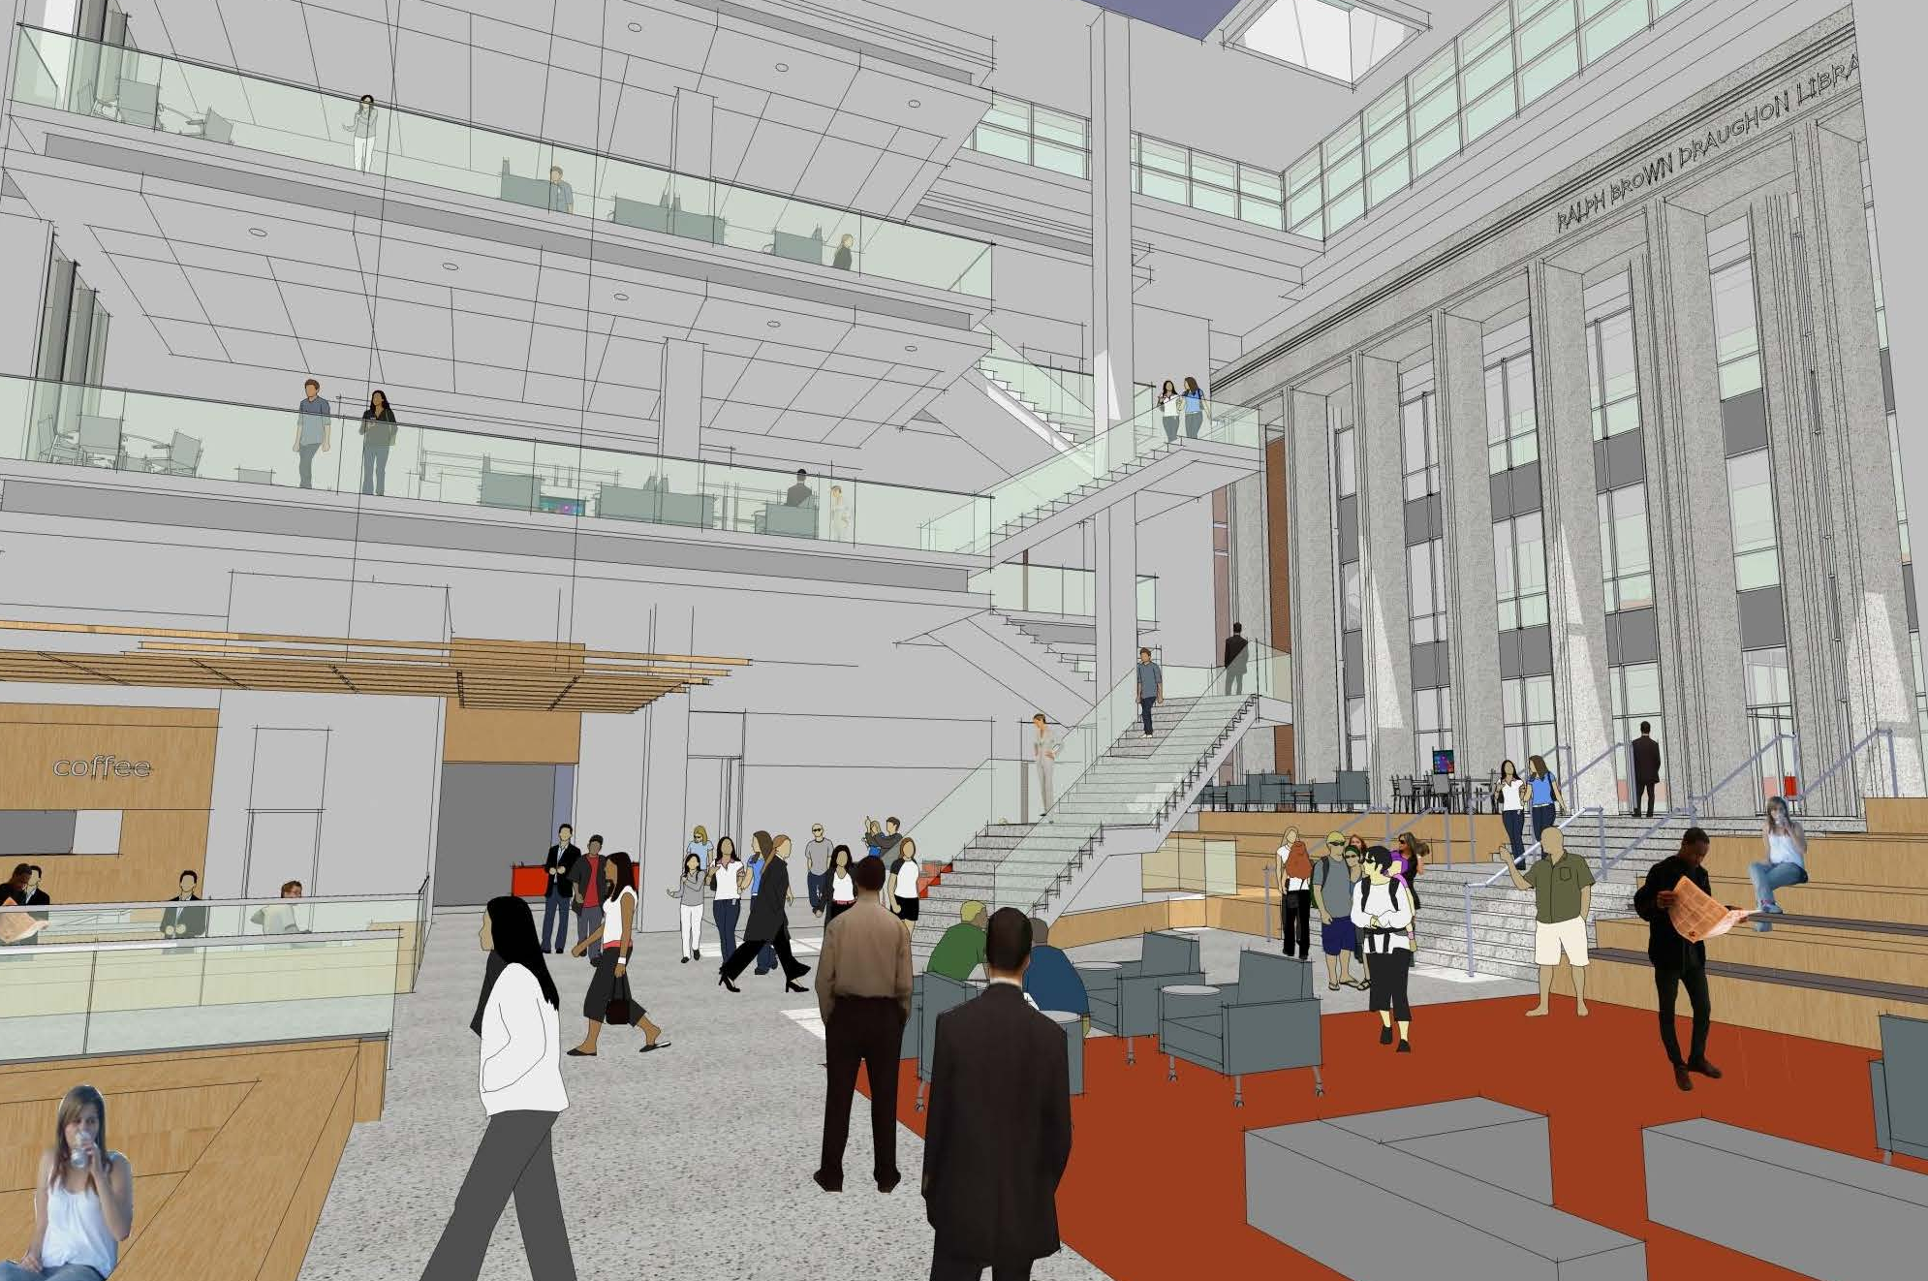
7

Slide 8
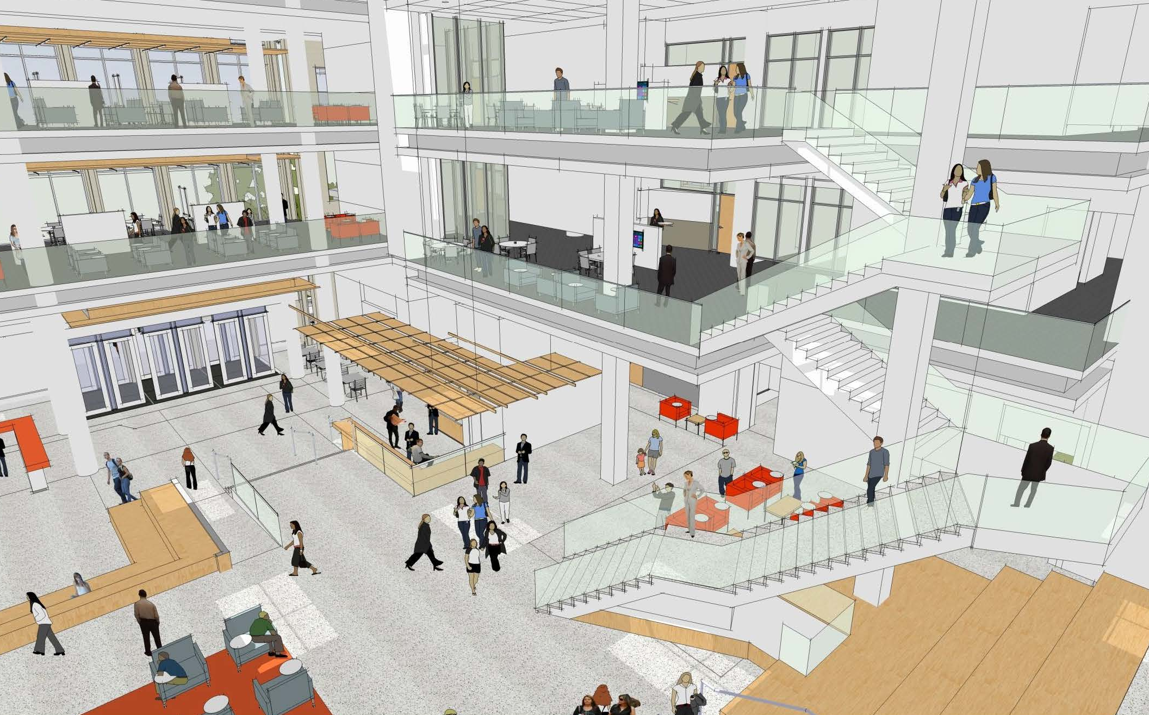
8

Slide 9
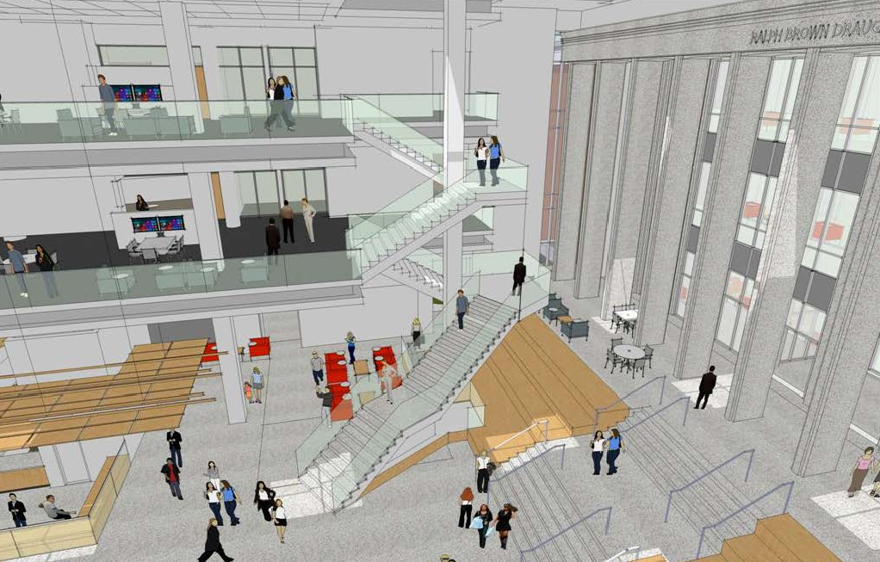
9

Slide 10
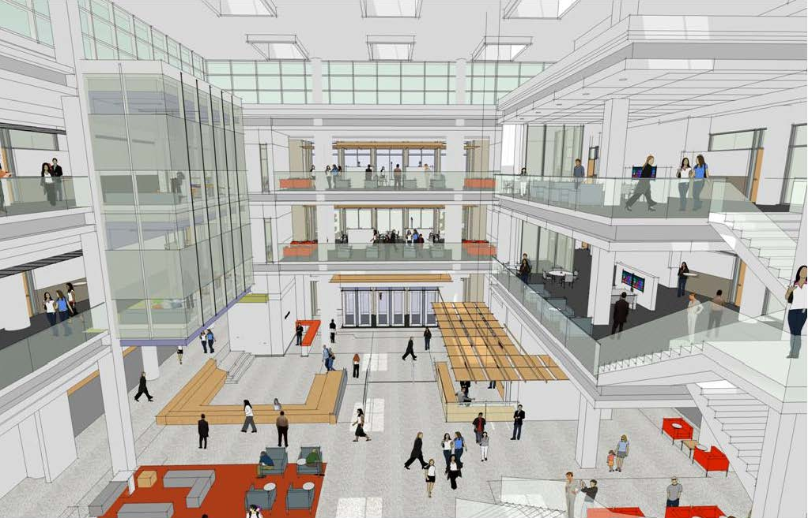
10

Slide 11
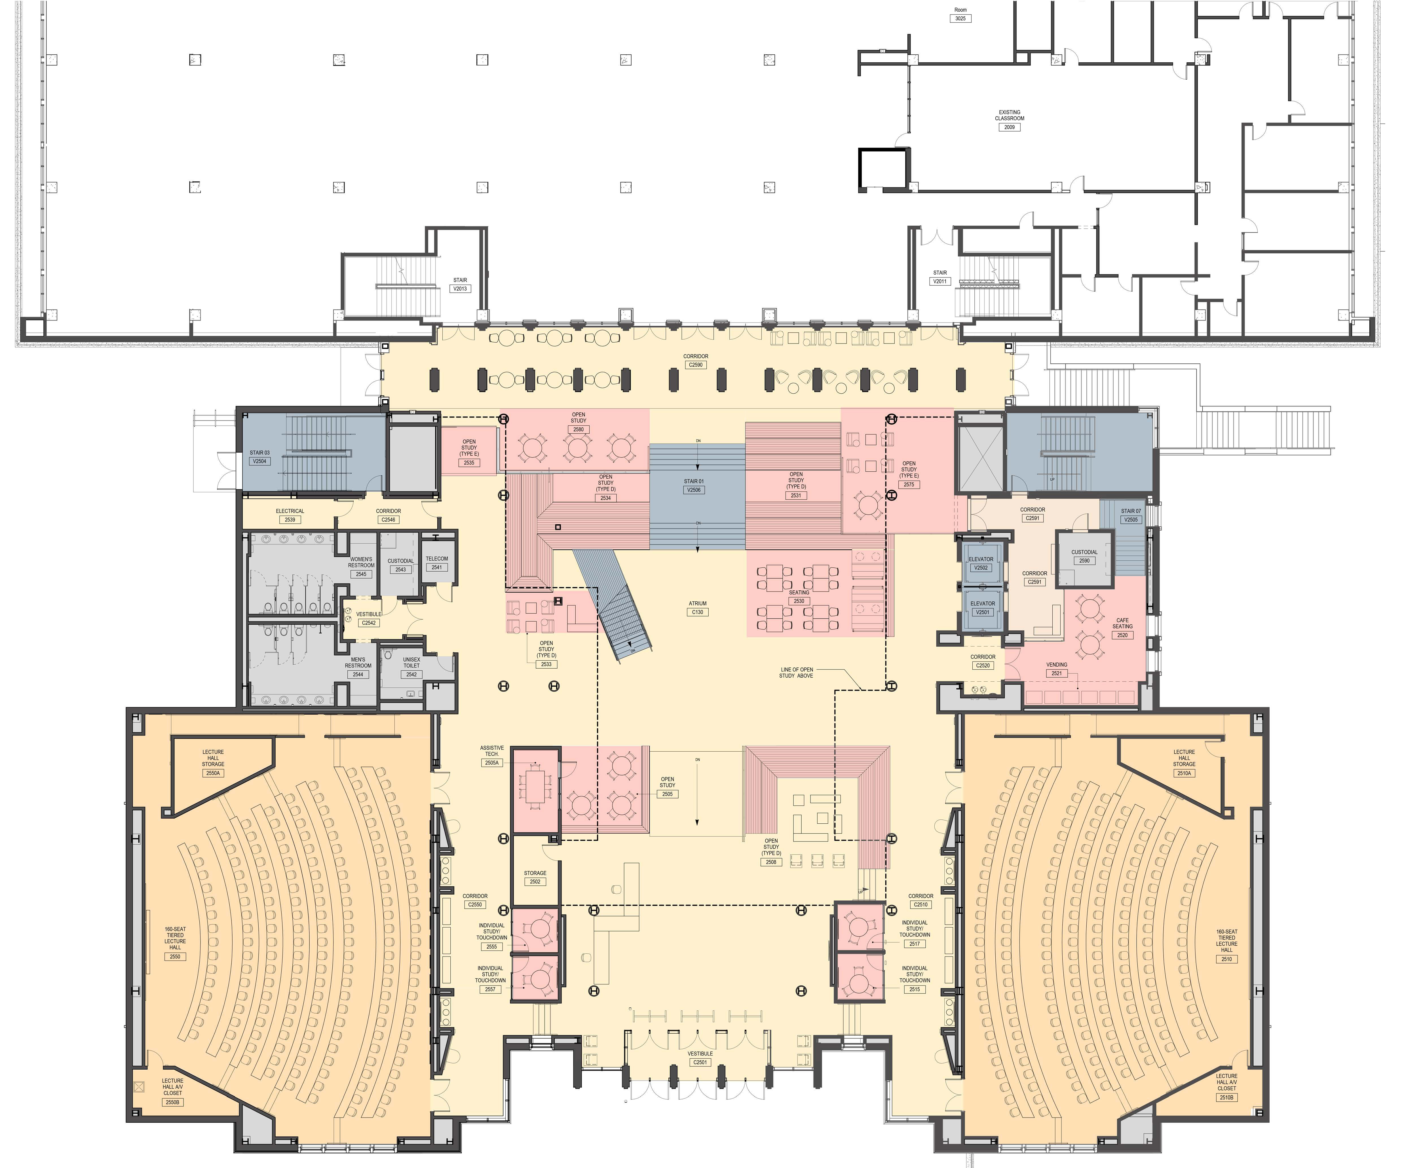
Second Floor of RBD Library with attached MCB
(1st & 2nd levels of MCB)
11

Slide 12
Third Floor of RBD Library with attached MCB
12

Slide 13
Fourth Floor of RBD Library with attached MCB
13

Slide 14
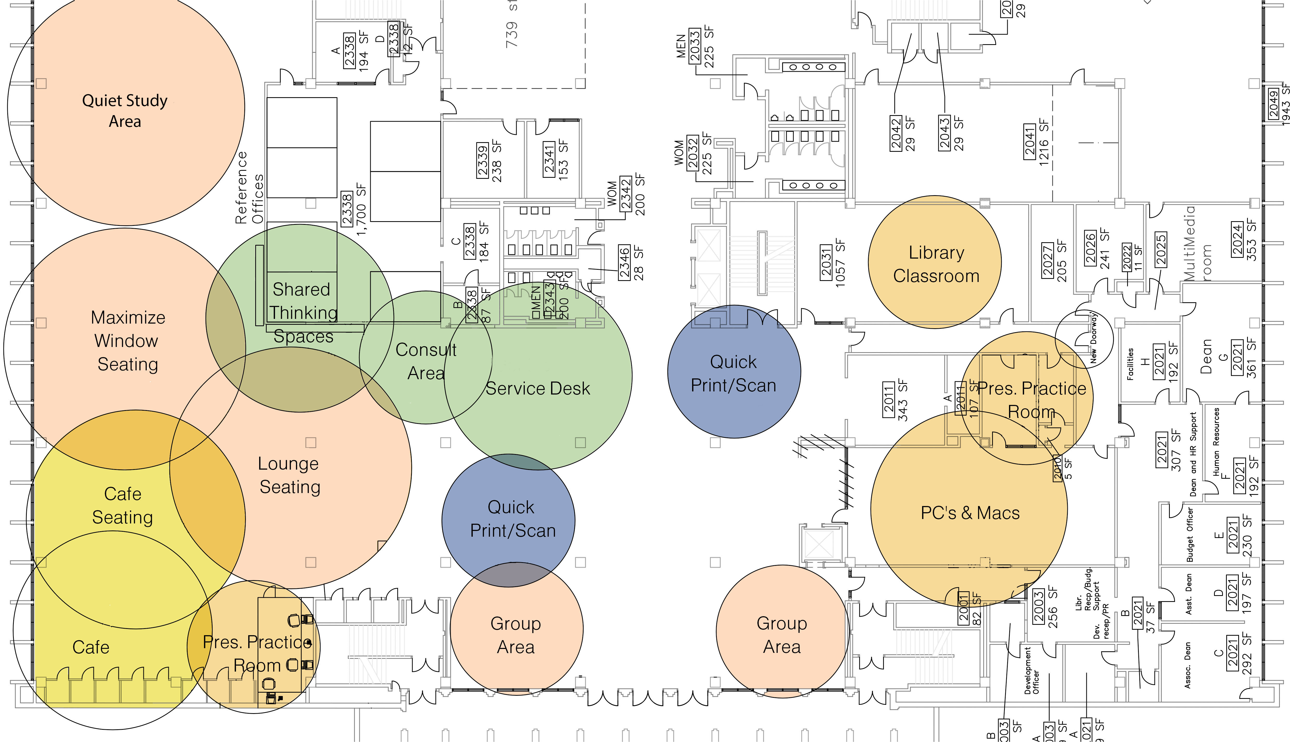
Second Floor of RBD Library after MCB construction
14

Slide 15
O.L.A.F.
Offsite Library Archive Facility
15

Slide 16
O.L.A.F. Project Quick Facts
Construction Dates - 12/2015 to 4/2016
Purpose - To house and preserve volumes for projects such as the Scholars Trust
^{Building – 16,900 square feet}
^{Shelving – 36,327 linear feet}
Accessibility - Library Courier Service with office or library delivery

Slide 17
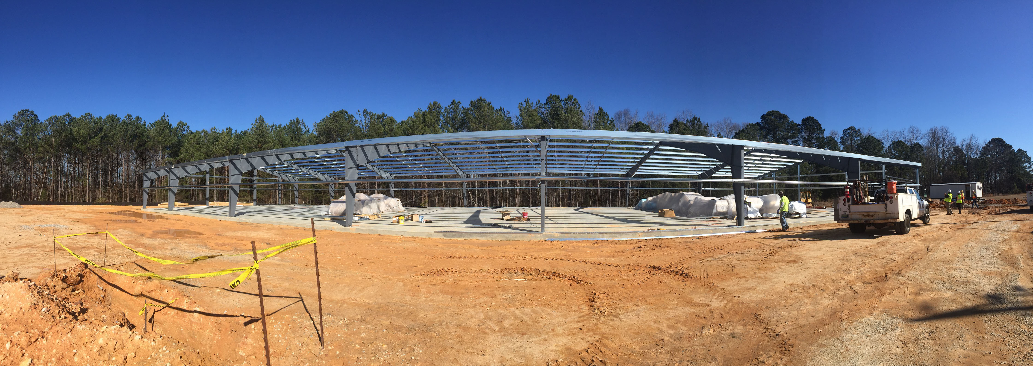
17

Slide 18
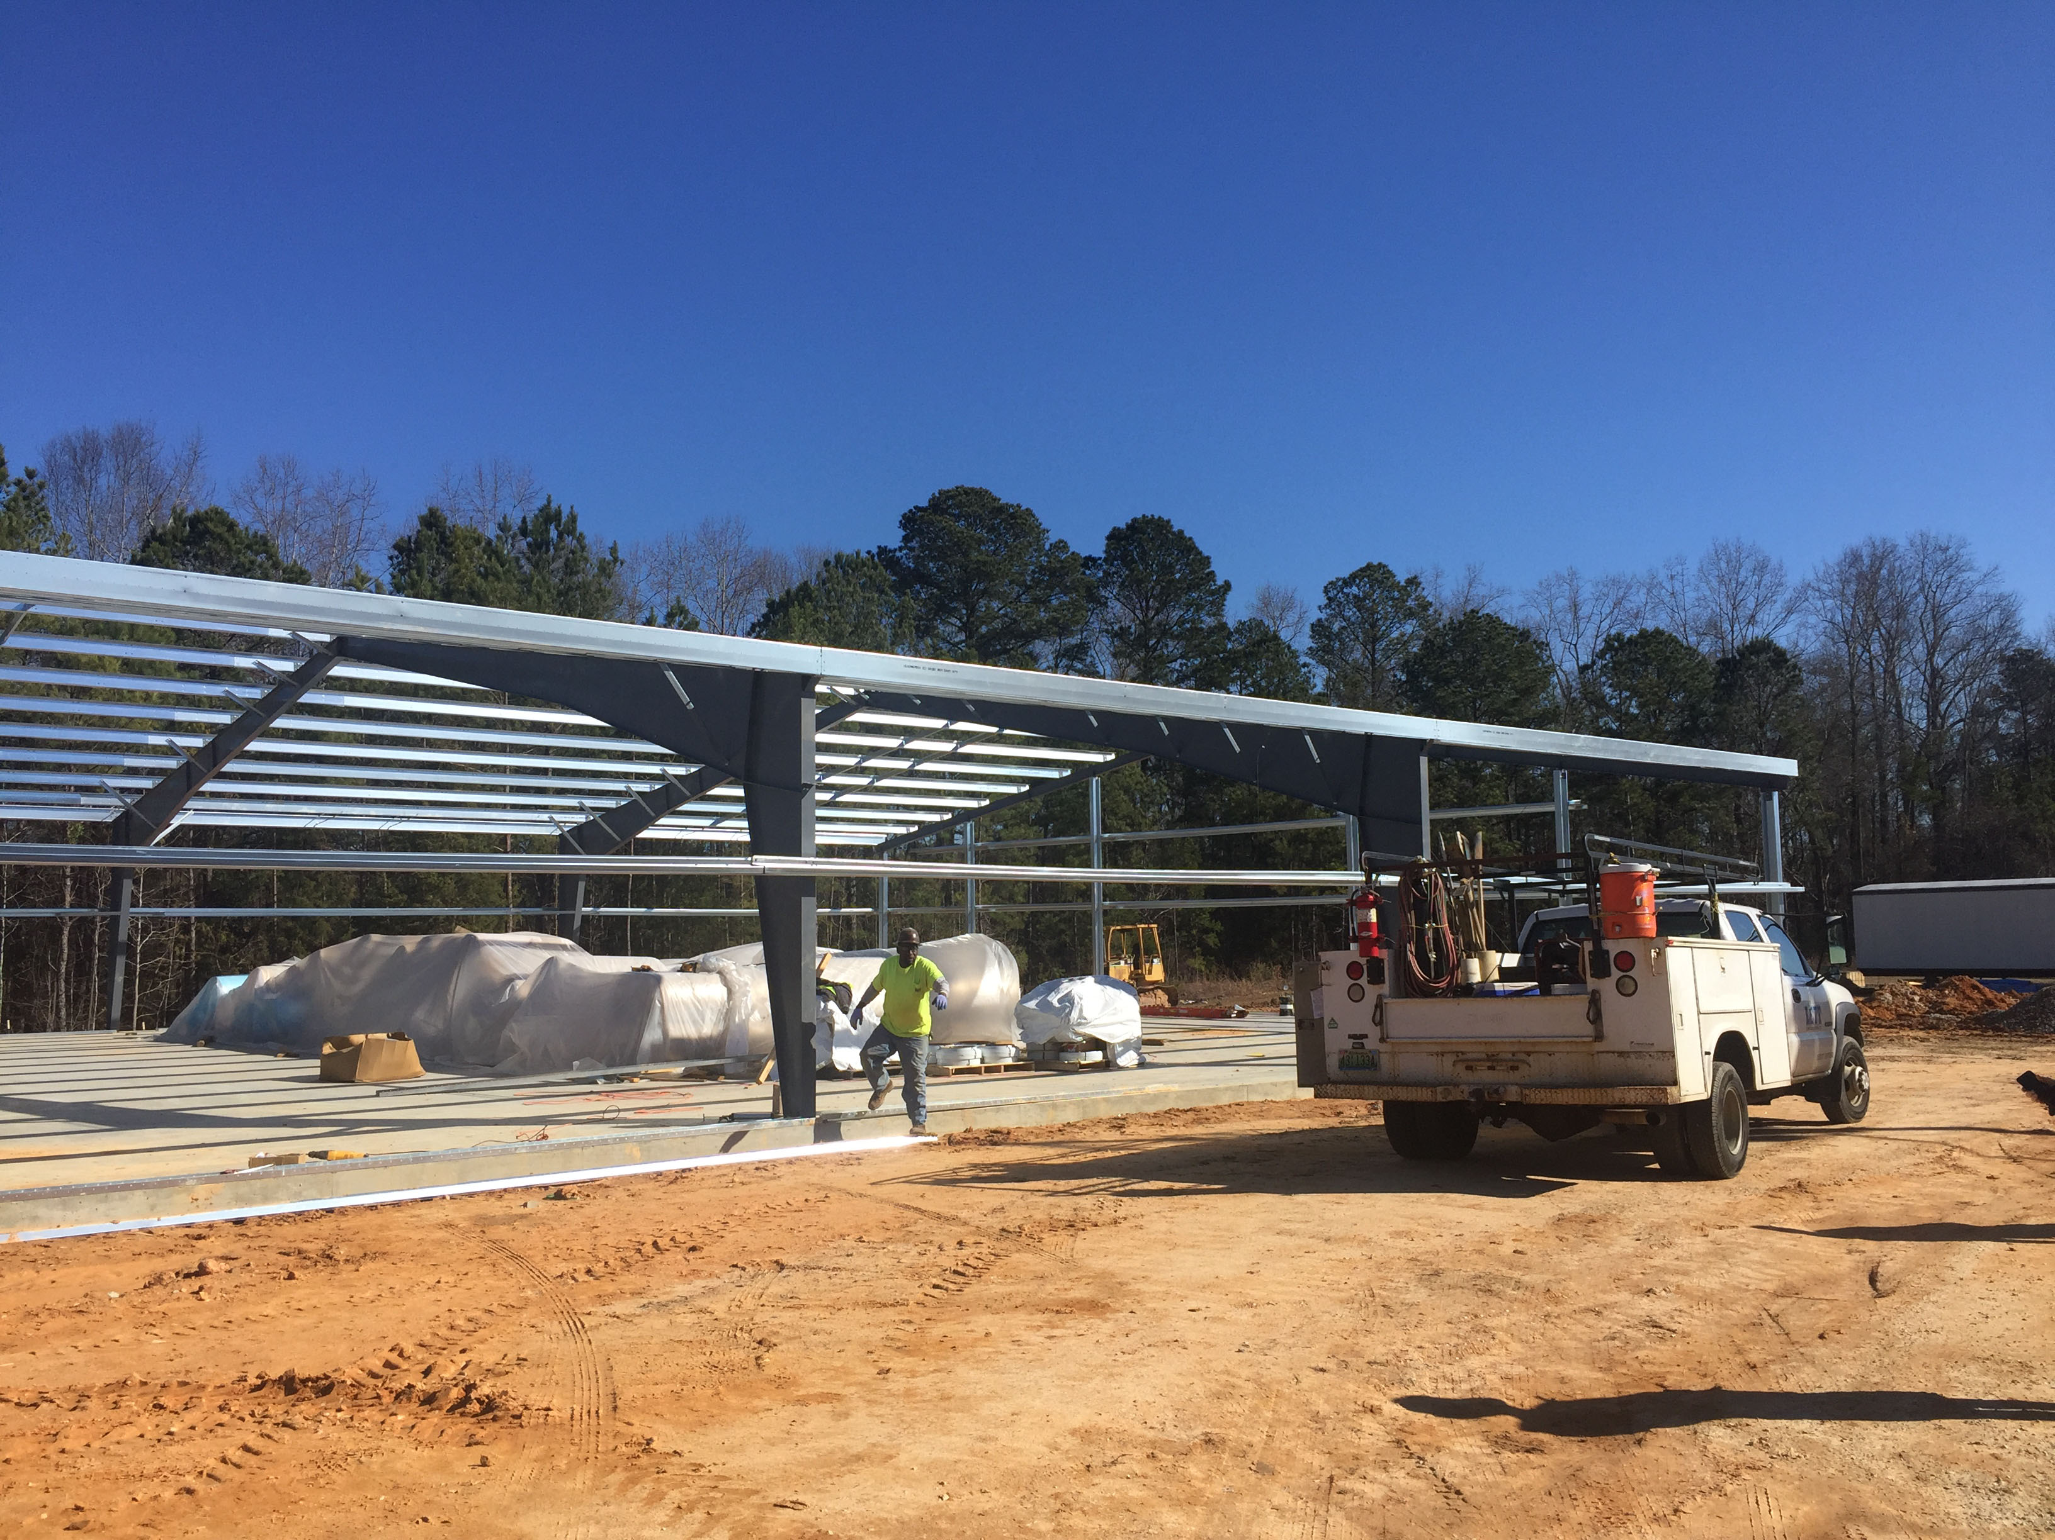
18

Slide 19
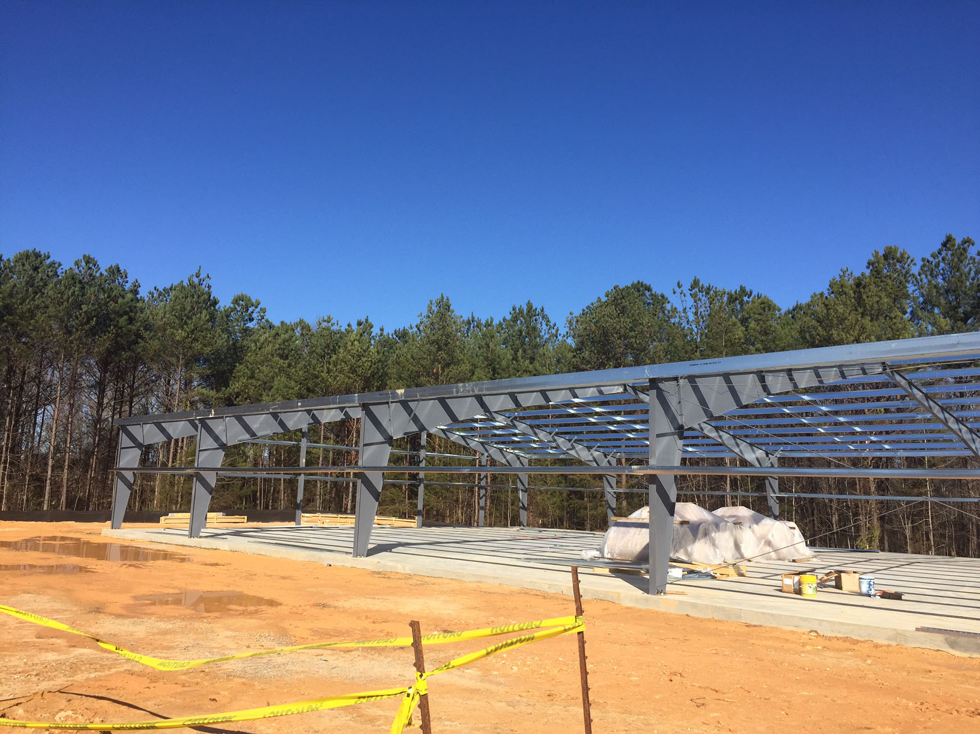
19

Slide 20
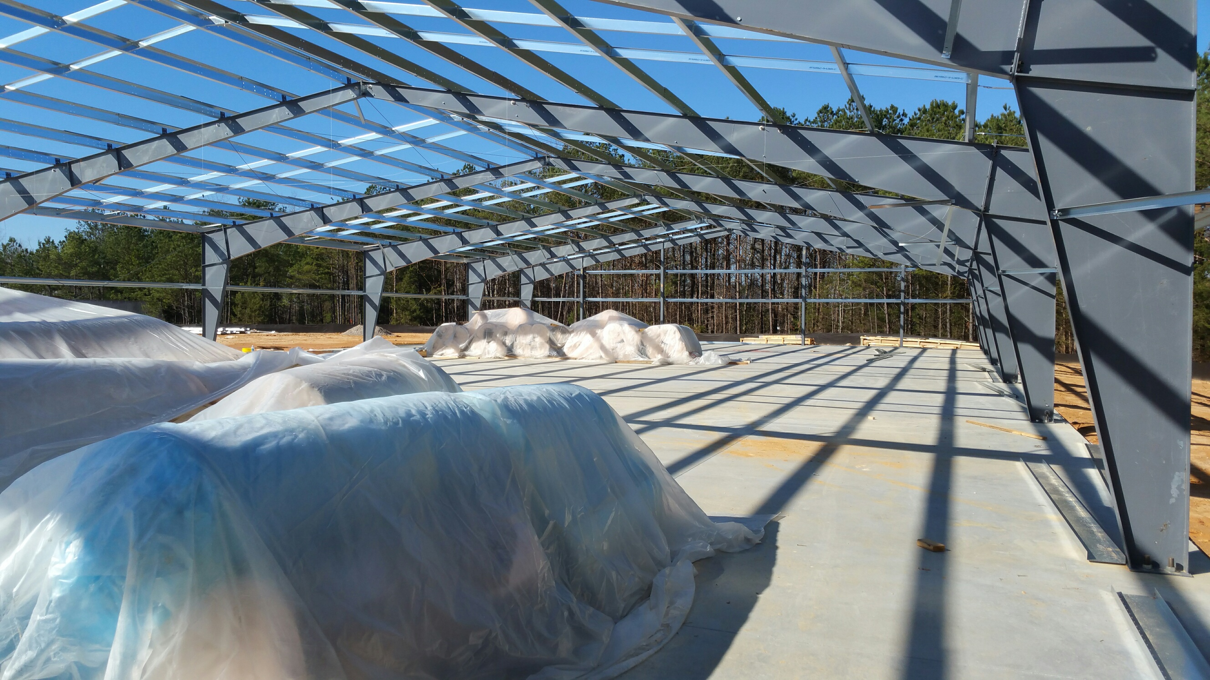
20

