Slide 1

Mell Street corridor planning
University senate meeting
22 march 2016 | broun hall 238
AUBURN UNIVERSITY
Facilities Management
Office of the University Architect

Slide 2
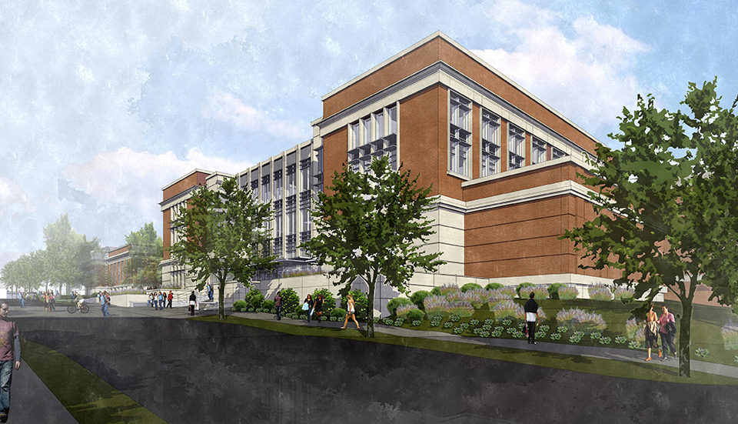
Mell classroom building
69,000 SF Addition
29 Classrooms
2 Lecture Halls
Over 1400 seats

Slide 3

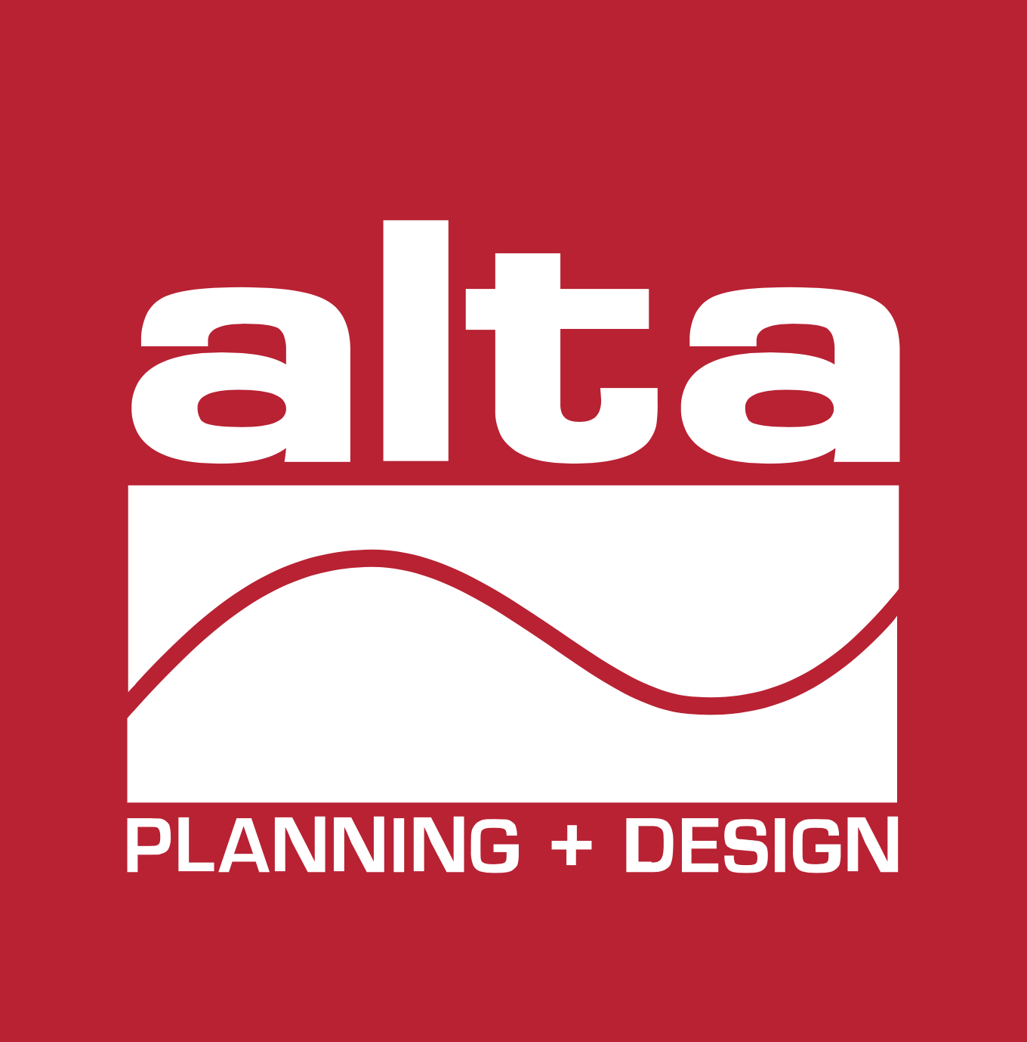



Mell street corridor planning
project team
HOLCOMBE NORTON PARTNERS, INC.
LANDSCAPE ARCHITECT / PRIME CONSULTANT
TOMMY HOLCOMBE, PLA, ASLA, LEED AP – PRINCIPAL IN CHARGE
STEPHEN SCHRADER, PLA, ASLA – DESIGN & PROGRAMMING FACILITATOR
CHRIS PUGH, PLA, ASLA – PROJECT MANAGER
TRAFFIC
DARRELL SKIPPER, PE
MICKEY HALL, PE
INTERMODAL PLANNING
KERRY BLIND, PLA
SITE CIVIL
CURTIS EATMAN, PE, LEED AP
SITE ELECTRICAL
CHARLIE CONWAY, PE
KENNETH LANGLEY
ARCHITECTURE
STEPHEN ALLEN, AIA
STRUCTURAL ENGINEERING
BRAD CHRISTOPHER, PE

Slide 4
Mell street corridor planning
Mell Classroom Construction
Dec 2015 – Aug 2017
Mell Street
Corridor
Feb 2016 – Aug 2017
Planning
Feb 2016 – May 2016
Design
May 2016 – Jan 2017
Construction
Jan 2017 – Aug 2017
Mar - April 2016
Breakout meetings with
constituents and University governance groups
Dec ‘15
Mar ‘16
June ‘16
Sept ‘16
Dec ‘16
Mar ‘17
June ‘17
Sep ‘17
February 24, 2016
September 2016
August 18, 2017
Provost Open Forum and Visioning Session
Provost Open Forum
Project Update
Fall Semester Begins
December 2015
April 2016
Mell Classroom Construction Begins
Conceptual Design Recommendations Presentation

Slide 5
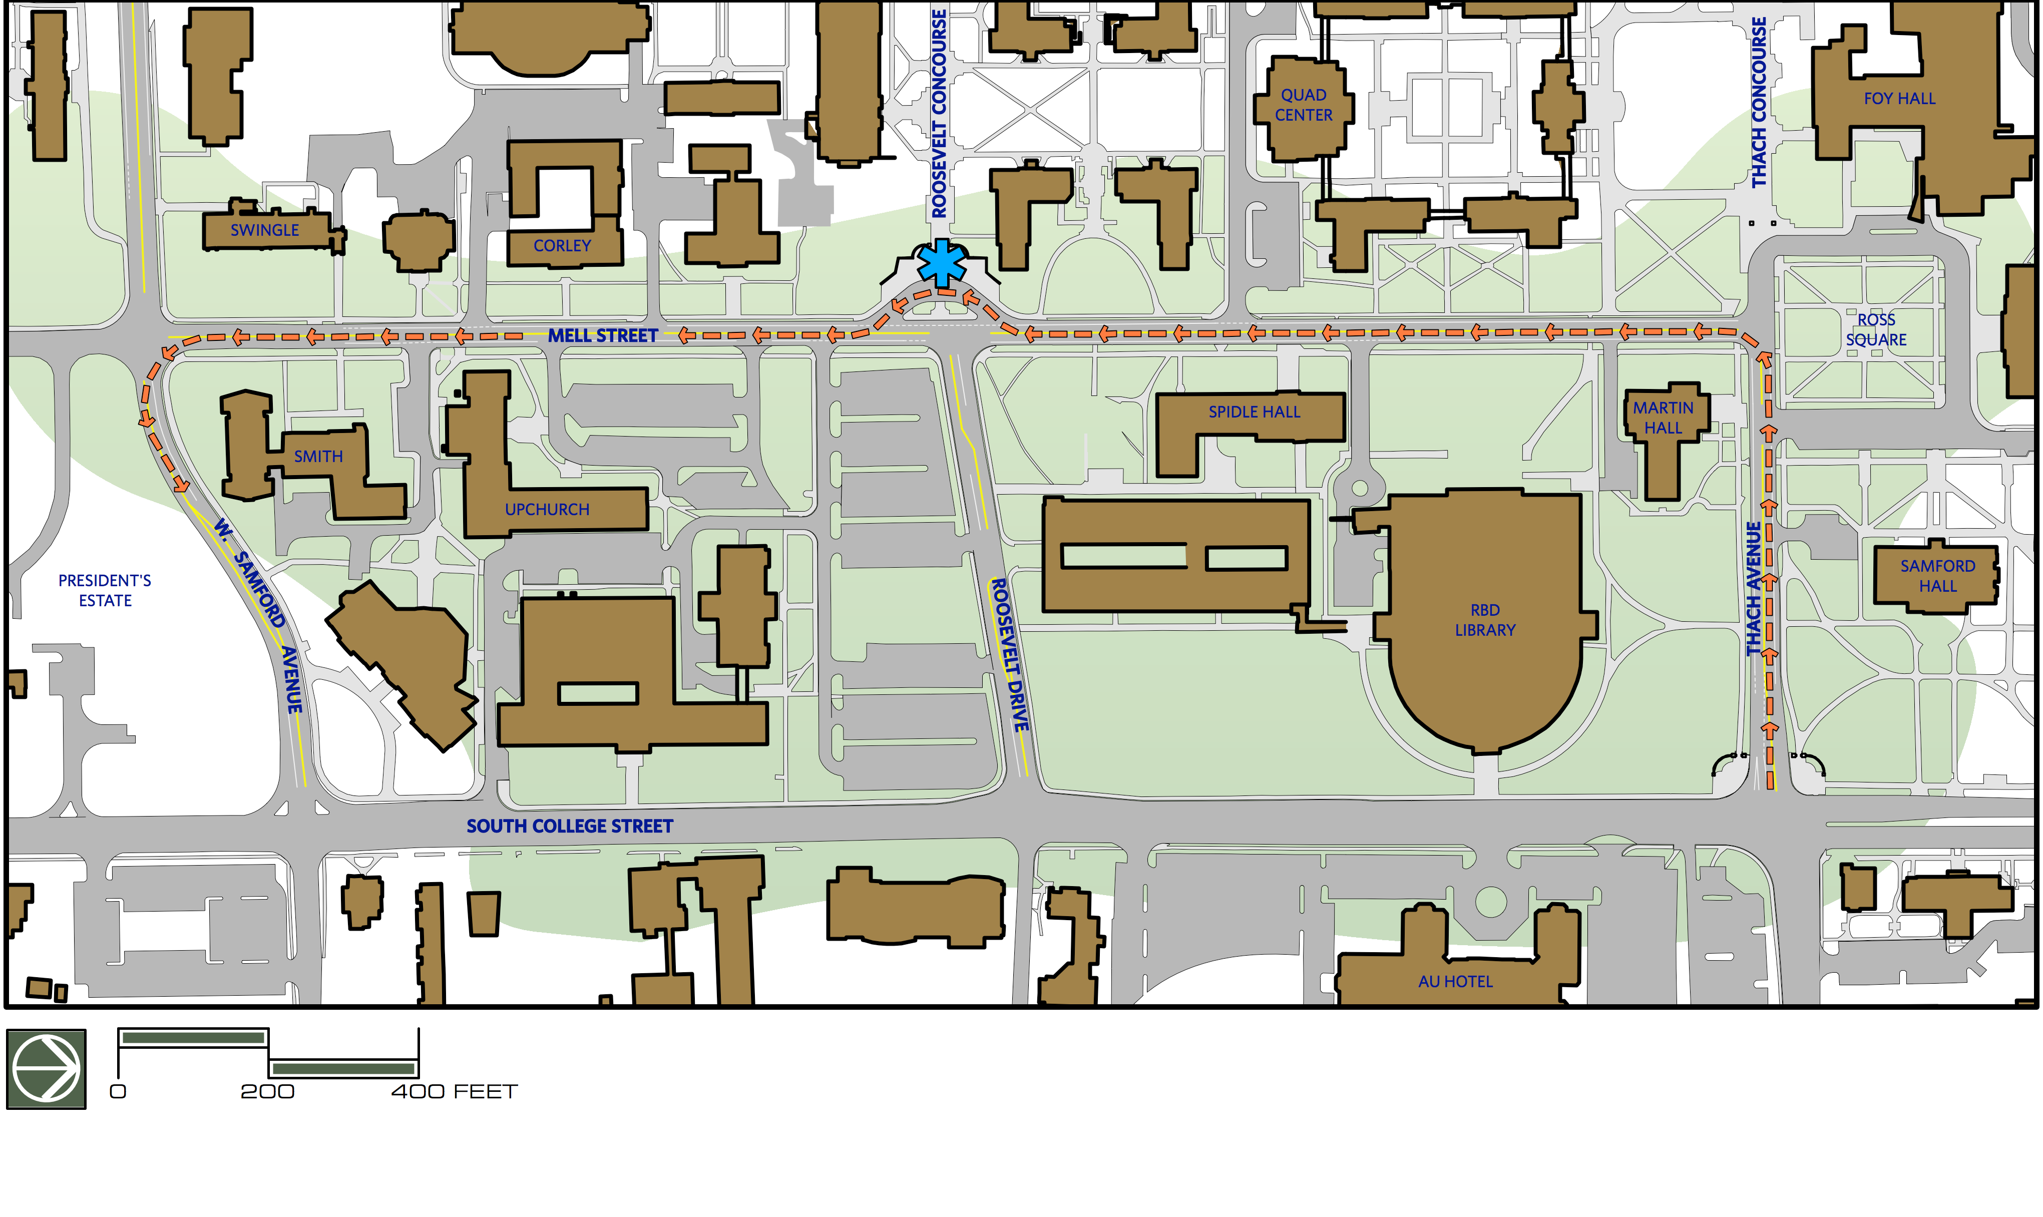
PRE-CONSTRUCTION CONDITIONS
MELL STREET CORRIDOR

Slide 6
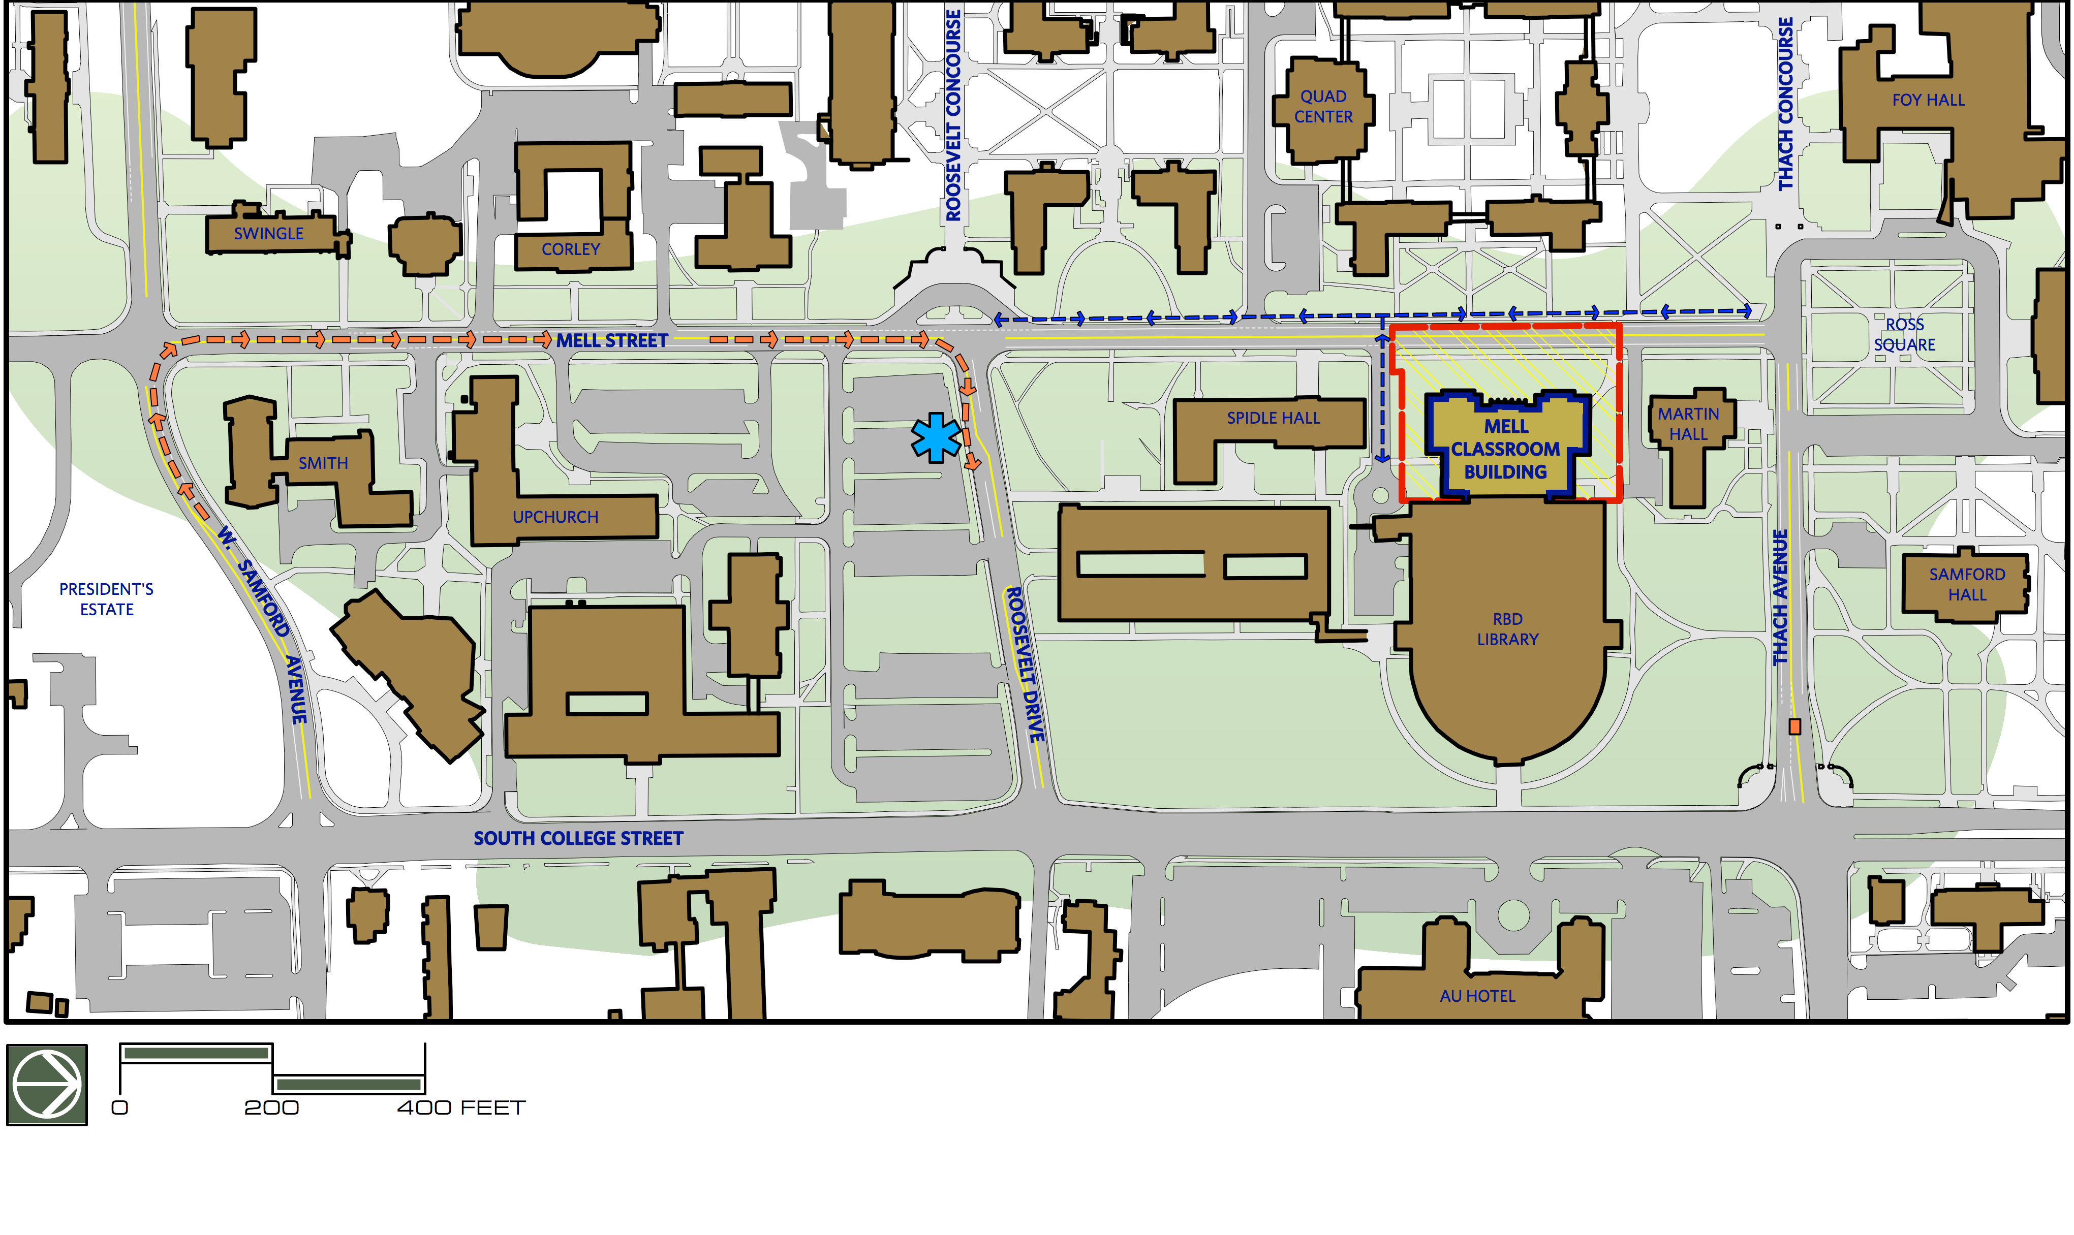
CONSTRUCTION CONDITIONS
MELL STREET CORRIDOR

Slide 7
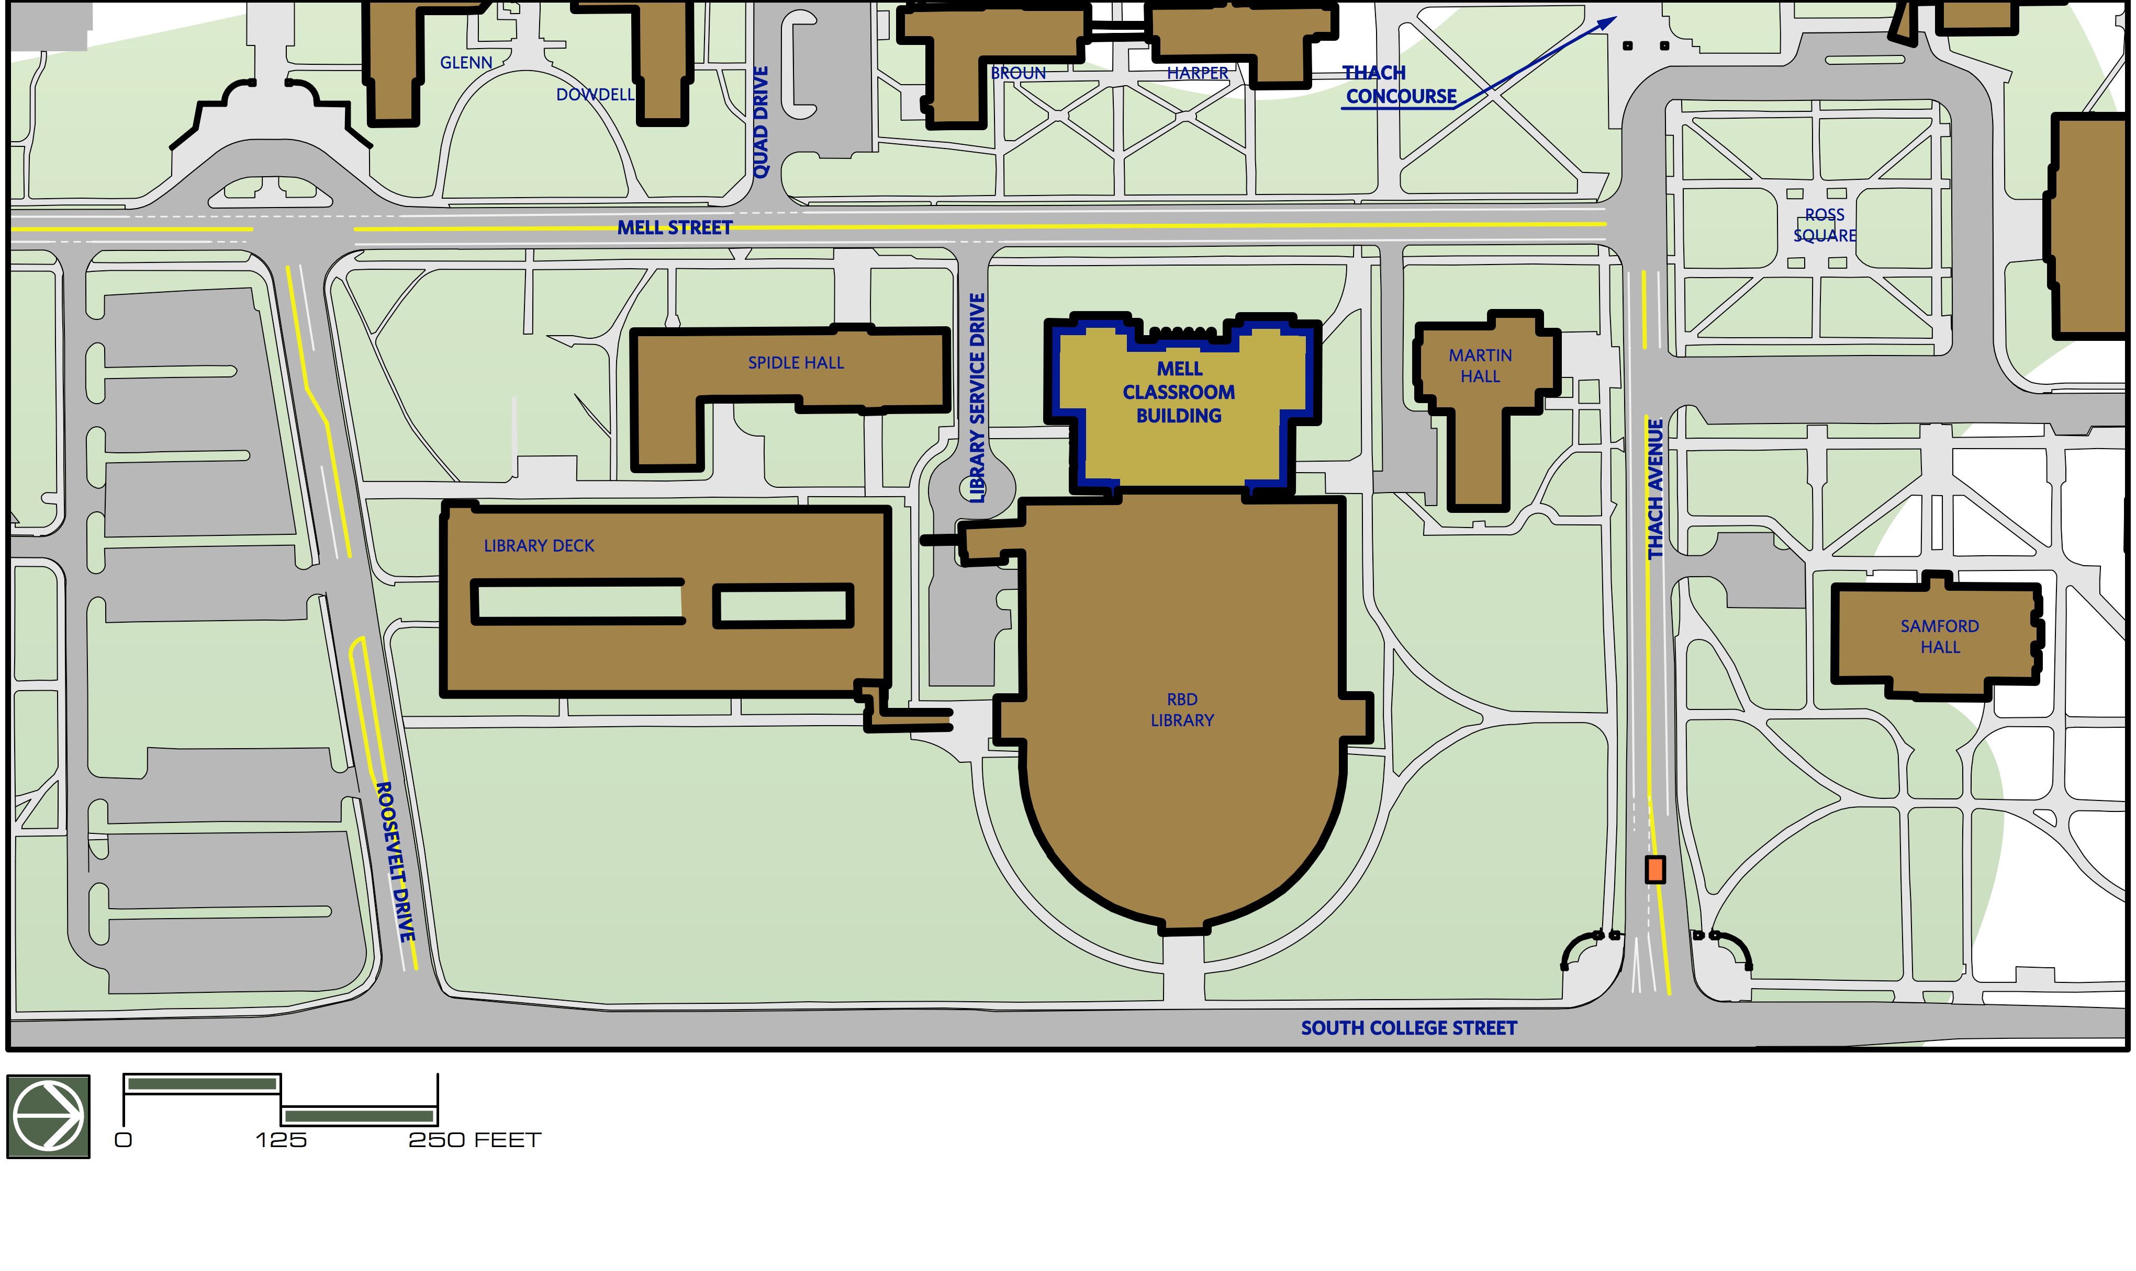
Re-open Mell to Traffic:
Less Desirable – 64%
Neutral – 19%
More Desirable – 17%
FUTURE POSSIBILITIES
MELL STREET CORRIDOR: ROSS SQUARE TO ROOSEVELT DRIVE FOCUS AREA

Slide 8
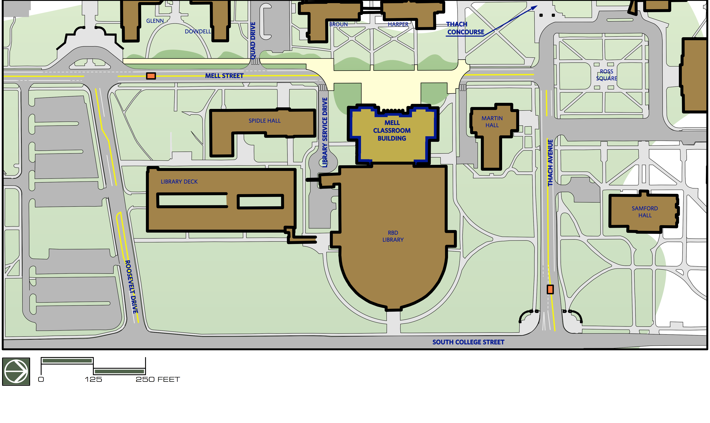
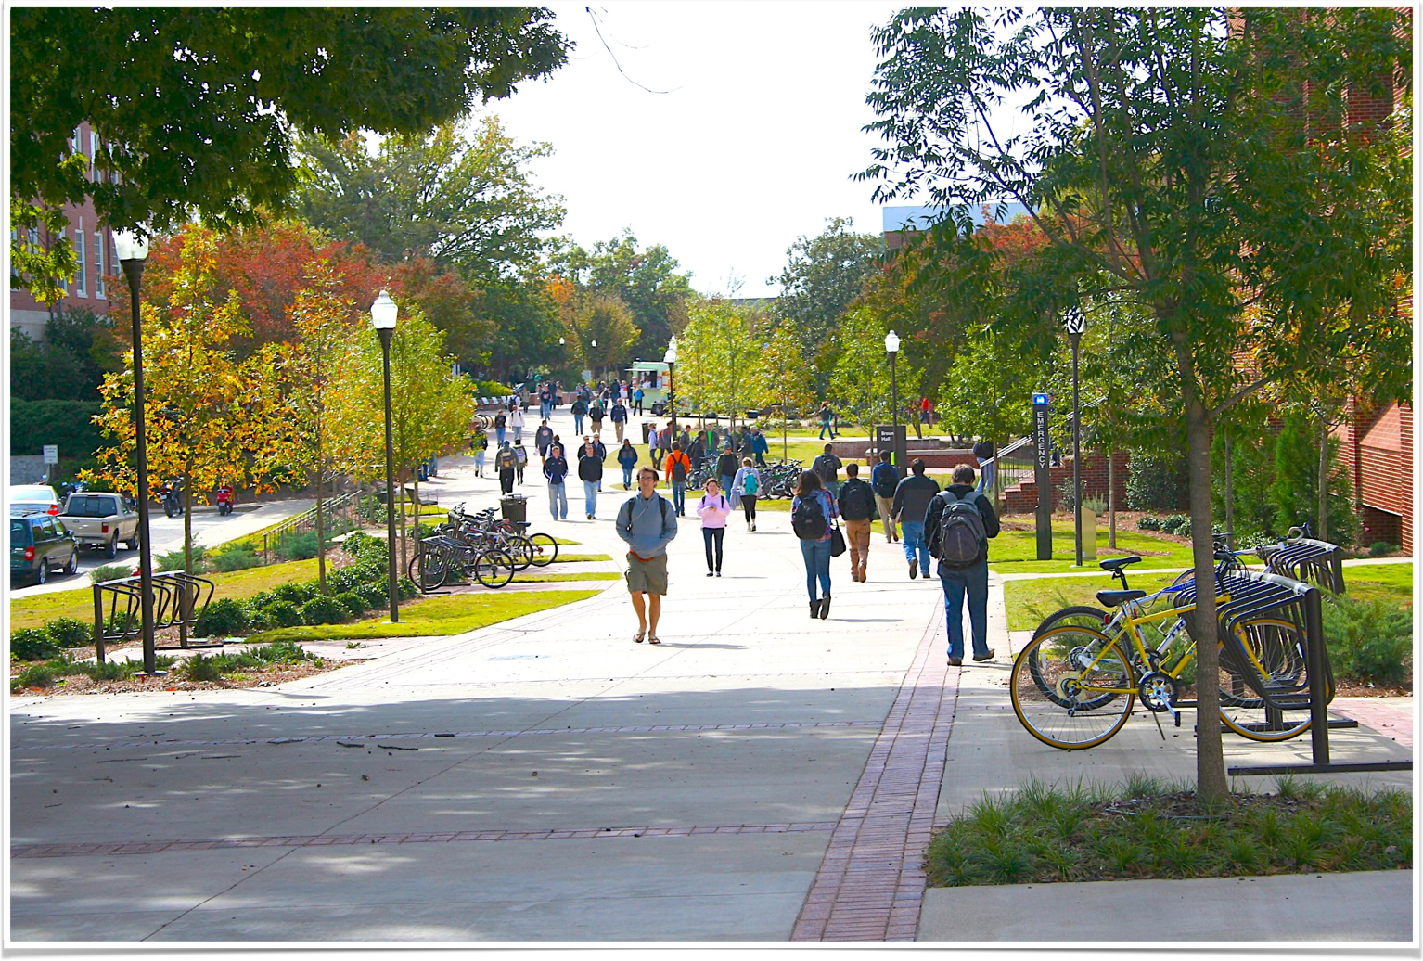
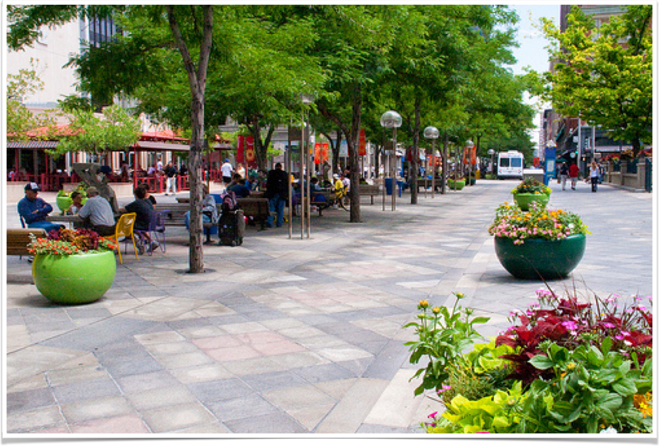
Mell Closure:
Less Desirable – 20%
Neutral – 12%
More Desirable – 68%
FUTURE POSSIBILITIES
MELL STREET CORRIDOR: ROSS SQUARE TO ROOSEVELT DRIVE FOCUS AREA

Slide 9
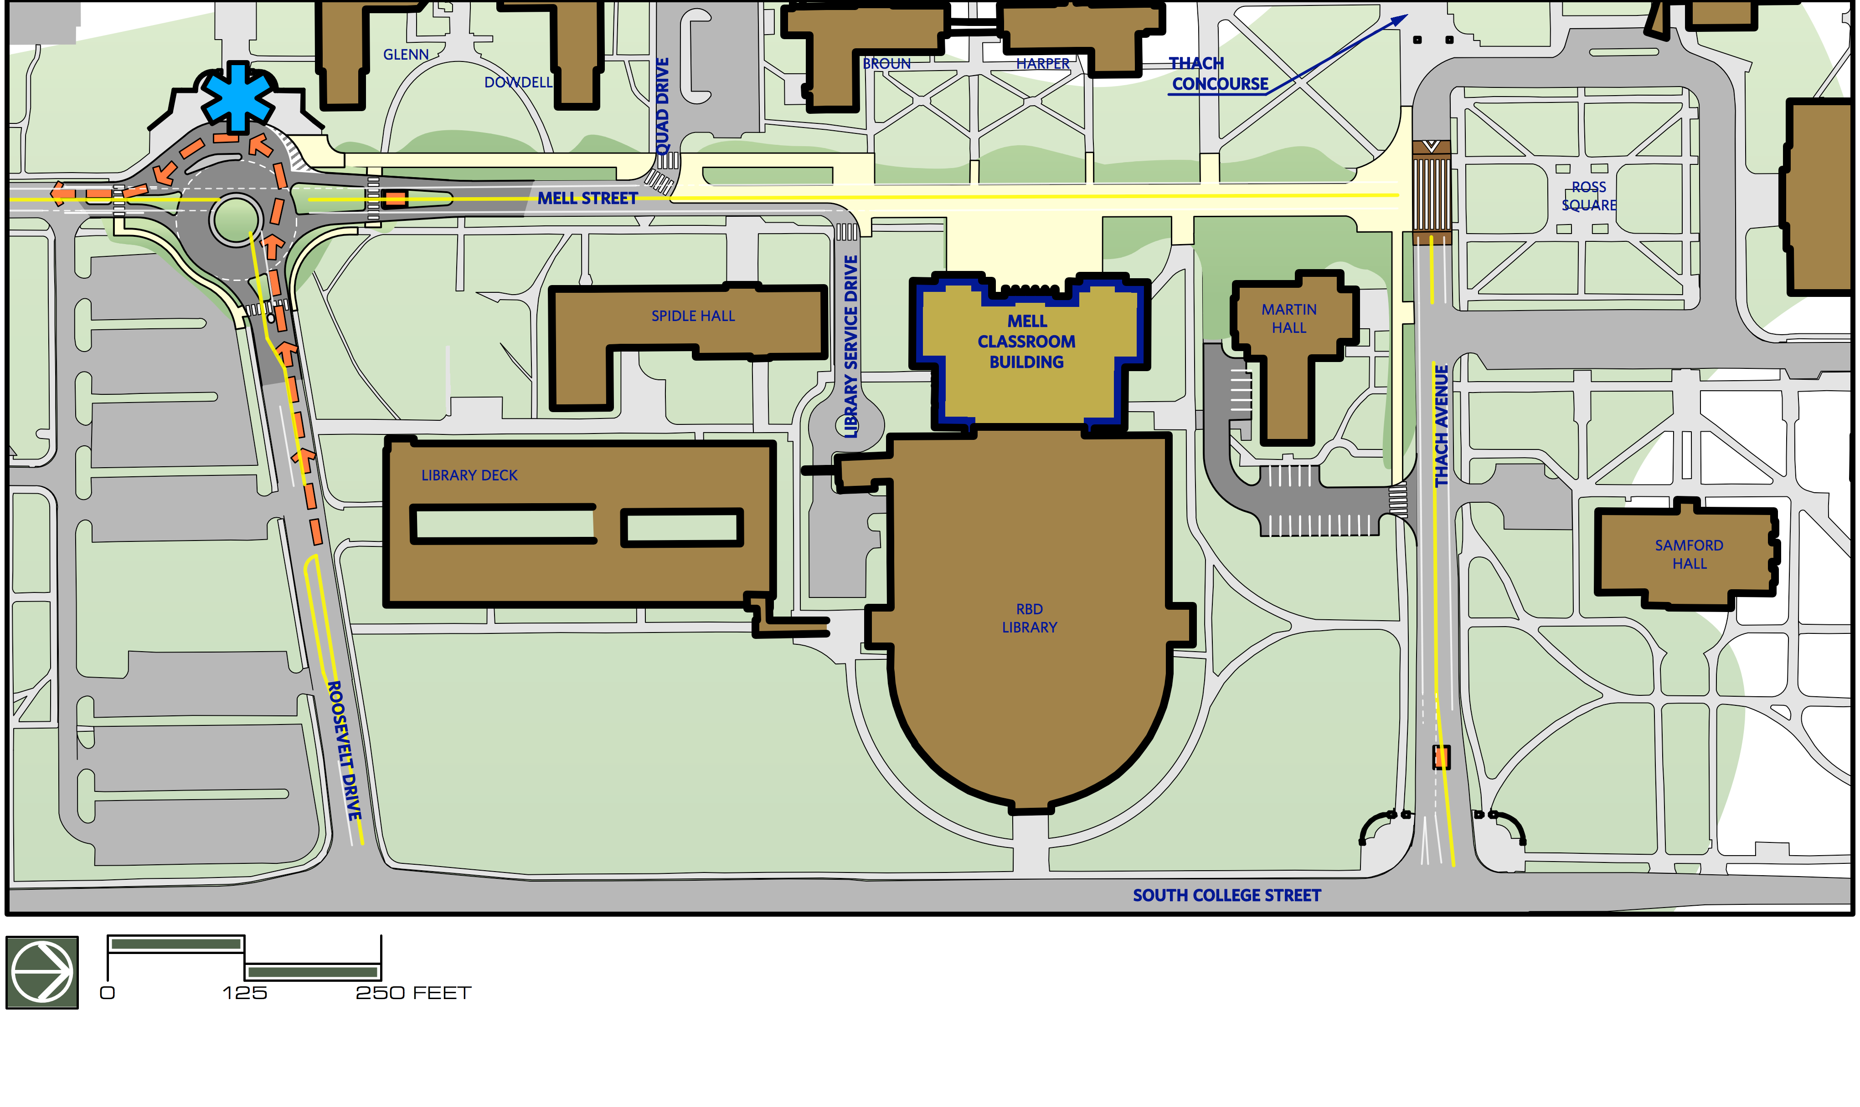
FUTURE POSSIBILITIES
MELL STREET CORRIDOR: ROSS SQUARE TO ROOSEVELT DRIVE FOCUS AREA

Slide 10
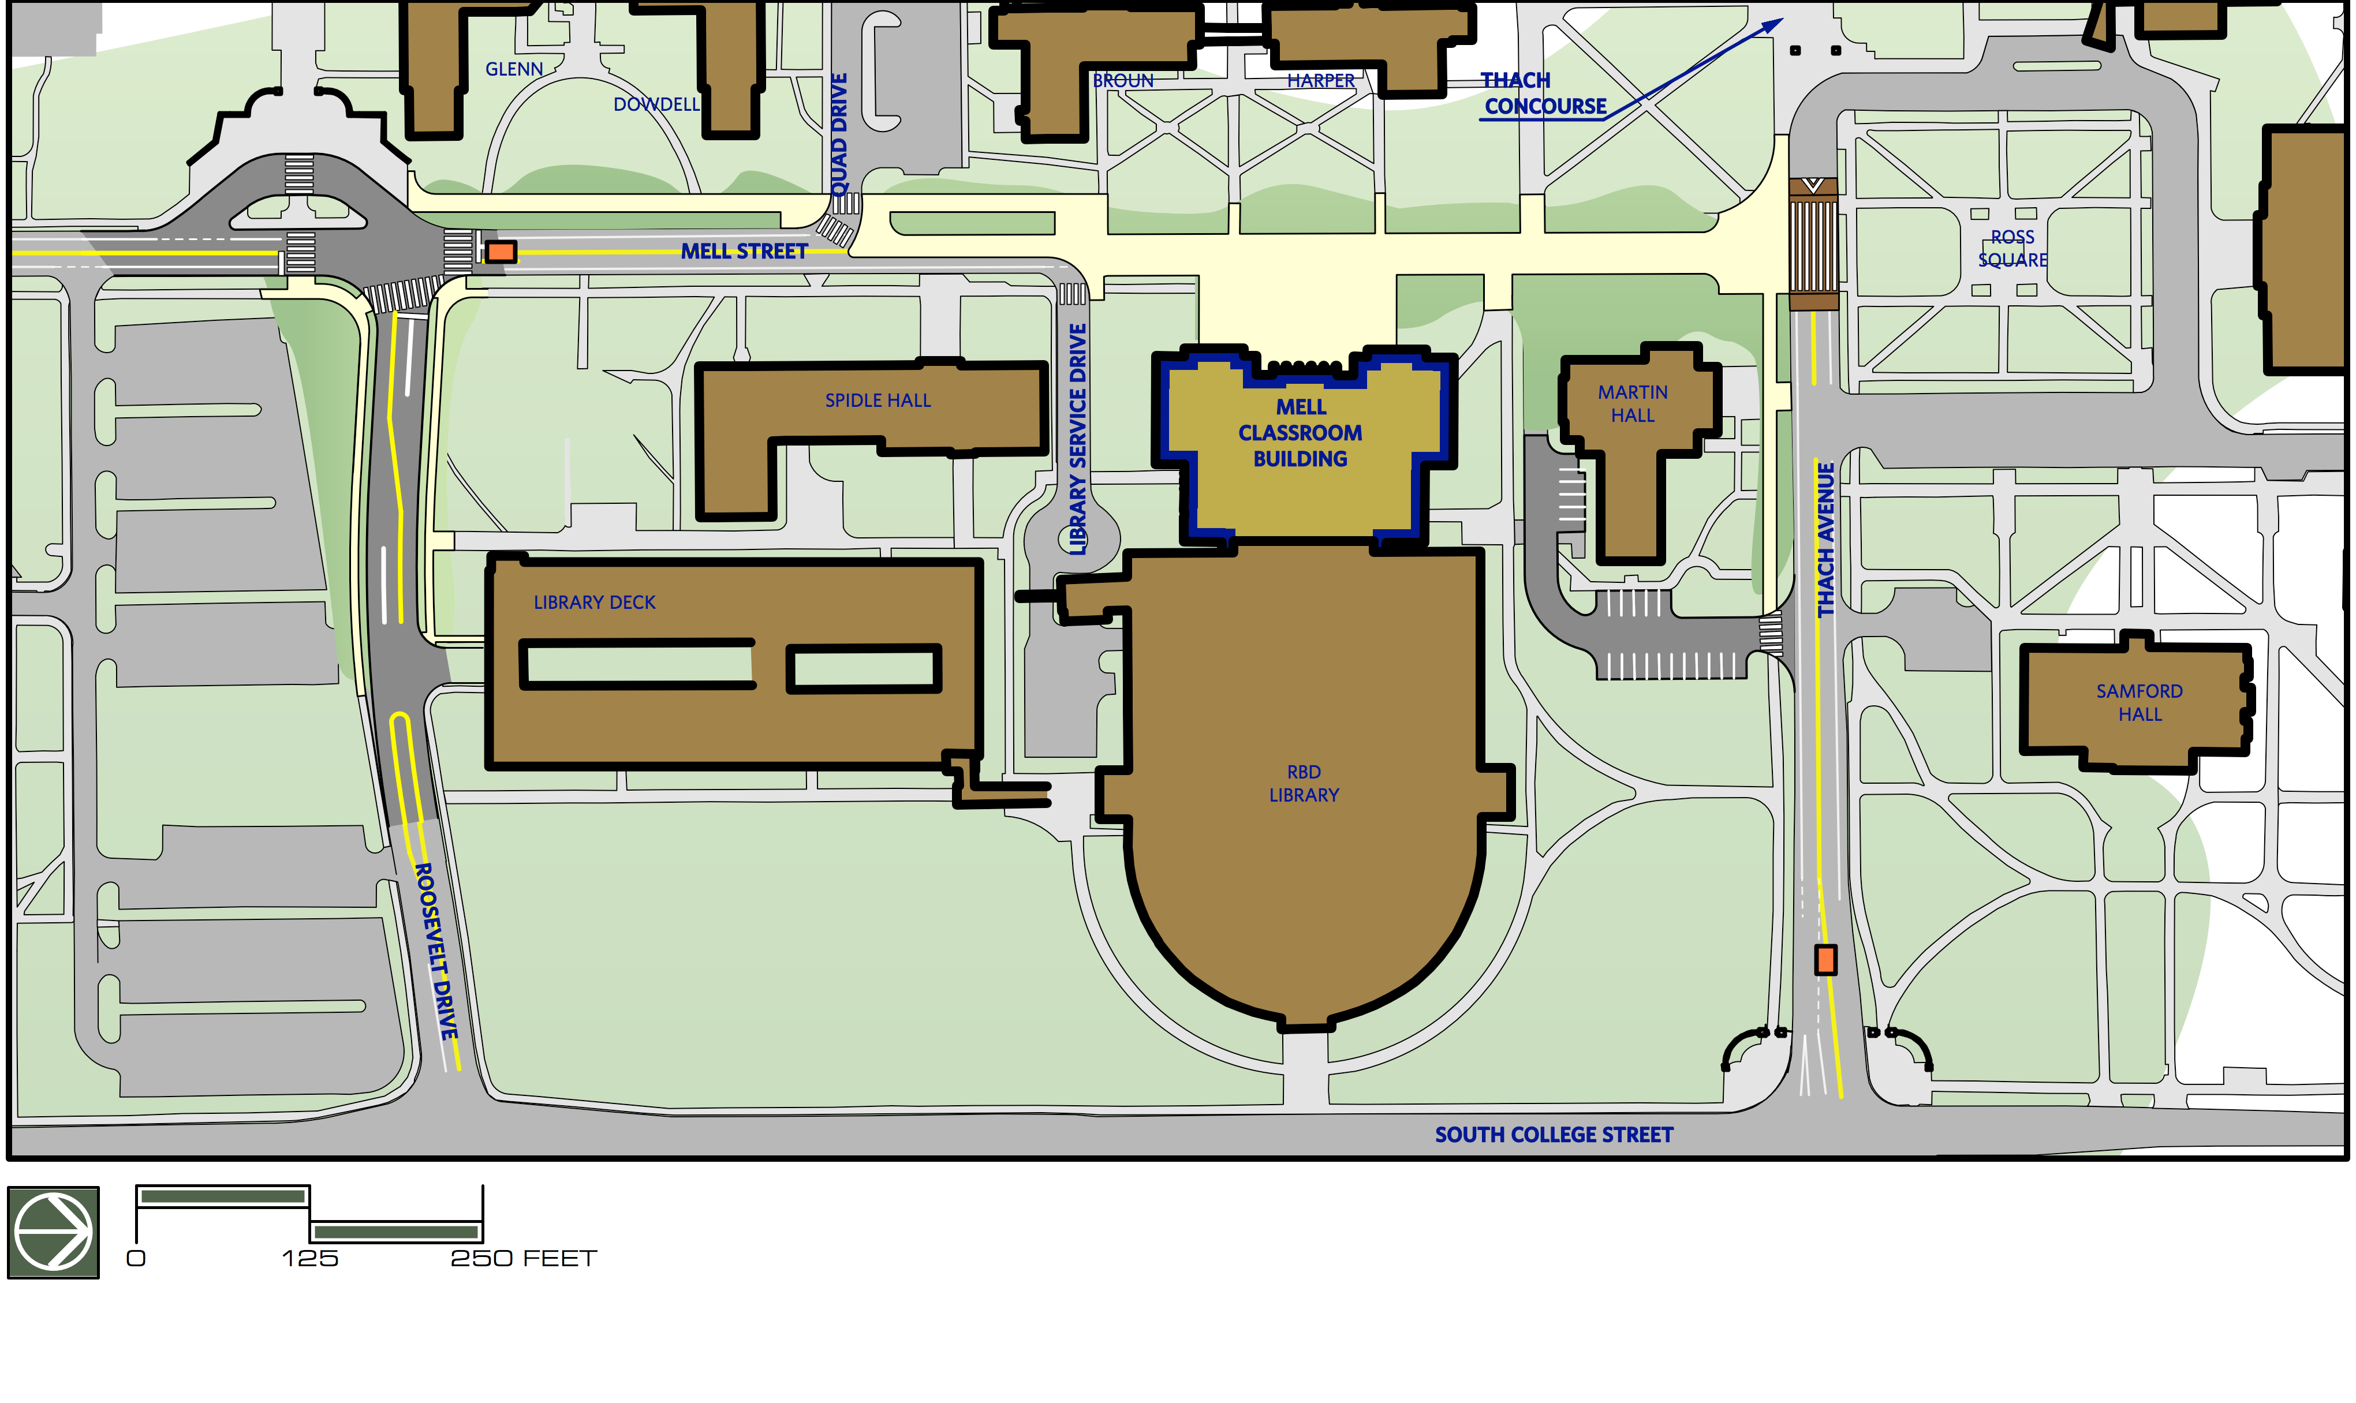
Mell/Roosevelt Intersection:
55% More Desirable – Round-a-bout
45% More Desirable – Realignment
FUTURE POSSIBILITIES
MELL STREET CORRIDOR: ROSS SQUARE TO ROOSEVELT DRIVE FOCUS AREA

Slide 11
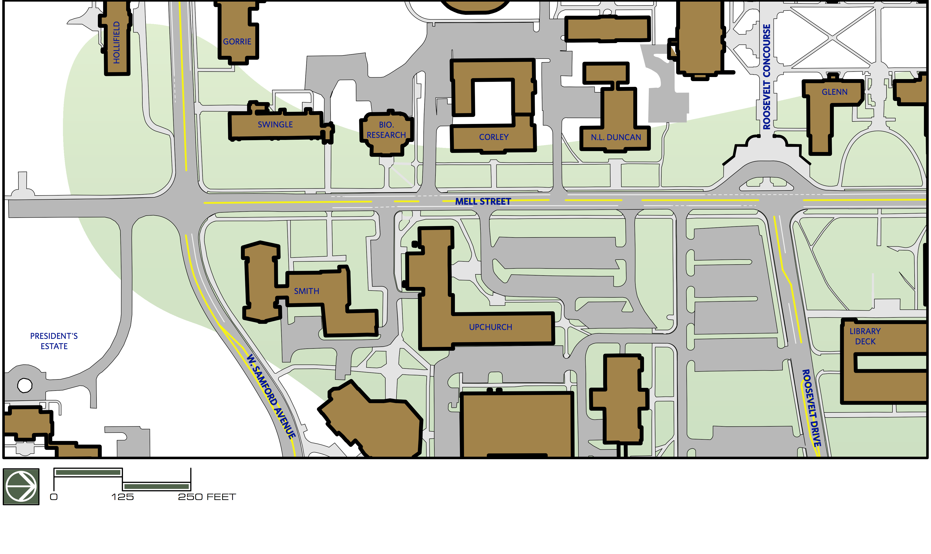
FUTURE POSSIBILITIES
MELL STREET CORRIDOR: ROOSEVELT DRIVE TO SAMFORD AVENUE FOCUS AREA

Slide 12
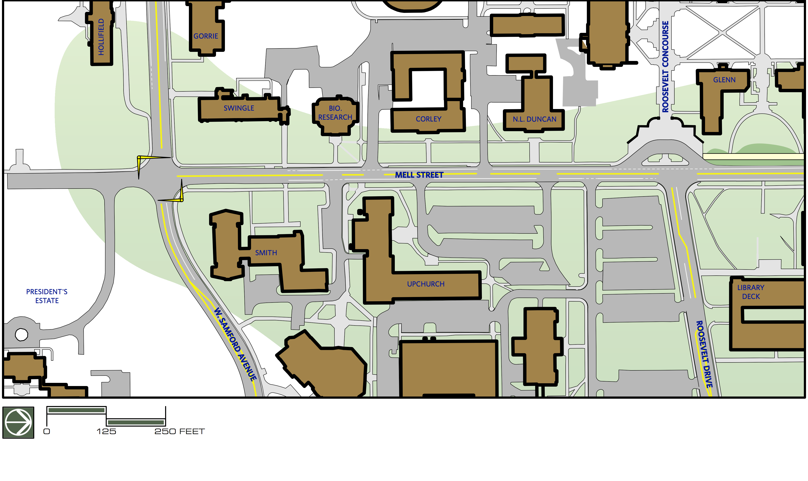
FUTURE POSSIBILITIES
MELL STREET CORRIDOR: ROOSEVELT DRIVE TO SAMFORD AVENUE FOCUS AREA

Slide 13
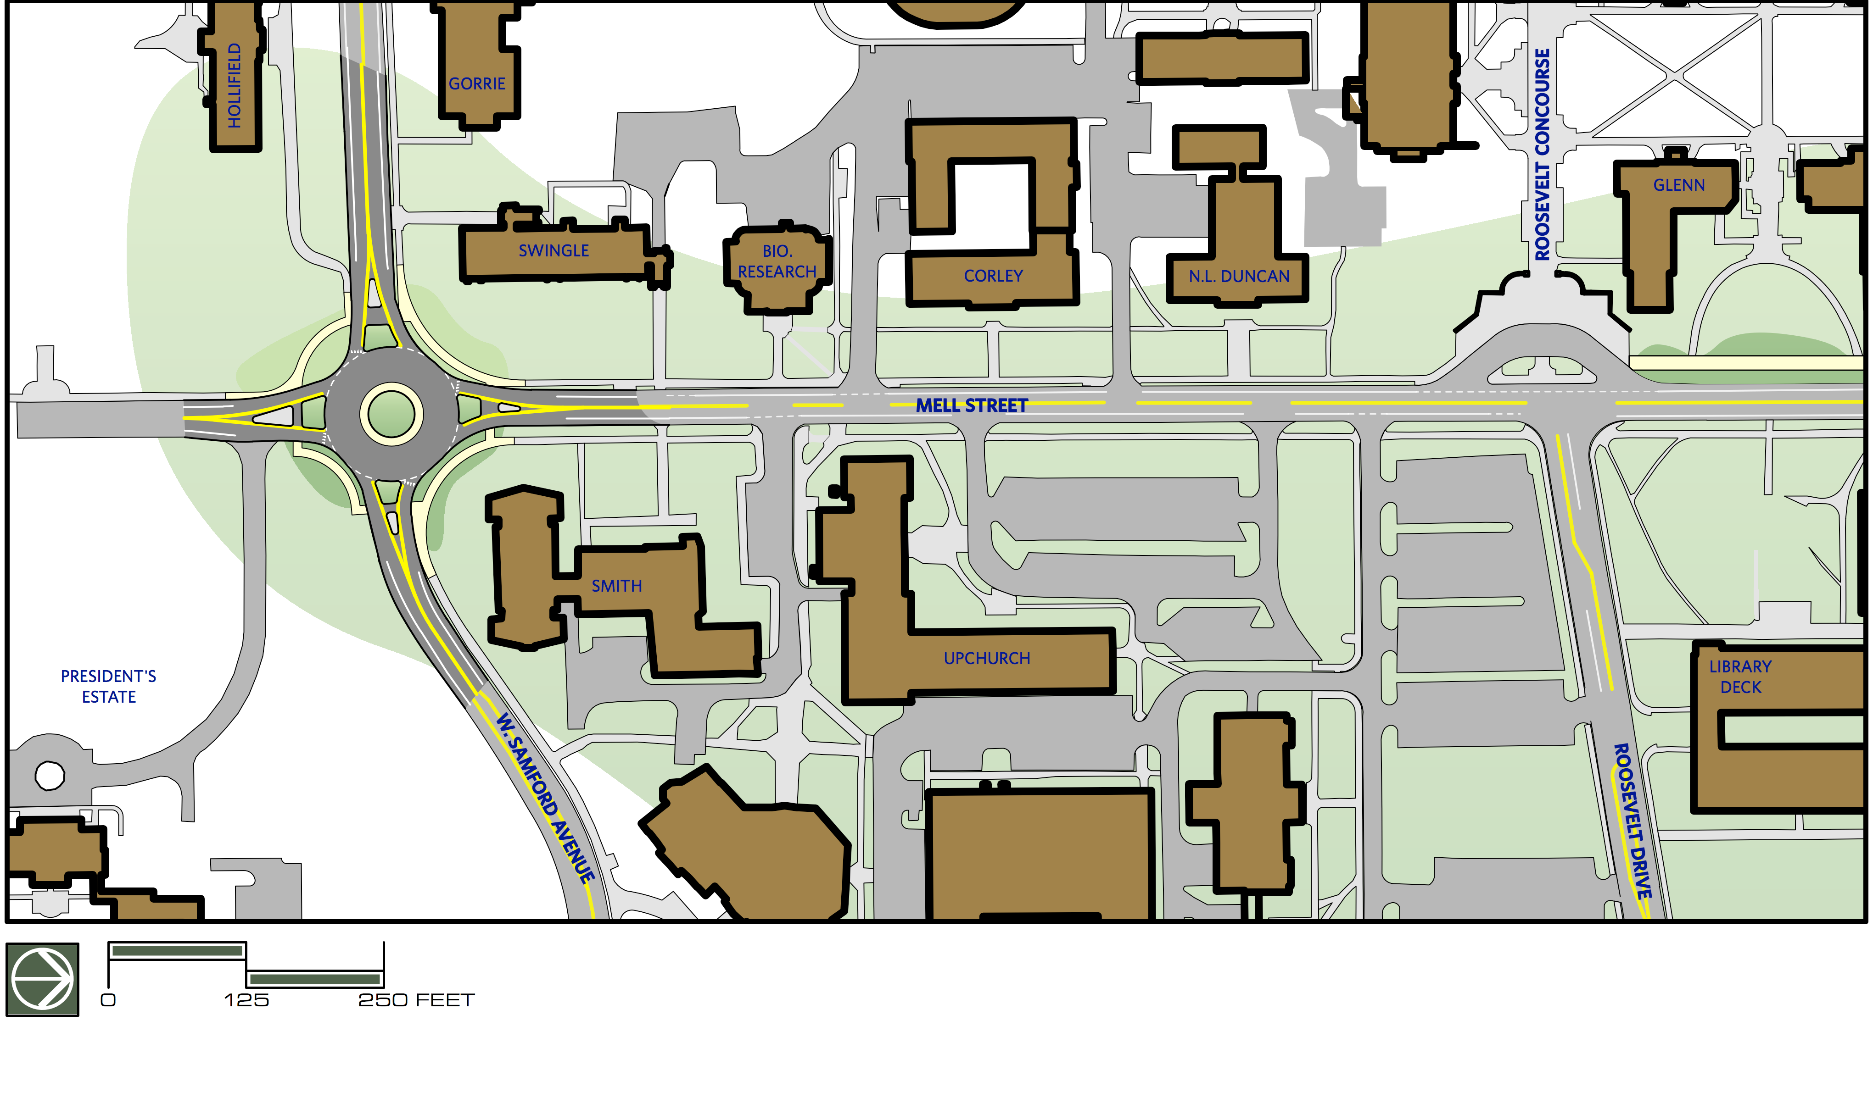
Mell/Samford Intersection:
55% More Desirable – Round-a-bout
30% More Desirable – Signal
FUTURE POSSIBILITIES
MELL STREET CORRIDOR: ROOSEVELT DRIVE TO SAMFORD AVENUE FOCUS AREA

Slide 14
Mell street corridor planning
www.auburn.edu/facilities/mellcorridorplanning
Ben Burmester, Pe, LEEd ap
Auburn university facilties management
burmebc@auburn.edu
334-740-3181

Slide 15
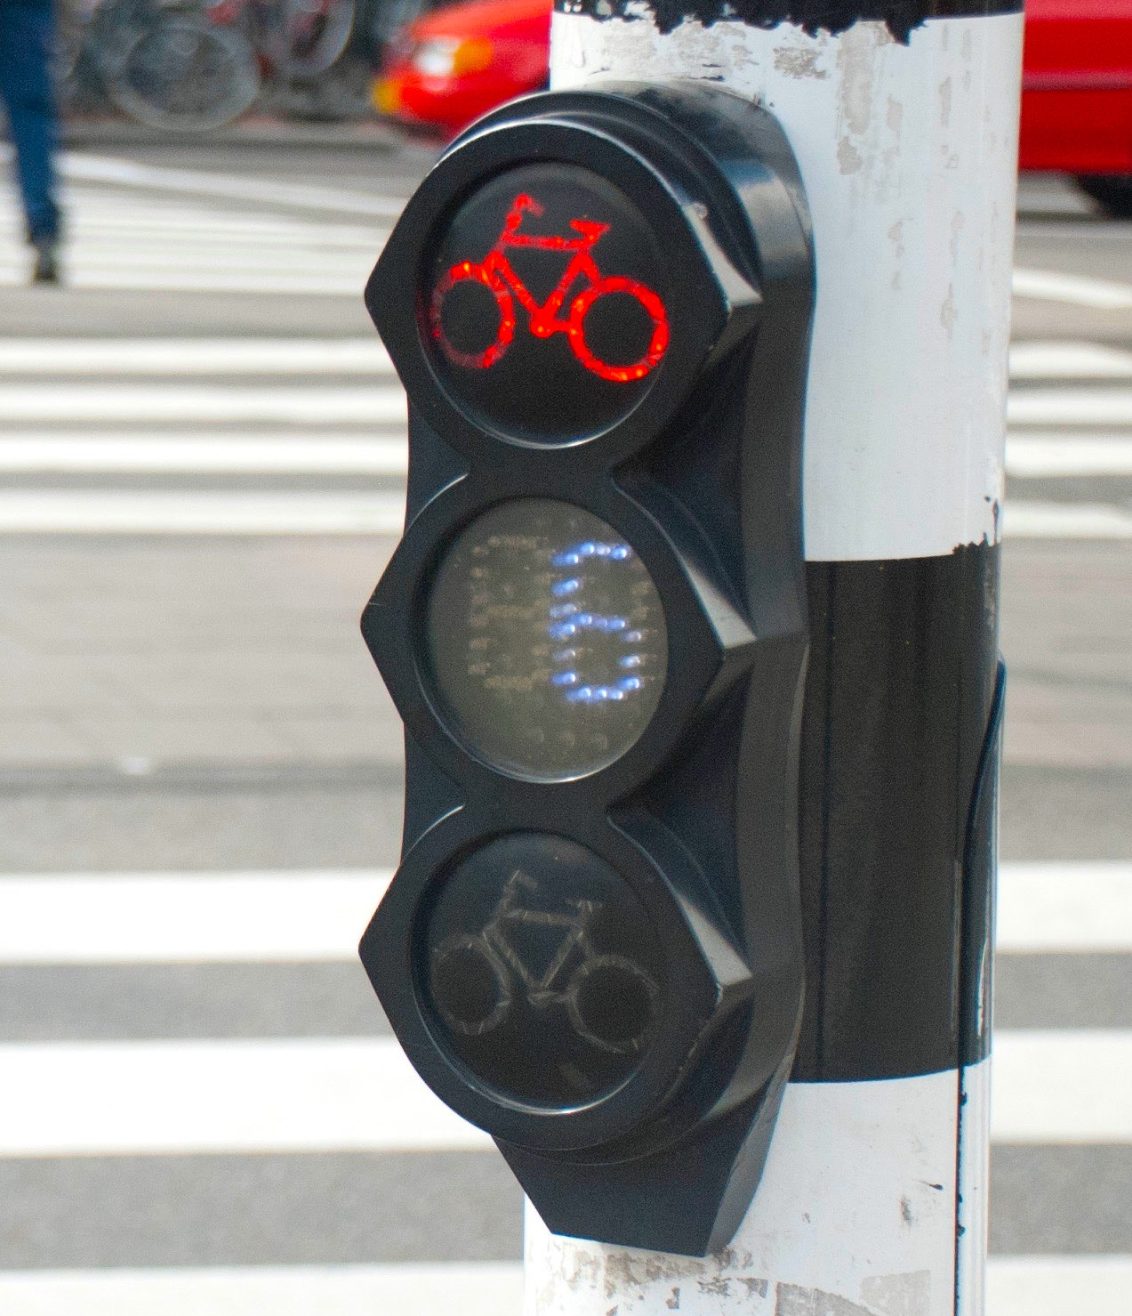
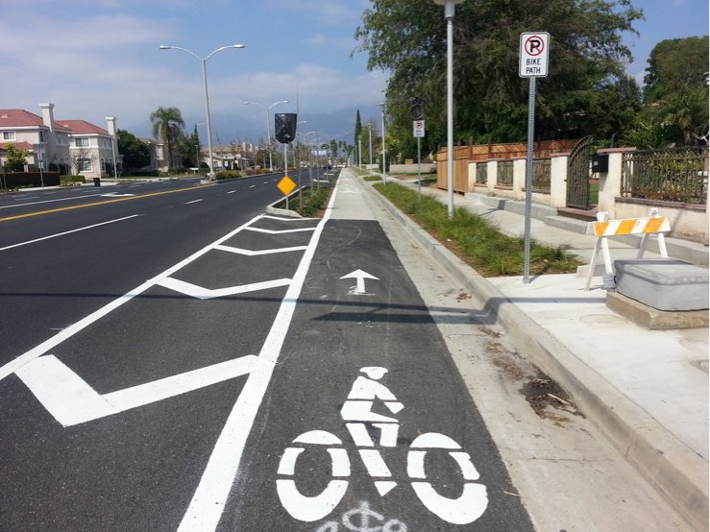
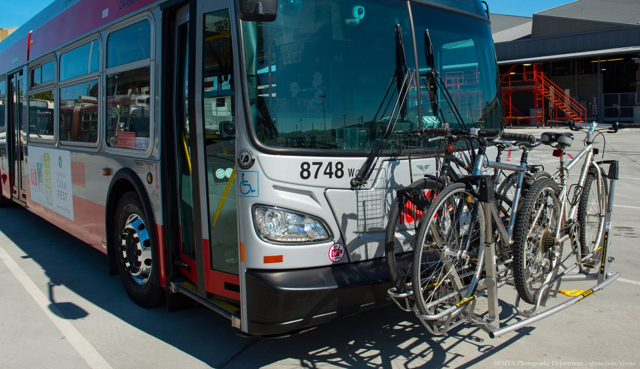
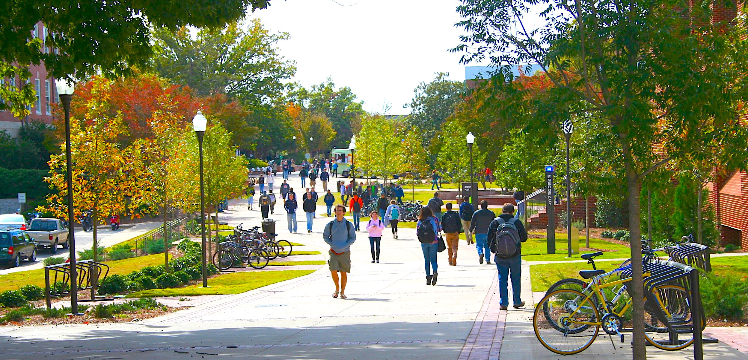
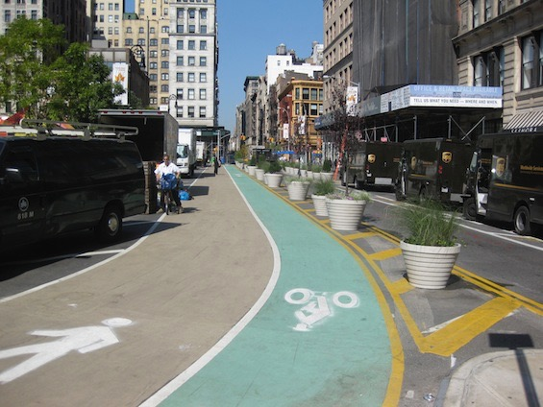
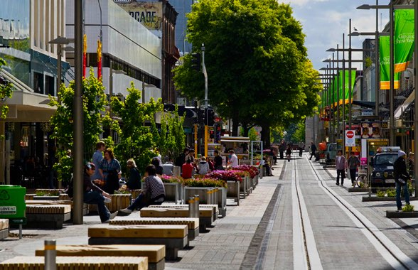
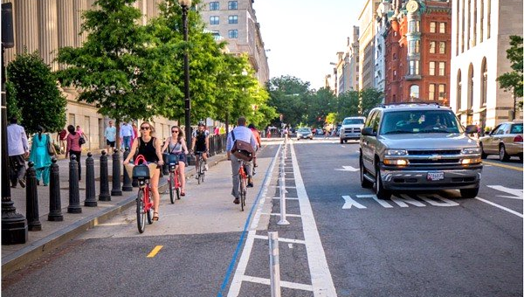
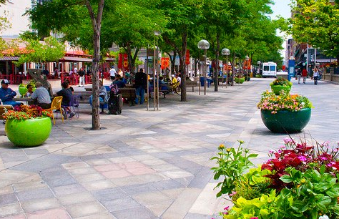
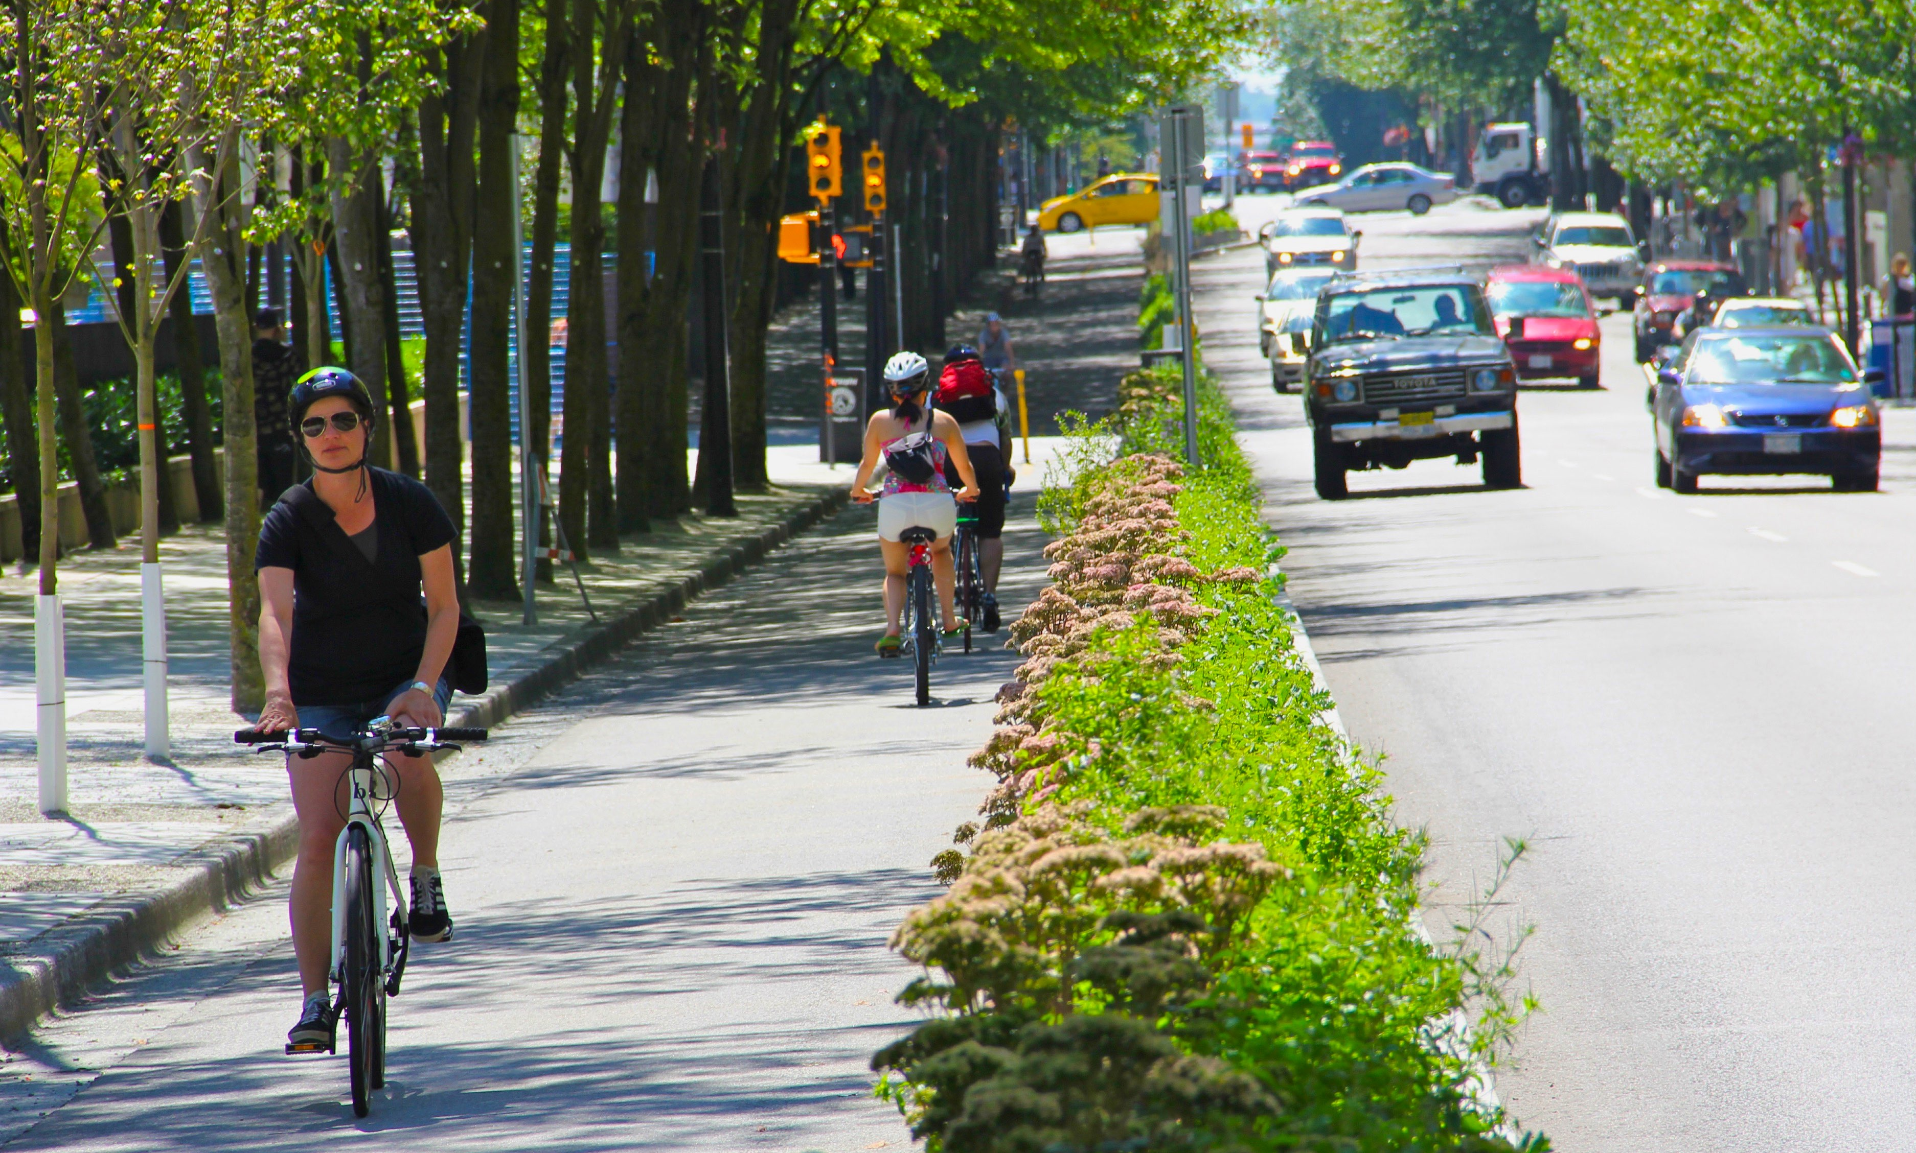
ACCOMMODATING ALL USERS
MELL STREET CORRIDOR

