Slide 1
Competency Based Education
Report from
Academic Standards
Invitation to join ad hoc committee to further assess the possibility of CBE at Auburn

Slide 2
Charge given to Academic Standards
Fall 2015
Executive Committee request:
  Investigate Competency Based Education (CBE) and make recommendations for next steps

Slide 3
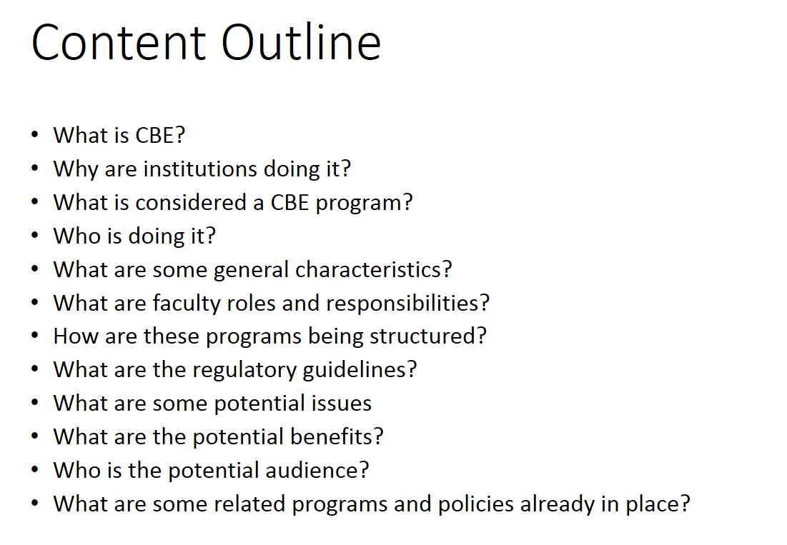
Shawndra T. Bowers
Auburn Online
Office of the Provost

Slide 4
What is Competency-Based Education (CBE)?
There is still no consensus definition of CBE, even among the institutions that provide it (Kelchen, 2015).
Asks students to learn important content information and skills; requires a student to demonstrate that learning by applying the content and skills in unique ways (Bramante & Colby, 2012).
A particular approach to postsecondary education that emphasizes mastery of knowledge and skills regardless of the amount of time required and the method chosen to achieve mastery (Quality Matters).
An innovative approach in higher education that organizes academic content or delivery according to competencies – what a student knows and can do – rather than following a more traditional scheme, such as by course (USDOE).

Slide 5
Why are institutions doing it?
Pressures for reform in higher education…
ACCCESS - Increase postsecondary educational opportunities to a different student population (lower socioeconomic status; non-traditional, working adults)
COMPLETION - Improve outcomes and accountability for potential graduates
  “Many of these programs are designed as flexible, affordable options for students who are not served well by existing postsecondary programs” C-BEN
  “We have a radical idea that the aims of education ought to be the outcomes of education” -Carol Geary Schneider, AAC&U

Slide 6
What is considered a
Competency-Based Program?
  Untethered from course material and credit hour, learners demonstrate competencies, particularly mastery, at their own pace, typically online, and progress through academic programs when they are ready to do so (Book, 2014).
  An academic degree program in which learners accumulate a series of competencies that are documented, proceeding at their own pace rather than through successful completion of scheduled courses and accumulation of credit hours (Quality Matters).
  A program that is outcome-based and assesses a student’s attainment of competencies as the sole means of determining whether the student earns a degree or a credential (SACSCOC).

Slide 7
What is considered a
Competency-Based Program?
In general, a CBE program is one that organizes content according to what a student knows and can do, often referred to as a “competency.” (USDOE, 2015)
Federal definition refers to two different CBE program types:
  Clock or Credit Hour Equivalencies: Must ensure that each credit hour requires sufficient educational activity to fulfill the Federal definition of a credit hour.
  Direct Assessment: Student progress measured solely by assessing whether the student can demonstrate that he or she has a command of a specific subject, content area, or skill, or can demonstrate a specific quality associated with the subject matter of the program; does not specify the level of educational activity in which a student is expected to engage in order to complete the program; must provide students with sufficient educational resources, including substantive interaction with instructors, for students to develop each competency required for completion.

Slide 8
Call for Ad Hoc CBE Committee Members
The purpose of the committee is to further assess the viability of CBE here at Auburn University and if deemed appropriate, develop a proposal for CBE implementation.
Proposal or final report due January 2017.
Email lisakensler@auburn.edu by June 15, 2016 to join the committee.

