Slide 1

Capital Projects Program
Faculty Senate Meeting
11.17.2015
AUBURN UNIVERSITY
Facilities Management

Slide 2
Capital Projects
2015-2020
Academic Capital Projects
Mell Classroom Building $33.0M
School of Nursing $29.0M
Pharmaceutical Research $16.6M
Cater Hall Renovation Phase II $ 2.0M
Library Archive Facility $ 1.9M
Food Animal Research Facility $ 3.4M
Engineering Achievement Center $30.0M
Gavin Engineering Lab Renov. $14.0M
Leach Science Center Addition $16.0M
Broun Hall Renovation $ 5.0M
Graduate Business Education $ 25.0M
Academic Classrooms & Lab $75.0M
Interdisciplinary Science Bldg $26.0M
Agricultural Sciences Research $40.0M
Performing Arts Center $65.0M
College of Education $35.0M
Band Rehearsal Facility $ 7.0M
Non-Academic Capital Projects
The Auburn Memorial $1.3M
Auburn Arena Volleyball Buildout $2.2M
Jordan-Hare Stadium Improvements TBD
Auxiliary Services Maintenance TBD
Risk Management & Safety TBD
Hill Residence Hall Renovation $56.0M
1st Year Student Housing TBD
Totals: $428.9M

Slide 3
Academic Capital Projects
2015-2020
Over
$400 Million
Investment in
New Academic Buildings
Over
900,000 SQ FT
of New Academic Space

Slide 4
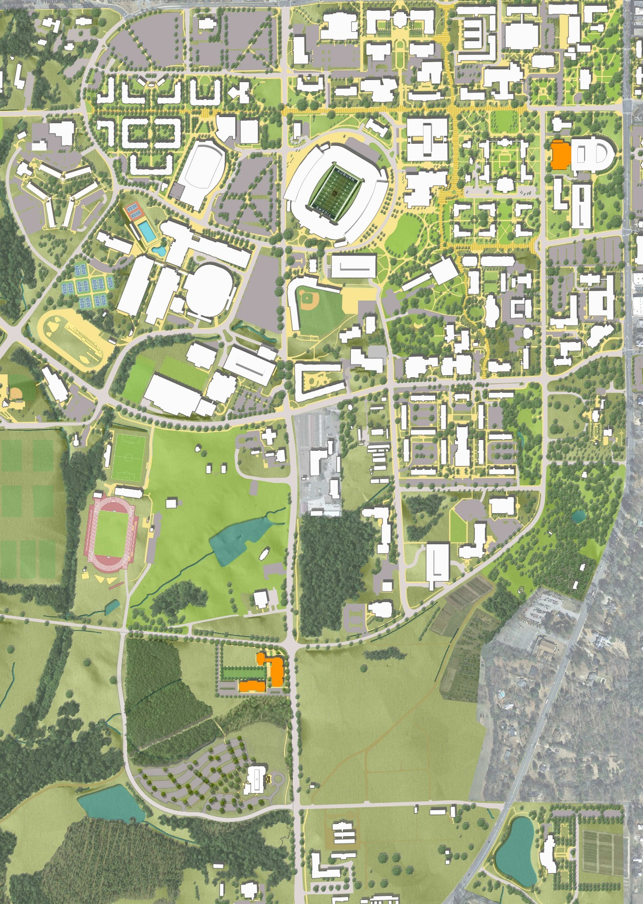
Mell Classroom Building
2015
Capital Project Construction
School of Nursing
Pharmaceutical Research Building
Health Science Sector Utility
Under Construction
Complete

Slide 5
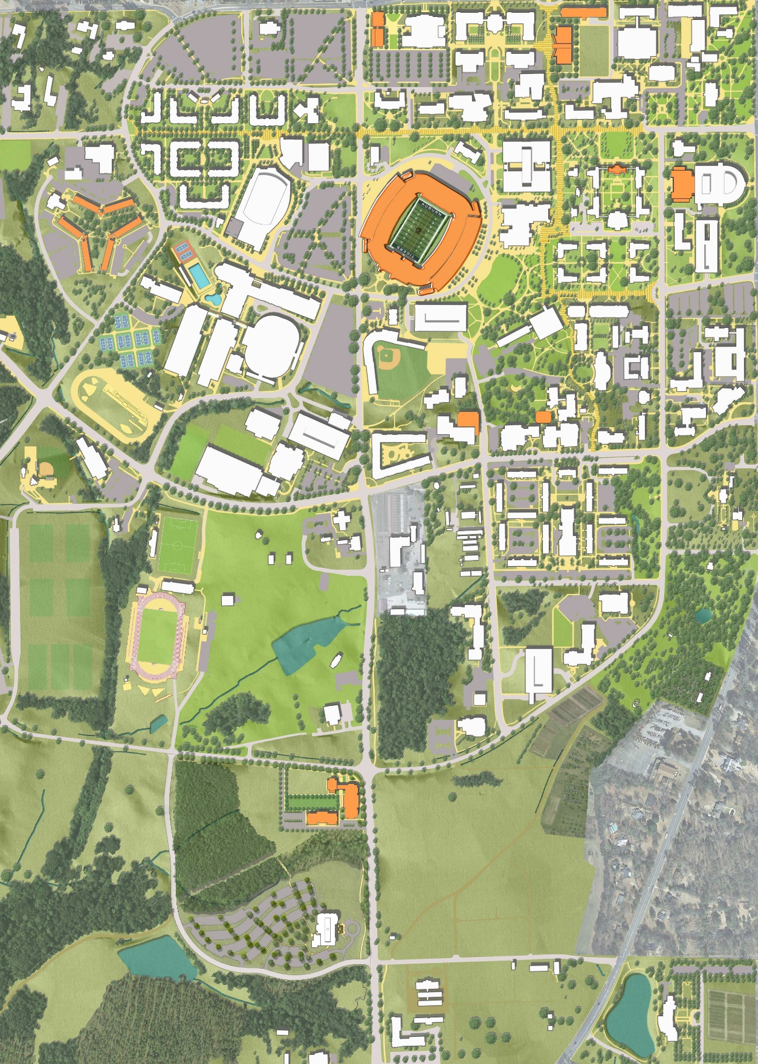
Graduate Business Education Building
Gavin Engineering Renovation
Demolish Shops & L-Building
Engineering Achievement Center
Cater Hall Phase II
Mell Classroom Building
Demolish CDV
Jordan-Hare Stadium Phase I
2016
Band Rehearsal Facility
Leach Science Center Addition
Capital Project Construction
The Auburn Memorial
School of Nursing
Pharmaceutical Research Building
Health Science Sector Utility
Under Construction
Complete

Slide 6
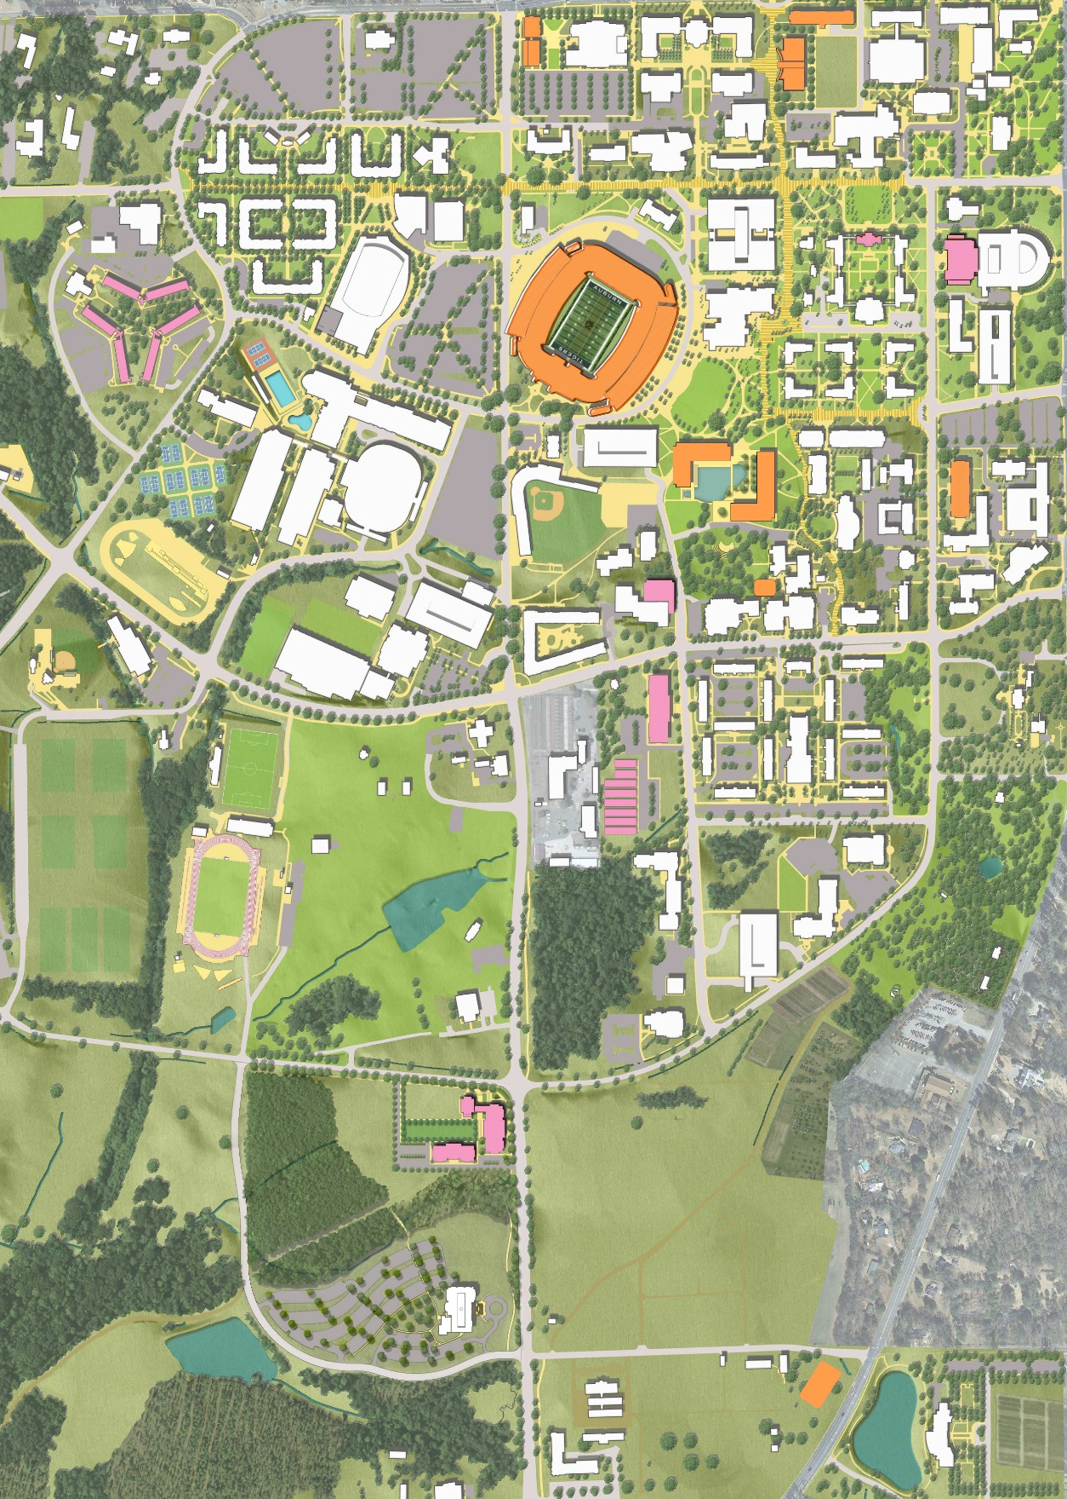
Gavin Engineering Renovation
Demolish Shops & L-Building
Engineering Achievement Center
Graduate Business Education Building
Jordan-Hare Stadium Phase II
Academic Classroom & Lab Complex
Interdisciplinary Science Building
2017
Band Rehearsal Facility
Capital Project Construction
Agricultural Sciences Research Building
Performing Arts Center
Under Construction
Complete

Slide 7
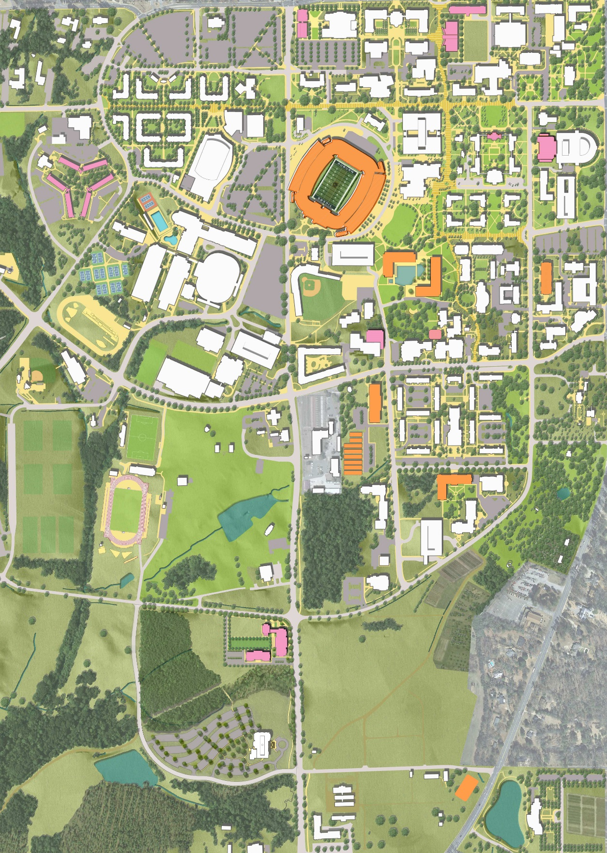
Jordan-Hare Stadium Phase II
Academic Classroom & Lab Complex
Interdisciplinary Science Building
2018
Capital Project Construction
Agricultural Sciences Research Building
College of Education Building
Performing Arts Center
Under Construction*
Complete*

Slide 8
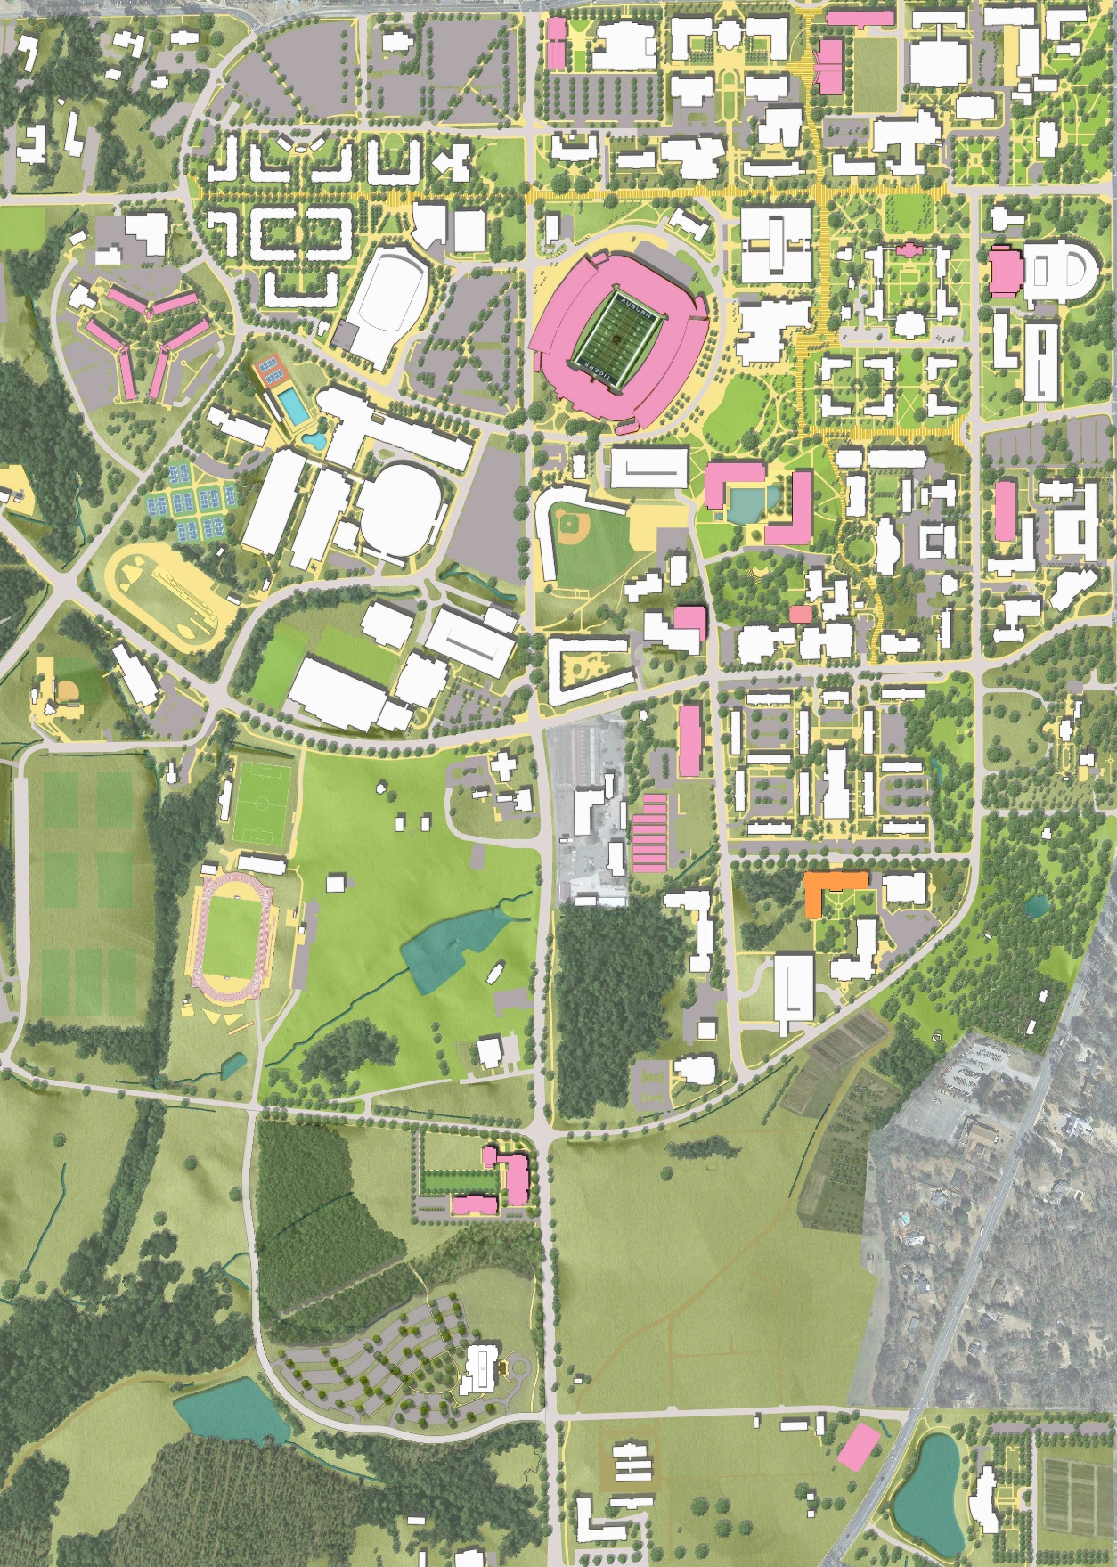
2019
Capital Project Construction
College of Education Building
Under Construction
Complete

Slide 9
Questions?

