Slide 1

Alabama Higher
Education Partnership
MISSION:
To advocate the importance of higher education in bettering the lives of people in Alabama.
Mr. Gordon Stone, Executive Director
Brett Johnson, Director of Membership & Student Activities
(334) 832-9911  Twitter @ALHigherEd  www.higheredpartners.org

Slide 2
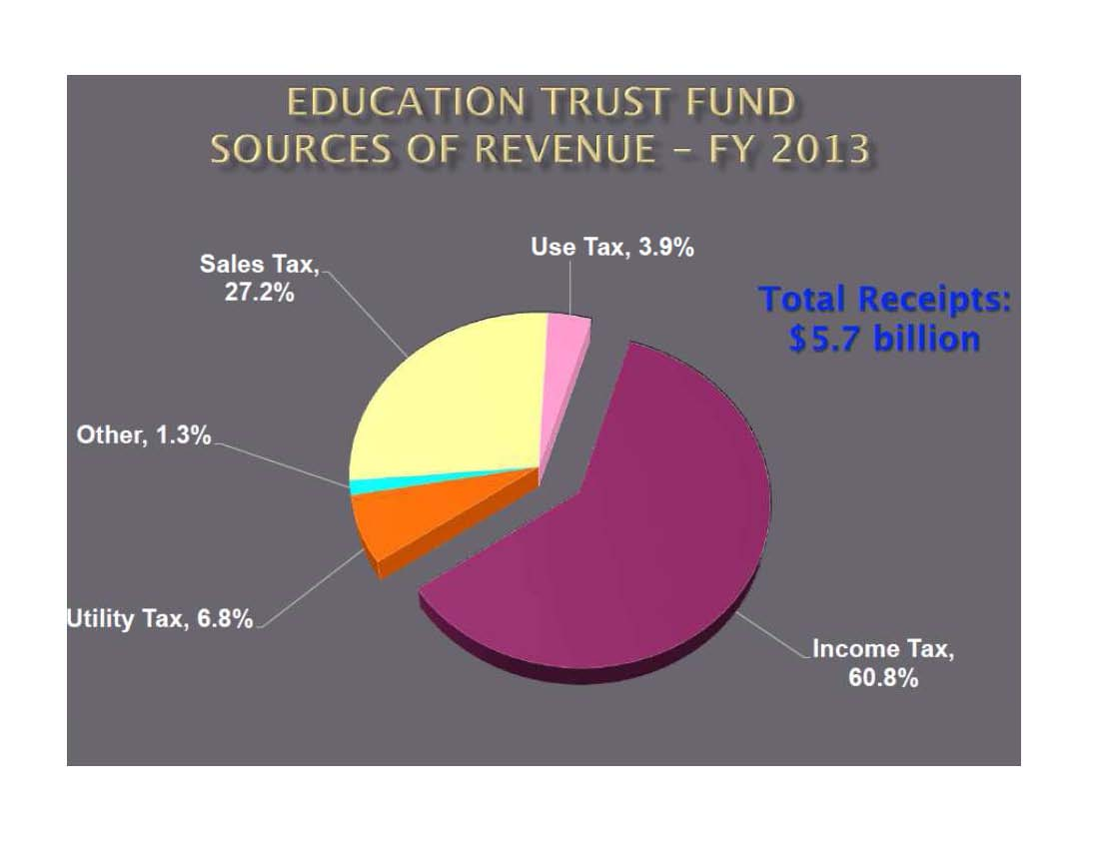

In 2013, more than 88% of Alabama’s Education Revenue came from Sales & Income Tax.

Slide 3
A Few Key Facts
Total AL Economic Impact= $20 Billion
Every $1,000 increase in higher ed funding = $8.7 Million increase in total per capita income
Alabama’s Economic ROI= 12.5:1
180,000 students attend AL public universities
60,000 employed by AL public universities
Largest economic producers in 12 AL counties
  Those counties produced over 50% of votes cast in last statewide election

Slide 4
HEP Membership Options
Level I = $12/year ($1/month)
Level II = $60/year ($5/month)
Level III = $120/year ($10/month)
  $2 Million Educators Professional Liability Insurance
Join Our Grassroots Advocacy Network Today!
www.higheredpartners.org

