Slide 1
Female Faculty Members at
Auburn University:
Findings from the Commission on Women in Academic Careers
Beth Guertal, Chair
Member, Faculty of Crop, Science and Environmental Sciences

Slide 2
Why this Commission was formed:
During the first year of the 2013-18 Strategic Plan, Auburn faculty participated in the Collaborative on Academic Careers in Higher Education (COACHE) survey.
Survey results showed benchmarks in which Auburn University faculty reported lower levels of satisfaction, including female faculty.
Among these areas, quality of life and work/life balance in both personal and professional areas were identified.
Female faculty at Auburn University also reported lower levels of satisfaction in these identified areas than women faculty at comparable institutions, including the University of Alabama, Washington State University, Clemson and Kansas State University.

Slide 3
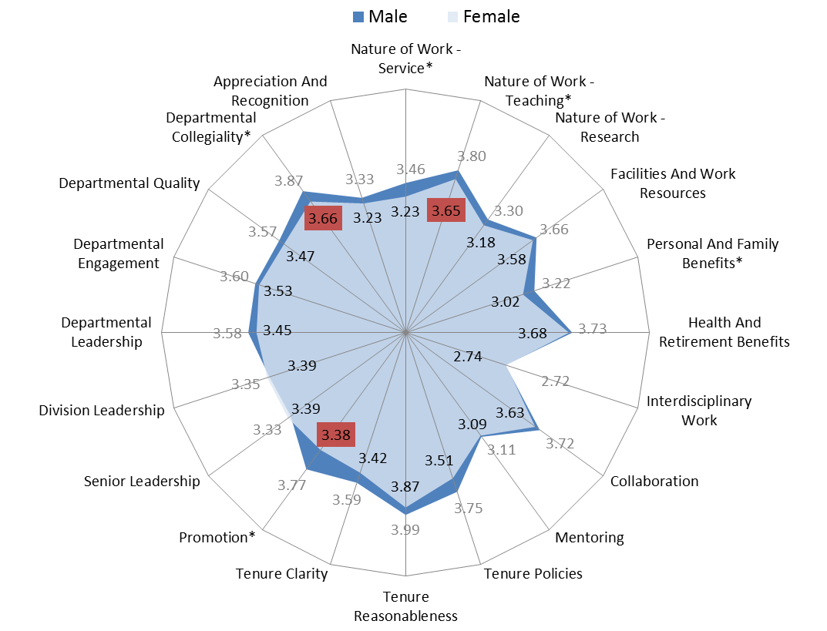
Example COACHE survey results, administered to 312 tenured or tenure-track male faculty and 214 tenure-track or tenured female faculty - Fall 2014 -Spring 2015.

Slide 4
Example Specific Responses (COACHE Survey)
Q70. Please rate your level of satisfaction or dissatisfaction with the following:
 |  | Male |  |  | Female
 | Mean | % at or above Median | N | Mean | % at or above Median | N
Q70A - The number of courses you teach* | 3.84 | 77% | 302 | 3.52 | 62% | 200
Q70B - The level of courses you teach* | 4.11 | 86% | 303 | 3.95 | 81% | 200
Q70C - The discretion you have over the content of the courses you teach | 4.43 | 55% | 303 | 4.31 | 52% | 200
Q70D - The number of students in the classes you teach, on average | 3.75 | 71% | 302 | 3.66 | 69% | 201
Q70E - The quality of students you teach, on average | 3.50 | 59% | 302 | 3.64 | 66% | 201
Q70H - How equitably the teaching workload is distributed across faculty in your department* | 3.30 | 72% | 301 | 2.98 | 61% | 201
Q70I - The quality of graduate students to support your teaching | 3.37 | 53% | 241 | 3.29 | 49% | 148

Slide 5
Following an analysis of the COACHE results, Provost Boosinger created a Commission on Women in Academic Careers at Auburn University in September, 2014.
Key Objectives of the Commission were:
Assess the findings of the COACHE study and collect additional data on the status of female faculty at Auburn University;
Explore working conditions for female faculty at Auburn University, specifically relating to the mobility, work-life balance, and functional equality of women;
Assess unique barriers to success for Auburn’s female faculty and identify opportunities to encourage movement toward the goal of full participation of women at Auburn;
4. Recommend policies to the Provost and other university administrators to improve the status of women and ensure an environment of equal educational and employment opportunities.

Slide 6
Analyses of Available Data – Time to Rank
The database contained 1,704 unique individuals. Appointment data were available for 1304, 1370, and 749 individuals for Assistant, Associate, and Full professorial rank, respectively.
Time from initial appointment as Assistant Professor to appointment as Associate Professor was determined. Data were available for 992 individuals, 301 females and 691 males.
Time from initial appointment as Associate Professor to appointment as Full Professor was determined. Data were available for 601 individuals, 123 females and 478 males.

Slide 7
Time to Rank – Findings as Affected by Gender
Mean values for Assistant to Associate were the same for females and males: 5.5 years for Assistant to Associate.
Similar (7.8 vs. 7.4 yrs – female/male) for Associate to Full.
Distributions for Time to Promotion were skewed to the right for both steps.

Slide 8
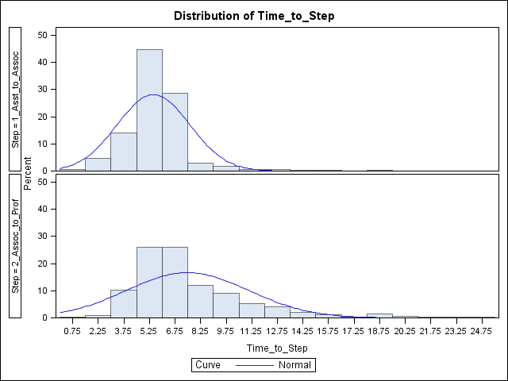
Assistant to Associate
Associate to Professor

Slide 9
Thus, a comparison of median values might make more sense, as it defines the time it took 50% of the individuals in a group to reach the next step; mean values are influenced by extreme values but medians are not.
A Wilcoxon two-sample median test. P-values were calculated based on a transformation of raw scores to a standard normal distribution. This test compares the frequency of observations above the overall median between the two groups.
The P-values were P = 0.141 from Assistant to Associate and P = 0.046 for Associate to Professor. Thus there is some statistical support for the hypothesis that the median time from Associate to Professor for females (7.0 yr) is longer than for males (6.1 yr).

Slide 10
Differences may be influenced by the time of initial appointment as Assistant Professor, which range from 1963 to 2013.
Difference in median time to promotion by decade. Number of females and males promoted in a given time and the P-values from the Wilcoxon test for the median.

Slide 11
So……..
There is a slight significant difference in time to Professor for women as compared to men (when everyone is considered, regardless of time).
There are differences by decade.
If a female faculty member is an Associate Professor for a long time (> 10 yrs) there is no difference in the odds of being promoted (as compared to a male).

Slide 12
BUT…
This data does not assess effort, or track difficulties that led to the statistically significant results from the COACHE survey.
Does not include any information about ‘leakage’.

Slide 13
Focus Groups
Six focus groups and several individual interviews with tenured and tenure-track female faculty members were conducted during late spring and early summer of 2015.
Focus groups were assembled by issuing invitations to randomly selected female faculty from within 6 specific university clusters:
Veterinary Medicine and Pharmacy
Human Sciences, Liberal Arts, Libraries, and Nursing
Education
Business and Architecture
Agriculture and Forestry/Wildlife Sciences
Engineering and COSAM
Focus groups were separated by research/teaching to identify discipline-specific concerns where possible.
Individual interviews were also planned to make sure that those who wanted their responses to remain confidential could participate.

Slide 14
Focus Groups, Contd.
The Auburn University Office of Institutional Research and Assessment (OIRA) reported in November, 2014 a total of 744 tenured or tenure-track male faculty, and 368 tenured or tenure-track female faculty.
An invitation to participate in focus groups (or a one-on-one session) was sent to 92 female faculty (randomly selected), approximately 25% of female faculty at Auburn University.
Of those invited 66 (72% of all women invited) either attended a focus group or participated in a one-on-one interview, a total of 18% of female faculty at Auburn University.
Focus groups were conducted by 3 trained staff/faculty members of Auburn University.

Slide 15
Focus Group Questions
In which areas does Auburn excel? (the University as a whole, not the individual unit).
In which areas does Auburn fall short?
If you had to identify three “good news” items about the faculty experience at Auburn what would they be? Now identify three “less than optimal things about the faculty experience at Auburn” items.
What aspects of your department have supported your success?
What aspects of your department have been barriers to your success?
What challenges have you personally experienced as a female faculty?
If you were to decide what would be the policies and recommendations to enhance success of female faculty at Auburn University, what recommendations would you put forward?

Slide 16
Summary of Responses: Nature of Work - Service
If there is only one tenured female faculty in a department, she is often asked to repeatedly serve on all the departmental committees.
While female faculty members are asked to serve on numerous committees, they are often not invited to serve on more important committees, such as the budget committee.
The more important fact may be that female faculty do serve on important committees (such as job search committees or curriculum committees) but they are not rewarded for this work.
Several focus group participants suggested that females are less likely to refuse a request to serve on a committee, and, therefore, frequently experience a higher service load.

Slide 17
Summary of Responses: Nature of Work - Teaching
Based on the focus groups, the perception is that women are frequently assigned higher teaching loads than male faculty. Women also tend to have more undergraduate classes and fewer graduate classes.
These perceptions need additional data collection to separate effects: 1) do women faculty consistently have a greater percentage of their budgeted assignment that is teaching, or 2) is the actual amount of teaching too large, and not in alignment with their budgeted effort?
According to focus group participants, Auburn does not maintain a consistent system for awarding faculty credit for dissertations and mentoring.

Slide 18
Summary of Responses: Personal and Family Life Policies
Some focus group participants felt that they are being forced to choose between family and work life: work flexibility does not exist, often due to a lack of parental leave policies, a lack of on-campus childcare, and the lack of spousal hiring policies.
When female faculty cannot balance their personal life and career, they frequently leave Auburn. The most commonly cited reason for female faculty to leave Auburn is lack of spousal accommodation.
The lack of fulltime on-campus childcare was cited as a major deficiency at the University.
Paternity leave was also addressed during focus groups.

Slide 19
Promotion
Based on focus group discussions, the information about tenure process was not available and there was lack of mentoring when many female faculty came here.
Focus group participants noted an inconsistency in terms of how women and men are mentored. Departmental leaders may not be having conversations with female faculty about going up “to the next level.”

Slide 20
Salary and Pay Inequity
Focus group participants also brought up an issue of pay inequity for males and females.
It was suggested that there should be some intervention at the Provost’s level to assess and ensure that women are being paid fairly and equitably.
This [pay inequity] was also cited as a cultural issue, as women are often not trained on becoming strong negotiators as they receive their offers.
Male faculty possesses cultural power that does not come across as aggressive or bitchy.
To improve morale of female faculty focus group participants also recommended a salary equity study.

Slide 21
Diversity and Lack of Female Leadership
Some focus group participants expressed a concern with sexism. In some instances female faculty face an attitude of “Your husband has a good job, so why are you working?” Auburn culture and environment were described as very traditional (e.g., engineering and good-old-boys network).
Certain stereotypes—i.e. women are better teachers and males are better researchers— were identified.
Cultural Barriers to Assertive Females—this can often be a reason for female faculty dissatisfaction, because culturally, female faculty who are assertive aren’t always accepted as part of the departmental culture.
Based on some comments from the focus groups, it is leadership that values women as opposed to leaders who are women that is important.

Slide 23
Positive Comments!
• In some cases there was a feeling that some issues have improved with recent hires. Several faculty mentioned that, in their departments, male and female faculty have recently been hired at the same salary.
• In some cases mentoring has been organized, useful and beneficial.
• Positive collegiality and the concept of ‘inclusion’ were variable by department. While there were faculty who noted a lack of social networks and collegiality, others mentioned strong networks and highly collegial faculty. This success was often a function of a motivated and excellent Department Head.
• In general, students are considered to be a positive part of working at Auburn University.
• Many of the concerns of female faculty are actually concerns of all faculty who work at Auburn University. High quality childcare, mentoring, workload issues, and a fair distribution of resources are issues that apply to all, regardless of gender.

Slide 24
Action Items
Additional Data Collection:
a. Assemble leakage data – how many women faculty have left Auburn, and why? Best data collection would include the survey of an equal number of men, as well.
Perform a salary data analysis – this would a survey of salary data, by rank, comparing female and male faculty. This must be done at the Departmental level.
c. Quantification on teaching loads. Are women faculty really teaching more than male, and is this over-teaching not reflective of their budgeted distributions?
Quantification of gender-neutral issues that were often mentioned by women. This would include mentoring, distribution of resources, and clear definition of workload.

Slide 25
The Committee
Becky Barlow Diane Boyd Charles Eick (retired) Martha Escobar (no longer at Auburn) Jeff Fergus Joe Hannah Roy Hartfield Julie Huff | Iryna Johnson Hulya Kirkici Gregg Newschwander Sharon Roberts Donna Sollie Kyes Stevens Chippewa Thomas Beth Guertal, Chair

Slide 26
COACHE Survey Results Available At:
https://oira.auburn.edu/factbook/survey/coache/2013-14/COACHE_2014_Provost_Report_Auburn_University.pdf

Slide 27
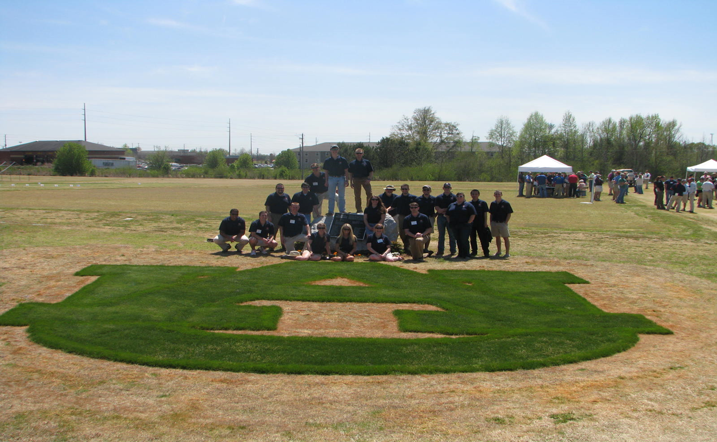
Thank You.

