Slide 1
Six Ways to make your
Canvas Course more Accessible
Office of Accessibility

Slide 2
Topics
Headers
Links
Images
Videos
Color Contrast
Documents

Slide 3
Headers (H1, H2, H3, H4)
Headings provide structural hierarchical information for a document.
Headers make it easier for blind users to navigate your page.
Notes:
How presentation will benefit audience: Adult learners are more interested in a subject if they know how or why it is important to them.
Presenter’s level of expertise in the subject: Briefly state your credentials in this area, or explain why participants should listen to you.

Slide 4
Headers Should be in Proper Order
H1 _______
  H2 _______
    H3 ______
      H4 ______
Notes:
Lesson descriptions should be brief.

Slide 5
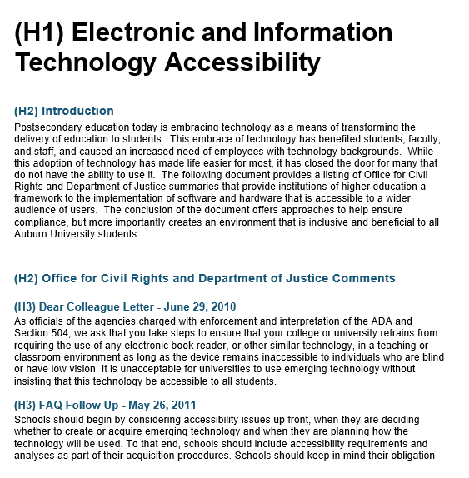
Headers Example

Slide 6
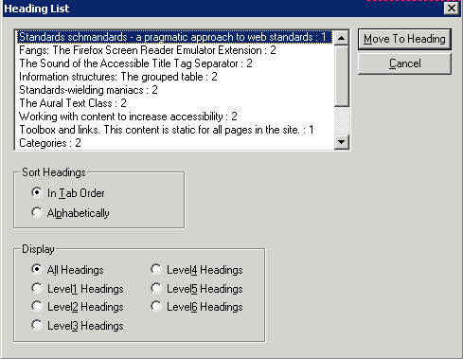
Header Listings using a Screen Reader

Slide 7
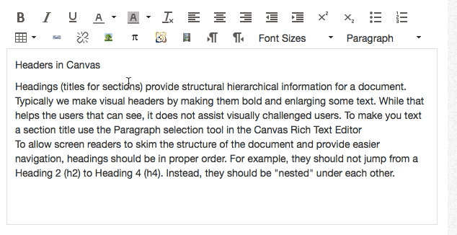
Headers Selections – Canvas Rich Text Editor

Slide 8
Better Links
Avoid “Click Here” and “Read More”
Links should make sense out of context
Avoid using long URLs (https://support.office.com/en-us/article/Accessibility-Features-in-Microsoft-Office-2010-324104a6-4736-4dc0-b930-197aa4ec76c6?CTT=1&CorrelationId=d30fa446-b25f-4419-808a-fdbe1318e805&ui=en-US&rs=en-US&ad=US&ocmsassetID=HA010369190)
Links should be descriptive - Microsoft Word Accessibility

Slide 9


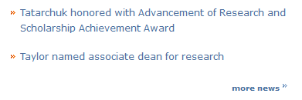
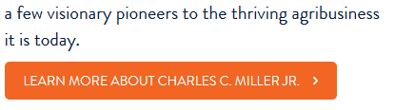
Link Examples
Links Need Improvement
Better Links

Slide 10
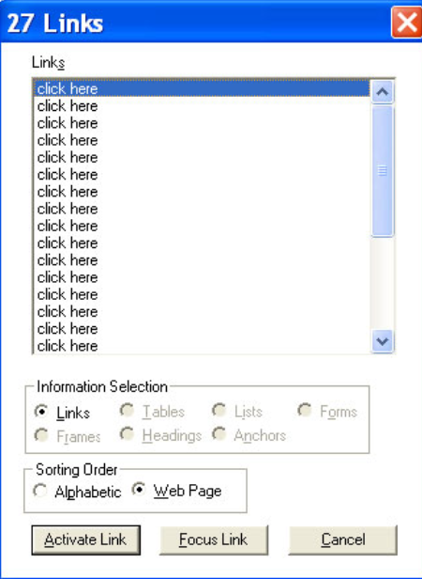
Links Listing using a Screen Reader

Slide 11
Describing Images
Use the “Alt Text” option when adding images
Descriptions should be less than 125 characters
Descriptions may not be needed if the image is described within the page
Use double quotes “” for images used for decoration or explained within the page

Slide 12
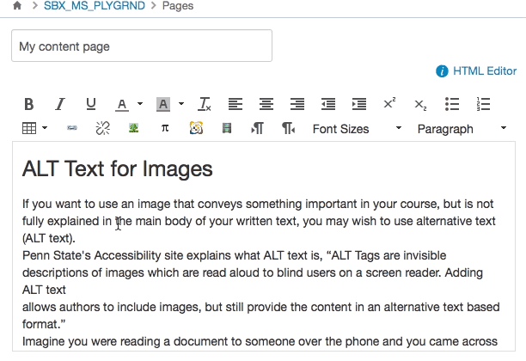
Adding Image Descriptions (ALT Text)

Slide 13
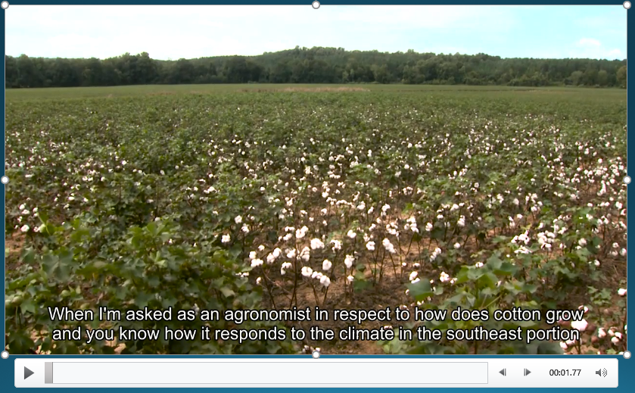
Caption Videos

Slide 14

Color Contrast
Fail: (under 4.5)
  Yellow Text: 1.07:1
  Pale Green: Text 1.12:1
  Orange Text: 2.14:1
  Pink Text: 3.14:1
  Red Text: 4:1
WebAim Color Contrast Checker http://webaim.org/resources/contrastchecker/

Slide 15
Documents
Microsoft Word
PDF
PowerPoint

Slide 16
Microsoft Word
Use Headers
Describe Images
Use Table Headers
Describe Charts

Slide 17
PDF
Documents that have been scanned as an image are inaccessible
PDFs created using Microsoft Word are more accessible

Slide 18
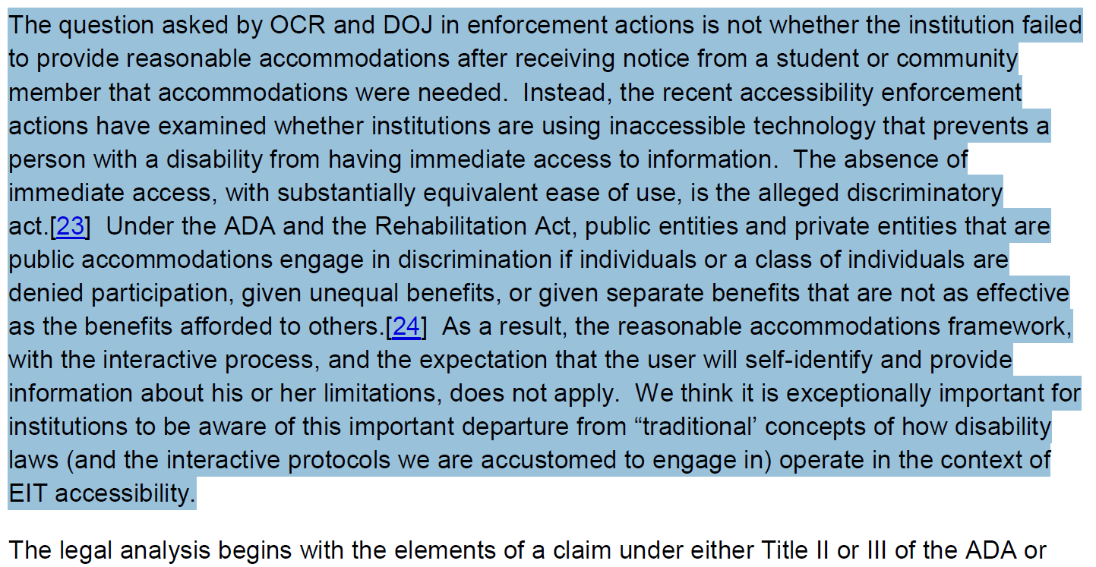
Text-Based PDF – The Start of Accessibility

Slide 19
PowerPoints
Use layout templates when possible
Add descriptions to important images
Give each slide a unique title
Use ordinary words for website links not URLs like http://www.auburn.edu/resources/activities/index.html

Slide 20
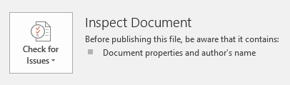
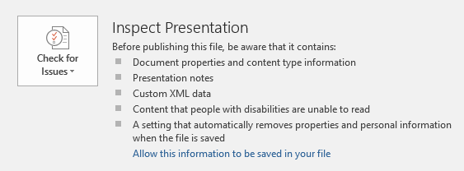
Accessibility Checkers
Microsoft Word
PowerPoint

Slide 21
OA Helpdesk
Days and Staff Members Available | 1137 Haley
Monday (Scott Renner) | 9:00am to 11:45am - 12:45pm to 3:00pm
Tuesday (Clay Yarbrough) | 9:00am to 11:45am - 12:45pm to 3:00pm
Wednesday (Tina Gilbert) | 9:00am to 11:45am - 12:45pm to 3:00pm
Thursday (Clay Yarbrough) | 9:00am to 11:45am - 12:45pm to 3:00pm
Friday (Tina Gilbert) | 9:00am to 11:45am - 12:45pm to 3:00pm
Dr. Scott Renner
734-2722
Office of Accessibility
844-2096
Faculty Resources
Access Academy

