Slide 1
Jeanne Clery Disclosure of Campus Security Policy and Campus Crime Statistics Act
University Senate
June 11, 2019

Slide 2

Clery Act
Jeanne Clery Disclosure of Campus Security Policy and Campus Crime Statistics Act, 1990
Jeanne’s story
Consumer disclosure

Slide 3

Overview of Requirements
Crime statistics and campus safety policy disclosures
Fire statistics and fire safety policy disclosures
Timely notification to campus – emergencies/crimes
Emergency procedures
Prevention & awareness programs
Missing student procedures

Slide 4
Title IX vs. Clery Act
Title IX – WHO?
  Anyone affiliated with university
  No matter where it occurs – if it limits ability to participate in or benefit from educational program
Clery – WHERE?
  Must occur on Clery Geography
  Affiliation to university does not matter

Slide 5
Clery Geography
On Campus
  Subset: On-campus Student Housing
  Properties owned or controlled within one mile
Noncampus
  Other properties owned or controlled (AU or student org) and used by students
Public Property
  Immediately adjacent and accessible from campus

Slide 6
Noncampus Properties – examples
Athletic field or property (i.e. golf course)
Classroom space
Office space to meet with students
Housing for students more than one mile from campus
Research boats, vans, other mobile classrooms
School-sponsored trips
  Repeated use
  Short-stay “away” trips
Report to crimereport@auburn.edu

Slide 7
Separate Campuses
Owned or controlled by institution
Not reasonably geographically contiguous to main campus
Organized program of study
On-site administrator
  Does not have to be full-time
Must independently comply with Clery requirements

Slide 8
Campus Security Authorities (CSAs)
Anyone with significant responsibility for student and campus activities outside of the classroom
  Student discipline officials
  Advisors to student organizations
  Faculty program leaders – Auburn Abroad
Regularly evaluating & updating

Slide 9
CSAs – Reporting Crime Allegations
If victim of or witness to a crime, report to police
If allegation of crime occurring on Clery Geography
  Encourage victim to report (their choice)
  Notify Campus Safety immediately – 334-750-9795
If allegation of gender-based misconduct involving AU affiliates, report to Title IX Office

Slide 10
Privacy/Confidentiality
Campus Safety does not require personally identifying information (PII)
If provided to victims of sexual assault, domestic violence, dating violence, or stalking, must maintain as confidential:
  Accommodations
  Protective measures

Slide 11
Campus Safety Actions
Assess for emergency notification and timely warning
Add to crime log as appropriate
Assess for inclusion in annual crime statistics
Coordinate with other offices
  Victim resources
  Follow up to address safety concerns

Slide 12
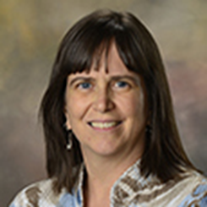
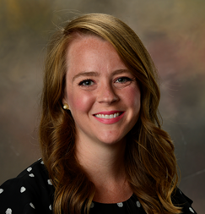




Clery Compliance Staff

