Slide 1


Parking and Transportation
A Master Plan: 2019-2024

Slide 2

New parking spaces
A multifaceted approach
Adding new parking spaces for students, faculty and staff
Implementing a Demand Management System (zones)
Improving the transit system
Aligning fees with cost of spaces

Slide 3
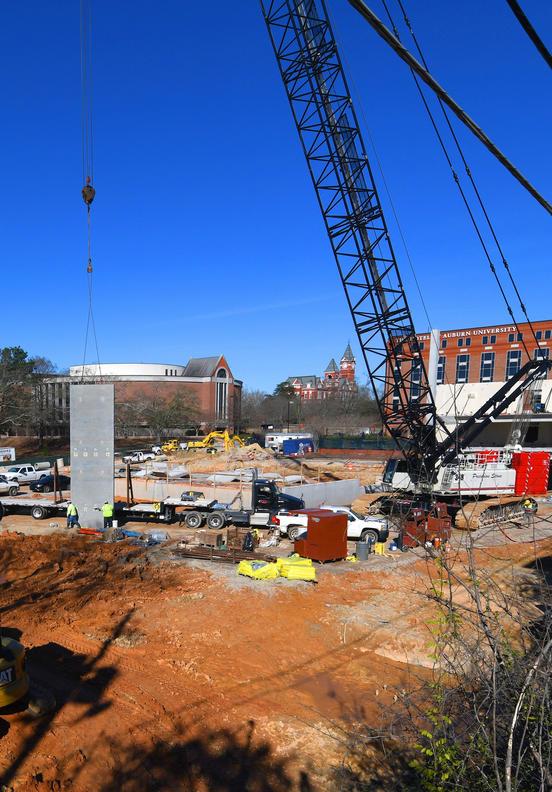
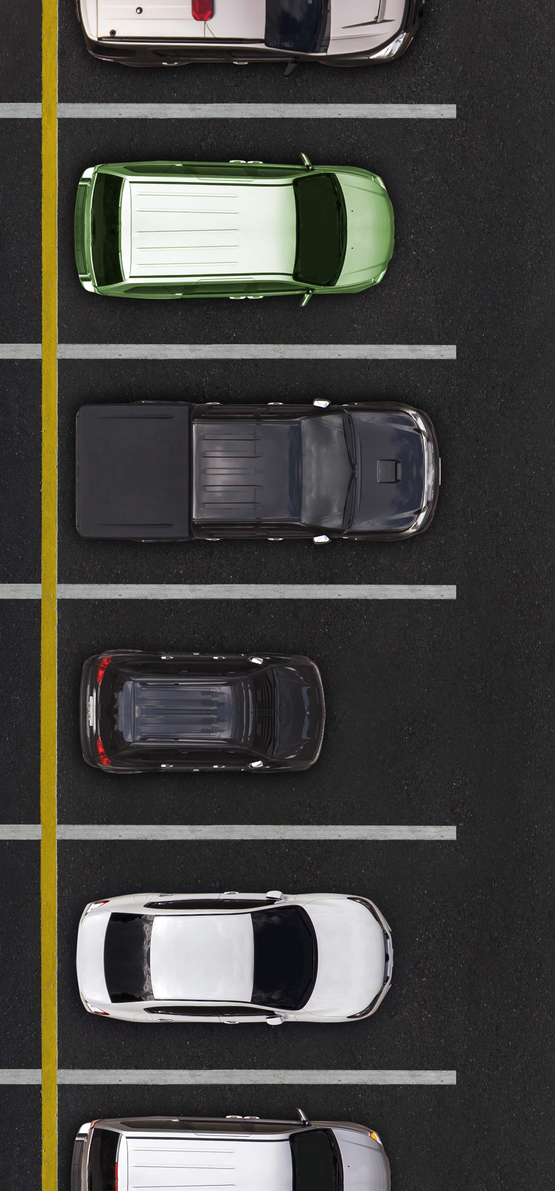

New parking spaces
Space inventory is increasing
New spaces available this fall
  Graduate Business Building
  Gogue Performing Arts Center
  S. College Street Parking Deck
1,795 total (1,160 net) new spaces in 2019
Total Inventory up 31% since 2012

Slide 4

New parking spaces
Upcoming additions
Replace and expand library parking deck
Off-campus spaces
New residence halls
More than 3,470 total (1,579 net) new spaces by 2023

Slide 5
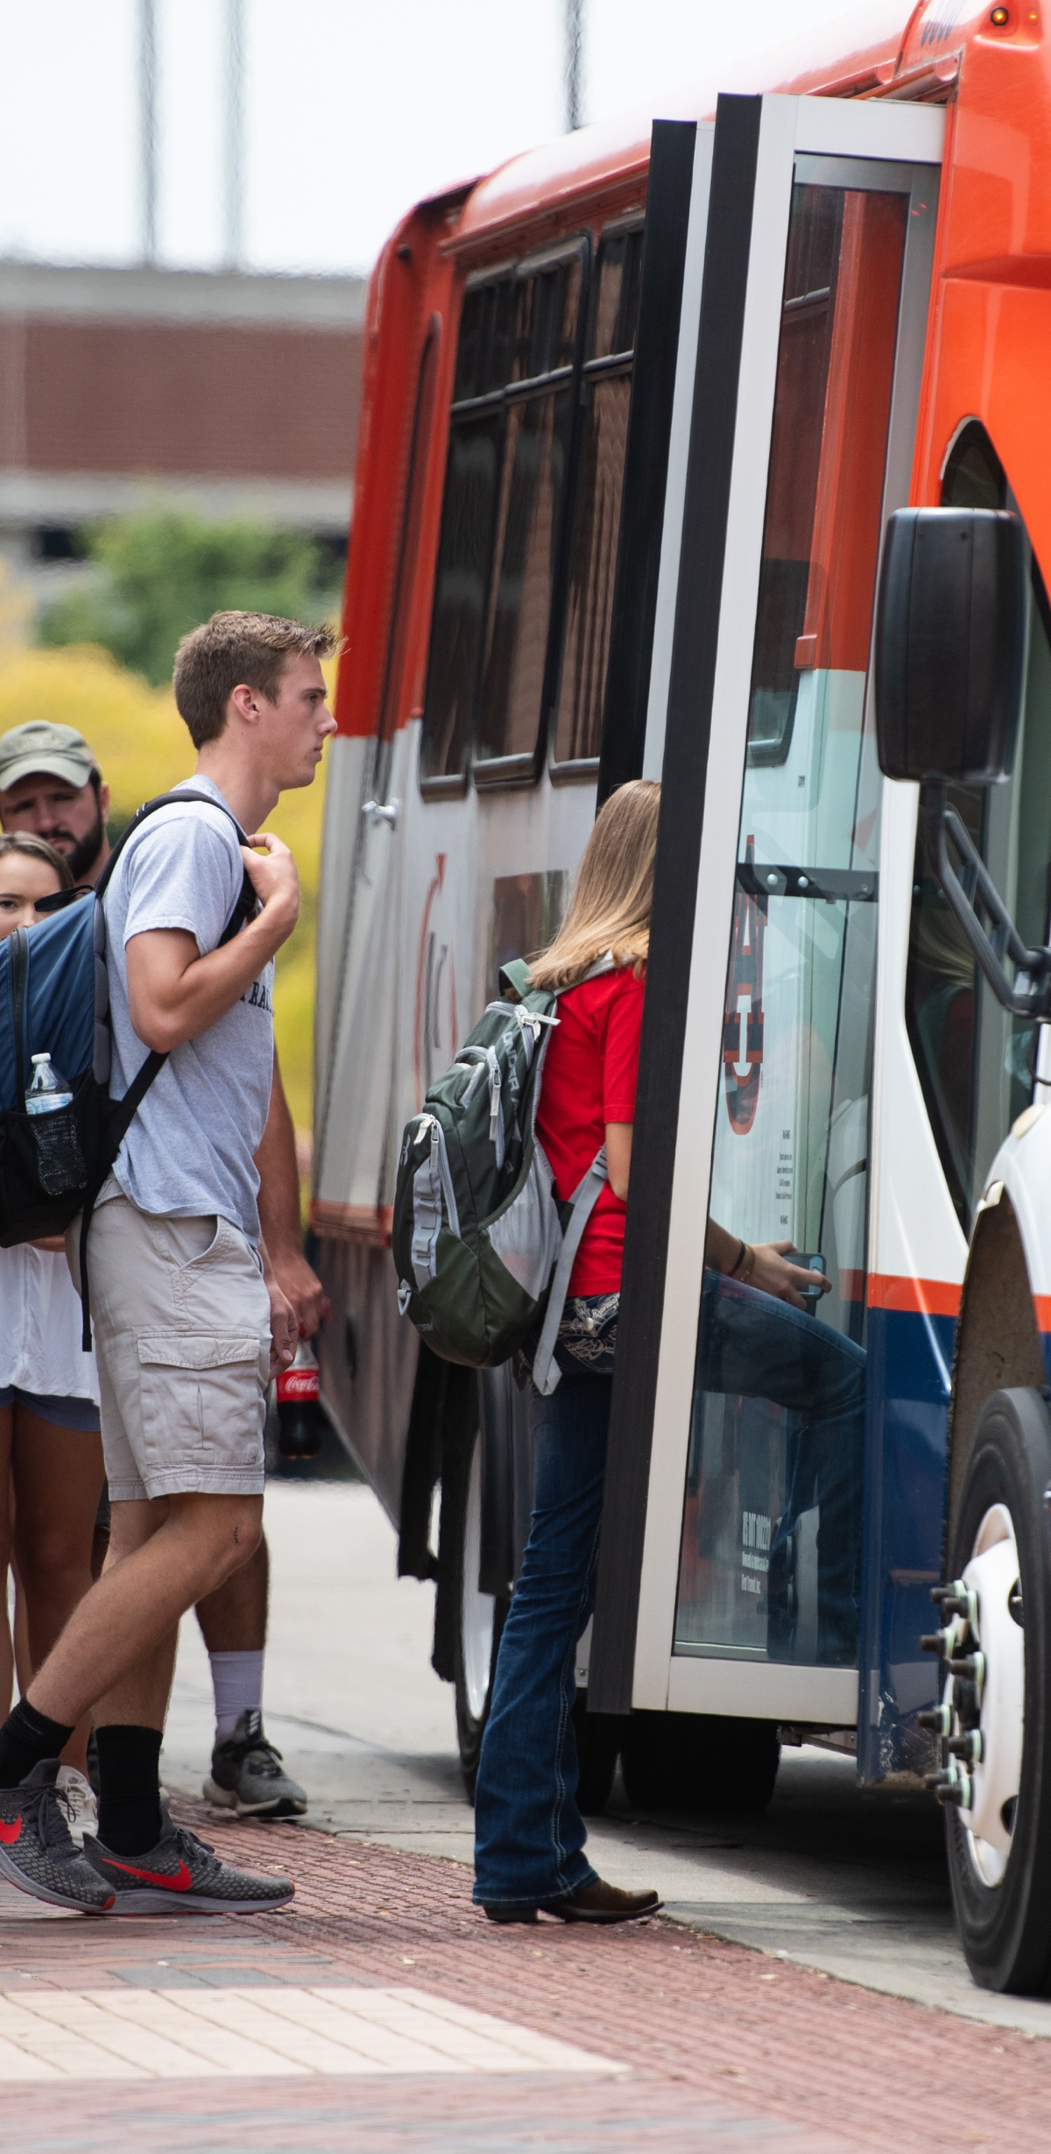
Transit System Improvements
Consolidate low-ridership routes
Extend service hours on popular routes
Improve infrastructure: pullouts, shelters, etc.
Partner with city and apartments
Make system more efficient and effective

Slide 6
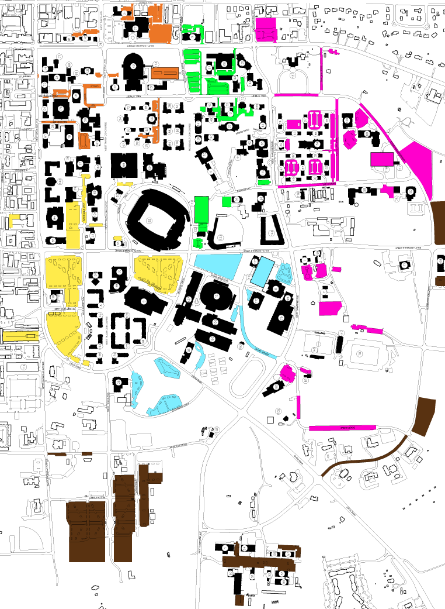
Demand Management System
High-demand spaces will cost more
Limit and charge units to store vehicles
All employees pay to park
Increase enforcement
  Cameras and gates in reserved lots and decks
  Enforcement until 6 p.m.

Slide 7
2019 Parking Costs
Registration | Current | Fall 2019
A—Faculty/Staff Exempt | $80/year $50/semester | $160/year $100/semester
B—Faculty/Staff Non-Exempt | $40/year $20/semester | $80/year $50/semester $40/summer only

Slide 8
Questions?

