Slide 1
Grants Listing
SENATE STEERING COMMITTEE – May 16, 2019

Slide 2
Background
Grant attribute and expenditure information is in multiple forms in Banner
Some information is not available in regular Self-Service Banner
Availability of reporting tools was a concern listed in recent research administration surveys
Tool was developed by Information Systems Support with feedback from Contracts & Grants Accounting
Final version was reviewed by Mike Fogle and FRC before being moved to production

Slide 3
What is it?
A web-based report in the Master Contact List of Self-Service Banner
Provides real-time grant/fund attribute information for active or expired sponsored awards
Includes filter, sort and download to Excel options
Offers ability to customize the view
Also includes columns for total budget, expenditures, encumbrance, and budget balance information (*)

Slide 4
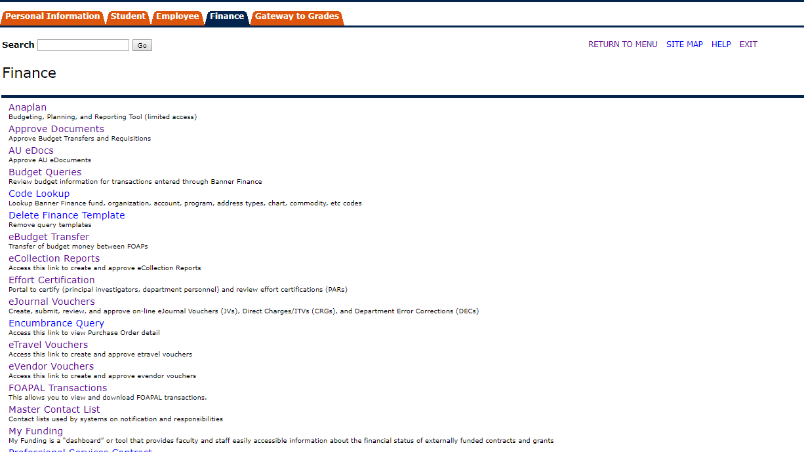
Where is it?

Slide 5
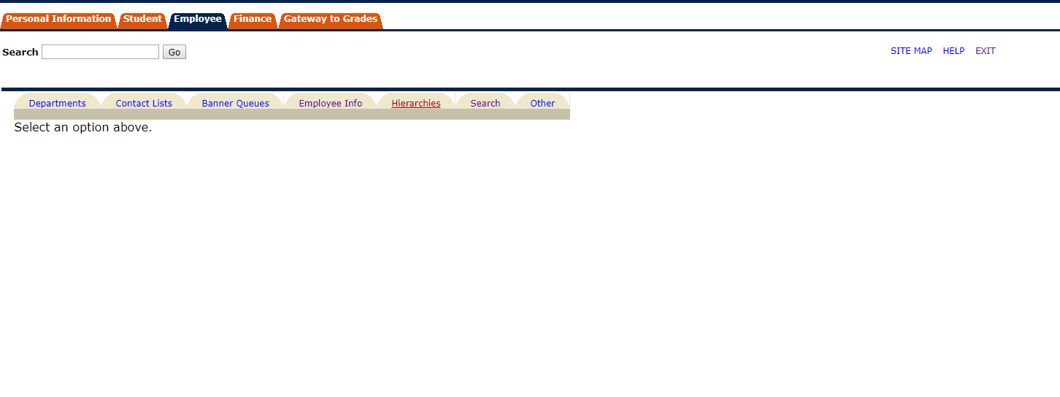
Where is it?

Slide 6
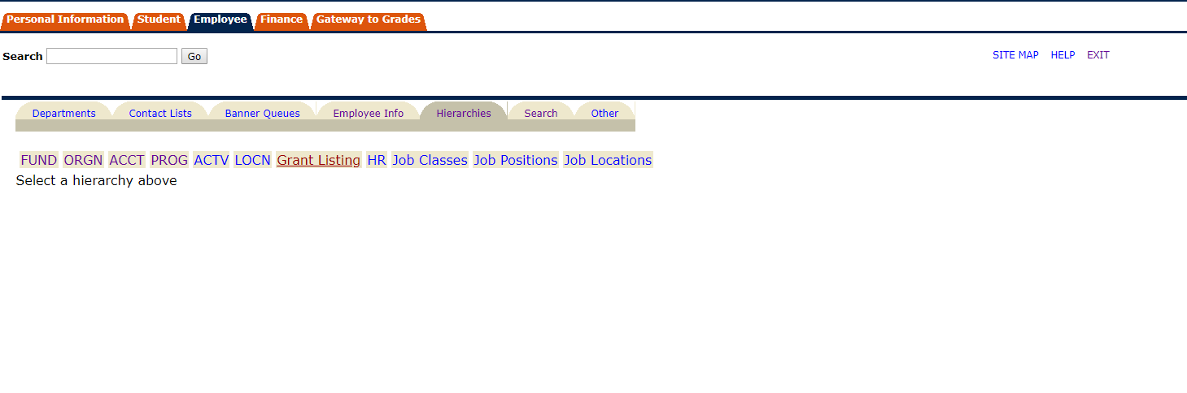
Where is it?

Slide 7
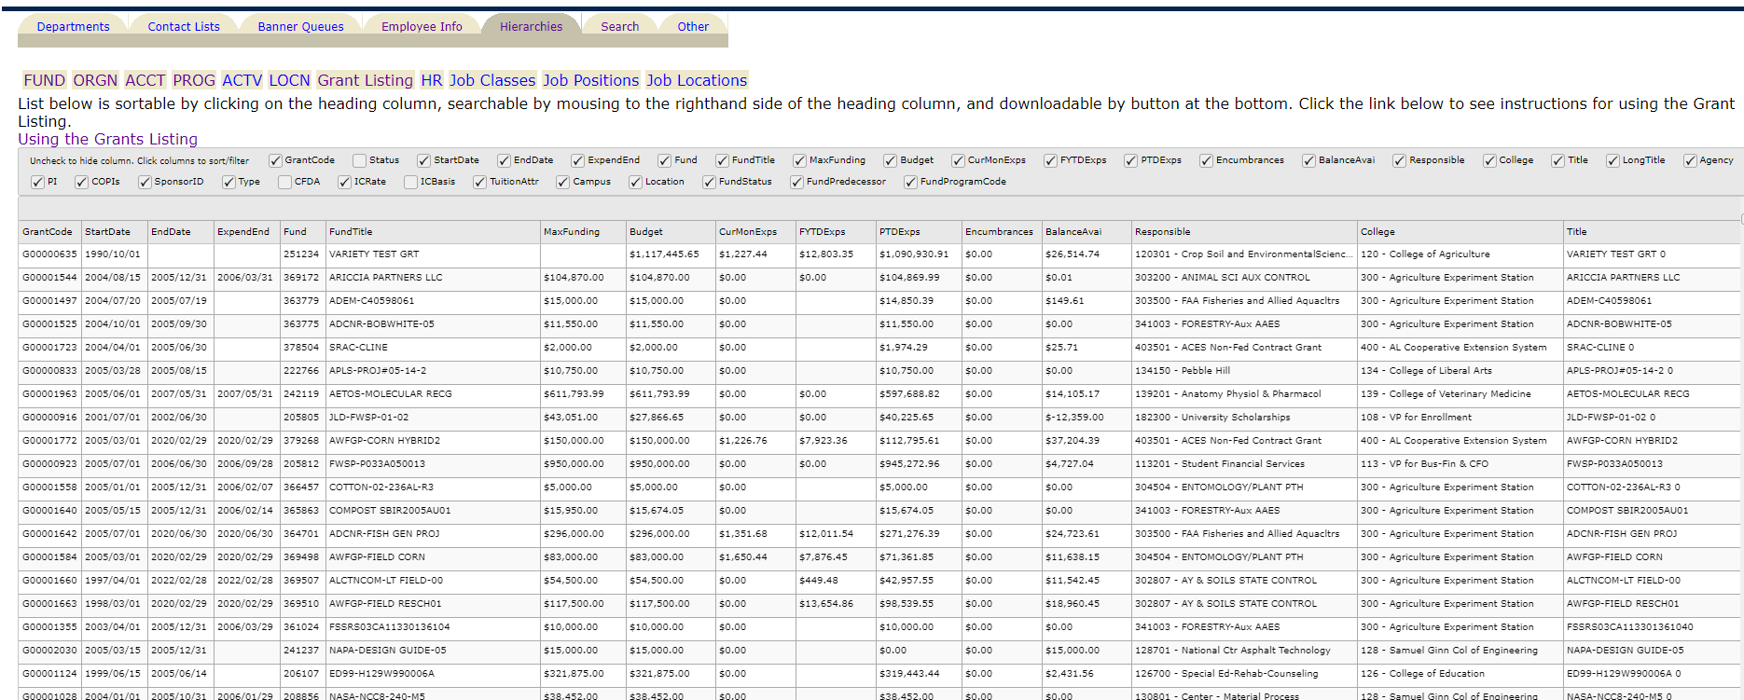

Slide 8
Questions?
Gina Bailey
Contracts & Grants Accounting
844-6293
gina.bailey@auburn.edu

