Slide 1
Auburn University
On-Campus Polling Location
University Senate Presentation
January 21, 2020

Slide 2

Why An On-Campus Polling Location?
Alleviate administrative pressure on other polling locations in the Auburn area.
In 2018 midterm election, Clarion S College served 16,173 registered voters.
Further Auburn University’s commitment to civic learning and civic engagement
“I believe in my Country, because it is a land of freedom.”

Slide 3
How Did We Get Here?
Student support (SGA)
Lee
County Commission
Auburn
University
Admin
Faculty support

Slide 4
Comments Thus Far
“I think we are doing students a disservice if we do not create a poll on campus for students! This should be a no-brainer. Students should exercise their right to vote and it should not be a challenge to do so.”
“It's absolutely ridiculous that there's no polling place on Auburn's campus. Election time comes around when many students have midterms or projects due, so to say that it's reasonable that students (many of whom lack transportation) should have to leave the school to participate in the democratic process is barefaced voter suppression.”
“A polling location on campus is necessary to ensure that students are given the ability to exercise their constitutional rights to vote. The lack of easy access to a polling site is gross disenfranchisement of this population. Many other universities across the United States provide polling sites located in dormitories and other public spaces on campus (e.g., the Student Center) in order to allow for students to easily vote.”

Slide 5
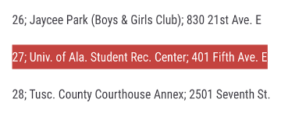

Polling Locations at Peer Institutions
University of Alabama
University of Georgia
https://www.redandblack.com/uganews/more-than-people-cast-ballots-in-early-voting-at-uga/article_f6951ac8-dd6e-11e8-a8d3-4f9d00706b57.html
Georgia Tech
https://www.news.gatech.edu/2016/09/19/tips-first-time-voters
Texas A&M University
https://today.tamu.edu/2019/09/24/how-to-vote-in-texas/

Slide 6
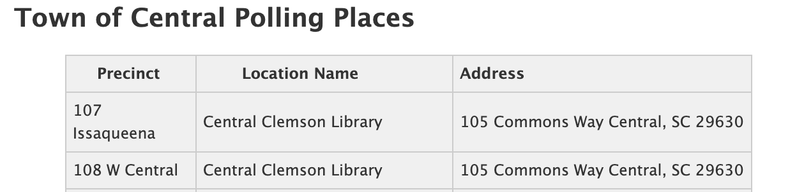
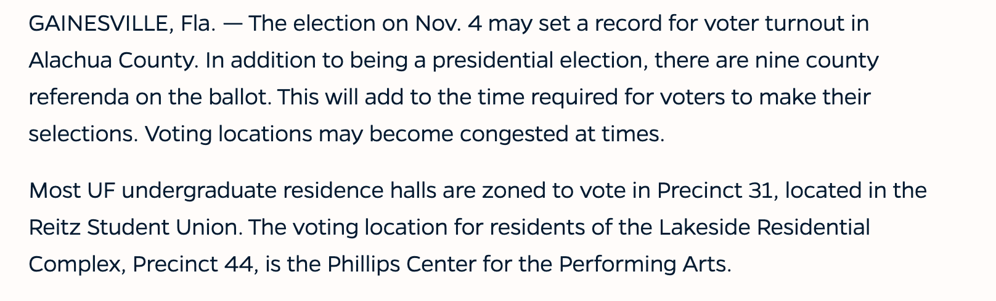
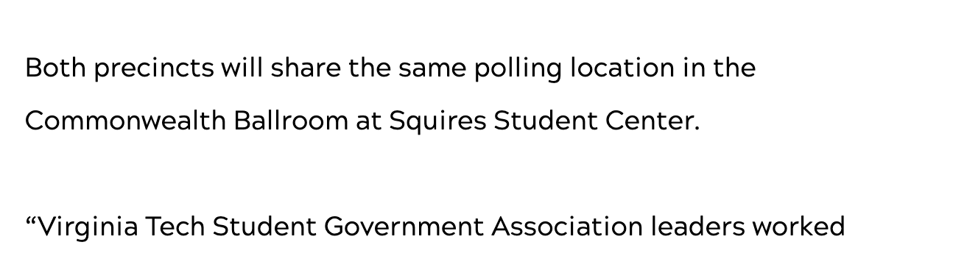
Polling Locations at Aspirant Institutions
Clemson
https://pickenselections.org/2019/08/21/2019-municipal-election-polling-places/
University of Florida
https://news.ufl.edu/archive/2008/10/campus-locations-make-voting-easy.html
Virginia Tech
https://vtnews.vt.edu/articles/2014/09/090814-vpa-votingchanges.html

Slide 7
Our Request
Letter/resolution of support to add a polling location on the Auburn’s campus.
  Location to be selected based on administrative assessment:
    Facilities management
    Parking services
    Tiger transit

Slide 8
Want to Learn More?
Voter registration information - AL
  https://www.campusvoteproject.org/stateguides/Alabama?fbclid=IwAR1mKf1K5_pwp6X8YSZE2sZ1658D2sOt8szpnQhyCyi3vzTqNGtbcZ3hCcs
Voter demographics - AL
  https://www.sos.alabama.gov/alabama-votes/voter/election-data
Polling location by the #’s - 2018 – Lee County
  http://cms6.revize.com/revize/leecountyal/government/probate_judge/docs/Results_20181106_unofficial.pdf
Voter Fraud
  https://www.brennancenter.org/our-work/research-reports/debunking-voter-fraud-myth

Slide 9
Questions?
Hannah Krawczyk
  hrk0007@auburn.edu
Beth McDaniel
  coopes1@auburn.edu
Elizabeth Devore
  ead00012@auburn.edu

