Slide 1

Discovery
New to Auburn University is…
A Single Search for [almost] Everything
Presented by:
Nadine Ellero & Toni Carter
November 12, 2019

Slide 2
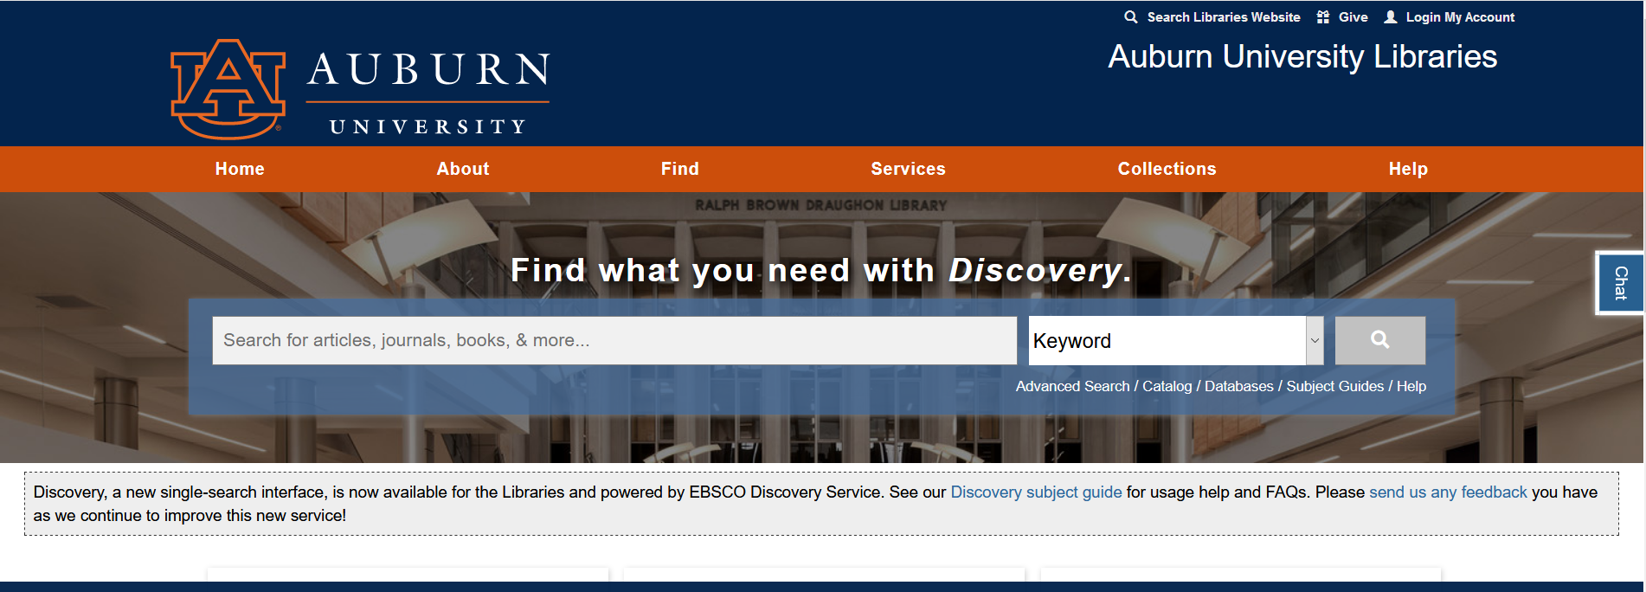

Slide 3

Single search or Web-scale discovery refers to ...
“...tools that search seamlessly across a wide range of local and remote content and provide relevance-ranked results – have the ambitious goal of providing a single point of entry into a library’s collections.”
-Marshall Breeding
Source: Breeding, M. (2014). Web-scale Discovery Services. American Libraries, 45(1/2), 25. Breeding, M. (2014). Web-Scale Discovery Services. American Libraries, 45(1/2), 25. Breeding, M. (2014). Web-Scale Discovery Services. American Libraries, 45(1/2), 25. Breeding, M. (2014). Web-Scale Discovery Services. American Libraries, 45(1/2), 25.

Slide 4
Other academic libraries
with single search discovery services:
Amherst College
Boston Conservatory
Brown University
California Institute of Technology
Case Western Reserve University
Clemson University
European University Institute
Florida International University
Georgia State University
James Madison University
Indiana University
Iowa State University
Louisiana State University
Ohio University
University of Alabama
University of Florida
University of Georgia
University of Missouri-Columbia
University of New Mexico
University of Virginia
Vanderbilt University
Virginia Tech

Slide 5


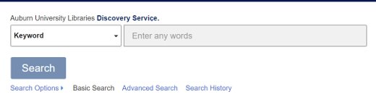

Auburn University Libraries chose the EBSCO Discovery Service as our single search tool.
EBSCO Industries is a privately held company based in Alabama that provides library and information services all over the world. EBSCO has provided financial support for many projects in the Libraries, including the Learning Commons.

Slide 6
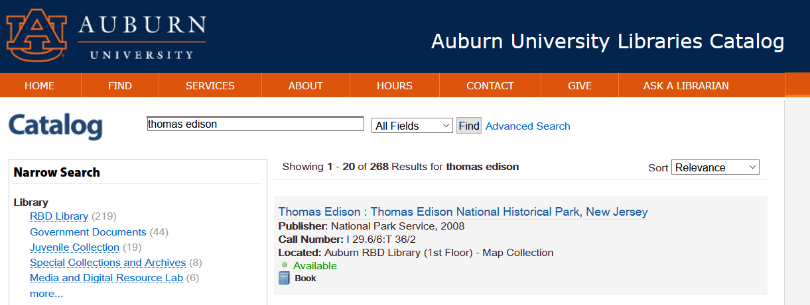
Library catalog
[simplified]
Searches books and most audio-visual resources by authors, titles, subjects
Searches journal titles and subjects

Slide 7
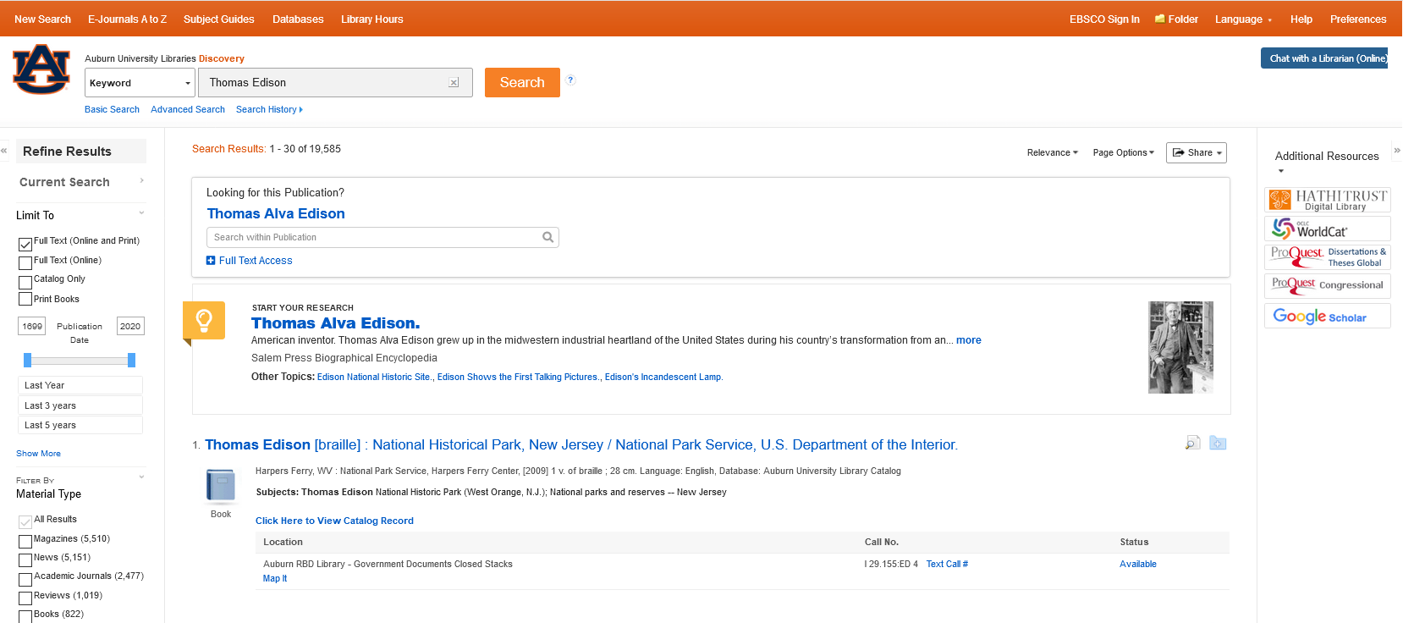
Discovery
[service]
Library catalog + journal articles & book chapters
Context-sensitive help
  Dynamic linking of research starters.
  Integration of subject guides created by AU Libraries.
APIs for additional resources

Slide 8
Comparing both…
Discovery
Articles from
journals
Databases
Library Catalog
Note: Diagram is not to exact scale

Slide 9
Benefits to Students
Provides a familiar single-box search approach
  Graduate students who come to Auburn from other universities accustomed to using web-scale discovery services
Searches for books and articles simultaneously
  Helpful to undergraduates not yet aware of differences between subject databases and the library catalog
Context-sensitive help

Slide 10
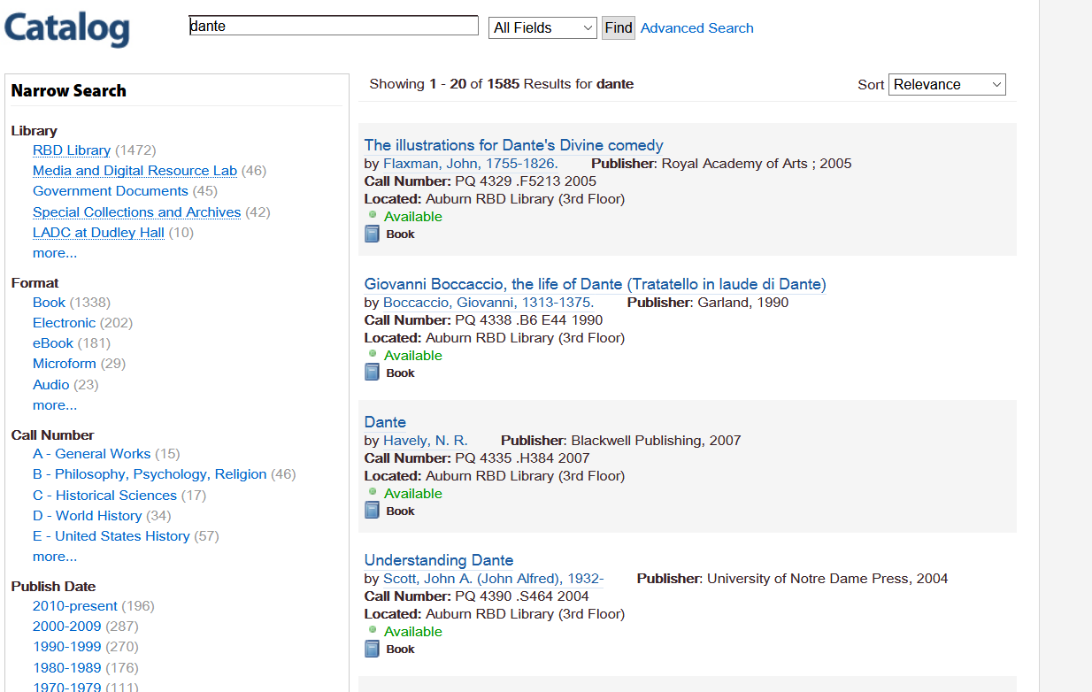
Library catalog

Slide 11
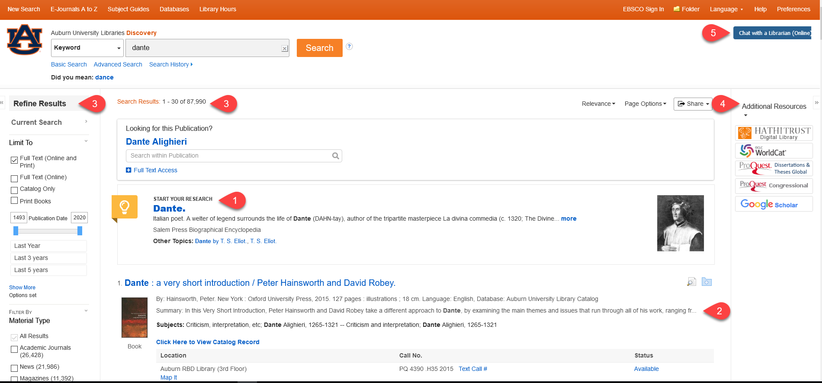
Discovery
[service]

Slide 12
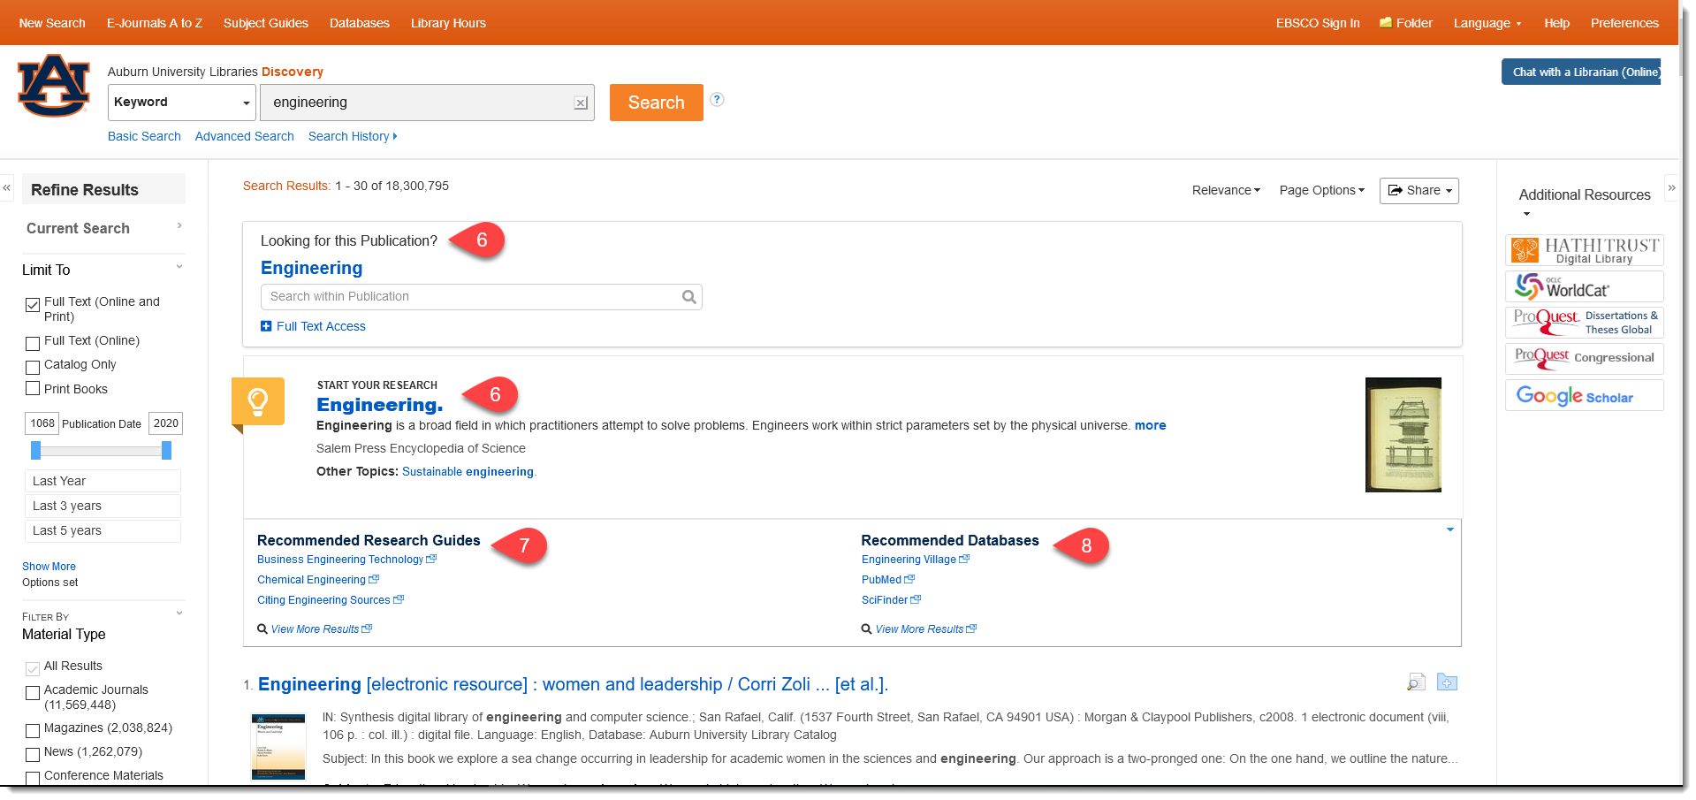
Discovery
[service]

Slide 13
Discovery
[service]
Features for teaching and learning
  Research starters
  Thick metadata for searching
  More search results with the ability to refine
  Integration with additional resources
  Chat with a librarian
  6. Publication finder
  7. Integrates subject guides created by
  AU research & instruction librarians.
  8. Points to other relevant databases

Slide 14
“I like the old way…”
Library catalog still available
  http://catalog.lib.auburn.edu/vufind/
Subject databases still available
  https://www.lib.auburn.edu/find/bytitle.php

Slide 15
Questions or Comments?

