Slide 1
CIVILITY ON CAMPUS
Faculty Senate
Auburn University
September 17,2019
Kevin Coonrod
University Ombudsperson

Slide 2
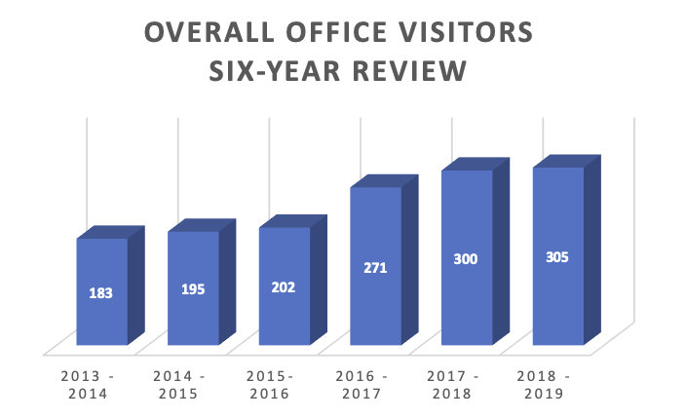
Six-Year Ombuds Office Chart
INDEPENDENT • NEUTRAL • CONFIDENTIAL • INFORMAL

Slide 3
Auburn University is an institution built upon honor, integrity, trust, and respect.
Consistent with these values, the University is committed to providing a safe and non-discriminatory learning, living, and working environment for all members of the University community.
Auburn University Policy on Sexual and Gender-Based Misconduct

Slide 4

Bullying Definition
Abusive behavior that is:
  Repetitive
  Intentional
  Power based

Slide 5
what is bullying about?
Control
(Lack of) respect
Fear of being incompetent
Fear of being perceived as incompetent
Lack of alternative behaviors

Slide 6
Workplace Bullying Statistic
72% of employers deny, discount, encourage, rationalize, or defend
Bosses are the majority of bullies
2014 WBI U.S. Workplace Bullying Survey, http://www.workplacebullying.org/wbiresearch/wbi-2014-us-survey/

Slide 7
consequences to the person
Profound feelings of confusion, fear, isolation, paranoia, embarrassment, shame, rage, guilt, depression, anxiety, lack of confidence, poor self-esteem, grief, shock, rejection, and worthlessness
Post Traumatic Stress Disorder and Prolonged Duress Stress Disorder
Focus and concentration impaired
Isolation and social withdrawal
Substance abuse
Domestic violence
Suicides attempted and completed
Kohut, M. (2008) The Complete Guide to Understanding, Controlling, and Stopping Bullies & Bullying at Work, Atlantic Publishing Group, Ocala, FL, at 139.

Slide 8
  consequences to the organization
Diminished morale and productivity
Employee turnover
Lost opportunities (client turnover)
Reputation
Absenteeism and Presenteeism
Litigation - Judgments, Settlements, Attorney Fees, Stress

Slide 9
Top Ten Workplace Bullying Tactics
Blame target for errors
Unreasonable job demands
Criticism of ability
Inconsistent compliance with rules
Threatening job loss

Slide 10
Insults and putdowns
Discounting or denial of accomplishments
Exclusion or “icing out”
Yelling, screaming
Stealing credit
Namie, G. and Namie, R. (2009) The Bully at Work - What You Can Do to Stop the Hurt and Reclaim Your Dignity on the Job. Sourcebooks, Inc., Napierville, IL, at 27.

Slide 11
Bullying in Academe
“The combination of power and lack of accountability breed bullying and aggression in higher education.” Hollis, at 120
Tenure; Academic Freedom; Long-term relationships
Competition for scarce resources
Long-term institutions; embedded cultures
Hollis, l. (2012). Bully in the Ivory Tower: How Aggression and Incivility Erode American Higher Education. Middletown, DE: Patricia Berkly, LLC., 111 - 113.

Slide 12
AUBURN UNIVERSITY POLICIES
No Comprehensive Anti-Bullying or Civility Policy
However, there are specific conduct policies that may apply
Policy Against Retaliation. “No employee shall take retaliatory action against any individual for reporting, or causing to be reported, in good faith, suspected wrongdoing, or for assisting in an authorized investigation of alleged wrongdoing. Retaliation, if confirmed, will result in disciplinary action.”

Slide 13
Employee and Student Anti-Harassment and Discrimination Policies
  These policies cover constitutionally protected classes and are restricted to issues concerning race, color, sex, age, religion, national origin, disability, covered veteran status, sexual orientation, or genetic information.

Slide 14
Federal law prohibits discrimination based on race, color, religion, sex and national origin. Title VII, Civil Rights Act 1964
Federal law also prohibits discrimination based on sex at educational institutions receiving federal funding in Title IX

Slide 15
AU WiFi. Users of Auburn University IT resources must take special care to avoid activity that is or could be perceived as harassing or threatening. Violations of this policy may result in actions ranging from warnings to loss of access to Auburn University IT resources. Deliberate disregard of this policy … will be considered a Group I infraction under the University Personnel Manual and is subject to disciplinary action, up to and including dismissal. Appropriate Use of Information Technology Policy, Sections VII and VIII

Slide 16
AUBURN POLICY
- Faculty -
FACULTY GRIEVANCE AVAILABLE FOR…”improper or unethical activities such as failure to honor commitments, harassment, discrimination.” FACULTY HANDBOOK, ARTICLE 6, SECTION 2(d).
GROUNDS FOR DISMISSAL OF FACULTY IN CLINICIAN AND RESEARCH TITLE SERIES INCLUDE LACK OF COLLEGIALITY AND UNPROFESSIONAL BEHAVIOR. FACULTY HANDBOOK 3.5.2(K) AND 3.5.3(K).
A TEACHER MAY NOT ENGAGE IN “CAPRICIOUS, INTIMIDATING, OR DISCRIMINATORY” ACTION AGAINST A STUDENT. STUDENT ACADEMIC GRIEVANCE POLICY 3.3.1.4.

Slide 17
Dismissal of tenured professor
  Certain crimes
  Serious and substantial violation of professional ethics
  Serious or substantial neglect in teaching, research or outreach

Slide 18
AUBURN POLICY
- Staff and A & P -
AUBURN EMPLOYEE MANUAL PROHIBITS “INTIMIDATING OR INTENTIONALLY IMPOSING ON THE RIGHTS AND PRIVILEGES OF OTHER EMPLOYEES…
INDULGING IN GROSSLY OFFENSIVE, OBSCENE, OR IMMORAL CONDUCT…
FIGHTING ON UNIVERSITY PROPERTY OR CREATING DISTURBANCES WHICH ADVERSELY AFFECT MORALE, PRODUCTION, STUDIES, OR DISCIPLINE.”
THE POLICY ALSO PROHIBITS “MAJOR MISCONDUCT AND SUBORDINATION.”
AUBURN UNIVERSITY EMPLOYEE RELATIONS POLICY 8.3.3.(A),(D),(H) AND (I).

Slide 19
Auburn policy
- Students -
Students are subject to disciplinary action for threatening and/or committing physical violence against another person, such as assault, hazing or harassment. Code of Student Discipline.
Student organizations should not negligently allow, condone or facilitate a member’s threatening and/or committing physical violence against another person, such as assault, hazing or harassment. Student Organization Code of Conduct.
Hazing. The Code of Alabama (1975), Section 16 -1-23; Auburn University Anti-Hazing Policy.
improper classroom behavior includes Verbal, psychological, or physical threats, harassment, and physical violence. POLICY ON CLASSROOM BEHAVIOR, NO. 1.9.

Slide 20
Civility Definition
Collegial
Respectful
Supportive
Abide by laws and policy

Slide 21
Steps we can take
Talk to your supervisor
  Or, your supervisor’s supervisor
Confront the bully — not recommended
  If you insist, address the behavior and not the individual
Bystander intervention
See the Ombudsperson
Self-Care, and Flight

Slide 22
Strategies to promote civil behavior
Culture change
  Transform culture through new hires. Screen for aggressive tendencies in hiring process, and educate through questions asked. Use external hires in leadership positions as agents of change. Twayle, D. and DeLuca, B. (2008) Faculty Incivility: The Rise of the Academic Bully Culture and What to do About It. San Francisco, CA: Jossey-Bass, 170 and 173.
Education of faculty, including supervisors, on how to address problems promptly
  Discuss appropriate and inappropriate behavior with faculty - individually, and as group

Slide 23
Policy
  Buy-in
  Fair and consistent enforcement
Leadership modeling civil behavior

Slide 24
Conclusion
Bullying begets bullying
Respect begets respect
Trust begets trust

Slide 25
CIVILITY ON CAMPUS
Faculty Senate
Auburn University
September 17,2019
Kevin Coonrod
University Ombudsperson

