Slide 1
Compensation Strategies: An Overview and Case Study
Shelly Murray, Manager of Compensation programs
Bailey Ward, Manager of Comp. & Class Administration
Loren Winn, SPHR, SHRM-SCP, Director Facilities Management Human Resources
Dave Smithwick, SPHR, GPHR, SHRM-CP, Interim Director, Comp & Class

Slide 2
Agenda
Welcome and introductions
FLSA Overview
Monitoring the external landscape
Applying the external conditions to internal compensation strategies
Market data analysis and application to AU jobs
Market study Phase II impact
A consultative approach: Earning trust and confidence
Facilities Management Human Resources: A case study
Q&A

Slide 3
FLSA:
Can I check E-mail now or is this important?
The Wage and Hour Division of the Department of Labor was created with the enactment of the Fair Labor Standards Act (FLSA) in 1939.
Includes minimum wage, overtime eligibility, record keeping requirements, and youth employment standards.
Created to establish a federal statute which requires employers to maintain better working conditions for employees.
Youngest age for non-agricultural work?
Current federal minimum wage?
Current minimum salary threshold to determine overtime eligibility?
Hey, maybe this is important!

Slide 4
FLSA:
Minimum Wage and Overtime Eligibility Salary Threshold Proposed New Rule
Current federal minimum wage is $7.25 per hour
AU minimum (wage) hiring rate is $14.50 per hour
~30 states have a minimum wage above $7.25
Federal minimum wage last changed on July 24, 2009
Current threshold is $35,568 annually/$684 per week (eff. 1/1/2020)
Must still meet one of the exemption categories based on job duties
Projections for the new threshold range from $45,000 - $52,000
Any increase which is implemented will raise wages and costs of the workforce for many employers

Slide 5
FLSA Exemption Flow Chart
Step 2: Exemption Applicability
Does the employee perform any of the following types of jobs?
Executive-leadership and/or management is the employee’s primary duty
Administrative-employee performing non-manual office work at a high level
Professional/Creative-employee whose work requires highly advanced knowledge; creative and artistic profession; faculty
Computer professional-employee involved in design or application of computers & related systems (does not apply to service desk roles)
Outside sales-employee makings sales or taking orders which influence sales outside of the employers premises
Step 1:Salary Basis Test
Is the employee paid at least $684 per week ($35,568 per year)
Step 3: Job Analysis
A thorough analysis of job duties must be performed to determine exemption status. An exempt position must pass both the salary and the duties test
YES
YES
NO
Employee is nonexempt
NO
Employee is nonexempt

Slide 6
The Fair Labor Standards Act (FLSA)
The Law
Enacted in 1939 to protect workers
Not all jobs covered by the law
Covered jobs must
Keep daily time records
“non-exempt” jobs are covered
Classification is based on the actual job duties and responsibilities. The job title, reporting relationships, or qualifications of the person or not considered
Multiple tests used to determine classification
Be paid overtime (1 ½ times regular hourly rate) for any time worked over 40 hours each week
Auburn University risks significant financial penalties for classifying jobs incorrectly
Requirements
Penalties

Slide 7
High Level Macro Considerations:
The Economy and the workforce
COVID-19 Pandemic impact on the workforce
“The Great Resignation”
Inflation
  2019=2.3%; 2020=1.9%; 2021=7%; 2022=6.5%
Rising federal interest rates
  from ~0% in 2021 to ~5.25% today
Low unemployment
  5% in 2016; 3.5% in 2019; 14% in 2020; 3.6% in June 2023 (low of 3.4%)
  In Alabama, at a record low of 2.2% in June 2023 (2.6% in June 2022)
Wage growth
  Reached 15% in 2021; now ~5%
Labor supply and demand has an impact on wages
  Follow the trends and think about our workforce outcomes

Slide 8
Auburn university related impact as a major employer
Talent acquisition; talent pools for posted jobs
Engagement and retention
Learning and professional development opportunities
Analyzing market-competitive wages using valid market data sources
Development and presentation of strategies supported by data for informed decision making
Investments in our workforce and return on those investments

Slide 9
What Can we do as Auburn Hr professionals?
If you are an HR team member supporting a unit or the enterprise for workforce decisions, we all have responsibilities for some elements of compensation and classification knowledge and support
Earn a seat at the table; trust and confidence is not given
Be a transactional expert and a consulting strategist
It is art and science; understand the “big picture”
Current and complete job descriptions are your best friend
Don’t ever give away your power: We are “They”
One Auburn HR: Pay solutions based in policy. Driven by data. Aligned with the culture, mission, and vision. Focused on customer requests and operational needs. War Eagle!

Slide 10
Utilizing Valid Market Data to Analyze Auburn University Jobs
Bailey Ward
Manager, Comp and Class Administration

Slide 11
Using Market Data to inform pay decisions
Compensation purchases salary surveys from reliable third-party vendors which are experts in collecting, analyzing, and disseminating salary data from a broad range of employers
Type of Surveys:
  Higher Education
  General Industry
  Industry Specific (Athletics, Advancement, Research, Museum, etc.)
Survey data is ONE data point at a specific point in time as part of the decision-making process
Survey data is utilized for
  Market pricing jobs
  Pay structure development and maintenance
  Collaboration on individual pay decisions

Slide 12
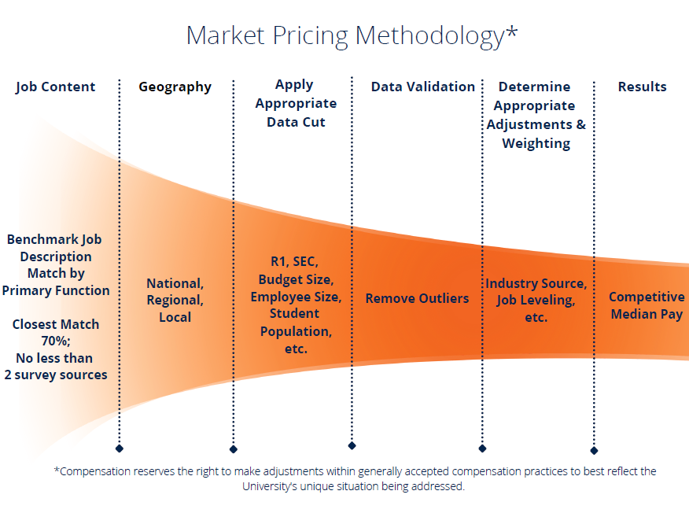
Using Market data to inform Pay decisions

Slide 13
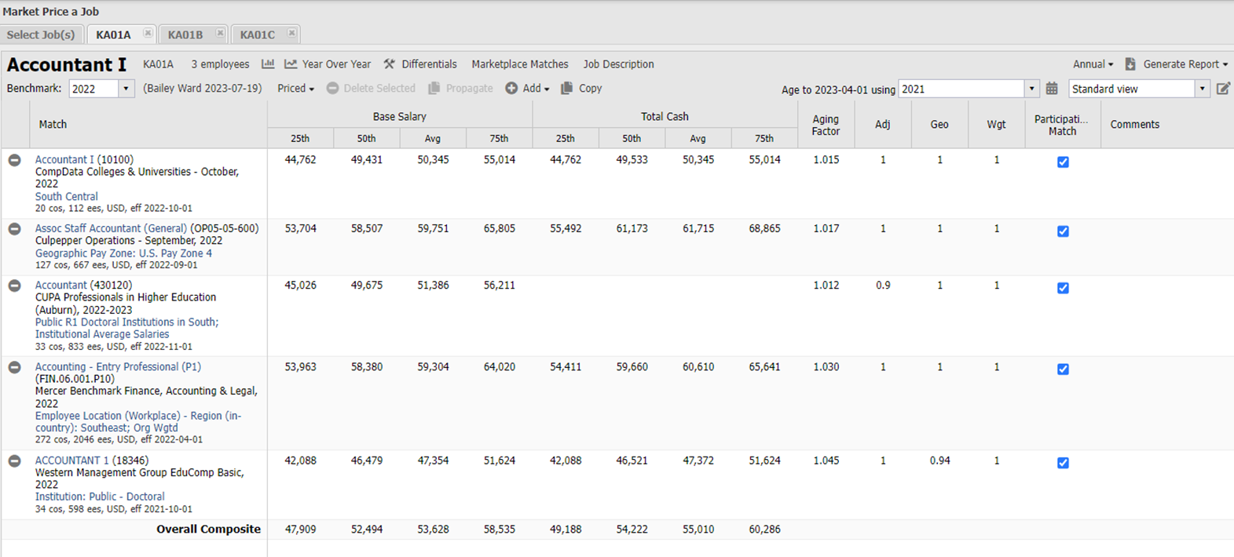

Using Market data to inform Pay decisions

Slide 14
Auburn’s Response to Market Conditions
Shelly Murray
Manager, Compensation Programs

Slide 15
AU’s Response to Changing Market Conditions
Competitive Compensation Analysis & Infrastructure Development Project (2019-2021)
  Implementation - Phase I (Oct 2022) – 1,300 preliminary market adjustments
  Implementation - Phase II (Oct 2023, if approved) – Comprehensive data collection; Usage of Pay Evaluator; 1,330 additional market adjustments
Provisional Procedures to “Level the Playing Field”
  Pay adjustment restrictions on lateral transfers removed; Now, use Pay Evaluator
  Ability to extend internal and external retention offers
  Consideration for provisional procedures to continue past FY23 – Feedback desired
Competitive Pay Structures
  Pay range movements for each pay structure reviewed and considered for adjustments on annual basis; Next potential adjustment – October 2024
Continued monitoring of AU’s minimum hiring rate (MHR)

Slide 16
Au Pay: We’ve come a long way, baby!

Slide 17
Best Practices for Position Management
Regular Monitoring – HRLs should partner with managers/directors to ensure all employees are accurately classified, which affects:
  FLSA Exemption Status
  Pay Grade
  Pay level (and potentially benefits tier)
  Performance management
  Recruiting and selection (if position becomes vacant)
Position Reclassifications
  Primary purpose is key; not just a promotional vehicle
  Understand the purpose of any reclassifications (changes in responsibilities, increased scope, change in organizational needs, etc)
  Organizational impact
  Employee communication (before vs after)

Slide 18
Best Practices for Position Management, cont.
Reorganization Planning
  Contact UHR Compensation (partnership with Employee Relations)
  Business case (Why / Who / When)
  Org charts
  Reclassification vs posting
  Ripple effect
  Budget implications
  Managing employee expectations through communication

Slide 19
Facilities Management Case Study
Loren Winn
Director Facilities Management Human Resources

Slide 20
Facilities Management Case Study
This case study explains the challenges that the reclassification process created for AUFM, demonstrates how AUFM addressed these challenges, and defines the lessons learned that helped create our current processes.

Slide 21

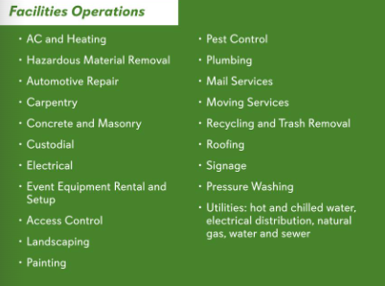
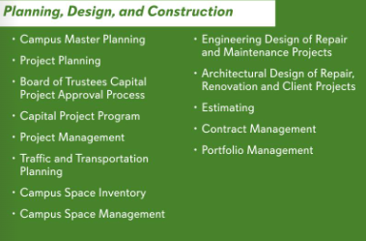
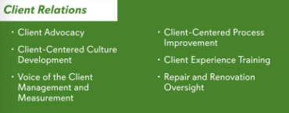
Facilities Management – Overview
450 Employees
3 three distinct service units
  Operations
  Planning, Design and Construction
  Client Relations
Administrative offices
  Accounting
  IT
  HR & Training
  Communications
  Safety

Slide 22
Challenges
FM had an unrealistic volume of reclasses/reorgs
No consistency in handling
  Popped up unexpectedly out of units - ad hoc, haphazard, often driven by a perceived crisis
  No strategic vision
    Little thought towards organizational or workforce planning beyond the subunit
    No thought towards properly defining essential functions
  No budget considerations
  No thought towards potential inequalities across units (or AU as a whole)

Slide 23
How We addressed the challenges
Gaining buy in from top leadership
  People Master Plan
  Forecast trends
  Thinking “Big Picture”
Three areas of opportunity:
  Manage volume of reclasses annually
  Implement PDQ user control
  Improve internal transactional support
Created collaborative business partnership with UHR Comp Team

Slide 24
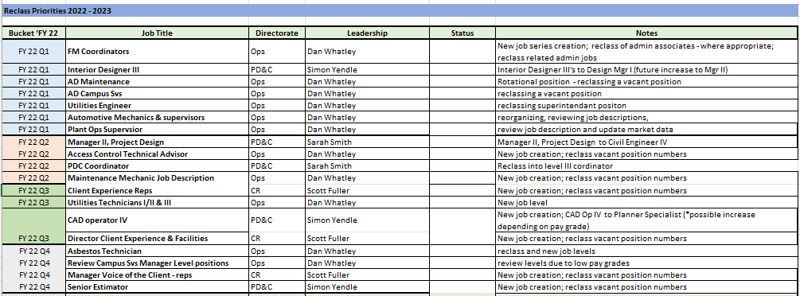
Managing Volume – Strategic Annual Plan
Example
Strategic Planning
  Organizational development – strategic realignments, management restructuring, service development
  Workforce planning – right jobs, right pay, right people with the right skills
  Pre-approved budgeting

Slide 25
Implement PDQ User Control
Streamlined more collaborative approach
  Altered how we interacted with leadership
    Allowed for more insight and benchmarking of industry: local and global
  Allowed leadership to focus on the more critical elements of their day-to-day responsibilities
FMR HR responsible from start to finish
  Quicker turn around/fewer iterations
    Resulting in a more relevant higher quality product
  Enabled us to manage impacts
    Budgets
    Across FM & AU

Slide 26
Process
Strategic Planning Meeting
Proposed reclasses reviewed by leadership
Collaboration with Department
FMHR conducts position interview
Documentation
Justification Memo
Collaboration with Comp
Budgetary considerations
Prioritized into quarterly buckets
Drafts PDQ & JD; sends to dept for feedback
Dept provides justification memo
HR34
Financial Statement
PDQ
Job Description
FMHR completes PE; receives recommended salary
Sends for Comp review
If applicable: market info, MQ comparison, dept’s presentation to Assoc VP, memo to Comp, invitation to overview meeting with Comp
If applicable: Overview meeting with Comp; dept leadership meetings with Comp; additional info and/or presentations

Slide 27
Restructured FM Human resources
Restructured FM HR for better support
  Trained, Scheduled and provided the FM HR transactional support
  Justified and quantified need for full time support
Goal- Gain trust and buy-in from leadership
  Facilitating an efficient and timely process
  SME’s for the entire reclassification process
  Provide consistent and quality product
  Provide metrics and tracking
  Reviewing and evaluating process for continuous improvement

Slide 28
Lessons Learned
Since October 2018, we have completed over 300 reclassifications which include new job creations, moves between existing jobs, position reclassifications, pay alignments, and job description updates.
Increasing Trust with Top Leadership
Becoming More Data Driven
Collaborating with UHR
Owning the process - Keeping our Power
(Not Giving It Away)
Important Takeaways

