Slide 1
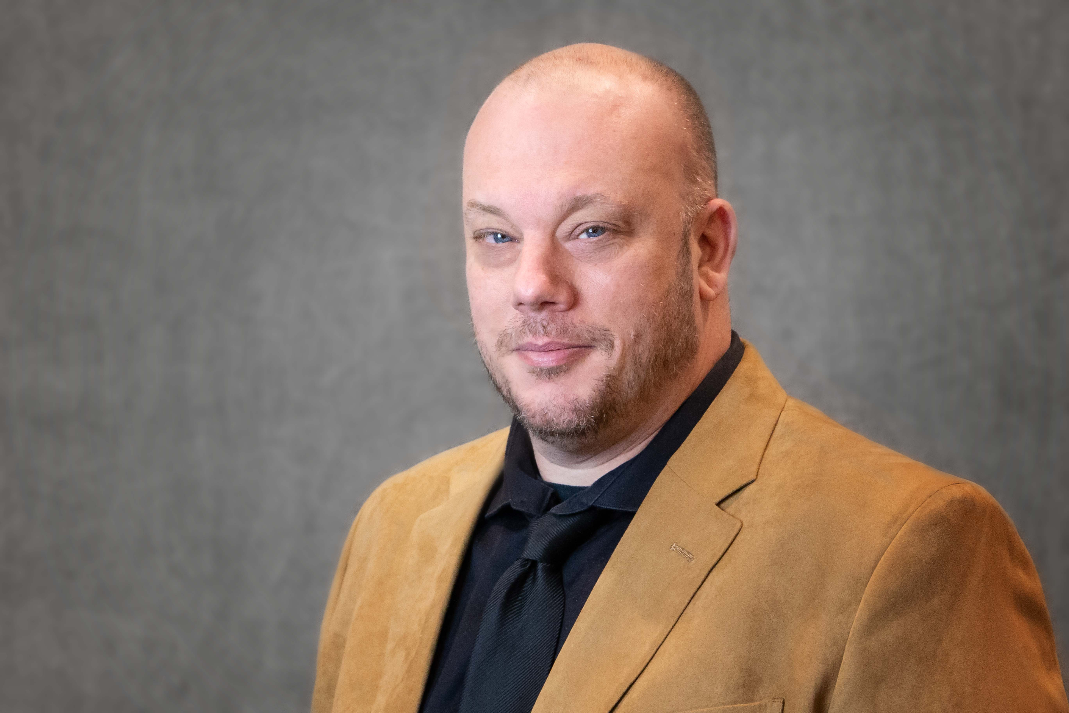
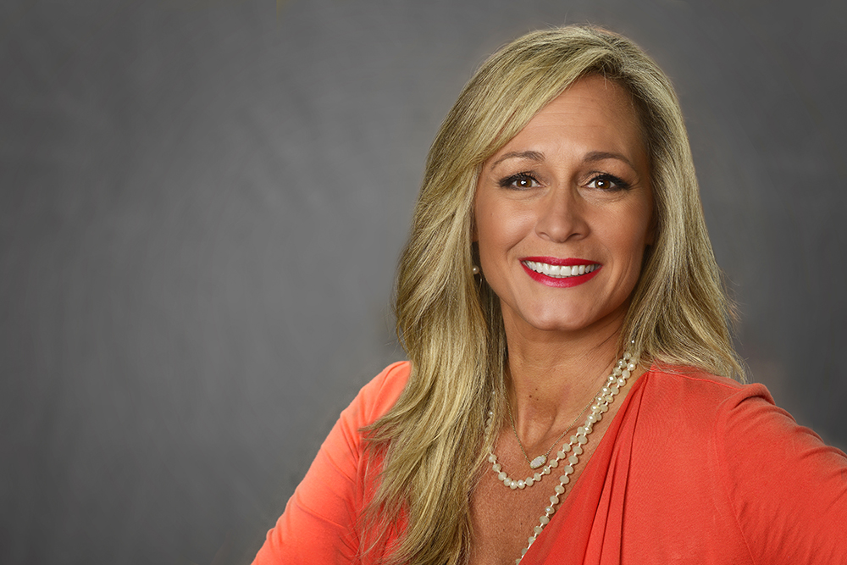
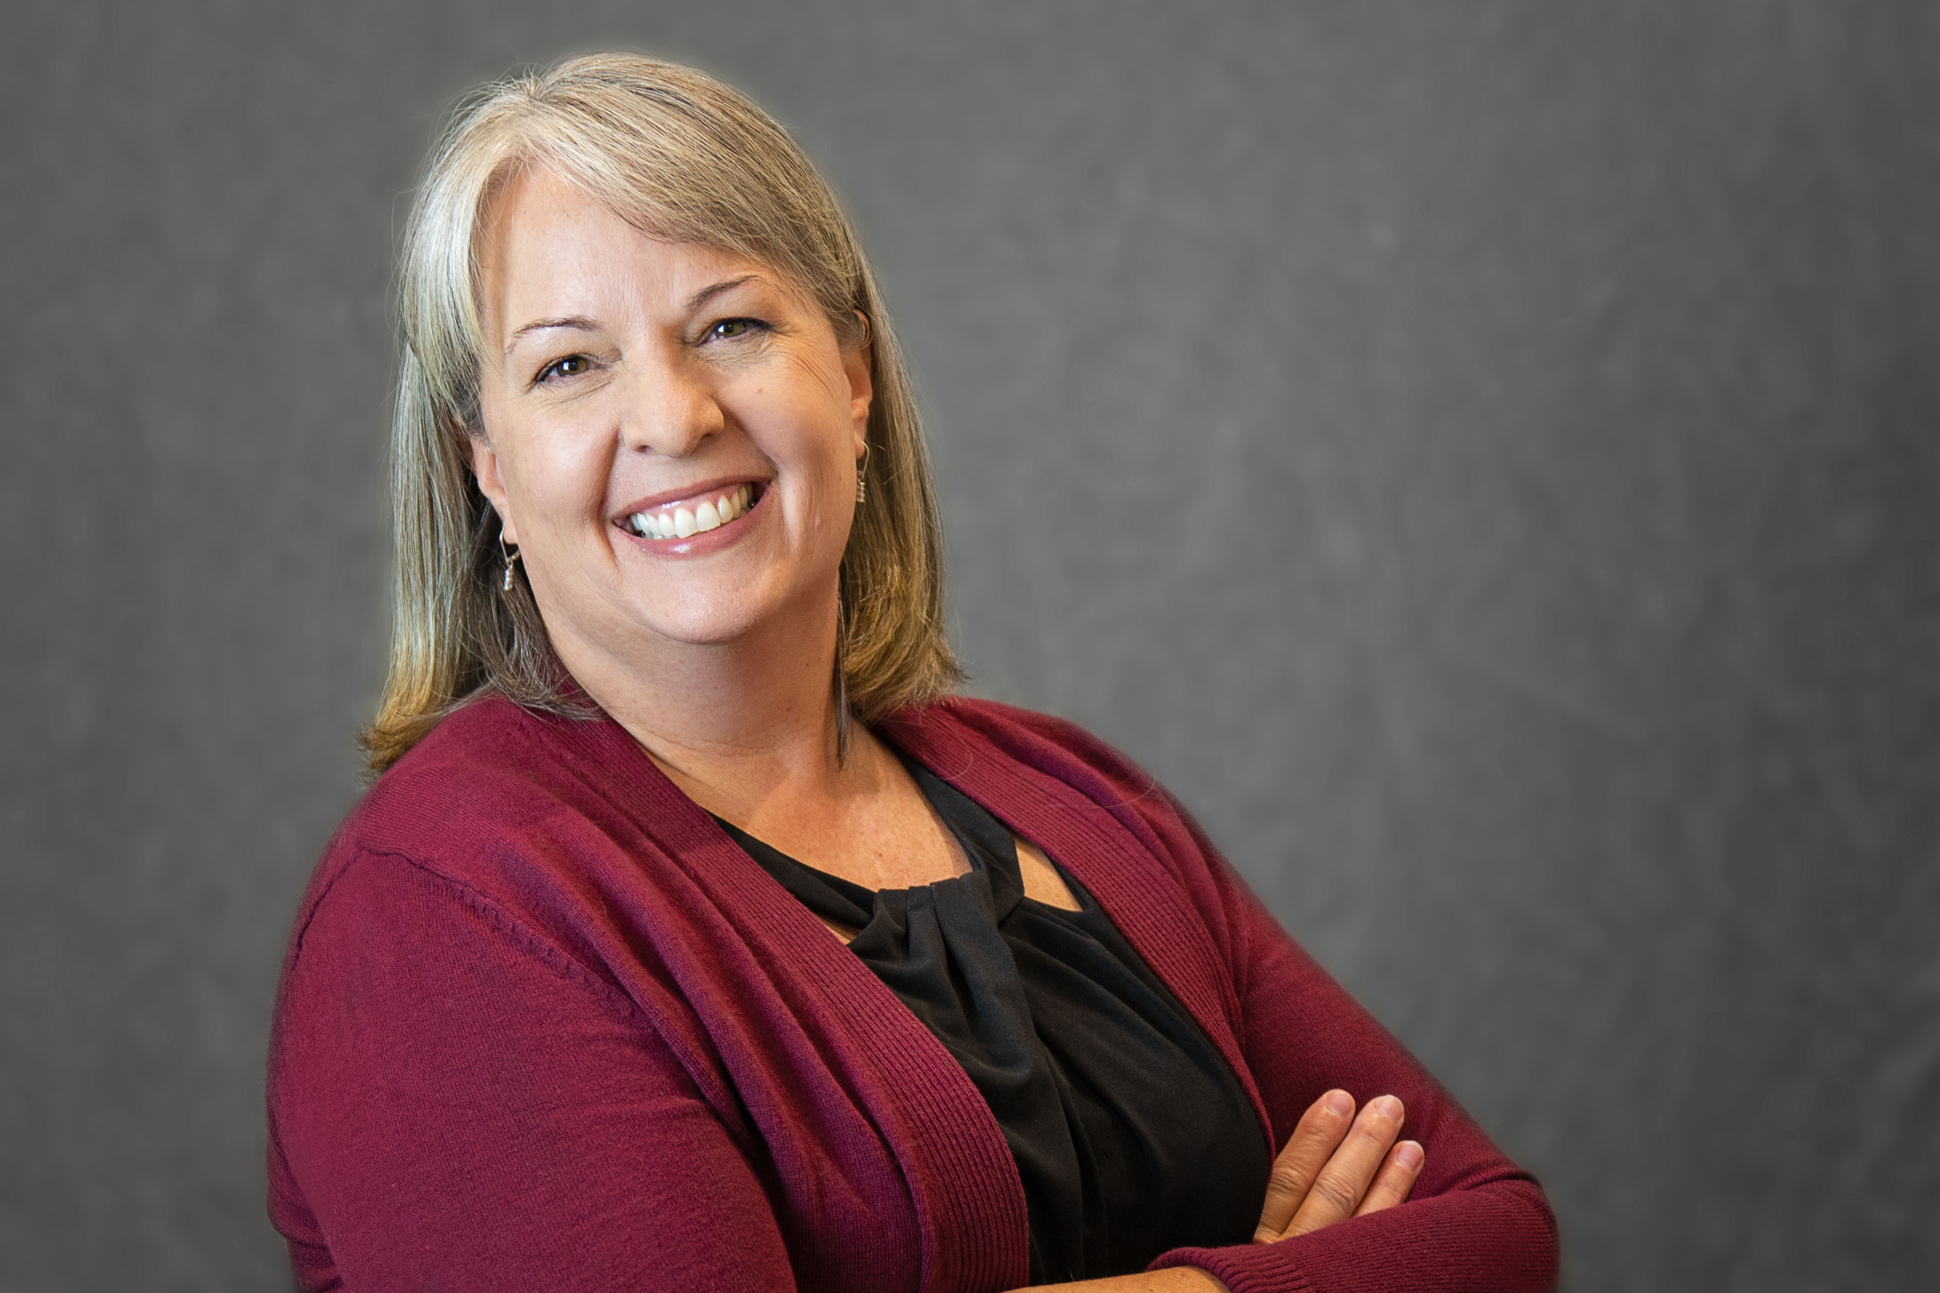

KRONOS AND TIMEKEEPING
Jeff Urstadt, Brandy Tucker, and Kelly Steele
University Human Resources, Payroll
August 2, 2023, 10:30-11:20 a.m. and 1-1:50 p.m., Oak Room I

Slide 2
Kronos/ Timekeeping
Auburn University HR Conference
Everyday Excellence

Slide 3

Non-Exempt EmployeeS
Non-exempt employees must record actual hours worked as well as paid and unpaid absences.
Time should be recorded in Kronos via the time clock or time stamp. Time can be submitted on paper (only when Kronos isn’t an option) and must reflect actual starting and stopping times of work as opposed to established work schedule.
Non-Exempt employees are responsible for punching in and out on the timeclock. With the understanding there may be the occasional missed punch, supervisors should not be adjusting timesheets for their employees regularly.
Supervisors have the responsibility and obligation to assure that all working hours and leave hours are properly recorded.
All leave must be requested, approved, and logged in Kronos.

Slide 4
Exempt EmployeeS
Exempt employees are monthly salaried employees.
Exempt employees are not eligible for overtime pay or compensatory time off.
AU requires exempt employees to turn in leave if hours worked in a week are less than 40.
All leave must be requested, approved, and logged in Kronos.

Slide 5
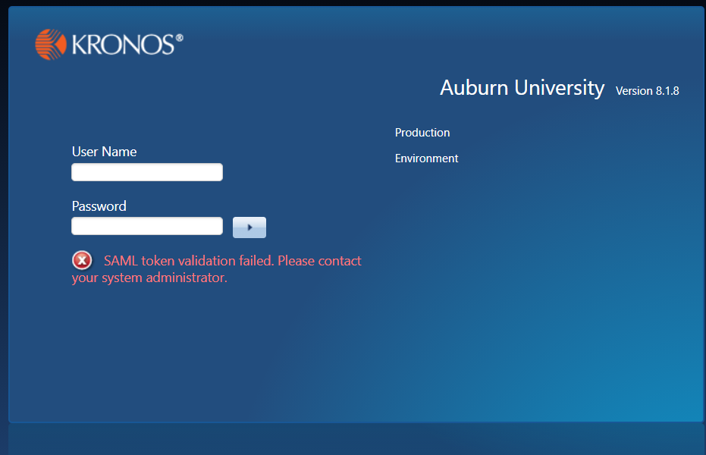
Log on to Kronos with your Auburn user ID and password.
autime.auburn.edu

Slide 6
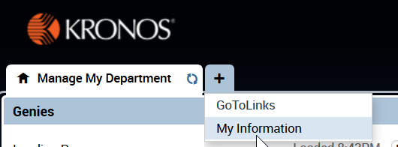


TigerTime Features (Managers and Timekeepers)
1
My Information Widget - Relocated for Managers and Timekeepers
Click + sign -> My Information
My Information is available to view your timecard punches, approvals, pay code edits, and totals.
Employees are able to view your timecard for specific pay period (current, previous, next) or a range of dates
Always click the 2 parallel lines and arrow to “Show or Hide More Content” to view timecard totals

Slide 7
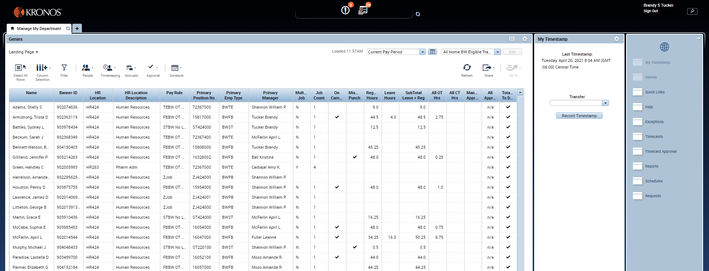

Slide 8
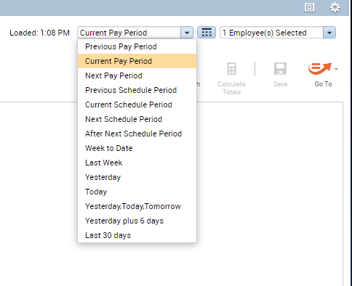
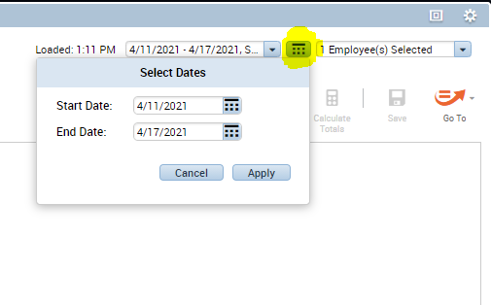
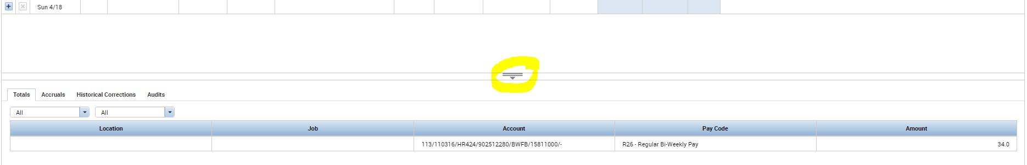

Slide 9
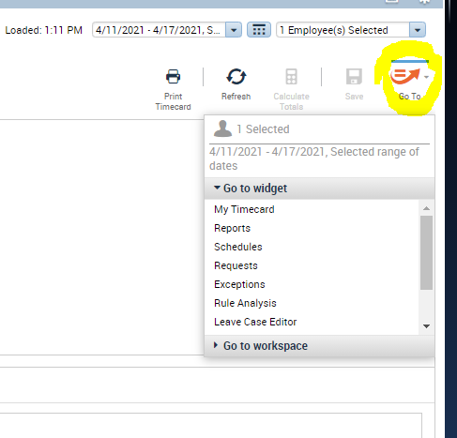

Slide 10
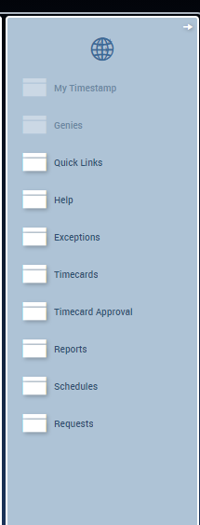

Slide 11
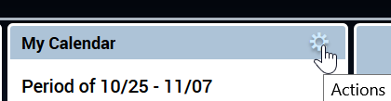
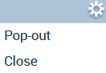
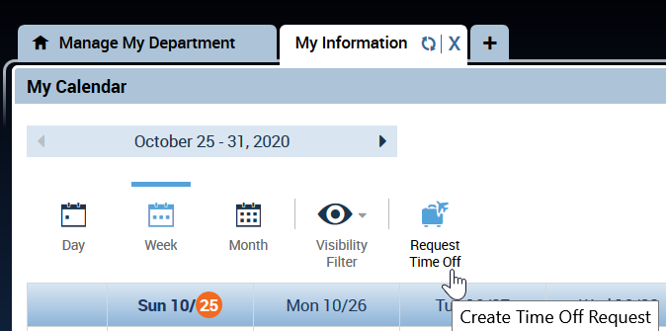
TigerTime Features (Managers and Timekeepers)
2
My Calendar Widget and Request Time Off - Relocated for Managers and Timekeepers
Click + sign ->
My Information
A second widget is available –>
My Calendar
Click on the Gear Icon to “pop out” the widget into full view
Request Time Off

Slide 12
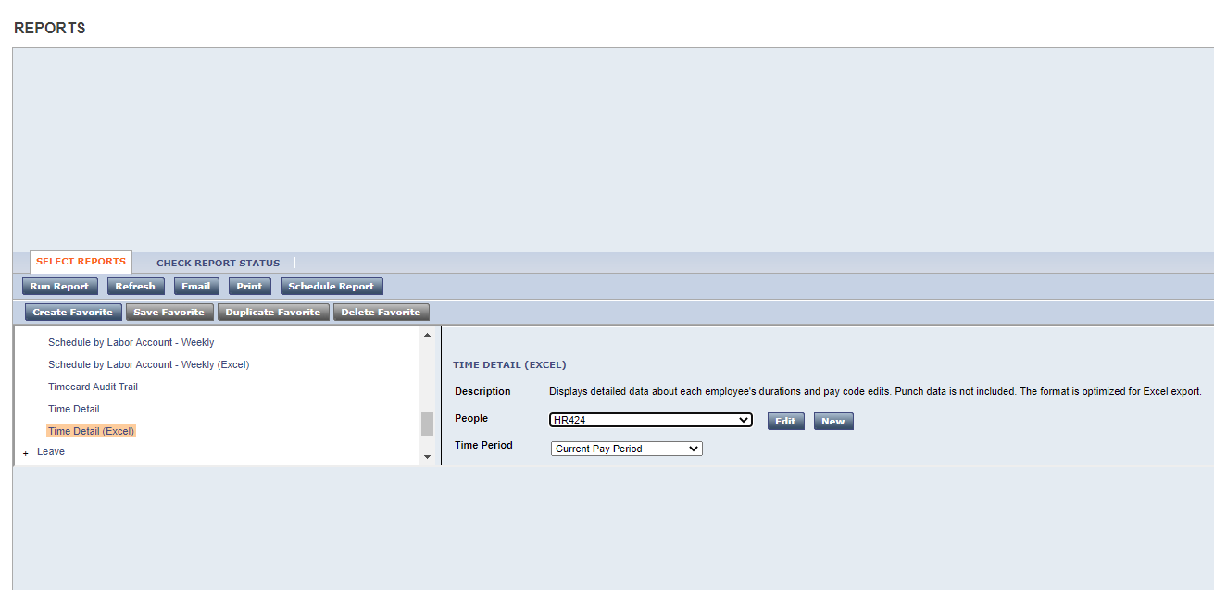

Slide 13
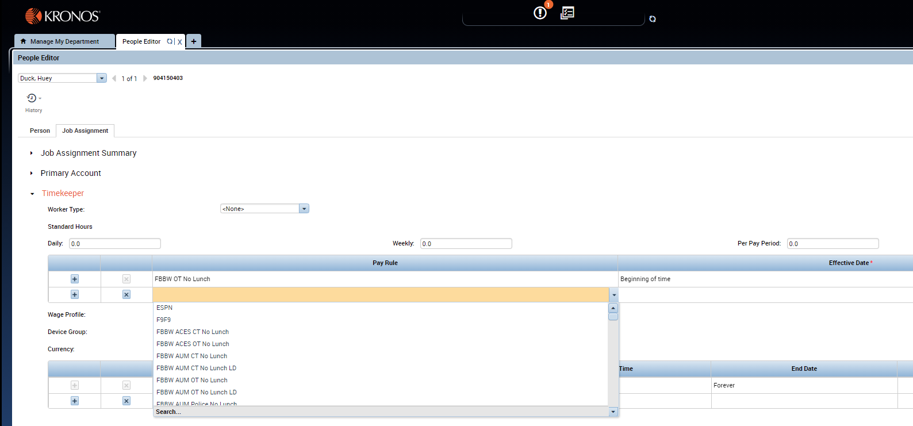

Slide 14
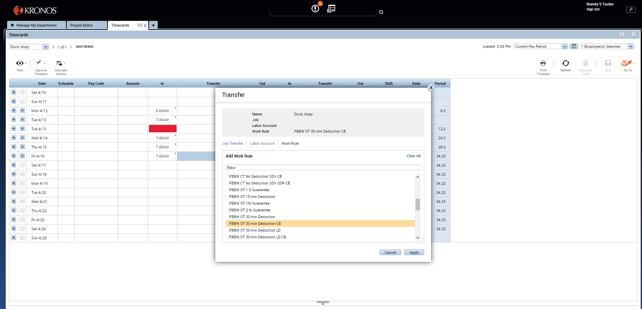

Slide 15
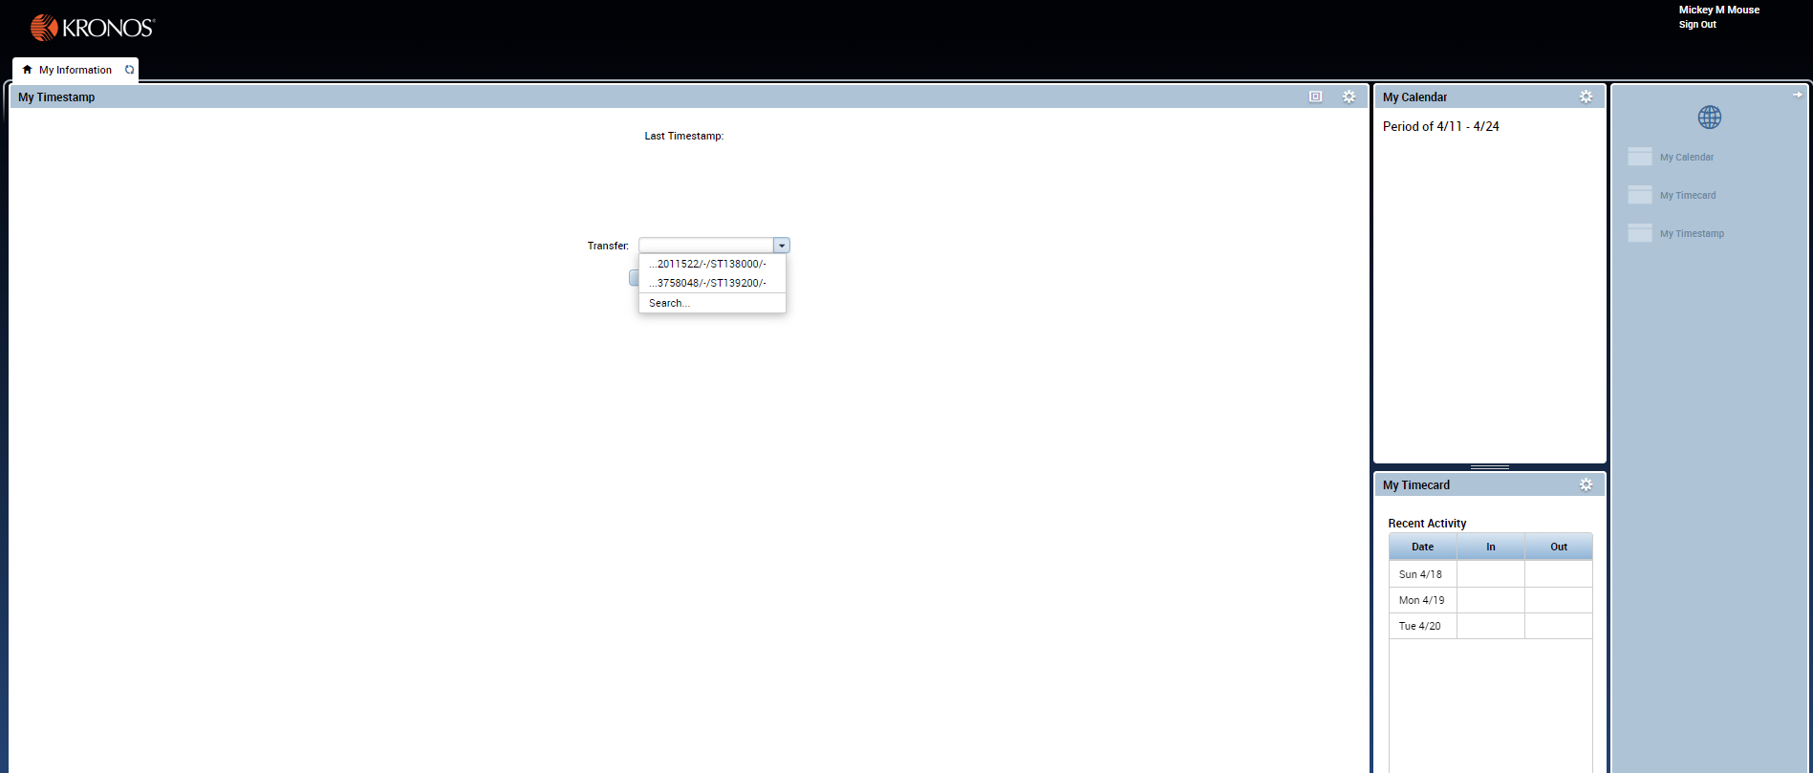
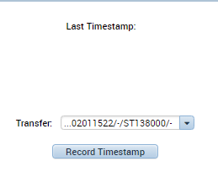

Slide 16
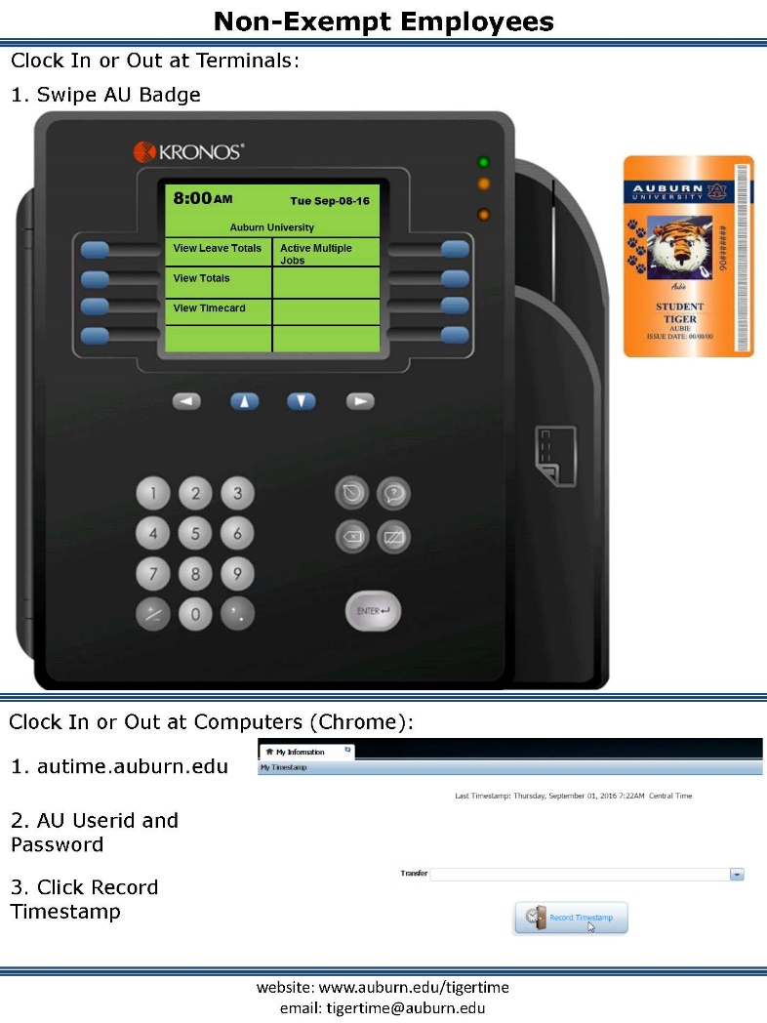

Slide 17


Slide 18
Time Off Request
http://www.auburn.edu/administration/human_resources/tigertime_files/time-off-emp-ne.mp4
Time Off Request- Manager Role
http://www.auburn.edu/administration/human_resources/tigertime_files/time-off-mgr.mp4

Slide 19
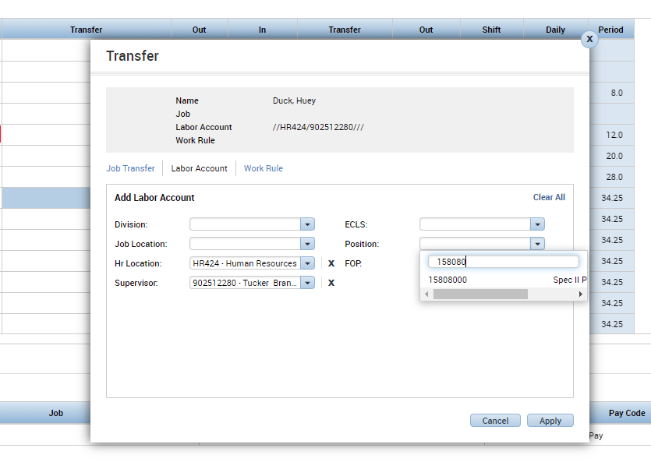

Slide 20
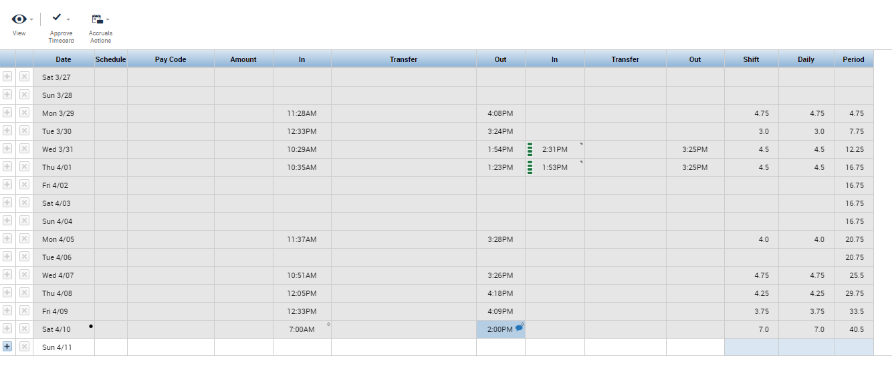

Slide 21
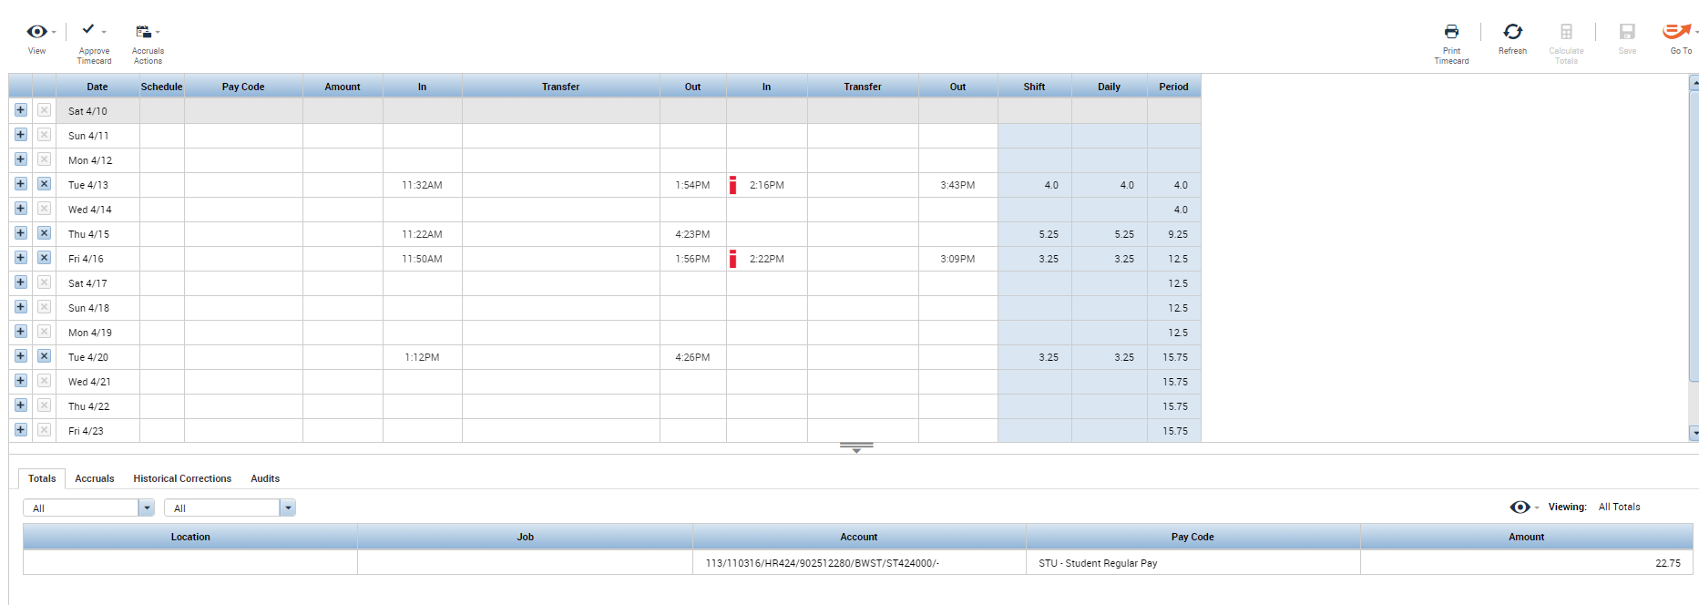

Slide 22
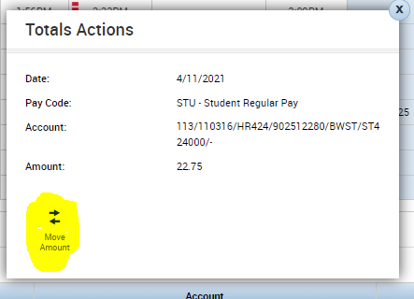
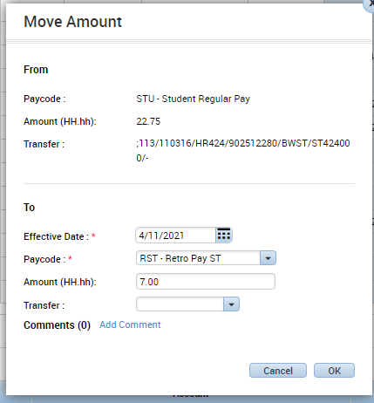

Slide 23
LATE PAY FOR BIWEEKLY PAID EMPLOYEES
Time worked or leave not paid in the regular scheduled pay cycle should be entered as a historical edit in Kronos and will be paid the next scheduled pay cycle.
Late pay forms for biweekly employees should only be submitted when there is a rate change for the previous pay period.
Off-cycle manual pays are not typically processed for biweekly employees. Only if the employee or job is terminated.

Slide 24
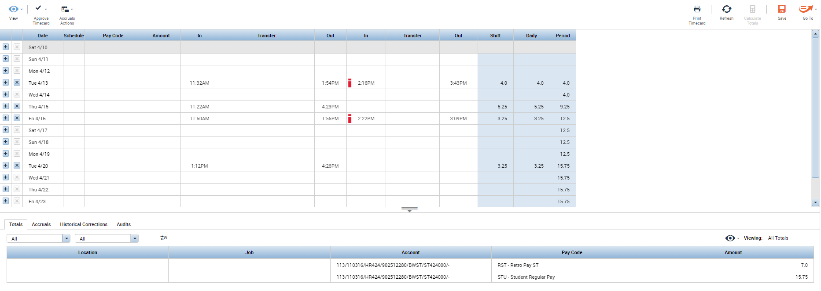

Slide 25
OVERTIME
The federal overtime provisions in the Fair Labor Standard Act (FLSA) requires hours worked over 40 in a workweek are paid at a rate not less than time and one-half times their regular rate of pay.
Averaging of hours over two or more weeks is not permitted. Normally, overtime pay earned in a particular workweek must be paid on the regular pay day for the pay period in which the wages were earned.

Slide 26
COMPENSATORY TIME
As a public employer, the University has the option of providing compensatory time off in lieu of the earned overtime premium pay for hours worked over 40 in a workweek.
Compensatory time off must be at a rate not less than one and one-half hours for each overtime hour worked.
The FLSA regulations allow us to enter into an agreement to offer compensatory time off to individual employees, if an agreement is in place prior to the performance of work.
  Overtime and compensatory time cannot be alternated back and forth once the agreement is in place.

Slide 27
ADDITIONAL RESOURCES
One-on-one 30-minute Kronos training hosted by Kelly Steele: aub.ie/kellykronos
US502E Kronos/TigerTime "How Do I Take Leave at Auburn? (self-paced) : https://learningmanager.adobe.com/app/learner?accountId=114654#/course/6761282
Tiger Time training and job aids: https://auburn.edu/administration/human_resources/tigertime.php

Slide 28
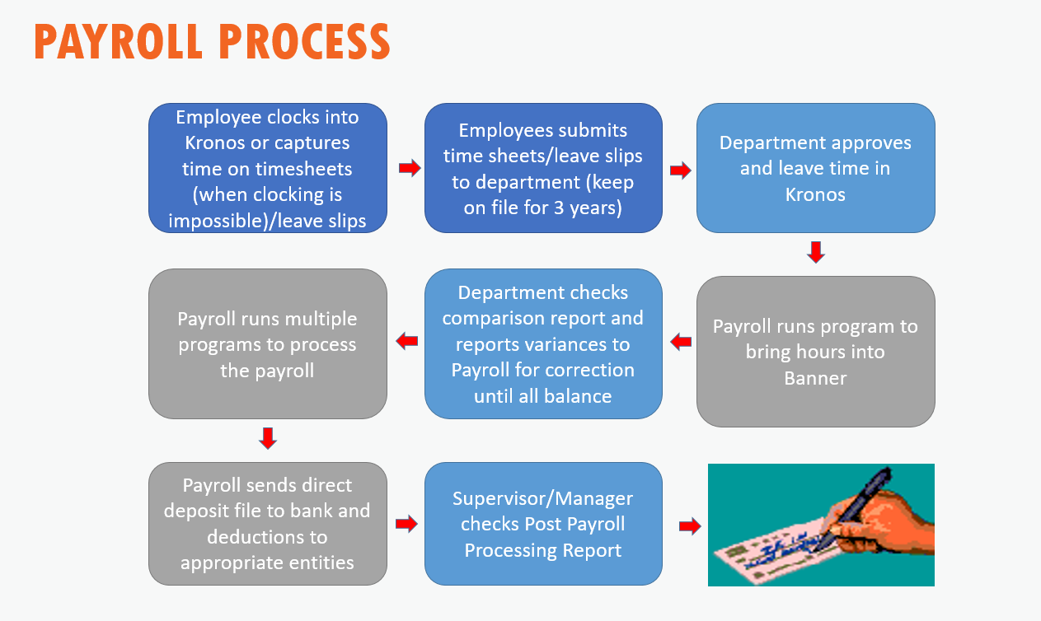

Slide 29
OUR CONTACT INFORMATION
Jeffrey Urstadt Kelly Steele Brandy Tucker
Manager, Payroll Sr. Payroll & Benefits Spec. Assistant Manager, Payroll
334-844-1787 334-844-1788 334-844-1783
jsu0003@auburn.edu kws0023@auburn.edu bst0005@auburn.edu
Payroll and Employee Benefits
AU Human Resources
Email: payroll@auburn.edu
1550 East Glenn Avenue
Auburn, AL 36849
www.auburn.edu/hr

Slide 30
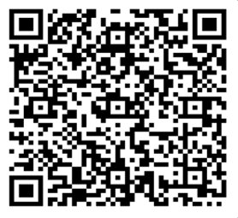
Thank you for attending!
We would love your feedback. Please scan the QR code to fill out a feedback form.

