Slide 1



AU Performance Management
Past, Present, Future
UHR Conference
2 Aug 2023

Slide 2
What is Performance Management?
The process of maintaining or improving employee job performance through the use of performance assessment tools, coaching and counseling as well as providing continuous feedback.
- Society for Human Resource Management

Slide 3
Why Performance Management at Auburn?
Communication
Development
Growth
Organizational/Departmental Goals
Teamwork
Recognize, Reward, Remediate
Policy

Slide 4
Auburn Policy
2022-23 Merit Increase and Promotional Increase Guidelines
A higher-performing employee should receive a larger percentage merit increase than a lower-performing employee.
All merit increases are required to be substantiated by employee performance documentation, typically the completed annual performance review.
AU Salary Administration Policy
In order to attract, retain, and motivate well-qualified employees, the objectives of the University's salary administration program are to:
  Set salaries that are equitable among
  all employees considering each individual's responsibilities; knowledge, skills and abilities; and performance
  in the work-place.

Slide 5
AU Performance Management
< < < Past

Slide 6


Slide 7
Pre-2017 AU Supervisor’s PM Toolkit
Job Proficiency:
Select 3-7 job duties that describe the employee’s most important activities/goals.
What if priorities change?
What about the non-rated job functions?
Rubric:
Leading performance
Strong performance
Building performance
Improvement essential
No middle ground
for meeting expectations
Vague measures
PM Workbook:
Included a log for employees to track job accomplishments throughout the year
What was appraised?
Soft skill behaviors (the how)
Hard skill behaviors (the what)

Slide 8
2018: Template with no vendor
Good:
  Regularly scheduled meetings (1v1)
  Documented goals & timelines
  Easy-to-use form
  (But we changed it)
  Constructive feedback
  Self-evaluation
Bad:
Paper form (not electronic)
Unclear expectations/goals
Confusing form
Subjective
Not merit-based, inequities
Rating choices
Timeline
(May evaluation | October merit pay)
Other (Improve):
Make the process and
new form electronic
Make reviews quarterly
Train on the process
Identify clear standards
for fairness
Add a “Meets Expectations” rating option
Add Supervisor evaluation
Real-time feedback
Merit pay transparency
  How is it determined?

Slide 9
2019-2022: Multi-page template; PeopleAdmin
2019-20
2020-21
2022-23
”New” paper form still being used while PeopleAdmin system is being built
PeopleAdmin introduced (not user-friendly)
Supervisors given option to submit “paper form” or PeopleAdmin.
PeopleAdmin contract cancelled.
Utilized “paper form” submissions only.

Slide 10
AU Performance Management
• • • Present

Slide 11
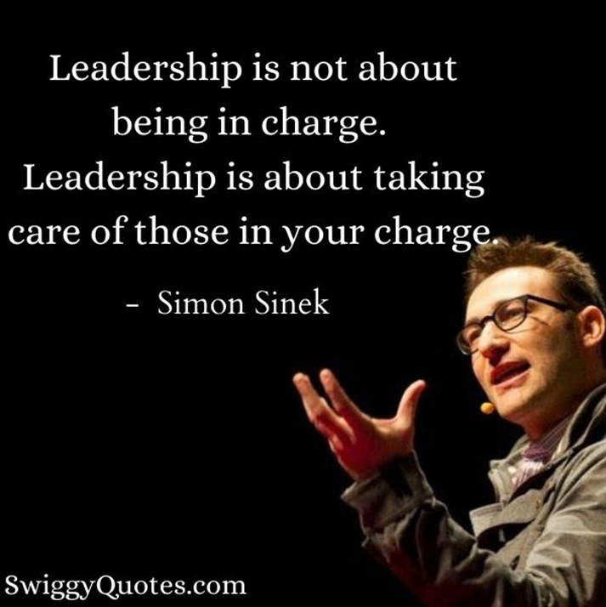
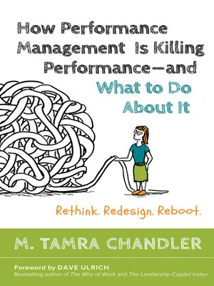

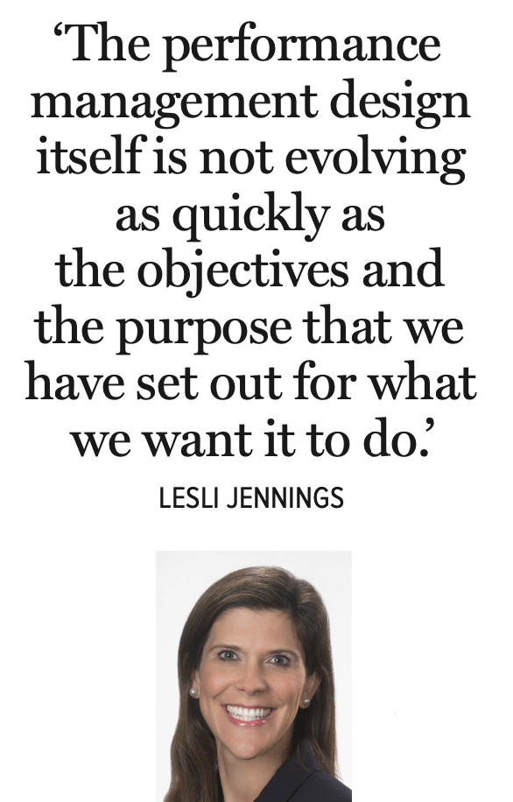
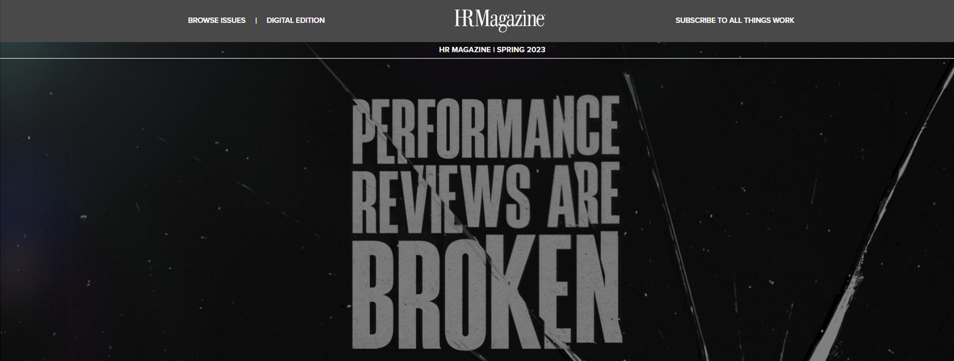
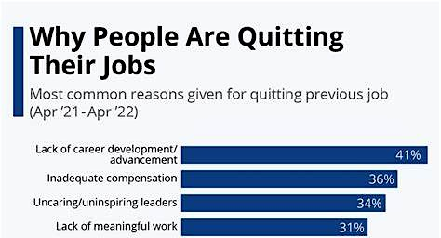

Slide 12
Are statements like this a trend?
Is there anything we can do to encourage supervisors to engage with this system? …my supervisor has mostly treated PM as a chore to do once a year. I will soon be leaving my position, but I don’t want others to end up in a similar situation. ​

Slide 13
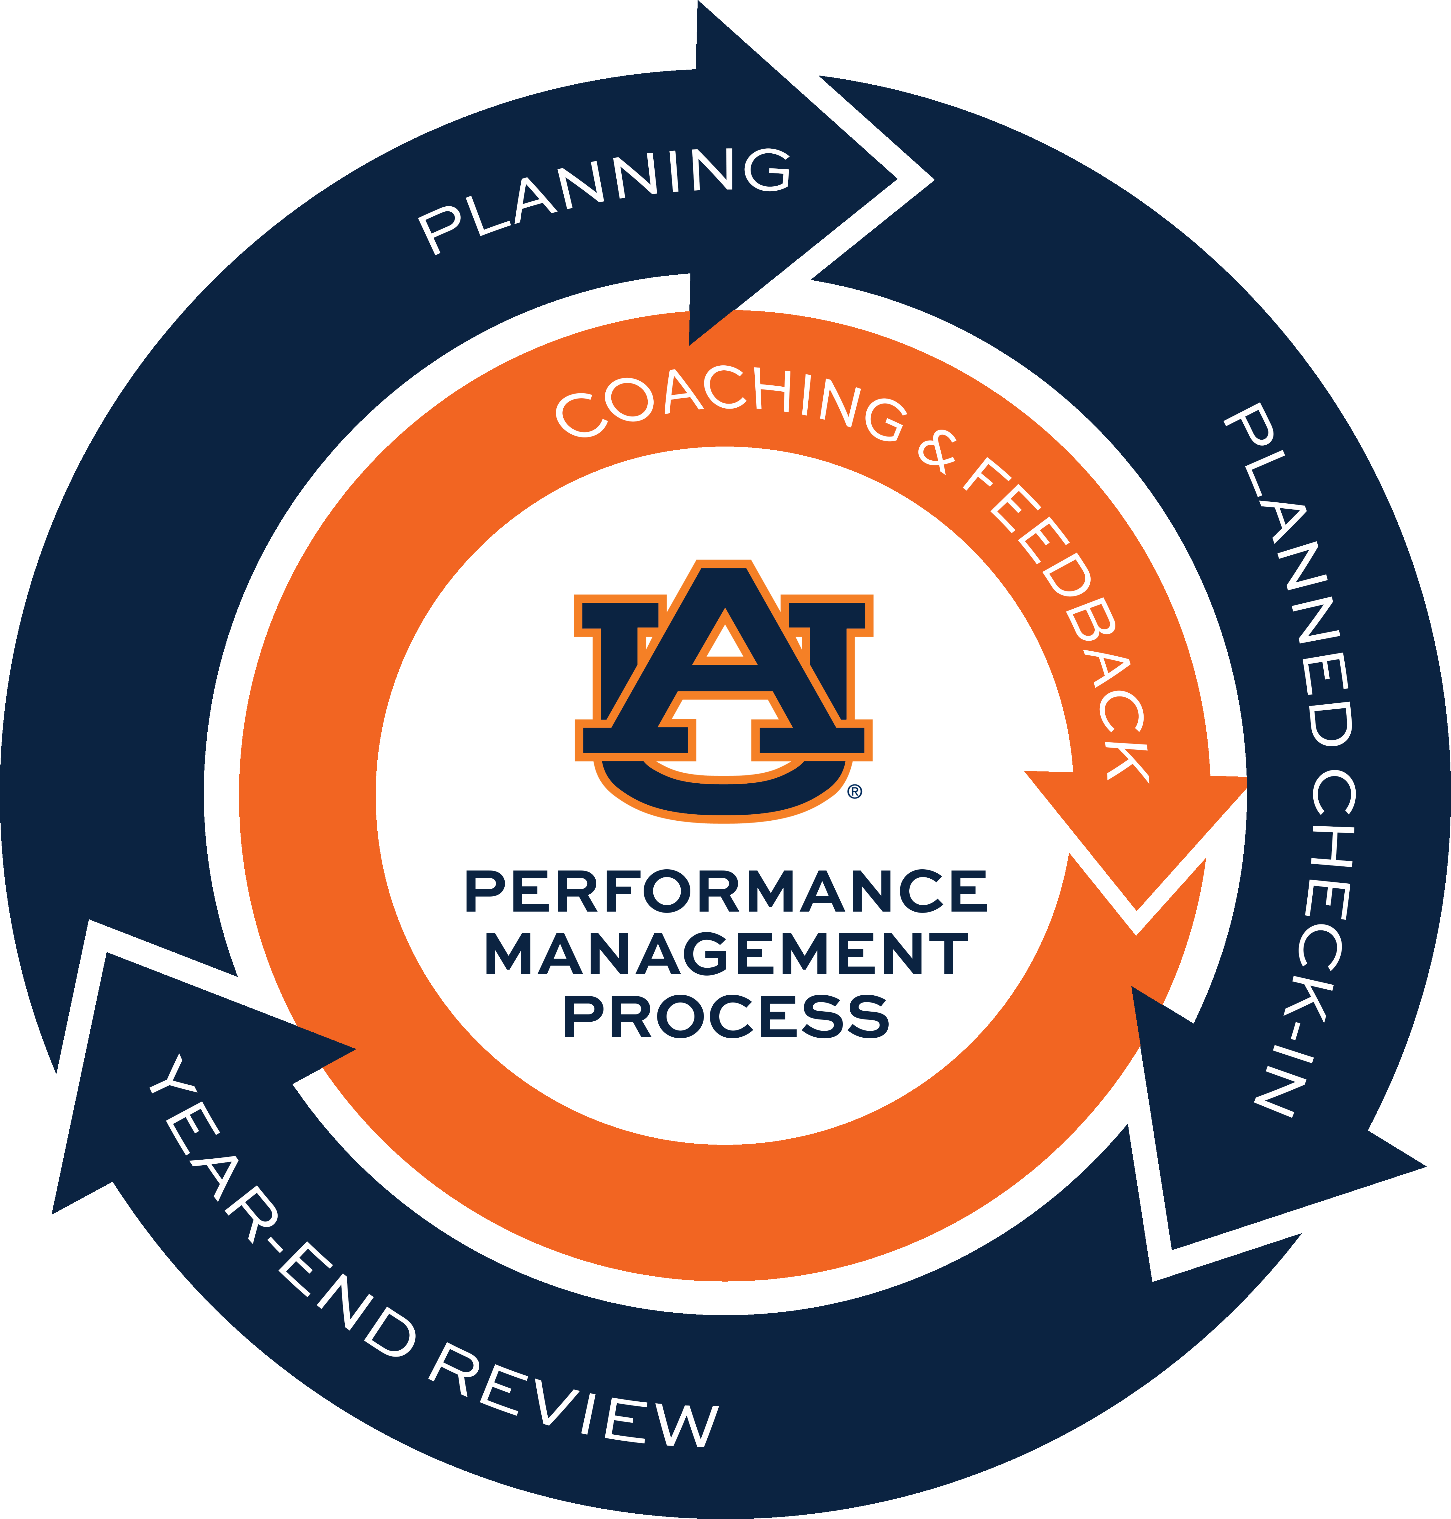
Current Process
Performance management:
  A basic leadership responsibility
  Supervisors should develop people
  to their highest potential
  Regular dialogue (goals, growth)
Performance review:
  The annual appraisal
  Merit pay determination
Employee development:
  The opportunity for personal
  and professional growth
  (HRD offers dozens of classes for free)

Slide 14
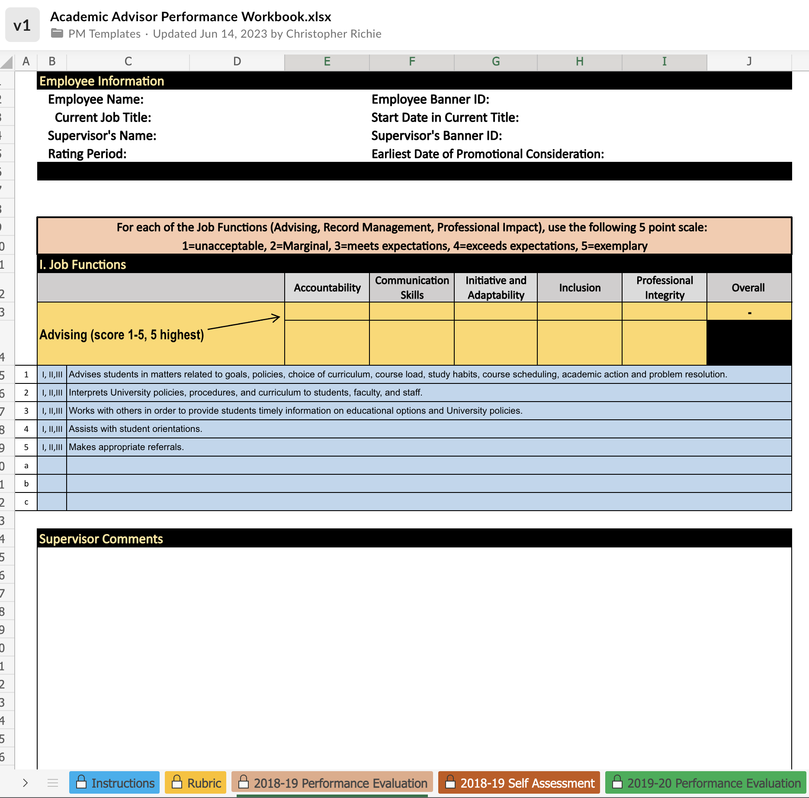
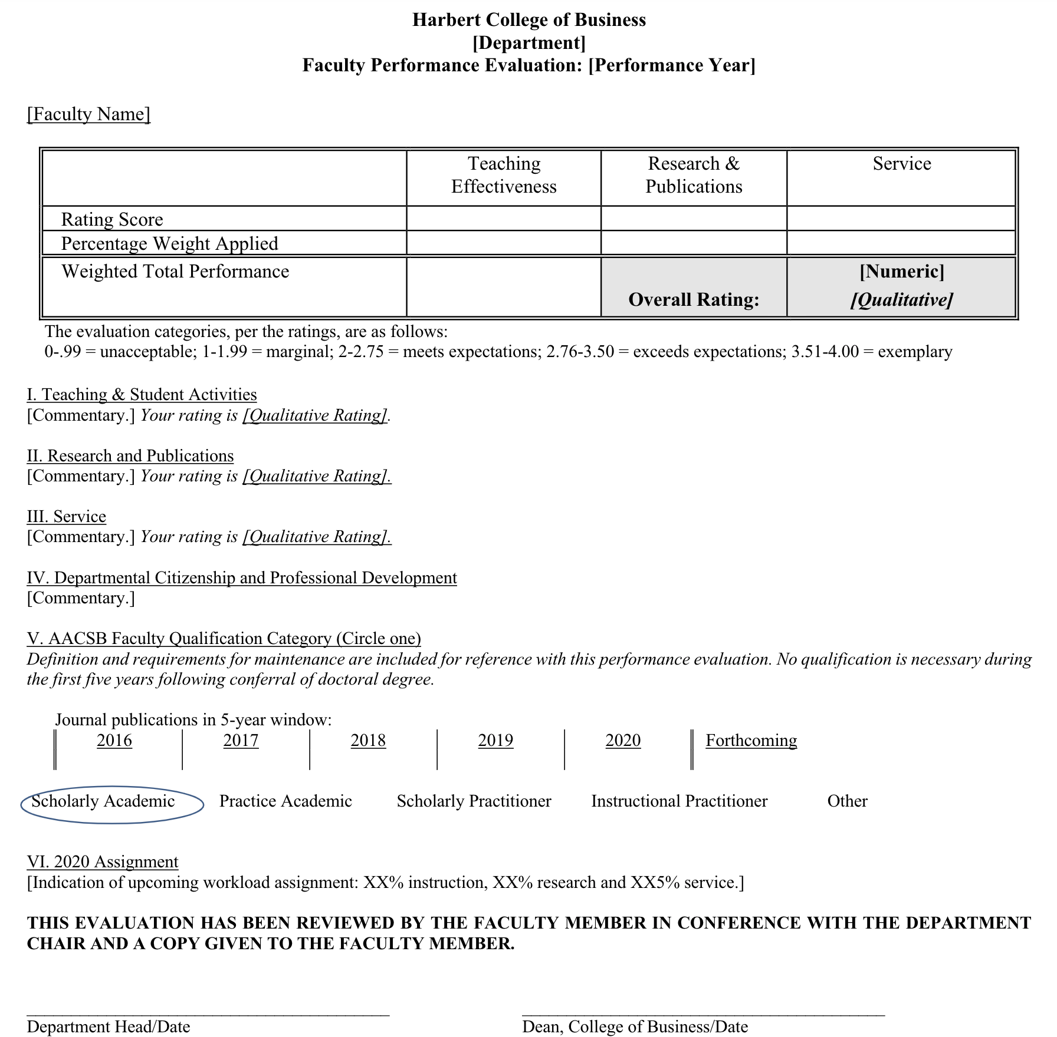
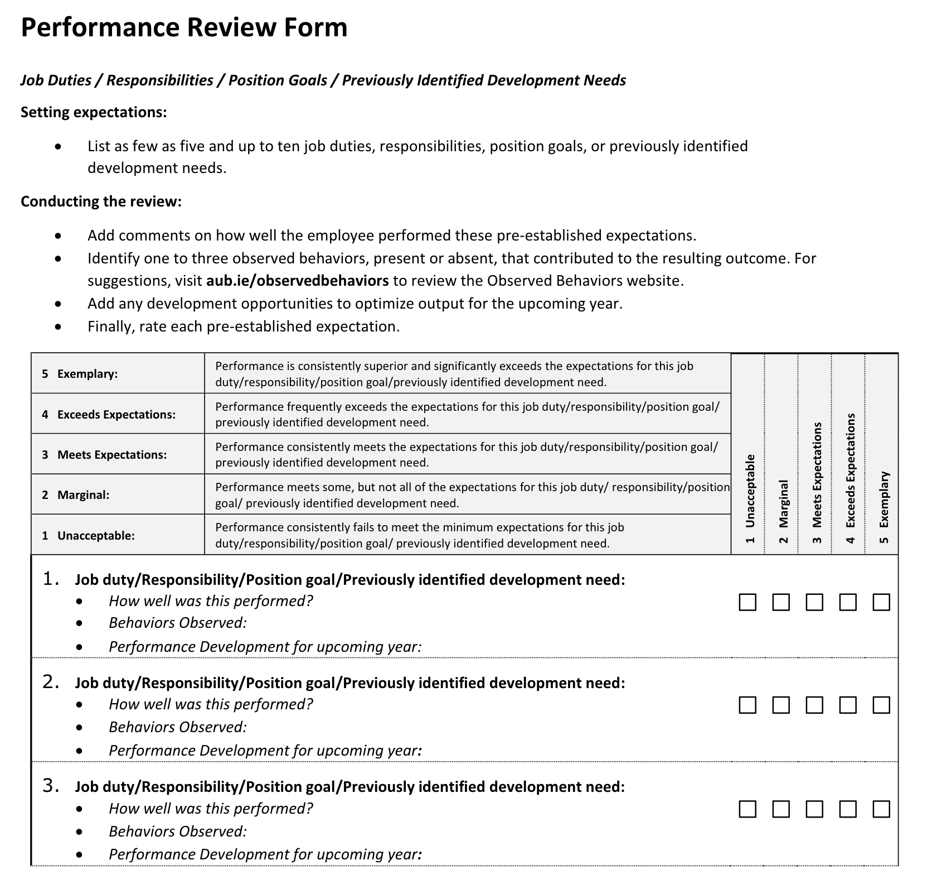
Where we are: Current Templates
Academic Advisors Performance Workbook (Jun-May)
Faculty Performance Evaluation
(Calendar year)
A&P and University Staff Performance Review Form (Jun-May)
…and possibly others floating around out there.

Slide 15









Working Group Team
22 Members representing 11 Colleges/Units

Slide 16
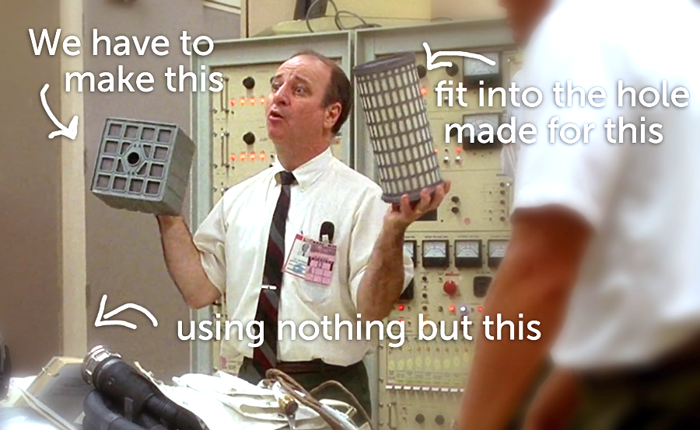

Slide 17
AU Performance Management
> > > Future

Slide 18


Slide 19
Qualtrics quick-look analysis as of July 25
Other take-aways:
  37%: Coaching & Feedback is
  not happening
  39%: Conversations are not happening
  94%: Both job functions and behaviors are important
  97%: Supervisors should be appraised on leadership
1,580 / 33% have taken the survey
Most important part of process:
  Coaching & Feedback
  Job Clarity
  Communication | Appraisal
  Planning/Goal Setting

Slide 20
Most Desired Behaviors / Values
Job functions | Technical:
What is being done
  Proficiency (Maybe knowledge)
  Customer Service
  Accountability
  Commitment to Excellence
  Leadership (Supervisors)
Values & Behaviors | Interpersonal:
How it is being done
  Teamwork
  Communication
  Integrity/Honesty
  Attitude
  Initiative
1
2
3
Most popular fill-in:
Innovation | Creativity | Work Ethic | Flexibility/Adaptable to change

Slide 21
Partnering For Performance
Auburn’s Performance Management & Review Process
1
We believe performance management is a basic leadership responsibility in which we develop people to their highest potential.
2
3

Slide 22
Partnering For Performance
Auburn’s Performance Management & Review Process
Performance Management
Developing capability and
opportunities to grow
1
2
We believe performance management is a basic leadership responsibility in which we develop people to their highest potential.
3

Slide 23
Partnering For Performance
Auburn’s Performance Management & Review Process
Performance Review
Performance is appraised and
a rating is assigned
1
We believe performance management is a basic leadership responsibility in which we develop people to their highest potential.
2
3

Slide 24
Partnering For Performance
Auburn’s Performance Management & Review Process
Performance Management
Developing capability and
opportunities to grow
1
Development
HRD provides classes to help employees either overcome noted deficiencies or
to grow personally and professionally…
to achieve their full potential.
We believe performance management is a basic leadership responsibility in which we develop people to their highest potential.
2
3

Slide 25
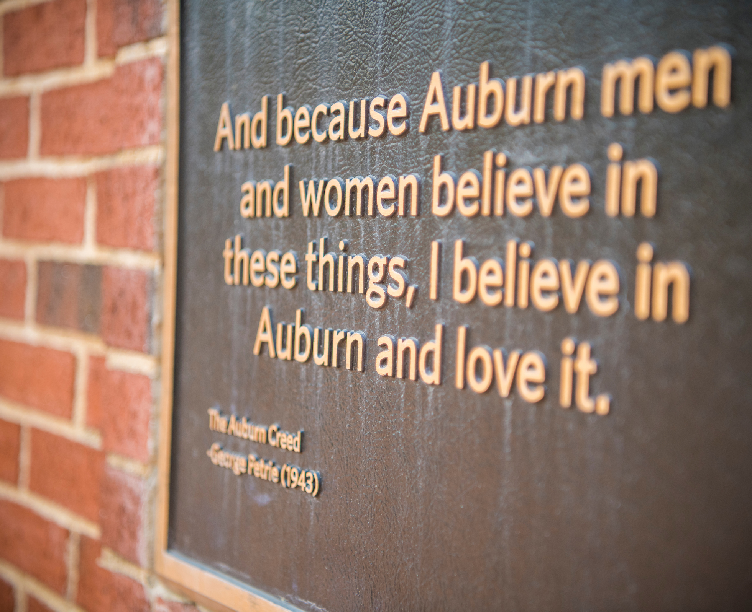
Valuable Behaviors
Auburn is a values-based institution
Values embodied over time creates
a culture (of excellence)
It is a focus on what we do
and how we do it
Auburn’s values can guide how supervisors coach, appraise, and develop their employees (family)
  Human touch, work ethic, honesty, education, development, compliance
1
2
3

Slide 26
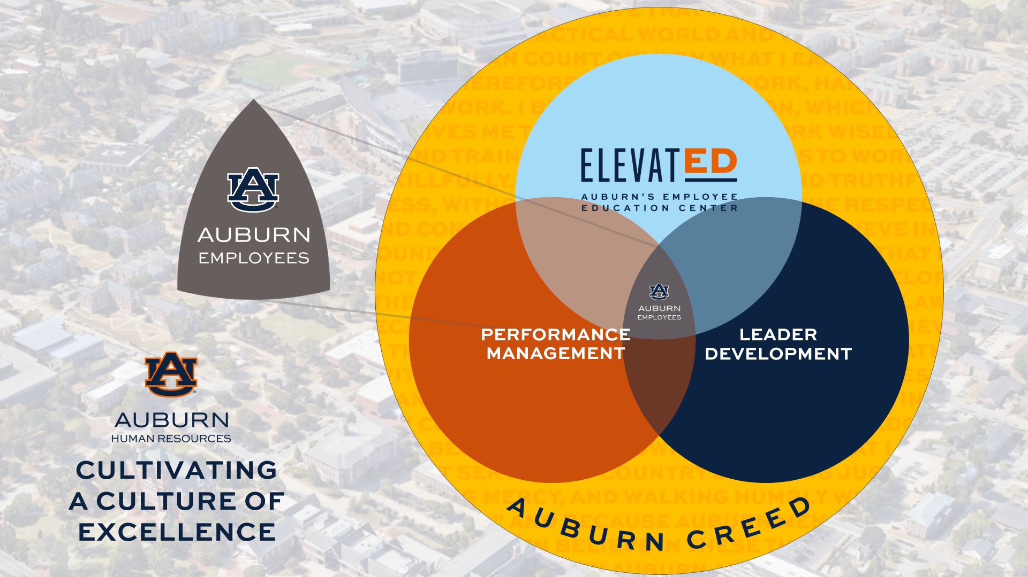
Potential Options for
Performance Standards
The Auburn family believes in strong
work ethic, education, honesty, sound body/mind, compliance, and the
human touch.​
These foundational values can be leveraged to guide coaching,
evaluating and developing our employees.
Work ethic​
  Job proficiency and Knowledge​
  Professionalism and soft skills​
Education ​
  Professional Development ​
Honesty​
  Integrity ​
Sound Body/Mind​
  Commitment to excellence​
  Personal Development​
Compliance​
  Adheres to AU and Department/unit policy​
Human Touch​
  Teamwork / Inclusion​
  Leadership​
​

Slide 27
Questions
Chris Richie, Director, Human Resource Development | Contact: hrddept@auburn.edu
The Auburn family believes in strong
work ethic, education, honesty, sound body/mind, compliance, and the
human touch.​
These foundational values can be leveraged to guide coaching,
evaluating and developing our employees.
Work ethic​
  Job proficiency and Knowledge​
  Professionalism and soft skills​
Education ​
  Professional Development ​
Honesty​
  Integrity ​
Sound Body/Mind​
  Commitment to excellence​
  Personal Development​
Compliance​
  Adheres to AU and Department/unit policy​
Human Touch​
  Teamwork / Inclusion​
  Leadership​
​

