Slide 1
Bridging Generations with Emotional Intelligence: A Guide for the Modern Workplace
Loren Winn & Moriah Kent

Slide 2
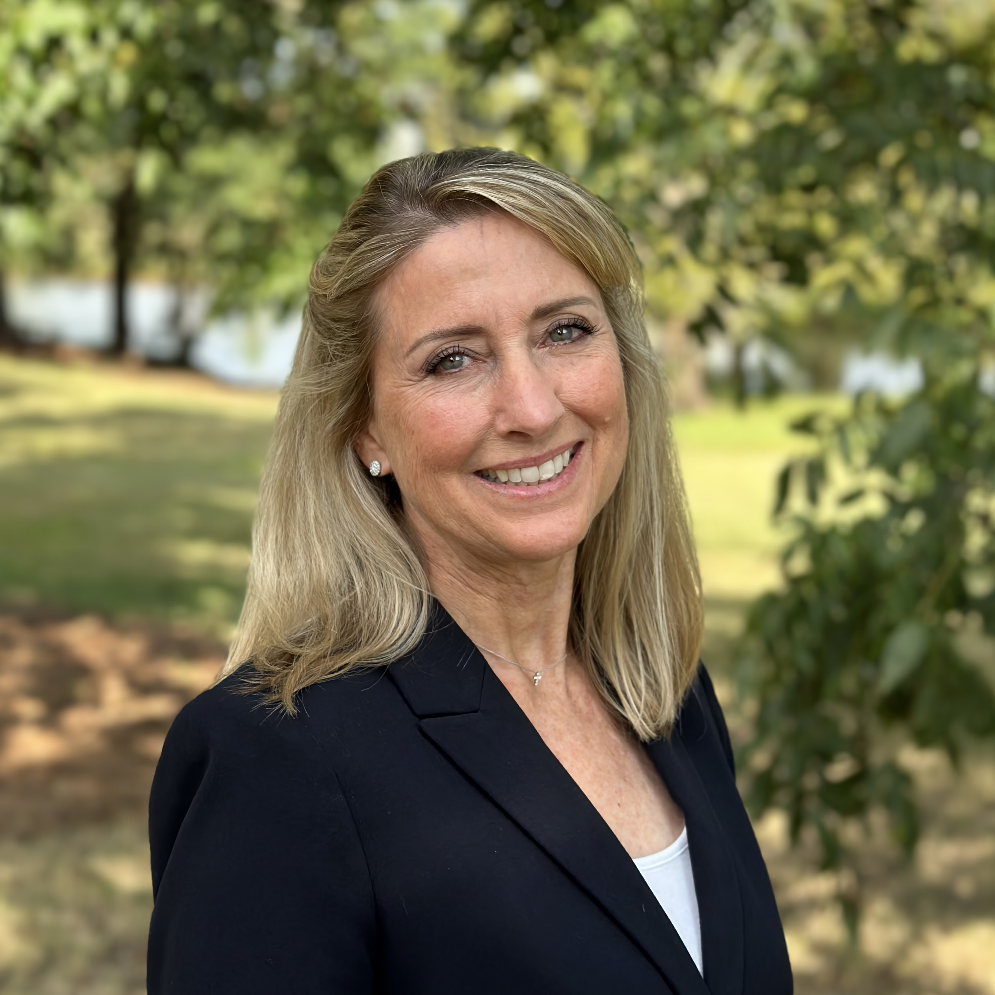
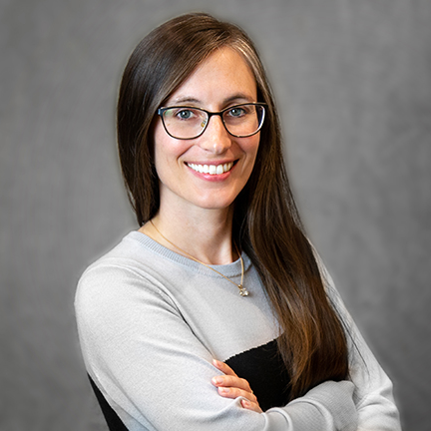
Who are we?
Loren Winn, Division Director Facilities Human Resources
20+ years Human Resources Management across multiple industries
Originally from San Diego, California
  B.S. Business Administration
  M.S. Management/Human Resource Management
  SPHR/SHRM SCP
Moriah Kent, Instructional Designer HRD​
10 years ESL Teacher before transiting to ID at Auburn University​
Originally from Colorado Springs, CO​
  B.A. Art History, UC Denver​
  M.A. Teaching English as a Second/Foreign Language, CSU ​

Slide 3
What’s in it for me? (WIIFMs)
A deeper understanding of generational generalizations.
Considerations for emotional intelligence to develop individualized approaches for inclusive workplaces.
Notes:
In this session, we’ll explore how emotional intelligence can bridge generational gaps in today’s work environment. The session will focus on navigating aspects of communication and collaboration across generations. Participants will be asked to reflect on and challenge generational assumptions to foster an inclusive workplace that values generational diversity.

Slide 4
Today’s Workplace
Notes:
Source: https://www.purdueglobal.edu/education-partnerships/generational-workforce-differences-infographic/​
​
As of 2022, according to a study at Purdue University, we have for the first time in history 5 generations in the workforce at once. You can see the breakdown here. And here at Auburn we work with and along side of many generations, particularly Gen-Z as our student workers and interns work with us.

Slide 5
Guess my generation!
When you were in your teens, what was popular? Think…
Music
Hair styles
Brands
T.V. shows
Movies
Restaurants
Notes:
Pick one or two and pop it in the chat or unmute and share. We’ll try and guess the generation you’re associated with.
Mine are:
Music – Britany Spears, Toxic
Hair Style – Chunky layers with blonde highlights
Brands – Abercrombie & Fitch
T.V. Shows – The Office, Friends
Movies – Love Actually, 2003
Restaurants – Chipotle
That was a great walk down memory lane!

Slide 6
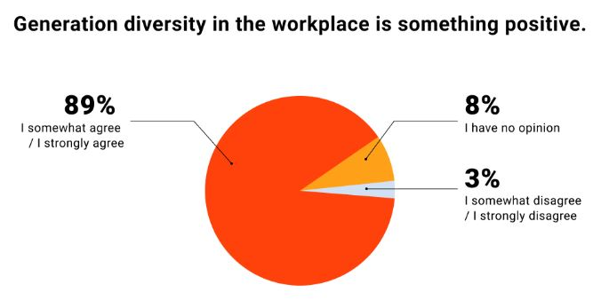
I Need Stats, Stat!
Notes:
BUT FIRST A STATISTIC!
In Live Career’s 2022 report “Different Generations in the Workplace; 2022 Study” which surveyed over 1,000 employees to look at general attitudes around the generations in the workplace, benefits and challenges, what expertise the different generations bring to the table and if age matters at all, they found that 89% of people somewhat or strongly agree that generation diversity in the workplace is something positive.

Slide 7
Generational Profiles
Disclaimer: generational context is less about age and more about common experiences by groups of people.
Things to Consider
Notes:
Disclaimer - generational context is not about age, but common experiences by groups of people.

Slide 8
Traditionalists (1925-1945)
Characteristics
  Dependable, loyal, tactful
Shaped By
  The Great Depression, WWII, Radio & Movies
World View
  Obedience over individual wants, seniority is marked by age, hierarchies are important
Values In the Workplace
  Being able to provide long-term value to their organization, respect and recognition
Notes:
Source: https://www.purdueglobal.edu/education-partnerships/generational-workforce-differences-infographic/
Go over characteristics, shaped by, and world view. Ask participants to imagine someone in their life who is this generation (professional or personal). Ask them to think about what they thing that person values in the workplace?

Slide 9
Baby Boomers (1946-1964)
Characteristics
  Optimistic, workaholics, competitive, but team-oriented
Shaped By
  The Vietnam War, Civil Rights Movement, Watergate
World View
  Sacrifice is required for success; achievement comes when you pay your dues/do the time
Values In the Workplace
  Company loyalty, teamwork and a sense of duty/responsibility, opportunities to knowledge share
Notes:
Source: https://www.purdueglobal.edu/education-partnerships/generational-workforce-differences-infographic/
Go over characteristics, shaped by, and world view. Ask participants to imagine someone in their life who is this generation (professional or personal). Ask them to think about what they thing that person values in the workplace?

Slide 10
Generation X (1965-1980)
Characteristics
  Flexible and informal, skeptical, independent
Shaped By
  The fall of the Berlin Wall, Dot-com boom, AIDS epidemic, Higher divorce rates
World View
  Quick to move if their needs aren’t being met, resistant to change if it affects their values, favors diversity in the workplace
Values In the Workplace
  Work/life balance, autonomy, putting their personal/professional needs first, diversity
Notes:
Source: https://www.purdueglobal.edu/education-partnerships/generational-workforce-differences-infographic/
Go over characteristics, shaped by, and world view. Ask participants to imagine someone in their life who is this generation (professional or personal). Ask them to think about what they thing that person values in the workplace?

Slide 11
Millennials (1981-2000)
Characteristics
  Competitive, civic-minded, open-minded, achievement-oriented
Shaped By
  Columbine, 9/11, the internet
World View
  Seeks challenges, growth and development, work/life balance, will leave an organization if they don’t like it/changes
Values In the Workplace
  Unique and purpose-driven work experiences, responsibility, the quality of their manager
Notes:
Source: https://www.purdueglobal.edu/education-partnerships/generational-workforce-differences-infographic/
Go over characteristics, shaped by, and world view. Ask participants to imagine someone in their life who is this generation (professional or personal). Ask them to think about what they thing that person values in the workplace?

Slide 12
Generation Z (2001-2020)
Characteristics
  Global, entrepreneurial, progressive, broader focus
Shaped By
  Life after 9/11, The Great Recession, technology access
World View
  Self-identify as addicted to technology, independent and individual, innovative
Values In the Workplace
  Opportunities for creativity, individuality, and personalization and diversity, immediate feedback
Notes:
Source: https://www.purdueglobal.edu/education-partnerships/generational-workforce-differences-infographic/
Go over characteristics, shaped by, and world view. Ask participants to imagine someone in their life who is this generation (professional or personal). Ask them to think about what they thing that person values in the workplace?

Slide 13
The individual
Moving from the Generations to the Individual

Slide 14

Moving from the Generations to the Individual
Understanding Generational Differences
Limitations of Generational Labels
Challenges in Employee Management
Emphasizing Individuality
Notes:
Moriah's insights remind us that while generational traits can guide us, they often oversimplify. It's crucial to see beyond stereotypes and manage each employee as a unique individual.
Moriah has shown us the importance of understanding generational differences… the characteristics of Baby Boomers, Millennials, Gen Z etc…
However, this can’t be the end point – while these characteristics, in some cases, are accurate reflections in their representations of the people in these generations AND can be helpful in understanding their broad interests and desires, they are also oversimplifications, general assumptions, and in some circumstances stereotypes.
You may have heard comments about how the Baby Boomer generation is characterized by hard work and the term work-acholic is attributed to this generation or that Generation X is known as the “lost generation” and the term “Latch-key” is attributed to this generation or even how millennials are the “everybody gets a ribbon” generation, and on and on each generational group with their own set of oversimplifications…. Or assumptions.
Which can make it difficult to apply this knowledge in managing our employees… WHY?.... because we are not managing generations, we are managing individuals.

Slide 15
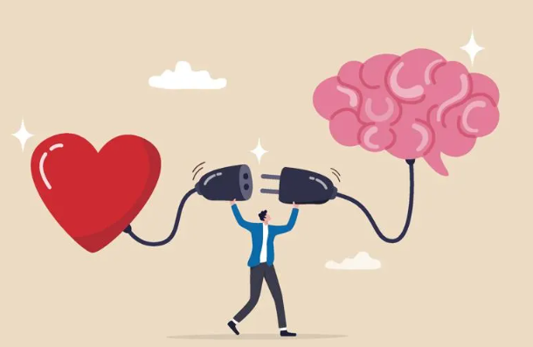
Introduction to Emotional Intelligence
Self Awareness – Recognizing Personal Emotions and their Impact
Motivation– Tailoring your approach to motivate and engage employees
Social Awareness – Understanding others’ emotions and perspectives
Relationship Management – Building and sustaining healthy relationships
Notes:
Emotional intelligence is the skill set that enables us to be aware of and manage our emotions, as well as understand and influence the emotions of others, fostering positive social interactio
Original Content:
How do we take the knowledge that the generations may have different values and goals and use that information to help us better manage our cross generational workforce?
One powerful concept that has developed over the past several years is Emotional Intelligence.
Emotional intelligence is a learned skill set that enables us to be aware of and manage our emotions, as well as understand and influence the emotions of others - - fostering positive social interactions..
Here's a brief breakdown of what emotional intelligence involves:
Self-awareness - Recognizing your own emotions and how they affect your thoughts and behavior.
Motivation – tailoring your approach to motivate and engage empoyees
Social awareness - Picking up on the emotions of others and understanding their perspectives.
Relationship management - Building and maintaining healthy relationships.
Essentially, emotional intelligence is about YOU being smart with your emotions. It allows YOU to use your feelings to your advantage and create positive outcomes in all areas of your life.

Slide 16
Emotional Intelligence: a Tool for optimizing workforce potential
understanding
Growth
limitations
Understanding Emotional Intelligence
Personal Journey of Growth
Limitations of a One-Hour Class
Notes:
Emotional Intelligence can also be used as a powerful tool for managers to effectively lead and motivate their employees.
Understanding the roll that emotional intelligence plays in the workplace can help to foster stronger relationships, will work to develop your confidence and , increases adaptability among the workforce.
But the study of emotional intelligence is also an ongoing journey… It's about how you as a leader approach challenges, deal with failure - - adapt and evolve. People learn at different paces and require individualized approaches….and Emotional Intelligence involves developing skills…and, like any skill, it takes time and consistent effort to refine.
Also - It is not reasonable to think you can learn all there is to know about Emotional intelligence in one class. However, our hope in this one-hour presentation is that we can open the possibility that supervisors can improve their abilities to navigate generational differences and bridge the gap in the work environment through effort, learning, and persistence.

Slide 17
Challenging the usefulness of Generational Characteristics
Generational Definitions
1
Assumptions & Stereotypes
2
Global Perspectives
3
Notes:
Let's revisit the concept of generational differences. With spans of over 20 years, can we assume uniform values within a generation? Internationally, the definitions vary, making global comparisons challenging.
Original Content:
With this in mind… I would like to take a step back… thinking back to the beginning of the presentation and the earlier focus on generational characteristics…. In addressing some these assumptions I would like for you to ponder a question:
Do the generations only exist in the ways they are defined?
If you think back - - some of those generations span 20 years or more …
This means that an 18 year old will have the same value system, want the same things at work and have the same stereotypes - - working either for them or against them - - as a 40-year-old – think about that…
In fact, different areas of the world define these generations differently so we can’t even compare the generations across various areas of the world - - for instance - Cambodia may or may not have an iPad generation. …

Slide 18

Navigating the Multi-generational Workplace
Leah Georges' TED Talk Insights
  Explores the multi-generational workforce dynamics
  Generations deeply imbedded into the US Culture
Key Perspective
  Emphasizes similarities over differences among workers
  Highlights universal desires for meaningful work and appreciation
Notes:
Leah Georges' TED talk sheds light on the multi-generational workforce, challenging the notion of generational gaps by highlighting our common desires for meaningful work, support, and appreciation.
Recently I listened to a TED talk titled, “Navigating the Multi-generational workplace” by Leah Georges, and her perspectives were very insightful…
She believes that the idea of generations has become so deeply imbedded in US culture that when we talk about “the generations” people know exactly what we are talking about and in fact…. you can just GOOGLE search and get a really good sense of the differences that people are thinking - - about each of these generations.
But what the researchers are learning, in talking to multiple organizations that employ a wide range of people of various ages - - is that we really are more alike than we think we are..
In her TED Talk, Leah Georges went on to ask… “WHAT IF… we really are all more similar than we are different?” “at the end of the day, people want work that matters, they want flexibility, they want support, they want appreciation - - and none of these things are tied to a generation”
So instead of focusing on differences - - what if we actively look for the similarities?? - -

Slide 19
All generations want…
…work that matters, flexibility, support, and appreciation.

Slide 20
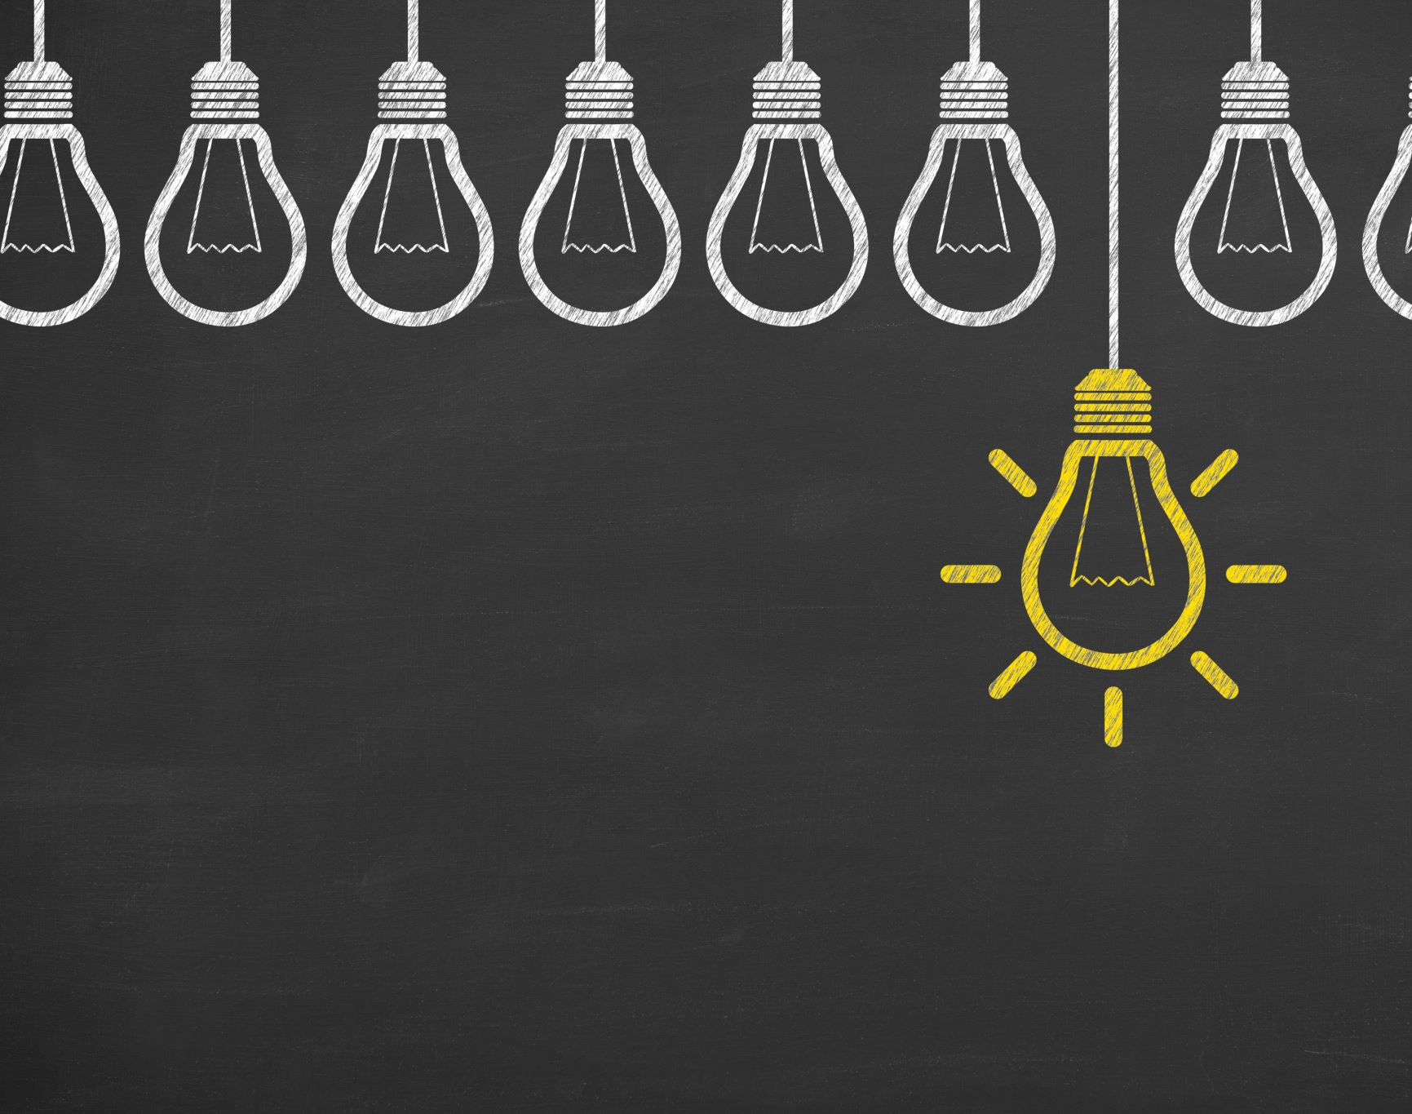
“Onlyness” in the Workplace
Meet people where they are
Insights from Nilofer Merchant
Vantage point – Your Spot in the world
Notes:
Today, we explore the concept of “onlyness” by Nilofer Merchant, a key idea in navigating generational differences. It's about recognizing the unique talents and perspectives of individuals, like Bob, John or Susie, and finding common ground beyond generational labels.
This leads me to another powerful idea in this interconnected world - -, “What if the idea that we really need to understand - - in “navigating the generations” , is to “meet people where they are”?
A Prominent thought leader and strategist on the future of work in the social era, Nilofer Merchant, - - came up with this concept of “meeting people in their “onlyness” –
According to Merchant, “Onlyness” – means that everyone is unique and has their own life experiences, perspectives, and passions. These combine to create a unique vantage point, a "spot in the world only you stand in"

Slide 21
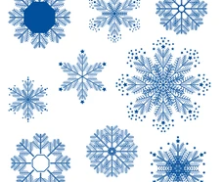
The Uniqueness of “Onlyness”
History & Experience
Visions & Hopes
Skills & knowledge
Notes:
This is seen by your unique:
History and Experiences: This includes your upbringing, education, career path, and life events that shape who you are.
Visions and Hopes: Your personal aspirations, dreams, and what you believe the world could be.
Skills and Knowledge: The specific talents and expertise you possess
Essentially, "onlyness" highlights the idea that everyone has a unique combination of these elements that makes them irreplaceable.
when you meet people in their “onlyness” you are not talking about a generation any longer, but you are talking about a person - - Bob or John or Susie... recognizing this and working towards this should help share ideas and work together. By recognizing and valuing our individual strengths, we can create a more powerful collective impact.

Slide 22
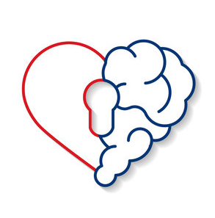
Combining Emotional Intelligence with “Onlyness”
Interplay of Emotional Intelligence and “Onlyness”
Enhancing Team Dynamics
Maximizing Potential
Notes:
If we combine the two thoughts from Leah Georges and Nilofer Merchant - Emotional intelligence is about you and “onlyness” is about them.
Utilizing emotional intelligence can help play a crucial role in navigating the unique strengths and contributions of individuals in a team, Here’s how:

Slide 23
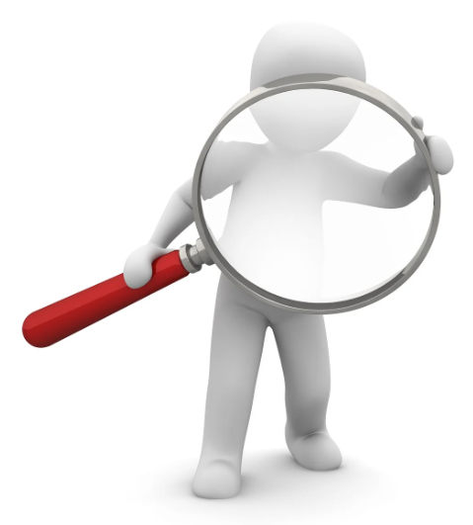
Navigating Self-Awareness
Understand Your Biases
Identify Strengths
Want to deepen your self-awareness? Sign up for Leading Self beginning August 2024 at aub.ie/aspire.
Notes:
Using Self Awareness, we become aware of our own biases and preconceived notions. This allows us as supervisors to approach each team member with an open mind and appreciate their unique perspective.
as well - - identifying and understanding our strengths, supervisors can better recognize the strengths of their team members. We begin to appreciate the different skills and talents that each individual brings to the table.

Slide 24
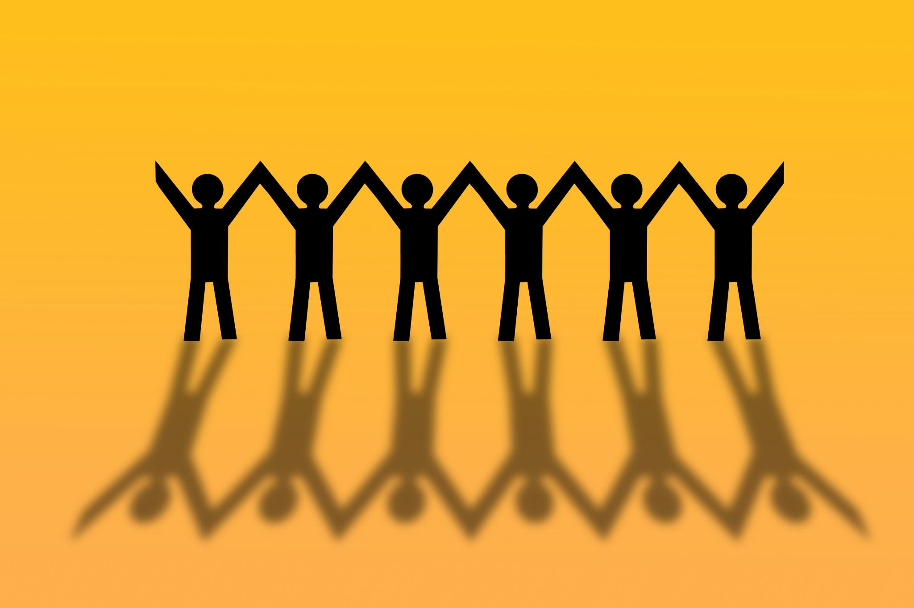
Navigating Motivation
Motivate Others
Pursue Collaboration
Want to learn more? Register for Employee Motivation at aub.ie/sm105c in ElevatED today.
Notes:
Motivation:
Understanding your employees individual strengths and aspirations allows you to tailor your approach to motivate team members. This helps them leverage their "onlyness" and contribute in a way that is fulfilling for them.
Pursue collaboration by encouraging employees to share their ideas and build upon each other's strengths. This creates a synergy that allows the team to achieve more than any individual could alone.

Slide 25

Navigating Social-Awareness
Engage Active Listening
Practice Empathy
Want to deepen your social-awareness? Supervisors can sign up for Leading People in late Fall 2024 at aub.ie/aspire.
Notes:
Social Awareness:
By actively listening to your employees, you can gain a deeper understanding of their experiences, goals, and perspectives. This helps you appreciate their "onlyness" and the unique value they contribute.
Practicing Empathy allows you to see things from another person's point of view. This helps you understand your team members motivations and contributions, even if they differ from your own.

Slide 26

Navigating Relationship management
Build Trust
Manage Conflict
Looking to build trust and manage conflict? Check out LinkedIn Learnings aub.ie/buildtrust & aub.ie/manageconflict in ElevatED today.
Notes:
Relationship Management:
Strong relationships are built on trust. By creating a safe and supportive environment, individuals feel comfortable sharing their ideas and perspectives, allowing their "onlyness" to shine through.
Relationship management helps you navigate disagreements constructively. By focusing on understanding the other person's perspective, you can find solutions that leverage everyone's strengths.

Slide 27
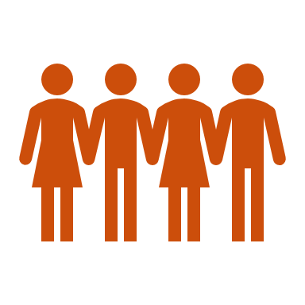
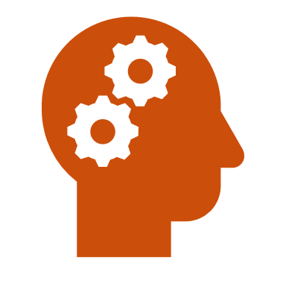
It’s a journey
Growth mindset
The power of humility
Notes:
Let's explore the concept of a Growth Mindset, where we learn to embrace our imperfections and see every setback as a chance to grow. It's about humility and recognizing that we're all on a unique journey of personal development.
Original Content:
o Growth Mindset - Embracing imperfections – build resilience by viewing failures, setbacks, as an opportunity to grow, humbly meet people where they are - - remember this is a journey.
And finally –
Wrapping up, I want to revisit today’s take away is… a reminder that building Emotional Intelligence, especially in navigating and bridging generations, is a very personal journey.
People learn at different paces and require individualized approaches.
Have a growth mindset - believe that your skills and intelligence can be developed through effort, learning, and perseverance.
build resilience by viewing setbacks as stepping stones and opportunities to grow,
understand the power of humility - humbly meet people where they are - - In their “onlyness”
remember this is a journey.

Slide 28
What would you do?
In a modern office, the generational divide between Susan, a Baby Boomer, and Alex, a member of Gen-Z, becomes apparent as they clash over the marketing strategy for a new project.
Susan advocates for traditional media, citing its proven track record and authenticity, while Alex pushes for the integration of social media, arguing its relevance and analytical advantages.
How do you help them navigate this challenge?
Notes:
If time scenario
The tension between Susan’s preference for established methods and Alex’s inclination towards innovation and adaptability reflects the broader conversation on how different generations navigate change.

Slide 29
Continuous Learning Opportunities
Aspire Auburn, Leadership Development programs
  Leading Self (Open to all in early Fall 2024)
  Leading People (For Supervisors beginning Spring 2025)
  Check out aub.ie/aspire for more information!
ElevatED Courses:
Emotional Intelligence Basics (Virtual)
Working Among Multiple Generations (Virtual)
Diversity Across Generations: Supporting Workplace Inclusion Self-Paced (LinkedIn Learning (LIL))
Emotional Intelligence Basics Self-Paced (LIL)
Employee Motivation (Classroom)
How to Proactively Manage Conflict as an Employee(LIL)
Building Trust (LIL)

Slide 30
Resources
West Virginia DOT, “generations: participant guide”​
West Virginia DOT, “generations: instructor guide”​
Purdue University, “generational differences in the workplace”​
The Employee Engagement Group, “engaging the generations”​
Articulate Rise, “managing the multigenerational workplace”​
Extension, University of Missouri, “meet the generations”​
Livecareer, “different generations in the workplace 2022 study”​
Defense Culture, “communicating across differences”​
​
This material incorporated the use of AI. However, all content was rigorously reviewed and approved by human subject matter experts for accuracy and relevance. For questions or more information, contact us at hrddept@auburn.edu.

