Slide 1
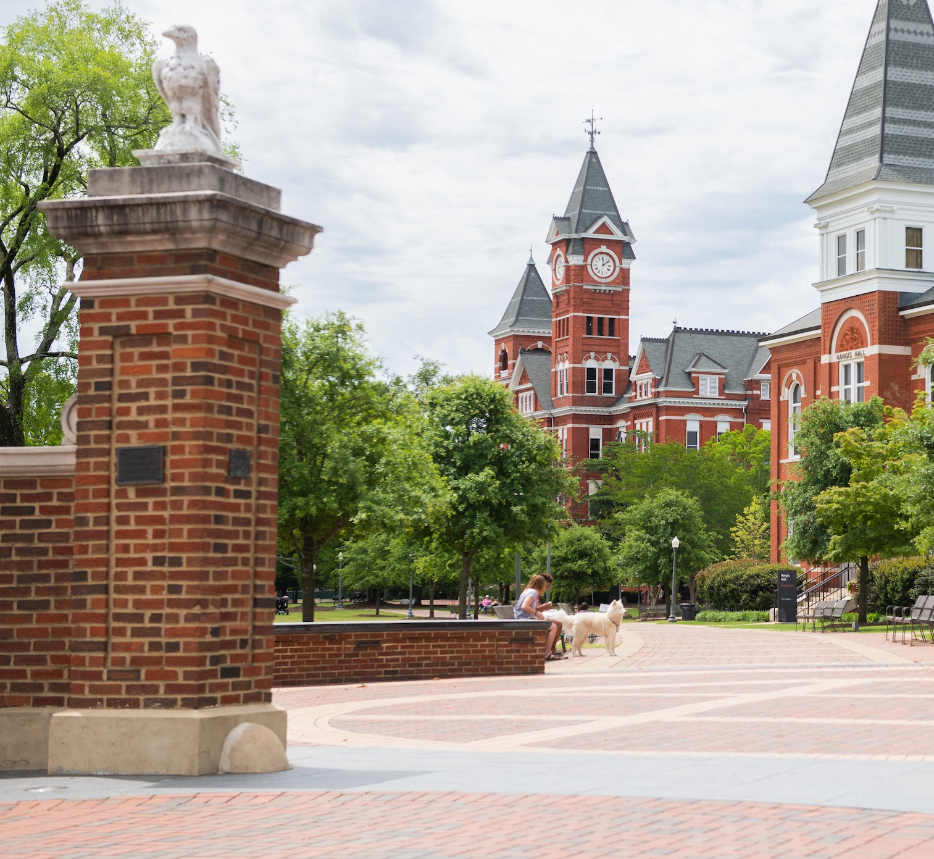
Cultural wallpaper
Mike von Ahnen, SHRM-scp, PMP, CBCP
Employee relations

Slide 2
CULTURAL WALLPAPER
aGENDA
Introduction
Cultural Wallpaper
What do you tolerate?
What can you do?
Summary

Slide 3
introduction
Work culture is the attitudes and behaviors of employees within an organization
Work culture evolves over-time based on the behaviors of the people within the organization, from the Dean, the Director/Manager level, all the way to entry-level positions
The work culture can be different from one section to another section, within the same college

Slide 4
introduction
Picture in your mind what your dream home would look like
What things are a “must” in your dream home? (swimming pool, 3 or 4 car garage, large closets, large pantry, etc…)
Where would your dream home be located?
Does your dream home look like any of the following homes…

Slide 5

California dream home

Slide 6
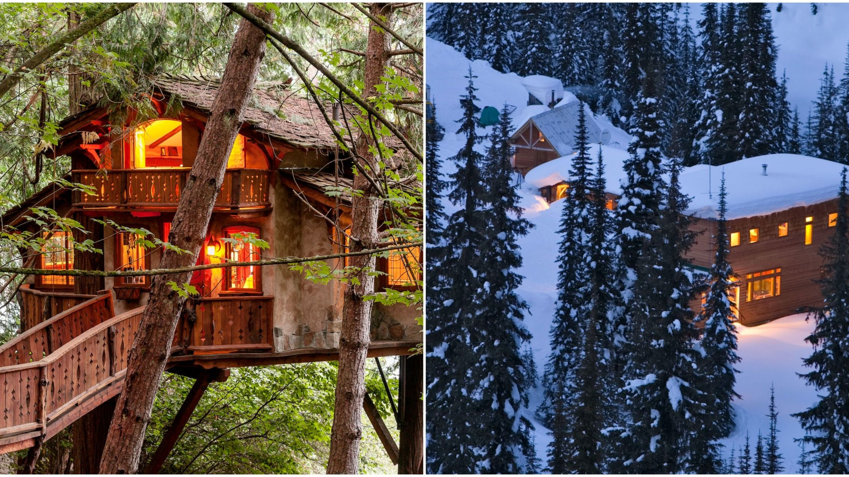
Mountain dream home

Slide 7
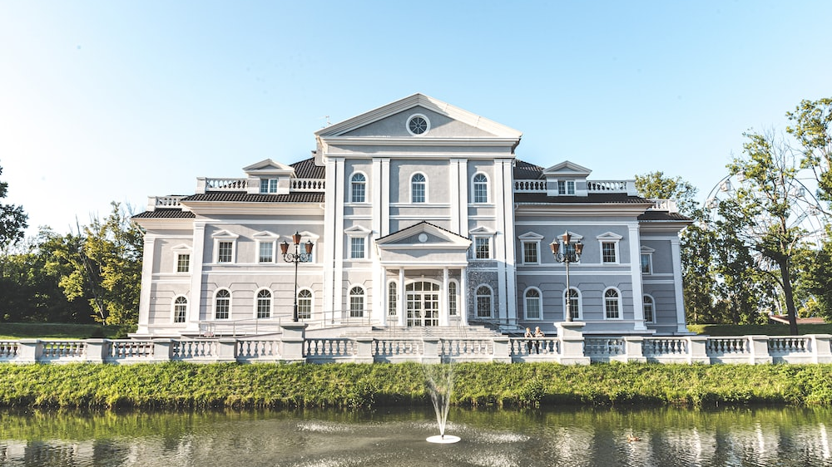
Southern Mansion Dream Home

Slide 8

Hawaiian Dream Home

Slide 9

Wallpaper at Home!
This is the wallpaper in the living room of your dream home!

Slide 10
Waller at Work!
This is potentially the wallpaper in your organization!

Slide 11
Cultural wallpaper
The culture in your organization is like wallpaper
The wallpaper is noticeable, it can be good or bad
Cultural wallpaper can potentially permeate the entire organization, even if it started in only one unit
Your wallpaper represents what you have created and what you have tolerated
Just like wallpaper in a house, you can change the wallpaper at work!

Slide 12
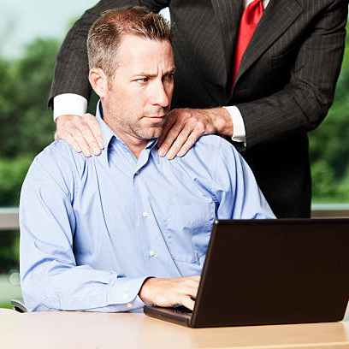

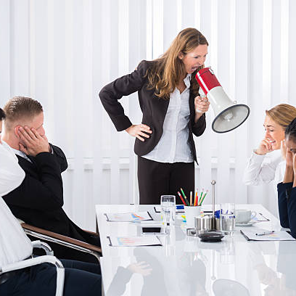
This is bad cultural wallpaper

Slide 13



This is good cultural wallpaper

Slide 14
They see the paper
The wallpaper is also seen by visitors/employees/students/potentially parents/donors!

Slide 15
Cultural wallpaper
There are several warning signs that negative cultural wallpaper may exist in your workspace
These signs include high turnover rates, office gossip, disengaged employees, poor morale, weak team communication, absenteeism, fear of failure, fear of presenting opposing viewpoints, bullying, low productivity, feeling unappreciated, quiet quitting, etc…
Comments that attempt to justify poor performance and negative behaviors; “they’re just a work in progress” // “that’s just the way they are” // “It’s not my concern, I don’t directly supervise that person”
Have you seen any of these signs before?

Slide 16
What do you tolerate?
Do any of the following get tolerated in your work section?
Employees arriving late to work
Employees departing work early
An unhealthy work environment (intimidating behaviors, cussing, offensive/obscene/immoral conduct, etc…
Stealing or misappropriating university property
Inappropriate pictures or posters that are displayed in office spaces
Consistently missed deadlines

Slide 17
What do you tolerate?
Sleeping while on duty during working hours
The refusal to obey reasonable and necessary supervisory directed tasks or job assignments
Disregarding normal safe work practices
Disputes between individuals that if left unchecked, could lead to a breakdown of communication
Lack of productivity
Timeliness of work (slower)

Slide 18
What do you tolerate?
Leaders deserve what they tolerate. To put it another way, “leaders get what they accept.”
Selective enforcement of the standards causes selective enforcement of the standards
Selective enforcement of standards can erode trust and lead to a perception of favoritism
Ignoring issues, failing to address issues, or hoping that issues simply disappear will not solve anything. It will make things worse

Slide 19
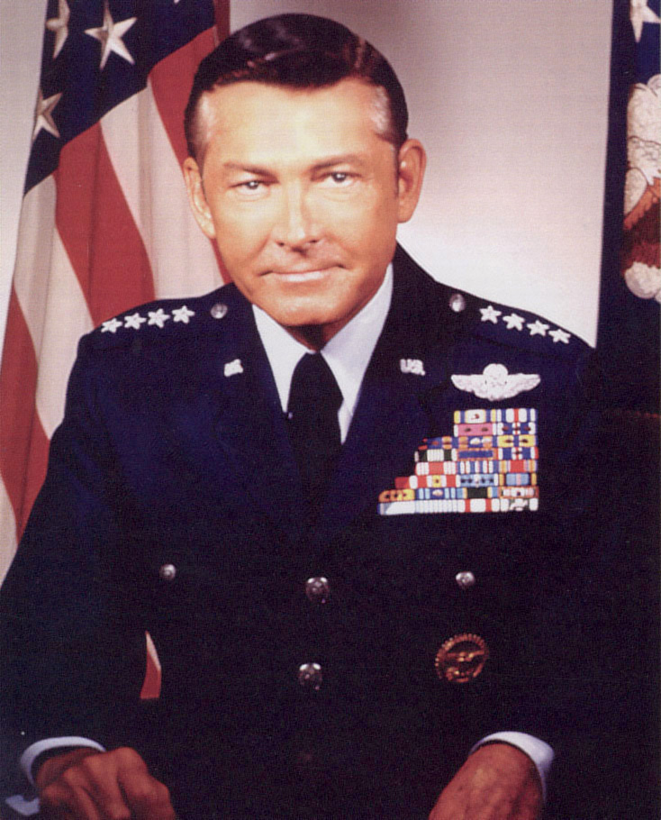
What do you tolerate?
General (ret) w.l. creech, u.s. air force
“I know of no more ruinous path for leaders than selective enforcement of rules and standards. Excellent leaders have very high standards, and they enforce them without fear or favors.”

Slide 20
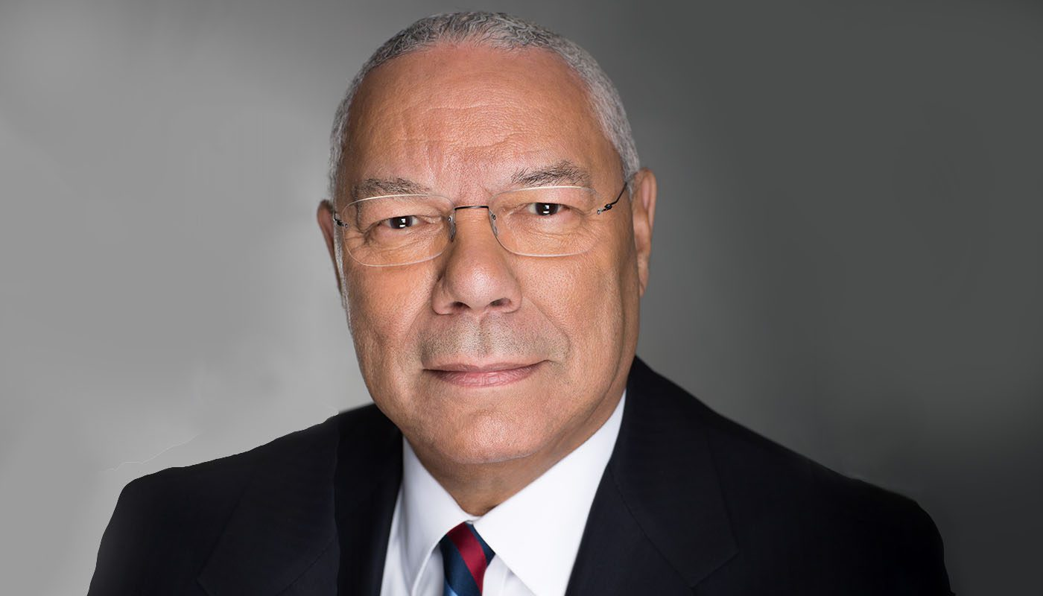
What do you tolerate?
Colin Powell, former secretary of state
“In the workplace, true leadership is about setting high standards and fostering an environment where professionalism thrives.”

Slide 21
What can you do?
Cultivate professionalism
PPP
Professionalism
Pride
Performance
Professionalism
Pride
Performance

Slide 22
What can you do?
Cultivate professionalism
PPP
As leaders, you can affect professionalism in your section.
If you create the environment and culture of a professional organization, pride and performance will follow. When they do, they become a self-reinforcing loop!
Professionalism
Pride
Performance

Slide 23
What can you do?
Ways that a leader can instill professionalism in the working environment include;
  Lead by example
  Establish clear expectations
  Provide training and resources
  Encourage open communication
  Promote psychological safety
  Recognize and reward professionalism
  Provide constructive feedback
  Emphasize accountability
  Be consistent
  Address unprofessional behavior immediately (progressive discipline)

Slide 24
What can you do?
Ways that a non-supervisory employee can address negative cultural wallpaper/issues in the workplace;
- Peer; speak with your peer or speak to your peer’s supervisor
- Supervisor; schedule a meeting to speak with your supervisor
- Supervisors boss; speak with your supervisor to see if they have already attempted to address any issues/concerns
Additional ways that a non-supervisory employee can address issues if the above approaches are unsuccessful;
- Seek assistance from Human Resources
- Speak to someone in a higher level of leadership (this approach takes personal courage)
- Submit an anonymous complaint (Ethics Point at AU)

Slide 25
What can you do?
Don’t ignore negative cultural wallpaper. The passage of time alone will not resolve the issues
When you identify negative wallpaper, address it immediately. You must have the difficult conversations!
Be honest and truthful when addressing individuals who have cultivated or have added to a negative work culture
Promote the following; trust, transparency, recognition programs, open communication, accountability, cooperation, growth opportunities, employee feedback and utilize the feedback when appropriate, shared goals, core values, teamwork, collaboration, psychological safety, compassion and empathy, innovation, etc…

Slide 26
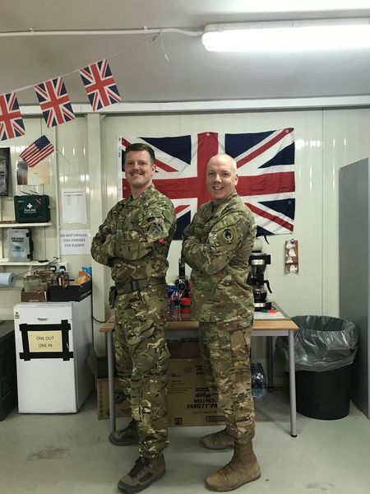
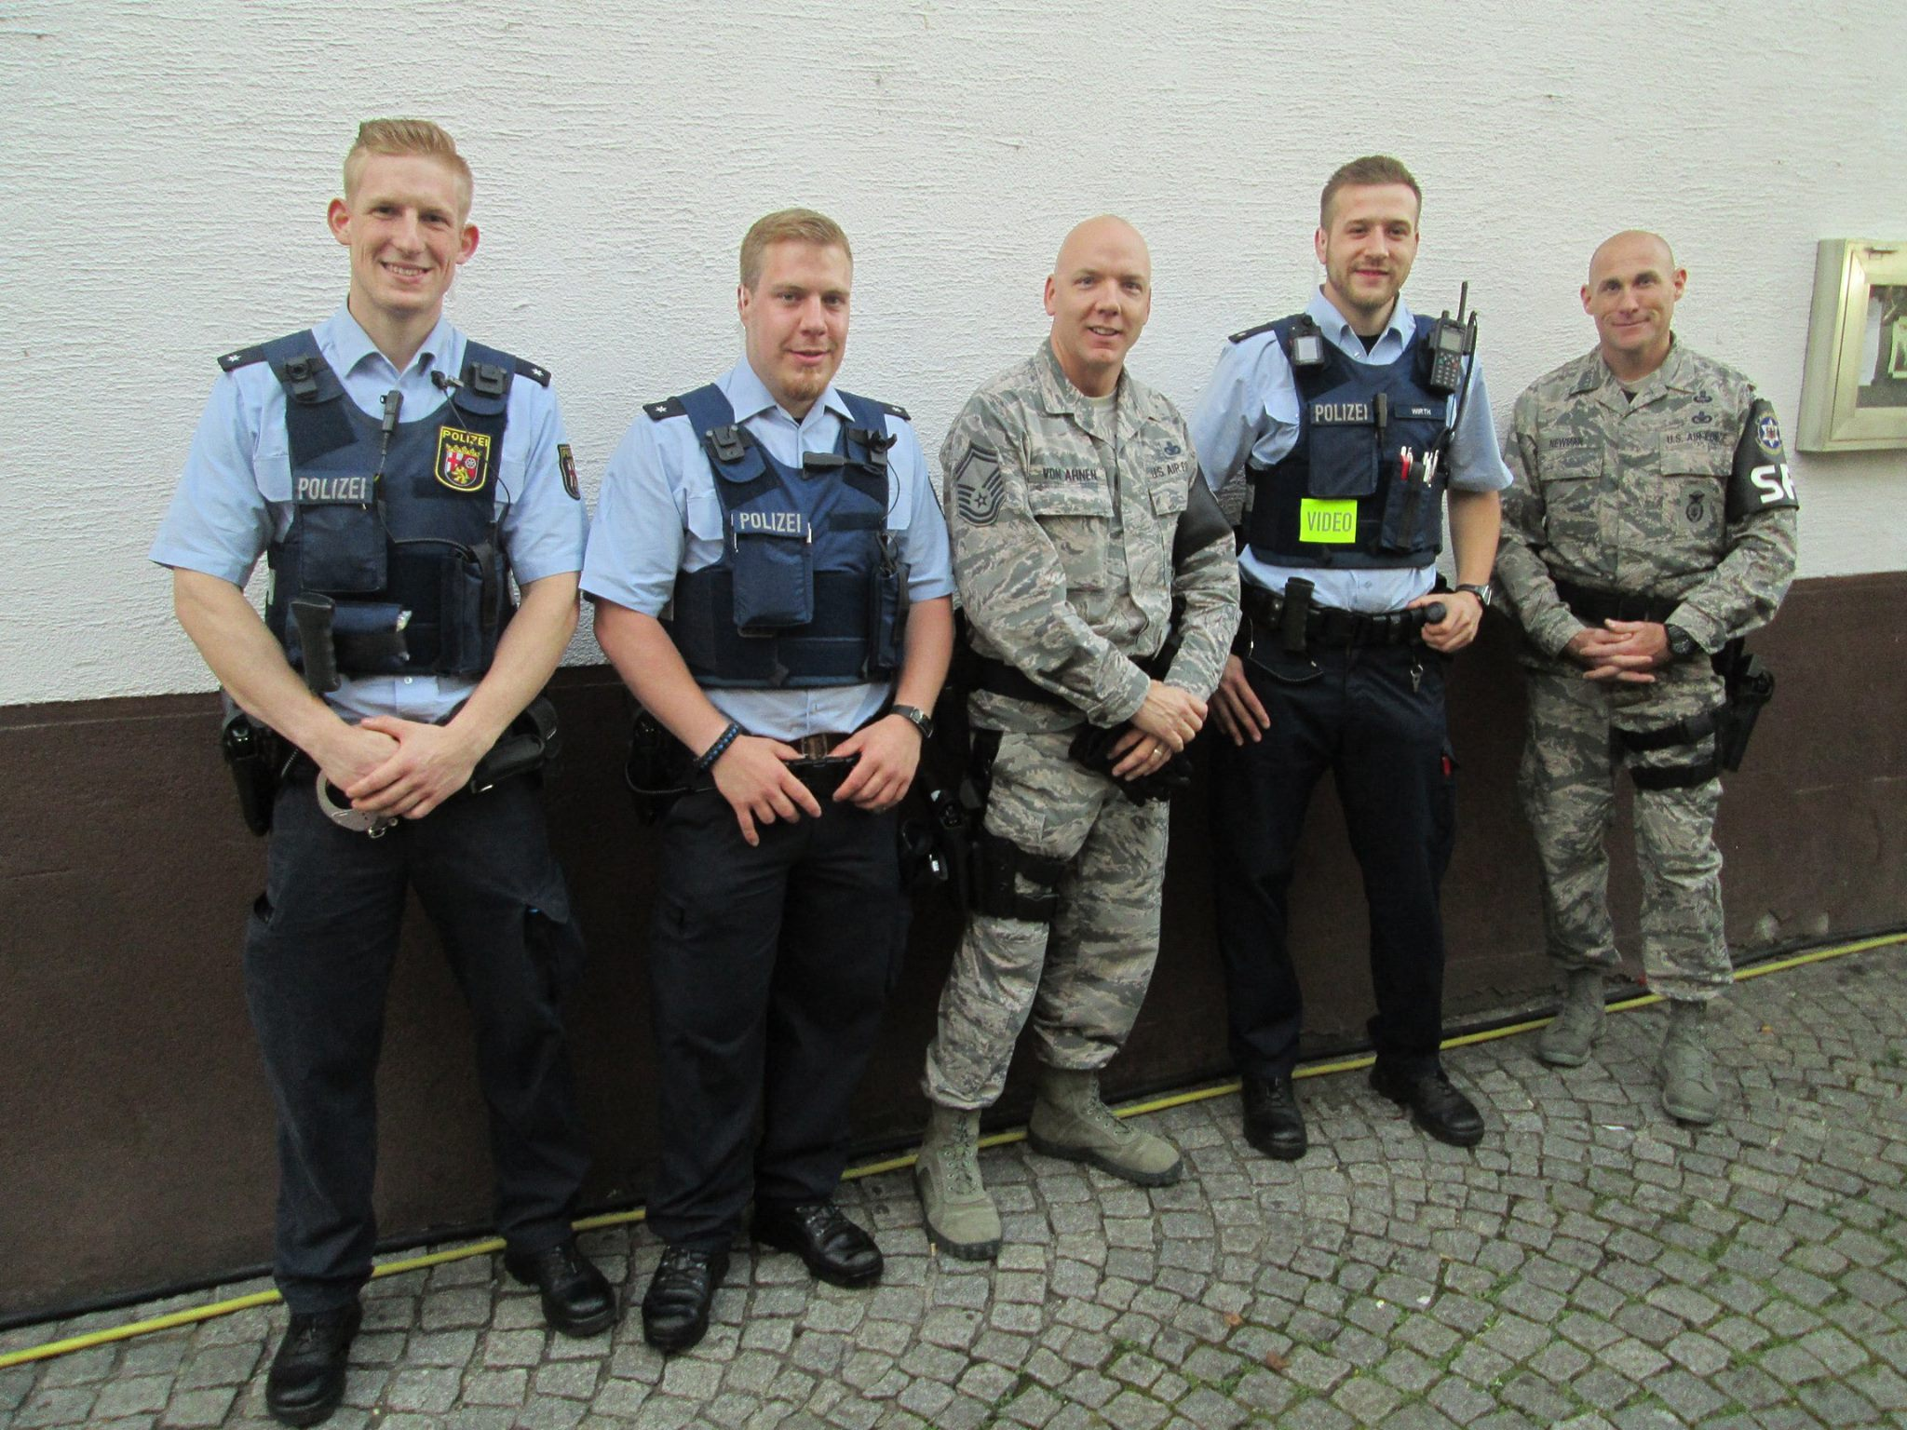

Cultivating professionalism = team success!

Slide 27
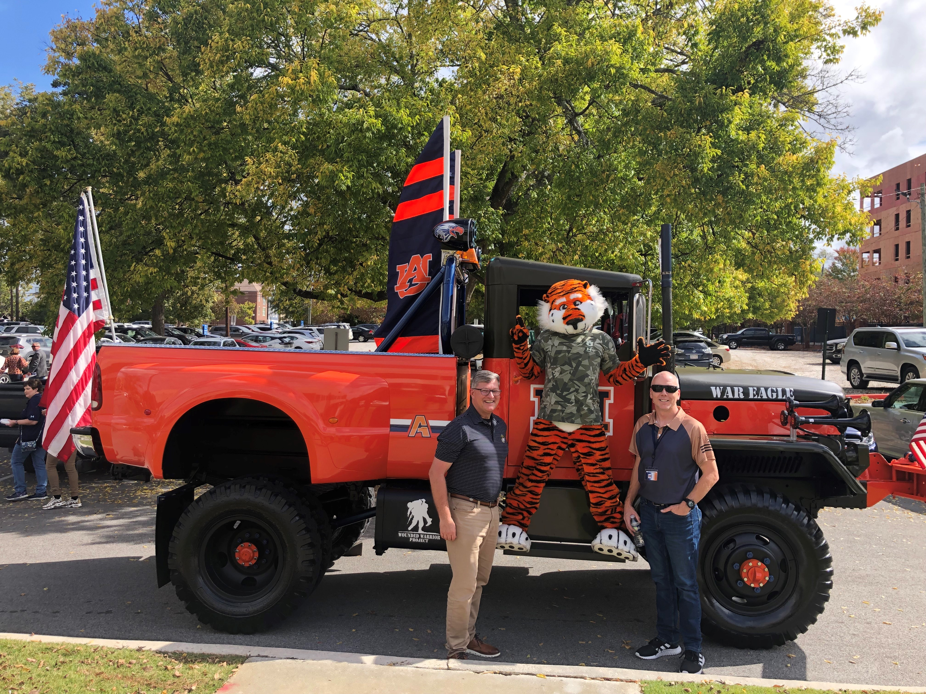
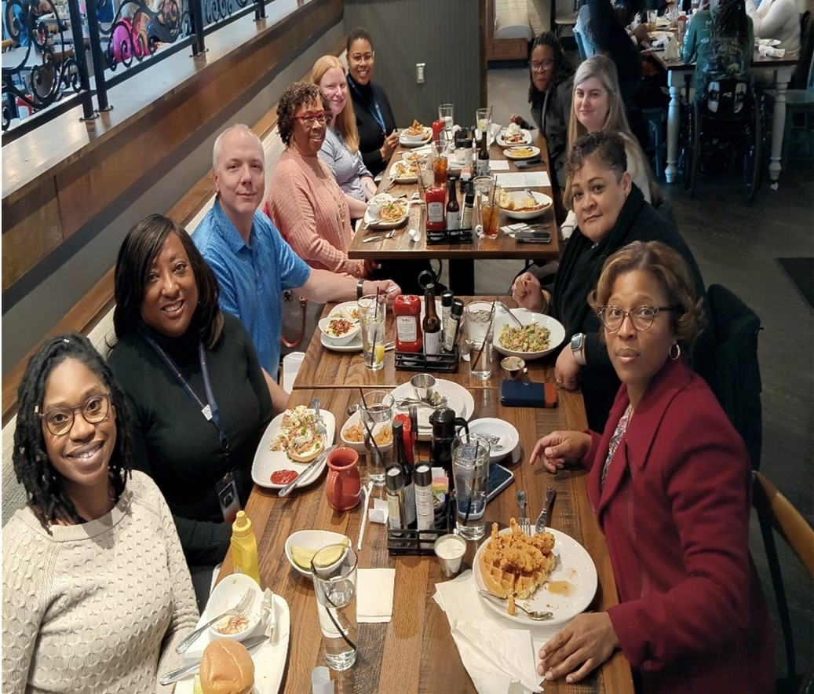
I believe in honesty and truthfulness, without which I cannot win the respect and confidence of my fellow people.
Auburn Creed, George Petrie

Slide 28
What’s in it for me?
Less negative personnel issues
Less burn-out, happier employees
More productivity
Employee longevity
Stronger teamwork
Greater communication
Better work quality
Employees feeling safe and comfortable in the workplace
Increased job satisfaction
Accountability
Trust

Slide 29

summary
Cultivate professionalism, pride, and performance to build and develop a positive work culture with beautiful wallpaper!
What does your cultural wallpaper look like?

Slide 30
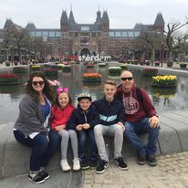

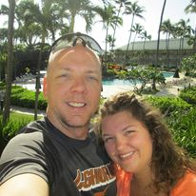
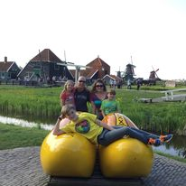
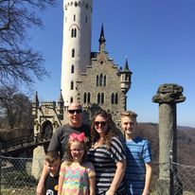
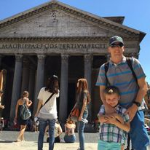
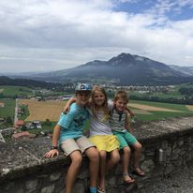
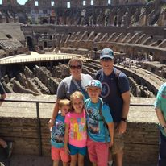
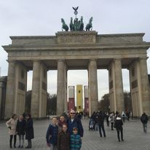
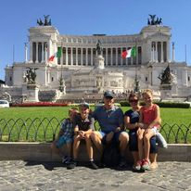
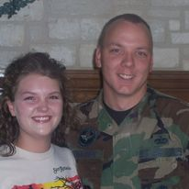

The end!
Thank you!
Mike Von Ahnen
Employee Relations Specialist
mpv0009@auburn.edu
334-844-1647

