Slide 1
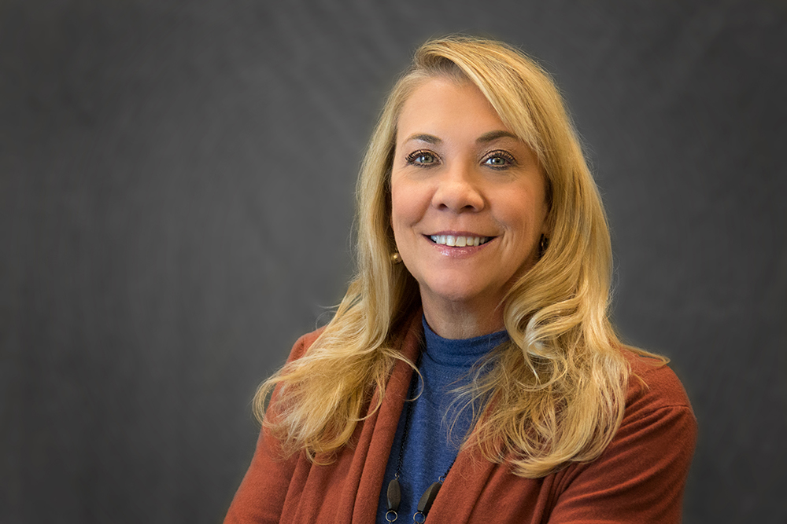

Scenarios regarding THE EMPLOYEE LIFE CYCLE
Ann Shore and Sonya Dixon
UHR Benefits and Campus Relations

Slide 2


Employee Lifecycle related to payroll & employee Benefits
Ann shore, Executive Director, Peb , Human resources

Slide 3
EMPLOYEE LIFE CYCLE
Agenda
Employee is hired (after Onboarding)
Employment tenure
Employee dies while employed
Employee resigns (Nonretirement)
Employee retires (TRS retirement)
AU annual retirement seminars
Other information

Slide 4
employee is hired (After onboarding)
Must attend New Employee Orientation within 30 days of hire date
  Benefit election/enrollment must be completed within 30 days of hire date per AU Section 125 Plan.
    Benefits are covered in detail with active enrollment during NEO for all full-time benefit eligible employees.

Slide 5
employee is hired (After onboarding)
Onboarding in department covers many items including:
  Kronos training; clocking if non-exempt
  Requesting annual/sick/other leave
  Pay schedules
  Department specific information
  Ideally-who admins and HRLs are in the department
  What else is best practice?

Slide 6
Employment Tenure
Employee life cycle
Annual Leave Accrual (Excluding F9 Faculty and Coaches)
  Full time eligible employees accrue at 13.34 hours per month. (160 hours per year)
  Part time employees who have an FTE accrue at a prorated amount based on the FTE.
Sick Leave Accrual
  Full time employees accrue at rate of 8 hours per month. (96 hours per year)

Slide 7
Employment Tenure
Employee life cycle
Requests time off in Kronos
  Supervisor approval/Timekeeper
Takes different types of leave over employment tenure
Uses health and welfare benefits to include health, dental, vision, supplemental plans, retirement plans, disability, etc.
PEB here to assist!
  benefit@auburn.edu
  payroll@auburn.edu

Slide 8
EMPLOYMENT TENURE
Employee Life cycle
If eligible may use leave to include:
  FMLA- REQUIRED NOT OPTIONAL – Must be eligible and must be approved by HR
  Annual Leave
  Sick Leave
  Paid Parental Leave
  Salary Continuation Plan
  Bereavement Leave
  Jury Duty Leave
  Military Leave
  On the Job Injury (OJI)
  Community Service Leave
  Leave without pay/Professional Improvement Leave (via Provost office)
    Voluntary or Involuntary

Slide 9
Employee dies while employed
Employee Life cycle
Contact Linda Sanders in PEB for life insurance information.
PEB sends beneficiary paperwork/information for The Standard. (term life insurance)
  Basic to $35k for full time benefit eligible
Certified death certificate required with claim form/PEB will assist with form completion.

Slide 10
Employee dies while employed
Employee Life cycle
PEB sends information for RSA Teacher’s Retirement to family/beneficiary.
  If the employee is not eligible to retire the beneficiary receives member contributions, total interest earned and one year of the employee’s annual salary
  If the employee is eligible to retire and the beneficiary is a spouse, the spouse has a choice of a lifetime monthly benefit option 2 (100%)
    If the beneficiary is not a spouse the beneficiary has a choice of option 3 (50%) or the beneficiary can choose to receive the member contributions, total interest earned and one year of the employee’s salary
  Certified death certificate required along with RSA Survivor Beneficiary Form- PEB will process and send to TRS.

Slide 11
Employee dies while employed
Employee Life cycle
Contact Debra Walters in PEB regarding welfare benefits to include health, dental, vision
COBRA offered on certain plans if eligible dependents covered (see above bullet)
May be eligible for other reimbursement from supplemental plans such as Cancer Plans, Critical Illness, additional life insurance
Options with voluntary retirement plans based on beneficiary – rollover, cash out, etc.
Final paycheck issued

Slide 12
Employee dies while employed
Employee Life cycle
Annual leave payout issued if employee has balance (up to 173.3 hours)
Advise Employee Relations
Advise if Employee Assistance Program (EAP) is needed for department and or family
Use correct termination code on EPAF with date of death
Stress importance of updated beneficiary and emergency contact information in Self Service Banner

Slide 13
Employee resigns (Nonretirement)
Employee life cycle
Assign correct termination reason on EPAF.
Send EPAF and resignation letter to humnres@auburn.edu.
Ensure EPAF is the last day of employment (date on letter).
PEB will send COBRA information where applicable.
Employee will contact RSA/TRS if vested at appropriate age requirement
  RSA will contact AU PEB for certification.
  If the employee not vested, they contact TRS for options.

Slide 14
Employee resigns (Nonretirement)
Employee life cycle
Some portability options with supplemental plans such as life, cancer, critical illness
Choices regarding voluntary retirement plans (403b, 457b, Roth) to include rollovers, cash out or leave at AU
Annual leave, if available, up to 173.3 hours will be paid out
  Bi-weekly-next pay period
  Monthly/Semi-monthly- as soon as possible after PLOP is processed

Slide 15
Employee retires (trs retirement)
Employee life cycle
The employee meets in advance with Linda Sanders in PEB for completion of information and paperwork.
  The employee is required to complete certain things, covered in meeting with due dates communicated
  MUST MEET TRS DEADLINES!
All completed paperwork must be submitted to TRS a minimum of 30 days in advance and a maximum of 90 days in advance of the retirement date.
Select correct termination reason on EPAF-RETD and correct termination date.
Send EPAF and resignation letter to humnres@auburn.edu.

Slide 16
employee retires (trs retirement)
Employee life cycle
PEB will send COBRA paperwork where applicable.
There are some portability options with supplemental plans such as life, cancer, critical illness.
Choices regarding voluntary retirement plans (403b, 457b, Roth) include rollovers, cash out or leave at AU.
Annual leave, if available, up to 173.3 hours will be paid out.
  Bi-weekly-next pay period
  Monthly/Semi-monthly- as soon as possible after PLOP is processed

Slide 17
aU Annual retirement seminars
Employee Life cycle
Annual retirement seminars held at AU include
  RSA/TRS/PEEHIP*
  Social Security Administration
  Tier I retirement- Johnson Sterling
  Tier II retirement- Johnson Sterling
* Employees invited include those that are already vested and/or within 5 years of vesting eligibility.

Slide 18
Other information
Employee life cycle
HRD classes for Payroll, Benefits, Kronos, financial wellness, etc.
Tiger Perks program
Postdoc benefits are different per Graduate School request-separate BAG for them.
Dependent Education Benefit
Employee Education Benefit

Slide 19
Other information
Employee life cycle
All employee are eligible for the Employee Assistance Program (EAP).
  Up to six free visits per year per covered employee/eligible dependent-counseling
  Up to six free visits per year per covered employee/eligible dependent-life coaching
    IMPORTANT: Open enrollment dates are different for 2024.
      October 1-31, 2024
      NO LATE ENROLLMENTS OR CHANGES WILL BE ALLOWED!

Slide 20
Questions? Comments?
war eagle!

Slide 21
Thank you for attending!
Please sign the attendance sheet if you have yet to do so.

