Slide 1
Employee Records and Retention
EPAF TRAINING

Slide 2
The Records Team
April McFarlin
Supervisor, Employee Records and Retention
844-1615
mcfaral@auburn.edu
Stacey Roby
Employee Records Specialist
844-1584
szr0098@auburn.edu
Catherine Budy
Employee Records Specialist
844-7609
clb0206@auburn.edu
Vonnie Loucka
TES Records Specialist
844-4145
vsl0004@auburn.edu

Slide 3
Commonly Asked Questions

Slide 4
What is an EPAF?
EPAF
EPAF – Electronic Personnel Action Form
An EPAF is used when any changes need to be made to an employee. i.e – pay actions, transfers….etc.
Notes:
When submitting an EPAF for approval, please make a comment at the bottom to let us know what is being done.
If it is an EPAF that needs back up (ADJSUM, Rate changes for FT, ZJobs, etc..) please send that to Humnres email. This email goes to the Record department, so if someone is out the EPAF can still be processed in a timely manner.

Slide 5
New Job vs Add Job
New Job
Add Job
NJ% EPAF is used when a department is hiring a student, but the student does not have any active jobs but an active PEAEMPL
NJ% EPAF changes the PEAEMPL to the new department.
ADJ% EPAF is used when you are adding an additional job to the student, but the student has a primary job already
ADJ% EPAF adds additional job, no other changes.
Notes:
If an employee is inactive in both, the process for a new hire must be completed.

Slide 6
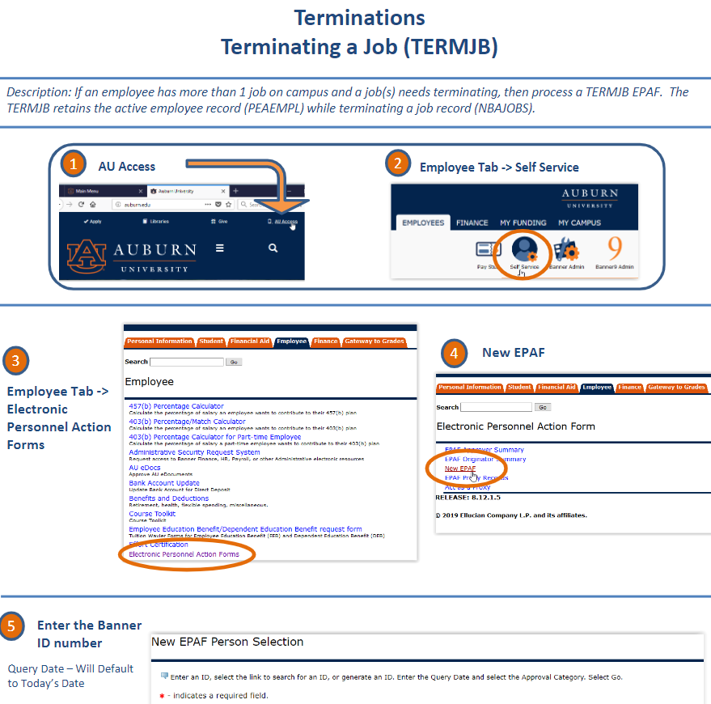
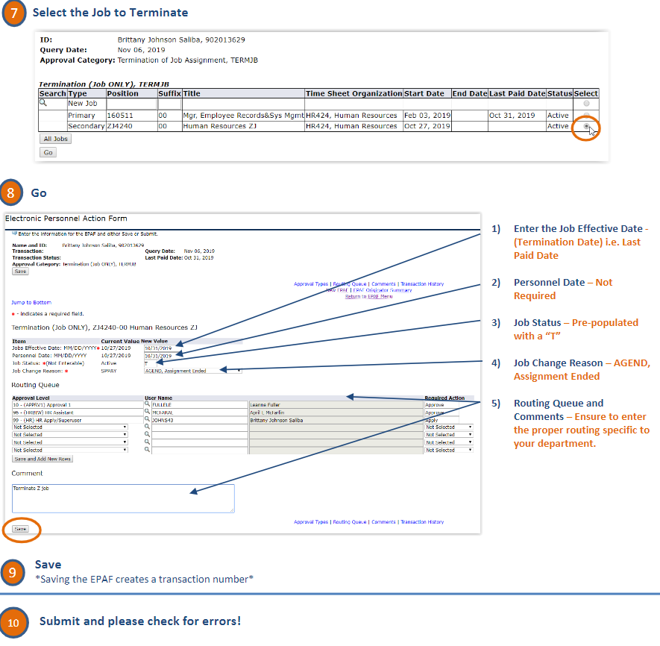
EPAF Termination Codes
TERMEE
  Terminate employee/job
  When a person is leaving University,
  not retirement
TERMJB
  Terminate job only
  When a person is transferring or
  your job has ended
TERMRT
  Employee is retiring from University
Notes:
TERMEE is for whole employee. This is used when an employee is leaving the university or if they are changing ECLasses. If a full-time employee is going part-time, they need to be TERMEE so their leave can be paid out. Backup is required for full-time employees.
TERMJB is just the job. This is used when an employee is moving positions, or departments. This can also be used with students that plan to come back while still enrolled. Please check your time comparison reports to make sure that students that are graduated are not active in your department. Backup is not required but make sure to comment what the plans are for the employee.
TERMRT is for employees retiring. The end date will be the day before their last day (i.e. someone retiring August 1st will have an end date of July 31st). Backup is required.

Slide 7
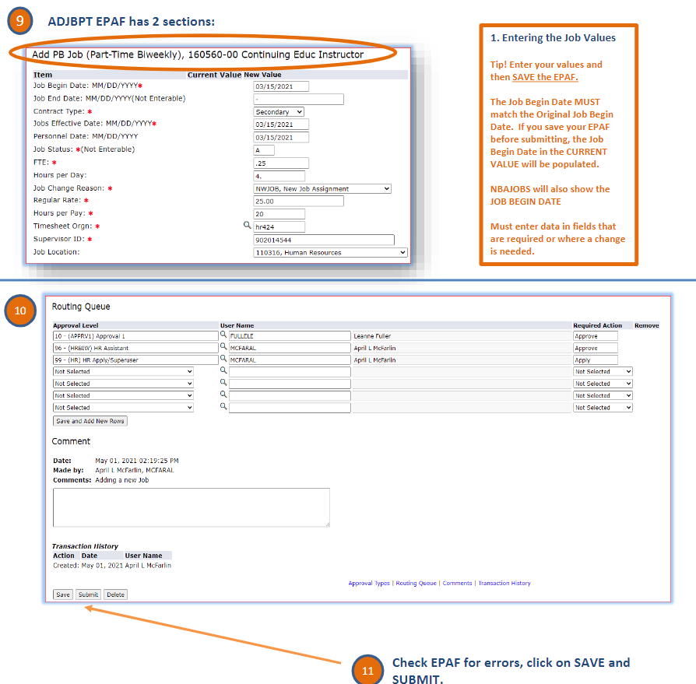
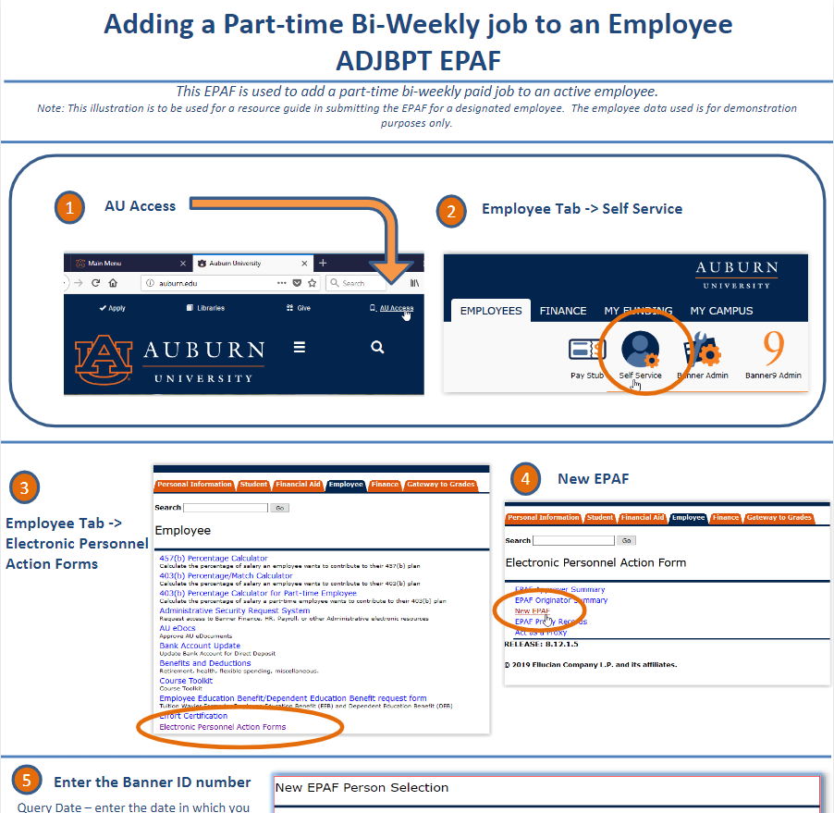
EPAF Hiccups...
Dates
  Begin date
  Effective date
  Query date
Notes:
Banner is a data driven platform. So, when you are putting dates in make sure to pay attention to them.
Query date is the date that the changed needs to be made on. For example, I need to add a job for a GA. The query date needs to match what the begin date is.
There are some expectations.
When an employee is going back into the same position and there is a “job begin date” listed then the date must match that. You will need to put the Effective and personnel date as the new start date.
When a change needs to be made, but they have been paid on the personnel date can be a previous date.

Slide 8
Questions ?

Slide 9

Training
One-on-One & Group Trainings available – click the QR code below.
Trainings will receive credit as US104J in ElevatED
Notes:
If you’re wanting to know more about EPAF’s or get a deeper understanding of them. This is the QR code to sign up for one-on-one trainings with April. Eventually, you will be able to sign up for trainings with Stacey and Catherine.
One-on-one trainings receive credit in ElevatED.

Slide 10
We think YOU are amazing!

Slide 11
Auburn University Human Resources
1550 East Glenn Ave
Auburn, AL 36830
334-844-4145
Let us know how WE can serve YOU.

