Slide 1

Pay:
Transparency, Equity & Communication
Shelly Murray, Lindsey Johnson & Bailey Ward

Slide 2



Your presenters
Shelly Murray
Director, Compensation & Classification
Lindsey Johnson
Senior Manager, Human Resources
Bailey Ward
Manager, Compensation & Classification Admin

Slide 3



What we'll cover
~
Pay Equity
Pay Transparency
Effective Employee Communication
Q&A and Discussion

Slide 4

Pay Transparency
Transparency means being open and sharing information about processes, decision-making, and data, with the goal of increasing understanding, collaboration, and communication throughout the organization.
Honest, clear, proactive communication
Another word for TRUST...
Notes:
When we trust people, we turn to them for help and support, especially in difficult or challenging situations. Those people become a rock we can lean on to regain our footing or a safe foundation to launch into something new.
But what is trustworthiness, exactly? In the workplace, trust is predicated on honest, clear, proactive communication — what we commonly call transparency.

Slide 5
Pay Transparency - Transparent about what?
Internal Transparency | External Transparency
Performance development processes | Posting salary ranges on job postings
Merit eligibility and processes | Informing selected and non-selected candidates of hiring decisions
How base pay is established | Posting benefit offerings on job postings
How promotions are determined
Why pay programs are created/ended
Restructuring a department or unit
Publishing of pay ranges
Notes:
Transparency means being open and sharing information about processes, decision-making, and data, with the goal of increasing understanding, collaboration, and communication throughout the organization.

Slide 6
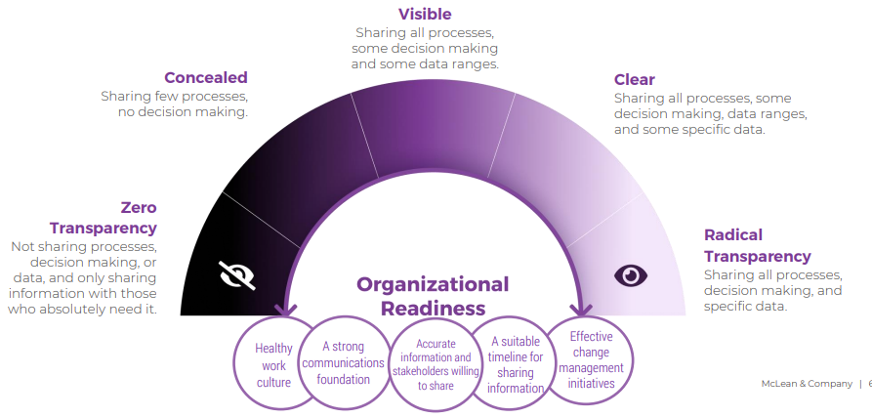
Pay Transparency - A Continuum
Notes:
Pay Transparency is not a "yes" or "no" concept. Instead, it's a continuum.
Exercise – Where is your department or division? Where is Auburn University as a whole?

Slide 7
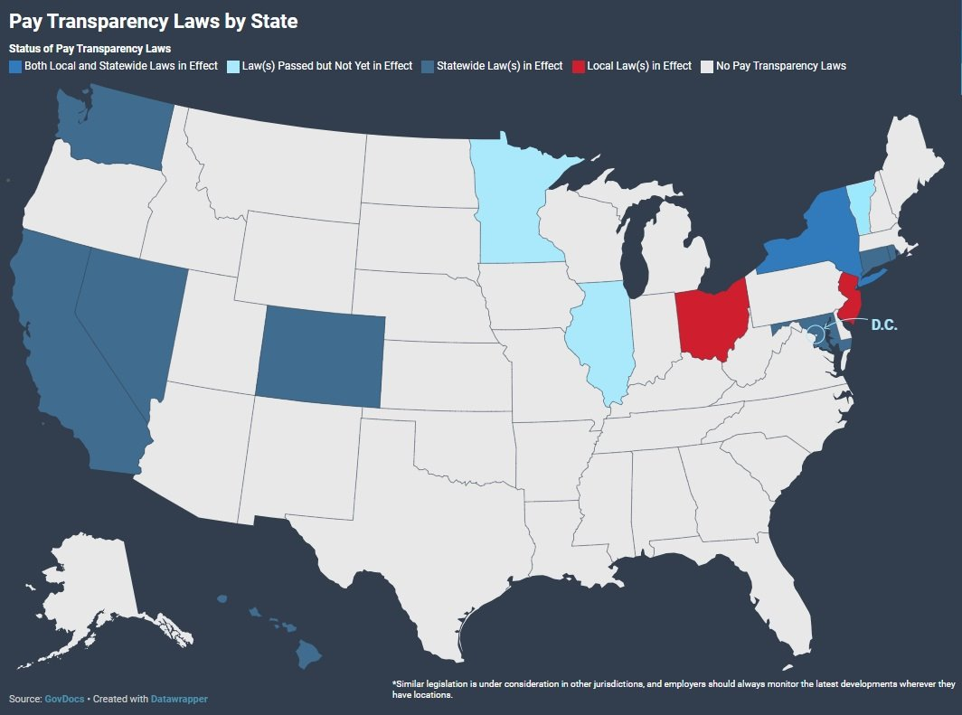
Regulatory landscape and business case for pay transparency
Changing regulatory landscape
  California
  Washington
  Nevada
  Hawaii
  Colorado
  Connecticut
  Rhode Island
  Maryland
  New York
  Washington, D.C
  Illinois (Effective 2025)
  Minnesota (Effective 2025)
  Vermont (Effective 2025)
Nevada:
Must disclose salary ranges after job interview.
Toledo, Ohio:
Must disclose salary ranges when requested after extending job offer.
Colorado:
Must disclose salary ranges, benefits, and promotional opportunities in job listings.
Notes:
Over the last several years, pay transparency has become a central topic for organizations. Initially, it was seen as an issue or checkbox that needed to be dealt with, similar to other compliance related
topics. However, now, organizations are realizing that transparency is a powerful force for earning trust.
Pay Transparency laws in the US are designed to promote fairness and reduce wage disparities by requiring employers to disclose salary information. States with such laws include California, Washington, Nevada, Hawaii, Colorado, Connecticut, Rhode Island, Maryland, New York, Wahington D.C, and in 2025 Ilinois, Minnesota, and Vermont.

Slide 8
Challenges with pay transparency
Breaching Employee Privacy - Privacy entails restricting access to private employee information and allowing employees to exercise some control over their personal information (The Ethics Centre, 2022).
Misinterpretation of Data - Sharing information and data without providing employees with context on how to interpret it can result in employees misinterpreting the data (e.g. providing employees with salary data, without the context to show why some employees earn higher salaries than others).
Information Overload - Sharing too much information or information that is irrelevant can result in information overload for employees, possibly leading to reduced productivity.
Failure to uphold promises - Sharing too much information too soon can lead to disengaged employees and loss of trust in the organization, if the promises and expectations set fail to be.
Notes:
Breaching Employee Privacy - Privacy entails restricting access to private employee information and allowing employees to exercise some control over their personal information (The Ethics Centre, 2022). When organizations expose the private data of employees (e.g. individual salaries, emails) in an effort to be radically transparent, they could risk breaching employee privacy, which can have legal consequences for the organization. Furthermore, it can undermine trust, and lead to disengaged employees and higher turnover rates.
Misinterpretation of Data - Sharing information and data without providing employees with context on how to interpret it can result in employees misinterpreting the data (e.g. providing employees with salary data, without the context to show why some employees earn higher salaries than others). These assumptions can then circulate to other employees, causing a flow of inaccurate information throughout the organization. Misinterpreted data can also inhibit managers and employees from making rational decisions, potentially leading to negative consequences for the organization.
Information Overload - Sharing too much information or information that is irrelevant can result in information overload for employees, possibly leading to reduced productivity. In addition, when employees don’t understand the purpose of the information being shared with them, they are less likely to benefit from transparency.
Failure to uphold promises - Sharing too much information too soon can lead to disengaged employees and loss of trust in the organization, if the promises and expectations set fail to be met (e.g. if an organization shared that a new technology will be implemented to improve a process before signing a contract with a vendor, employees can become disengaged if the deal falls through).

Slide 9
Strategies for implementing pay transparency in your area
Establish clear communication channels
Proactively and regularly communicate on compensation changes
Address employee concerns
Strike a balance between transparency and confidentiality
Notes:
Establish clear communication channels with your supervisors and employees. When sharing new information, ensure that supervisors and the HR team are sharing the same information. When conflicting information is shared, employees lose trust in our collective decision-making.
Proactively and regularly communicate with employees about upcoming compensation changes or pay-related processes. Sometimes, multiple communications are needed to ensure full understanding.
Address employee concerns. Be prepared to address concerns or questions from employees about their pay. (Not others' pay - too transparent!)
Be intentional. The purpose is not to be transparent for transparency's sake. You must strike a balance between being transparent and confidential.

Slide 10
pay transparency in action
Goal: The aim of pay transparency is to foster increased understanding, collaboration, and communication.
Examples: Auburn University exemplifies pay transparency by:
  Publishing salaries,
  Assigning pay grades with specified ranges,
  And implementing a performance development process.
Communication: It's crucial to maintain open lines of communication with employees about how their performance influences their compensation and to regularly update them on their progress.
Where do you see opportunities for improving transparency, and what can you do to encourage your department and your supervisor?
Notes:
Performance Development process:
Performance development plans and performance reviews should be transparent in illustrating why a promotion was determined.
Creating personalized development plans that outline specific goals and the steps needed to achieve them, helps employees understand how they can improve their performance and potentially increase their compensation by growing their role or moving into a higher-level role.

Slide 11
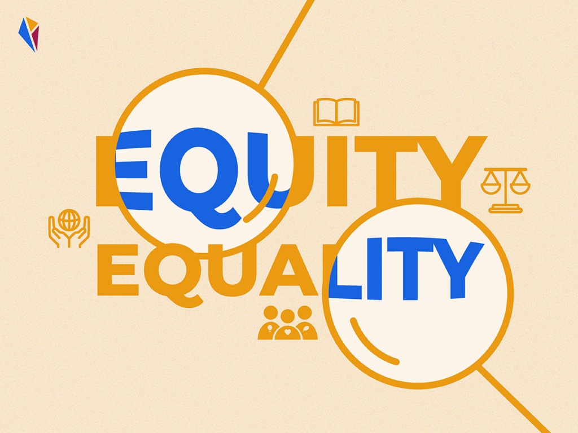
Pay Equity vs pay equality
  Pay Equality refers to providing the same compensation to all employees, regardless of their roles, responsibilities, or individual credentials.
  Emphasizes uniformity and equal treatment.
  If 2 employees have identical job titles and perform identical tasks, they would receive the same pay.
  Does Auburn practice Pay Equality?

Slide 12

PAY EQUITY VS PAY EQUALITY
Pay Equity aims to ensure fairness by considering factors beyond equality. It acknowledges that different roles may have varying levels of value and impact.
Examines comparable work, accounting for differences in skill requirements, responsibilities, and the employee’s contribution level.
Two employees in different roles (Accountant and Communications/ Marketing Specialist) may receive equitable pay if their contributions are similarly valued by the organization.
Does Auburn practice Pay Equity?
In summary, pay equality treats everyone the same, while pay equity recognizes and addresses relevant differences (credentials, experience, etc.) to achieve fairness.

Slide 13

Pay Equity
Employees who believe they are paid fairly are:
85% more engaged, and
60% more committed to their organization.
*2023-2024 Inside Employees' Minds Survey by Mercer
Notes:
According to Mercer’s 2023-2024 US Inside Employees’ Minds Survey, employees who believe they are paid fairly are 85% more engaged and 60% more committed to their organization.

Slide 14
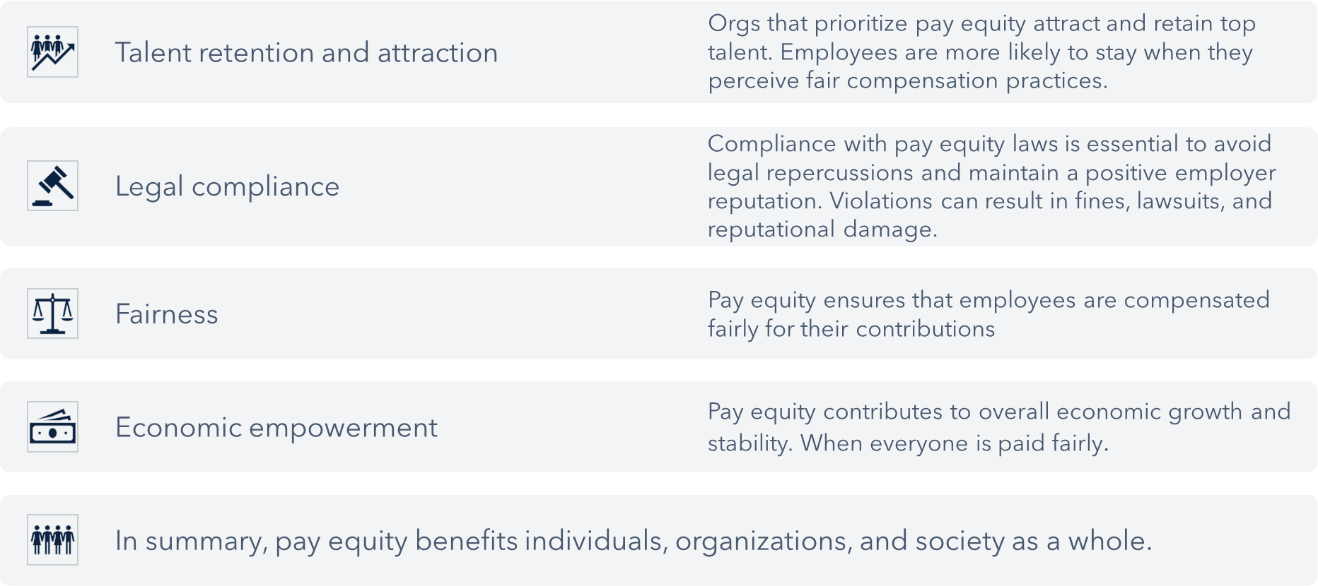
Pay equity - Why it matters
"I believe in honesty and truthfulness, without which I cannot win the respect and confidence of my fellow men."

Slide 15
Regulatory landscape and business case for pay equity
"I believe in obedience to law because it protects the rights of all." -The Auburn Creed​
Equal Pay Act, enacted in 1963, requires that men and women receive equal
pay for equal work within the same establishment. Specifically targets
gender
-
based wage disparities.
Title VII of Civil Rights Act of 1964, prohibits discrimination on race, color,
religion, sex, or national origin. Includes provisions related to equal pay and
compensation.
-
These laws aim to promote fairness and eliminate gender
based pay gaps.
Additionally, each state may have its own regulations regarding pay equity.

Slide 16
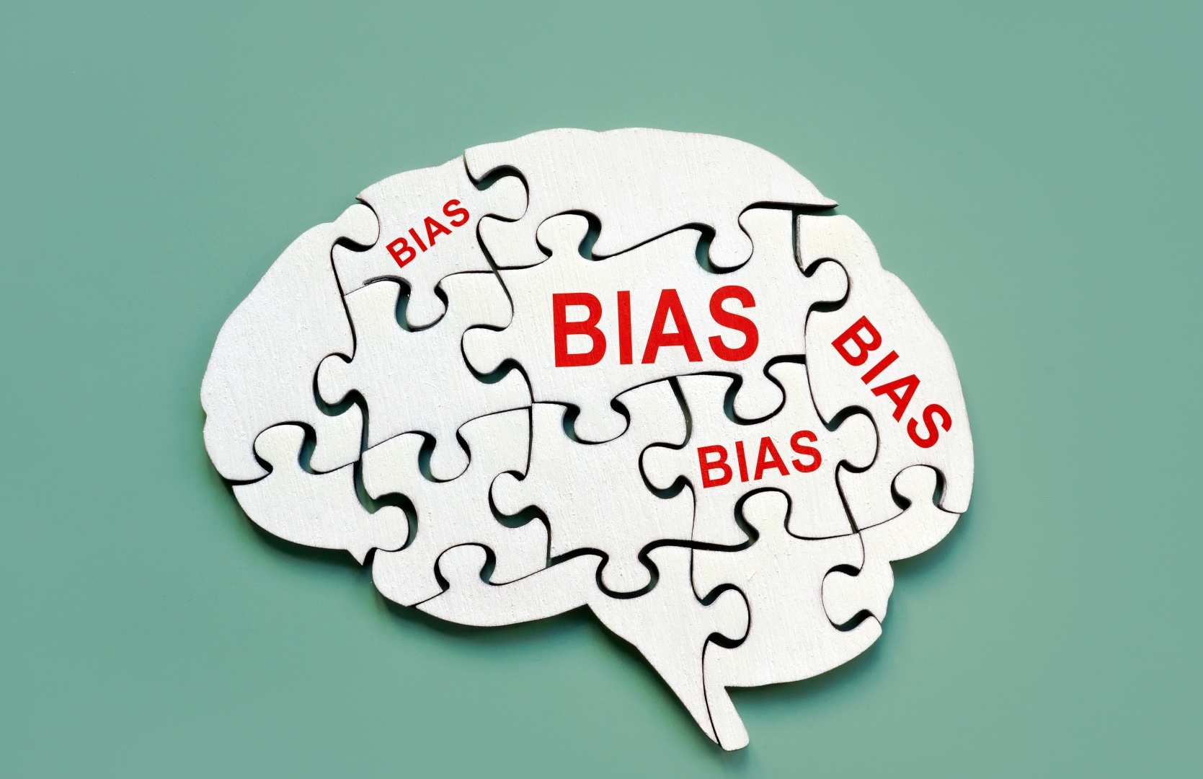
Challenges with pay equity
Being biased can play a significant role in perpetuating pay disparities. Much of the time, this bias is unconscious.
These biases can be rooted in societal stereotypes and can influence compensation decisions.
  Valuation Bias - Decision-makers may unconsciously value certain roles or individuals more than others.
  Gender and Race Bias – Assumptions and stereotypes about gender and race can seep into performance evaluations, promotional offers, and career development opportunities.
Notes:
Being biased can play a significant role in perpetuating pay disparities. Even worse is when that bias is unconscious

Slide 17
AU Practices re: Pay Equity
Equitable policies and procedures
Use of Pay Evaluator, an unbiased tool
Regularly monitor and address concerns
Identify opportunities for Pay Alignment Reviews
Align pay ranges with market rates
Communicate, Communicate, Communicate

Slide 18
pay equity in action
What can you do?
Audits: Perform pay equity audits when triggered to identify and rectify any disparities, ensuring similar work is compensated fairly.
  New Hires
  Department Reorganization
  Changes in Processes and Redistribution of Job Duties
Pay Evaluator: Objective and equitable. Not Black and White.
Diversity and Inclusion: Help others understand that diversity goes beyond race and gender. It encompasses various backgrounds, education, and life experiences which promote equitable opportunities.
  Search Committees
  Pay Decision Makers
If you are not the HR person for your office, what can you do?
Notes:
Pay Evaluator: Is responsible for counting factors relevant to the job as they relate to the minimum qualifications. This is Auburn's response to pay equity, by ensuring that employee's are paid for what they bring to the table. At the same time, it cannot account for everything and sometime further conversations should be had with the compensation team or your HRL to discuss additional factors.
Question Answer:
Assist with dissemination of information, gathering data, and ensuring processes are accurate and efficient.

Slide 19

Effective employee Communication
"The single biggest problem in communication is the illusion that it has taken place." - George Bernard Shaw
Importance of Clear Communication
Appropriate transparency - Clearly explain the what, why, & how.
Regular updates - Provide consistent updates on any changes to compensation. Trust is built on consistency.
Open dialogue - Encourage employees to ask questions and provide feedback.
Training - Equip managers with the skills to effectively discuss compensation; Ensure they are sending the same/ similar message
Confidentiality - Ensure that personal compensation details are kept confidential to maintain trust.

Slide 20
EFFECTIVE EMPLOYEE COMMUNICATION
"In the absence of information, people will make up their own story*."
Do's | Don'ts
Anticipate employees' reactions and prepare accordingly | Voice personal opinions, but focus on the rationale
Start with appreciation | Express dissatisfaction with the pay or performance decision.
Be ready to explain organizational and individual context | Reveal individual pay or performance of other employees
Keep comments neutral | Use complicated compensation terms.
Listen attentively to the employee, accept feedback, and answer questions | Ignore signals that an employee is confused
End on a positive note and be ready for feedback | Not follow up on open issues
*Pay People Right!, by Patricia Zingheim & Jay Schuster

Slide 21

effective communication in action
Communicating Performance Development Progress: Explain how employees' performance influences their compensation with regular updates.
Provide Training Sessions: Provide opportunities to attend training sessions and workshops focused on upcoming compensation changes.
Feedback Mechanisms: Implement feedback mechanisms like anonymous surveys for employees to voice concerns or suggestions regarding pay and communication practices.
  Establish office hours at different locations for drop-ins specifically related to communication efforts.
Caution: While transparency is important, it's essential to collaborate with your compensation team to set realistic expectations and frame communication appropriately to avoid frustration from unfulfilled promises.

Slide 22
What we covered
~
Pay Transparency
Pay Equity
Effective Employee Communication
Q&A and Discussion

Slide 23
Questions & Discussion

