Slide 1
Payroll Best Practices

Slide 2
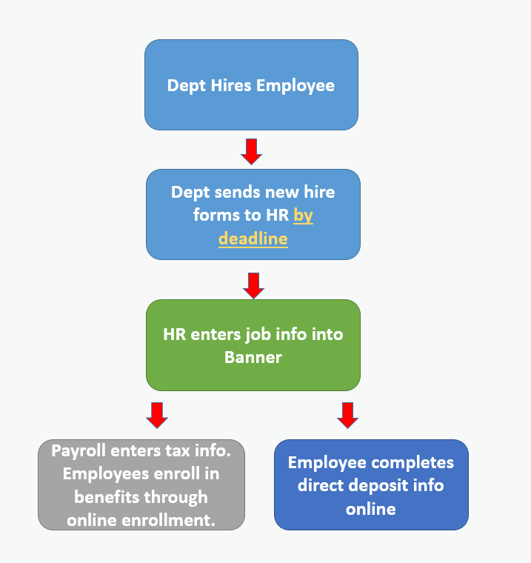
NEW HIRE
PROCESS

Slide 3
The Payroll Calendar
Familiarize yourself with the payroll calendar.
Biweekly - https://www.auburn.edu/administration/human_resources/payroll/documents/2024-biweekly.pdf
Semimonthly - https://www.auburn.edu/administration/human_resources/payroll/documents/2024-semimonthly.pdf
Monthly - https://www.auburn.edu/administration/human_resources/payroll/documents/2024-monthly.pdf
Calendar View
https://www.auburn.edu/administration/human_resources/payroll/documents/2024-payroll-calendar.pdf

Slide 4
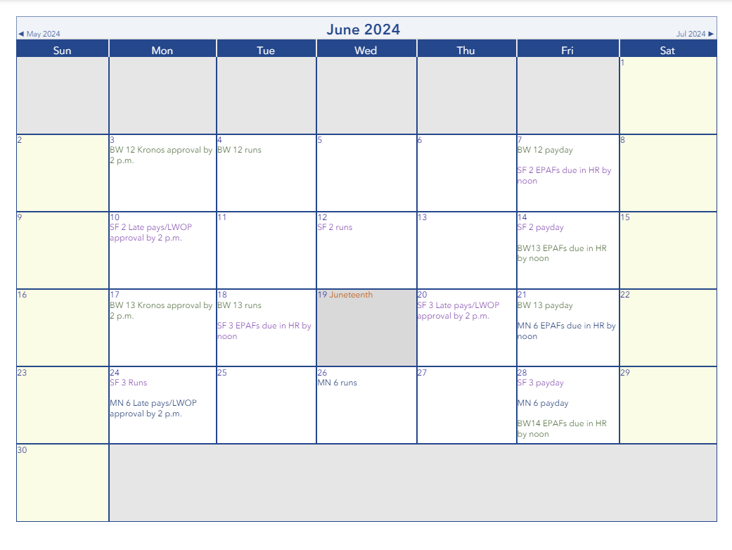

Slide 5
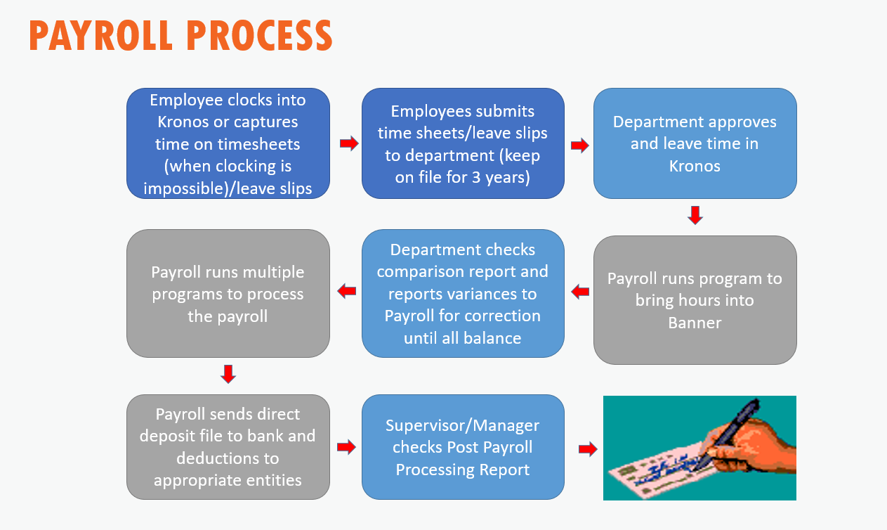
Notes:
Approving Timecards
Important Dates
Checking for Exceptions
Checking for Requests
Deadlines
Time comparison
Changes to Kronos after timecards are locked
Information to send to Payroll
TES chargebacks
Banner Scripts
Questions?

Slide 6
Helpful Payroll Reports
Recap Sheets - runs the morning of Time Entry which is due by 2pm. This report includes all employees in department that have an active job, vacation, sick, and if applicable compensatory time. This is not a required form; some departments find it useful because the information provided.
Time Comparison Report - Payroll runs this report after all time and leave has been extracted from Kronos and loaded into Banner. It shows the hours from Kronos in one column and hours fed into Banner in another column. This report should be reviewed the day after time entry (see payroll schedule for dates). Please email corrections to payroll@auburn.edu no later than 2 pm. An email is sent to timekeepers when the Time Comparison Report is available.
  Timekeepers are solely responsible for meeting these deadlines and requesting any changes in a timely manner.
  Details everyone who worked that is going to be paid, note exclusions
Post Payroll Processing Report - This report is available after the payroll has completed. It should be printed, reviewed, signed by the supervisor, and maintained in the department for 3 years.
** Using all three reports in conjunction will go a long way to not missing anyone who needs to get paid as well as preventing overpayments.

Slide 7
Helpful Payroll Reports (cont.)
Payroll Distribution Report - This report is available when the payroll process is complete. It is a list of employees that were paid by Direct Deposit or by check.
** Auburn University requires direct deposit enrollment for all Alabama based employees. Live checks may be picked up in Human Resources on payday with proper id on payday. We will hold checks for approximately two pay cycles afterward they are mailed to the address on file.
Labor Distribution reporting is available in HR e-print after the Payroll has completed
Labor Distribution - This report is in e-print after each regular scheduled payroll has completed.
Labor Distribution, Adjustment - This report is in e-print after manual checks or voids are processed.
Labor Redistribution - This report is in e-print after Salary Wage Transfers are processed.

Slide 8
Helpful Payroll Reports (cont.)
PZRK142 - to use with the Comparison Report and can be run for one or more TKL
Shows hours, earnings codes, and amounts, per employee
** This report can be run at any time during the payroll process or afterward. If you run this report prior to the second comparison report, you will hours only. If you run it after, you will get dollar amounts and FOAPs. We need to run a CALC script during the payroll process to produce dollar figures and capture finding sources.
PZRK146 - This is a report of leave balances by Timekeeping Location (TKL) and can be run for multiple TKL at one time. This report gives the following information:
  Banner ID
  Name
  Employee Class
  Current Hire Date
  Years of Service
  Vacation Leave Balance
  Vacation Current Accrual
  Sick Leave Balance
  Sick Current Accrual
  Compensatory Leave Balance, if applicable
  Last Accrual Date
  Last Pay Period

Slide 9
Helpful Forms in Banner
PHAHOUR - after hours are extracted from Kronos they are loaded into Banner and can be viewed on this form.
NHIEDST - this form shows all hours paid, earn codes paid and Fringe Charge. This can be done with a date range (date ranges reflects pay dates, not periods worked)
NBAJOBS - This for shows all jobs an employee has had for a selected time period. Very handy for employees with multiple positions.
PEALEAV - This shows time off accrual balances

Slide 10
Employees with Exempt Positions
Employees with exempt positions are monthly salaried employees
Employees with exempt positions are not eligible for overtime pay or compensatory time off
AU requires exempt employees to turn in leave if hours worked in a week are less than 40
All leave must be requested, approved, and logged in Kronos.

Slide 11
Employees with Non-Exempt Positions
As of July 1, 2024, the minimum salary threshold for an employees with exempt positions is $844 weekly, or $43,888 on an annualized basis.
Employees whose positions are designated as non-exempt must record actual hours worked as well as paid and unpaid absences.
Time should be recorded in Kronos via the time clock or time stamp. Time can be submitted on paper only when Kronos isn’t an option and must reflect actual starting and stopping times of work as opposed to the established work schedule.
Employees whose positions are designated as non-exempt are responsible for punching in and out on the timeclock. While there may be the occasional missed punch, supervisors should not be adjusting timesheets for their employees regularly.
Supervisors have the responsibility and obligation to ensure that all working hours and leave hours are properly recorded.
All leave must be requested, approved, and logged in Kronos. Please do not allow anyone to log time off on your behalf.
Notes:
Bullet 2: Regular work hours 7:45 – 11:45, 12:45 – 4:45 but works 8:00 – 12:00, 1:00 – 5:00 time should be recorded as such. Another example - a drs. Appt.

Slide 12
Overtime
The federal overtime provisions in the Fair Labor Standard Act (FLSA) requires that any hours worked over 40 in a workweek are paid at a rate of not less than 1 1/2 times the regular rate of pay.
Averaging of hours over two or more weeks is not permitted. Normally, overtime pay earned in a particular workweek must be paid on the regular pay day for the pay period in which the wages were earned.
For the purposes of overtime holidays are considered time worked. Leave time is not.
Overtime is not subject to Alabama State Income Tax. Federal and local taxes do apply.
Notes:
Bullet 2: Regular work hours 7:45 – 11:45, 12:45 – 4:45 but works 8:00 – 12:00, 1:00 – 5:00 time should be recorded as such. Another example - a drs. Appt.

Slide 13
Late Pay Certification for
Monthly & Semimonthly Paid Employees
When to process a Late Pay (hopefully never)
Late Pays should be processed when a monthly or semimonthly employee is not paid or not paid correctly during the normal pay cycle. The Late Pay should be submitted prior to the processing of the next regular scheduled pay cycle and after the job has been corrected. The form may be emailed to payroll@auburn.edu.
How to calculate amount to pay if less than a full payment was earned.
Assigned salary x days worked / total working days in pay period (workdays do not include Saturday or Sunday).
Off-Cycle Manual Pays are considered exceptions and are processed at our discretion, based on our available time and capacity to process them. At a minimum they require a detailed explanation or demonstrable hardship for the employee in question. Failing to meet established payroll deadlines should not automatically warrant a manual check. It’s essential for the department to take ownership of its processes and effectively manage employee expectations.
** Late pays should be an occasional exception, not the norm.

Slide 14
Late Pay for Employees with Non-Exempt Positions
Time worked or leave not paid in the regular scheduled pay cycle should be entered as a historical edit in Kronos and will be paid the next scheduled pay cycle.
Late pay forms for biweekly employees should only be submitted when there is a rate change for the previous pay period.
Off-cycle manual pays are not typically processed for biweekly employees. Only if the employee or job is terminated.

Slide 15
Overpayment Recovery
Salary paid to an employee incorrectly is expected to be re-paid to Auburn University by employee.
PROCEDURES :
Departments must notify Payroll & Employee Benefits (PEB) of overpayment
Department must correct information in payroll system
Payroll Office is responsible for calculating and notifying department amount to be re-paid
Department will work with employee to establish a reasonable payment arraignment.
Department is solely responsible for the timely recovery of overpaid funds
Payroll is responsible for adjustments to W2 or W2c when overpaid amount is paid in full
Please do not overpay anyone, it’s difficult to get the funds back and it’s a headache to fix for everyone involved

Slide 16
Compensatory Time
As a public employer, the University has the option of providing compensatory time off in lieu of the earned overtime premium pay for hours worked over 40 in a workweek.
Compensatory time off must be at a rate not less than one and one-half hours for each overtime hour worked.
The FLSA regulations allow us to enter into an agreement to offer compensatory time off to individual employees, if an agreement is in place prior to the performance of work.
Overtime and compensatory time cannot be alternated back and forth once the agreement is in place.
Notes:
Bullet 2: Regular work hours 7:45 – 11:45, 12:45 – 4:45 but works 8:00 – 12:00, 1:00 – 5:00 time should be recorded as such. Another example - a drs. Appt.

Slide 17
Leave Administration
Annual Leave:
Full-time eligible employees earn annual leave at the accrual rate of 160 hours per year.
Accrual rates of annual leave for full-time nonexempt and exempt employees are identical. Part-time employees who have an FTE (Full Time Equivalent) will accrue leave at a prorated amount, based on that FTE.
Sick Leave:
Full-time employees will accrue sick leave at the rate of 96 hours per year.
Can be used for personal or family reasons, must be related to a medical condition.
Auburn defines immediate family as spouse, son, daughter, parents, stepchild, stepparent, brother, sister, stepbrother, stepsister, half-brother, half-sister, father-in-law, mother-in-law, brother-in-law, sister-in-law, son-in-law, daughter-in-law, grandchild, grandparent, and grandparent-in-law.
Auburn also offers leave for Community Service, Bereavement, Jury Duty, Military Service, and Poll Workers.
All leave is to be requested by the employee in Kronos. Please do not allow anyone to log leave time on your behalf.
Notes:
Bullet 2: Regular work hours 7:45 – 11:45, 12:45 – 4:45 but works 8:00 – 12:00, 1:00 – 5:00 time should be recorded as such. Another example - a drs. Appt.

Slide 18
Leave Without Pay (LWOP)
Extended sick leave without pay (Involuntary LWOP): A memorandum of request for extended sick leave without pay should be submitted in advance through the department head to Human Resources for approval. The employee should provide a statement of their intended return date. Such leave, once approved, will not exceed a period of six months.
Voluntary Leave Without Pay: Refers to employees who have exhausted applicable paid leave time, but who, for approved reasons, are not immediately returning to work.
Disciplinary LWOP: See Employee Relations

Slide 19
Other Items
Request for Manual Payment - Charge $100.00 per payment
Remember this is a request subject to approval, not a guarantee of off-cycle payment.
Request for Overpayment Calculation - Charge $100.00 per employee
Please remember to keep timekeepers updated in Kronos.
When a timekeeper terminates, they are removed from Kronos but if their duties change or if they transfer, please notify the department’s Computer Coordinator so they can be removed. Questions concerning Kronos can be directed to payroll@auburn.edu.
Every department should have a trained backup.
The payroll calendar and all deadlines are posted well in advance. It is incumbent on the timekeepers and supervisors to adhere to those deadlines to avoid late payments and adjustments.

Slide 20
Additional Resources
Other Training Available:
US107C Kronos/Timekeeping
https://learningmanager.adobe.com/app/instruc?i_qp_user_id=19460686&accountId=114654#/session/1680093/overview
HR103C Human Resources-Payroll Processes and Leave Administration
https://learningmanager.adobe.com/app/instructor?i_qp_user_id=19460686&accountId=114654#/session/1680092/overview
HR505E Auburn's Guide on Timekeeping.
https://learningmanager.adobe.com/app/learner?accountId=114654#/course/9736784
One-on-one 30-minute Kronos training:
aub.ie/kellykronos
One-on-one EPAF training:
https://aub.ie/aprilm
Notes:
Bullet 2: Regular work hours 7:45 – 11:45, 12:45 – 4:45 but works 8:00 – 12:00, 1:00 – 5:00 time should be recorded as such. Another example - a drs. Appt.

Slide 21
Contact Information
Payroll & Employee Benefits
AU Human Resources
1550 East Glenn Avenue
Auburn, AL 36849
payroll@auburn.edu

