Slide 1
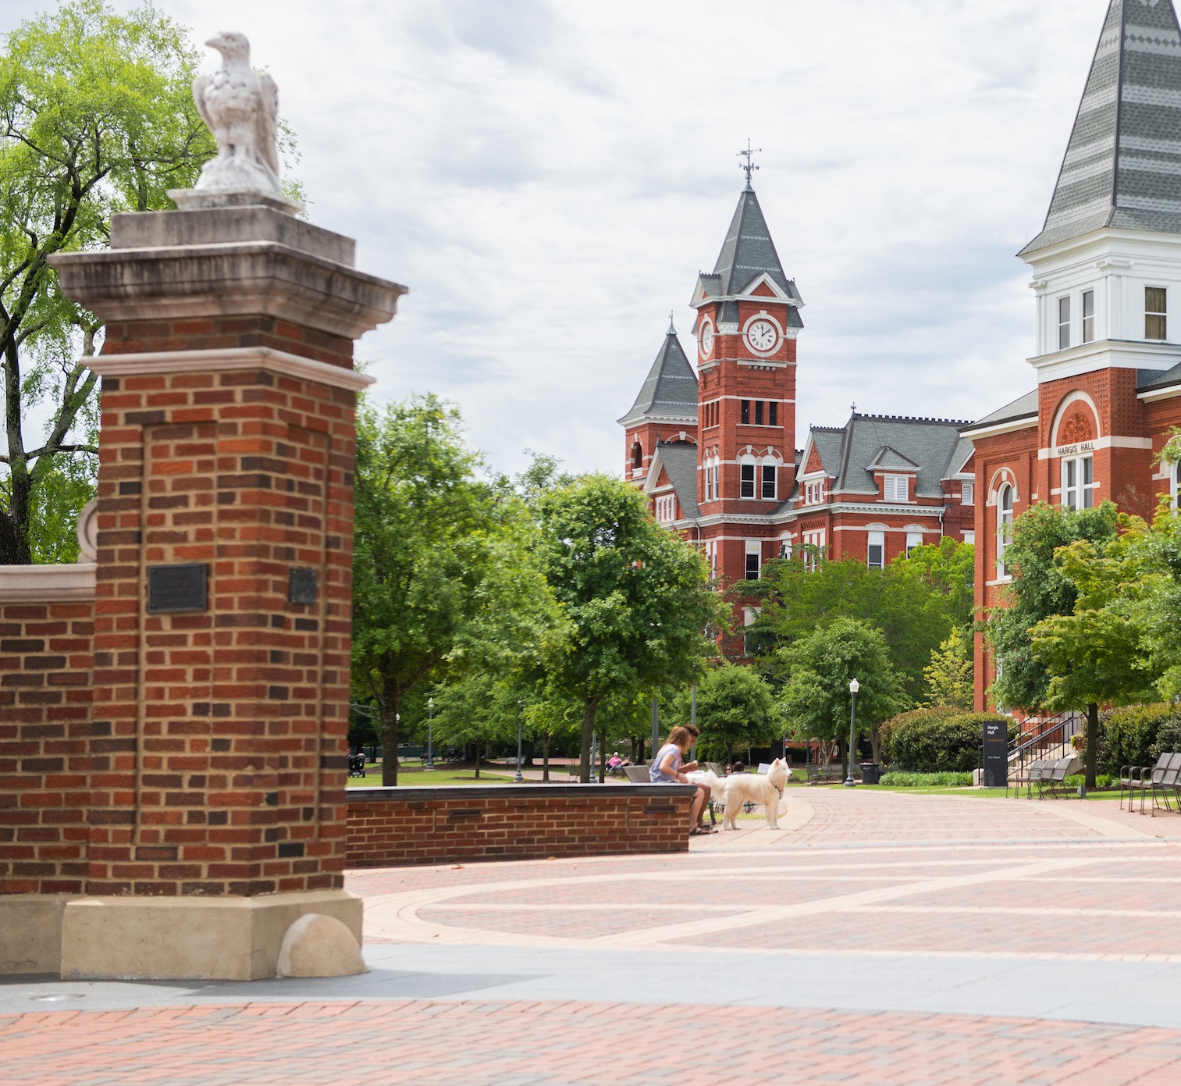
AU Performance & Leadership Development Journey
UHR Conference
23 July 2024
Notes:
Auburn’s Performance & Leadership Development Journey

Slide 2
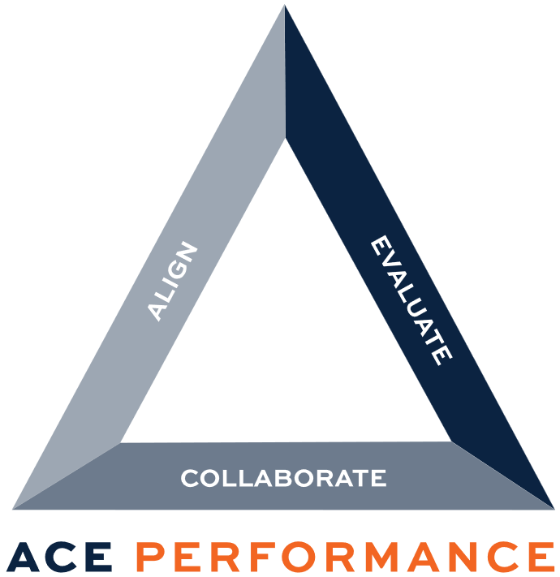

Two Simultaneous Initiatives
Introduced on 15 July 2024

Slide 3


Slide 5


AU Performance Management
< < < Past

Slide 6

Pre-2017 AU Supervisor’s PM Toolkit
Job Proficiency:
Select 3-7 job duties that describe the employee’s most important activities/goals.
What if priorities change?
What about the non-rated job functions?
Rubric:
Leading performance
Strong performance
Building performance
Improvement essential
No middle ground
for meeting expectations
Vague measures
PM Workbook:
Included a log for employees to track job accomplishments throughout the year
What was appraised?
Soft skill behaviors (the how)
Hard skill behaviors (the what)

Slide 7
2018: Template with no vendor
Good:
  Regularly scheduled meetings (1v1)
  Documented goals & timelines
  Easy-to-use form
  (But we changed it)
  Constructive feedback
  Self-evaluation
Bad:
Paper form (not electronic)
Unclear expectations/goals
Confusing form
Subjective
Not merit-based, inequities
Rating choices
Timeline
(May evaluation | October merit pay)
Other (Improve):
Make the process and
new form electronic
Make reviews quarterly
Train on the process
Identify clear standards
for fairness
Add a “Meets Expectations” rating option
Add Supervisor evaluation
Real-time feedback
Merit pay transparency
  How is it determined?

Slide 8
2019-2024: Multi-page template; PeopleAdmin
2019-20
2020-21
2022-24
”New” paper form still being used while PeopleAdmin system is being built.
PeopleAdmin introduced (not user-friendly).
Supervisors given option to submit “paper form” or PeopleAdmin.
PeopleAdmin contract cancelled.
Utilized “paper form” submissions only.

Slide 9









Working Group Team
22 Members representing 11 Colleges/Units: March 2023-present
Notes:
Problem frame // Assumptions // Qualtrics // KLEs // Focus-groups // UHR Conference

Slide 10
We wanted to know if the below was a trend
Is there anything we can do to encourage faculty supervisors to engage with this system? …my supervisor has mostly treated PM as a chore to do once a year. I will soon be leaving my position, but I don’t want others to end up in a similar situation. ​
                E-mailed to HRD from an
                AU employee on 6 Jun 2023
Qualtrics Engagement Survey Conducted: July 2023

Slide 11
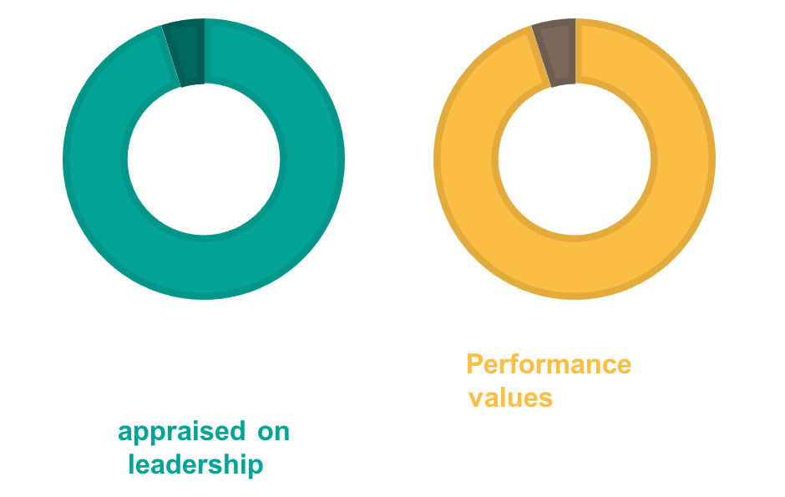
Performance Development
    Campus Survey, Summer 2023
      Job clarity and feedback discussions are lacking.
      The form is cumbersome and not automated.
      Leadership training at the supervisor level is needed.
    Paradigm shift (New Process)
      Partnership, collaboration, communications.
      Simple and automated. Internal vendor.
      Values (What we do and How we do it).
      Supervisor Leadership Competencies.
Notes:
Functions and Values
“My supervisor has mostly treated PM as a chore to do once a year.” - AU employee, 6 Jun 2023
3,983 US, A&P employees eligible to take the survey. 1,936 took the survey. 49%
1,606 comments.
1,877 stated supervisors should be appraised on leadership.
1,839 stated both performance and values should be evaluated.
716 stated PM Conversations are not happening.
677 stated planning and goal setting is not happening.

Slide 12
What is Performance Development?
The process of developing people to achieve optimal performance through collaboration, goal-setting, and growth opportunities.
- Auburn University Human Resource Development

Slide 13
AU Performance Development
• • • Present

Slide 14

Align, Collaborate, Evaluate (ACE) Performance:
AU Performance Development for A&P and Staff
1
2
3
Align:
June-July
Review job summary, functions assigned, other functions performed.
Collaborate: July-April
Review job performance, goals, development opportunities, accomplishments.
Evaluate:
May-June
Rate employee job functions and adherence to Aspire core values.
Rate supervisor’s adherence to leadership principles.
www.aub.ie/performance
Notes:
https://www.auburn.edu/administration/human_resources/hrd/documents/ace-align-collaborate.docx

Slide 15
ace-align-collaborate.docx (live.com)
Align Phase
Collaborate Phase
Evaluate phase

Slide 16
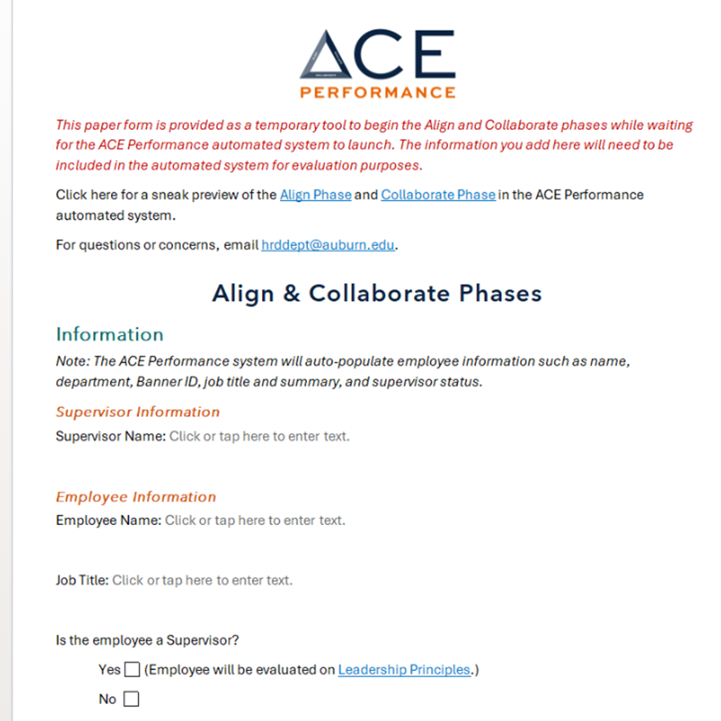
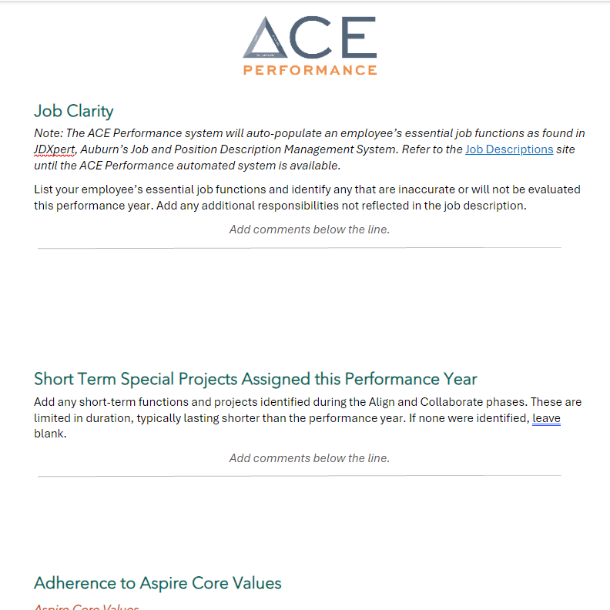

Slide 17
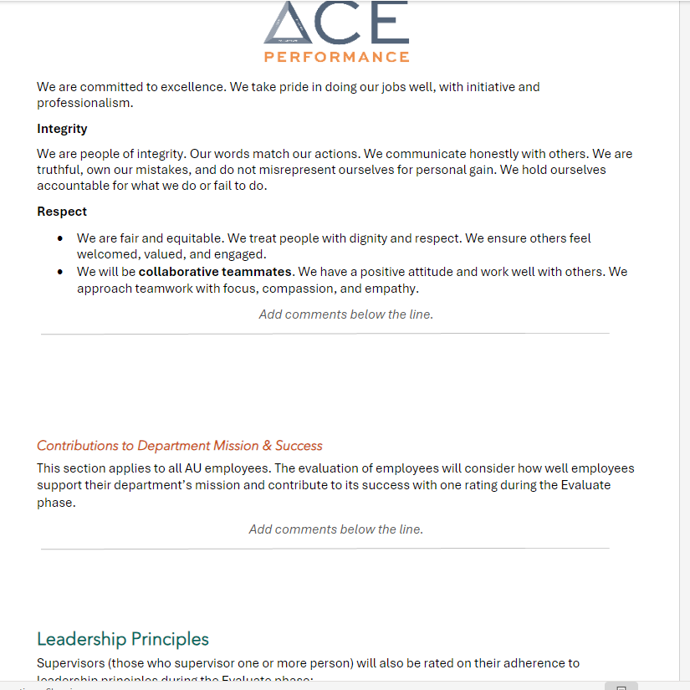
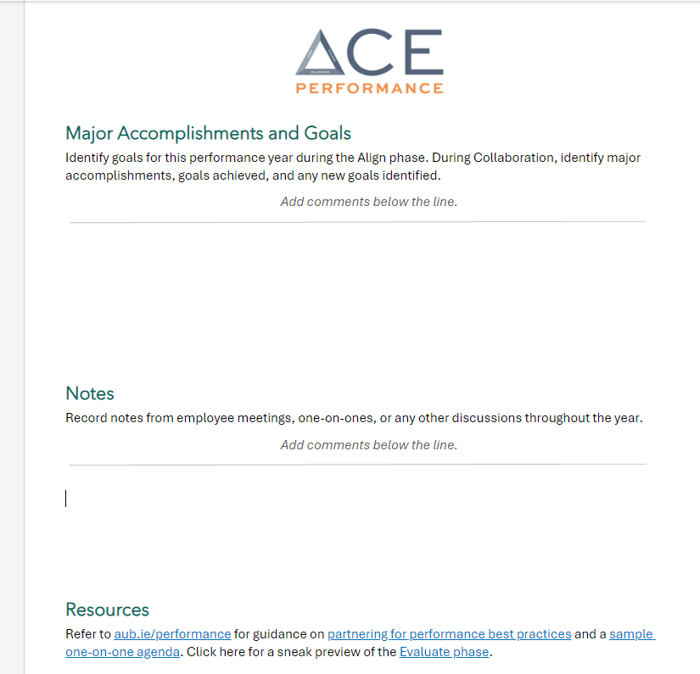

Slide 18
AU Performance Development
> > > Future

Slide 19
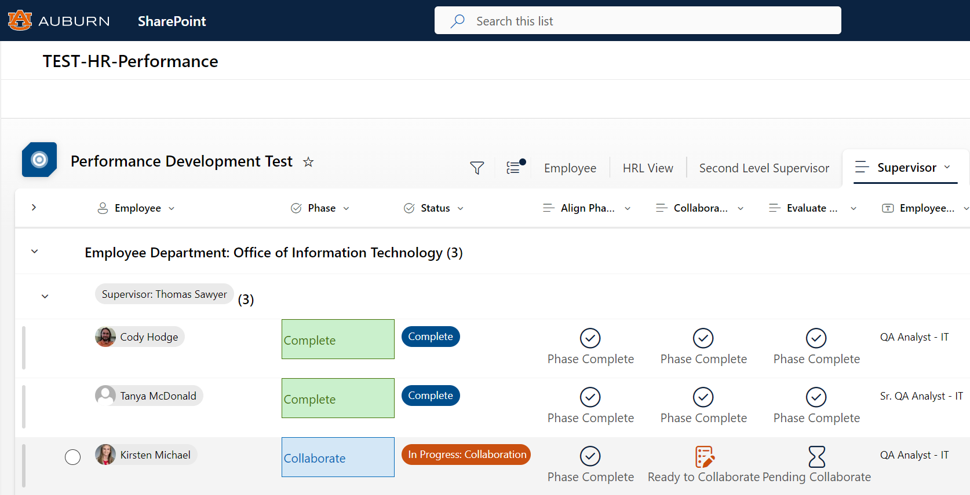
Notes:
Four primary roles:
Supervisor; Employee; 2nd Level Reviewer; HRL

Slide 21
AU Leadership Development
< < < Past

Slide 22
Leadership Development
Prior to 2019:
  HRD classes
2020-2024:
  Supervisor Pathways
    Primarily for Supervisor’s
    Two-year commitment
    135 trained in 4 years
  HRD Classes
Notes:
Oji Life Lab study
We need to break the cycle and implement leader development before statements like the above happen at AU.

Slide 23
Inconsistent Supervisory Leadership
My supervisor’s comments were hurtful.
Supervisors just breeze through it like another administrative task and do not really sit down with you.
There is more focus on negative development needs rather than professional growth opportunities.
I am blessed to have an amazing supervisor who spends a lot of time and effort on my performance planning and review.
From Qualtrics Engagement Survey: Jul 2023

Slide 24
40% of U.S. workers feel stress or anxiety about going
to work because they feel they have a first-time manager who seems unprepared to take on the leadership role.
36% of workers said they lack motivation at work due
to the new manager’s lack of leadership skills and training.
- HRDIVE, 24 July 2023
Notes:
Oji Life Lab study
We need to break the cycle and implement leader development before statements like the above happen at AU.

Slide 25

According To Gallup:
Seventy-nine (79%) of employees (in the US) who resign cite “Perceptions of not being appreciated by their manager” as a key reason for leaving.
Notes:
This slide represents 100 women / employees. 79% of employees who resign say it’s due to management or leadership. People don’t leave organizations, they leave leaders.
Consider the impact of those resignations.– ASK: what happens to teams and organizations when people leave?
(Look for: Knowledge loss, re-training, the time and cost to hire replacements.)
It’s very significant. Boeing example: For 12 years Boeing with no profit. The last time they were in economic trouble, they offered seasoned and experienced engineers early retirement. A bunch said they’d take it. Then, all of a sudden, Boeing lost all of their job knowledge. They ended up hiring many of them back as consultants and at a much higher price!

Slide 26
AU Leadership Development
• • • Present

Slide 27
Leadership Development
Advisory & Working Groups
Kelli Shomaker
Dean Susan Hubbard​
Dean Jason Hicks​
Dean Leigh Ann Ross​
Dean Jennifer Mueller-Phillips​
Kevin Robinson
Erin Lewis
Dr. Asim Ali​
​ ​Karla McCormick
Dr. Maria Witte​
Julie Huff​
Dr. Angela Wiley​
Dr. Lisa Kensler​
Dr. Cindy Bowling​
Dr. Laura Downey​
Dr. Dan Surry​
Dr. Liesl Reiners​
Dr. Karen Hopkins​
Julia Wiard​
Bill Shannon​
Loren Winn​
Jill Albin-Hill​
Hope Stockton​
Mandy Deveraux​
Mallory Carden​
Ashley Gann​
Kim McCadden​
Josh Henderson​
Evelyn Johnson​
October 2023- Present
Notes:
Cross section of Deans, SVPs, Faculty, and Staff.
Built for us, by us. Not outsourced. AU culture & values.

Slide 28
Leadership Development
    Survey Results led to:
    Leadership Development Advisory Group & Working Groups.
    Leadership development for ALL employees.
      Built on foundation of Auburn Creed, Core Values, Strategic Plan.
      Leading Self, Leading People, Leading Teams and Leading the Organization.
    Self Paced, Classroom, Virtual, Cohorts, Seminars.

Slide 29
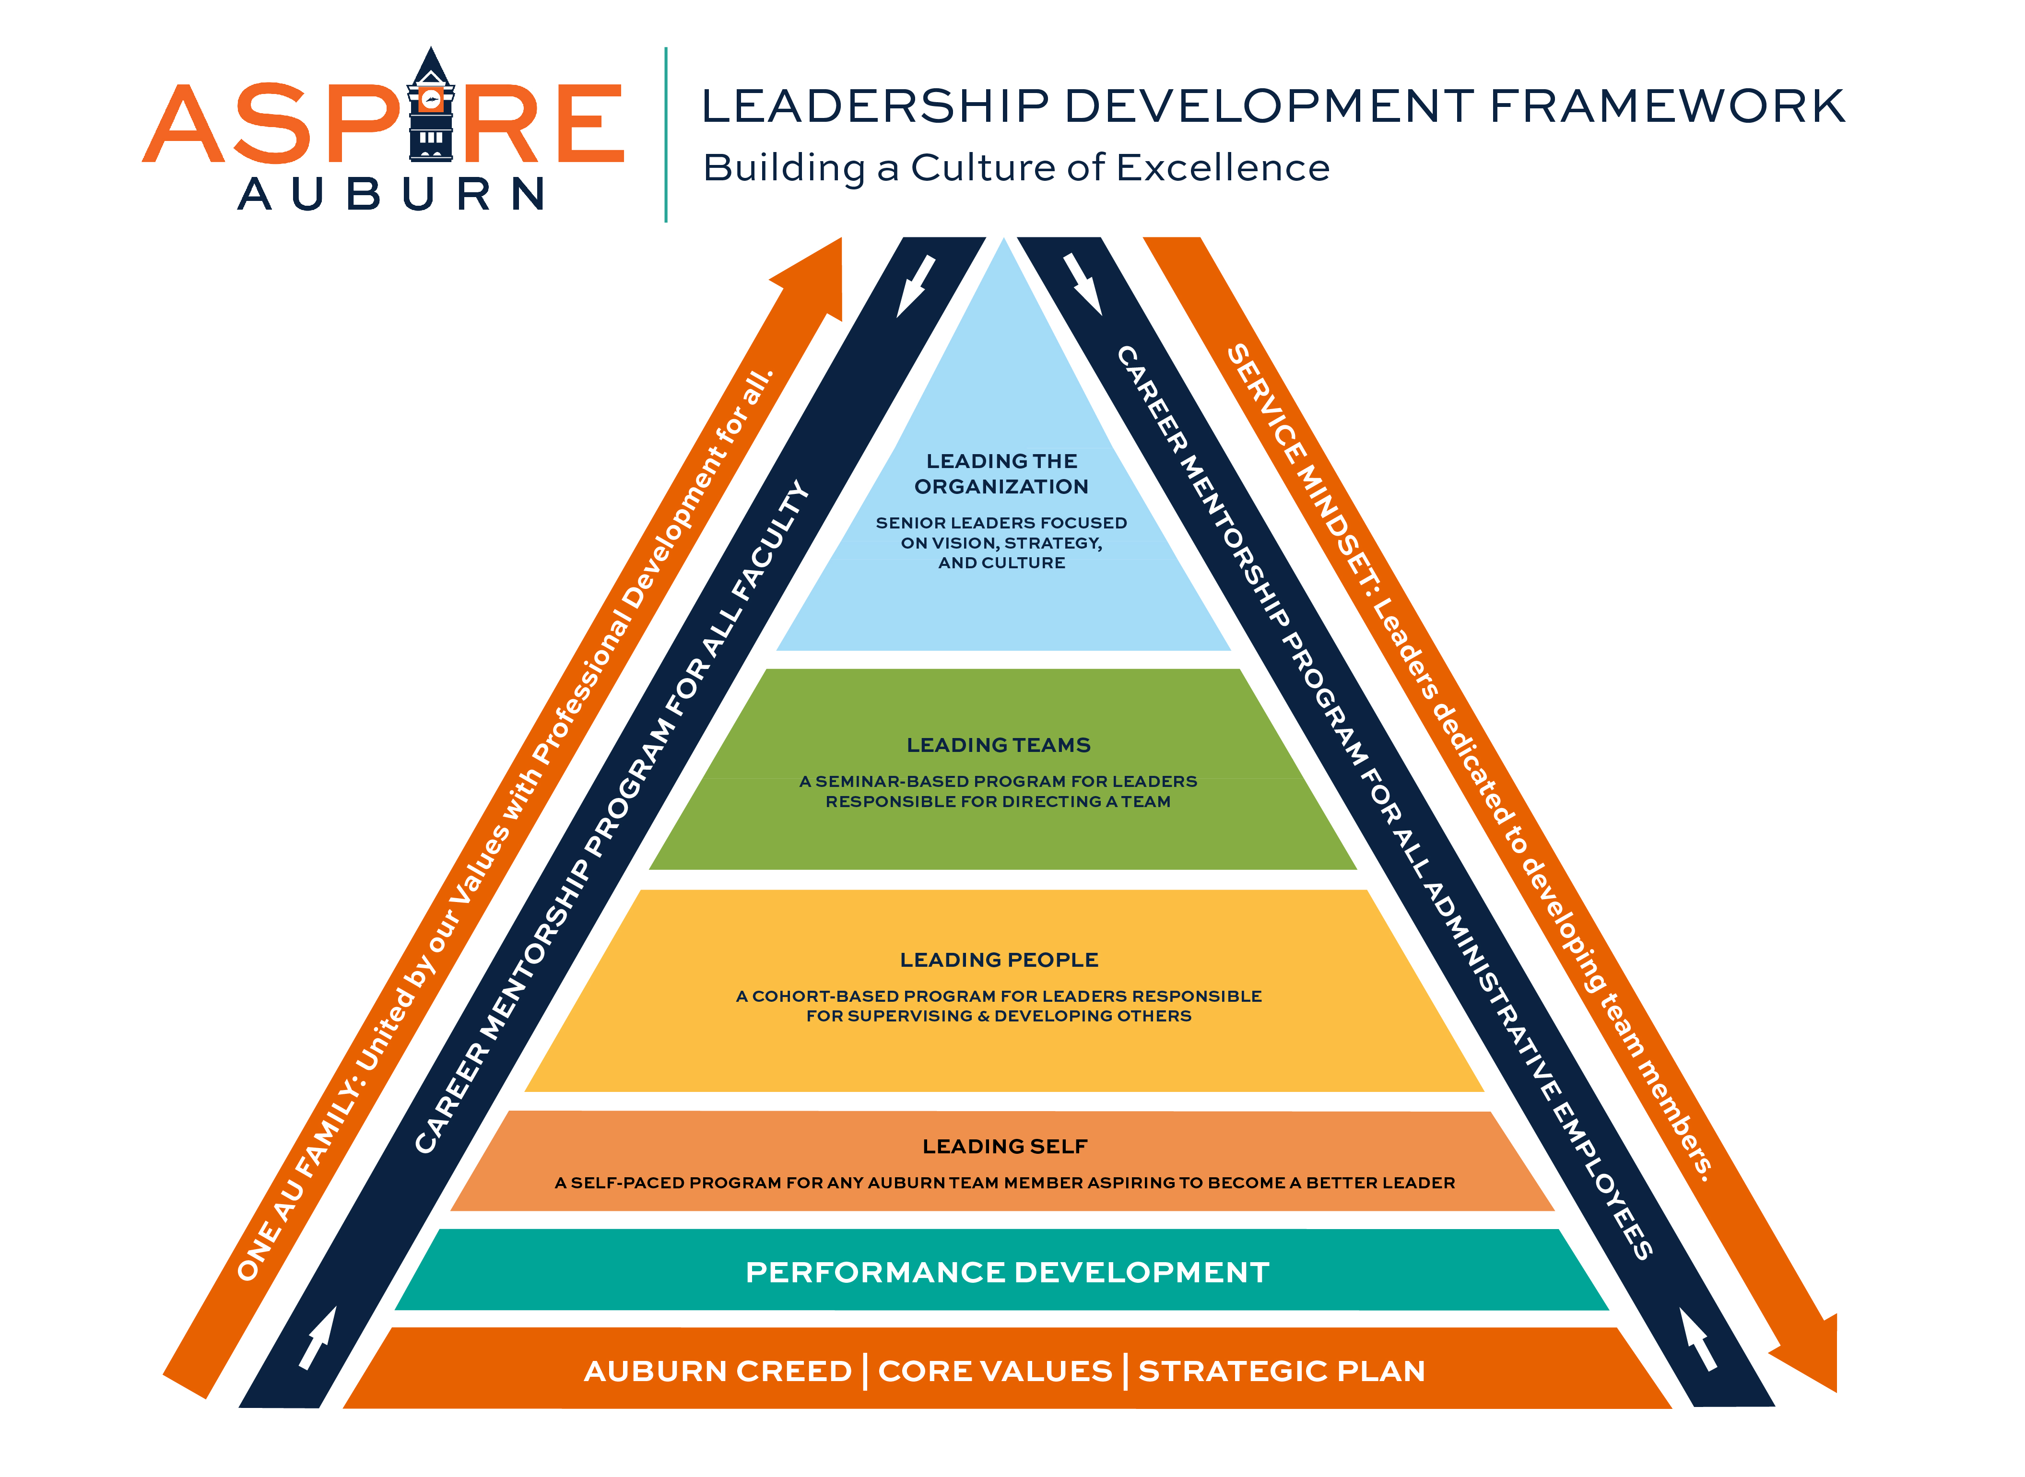
Notes:
Identify the standard,
Train to the standard,
Hold people accountable to the standard.

Slide 30
Aspire Core Values
Excellence:
  We are committed to excellence. We take pride in doing our jobs well, with initiative and professionalism.
Integrity:
  We are people of integrity. Our words match our actions. We communicate honestly with others. We are truthful, own our mistakes, and do not misrepresent ourselves for personal gain. We hold ourselves accountable for what we do or fail to do.
Respect:
  We are fair and equitable. We treat people with dignity and respect. We ensure others feel welcomed, valued, and engaged.
  We will be collaborative teammates. We have a positive attitude and work well with others. We approach teamwork with focus, compassion, and empathy.

Slide 31
Aspire Leadership Principles
Empower and Enable Teammates:
  Supervisors will foster an open dialogue. They will let people finish their work and be responsible for their work. They will define success and ensure team members are equipped to achieve department/unit goals.
Develop Self and Teammates:
  Supervisors will provide tasks and assignments that promote development. They will hold frequent development discussions and seek growth opportunities for self and others. They will be aware of team members’ career goals and construct compelling development plans. Supervisors will care for their team members.
Practice a Service Mindset:
  Supervisors are dedicated to meeting the expectations and requirements of internal and external "customers" and teammates. They will communicate with them to build relationships, find win/win solutions, and solve problems together. They will act in the interest of others to build trust.
Notes:
“Supervisors will uphold basic leadership principles…”

Slide 32
AU Leadership Development
> > > Future

Slide 33
Timeline
Spring 2026
Spring 2025
Leading Teams
Leading People (New Supervisors)
Summer/
Fall 2024
Fall 2024
Leading People
  AU Strategic Plan
  Leading Self
ACE Performance
Leading the Organization
FTE (Faculty, Staff, A&P) = 6,635
FTE (Faculty) = 1,435
Total Supervisors = 1,228 (Not including below)
Dir/Dept Chairs = 282
AVP/Dean/VP/SVP = 37
Notes:
Fall 2024: HRL discussions with departments.

Slide 34
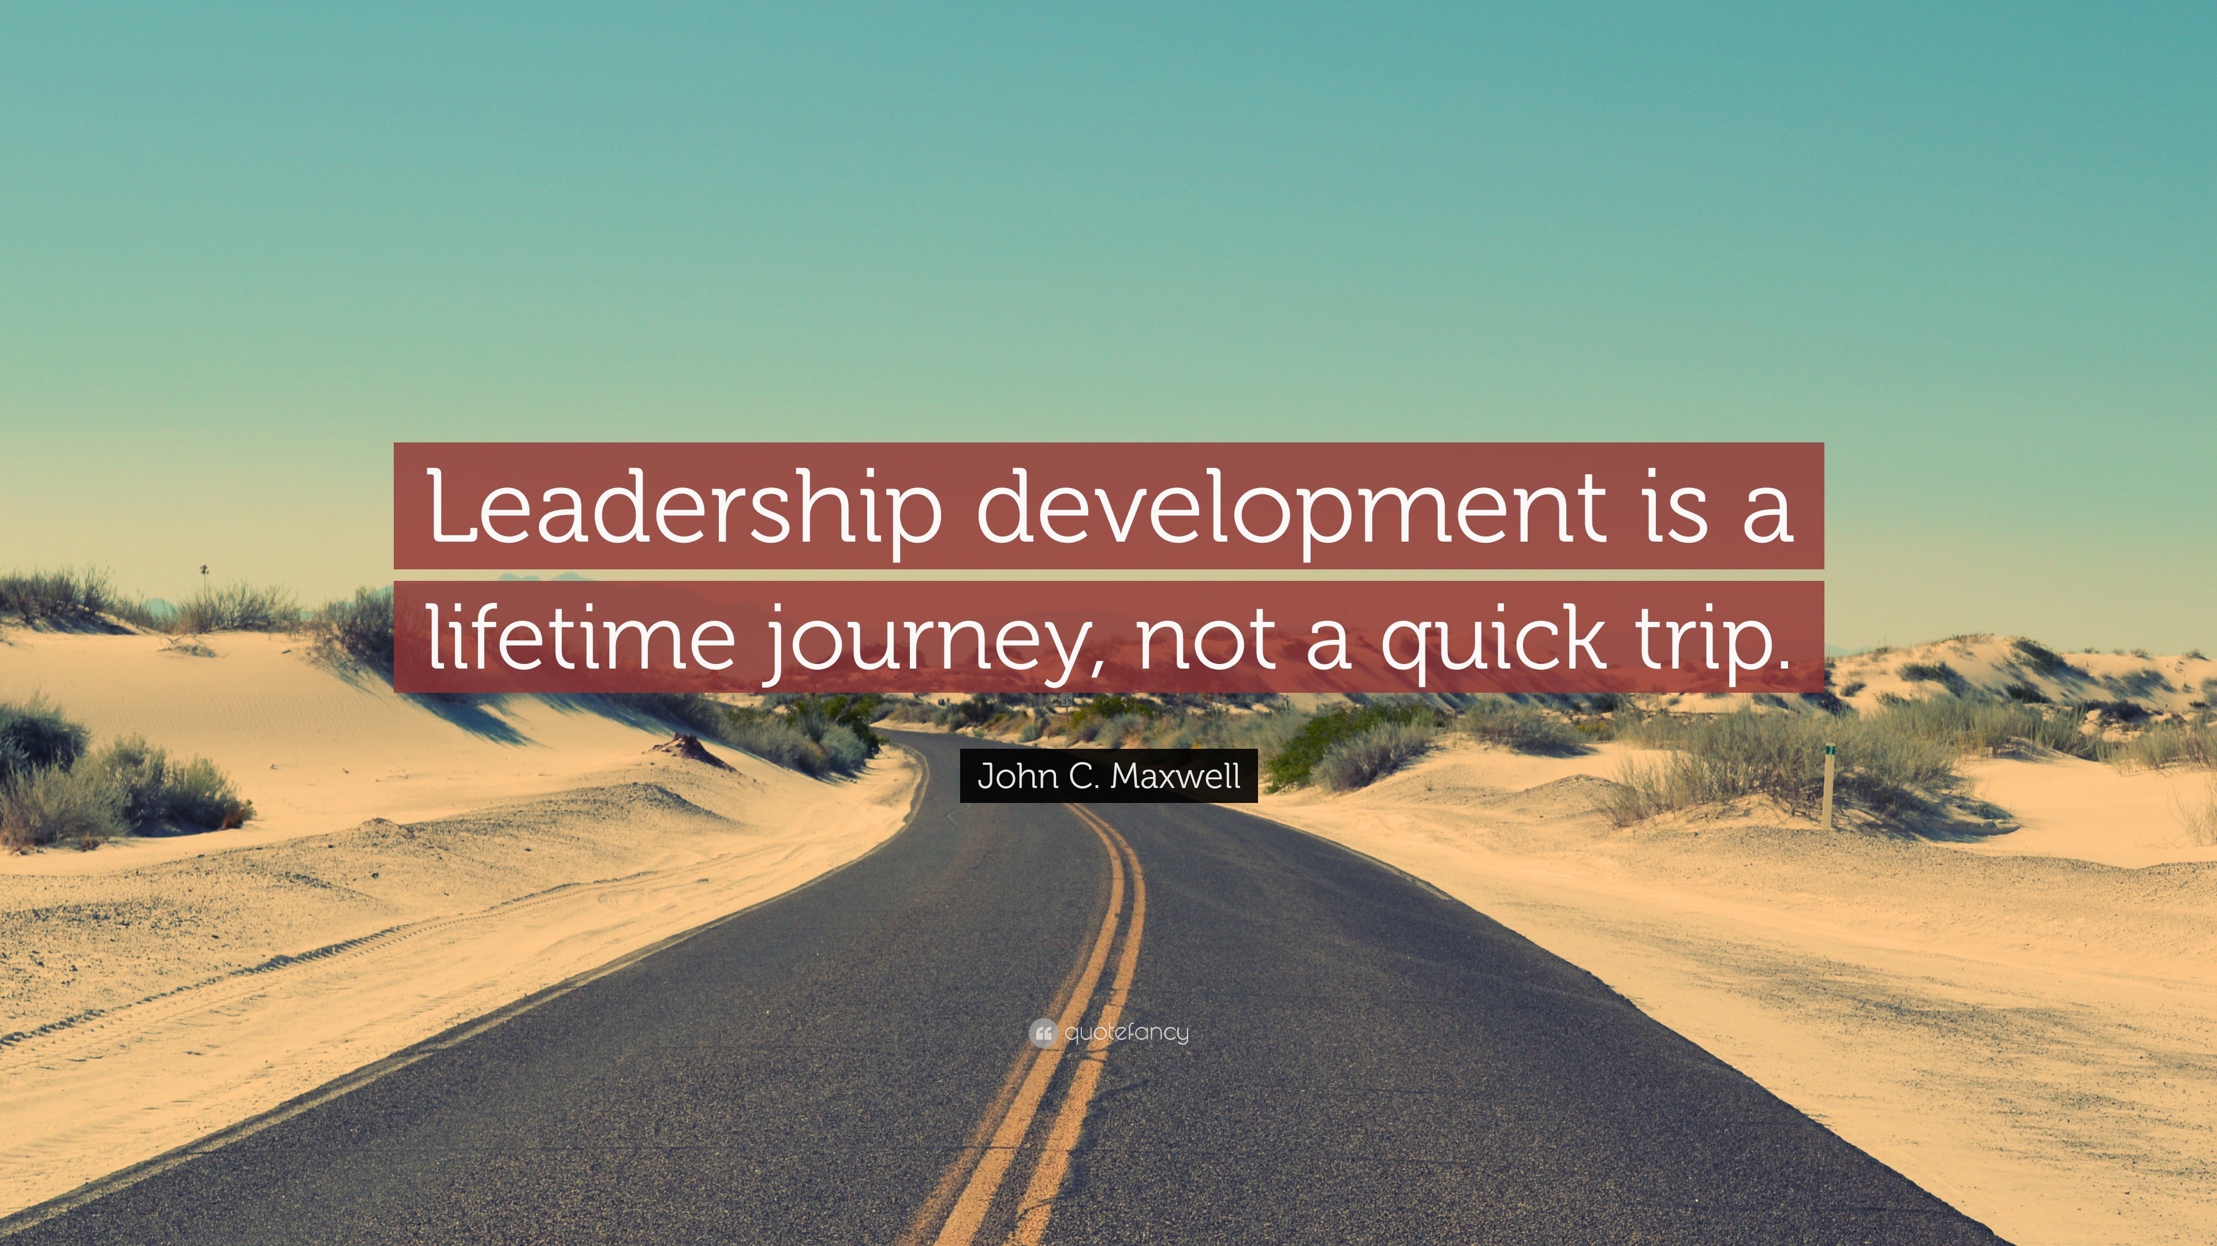

Slide 35
Comments & Questions
Chris Richie, Director, Human Resource Development | csr0037@auburn.edu
The Auburn family believes in strong
work ethic, education, honesty, sound body/mind, compliance, and the
human touch.​
These foundational values can be leveraged to guide coaching,
evaluating and developing our employees.
Work ethic​
  Job proficiency and Knowledge​
  Professionalism and soft skills​
Education ​
  Professional Development ​
Honesty​
  Integrity ​
Sound Body/Mind​
  Commitment to excellence​
  Personal Development​
Compliance​
  Adheres to AU and Department/unit policy​
Human Touch​
  Teamwork / Inclusion​
  Leadership​
​

