Slide 1
Timekeeping Q & A

Slide 2
Accurate Time Recording
The complete and accurate recording of actual working and leave hours is not only an Auburn University policy but more importantly a federal law which ensures that employees are paid fairly for the work that they perform. This includes any work done after regular business hours.
Auburn University employees whose positions are designated as non-exempt are required by the FLSA to maintain accurate daily records of work time — through Kronos, the electronic timekeeping system used at Auburn.
Notes:
Bullet 2: Regular work hours 7:45 – 11:45, 12:45 – 4:45 but works 8:00 – 12:00, 1:00 – 5:00 time should be recorded as such. Another example - a drs. Appt.

Slide 3
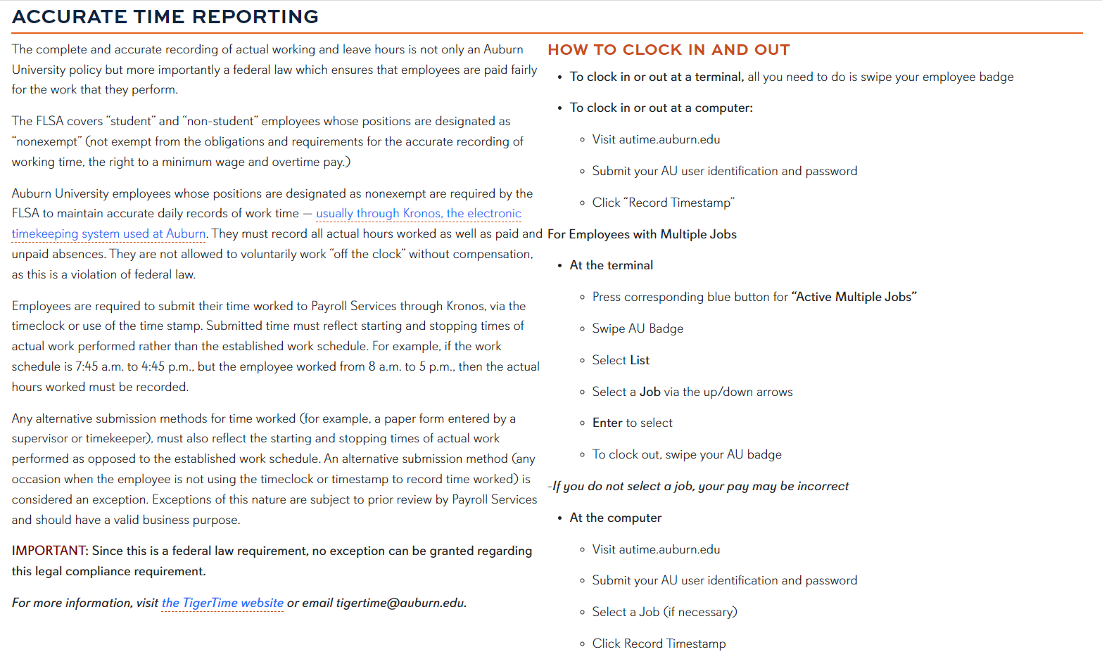

Slide 4
The Payroll Calendar
Familiarize yourself with the payroll calendar.
Biweekly - https://www.auburn.edu/administration/human_resources/payroll/documents/2024-biweekly.pdf
Semimonthly - https://www.auburn.edu/administration/human_resources/payroll/documents/2024-semimonthly.pdf
Monthly - https://www.auburn.edu/administration/human_resources/payroll/documents/2024-monthly.pdf
Calendar View
https://www.auburn.edu/administration/human_resources/payroll/documents/2024-payroll-calendar.pdf

Slide 5
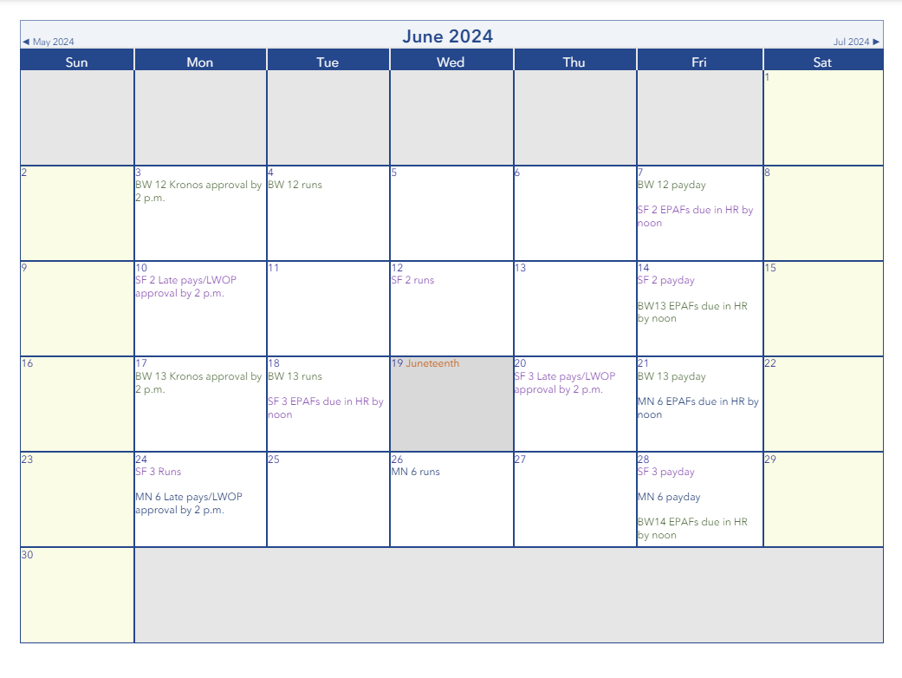

Slide 6
Timekeeper responsibilities
Monitor Timecards Weekly:
  Review timecards every Friday to ensure completeness and accuracy.
  Follow up with employees and supervisors as needed.
Address Missed Punches and Unexcused Absences:
  Promptly handle discrepancies in timecards.
  Ensure missed punches and unexcused absences are appropriately addressed.
Manage Employee Requests:
  Process timecard edits requested by employees.
  Address time-off requests and ensure they are no longer in the “submitted” status.
Confirm Weekly Standard Hours:
  Verify that nonexempt employees meet their weekly standard hours (typically 40 hours).
  Consider time worked, requested time off, or leave without pay.
Review Timecards Before Payroll Processing:
  Before each pay period ends, review timecards.
  Manage leave approvals and approve pending requests.

Slide 7
Timekeeper responsibilities (cont.)
Approve Timecards:
  If requested in writing, approve timecards for supervisors.
  Ensure all timecards are approved by 2:00 p.m. on the day before payroll processing.
Sign Off on Unapproved Timecards:
  As a timekeeper, sign off on unapproved department or division timecards.
  Demonstrate due diligence in addressing missed punches and pending time-off requests.
Adhere to Payroll Calendars and Deadlines:
  Stay informed about payroll schedules and deadlines.
  Timely approvals are critical for accurate compensation.

Slide 8
Best Practices in Timekeeping
Direct Employees to Their Supervisors:
  For timecard edits, guide employees to their supervisors rather than making changes yourself.
Encourage Employees to Own Their Time:
  Advise employees to retract or cancel time off requests if changes are necessary.
Save Email Documentation:
  Keep records of all change requests via email for reference.

Slide 9
What Not to Do
Do Not Approve Timecards on Behalf of a Supervisor Without a Written Request:
  Exceptions require a written request and should be rare.
Do Not Approve Time-Off Requests Without a Written Request:
  Supervisors should approve time-off.
** You should give supervisors every opportunity to edit and approve timecards and time-off requests. In the absence of direct supervisor activity, it is a timekeeper responsibility to ensure all time worked and time-off is reviewed and approved prior to the time entry deadline.

Slide 10
Employees with Non-Exempt Positions
As of July 1, 2024, the minimum salary threshold for an employees with exempt positions is $844 weekly, or $43,888 on an annualized basis.
Employees whose positions are designated as non-exempt must record actual hours worked as well as paid and unpaid absences.
Time should be recorded in Kronos via the time clock or time stamp. Time can be submitted on paper only when Kronos isn’t an option and must reflect actual starting and stopping times of work as opposed to the established work schedule.
Employees whose positions are designated as non-exempt are responsible for punching in and out on the timeclock. While there may be the occasional missed punch, supervisors should not be adjusting timesheets for their employees regularly.
Supervisors have the responsibility and obligation to ensure that all working hours and leave hours are properly recorded.
All leave must be requested, approved, and logged in Kronos. Please do not allow anyone to log time off on your behalf.
Notes:
Bullet 2: Regular work hours 7:45 – 11:45, 12:45 – 4:45 but works 8:00 – 12:00, 1:00 – 5:00 time should be recorded as such. Another example - a drs. Appt.

Slide 11
Late Pay for Employees with Non-Exempt Positions
Time worked or leave not paid in the regular scheduled pay cycle should be entered as a historical edit in Kronos and will be paid the next scheduled pay cycle.
Late pay forms for biweekly employees should only be submitted when there is a rate change for the previous pay period.
Off-cycle manual pays are not typically processed for biweekly employees. Only if the employee or job is terminated.

Slide 12
Overtime
The federal overtime provisions in the Fair Labor Standard Act (FLSA) requires that any hours worked over 40 in a workweek are paid at a rate of not less than 1 1/2 times the regular rate of pay.
Averaging of hours over two or more weeks is not permitted. Normally, overtime pay earned in a particular workweek must be paid on the regular pay day for the pay period in which the wages were earned.
For the purposes of overtime holidays are considered time worked. Leave time is not.
Overtime is not subject to Alabama State Income Tax. Federal and local taxes do apply.
Notes:
Bullet 2: Regular work hours 7:45 – 11:45, 12:45 – 4:45 but works 8:00 – 12:00, 1:00 – 5:00 time should be recorded as such. Another example - a drs. Appt.

Slide 13
Compensatory Time
As a public employer, the University has the option of providing compensatory time off in lieu of the earned overtime premium pay for hours worked over 40 in a workweek.
Compensatory time off must be at a rate not less than one and one-half hours for each overtime hour worked.
The FLSA regulations allow us to enter into an agreement to offer compensatory time off to individual employees, if an agreement is in place prior to the performance of work.
Overtime and compensatory time cannot be alternated back and forth once the agreement is in place.
Notes:
Bullet 2: Regular work hours 7:45 – 11:45, 12:45 – 4:45 but works 8:00 – 12:00, 1:00 – 5:00 time should be recorded as such. Another example - a drs. Appt.

Slide 14
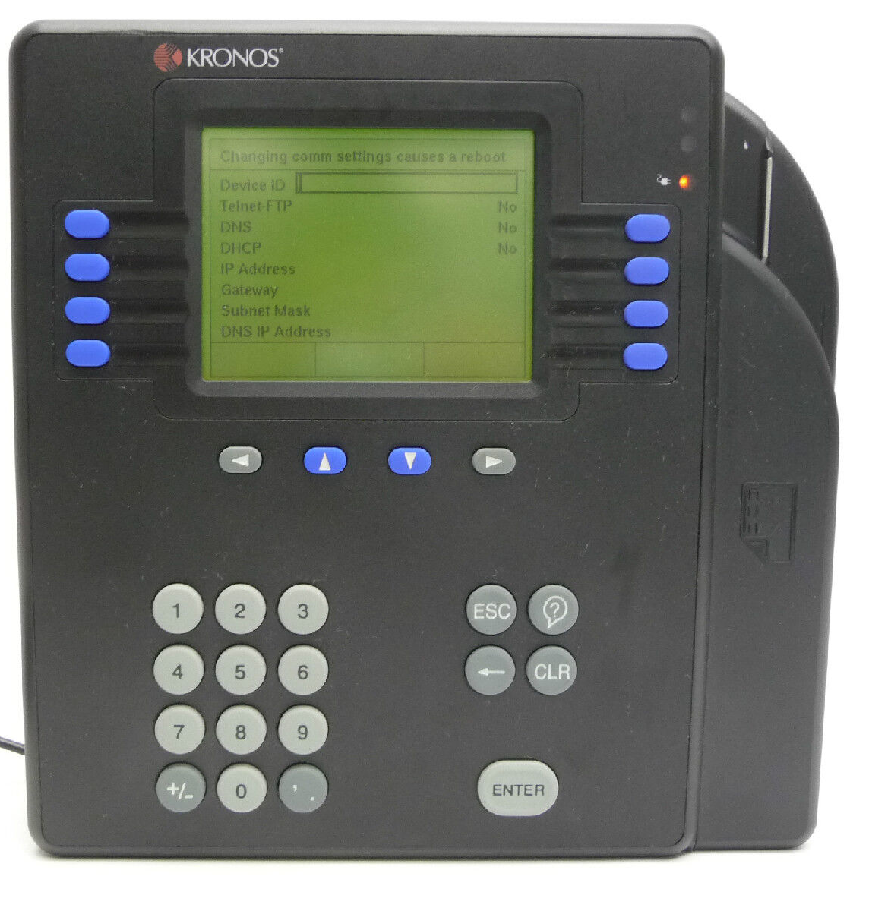
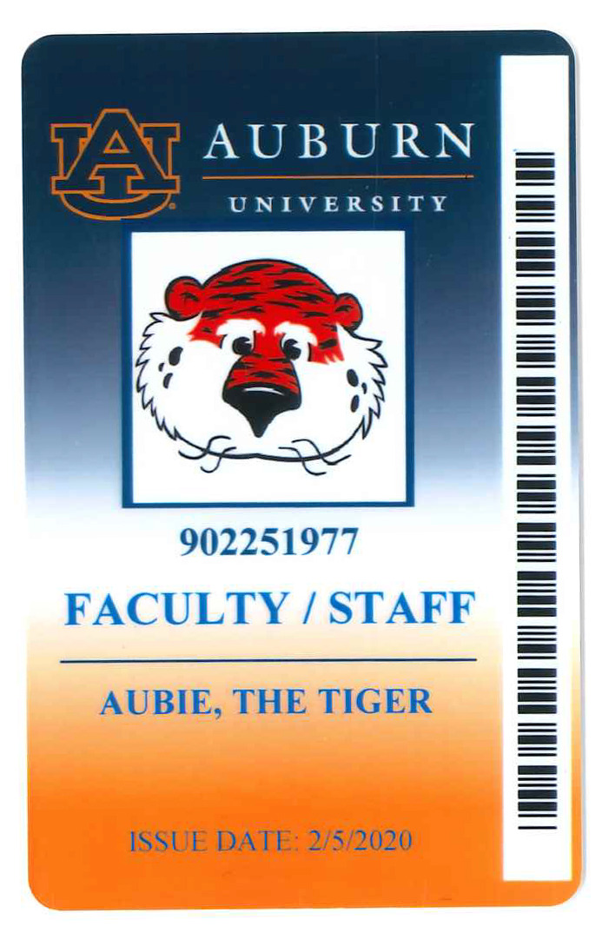
How to Clock In and Out
To Clock In or Out at a Terminal
  All you need to do is swipe your employee badge.
To Clock In or Out at a Computer
  Visit the Kronos website.
  Submit your AU user identification and password.
  Click “Record Timestamp.”
Notes:
Bullet 2: Regular work hours 7:45 – 11:45, 12:45 – 4:45 but works 8:00 – 12:00, 1:00 – 5:00 time should be recorded as such. Another example - a drs. Appt.

Slide 15
For Employees with Multiple Jobs
At the Terminal
  Press the corresponding blue button for “Active Multiple Jobs.”
  Swipe your AU Badge.
  Select “List.”
  Select a ”Job” via the up/down arrows. (If you do not select a job, your pay may be incorrect.)
  Press ”Enter” to select.
  To clock out, swipe your AU badge.
At the Computer
  Visit the Kronos website.
  Submit your AU user identification and password.
  Select a ”Job” if necessary.
  Click ”Record Timestamp.”
Notes:
Bullet 2: Regular work hours 7:45 – 11:45, 12:45 – 4:45 but works 8:00 – 12:00, 1:00 – 5:00 time should be recorded as such. Another example - a drs. Appt.

Slide 16
Work Breaks
Supervisors may authorize two 15-minute breaks, one mid-morning and one mid-afternoon, for employees with non-exempt positions
. Employees may leave their work area during their break unless notified otherwise by their supervisor.
Where it is necessary to always have someone on duty, care should be taken to make sure the work assignment is covered.
Breaks are not cumulative; employees cannot forgo a break time to use later.
Notes:
Bullet 2: Regular work hours 7:45 – 11:45, 12:45 – 4:45 but works 8:00 – 12:00, 1:00 – 5:00 time should be recorded as such. Another example - a drs. Appt.

Slide 17
Q & A
Question: What is a historical edit?
Answer: A historical edit is a correction on a timecard that has been processed. It will be indicated by a black dot on the date and once saved it will have a diamond on the time entry. You can further confirm the edit in the totals of the current timecard. If you do not see the back dot, it is not a historical edit. The total hours owed need to be added on the current pay period timecard
using retro-pay earnings. (RST, RTB, RPB)

Slide 18
Q & A
Question: Why am I seeing former employees on my Kronos landing page?
Answer: Kronos temporarily pulls previous job information on employees in new positions. This should clear from your view within a pay period.

Slide 19
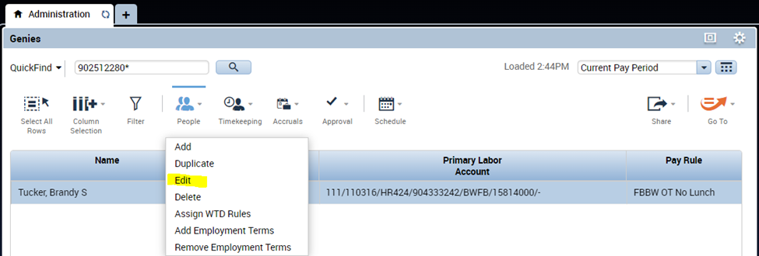
Q & A
Question: How do you change a pay rule?
Answer: **Only Managers and Timekeepers have access to change pay rules.
Highlight the
employee on
the Landing Page,
click on People,
and select Edit.

Slide 20
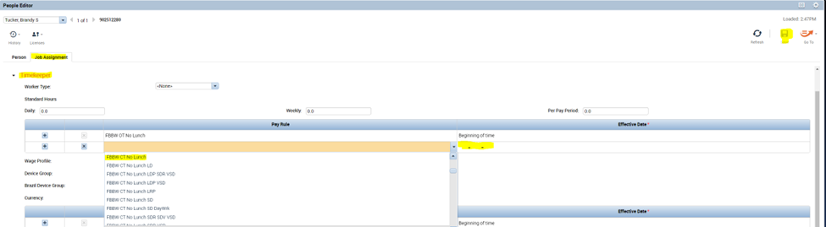
Click Job Assignment tab and select Timekeeper. You will see the current Pay Rule listed (FBBW OT No Lunch). In the cell below the current pay rule, you would find and select the new pay rule (FBBW CT No Lunch). Once selected, you would enter the new effective date and click save. Effective date is primarily the beginning of the pay period.
You can refresh Kronos to see changes on your landing page.

Slide 21
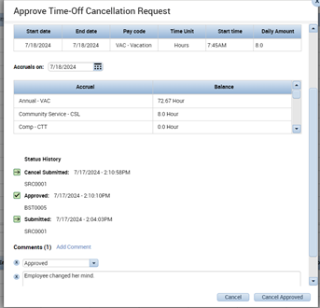
Q & A
Question: How do I pull back an approved leave request?
Answer: A cancel request must
be submitted by the employee
and requires approval by the
supervisor or timekeeper.
Do not use the retract option.

Slide 22
Additional Resources
Other Training Available:
US107C Kronos/Timekeeping
https://learningmanager.adobe.com/app/instruc?i_qp_user_id=19460686&accountId=114654#/session/1680093/overview
HR103C Human Resources-Payroll Processes and Leave Administration
https://learningmanager.adobe.com/app/instructor?i_qp_user_id=19460686&accountId=114654#/session/1680092/overview
HR505E Auburn's Guide on Timekeeping.
https://learningmanager.adobe.com/app/learner?accountId=114654#/course/9736784
One-on-one 30-minute Kronos training:
aub.ie/kellykronos
One-on-one EPAF training:
https://aub.ie/aprilm
Notes:
Bullet 2: Regular work hours 7:45 – 11:45, 12:45 – 4:45 but works 8:00 – 12:00, 1:00 – 5:00 time should be recorded as such. Another example - a drs. Appt.

Slide 23
Contact Information
Payroll & Employee Benefits
AU Human resources
1550 East Glenn Avenue
Auburn, AL 36849
payroll@auburn.edu

