Slide 1

Psychological Safety
In the workplace

Slide 2

AGENDA
  Understanding psychological safety
  Why does it matter?
  Identifying barriers and signs
  Acknowledging and encouraging
  Understanding our roles
  Impact on performance
  Developing action plans

Slide 3
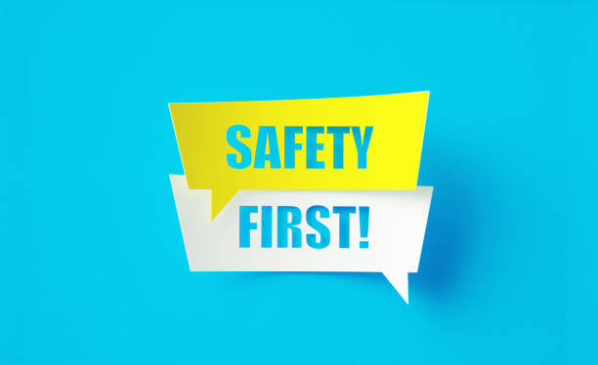
Psychological safety is a shared belief within a team or group that it's safe to take interpersonal risks, like sharing ideas, asking questions, or admitting mistakes, without fear of negative consequences or humiliation
Definition

Slide 4
Why Does Psychological Safety Matter?
Enhances team performance
Improves employee well-being
Fosters stronger relationships
Reduce employee turnover
Improves safety in high-risk environments
It’s not about “being nice” rather than creating a space where honesty and vulnerability are not punished but encouraged.
Company-wide psychological safety exercises can help your team connect on a deeper level and as personal connection develops, your team will evolve into a strong, psychologically safe group of people.
Team-Building activities like icebreaker games, active listening exercises, or reflective sessions are some types of psychological safety exercises.

Slide 5

Signs of Low Psychology Safety
  Fear of failure: Individuals may hesitate to share ideas, ask questions, or admit mistakes if they fear negative consequences or judgment.
  Lack of trust: A lack of trust within a team or organization can create a climate of suspicion and reluctance to be vulnerable.
  Unclear expectations: When roles, responsibilities, and performance standards are not clearly defined, team members may feel unsure about how to contribute and may be less likely to take risks.
  Lack of open communication: A culture of silence or a fear of speaking up can stifle creativity, innovation, and problem-solving.
  Power imbalances: Perceived favoritism or unequal distribution of power can lead to some team members feeling silenced or unable to contribute effectively.
  What barriers have you observed?
  ”

Slide 6

Other Signs of Low Psychological Safety
Employees may:
Avoid speaking up
Stay silent during meetings
“Yes” everything (agree without honesty)
Show low engagement or withdraw
Fear mistakes
Avoid asking for help
“Think of a time you hesitated to speak up at work. What stopped you? What might have helped you feel safer?”

Slide 7

The Data Behind It
Research shows that teams with high psychological safety are:
76% more engaged
50% more productive
67% more likely to retain employees
Fact: 43% of employees say they’re afraid to speak up at work.

Slide 8
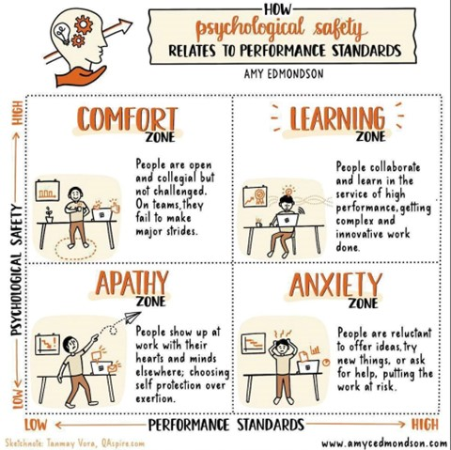
Performance
X-Axis= performance standards from low to high
Y-Axis=psychological safety a team may feel
Low Standards + Low Safety = Apathy
High Standards + Low Safety = Anxiety
Low Performance + High Safety = Comfort
High Performance + High Safety = Learning
How do you get to learning stage? (Share thoughts)

Slide 9
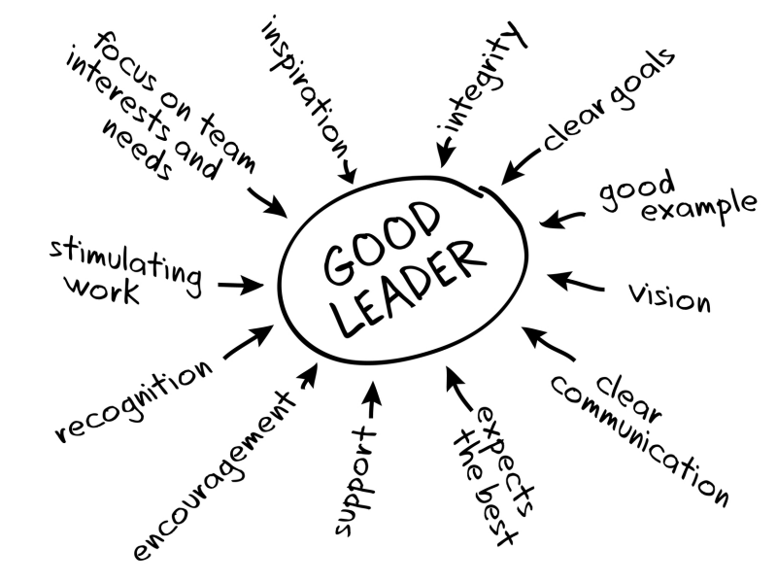
The Role Of Leadership In Psychological Safety
  Leaders set the tone for openness and risk-taking
  Modeling vulnerability and active listening
  Empowering team members to speak up
Training managers to respond constructively to feedback
Creating anonymous feedback channels
“Psychological safety means you feel comfortable talking about what makes you uncomfortable.”
– Esther Derby

Slide 10

Psychological safety directly impacts:
1. Retention
2. Engagement
3. Conflict resolution
4. Innovation
"The cost of silence is greater than the cost of speaking up.“
– Amy Edmondson
HR Sits at the Crossroads of Policy & People

Slide 11

How Do We Improve?
Look in the Mirror
- Assess your current workplace climate (surveys, discussions)
Model transparent Communication
-Lead by example, promote empathy, avoid blaming
Foster Inclusivity and Respect
-Value perspectives, consistency, be aware of power dynamics, advocate for fairness
Create a Culture of Learning and Growth
-Celebrate success, encourage vulnerability, mistakes=lesson
Lead by example in everyday interactions

Slide 12

Resources
Recommended LinkedIn Learning courses:
From Compliance to Culture: A Psychological Safety Framework for Inclusion
Psychological Safety: Clear Blocks to Innovation, Collaboration, and Risk-taking
Creating Pyschological Safety For Diverse Teams
Books:
The Fearless Organization: Creating Psychological Safety in the Workplace for Learning, Innovation, and Growth (Amy C. Edmondson)
The Gifts of Imperfection: Let Go of Who You Think You’re Supposed to Be and Embrace Who You Are (Brené Brown)

Slide 13


THANK YOU
Ashley Carter
Email: alc0253@auburn.edu

