Slide 1
Next-Gen Business Modernization
July 23, 2025

Slide 2
Overview of Modernization Initiatives and Benefits
AUBURN BUSINESS MODERNIZATION PROGRAM
Area | ID | Business Modernization Initiatives in Scope
ERP | 1 | Conduct ERP Strategy
Administrative Operations Modernization Efforts | 2 | Re-engineer Finance Operating Model
 | 3 | Re-engineer HR Operating Model
 | 4 | Implement Identity Access Management. Phase I – resource provisioning | Complete
 | 5 | Modernize Timekeeping System
 | 6 | Remediate HR Data to Address Data Integrity
 | 7 | Assess SIS Digital Experience
 | 8 | Move ISS Web Rehosting to Core Platform
 | 9 | Drive Adoption and Utilization of Data Warehouse (continued development)
 | 10 | Adopt a Single Integration Platform
 | 11 | Develop Research Admin Strategy (interface between ERA ←→ ERP systems)
IT Modernization | 12 | Enhance IT Governance Model & Supporting Operational Capabilities (e.g., risk, PM)
 | 13 | Enhance IT Talent Capabilities and Experience
 | 14 | Establish a Robust Disaster Recovery and Business Continuity Strategy
 | 15 | Define Enterprise Architecture Strategy in Support of Data, Data Center, and Cloud
 | 16 | Enhance IT Asset Management
 | 17 | Define Auburn-wide IT Operating Model Through Clear Roles and Responsibilities
 | 18 | Enhance OIT Organizational Model To Support Strategic Direction & IT Modernization
 | 19 | Conduct an Application Rationalization Exercise and Create an Institution-Wide Application Catalog
 | 20 | Enhance OIT IT Service Management Capabilities
Cybersecurity | 21 | Revisit Approach to Network Segmentation Efforts With a Greenfield Mindset
 | 22 | Enhance and Invest in Cybersecurity Capabilities (Operating Model and Current Vulnerabilities)
ERA | 23 | Implement Electronic Research (ERA)
Notes:
Green – Projects are ongoing and progress is being made
Yellow – Started but may have an obstacle or dependency issue
Red – Deferred or may not happen
Black – Has not started
2 – Emburse
3 – iCIMS
5 – UKG
Informatica, Jitterbit, MS data factory, Mulesoft, Boomi

Slide 3
Modernization Program Updates
AUBURN BUSINESS MODERNIZATION PROGRAM
ERP Process re-engineering
Discussing possible demos from implementation providers on specific processes in functional areas
Forming a small group to evaluate vendor proposals
Retire legacy Self-Service Banner 8 applications
Ellucian ends support on delivered Self-Service 8 applications 12/31/2025
Business Administration and OIT have a team to identify all legacy applications for removal
Applications fall into three main categories:
  Applications already duplicated in Self-Service Banner 9 or are no longer needed
  Applications that could be replaced with Self-Service Banner 9 functionality or a vendor supported solution
  Applications that AU will require post 12/31/2025
Plan to periodically remove applications between now and 12/31/2025 to reduce the change impact
Notes:
UA had great results with this
Examples – eJournal Voucher – Effort certification – HR Recruitment – Budgeting – Post Award processing/labor distribution
We want to have as many questions answered as possible before we launch.
Helps end users be more ready for the actual demos.
Small group to evaluate consulting firms – eye toward firms that could ultimately be implementation partners.
One component of ERP strategy is to reduce technical debt
Need awareness and communication across campus
Examples Legacy Applictions – Cat 1: Paystub, personal information
Cat 2: electronic Journal Voucher, Effort certification, Salary wadge transfers
Cat 3: Bank account update

Slide 4
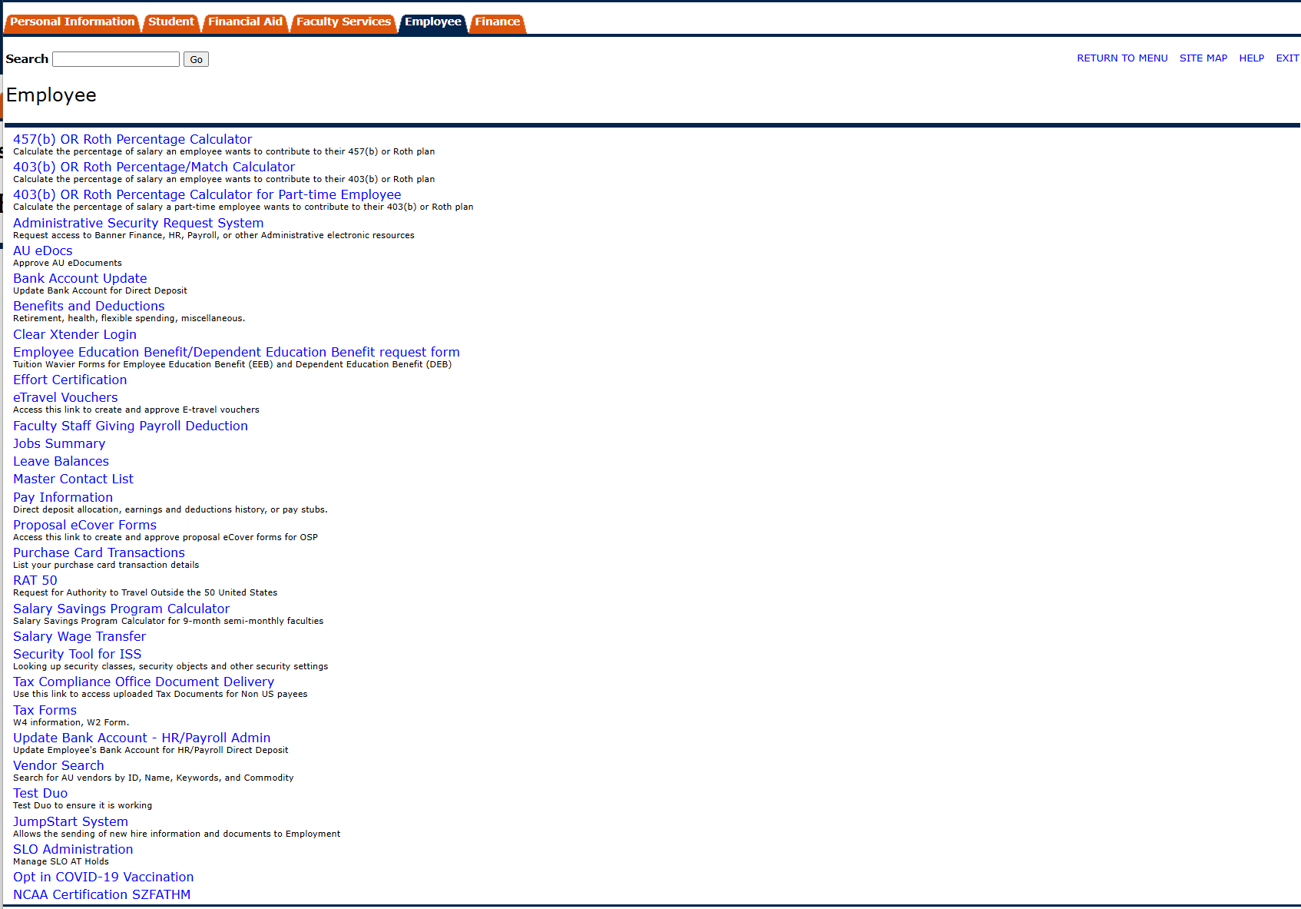

Slide 5
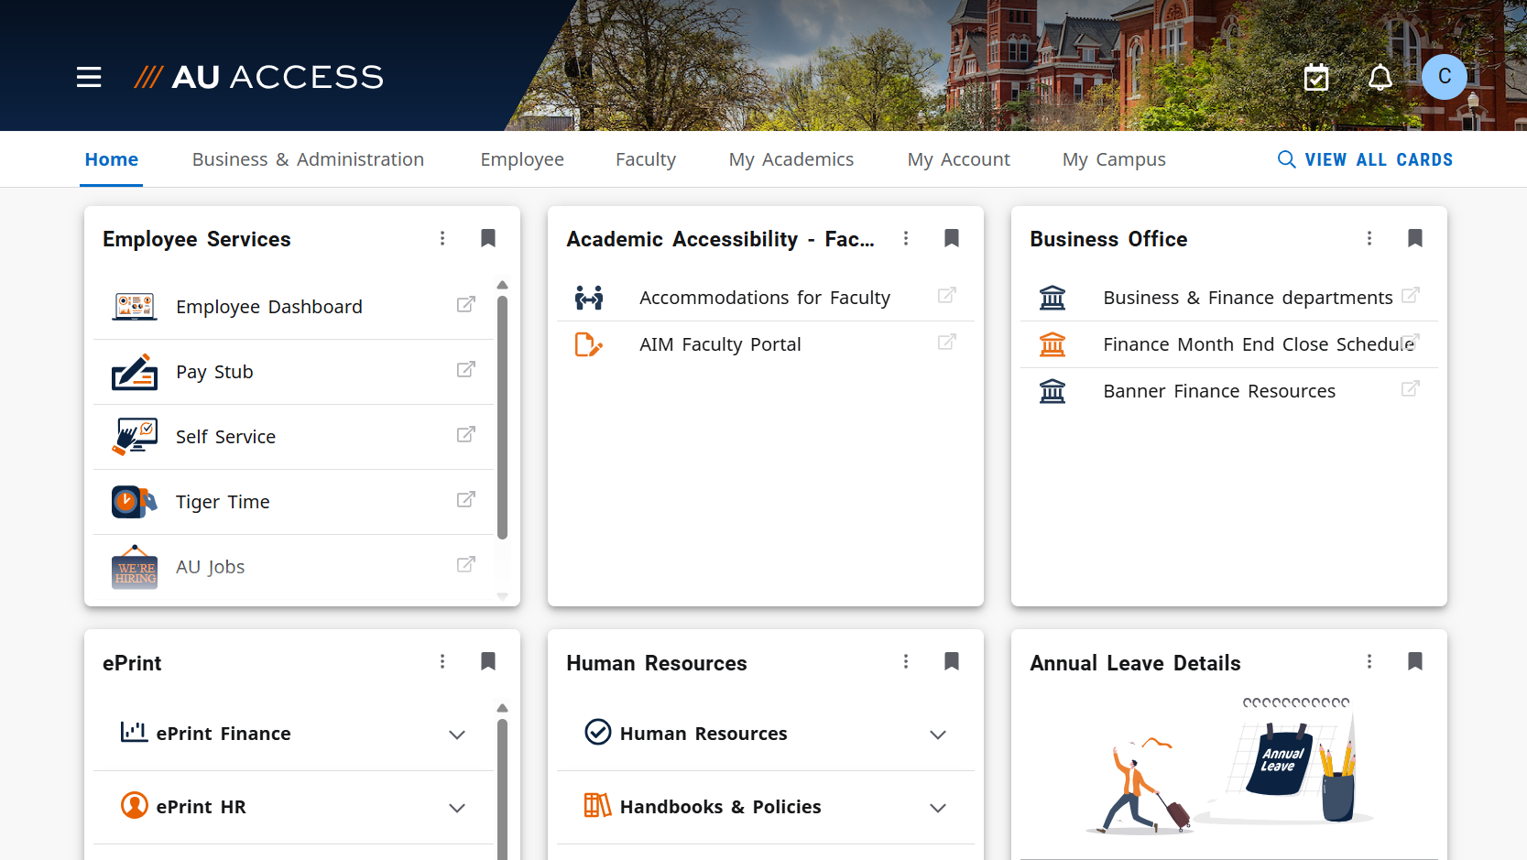

Slide 6
Modernization Program Updates
AUBURN BUSINESS MODERNIZATION PROGRAM
UKG
Go live scheduled for November 2
Completing build phase, entering Test phase
Timeclock removal for underutilized clocks is underway
What’s in it for Employees?
More Flexibility: Employees will have the ability to clock in from wherever they start their day—no need to find a physical timeclock.
Faster Punch-Ins: Skip the lines and get straight to work. No more waiting behind a broken or slow timeclock.
Real-Time Visibility: View your hours instantly and correct missed punches directly from the app or desktop.
Leave: Submit time-off requests or check your leave balances right from your phone.
Touch-Free Convenience: No shared surfaces or crowded stations, adding peace of mind and privacy.

Slide 7
Modernization Program Updates
AUBURN BUSINESS MODERNIZATION PROGRAM
iCIMS
Go live TBD
Consolidating to a single platform for Auburn and AUM
What’s in it for Candidates?
Simplified process for completing applications, including ability to apply from LinkedIn
Separate portal for internal postings
Mobile friendly career sites
Ability to self-select interview times based on parameters set by hiring manager
Integrations with systems allowing a more seamless and transparent hiring process

Slide 8
Modernization Program Updates
AUBURN BUSINESS MODERNIZATION PROGRAM
iCIMS
What’s in it for Hiring Teams?
Centralized job postings, application review, and candidate communications
Automated interview scheduling, streamlined recruitment workflows
Customized integration with JDXpert that will feed into job templates
Customized integration with TrueScreen, allowing transparent updates with background status
Robust onboarding tool - customized portals, digital paperwork with built in integration to Equifax
Branded career pages & social media integration
Delivered integrations with numerous job boards including: The Chronicle of Higher Ed, Academic Keys, Higher Ed Jobs, LinkedIn, ZipRecruiter
Ability to gather and review interview feedback within system
Microsoft Teams integration for workflow approvals
Ability to engage hiring managers in the system and from the start of process, whereas now, they are not directly involved 100% of the time

Slide 9
Modernization Program Updates
AUBURN BUSINESS MODERNIZATION PROGRAM
Emburse
Go live January 2026
Replaces two homegrown Banner tools (eTravel and Purchasing Card Reconciliation)
Partnering with Huron for Business Process/Policy Review
What’s in it for Employees?
Mobile Receipt Capture
Automated Expense Reports
Faster Reimbursement - Out-of-policy expenses are flagged during entry/before submission, helping employees avoid delays or rework
Automatic matching for Purchasing Card transactions
Consistent pre-approval process
Easy to use tiles for adding expenses/auto select of appropriate account code

Slide 10
Thank you!
Q&A

