Slide 1
What EQ Can do for You: Strategies for Enhancing Emotional Intelligence

Slide 2


Training Objectives
Understand all the components of Emotional Intelligence (EI)
Translate EI from theory to day-to-day strategies
Learn strategies for enhancing your “EQ”
Explore the role of emotional intelligence in the workplace
Harness the power of EI for greater success and fulfillment
Notes:
It’s not just what you know that will help you to succeed in life, but more specifically what you know about emotions—your own, and those of others. The way in which we are able to respond vs. react, sense what others are feeling and adjust accordingly is at the heart of successful relationships—and personal and professional success.

Slide 3

“Emotional intelligence is a way of recognizing, understanding, and choosing how we think, feel, and act. It shapes our interactions with others and our understanding of ourselves.”
- Joshua Freedman

Slide 4

What is EQ?
Emotional intelligence is sometimes called EQ (or EI) for short. It describes an ability or capacity to perceive, assess, and manage the emotions.

Slide 5
The EI Equation
A person’s ability to:
perceive, process and regulate emotional information accurately (both within themselves and in others)
+
use this information to act in a way that benefits them and facilitates positive relationships with others
= EI
Notes:
EI is still a relatively young concept; the term was coined in 1990 (by Peter Salovey and John Mayer and further developed by Daniel Goleman). They defined it as “a form of social intelligence that involves the ability to monitor one’s own and other’s feelings and emotions, to discriminate among them, and to use this information to guide one’s thinking and action.”
What is EQ? Emotional intelligence is sometimes called EQ (or EI) for short. It describes an ability or capacity to perceive, assess, and manage the emotions.

Slide 6
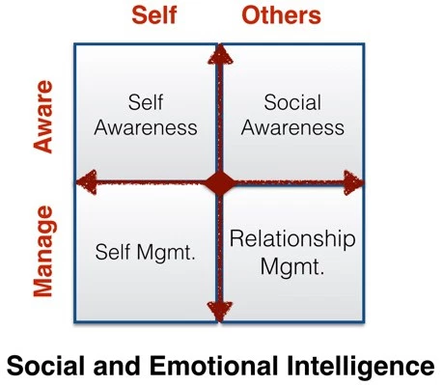
A Crash Course on Emotional Intelligence
Emotional Intelligence relates to two of the multiple intelligences:
Interpersonal
Intrapersonal

Slide 7
Did you Know?
On average, people with high EQ make about $30,000 more each year than people with low EQ.*
A single-point increase in your EQ can add $1,300 to your salary.*
81% of the skills that companies attribute to outstanding managers are related to emotional intelligence.*
One study of Fortune 500 companies found that salespeople with high EQ brought in twice as much money as those with average/below average EQ.*
Everyone has the power to enhance their EQ.
*Statistics from https://blog.dtssydney.com/30-interesting-statistics-on-emotional-intelligence

Slide 8
“If you don’t have self-awareness, if you are not able to manage your distressing emotions, if you can’t have empathy and have effective relationships, then no matter how smart you are, you are not going to get very far.”
- Daniel Goleman
Notes:
It’s not just what you know that will help you to succeed in life, but more specifically what you know about emotions—your own, and those of others. The way in which we are able to respond vs. react, sense what others are feeling and adjust accordingly is at the heart of successful relationships—and personal and professional success.

Slide 9

EI Effects Everything
Emotional intelligence impacts:
Your performance and success
Your physical health
Your mental health
Your relationships
Your happiness
Notes:
Emotional intelligence affects:
Your performance. High emotional intelligence can help you navigate the social complexities of the workplace, lead and motivate others, and excel in your career. In fact, when it comes to gauging important job candidates, many companies now rate emotional intelligence as important as technical ability and employ EQ testing before hiring.
Your physical health. If you’re unable to manage your emotions, you are probably not managing your stress either. This can lead to serious health problems. Uncontrolled stress raises blood pressure, suppresses the immune system, increases the risk of heart attacks and strokes, contributes to infertility, and speeds up the aging process. The first step to improving emotional intelligence is to learn how to manage stress.
Your mental health. Uncontrolled emotions and stress can also impact your mental health, making you vulnerable to anxiety and depression. If you are unable to understand, get comfortable with, or manage your emotions, you’ll also struggle to form strong relationships. This in turn can leave you feeling lonely and isolated and further exacerbate any mental health problems.
Your relationships. By understanding your emotions and how to control them, you’re better able to express how you feel and understand how others are feeling. This allows you to communicate more effectively and forge stronger relationships, both at work and in your personal life.
Your social intelligence. Being in tune with your emotions serves a social purpose, connecting you to other people and the world around you. Social intelligence enables you to recognize friend from foe, measure another person’s interest in you, reduce stress, balance your nervous system through social communication, and feel loved and happy.

Slide 10
EI and Happiness
Over 50% of happiness is associated with EI competencies, including:
Empathic perspective taking
Self-monitoring and coping skills
Greater cooperation with partners and relationship satisfaction
Self-actualization
Notes:
EI facilitators such as happiness contribute to our self-actualization and self-actualization (the realization or fulfillment of one's talents and potentialities( in turn, contributes to our happiness in a positive feedback loop. Happiness, according to Wechsler (1943), is the key factor that has a positive impact on intelligent behavior.
Studies examining the link between EI and a range of interpersonal relations found that participants with higher EQ scores had higher scores for empathic perspective taking, self-monitoring and social skills, cooperation with partners, relationship satisfaction, and more affectionate relationships. By developing the skills for EI one can reduce stress, which consequently has a positive impact on well-being and happiness. In addition to its motivational value, happiness monitors one’s immediate well-being and interjects positive mood in the way individuals cope with daily demands, challenges, and pressures.
It is this positivity that encourages the emotional energy required to increase one’s motivational level to get things done, in short, it helps individuals to achieve what they want to achieve and tells them how well they are doing (Bar-On, 2001).
Research conducted by Furnham (2003) indicated that a large amount of the variance found in happiness and well-being to be determined by people’s emotion-related self-perceptions and dispositions such as the ability to regulate emotions, relationship skills, and social competence.
While these EI skills are not the sole contributor to levels of happiness, it is important to recognize their impact, with over 50% of the total variances in happiness being attributed to emotional intelligence competencies.
From Aristotle to Freud, the emphasis on the optimization of happiness has been thoroughly discussed. To augment happiness one is often required to use more sophisticated behavioral patterns such as self-regulation to subdue instant pleasure motivations.

Slide 11
A Crash Course on Emotional Intelligence
Self-awareness: the ability to recognize and understand one’s own
triggers, motivators, and emotions and their impact on others.
Self-regulation: the ability to manage one’s negative or disruptive
emotions, and to adapt to changes in circumstance.
Empathy: the ability to recognize how others are feeling and consider
those feelings before responding in social situations.
Social awareness: the ability to connect with others through skills
such as active listening, verbal and nonverbal communication.
Notes:
Categories of Emotional Intelligence (EI/EQ)
Self-awareness: the ability to recognize and understand one’s own emotions and their impact on others. You recognize your own emotions and how they affect your thoughts and behavior. You know your strengths and weaknesses, and have self-confidence.
Self-regulation: the ability to manage one’s negative or disruptive emotions, and to adapt to changes in circumstance. You’re able to control impulsive feelings and behaviors, manage your emotions in healthy ways, take initiative, follow through on commitments, and adapt to changing circumstances.
Motivation: the ability to self-motivate, with a focus on achieving internal or self-gratification as opposed to external praise or reward.
Empathy: the ability to recognize and understand how others are feeling and consider those feelings before responding in social situations. You can understand the emotions, needs, and concerns of other people, pick up on emotional cues, feel comfortable socially, and recognize the power dynamics in a group or organization.
Social skills: the ability to manage the emotions of others through emotional understanding a Emotional intelligence (otherwise known as emotional quotient or EQ) is the ability to recognize the needs and emotions of others as well as to manage our own emotions effectively. You know how to develop and maintain good relationships, communicate clearly, inspire and influence others, work well in a team, and manage conflict.

Slide 12
EI Skill #1: Self-Awareness
Thoughts Feelings Actions (and reactions)
Tune in to your thoughts and feelings, without judgment. Ask yourself:
  What triggered this emotion or behavior?
  What are the thoughts attached to it?
  Are any of my reactions rooted in something from my past?
Notice how emotions may manifest in other ways, i.e.:
  Physical sensations in your stomach, throat, or chest
  Subtle facial expressions or body language
Ask others for their honest feedback on your behaviors and reactions.
Notes:
Most of us have a negative internal dialogue that we’re not consciously aware of. Our thoughts affect our feelings, and our feelings impact our behavior. In today’s world of distractions, being able to connect to our emotions can be challenging, particularly if we have a lot of strong/painful emotions. However, it’s essential that we do make time for this, as our emotions effect our thoughts, and these effect our actions. The first step is simply to tune in to our thoughts and feelings, without judgment (this part is important!). In addition to examining our thoughts and feelings, it’s also helpful to notice how these may manifest in physical sensations and in other ways. For example:
Are your emotions accompanied by physical sensations that you experience in places like your stomach, throat, or chest?
Do you experience individual feelings and emotions, such as anger, sadness, fear, and joy, each of which is evident in subtle facial expressions?
If any of these experiences are unfamiliar, you may have “turned down” or “turned off” your emotions. In order to build EQ—and become emotionally healthy—you must reconnect to your core emotions, accept them, and become comfortable with them. You can achieve this through the practice of mindfulness.
Mindfulness is the practice of purposely focusing your attention on the present moment—and without judgment. The cultivation of mindfulness has roots in Buddhism, but most religions include some type of similar prayer or meditation technique. Mindfulness helps shift your preoccupation with thought toward an appreciation of the moment, your physical and emotional sensations, and brings a larger perspective on life. Mindfulness calms and focuses you, making you more self-aware in the process.
Developing emotional awareness
It’s important that you learn how to manage stress first, so you’ll feel more comfortable reconnecting to strong or unpleasant emotions and changing how you experience and respond to your feelings.

Slide 13
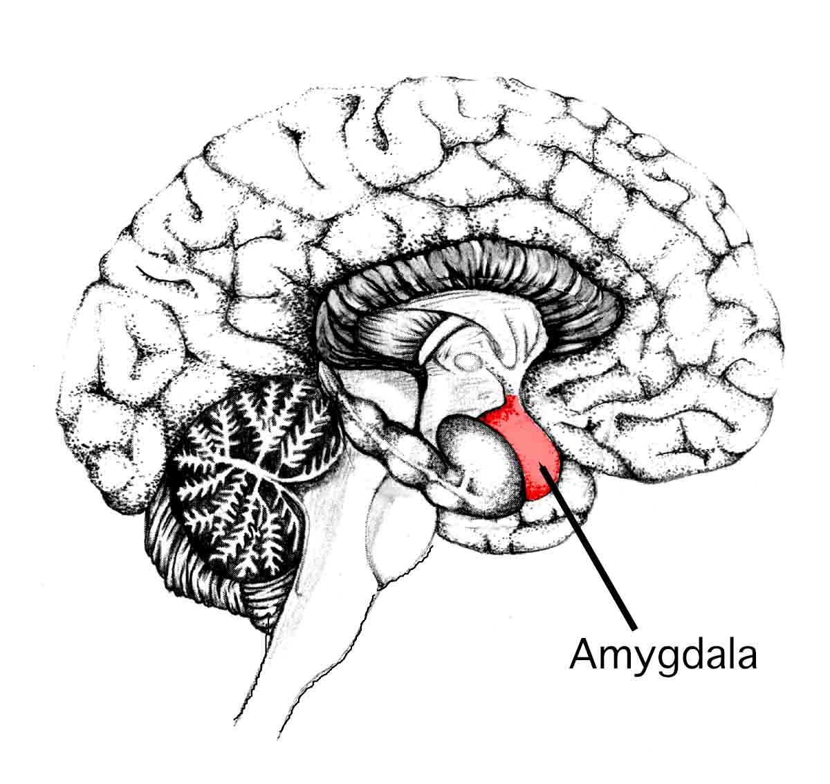
Amygdala Hijack – Don’t Let it Attack!
What “trips” the amygdala?
Perceived threats to:
  Safety
  Status
  What is familiar
  Control
Notes:
The amygdala is the area of the brain that controls reactions to stimuli and events, causing emotional, rather than rational reactions – primary senses travel through this limbic area before they get to the more rational front of the brain

Slide 14

EI Skill #2: Self-Regulation
Make a list of your triggers
Tune in regularly to your feelings
Practice pausing before reacting
Make self-care a priority
Build proactive stress management into the
day:
  Physical activity
  Mindfulness
  Deep breathing and other relaxation techniques
Notes:
Ask audience: Think about a time when stress has overwhelmed you. Was it easy to think clearly or make a rational decision?
In order for you to engage your EQ, you must be able use your emotions to make constructive decisions about your behavior. When you become overly stressed, you can lose control of your emotions and the ability to act thoughtfully and appropriately.
Emotions are important pieces of information that tell you about yourself and others, but in the face of stress that takes us out of our comfort zone, we can become overwhelmed and lose control of ourselves. With the ability to manage stress and stay emotionally present, you can learn to receive upsetting information without letting it override your thoughts and self-control. You’ll be able to make choices that allow you to control impulsive feelings and behaviors, manage your emotions in healthy ways, take initiative, follow through on commitments, and adapt to changing circumstances.
Mindfulness is the practice of purposely focusing your attention on the present moment—and without judgment. helps shift your preoccupation with thought toward an appreciation of the moment, your physical and emotional sensations, and brings a larger perspective on life. Mindfulness calms and focuses you, making you more self-aware in the process.

Slide 15

EI Skill #3: Empathy
Practice active listening
  Listen “between the words”
  Pay attention to non-verbal cues
  Reflect and clarify
Seek to understand as opposed to influence
or agree
Acknowledge and validate vs. pitying
Notes:
Review the components of active listening
Seek to understand as opposed to influence or agree (i.e., ask yourself what the other person might need, be experiencing…etc.)
Acknowledge and validate vs. pitying (i.e. ”that sounds really stressful; I give you credit for what you’ve been doing to get through it.”)

Slide 16
EI Skill #4: Social Awareness
Set and respect boundaries
Seek to be assertive vs. aggressive
Monitor facial expressions and body language
Aim for consistency, trust, and respect
Practice effective communication
Learn to see conflict as an opportunity to grow closer
“I’ve learned that people will forget what you said, people will forget what you did, but people will never forget how you made them feel.” - Maya Angelou
Notes:
Working well with others is a process that begins with emotional awareness and your ability to recognize and understand what other people are experiencing. Once emotional awareness is in play, you can effectively develop additional social/emotional skills that will make your relationships more effective, fruitful, and fulfilling.
Become aware of how effectively you use nonverbal communication. It’s impossible to avoid sending nonverbal messages to others about what you think and feel. The many muscles in the face, especially those around the eyes, nose, mouth and forehead, help you to wordlessly convey your own emotions as well as read other peoples’ emotional intent. The emotional part of your brain is always on—and even if you ignore its messages—others won’t. Recognizing the nonverbal messages that you send to others can play a huge part in improving your relationships.
Use humor and play to relieve stress. Humor, laughter and play are natural antidotes to stress. They lessen your burdens and help you keep things in perspective. Laughter brings your nervous system into balance, reducing stress, calming you down, sharpening your mind and making you more empathic.
Learn to see conflict as an opportunity to grow closer to others. Conflict and disagreements are inevitable in human relationships. Two people can’t possibly have the same needs, opinions, and expectations at all times. However, that needn’t be a bad thing. Resolving conflict in healthy, constructive ways can strengthen trust between people. When conflict isn’t perceived as threatening or punishing, it fosters freedom, creativity, and safety in relationships.

Slide 17






Actions Speak Louder

Slide 18
EI in Action
Employee A gets into a fight with their partner before leaving the house for work. They’re running late so they don’t eat breakfast or have coffee. Then there’s traffic, so they’re late and irritated by the time they get to work. The moment they arrive; their colleague asks for help with something.
Notes:
Questions for group: Which EI skills could Employee A use to make sure they respond to their colleague in a constructive way, instead of just reacting?
What could get in the way of Employee A being able to use these skills? How could they navigate these potential challenges?

Slide 19

“Until you make the unconscious conscious, it will direct your life and you will call it fate.”
- Carl Jung
Notes:
It’s not just what you know that will help you to succeed in life, but more specifically what you know about emotions—your own, and those of others. The way in which we are able to respond vs. react, sense what others are feeling and adjust accordingly is at the heart of successful relationships—and personal and professional success.

Slide 20
EI in Action
Employee B has a call with a colleague to discuss a challenging situation. Employee B has a strong opinion on what the next best steps are and has already played out how this conversation will go in their mind, including what their colleague will say.
Notes:
Questions for group: What could Employee B do to prepare for an effective conversation?
What are some questions Employee B could ask themselves?
What EI skills would help to turn this into a productive meeting

Slide 21
The STOP Technique
A few times each day, practice STOP-ping
Stop what you are doing
Take a few deep breaths
Observe your thoughts and physical sensations
Proceed with mindful intention
Notes:
We’re so busy during the day that we don’t always stop to check in with ourselves, and then we aren’t in touch with what we need. This technique can be very helpful in reconnecting with yourself. Take deep breaths, as we usually start to take quick, shallow breaths when stressed and this tricks the body into thinking that something is wrong. Observe your thoughts without judgment—just notice what’s going on in your mind. Notice how you’re feeling in your body (i.e., are you holding tension anywhere, have you eaten, need to get up to stretch…etc.). Identify what you need and then proceed with that mindful intention, in tune with your thoughts, feelings, and needs, and more in control of your behavior.

Slide 22
Explore Your Current EQ
My emotions strongly impact my behavior
When under pressure, my behavior can change
I am generally averse to change and new people
I sometimes find obstacles and setbacks overwhelming
I have a tendency to lose my temper when challenged
I find it difficult to move on after a setback
I find it difficult to build relationships with new people
I tend to avoid conflict at all costs
**EQ is not a fixed number—it can be developed like any muscle!**
Notes:
Unlike IQ, your EQ is ingrained and based upon early childhood experience and genetics, but can be changed
EQ tends to increase with age and maturity
It’s important to be receptive of constructive and authentic feedback and to be honest with yourself!

Slide 23
Build Your EQ “Muscle”
Take time to tune in to your feelings and thoughts
Work on reframing non-productive thoughts
Make self-care a priority
Identify and ask for what you need
Ask for feedback
Tune in to the needs and emotions of others
Put preconceived ideas to the side
Practice active listening
Seek to continuously learn and grow

Slide 24
Helpful Resources
Books:
Emotional Intelligence, by Daniel Goleman
Emotional Intelligence 2.0, by Travis Bradberry & Jean Greaves
Primal Leadership, by Daniel Goleman
Websites and apps
Stress & Anxiety Companion app
Positivepsychology.com
Inc.com (15 Websites That Will Heighten Your EI)

Slide 25
Thank you for your time and attention!
Contact the EAP: uprisehealth.com/members

