Slide 1
Understanding
Imposter Syndrome

Slide 2
Olivia Singleton, LMSW
Senior Staff Clinician at Auburn University Student Counseling and Psychological Services (SCPS)

Slide 3
what have you heard about imposter syndrome?

Slide 4
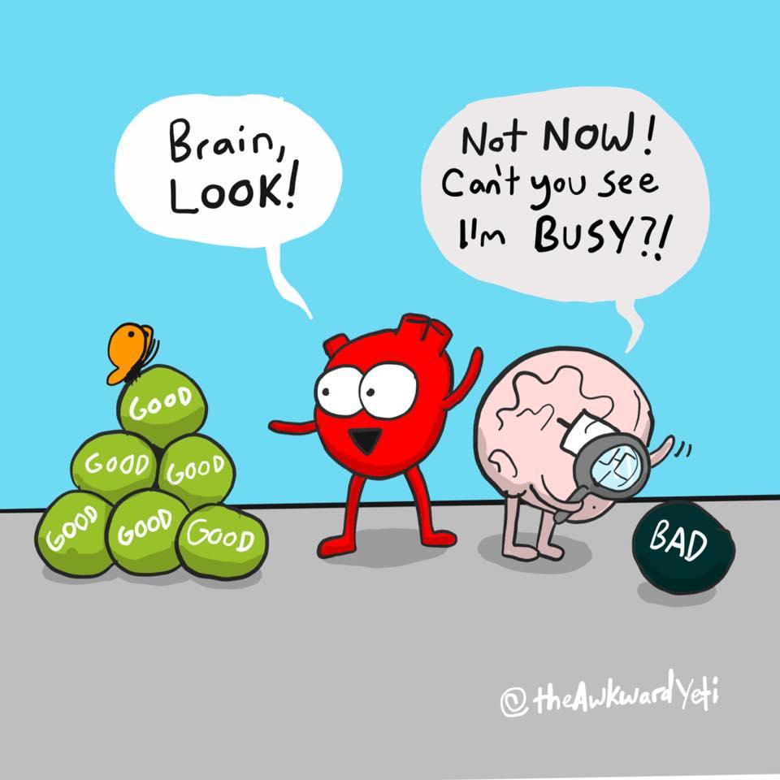
What is imposter syndrome?
When an individual believes that they are inadequate, incompetent, and likely to fail despite evidence that shows they are skilled and successful—resulting in them being unable to internalize their accomplishments.

Slide 5
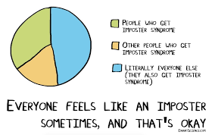
Good news, everybody’s thinking it
70% of people experience imposter syndrome at some point in their career

Slide 6
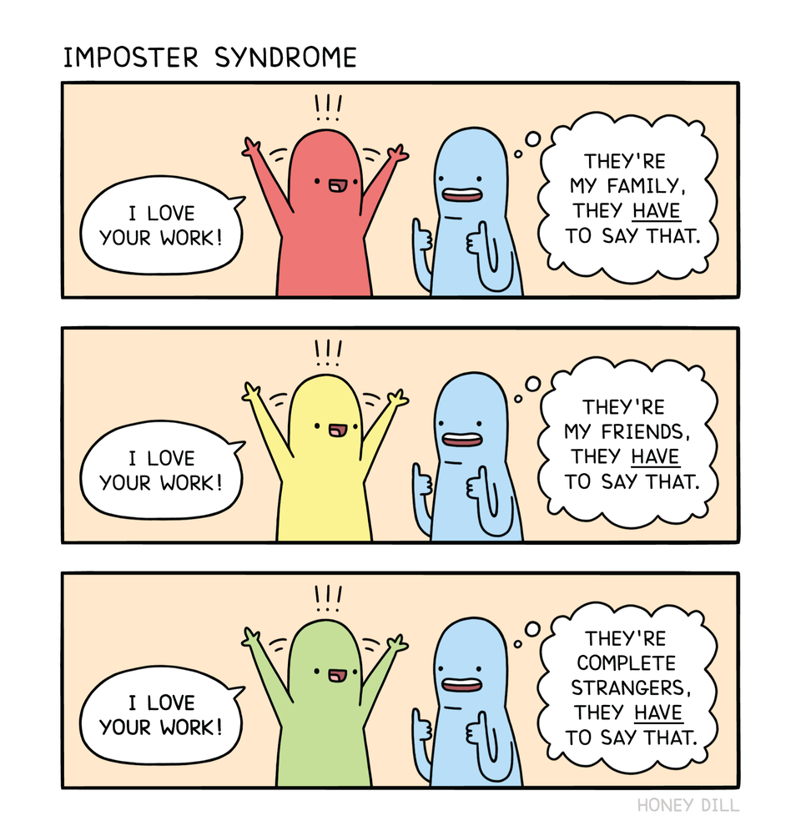
“I must not fail. Failure isn’t an option. It would be too much”
“I feel like a fake. I have no clue what I'm doing.”
“Why did anyone think I could do this?”
“My acceptance was a mistake”
“I just got lucky. They’ll see soon enough that I didn’t deserve____”

Slide 7
What similar thoughts have you had?

Slide 8



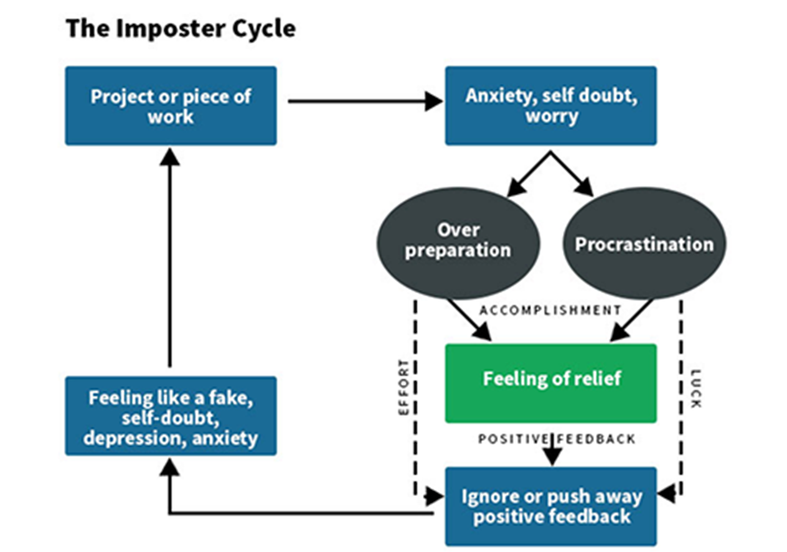
6 dimensions of imposter syndrome
Imposter cycle
Three fears of failure
Characteristics of the super person
Fear of Evaluation
Fear of Not Continuing Success
Fear of not being as capable as others
Have to be all things to all people at all times
Impossible standards
Can do everything
Feel they have to keep super hero image

Slide 9
6 dimensions of imposter syndrome
Denial of ability & Discounting praise
Feeling fear and guilt of success
The need to be “special” or “the best”
Deflect praise
Self deprecating talk
Discount positive feedback
Experiencing success in a way that others may not have been able to
In a space people in their family or community may not be
Secretly have the need to stand out and be the very best
If they are not the best then they are a failure
Need at least two of the six dimensions to be experiencing imposter syndrome

Slide 10


Slide 11
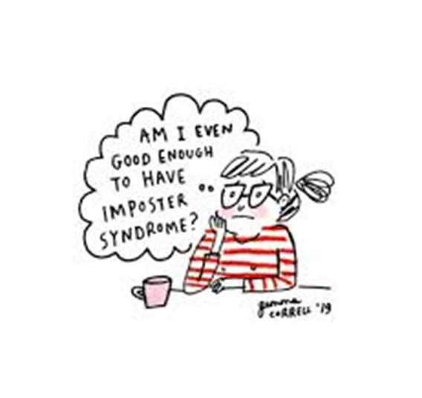
You are in good company:
Tom Hanks
  “No matter what we've done, there comes a point where you think, 'How did I get here? When are they going to discover that I am, in fact, a fraud and take everything away from me?’ “
Maya Angelou
  I have written eleven books, but each time I think, ‘Uh oh, they’re going to find out now. I’ve run a game on everybody and they’re going to find me out.”
  “Do the best you can until you know better. Then, when you know better, do better.”

Slide 12





5 types of imposters
Perfectionist
expert
Rugged individualist
Natural genius
Super person
If I want something done right, I have to do it myself
100% of work has to be 100% perfect 100% of the time
Slight error=failure
Deep fear of being exposed as unknowledgeable
Seek outside training or certificates
Wrong answer=failure
I don’t need anyone’s help
If you need help you are lacking
Help=weakness/failure
Expect to reach high goals effortlessly
Avoid trying new things
Things too hard=failure
Workaholic
Addicted to the validation
Downtime is wasteful
Relaxing=failure

Slide 13
Strategies to assist in combatting imposter syndrome
Break the silence
Separate feelings from facts
Recognize when you feel like a fraud
Know your rights
Develop a new response to failure
Talk about it, ask for help
Feelings are not facts
Feeling something does not make it true
What people or situation make you question yourself?
Experiencing self doubt does not equal ineptness
Recognize you have just as much right as the next person to have a day off or ask for help
Collecting data to change next outcome

Slide 14
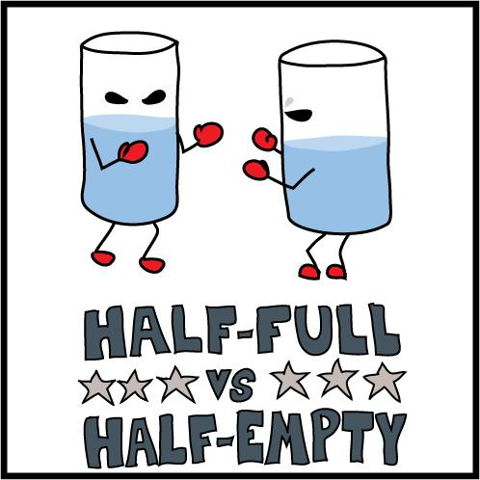
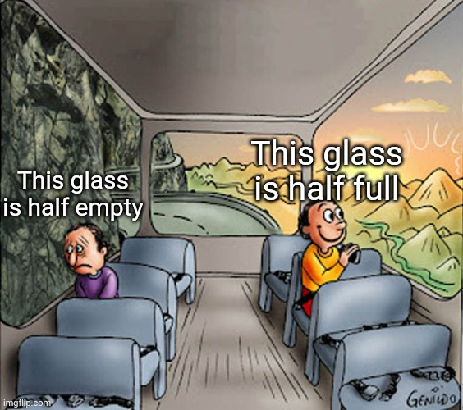

Develop a new script
Visualize success
Accentuate the positive
Reward yourself
Allow confidence to build
Instead of I have no idea what I am doing…I am smart enough to find out
Picture yourself being successful---in presenting, in a group, or taking exam
Not everything will be positive
Things have gone well before focus on those
Brag folder
Reward behaviors not the outcome
Confidence increases when we seek knowledge and take calculated risks

Slide 15
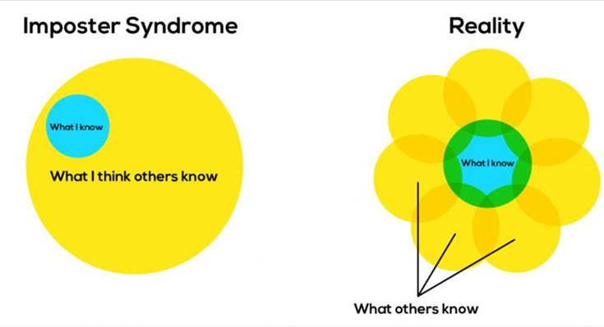

Slide 16
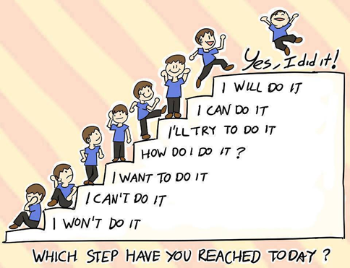
The fastest way to kick the imposter feeling is to adopt what I’ve dubbed the cardinal rule, competence doesn’t mean you need to know everything, to do it all yourself, or to do everything perfectly or effortlessly. Instead competence is being able to identify the resources it takes to get the job done
“
”
Valerie Young, EdD

Slide 17


Imposter Syndrome??? Never heard of it!
Sounds like something you should talk to someone about!

