Slide 1

Onboarding is everyone’s job
Exploring ways to engage all stakeholders in the onboarding process

Slide 2
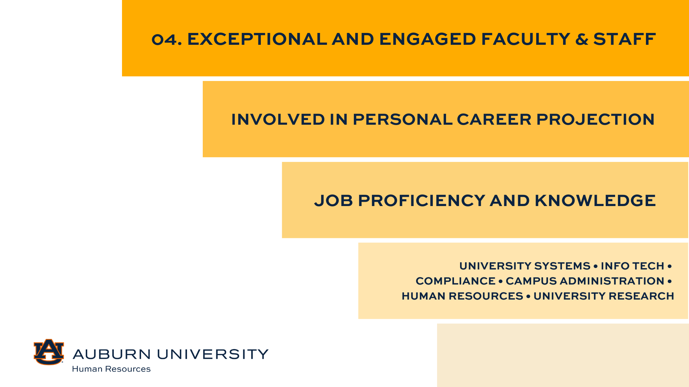
Title or divider slide — avenir next lt pro, demi, 36 pt, dark blue, all caps
Changing this image:
To change this image, delete the existing image on this slide.
Click the icon in the placeholder box and select your photo when prompted to do so.
To adjust the placement of your photo, select the placeholder box and go to the “Picture Format” tab
Select “Crop” and adjust the size and placement of the photo as needed.
It is important that you do not change the size of the actual placeholder. If you think you have done this, on the ”Home” tab, click the “Reset” button
Delete this text box.
Subtitle — avenir next lt pro, demi, 18 pt, orange, all caps
HR Conference 2025

Slide 3
Session objectives
Recognize the importance of onboarding as a cross-functional responsibility, not just an HR task.
Identify key stakeholders involved in the onboarding process and define their roles and responsibilities.
Assess current onboarding practices to pinpoint gaps in engagement and accountability across units.
Apply strategies to engage managers, peers, and leaders in delivering a cohesive and impactful onboarding experience.
Utilize tools and templates to create or enhance a stakeholder-driven onboarding plan in your department.

Slide 4
Effective onboarding drives faster productivity, stronger culture, and better retention

Slide 5

Reframing onboarding

Slide 6
Onboarding explained
Definition: Onboarding is more than just orientation and the completion of new hire paperwork; it is a strategic process to integrate new hires into the organizational culture and equip them for success
Key Goals:
  Accelerate time to productivity
  Foster a sense of belonging and engagement
  Align new hires with organizational goals and values
Reframing: Onboarding is a strategic business function and not just an HR task. HR facilitates the process, but true integration comes from holistic ownership among all stakeholders.

Slide 7

The steakholders
Notes:
This is just a transition slide to place participants in the mindset of sitting at a table in preparation of a meal…

Slide 8
The Stakeholders: Who’s at the table?
New Employee
University Human Resources (UHR)
Departmental Onboarding Contact
Supervisor
Colleagues/Peers
IT
Hiring Manager / HRL
Notes:
So, who are the real stakeholders at the table? Perhaps, our HRLs / hiring managers, UHR, departmental onboarding contact, supervisors, new employees, IT, Facilities, etc…

Slide 9

Meet Taylor
The new Administrative assistant
Hiring Manager / HRL
  The hiring manager or HRL reaches out to Taylor with a personalized welcome and confirms Taylor’s start date with her supervisor.
  The hiring manager or HRL submits the necessary paperwork through the system to initiate the finalization of Taylor’s hiring proposal and to begin the onboarding process.
  The hiring manager or HRL will also flag Taylor’s start to other support units such as IT and Facilities.
University Human Resources (UHR)
  After Taylor signs the offer letter, Employment Services reviews the details of the hiring proposal prior to its finalization.
  Once finalized, Employment Services and Onboarding initiates onboarding tasks through the electronic system.
  The onboarding system triggers an automatic welcome email with details regarding Taylor’s next steps.
  Taylor attends her onboarding appointment with the Onboarding Center team where she is provided with details regarding new employee orientation, benefits enrollment, and general information to get started with Auburn University.

Slide 10
Taylor’s onboarding journey
Departmental Onboarding Contact
  The departmental onboarding contact monitors Taylor’s onboarding progress, ensuring that she completes her electronic new hire paperwork and schedules her Onboarding Center appointment.
  They remain in contact with Taylor’s supervisor and the Onboarding Center team to communicate any changes, special circumstances, or delays in Taylor’s onboarding progress.
  The departmental onboarding contact may work with the supervisor to coordinate Taylor’s first week agenda, including donuts and coffee with team members, a tour of the building, and an introduction to department tools and resources.
Supervisor
  Taylor’s supervisor communicates with the departmental onboarding contact to ensure that her onboarding progress has been smooth.
  They remain in contact with Taylor prior to her start date to communicate first day expectations, including when and where to report, parking expectations, dress code, etc.
  They set up a one-on-one meeting to discuss her first week schedule, performance expectations, time off requests, the department’s mission, short-term goals, 30/60/90-day plan, and schedule regular check-ins.
  They complete the supervisor onboarding checklist.

Slide 11
Taylor’s onboarding journey
IT / Facilities
  The hiring manager has placed a request with Facilities to have Taylor’s office name plate created and her office keys made.
  IT works with the supervisor and hiring manager to ensure Taylor’s computer, phone, email, and necessary software are set up before her first day.
  IT schedules a 30-minute “tech walk-through” on Day 1 to help Taylor log in and access tools like Zoom, shared drives, and Microsoft 365.
Colleagues / Peers
  Taylor’s colleagues decorate her new desk with a welcome banner, balloons, and a small basket with departmental SWAG for her first day.
  A peer or “buddy” is paired with Taylor for her first 30 days – this individual serves as a go-to person for questions like, “Where are office supplies kept?”, “What is the preferred way the team communicates- email, Teams?”, “Do we have a shared kitchen or breakroom etiquette I should know about?”
  Team members take Taylor out to lunch during the first week to foster informal connections.

Slide 12
Taylor’s Onboarding journey
Notes:
Taylor arrives feeling well-prepared thanks to the early communication from HR and the department. She engages actively in onboarding meetings, ask questions, and begins contributing to the team within the first few weeks.

Slide 13
What made Taylor’s onboarding successful?
Notes:
Successful onboarding was the result of coordination across all of the roles – not just HR or the department. It’s a shared investment in the new employee’s success.

Slide 14
Stakeholder roles & responsibilities
Stakeholder | Role in Onboarding | Pain Points | Opportunity
HR | Design and facilitate onboarding processes | Communication Flow | Building scalable frameworks
Hiring Manager | Ensures accuracy of hiring data provided to HR | Unclear or incorrect information | Maintain and adapt unit-level internal processes
Departmental Onboarding Contact | Monitoring new employee onboarding progress | Competing priorities | Empowerment through toolkits and resources
Supervisor | Ensures new employee understands expectations and transitions seamlessly | Time constraints | Drive early engagement and team integration

Slide 15
Stakeholder roles & responsibilities
Stakeholder | Role in Onboarding | Pain Points | Opportunity
Team/Peers | Social integration, Transfer of knowledge | Unclear expectations | Use of peer buddy systems
IT | Responsible for employee’s operational readiness | Siloed, Reactive | Defined workflows with integration into onboarding design
Unit Leaders | Shaping the culture of the unit, Clearly communicating unit goal and expectations | Distant from onboarding | Sponsor welcome events, cultural storytelling, or videos
New employee | Completing internal forms and mandated trainings | Overwhelmed | Actively seek connections, clarity, and early wins

Slide 16

From knowing to doing: Are we aligned?
awareness
Ensure all stakeholders understand what onboarding is, why it matters, what roles are involved, and how they can contribute meaningfully.
alignment
Processes and responsibilities must be clearly defined, communicated, and agreed upon. Ensuring that accountability is shared and not siloed.
action
Stakeholders actively fulfill their roles with consistency and intention.
Notes:
It is important for stakeholders to understand what onboarding is, why it mattes, what roles are involved, and how they can contribute meaningfully. Within your unit, reflect on the following: Who do you believe owns onboarding in your department? Do your stakeholders know their specific roles? Have expectations been clearly communicated?
In order to create alignment, stakeholders must be on the same page about who does what, when, why, and how. Processes and responsibilities should be clearly defined, communicated, and agreed upon. Our goal is to ensure that accountability is shared and not siloed. Some examples of misalignment may include, supervisors being unsure of onboarding timelines and compliance requirements (Form I9), hiring managers unaware of changes that have been communicated to or by the new employee, IT/Facilities reacting to first day needs, and peers being left out of early engagement opportunities.
Action requires that stakeholders actively fulfill their roles with consistency and intention. Onboarding is integrated into each function’s workflow and not treated as an extra task.
Moving from awareness to action requires intentional alignment. That’s why our next step is to assess where your department stands today. Our goal is to close the gaps and drive a more engaging and accountable onboarding experience.

Slide 17
Stakeholder mapping activity
Notes:
Using the form provided, identify key stakeholders in your unit’s onboarding process, evaluate their current involvement, and define ideal responsibilities to pinpoint gaps and opportunities. You are encouraged to complete this activity honestly, this is not about blame, it is about building clarity and shared ownership.

Slide 18
Shared responsibility matrix (raci)
In practice
Role | What It Means | Key Characteristics | Onboarding Example
Responsible (R) | The people who do the work to complete a task. | Multiple people possible; hands-on execution | Departmental onboarding contact prepares Taylor’s first-week schedule
Accountable (A) | The person who is ultimately answerable for the task being completed | Only one person per task; owns the outcome | Hiring manager is accountable for ensuring onboarding tasks are completed correctly
Consulted (C) | People who provide input, feedback, or expertise before a decision is made or task is completed | Two-way communication; active collaboration | IT may be consulted to recommend equipment setup that fits Taylor’s role
Informed (I) | People who need to be kept in the loop after decisions are made or tasks are done | One-way communication; kept up to date | The supervisor is informed when Taylor’s onboarding is complete and when she is ready to begin
Notes:
Individuals that are consulted with for various tasks are considered to be the subject-matter experts or advisors. Their input is valuable, and often essential, before taking action. They are not responsible or accountable for task completion, but their guidance may shape how the task is completed. For example, before assigning Taylor access to certain databases or systems, the hiring manager will consult with the supervisor to determine which systems are needed and IT will ensure that proper access is granted. Stakeholders that are informed are those who need to know what is going on but do not need to be consulted or take action. They are updated on progress, decisions, or completions of tasks. Once Taylor’s first-day agenda is finalized, the department chair or unit leader is informed.

Slide 19
Shared responsibility matrix (Raci)
(raci = responsible, accountable, consulted, informed)
Task | HR | Hiring Manager | Supervisor | IT | Unit Leader | New Hire
Process Hiring Proposal | C | R | C | I | I
Send Welcome Email |  | R | I |  | C
Setup Office Space |  | C | C | R | I
Create Username (GID) | A |  | R |  |  | I
Intro to team culture |  |  | R |  | C | I
Request software access |  | R | C | A |  | I
First week schedule |  | C | R |  | I | I
Supervisor Checklist | C | I | R
Notes:
As you begin to flesh out the roles and responsibilities of the stakeholders in the onboarding process, another tool that you may find helpful is the Shared Responsibility Matrix, this allows you to clearly define the tasks that need to be completed to support your new hire’s journey. It is important to align stakeholders on consistent messaging, timing, and responsibilities throughout the onboarding process. Our goal is define exactly when and how each stakeholder contributes. The RACI model highlights individuals who are responsible (this could be multiple people) – the person who actually does the work to complete the task or activity. For example, IT is responsible for setting up Taylor’s office space ensuring that her computer and phone functions properly. For accountability, this is the individual who is ultimately on the line for the task being completed correctly and thoroughly. There is only one accountable person per task. This is the owner, they ensure the task gets done and can delegate work, but not responsibility. So, the hiring manager is accountable for ensuring Taylor’s onboarding is completed effectively, even though they may delegate specific tasks to others. Individuals that are consulted with for various tasks are considered to be the subject-matter experts or advisors. Their input is valuable, and often essential, before taking action. They are not responsible or accountable for task completion, but their guidance may shape how the task is completed. For example, before assigning Taylor access to certain databases or systems, the hiring manager will consult with the supervisor to determine which systems are needed and IT will ensure that proper access is granted. Stakeholders that are informed are those who need to know what is going on but do not need to be consulted or take action. They are updated on progress, decisions, or completions of tasks. Once Taylor’s first-day agenda is finalized, the department chair or unit leader is informed.

Slide 20
Who owns what?
Breaking down shared accountability
Notes:
Now that we have outlined which stakeholders are responsible for respective tasks, let’s clarify differences between task completion versus experience delivery.

Slide 21
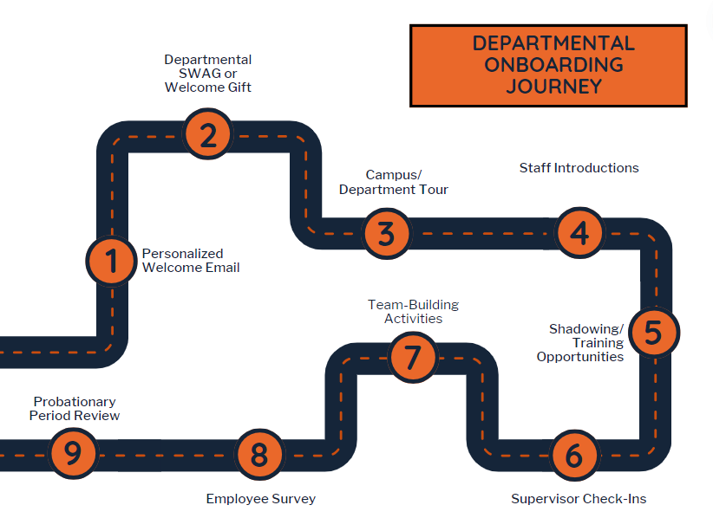
Departmental onboarding journey
Notes:
You may be familiar with some of these resources either from previous onboarding trainings or through your engagement with our onboarding platform PeopleAdmin. The goal in displaying these for you today is because as you can see, these steps along the employee’s journey may include one or more stakeholders.

Slide 22
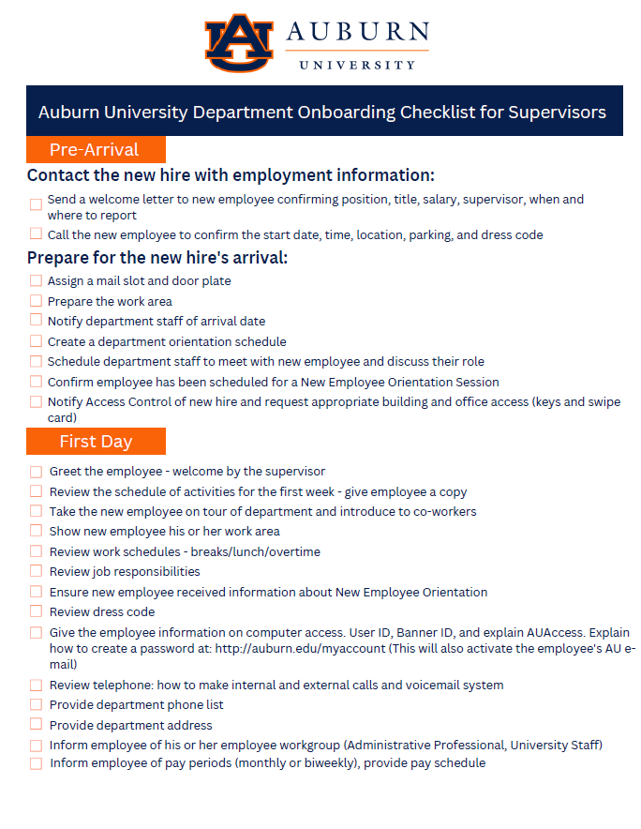
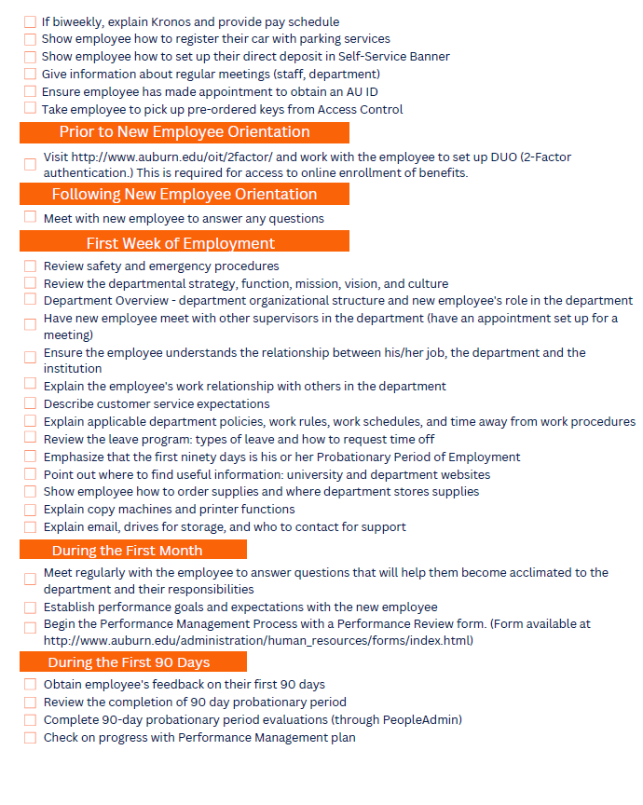
Onboarding checklist for supervisors

Slide 23

The disconnect dilemma
Everyone thinks someone else owns the experience
Notes:
When discussing departmental onboarding practices with department admins or hiring managers, I often hear what is described as the disconnect dilemma, where everyone thinks someone else owns the responsibility of creating the experience. In these cases, everyone is aware of their task ownership, but no one owns the experience. As mentioned previously, we often get so tied up in our day-to-day responsibilities and see onboarding as another to do task, but who really ensures that the employee feels welcomed, understands expectations, or connects to team culture?

Slide 24

The Accountability gap in onboarding
Tasks Completed
Laptop delivered
System access granted
Office space reserved
Name plate ordered
Welcome email sent
Trainings scheduled
Notes:
We often check off onboarding tasks but fail to deliver a consistent, high-impact experience. Why? Because task ownership does not equal experience ownership. Often, we leave the new employee feeling overwhelmed, isolated, and unclear on their roles and expectations.

Slide 25
Task completion vs. experience delivery: what’s the difference?
Task Completion | Experience Delivery
Activity-Focused | Outcome and Emotion Focused
Transactional | Relational
Assigned to individuals | Shared across teams
Often automated | Requires intentional design
Measured by checklists | Measured by perception (e.g. surveys, retention, engagement)
Notes:
As we compare the differences between task completion and experience delivery we can put these in practical terms. For instance, just because IT sets up a laptop does not mean that the employee feels set up for success. Just because HR highlights the history, mission, and traditions of the university does not mean that the employee understands or cares about the institution’s values and how their role contributes to our mission. There is a shared responsibility among all stakeholders in the onboarding process to ensure the employee has an optimal experience.

Slide 26
Why experience ownership matters
We often assume that completing a task means the box is checked. However, onboarding isn’t a checklist – it is a trust-building journey.
Notes:
So why does experience ownership matter? We often assume that completing a task means the box is checked but onboarding isn’t a checklist, it’s a trust-building journey. The moments that shape that journey are rarely captured in a task list. Are we managing onboarding like a transaction or designing it like a relationship?

Slide 27
Accountability framework: Task vs experience ownership
Onboarding Element | Task Owner | Experience Leader
Onboarding task completion | New Employee | Supervisor / Department Admin
Equipment setup | IT | Hiring Manager
Culture and values intro | HR | Department Head / Division Leader
Role clarity | Supervisor | Supervisor/Peers
Social integration | Department Admin | Colleagues/Peers
First week structure | HR | Supervisor / Department Admin

Slide 28
Put yourself in their shoes
Clarity of role and expectations
Emotional impact
Sense of belonging
Just as your early experiences shaped your sense of purpose and belonging, your role as a stakeholder directly impacts how new hires perceive and engage with our institution from day one.
Notes:
As we consider the experience that we give to new employees throughout the onboarding process, I want you put yourself in their shoes. Let’s take a moment to reflect and discuss. Think about your personal onboarding experiences, whether it was for your current position, a role at another organization, or even if you can’t reflect that far back, consider your observation of other individuals that may have joined your department or team. What stuck with you, the process or how people made you feel? So just as your early experiences shaped your sense of purpose and belonging, your role as a stakeholder directly impacts how new hires perceive and engage with our institution from day one.

Slide 29
From ownership confusion to cultural clarity
What if onboarding wasn’t a task…but a message?
Notes:
The way we onboard doesn’t just say what we do but it reveals who we are and what we care about.

Slide 30

Onboarding is a living expression of our values
Onboarding is where our mission, values, and leadership style becomes real – or doesn’t…
If we say we are an Auburn Family – but deliver cold, transactional onboarding, new employees notice.
Every stakeholder – from IT to finance to managers send a signal through how they engage.
Experience ownership means ensuring that our signals align with our cultural intentions.

Slide 31
From process to practice

Slide 32
Short term action
Audit
Converse
Identify
Audit your current departmental onboarding processes:
  Where do values show up (or not)?
  Where are roles and responsibilities unclear?
  Where can improvements be made?
Identify who the key onboarding stakeholders are in your unit
  Complete stakeholder mapping activity
Have a conversation with key stakeholders:
  Who thinks they “own” onboarding?
  Who maintains authority to integrate or eliminate activities in the onboarding process?
  Create buy in from individuals who do not believe they have a role in the onboarding process.
Assign RACI responsibilites
Identify opportunities to embed institutional or departmental values into your onboarding message.
  Welcome messages
  Team building activities
  Campus tours

Slide 33

Long Term vision
The Onboarding experience
Design departmental onboarding as a cross-functional experience let by shared ownership.
Align every touchpoint – from offer letter to the probationary period review process – with institutional values.
Measure onboarding not just by task completion, but how the new hire engages, feels a sense of belonging, has role clarity, and maintains a cultural fit within the unit.
Design onboarding as an ongoing experience that supports employees through their first year.
Integrate onboarding into the employee lifecycle strategy tying into performance management, professional development, and retention planning.

Slide 34
Thank you!
Questions and answers

