Slide 1
People First: Elevating Customer Service Excellence at Auburn
Presented by Auburn University Bookstore and Facilities Management
Moderated by Latoria Akins-Jackson, HR Business Partner

Slide 2
Video

Slide 3
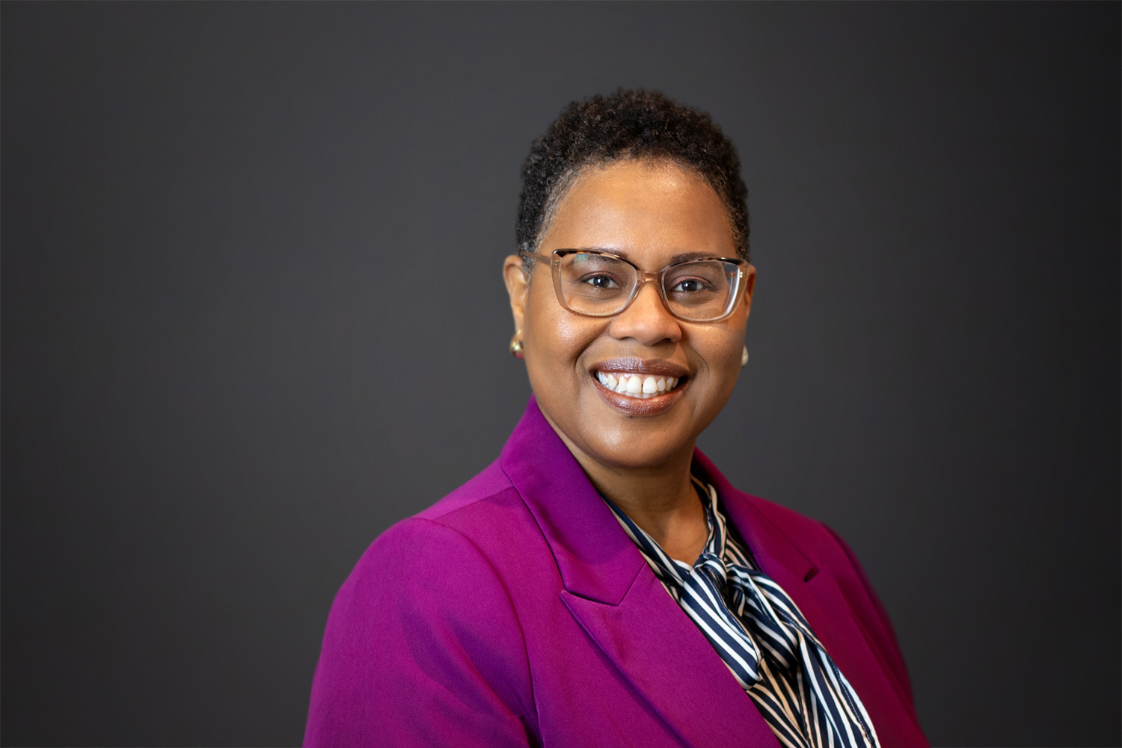
Meet the Moderator
Latoria Akins-Jackson
HR Business Partner
University Human Resources

Slide 4

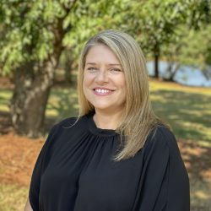
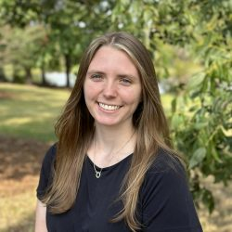
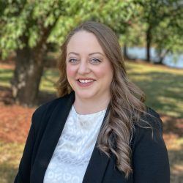
Meet the panel
Rusty Weldon
Director, Auburn University Bookstore
Jessica Johnson, PHR
HR Generalist II, Facilities Management Human Resources
Sara Newman, PHR
HR Generalist II, Facilities Management Human Resources
Hayley White, PHR
Training Manager, Facilities Management Human Resources

Slide 5


Slide 6
Video

Slide 7

Want to learn more?
Check out the Customer Service Learning Path on Elevated!

