Slide 1
Working Among Multiple Generations
Facilitated by Moriah kent

Slide 2
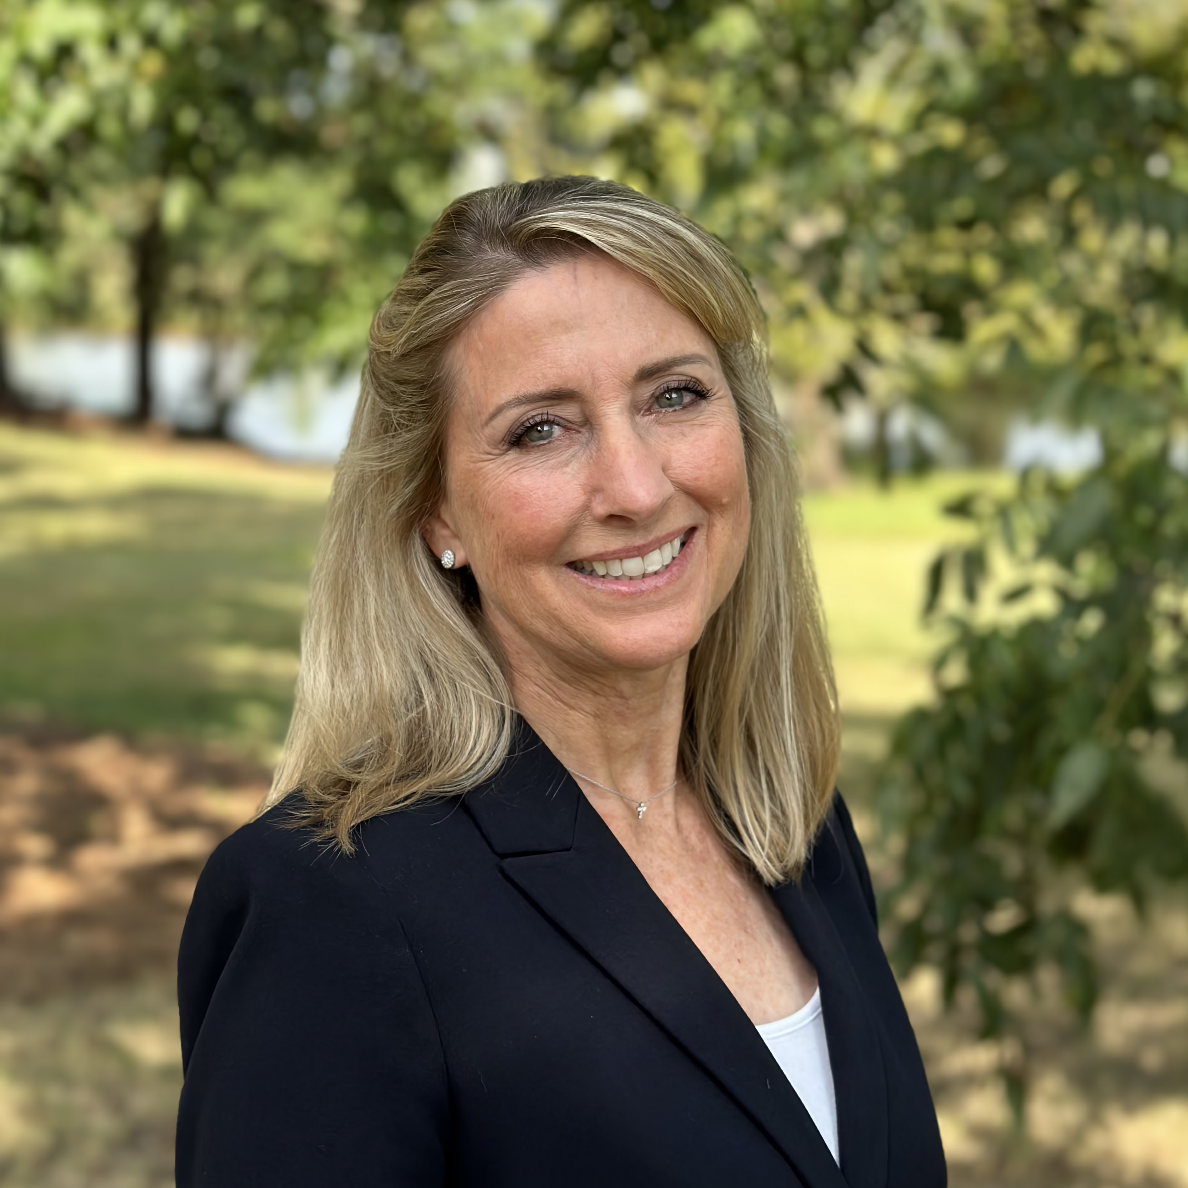
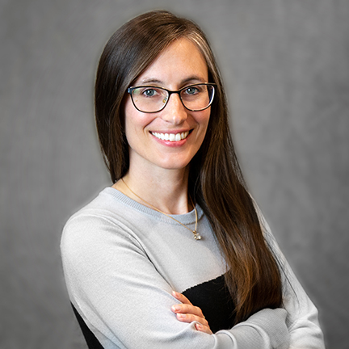
Who are we?
Loren Winn, Division Director Facilities Human Resources
20+ years Human Resources Management across multiple industries
Originally from San Diego, California
  B.S. Business Administration
  M.S. Management/Human Resource Management
  SPHR/SHRM SCP
Moriah Kent, Instructional Designer HRD & AI Implementation Specialist Biggio Center​
10 years ESL Teacher before transiting to ID at Auburn University​
Originally from Colorado Springs, CO​
  B.A. Art History, UC Denver​
  M.A. Teaching English as a Second/Foreign Language, CSU ​

Slide 3
What’s in it for me?
A deeper understanding of generational generalizations and the role they play in today’s evolving workplace.​

Slide 4
Generational cohorts in the workplace
(2018 Pew Research)
Notes:
Fry, R. (2018, April 11). Millennials are the largest generation in the U.S. labor force. Pew Research Center. https://www.pewresearch.org/short-reads/2018/04/11/millennials-largest-generation-us-labor-force/
As of 2018, according to The Pew Research Center, we have for the first time in history 5 generations in the workforce at once. You can see the breakdown here. And here at Auburn we work with and along side of many generations, particularly Gen-Z as our student workers and interns work with us. For more in depth information by age group see the US. Bureau of Labor Statistics:
U.S. Bureau of Labor Statistics. (n.d.). Labor force share, by age group, 2003, 2013, 2023, and projected 2033. Employment Projections. https://www.bls.gov/emp/graphics/labor-force-share-by-age-group.html

Slide 5
Guess my generation!
When you were in your teens, what was popular? Think…
Music
Hair styles
Brands
T.V. shows
Movies
Restaurants
Ways to socialize?
Ways to do work?
Notes:
Pick one or two and pop it in the chat or unmute and share. We’ll try and guess the generation you’re associated with.
Examples for a Millennial:
Music – Britany Spears, N*Sync, Backstreet Boys
Hair Style – Chunky layers with blonde highlights, Iced Tips
Brands – Abercrombie & Fitch, Claire’s
T.V. Shows – The Office, Friends, How I Met Your Mother
Movies – Love Actually, Titanic
Restaurants/Food – Chipotle, Clear Coke, Orbitz
That was a great walk down memory lane! And it looks like we might have a good cross section of generations represented today.

Slide 6
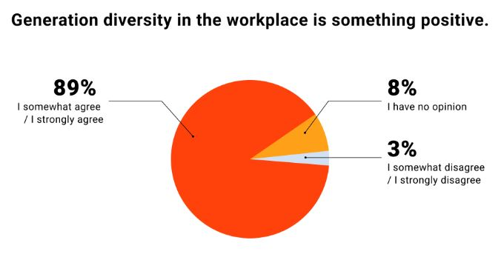
I Need Stats, Stat!
Notes:
BUT FIRST A STATISTIC!
Live Career is a company that works to help individuals in the job search market build effective resumes and cover letters and ultimately land a job. In 2022, they released a report “Different Generations in the Workplace; 2022 Study” which surveyed over 1,000 employees to look at general attitudes around the generations in the workplace, benefits and challenges, what expertise the different generations bring to the table and if age matters at all, they found that 89% of people somewhat or strongly agree that generation diversity in the workplace is something positive. Keep this in mind as we discuss generations in the workplace today.
Source: Paczka, N. (2023, January 3). Different generations in the workplace | 2024 study. Live Career. https://www.livecareer.com/resources/careers/planning/generation-diversity-in-the-workplace

Slide 7
Generational Cohorts
Generational context is less about age and
more about common experiences by groups
of people and can be very US-centric.
Notes:
Now, we're going to get into the generational profiles, but I want to provide an important disclaimer: generational context is less about age and more about common experiences by groups of people. And most of the conversation around generations is very US-centric. For example, Cambodia may not even have an “i-pad generation”.

Slide 8
Traditionalists (1925-1945)
Characteristics
  Dependable, loyal, tactful
Shaped By
  The Great Depression, WWII, Radio & Movies
World View
  Obedience over individual wants, seniority is marked by age, hierarchies are important
Values In the Workplace
  Being able to provide long-term value to their organization, respect and recognition
Notes:
Source: https://www.purdueglobal.edu/education-partnerships/generational-workforce-differences-infographic/
Go over characteristics, shaped by, and world view. Ask participants to imagine someone in their life who is this generation (professional or personal). Ask them to think about what they thing that person values in the workplace?

Slide 9
Baby Boomers (1946-1964)
Characteristics
  Optimistic, workaholics, competitive, but team-oriented
Shaped By
  The Vietnam War, Civil Rights Movement, Watergate
World View
  Sacrifice is required for success; achievement comes when you pay your dues/do the time
Values In the Workplace
  Company loyalty, teamwork and a sense of duty/responsibility, opportunities to knowledge share
Notes:
Source: https://www.purdueglobal.edu/education-partnerships/generational-workforce-differences-infographic/
Go over characteristics, shaped by, and world view. Ask participants to imagine someone in their life who is this generation (professional or personal). Ask them to think about what they thing that person values in the workplace?

Slide 10
Generation X (1965-1980)
Characteristics
  Flexible and informal, skeptical, independent
Shaped By
  The fall of the Berlin Wall, Dot-com boom, AIDS epidemic, Higher divorce rates
World View
  Quick to move if their needs aren’t being met, resistant to change if it affects their values, favors diversity in the workplace
Values In the Workplace
  Work/life balance, autonomy, putting their personal/professional needs first, diversity
Notes:
Source: https://www.purdueglobal.edu/education-partnerships/generational-workforce-differences-infographic/
Go over characteristics, shaped by, and world view. Ask participants to imagine someone in their life who is this generation (professional or personal). Ask them to think about what they thing that person values in the workplace?

Slide 11
Millennials (1981-2000)
Characteristics
  Competitive, civic-minded, open-minded, achievement-oriented
Shaped By
  Columbine, 9/11, the internet
World View
  Seeks challenges, growth and development, work/life balance, will leave an organization if they don’t like it/changes
Values In the Workplace
  Unique and purpose-driven work experiences, responsibility, the quality of their manager
Notes:
Source: https://www.purdueglobal.edu/education-partnerships/generational-workforce-differences-infographic/
Go over characteristics, shaped by, and world view. Ask participants to imagine someone in their life who is this generation (professional or personal). Ask them to think about what they thing that person values in the workplace?

Slide 12
Generation Z (1997-2012)
Characteristics
  Global, entrepreneurial, progressive, broader focus
Shaped By
  Life after 9/11, The Great Recession, technology access
World View
  Self-identify as addicted to technology, independent and individual, innovative
Values In the Workplace
  Opportunities for creativity, individuality, and personalization and diversity, immediate feedback
...and artificial intelligence
Notes:
Source: https://www.purdueglobal.edu/education-partnerships/generational-workforce-differences-infographic/
Go over characteristics, shaped by, and world view. Ask participants to imagine someone in their life who is this generation (professional or personal). Ask them to think about what they thing that person values in the workplace?

Slide 13
If you can't find empathy…
…find curiosity.
Notes:
Leah Georges’ has a TED talk called “Navigating the Multigenerational Workplace: Shoulder Pads Not Required”. In it, she sheds light on the multi-generational workforce, challenging the notion of generational gaps by highlighting our common desires for meaningful work, support, and appreciation.​
She believes that the idea of generations has become so deeply imbedded in US culture that when we talk about “the generations” people know exactly what we are talking about and in fact…. you can just google search and get a really good sense of the differences that people are thinking - - about each of these generations.​
2. But what the researchers are learning, in talking to multiple organizations that employ a wide range of people of various ages - - is that we really are more alike than we think we are.
3. In her TED Talk, Leah Georges went on to ask… “What if… we really are all more similar than we are different…[because] at the end of the day, people want work that matters, they want flexibility, they want support, they want appreciation - and none of these things are tied to a generation”​.
4. So instead of focusing on differences - what if we actively look for the similarities?
​
Ask “tell me more” when you can’t find empathy.

Slide 14
The individual

Slide 15

Navigating the Multi-generational Workplace
Leah Georges' TED Talk Insights
  Explores the multi-generational workforce dynamics
  Specifics of US/Western Culture
Key Perspectives
  Emphasizes similarities
  Highlights universal desires
Notes:
Leah Georges' TED talk sheds light on the multi-generational workforce, challenging the notion of generational gaps by highlighting our common desires for meaningful work, support, and appreciation.
Recently I listened to a TED talk titled, “Navigating the Multi-generational workplace” by Leah Georges, and her perspectives were very insightful…
She believes that the idea of generations has become so deeply imbedded in US culture that when we talk about “the generations” people know exactly what we are talking about and in fact…. you can just GOOGLE search and get a really good sense of the differences that people are thinking - - about each of these generations.
But what the researchers are learning, in talking to multiple organizations that employ a wide range of people of various ages - - is that we really are more alike than we think we are..
In her TED Talk, Leah Georges went on to ask… “WHAT IF… we really are all more similar than we are different?” “at the end of the day, people want work that matters, they want flexibility, they want support, they want appreciation - - and none of these things are tied to a generation”
So instead of focusing on differences - - what if we actively look for the similarities?? - -

Slide 16

“Onlyness” in the Workplace
Notes:
Today, we explore the concept of “onlyness” by Nilofer Merchant, a key idea in navigating generational differences. It's about recognizing the unique talents and perspectives of individuals, like Bob, John or Susie, and finding common ground beyond generational labels.
This leads me to another powerful idea in this interconnected world - -, “What if the idea that we really need to understand - - in “navigating the generations” , is to “meet people where they are”?
A Prominent thought leader and strategist on the future of work in the social era, Nilofer Merchant, - - came up with this concept of “meeting people in their “onlyness” –
According to Merchant, “Onlyness” – means that everyone is unique and has their own life experiences, perspectives, and passions. These combine to create a unique vantage point, a "spot in the world only you stand in"

Slide 17
Let's talk about that
Notes:
Ask participants to sit in groups of 4-5 with folks they feel similar generational worldviews.

Slide 18
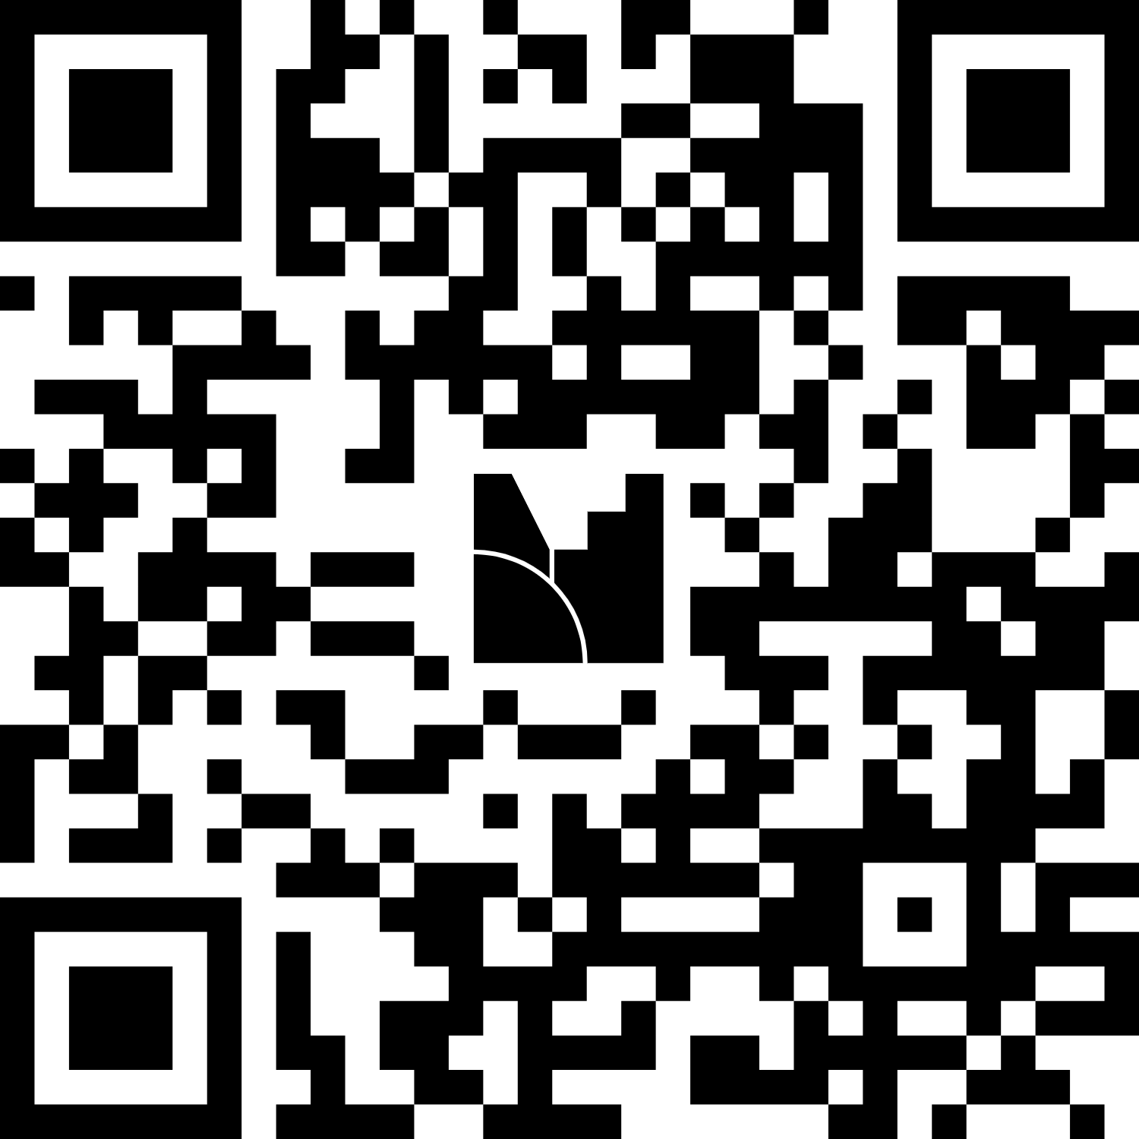
What generational cohort do you feel most aligned with?
Notes:
https://www.menti.com/alcvydo7k9vz
AUhrd05T3@m

Slide 19
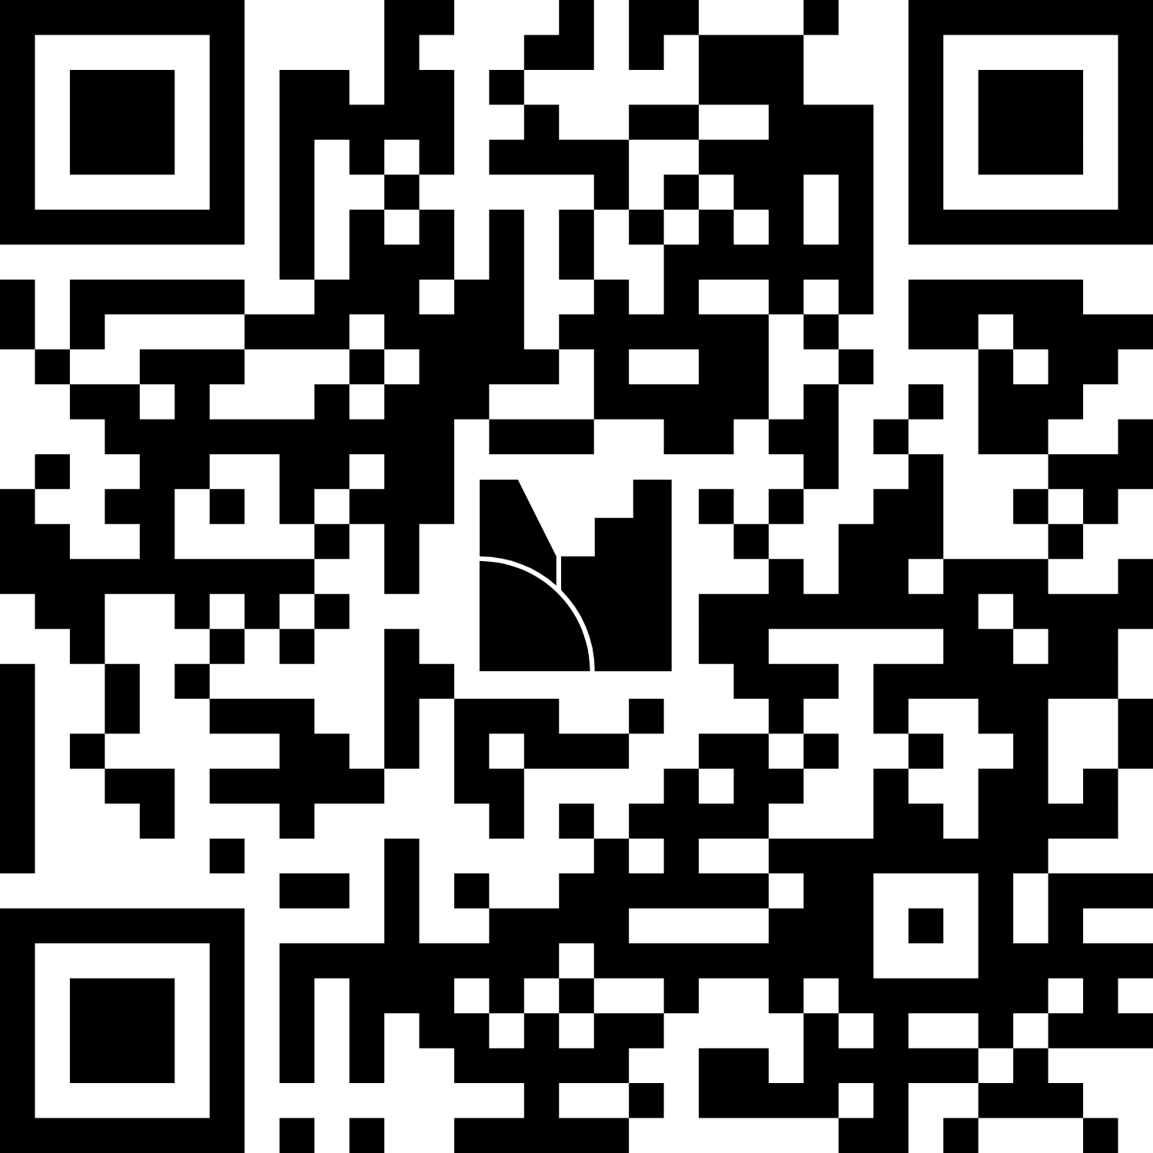
What matters to you most in your professional life?
Responses are anonymous!
Notes:
https://www.menti.com/alnydbcaw9xs

Slide 20
All generations want…
…work that matters, flexibility, support, and appreciation.

Slide 21
Continuous Learning Opportunities
Diversity Across Generations: Supporting Workplace Inclusion
Managing Multiple Generations
Driving Inclusion with Empathy
Inclusion During Difficult Times
Aspire Auburn: Leadership Development
  Leading Self – Register today at https://aub.ie/leadingself
  Leading People – Register at https://aub.ie/leadingpeople (Non-supervisors must complete Leading Self first)
  Leading Teams – Coming Soon!
Interested in joining TIGER Tech Leaders? Visit https://aub.ie/m365copilot

Slide 22
Sources
Fry, R. (2018, April 11). Millennials are the largest generation in the U.S. labor force. Pew Research Center. https://www.pewresearch.org/short-reads/2018/04/11/millennials-largest-generation-us-labor-force/
U.S. Bureau of Labor Statistics. (n.d.). Labor force share, by age group, 2003, 2013, 2023, and projected 2033. Employment Projections. https://www.bls.gov/emp/graphics/labor-force-share-by-age-group.html
Purdue Global. (n.d.). Generational differences in the workplace [Infographic]. Purdue Global. https://www.purdueglobal.edu/education-partnerships/generational-workforce-differences-infographic/?abtestactive=true
Parker, K. (2023, May 22). How Pew Research Center will report on generations moving forward. Pew Research Center. https://www.pewresearch.org/short-reads/2023/05/22/how-pew-research-center-will-report-on-generations-moving-forward/
Dimock, M. (2023, May 22). 5 things to keep in mind when you hear about Gen Z, Millennials, Boomers and other generations. Pew Research Center. https://www.pewresearch.org/short-reads/2023/05/22/5-things-to-keep-in-mind-when-you-hear-about-gen-z-millennials-boomers-and-other-generations/
Paczka, N. (2023, January 3). Different generations in the workplace | 2024 study. Live Career. https://www.livecareer.com/resources/careers/planning/generation-diversity-in-the-workplace
Georges, Leah (2018, April). Navigating the Multigenerational Workplace: Shoulder Pads Not Required. https://www.ted.com/talks/leah_georges_navigating_the_multigenerational_workplace_shoulder_pads_not_required
This material incorporated the use of AI for synthesizing, editing, and scenario development. All content was rigorously reviewed and approved by human subject matter experts for accuracy and relevance.

Slide 23
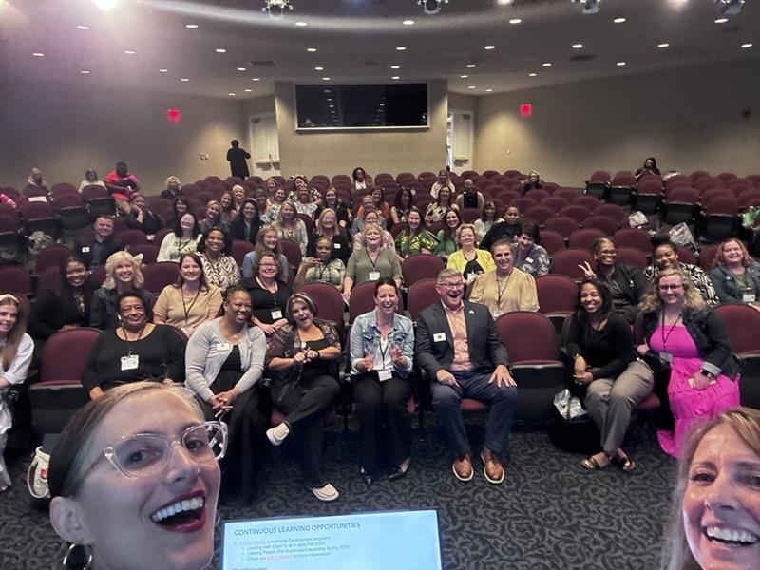
Millennial Moment - Can we take a selfie?

Slide 24

Thank you & let's stay connected!
Moriah Kent
Email: mmk0036@auburn.edu
LinkedIn: https://aub.ie/moriahkent
Or chat me on Teams!
Scan to follow me on LinkedIn!

