Slide 1
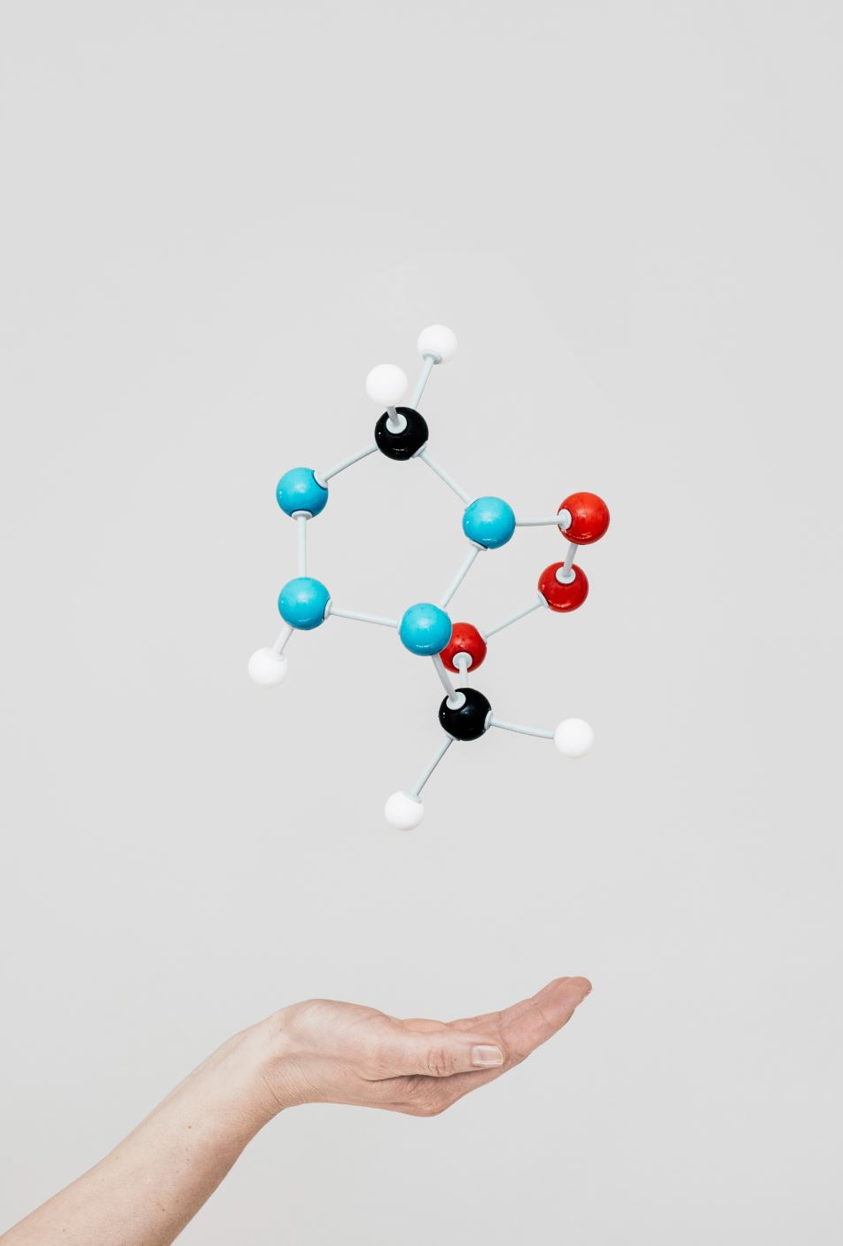
Healthy Connections
Notes:
Studies have shown that individuals who feel a sense of connection to others and to their communities are likely to live longer and enjoy happier, healthier lives than those who do not. Though we're more "connected" than ever these days through technology, the amount of real, quality interactions is dwindling. We're living farther apart from family and friends and spending more time in front of screens-even when we're surrounded by others, we're often in our own world. This session will review some simple steps for enhancing a sense of connection, even for those of us with the busiest of schedules. We'll learn how some very small, sustainable changes can make a huge impact on both physical and emotional well-being.

Slide 2
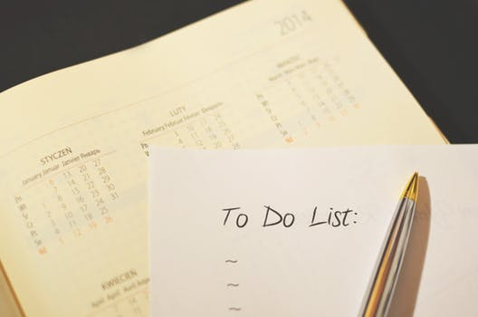

Objectives
Define community & connection
Discuss disconnection from others
Downsides of not being healthily connected
Ways to reconnect during busy lives
How to rebuild community
The challenges of connection
Additional resources
Notes:
Welcome to Healthy Connections. In today’s presentation we will discuss what community and connection is. Why we are disconnected from others. Research on the downside of not being healthily connected. Ways to connect for those that have busy schedules. How we can rebuild community. Resources to learn about how to deep dive into connection and we will have a connection challenge.

Slide 3

What is Connection?
Notes:
What is connection? Let’s explore what connection is, is not, and why it’s challenging. Research has proven that connection is one of the second most important factors next to survival. John Bowlby’s research on attachment explores that in order for a child to grow up healthy, strong, and achieve its full potential, the child needs at least one caregiver that it can trust and feel connected to. Connection is one or more person's being open and available to one another and engaging by being themselves, being open, and most of all present. We engage a lot online, but we don’t engage as much as we should in person. We are becoming connected online but disconnected in real life. It’s challenging for many because we don’t always feel accepted or like we belong. There can even be deep rooted issues from the past that can affect why someone is able to connect or not.

Slide 4
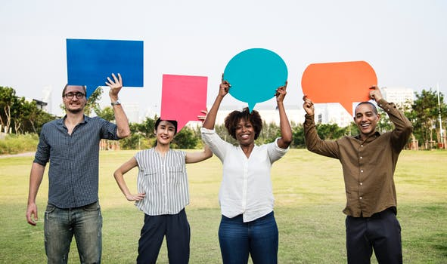
What is Community?
It’s about people
Caring & kindness
We belong to many communities
Notes:
Community is very broad word to explain but today we are going to try to get to the root of it. A community is a sense of fellowship. It’s meeting with other like-minded individuals and spending time with them. A community means that it is about the people. It’s moving from “me” to “we” and caring about everyone involved. A community is not a place although it happens in places it is a feeling of belonging somewhere. You will hear this when people say “my community” they are talking about the places in which they belong. We belong to many communities. One person can be apart of a sorority or fraternity community, church, sports team, job, book club, and more these are all communities that one person could be apart of. Our lives bring us to many communities. These communities can be organized in different ways based on factors like religion, culture, and more. The ultimate goal of the community is to meet the needs of all who are apart of it.

Slide 5
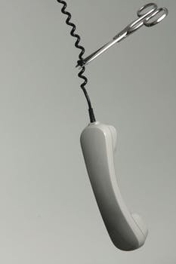
Why We Are Disconnected
Why Are We Disconnected?
Background
Anxiety
Focused on self
Social Media
Technology
Notes:
Let’s talk about why we are disconnected from others. The way we connect or not can depend on a number of different things, but we will explore a few. Background is one. You may or may not come from an environment that is big on being connected especially if you are from a big city. A small town where everyone knows one another can feel a lot more connected than a big city where people are rushing past each other to get somewhere. Anxiety can affect our ability to connect. Although we are more digitally advanced than ever before we are also more stressed than ever from juggling so much. Work, the kids, family, bills, and more just to name a few can sometimes leave us with a feeling of so much stress and anxiety that we feel disconnected. Another reason we are disconnected is because we might have become a little focused on the self. Being selfish at times is good for us, we need to exercise self care but when we are only focused on ourselves then it deters others from wanting to connect with us. Social media keeps us all interconnected but with this interconnection, we don’t go and see one another as much as we used to. Before social media if we hadn’t seen our grandparents in awhile, we would hop in the car or on the plane and go see them. However, now that grandma and grandpa are on Facebook, we don’t visit as often. Social media keeps us in the “know” of what’s going on and because of this face-to-face interaction is dwindling. Advancements in technology like smart tvs, ipads, laptops, and even smart refrigerators have made things more convenient for us but have also distracted us from time with others.

Slide 6
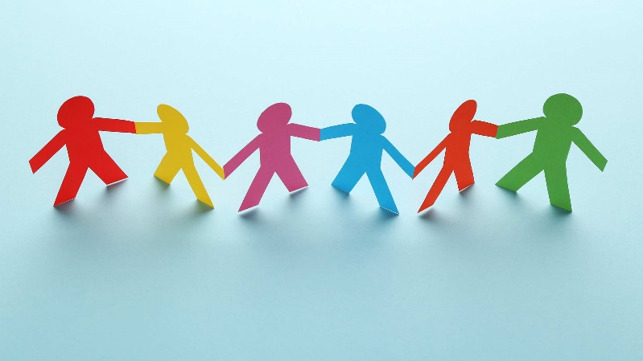

Studies About Connection
Quality of social connections directly related to risk of cardiovascular disease
“Perceived Loneliness”
    29% increased risk of heart disease
    32% increased risk of stroke
Poor social integration for people with Heart Disease
    61% increased risk of death
Notes:
The quality of your social connections is directly related to your risk of cardiovascular disease. Even “perceived loneliness” has been associated with a 29% increased the risk of heart disease and a 32% increased risk of stroke. And the mortality rates are worse for people who already have heart disease. Poor social integration (e.g., a low number of close relationships) predicts a 61% increased risk of death. Some studies show even higher risks to social isolation.
SOURCE: Dr. Tzvi Doron is board certified family doctor and the Clinical Director of Roman. He’s a member of the American Osteopathic Association (AOA) and the American Academy of Family Physicians (AAFP).

Slide 7
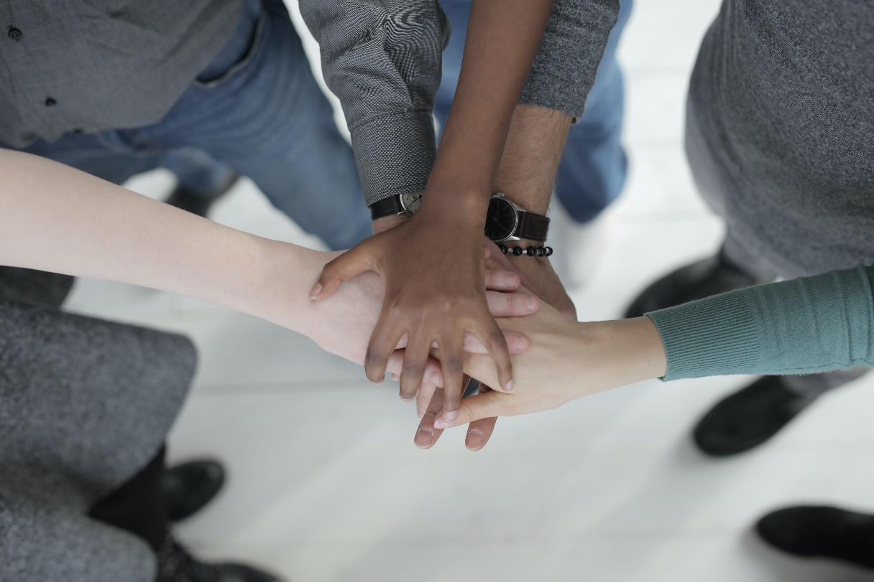
Data from the Blue Zones: Right Tribe
Evidence-based common denominators
Notes:
Blue Zones are areas in the world where people live longer and healthier lives than anywhere else on the planet. These “Blue Zone” regions are incredible because the people there live not only longer, but better. Besides having a large percentage of people that live to 100, the aging population also remains active well into their 80 and 90s, and typically do not suffer the degenerative diseases common in most of the industrialized world. There are nine common denominators of these regions and YES one is about connection, The Blue Zones call this “Right Tribe.” The world’s longest-lived people have close friends and strong social networks. Recently, Buettner, the founder of the Blue Zone Research project spoke at the World Economic Forum about Nicoya, Costa Rica (a Blue Zone). He discovered that this is where longevity and happiness converge. In Nicoya, residents have the largest number of people enjoying their day compared to any other place in the world. Why? Because they are enjoying it together!
Buettner uncovered that Nicoya people value social connection; they are getting 7 to 8 hours of face-to-face meaningful conversation each day. Equally important is who they are having these conversations with. It turns out health, happiness, and longevity are contagious. In fact, individuals exposed to supportive interactions have the following benefits:
Stronger immune system
Better functioning of their cardiovascular system
Efficient production of hormones that keep your body functioning properly
There are cities in the US who are working to create Blue Zone communities.
Sources: The Blue Zone Project. Resource: Blue Zone books, Ted Talks, Blue Zone social media groups.

Slide 8

Connecting When Busy
Technology is your friend
Plan & stick to it!
Find time that works for everyone
Ask how others are doing
Catch up on lost time!
Notes:
Since we are busy, we want to share ways in which we can connect when we are busy. These are just simple ways to connect. The first one is to use technology in positive ways. Check in using email, Facebook, and text messages but don’t use it as a substitute to connect in person. If you can meet in person, please do but if you can’t, then use technology to connect with your loved ones. Plan ahead of time. Everyone is busy and has things going on so plan to connect with your loved one's weeks in advance you can plan 3-4 weeks in advance and then once a date is set use technology to set up a Google calendar invite that will remind you and the ones you are connecting with that something is coming up soon. When trying to connect be considerate of other people’s schedules. Since we are all busy, compromise is something that everyone must do. See where you can comprise. Do things together are is another way to connect. We can connect via email and phone but going out and doing things together increases unbreakable bonds. Bonding time is important for connection. Last but not least we want to talk about asking how others are doing. We can’t assume that everyone is okay just because they are smiling and laughing. When we aren’t feeling happy, we aren’t necessarily yelling or breaking down in tears. We have things to do, there is no time for a meltdown. Life is easier when you have support. Ask your loved ones how they are doing and then genuinely listen to them respond. They will appreciate it and it will increase the connection.

Slide 9
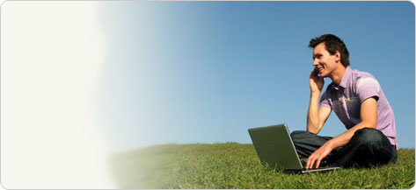
Online Connections
Utilize Zoom, Microsoft Teams, Etc.
Have virtual parties & hangouts!
Benefits
Online communication always reinforces local relationships and local identities
Builds a network of interacting individuals who are mutually aware of each other
Keeps connection during turbulent times
Notes:
Source: Haythornthwaite and Co-investigator Lori Kendall, a professor in the Graduate School of Library and Information Science at Illinois, said the study found that online interactions have positive outcomes for real-life, place-based communities.

Slide 10
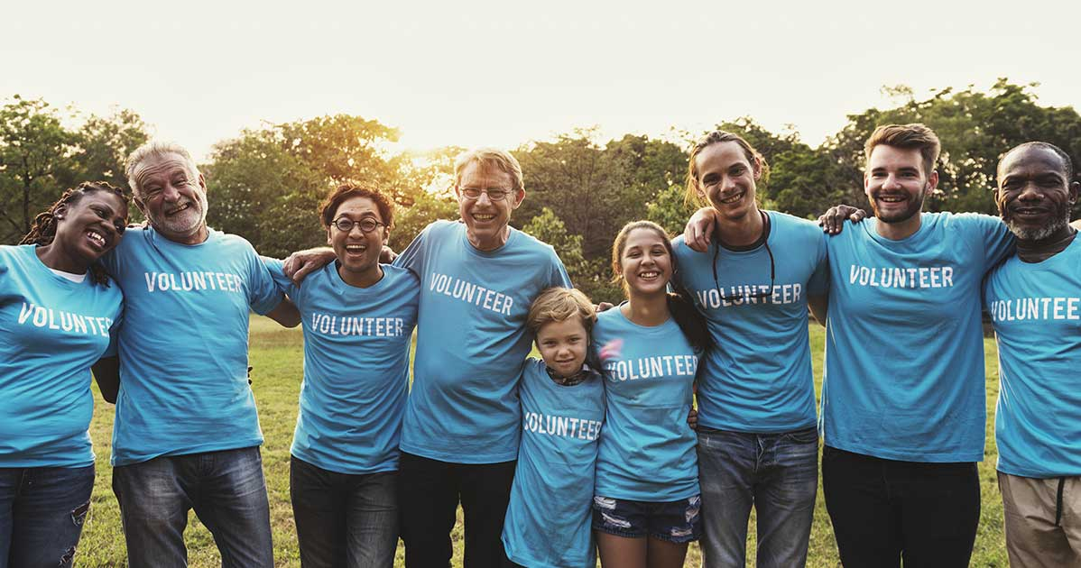
Ways to Rebuild Community
Shop local
Volunteer
Respond
Mindfulness
Communicate
Notes:
Community is important and it take time, but we can all do our part to rebuild our communities. One way is to shop local and support the local business in the areas in which we live. Not only will this help the economics in our neighborhoods, but it will also allow us to become more familiar with the people we live amongst. Volunteering is always good. It keeps us aware that we should all do our part to give back and the people who receive our assistance are always grateful. Volunteering is a win for all parties involved. Respond, don’t react. In light of the climate of our nation with government, tragedies, and more we all have to respond. When we respond we are calm and connected we are thinking. When we react, it comes from a place of murky emotions and negative emotions do not help us rebuild community. Mindfulness is key in building our communities. If we can think of others, then we can add to the space in a positive way

Slide 11
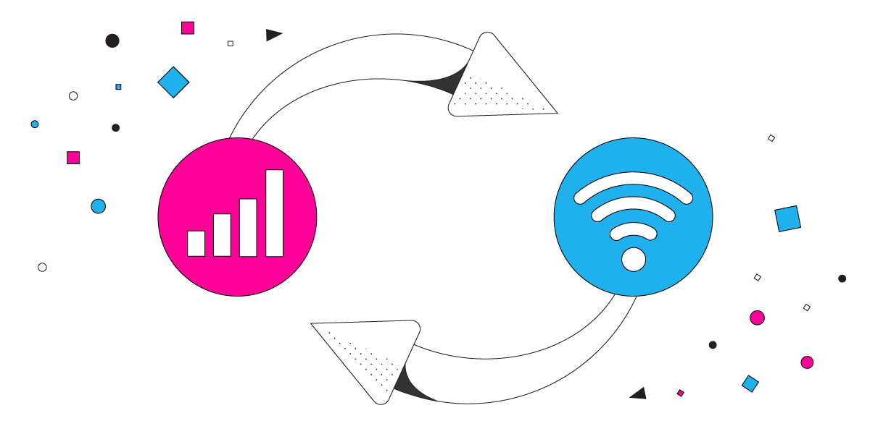
Why is Connection So Hard?
Most things are virtual!
Humans have the need for real connection
    Not just over the phone or computer!
Life is busy
    Work schedules rarely cooperate
People are nervous
    41% of people have reported an increase in anxiety since Covid-19

Slide 12

Stop & Think
Exercise
When is the last time you saw a family member that lives outside of your home?
Do most of your family and friends live in the same state as you?
Do you use social media to stay in “the know” of what’s happening with family and friends as opposed to a meet up or phone call?
Are you on your cell phone or computer when in the presence of other people?
When speaking with friends and family does the statement, “we haven’t seen each other in awhile” come up?
Are you excited about connecting with others?
Notes:
Now, lets stop and think. I am going to read these statements and questions out loud. As I read, consider them to yourself.

Slide 13
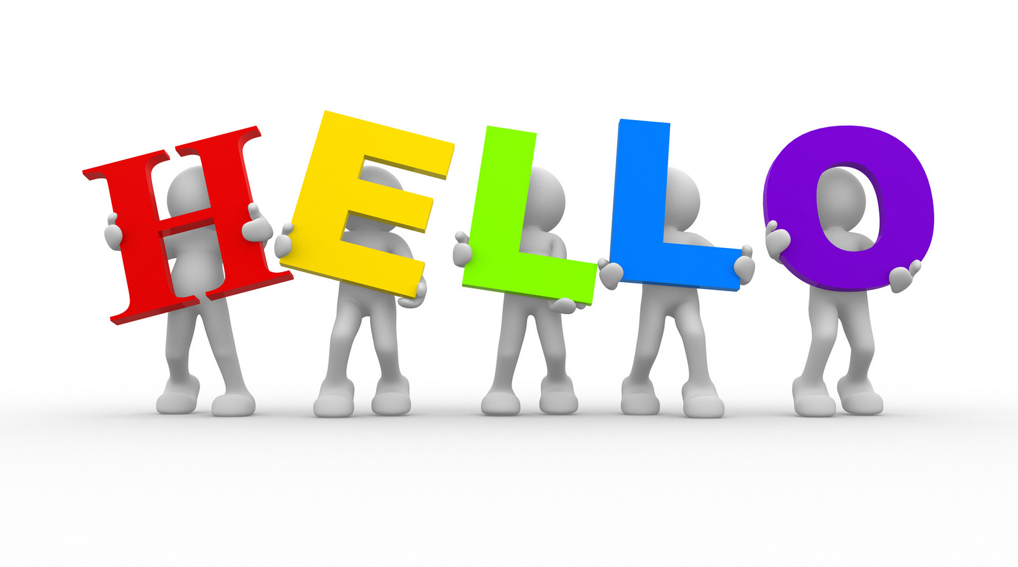
Connection Challenge
Say, “Hello” to one new person each week.
Notes:
Connect with one new person each week. Just say, “Hello.” We are rushing to work, through the grocery store, and to our next appointment. Slow down and acknowledge those around you. Many times, we are just moving too fast. My challenge to you is to say Hello to one new person each week for the next 30 days. That is only four brand new “Hellos”

Slide 14
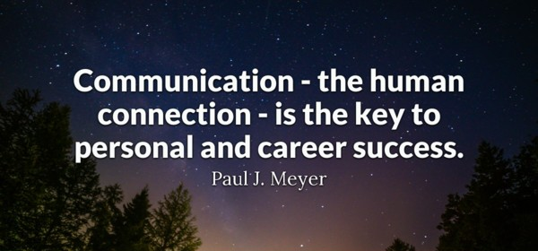
TITLE

Slide 15
Additional Resources
Hey Friend: 100 Ways to Connect with 100 People in 100 Days
Stanford Social Innovation Review
Books
Never Eat Alone by Keith Ferrazi
Symptoms of Being by Jeff Garvin
Notes:
Thank you so much for connecting through this presentation. Here are a few resources that you can check out.
Hey Friend: 100 Ways to Connect with 100 People in 100 Days is a book that shows us how to: make friends everywhere (on planes, on trains, in lines and while they dine); be connectors not networkers and yes there's a difference; connect with 21st century techniques like hashtags, swag, podcasts, retweets and street teams; share their "who" not their "do" when meeting people that are new and use 100 creative techniques to curate new friendships while cultivating the friendships they already have.
Stanford Social Innovation Review is an online journal publication that informs and inspires leaders of social change.
Never Eat Alone and other secrets to success, one relationship at a time by Keith Ferrazzi is another great resource to build social connection.

Slide 16
Thank you for your time and attention!
Contact the EAP: uprisehealth.com/members

