Slide 1

Judging too quickly
Mike von Ahnen, SHRM-scp, PMP, CBCP
Employee relations

Slide 2
Judging too quickly
agenda
Introduction
Do you judge?
Pitfalls of judging too quickly
Ways to avoid judging too quickly
Summary

Slide 3
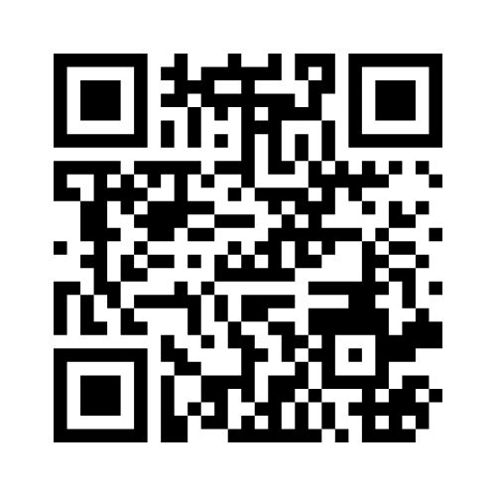
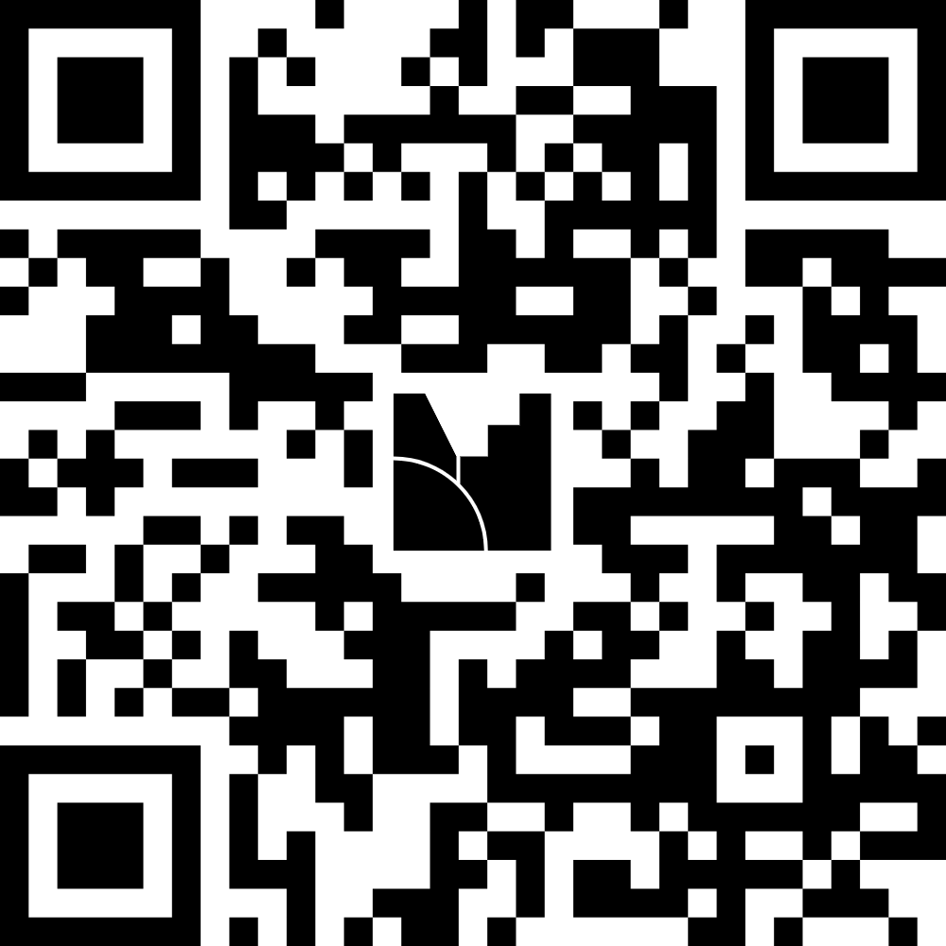

introduction
How often do you judge people too quickly?
https://www.menti.com/al8bzgwjkmu6
Utilize the Mentimeter QR Code to answer.

Slide 4
introduction
You have the opportunity to pick 1 person to be the new world leader out of 3 candidates.
Only your vote counts!
The only info you have to make your decision is the info that’s provided. You must make your decision based off of the info presented.

Slide 5

Candidate #1
He associates with crooked politicians and consults with astrologers
He has had 2 mistresses
He chain smokes and drinks up to 10 Martini’s a day
Quote: “I’m not the smartest fellow in the world, but I can sure pick smart colleagues.”

Slide 6

Candidate #2
He was removed from public office twice
He sleeps until noon and used opium in college
He drinks a large amount of whiskey every evening
Quote: “The best argument against democracy is a five-minute conversation with the average voter.”

Slide 7

Candidate #3
He is a decorated war hero
He is a vegetarian, doesn’t smoke, and only drinks an occasional beer
He has not had any extra-marital affairs
Quote: “Words build bridges into unexplored regions.”

Slide 8

introduction
Did you choose candidate 1, 2, or 3 and why?

Slide 9

introduction
Candidate #1; Franklin D. Roosevelt

Slide 10
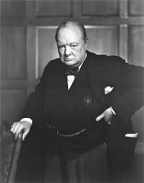
introduction
Candidate #1; Franklin D. Roosevelt
Candidate #2; Winston Churchill

Slide 11
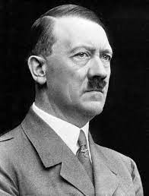
introduction
Candidate #1; Franklin D. Roosevelt
Candidate #2; Winston Churchill
Candidate #3; Adolf Hitler

Slide 12
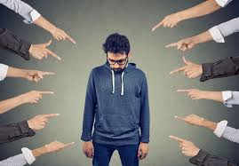
Do you judge?
First Contact/interaction
It’s human nature
What do you base it off? Looks, clothing, grooming standards, handshake, body language, political view, religion, bald vs. full head of hair, a lazy eye, old or young, straight or crooked and/or missing teeth, voice accent etc…
How you judge can change over your lifespan, either positively or negatively
Judging others can make some people feel good about themselves (ego boost)

Slide 13
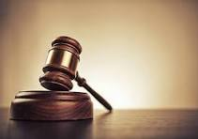
Do you judge?
Self reflection questions;
Are you quick to think someone is “guilty” before you have all the facts?
Do you think someone is weak if they get emotional?
Do you think someone is not intelligent if they don’t have a college degree?
Do you think someone is less valuable at work because you have a “better” work or duty title?
Do you think someone is not as competent or less important than you if they serve in a “lower” position than you?
Do you allow a duty title to define your value versus the content of your character?

Slide 14
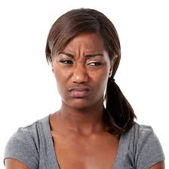
Do you judge?
Yes, everyone judges, it’s human nature
Your judgement could be adding undue stress onto the person you are judging
Your premature judgement could end up becoming a fulfilling prophecy (someone’s morale, commitment, self-worth, self-esteem, can all be impacted)
The key is to avoid the pitfalls of judging

Slide 15
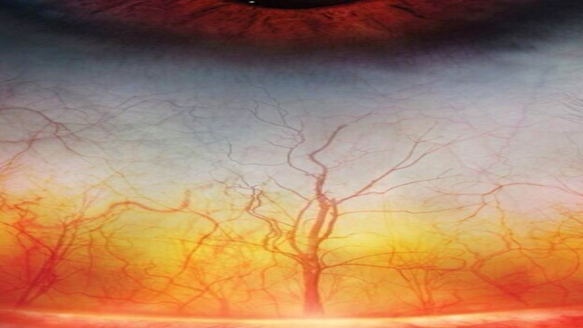

Image slide:
To change this image, delete the existing image on this slide.
Click the icon in the placeholder box and select your photo when prompted to do so.
To adjust the placement of your photo, select the placeholder box and go to the “Picture Format” tab.
Select “Crop” and adjust the size and placement of the photo as needed.
It is important that you do not change the size of the actual placeholder. If you think you have done this, on the “Home” tab, click the “Reset” button.
Last, once you are happy with the placement of your photo, select the photo once more, right-click > select “Send to back” > and select “Send to back” again.
After sending the photo to the back, it should be completely behind the white, semi-transparent arrows and the Auburn logo.
Delete this text box.

Slide 16
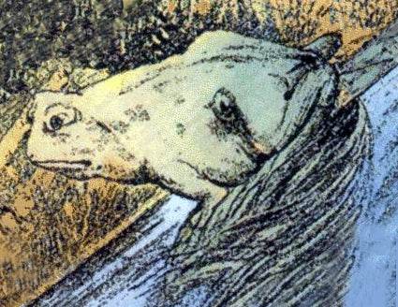
Pitfalls of judging
The last picture was a high-def photo of blood vessels in a human eye
What do you see in the photo to the right?

Slide 17
Pitfalls of judging
The last picture was a high-def photo of blood vessels in a human eye
What do you see in the photo to the right?
Is it a frog or a horse?
https://nypost.com/2022/07/19/frog-horse-optical-illusion-determines-your-personality-type/

Slide 18

Pitfalls of judging
You are not giving a person a fair chance. You have incomplete info about them
We are all different, no one is identical to you
No one is perfect
You can potentially write someone off who is actually awesome!
Appearances are often deceptive

Slide 19
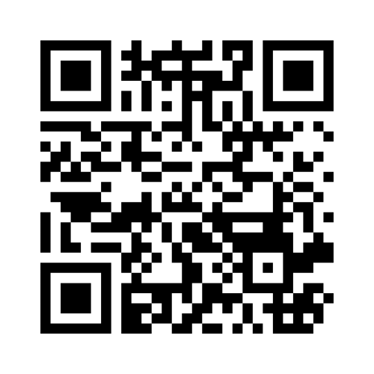
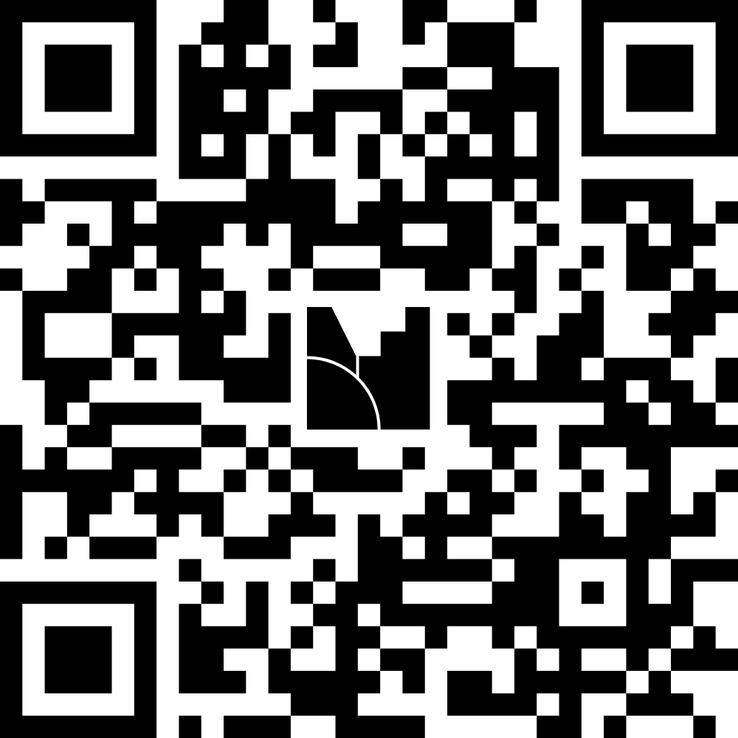
PITFALLS OF JUDGING
The next slide shows 3 people
https://www.menti.com/ali1s3h6t3da
Who has a net worth of $1 million or more?

Slide 20
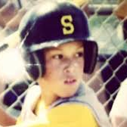
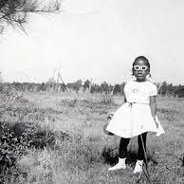
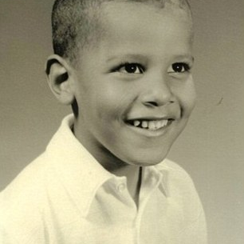
Pitfalls of judging
A
B
C

Slide 21
Pitfalls of judging
Aaron Judge
($50 million)
Oprah Winfrey
($3 Billion)
Barack Obama
($70 million)

Slide 22
Pitfalls of judging
https://www.youtube.com/watch?v=tvHoOjJ_9SU
https://www.youtube.com/watch?v=0Q1B2s6le2g
You are not giving someone a fair chance when you judge them too early

Slide 23
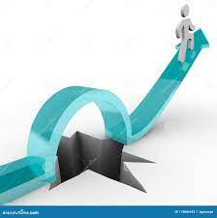
Ways to avoid judging
Set a goal to break this habit
Make a conscious effort
Try to be self-critical. Do you like when people are judging you?
Keep in mind, you don’t have all the facts to judge
Have compassion. Seek out additional info
Remember, you are not in their shoes

Slide 24
Ways to avoid judging
Be kind
Keep in mind that thoughts are not facts
Take time to get to know someone
Have patience
Give people a chance, they may surprise you!

Slide 25
What’s in it for me?
You become more open-minded
Provides the opportunity to build and strengthen relationships
It allows you to learn from others experiences
You create a more welcoming environment
It allows you to gain an understanding of different perspectives
Can potentially reduce stress
Better work quality
Employees feeling safe and comfortable in the workplace
Good culture = competitive advantage (people are our competitive adv)
Trust!

Slide 26

summary
Introduction
Do you judge?
Pitfalls of judging too quickly
Ways to avoid judging too quickly
Summary

Slide 27



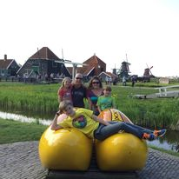






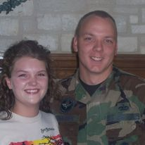

The end!
Thank you!
Mike Von Ahnen
Manager, ER & Investigations
mpv0009@auburn.edu
334-844-1647

