Slide 1

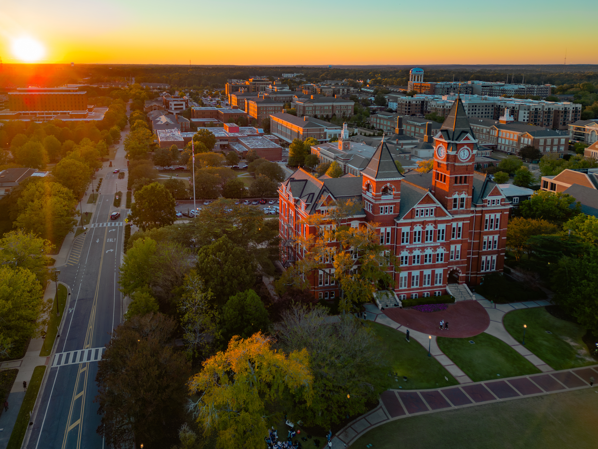
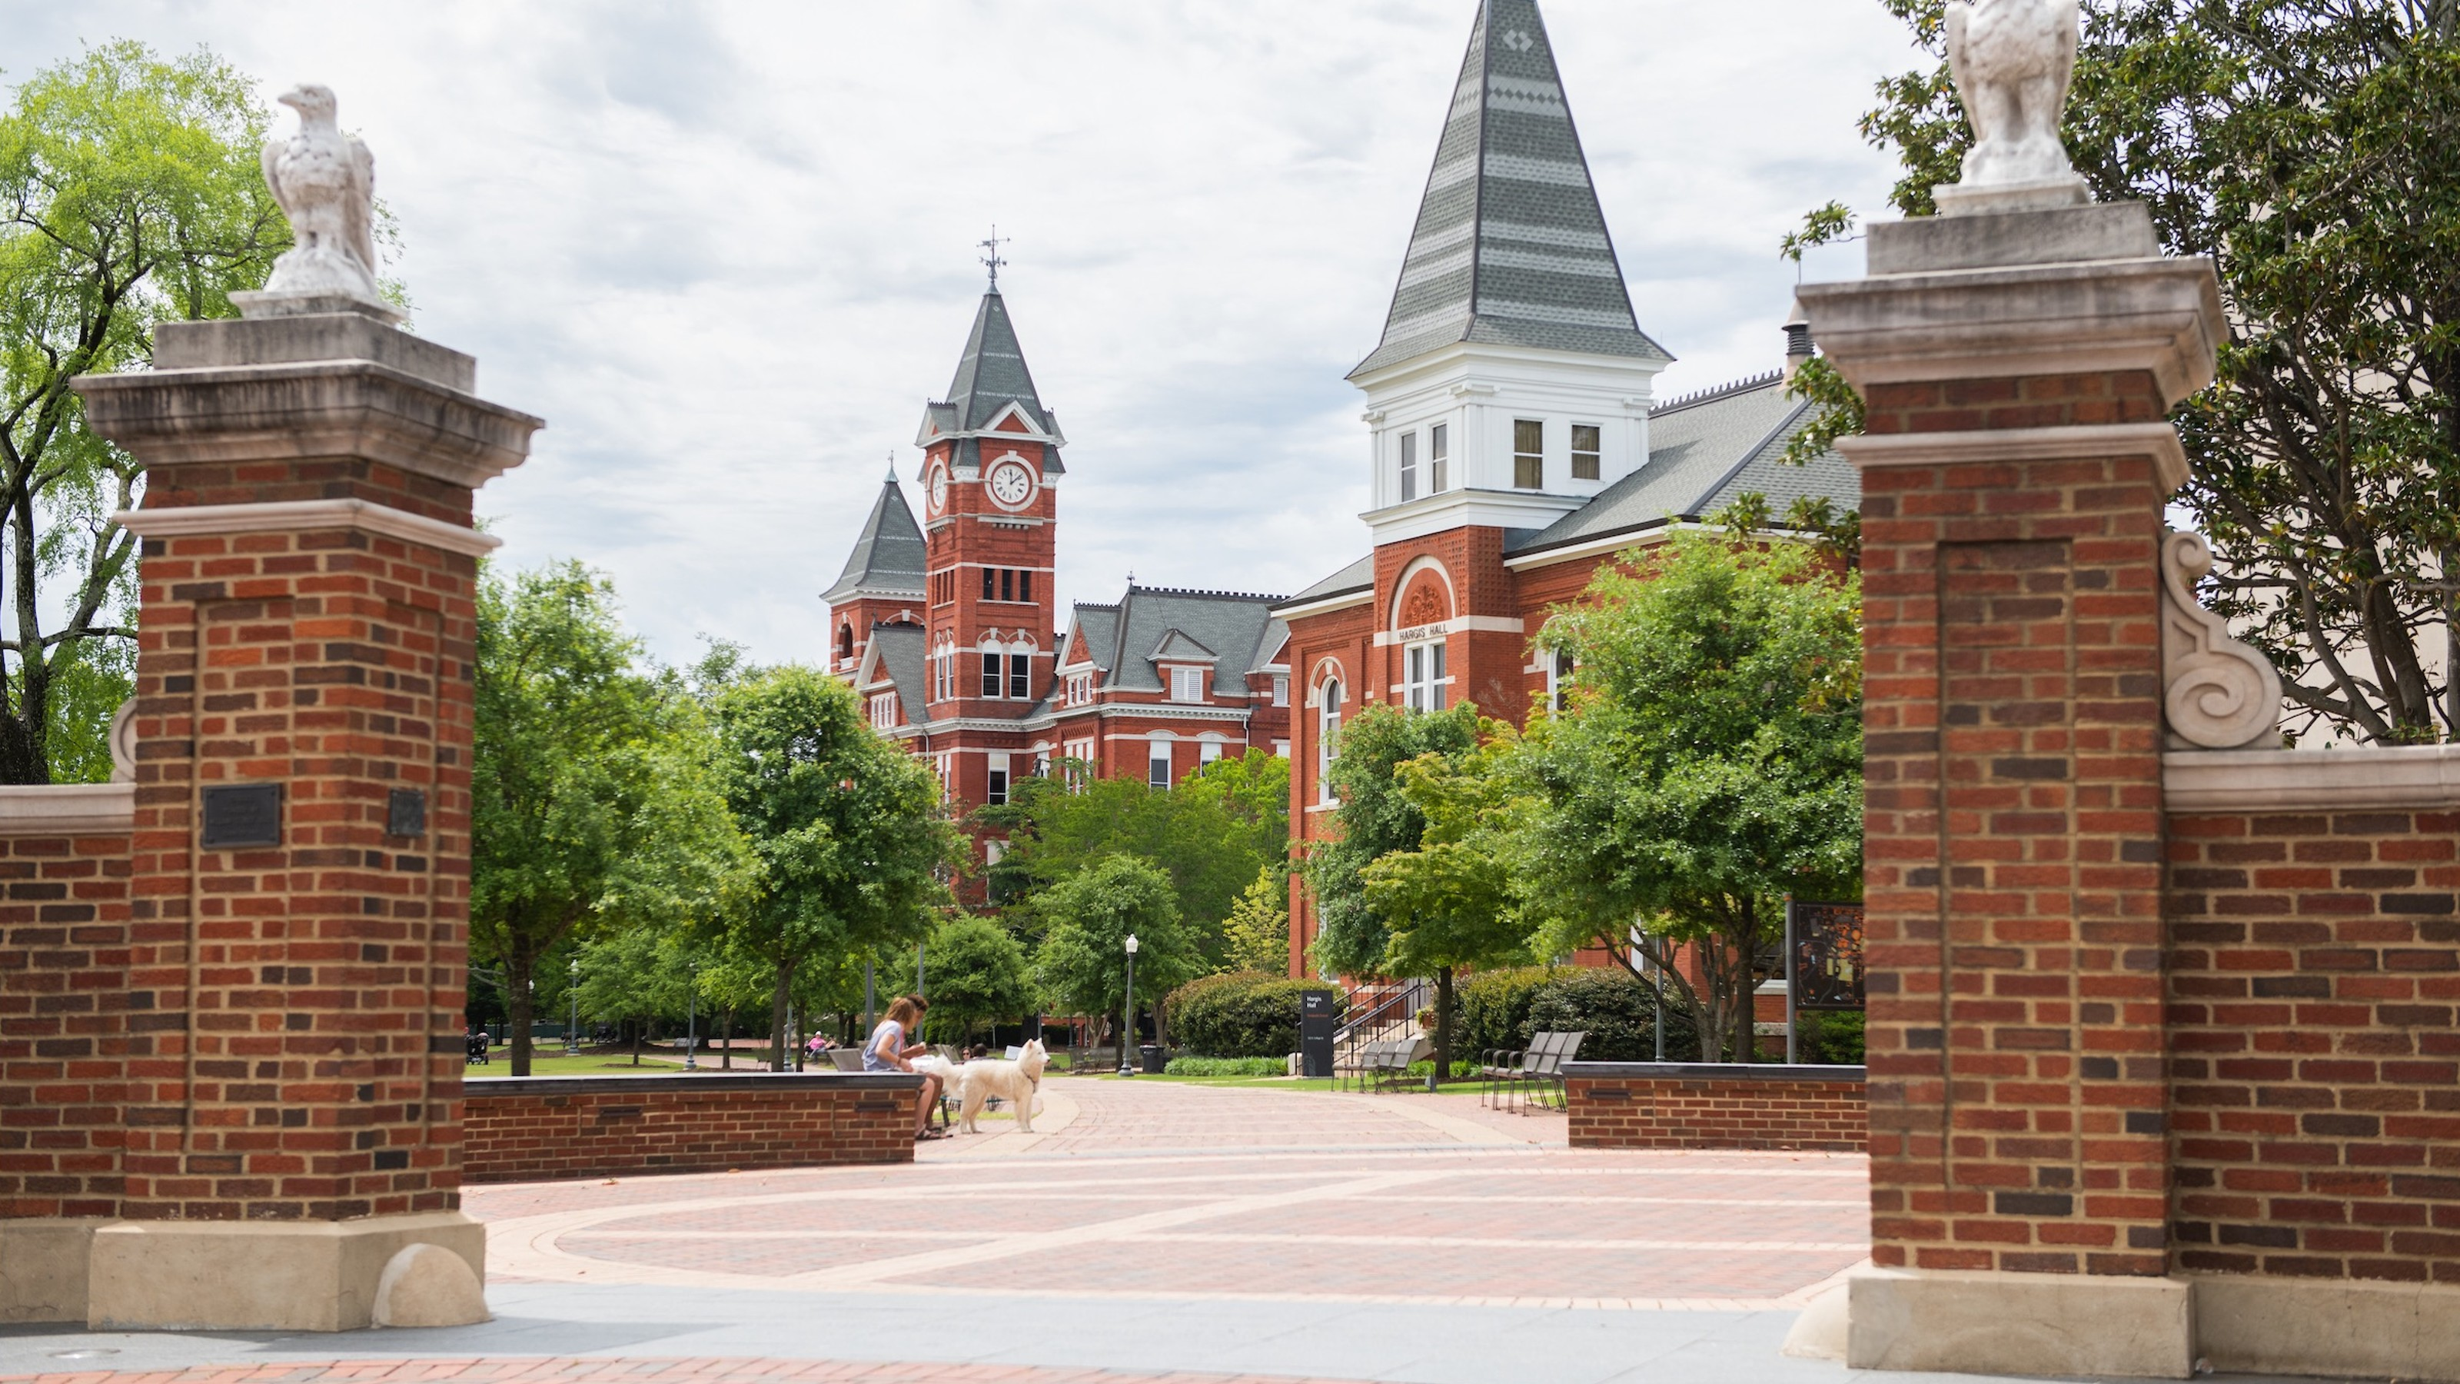
HIRE LEARNING
Tips & Tales from the Front Lines of
Student Employment
Employment services

Slide 2

HIRE LEARNING
SESSION OBJECTIVES
DISCOVER BEST PRACTICES & CLARIFY
MISCONCEPTIONS
LEGAL & POLICY COMPLIANCE
CHANGE THE NARRATIVE BY ENHANCING
CANDIDATE EXPERIENCE
PHONES UP!!
Tips & Tales from the Front Lines of
Student Employment
Employment services
SCAN THIS

Slide 3
PHONES UP!!
SCAN THIS
DISCOVER BEST PRACTICES FOR
STUDENT EMPLOYMENT

Slide 4
DISCOVER BEST PRACTICES FOR
STUDENT EMPLOYMENT
Notes:
Welcome to “Hire Learning: Tips & Tales from the Front Lines of Student Employment,” presented by Employment Services. We’re so glad you’re here to join us for a session that’s all about sharing practical insights, real-life stories, and strategies that can make a meaningful difference in how we support student employees.
Whether you’re new to hiring student workers or a seasoned pro, today’s session is designed to offer something valuable for everyone.

Slide 5
HIRE LEARNING
Understanding student position types & structure
discover best practices
Tips & Tales from the Front Lines of
Student Employment

Slide 6
HIRE LEARNING
Understanding student position types & structure
discover best practices
Tips & Tales from the Front Lines of
Student Employment
BACKGROUND CHECKS ARE VALID FOR 12 MONTHS FROM COMPLETION BEFORE REQUIRING AN UPDDATE FOR A NEW POSITION
WORK STUDY
GRADUATE ASSISTANT (GA)
MINIMUM PAY RATE
FTE OVERLOAD
Must be approved through Financial Aid to be assigned to WA position number.
Positions must contain specific functional knowledge, skills and abilities learned in the student’s educational program that will be applied in the work during assistantship.
Graduate assistantships require minimum pay rate of $14.12/hour, all positions.
Requires approval from Dean of Graduate School and Manager of Employment Services
CO-OP
OFFER LETTERS
Must be enrolled in co-op course for semester
Required completion in applicant tracking system (ATS) for all new hires
GRADUATE TEACHING ASSISTANT (GT) – FOREIGN NATIONAL
Speak test scores required or Graduate School Dean approved alternative

Slide 7
Understanding Hiring requirements discover best practices
UNDERGRAD
UNDERGRAD TRANSFERRING TO GRADUATE POSITION
ALL
ACTIVE PEAEMPL
SAME POSITION
ACTIVE PEAEMPL
Based on position
Required if working with minors
MVR is also considered part of the background. If student will be driving at any point, they must have an MVR.
If returning to the same graduate position from a previous semester, background check is not required
Must be notated on EPAF
GRA/GTA rotations do not require updated backgrounds if rotating was original intent of assistantship
Recommended to include as part of offer letter
Summer: If transitioning to GB due to the student not being enrolled but will continue same job duties, no background is required
Must be noted on EPAF
Requires a full, standard background check
If driving, utilize the expanded code NOT standard code
If transferring from a different employment type, they should only require a partial background = partial code
NEW POSITION
If job has not been previously assigned
Utilize partial background code
WORK STUDY
GRADUATE ASSISTANT (GA)
MINIMUM PAY RATE
FTE OVERLOAD
Must be approved through Financial Aid to be assigned to WA position number.
Positions must contain specific functional knowledge, skills and abilities learned in the student’s educational program that will be applied in the work during assistantship.
Graduate assistantships require minimum pay rate of $14.12/hour, all positions.
Requires approval from Dean of Graduate School and Manager of Employment Services
CO-OP
OFFER LETTERS
Must be enrolled in co-op course for semester
Required completion in applicant tracking system (ATS) for all new hires
GRADUATE TEACHING ASSISTANT (GT) – FOREIGN NATIONAL
Speak test scores required or Graduate School Dean approved alternative
BACKGROUND CHECKS ARE VALID FOR 12 MONTHS FROM COMPLETION BEFORE REQUIRING AN UPDDATE FOR A NEW POSITION
Notes:
TOEFL (iBT Speaking Section) - Score of 23 or higher.
IELTS (Speaking Section)- Score of 7 or higher.
iTEP (Speaking Section) (Auburn University administered)- Score of 4.5 or higher.
If the student does not meet any of the requirements stated above, the student must have one of the following:
Enroll in INTL 1820. (Upon completion with a “PASS” the student will become eligible to be hired as a GTA)
The student has a degree from an accredited college/university in the United States OR the Graduate Dean approved alternative certification of English proficiency.
For returning International GTAs, please notate in the EPAF they are returning and their speak score is on file.

Slide 8
BACKGROUND CHECKS discover best practices
START DATE VS HIRE DATE
STANDARD START DATES
UNDERGRAD
UNDERGRAD TRANSFERRING TO GRADUATE POSITION
ALL
ACTIVE PEAEMPL
SAME POSITION
ACTIVE PEAEMPL
HIRE DATE
Under the Policy on Employment Start Dates, applies to all student positions with exception of graduate assistantships.
Based on position
Required if working with minors
MVR is also considered part of the background. If student will be driving at any point, they must have an MVR.
If returning to the same graduate position from a previous semester, background check is not required
Must be notated on EPAF
GRA/GTA rotations do not require updated backgrounds if rotating was original intent of assistantship
Recommended to include as part of offer letter
Summer: If transitioning to GB due to the student not being enrolled but will continue same job duties, no background is required
Must be noted on EPAF
It marks the point at which the individual is officially recognized as an employee by the university, even if they haven’t begun working yet.
Requires a full, standard background check
If driving, utilize the expanded code NOT standard code
If transferring from a different employment type, they should only require a partial background = partial code
FIRST TIME STUDENTS
Ineligible for student employment until one week prior to the first class date.
Application of ‘first time student’
Foreign National students
START DATE
NEW POSITION
The date the employee begins performing job duties. It’s the first day they are eligible to receive compensation
If job has not been previously assigned
Utilize partial background code
BACKGROUND CHECKS ARE VALID FOR 12 MONTHS FROM COMPLETION BEFORE REQUIRING AN UPDDATE FOR A NEW POSITION
WORK STUDY
GRADUATE ASSISTANT (GA)
MINIMUM PAY RATE
FTE OVERLOAD
Must be approved through Financial Aid to be assigned to WA position number.
Positions must contain specific functional knowledge, skills and abilities learned in the student’s educational program that will be applied in the work during assistantship.
Graduate assistantships require minimum pay rate of $14.12/hour, all positions.
Requires approval from Dean of Graduate School and Manager of Employment Services
CO-OP
OFFER LETTERS
Must be enrolled in co-op course for semester
Required completion in applicant tracking system (ATS) for all new hires
GRADUATE TEACHING ASSISTANT (GT) – FOREIGN NATIONAL
Speak test scores required or Graduate School Dean approved alternative

Slide 9
HIRE DATES discover best practices
START DATE VS HIRE DATE
STANDARD START DATES
HIRE DATE
Under the Policy on Employment Start Dates, applies to all student positions with exception of graduate assistantships.
It marks the point at which the individual is officially recognized as an employee by the university, even if they haven’t begun working yet.
FIRST TIME STUDENTS
Ineligible for student employment until one week prior to the first class date.
Application of ‘first time student’
Foreign National students
START DATE
The date the employee begins performing job duties. It’s the first day they are eligible to receive compensation
BACKGROUND CHECKS ARE VALID FOR 12 MONTHS FROM COMPLETION BEFORE REQUIRING AN UPDDATE FOR A NEW POSITION

Slide 10
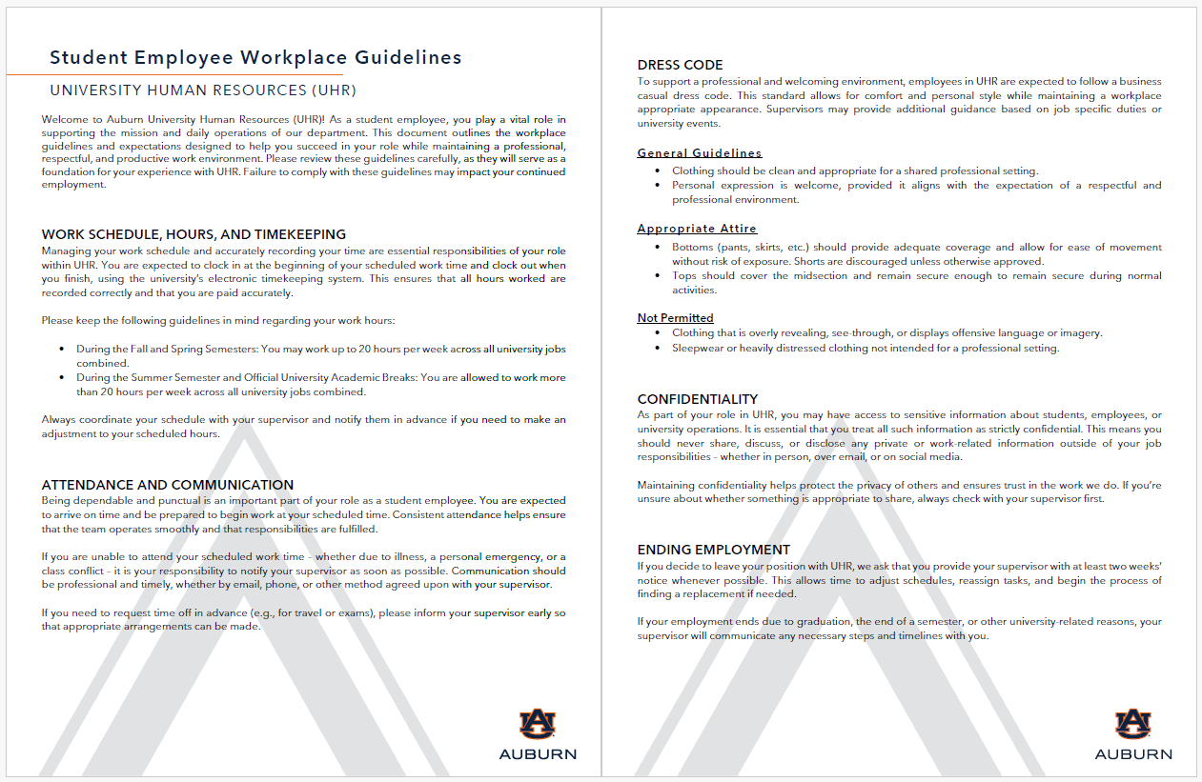
Pay, hours & expectations
Discover best practices
FEDERAL MINIMUM WAGE | $7.25/HOUR
AVERAGE HOURLY PAY RATE | $12.00/HOUR
GRADUATE ASSISTANTSHIP MINIMUM HOURLY RATE | $14.12/HOUR
GRADUATE ASSISTANT AVERYAGE HOURLY RATE
HOURS & FTE
Students are limited to working 20 hours per week during Fall and Spring semester but allowed to work above the hours threshold during Summer semester. However, unless they are on assistantship, their FTE may not exceed .5 FTE.
→ TAX IMPLICATIONS
→ TEACHERS RETIREMENT
EXPECTATIONS AND GUIDELINES
Share expectations and guidelines for your unit on day one of employment or create a standard that your supervisors share with students at hire.
LEGAL & POLICY COMPLIANCE

Slide 11
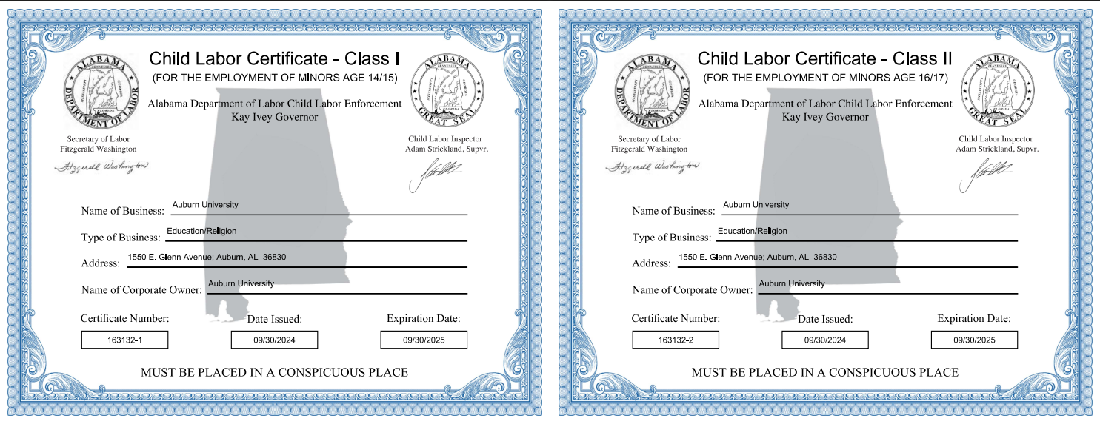
LEGAL & POLICY COMPLIANCE
DEPARTMENT OF LABOR
FAIR LABOR STANDARDS ACT (FLSA)
  Current federal minimum wage is $7.25/hour
  Accurate record keeping of work hours
  STATE OF ALABAMA CHILD LABOR LAWS
    Class I Certificate: To employ minors age 14-15
    Class II Certificate: To employ minors age 16-17
FAIR CREDIT REPORTING ACT (FCRA)
Adverse action processing
AFFORDABLE CARE ACT (ACA)
Requires employers to offer health insurance to an employee who works 1560 hours within a 12-month measurement period.
US CITIZENSHIP AND IMMIGRATION SERVICES (USCIS)
Immigration Reform and Control Act of 1986
Form I-9 / E-Verify

Slide 12


Policy on Student Employment
Policy on Employment Start Dates
Policy on Conducting Background Checks
Driver qualification policy
Youth protection policy
Family educational rights and privacy act
Federal & State employment regulations
Legal & Policy compliance
DEPARTMENT OF LABOR
FAIR LABOR STANDARDS ACT (FLSA)
  Current federal minimum wage is $7.25/hour
  Accurate record keeping of work hours
  STATE OF ALABAMA CHILD LABOR LAWS
    Class I Certificate: To employ minors age 14-15
    Class II Certificate: To employ minors age 16-17
FAIR CREDIT REPORTING ACT (FCRA)
Adverse action processing
AFFORDABLE CARE ACT (ACA)
Requires employers to offer health insurance to an employee who works 1560 hours within a 12-month measurement period.
US CITIZENSHIP AND IMMIGRATION SERVICES (USCIS)
Immigration Reform and Control Act of 1986
Form I-9 / E-Verify
Notes:
DEPARTMENT OF LABOR
Fair Labor Standards Act (FLSA): Establishes minimum wage, overtime pay, and recordkeeping affecting employees in Federal, State, and local governments.
Current federal minimum wage is $7.25/hour
State of Alabama Child Labor Laws: Employers are required to obtain and display proper Child Labor Certificates for each location where minors are employed. UHR renews certificates yearly, departments may find the certificates
Class I Certificate: To employ minors age 14-15
Class II Certificate: To employ minors age 16-17
FAIR CREDIT REPORTING ACT (FCRA)
Federal law that ensures accuracy of information obtained from a background check report, it requires employers to provide adverse action processing when the information obtained potentially effects an employment decision and gives the individual opportunity to dispute.
AFFORDABLE CARE ACT (ACA)
Requires employers to offer health insurance to an employee who works 1560 hours within a 12-month measurement period.
US CITIZENSHIP AND IMMIGRATION SERVICES (USCIS)
Under the Immigration Reform and Control Act of 1986, all employers are required to verify an employee’s eligibility for employment in the United States upon offer and acceptance of appointment. Hiring an employee who is not authorized to work in the U.S. may result in civil and federal penalties.

Slide 13
University policy
Legal & Policy compliance
Policy on Student Employment
Policy on Employment Start Dates
Policy on Conducting Background Checks
Driver qualification policy
Youth protection policy
Family educational rights and privacy act
PLAN
AHEAD
UNIT STANDARD OPERATING PROCEDURES (SOP’s)
UNDERSTAND AND
ADHERE TO GUIDELINES
REGULAR TRAINING AND UPDATES
ASK
QUESTIONS

Slide 14
Avoiding common pitfalls
Legal & Policy compliance
PLAN
AHEAD
UNIT STANDARD OPERATING PROCEDURES (SOP’s)
UNDERSTAND AND
ADHERE TO GUIDELINES
REGULAR TRAINING AND UPDATES
ASK
QUESTIONS
Clarifying misconceptions
Notes:
This includes constant communications and reminders with your supervisors
Educate your unit on these guidelines

Slide 15
Changing the Narrative:
Enhancing the Student Candidate Experience

Slide 16

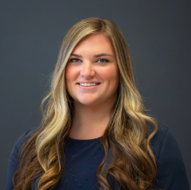
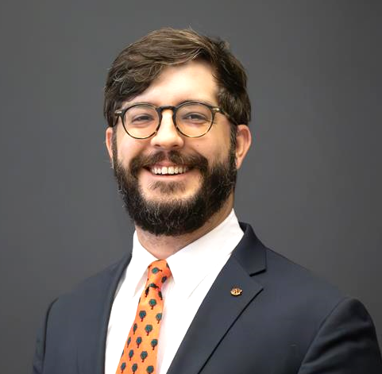
Talent Acquisition & student Employment
How we can support you
Student employee recruitment
Advertising student jobs
Managing student communication
Advise on best practices
Angela Graham
Specialist,
Talent Acquisition
Hannah Russell
Specialist,
Talent Acquisition
Andrew West
Specialist,
Talent Acquisition

Slide 17
The Student Candidate Experience
Changing the narrative
Student candidates should feel valued and treated with the respect and professionalism that any other University job candidates would be.
Let's talk about:
Best practices for student searches
Timely candidate communication
Marketing and maintenance of job postings
Average # days
For Application Updates
454
Would you want to work for a company that treats their candidates this way?

Slide 18
The Student Candidate Experience
Changing the narrative
Timing
Communication
Marketing the Job
When you are posting a student job consider….
How many students do I need to hire?
What is the timeframe for these hires?
Weigh your options and needs for long-term postings vs. short term.
Monitor candidate pools frequently.
If a candidate has potential, reach out within a few days.
If the candidate does not fit your needs, disposition the application as soon as possible.
Job Summaries should SELL the job to potential candidates.
Frequently, we see student job postings with minimal information.
Detailed postings increase interest and promote candidate alignment.

Slide 19
The Student Candidate Experience
Changing the narrative
Connection to Auburn’s Strategic Plan 2035
Goal 1: Exceptional Student Experience
“Provide high-quality services and programs that are signature contributors to the Auburn Experience.”
“Offer a vibrant campus culture characterized by abundant and engaging student life programs…[and] on-campus experiences…”
Goal 3: Commitment to Excellence and Innovation
“Continuously improve institutional processes and systems that support the university enterprise and operate at the highest levels of effectiveness and efficiency.”

Slide 20

HIRE LEARNING
closing
Tips & Tales from the Front Lines of
Student Employment
Resources
Questions?

Slide 21
Thank you!

