Slide 1
Mental Health 101

Slide 2
Agenda
What is mental health?
Signs of struggle
What to do?

Slide 3

What is mental health?

Slide 4
“Mental health is a state of mental well-being that enables people to cope with the stresses of life, realize their abilities, learn well and work well, and contribute to their community. It is an integral component of health and well-being that underpins our individual and collective abilities to make decisions, build relationships and shape the world we live in. Mental health is a basic human right. And it is crucial to personal, community and socio-economic development.”
Having good boundaries
You take care of yourself
You are grateful for something
You persist when times are tough
You do things for others

Slide 5
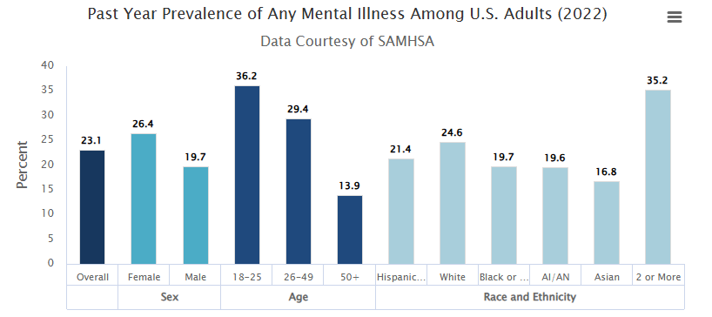
Rates of mental Illness
Depression and anxiety disorders cost the global economy $1 trillion in lost productivity each year
Depression is a leading cause of disability worldwide

Slide 6
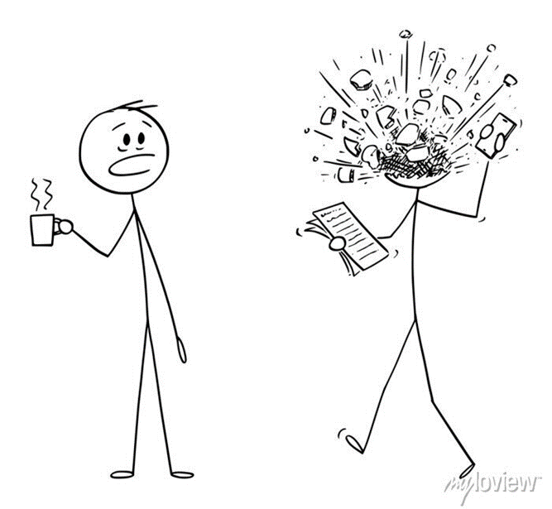
Reasons to seek services:
Depression
Anxiety and stress management
Relationship concerns
Adjustment to life events
Alcohol and substance abuse
Academic Concerns (Test Anxiety)
Eating disorders and body image concerns
References to suicide
Grief and loss
Sexuality and gender identity issues
Relationship violence and sexual assault
And many more

Slide 7

Signs of struggle

Slide 8
Stress vs. Anxiety
Everyday anxiety: Stress
Anxiety disorder
Response to an unknown source, or to the experience of stress
Symptoms remain despite no identifiable stressor
Constant & unsubstantiated worry that interferes with your daily life
Avoidance of situations due to anxiety
Panic attacks or fear of having another panic attack
Irrational fear or avoidance of object, place, or situation that poses little to no threat
Performing uncontrollable repetitive actions
Response to known environmental factor
Symptoms go away when stressor goes away
Worry about important life events
Embarrassment or self-consciousness in awkward situations
Feeling nervous about a test
Realistic fear of a dangerous object, place, or situation
Making sure that you are healthy & living in a safe environment

Slide 9
Sadness vs depression
Sadness
depression
Normal, painful response to challenging life events
Usually passes once the challenging event passes
Something we all experience at some point in our lives.
May or may not include feelings of sadness.
A more persistent experience that includes a cluster of different symptoms
May or may not arise out of a painful experience
Individual might not be able to identify a reason for symptoms.
Symptoms last more than two weeks

Slide 10
Signs of struggle
Mood changes — Rapid or dramatic shifts in emotions or depressed feelings, greater irritability.
Sleep or appetite changes — Dramatic sleep and appetite changes or decline in personal care.
Withdrawal — Recent social withdrawal and loss of interest in activities previously enjoyed.
Drop in functioning — An unusual drop in functioning, at school, work or social activities, such as quitting sports, failing in school or difficulty performing familiar tasks.
Problems thinking — Problems with concentration, memory or logical thought and speech that are hard to explain.
Apathy — Loss of initiative or desire to participate in any activity.

Slide 11
Signs of struggle (cont.)
Feeling disconnected — A vague feeling of being disconnected from oneself or one’s surroundings; a sense of unreality.
Illogical thinking — Unusual or exaggerated beliefs about personal powers to understand meanings or influence events; illogical or “magical” thinking typical of childhood in an adult.
Nervousness — Fear or suspiciousness of others or a strong nervous feeling.
Unusual behavior — Odd, uncharacteristic, peculiar behavior.
Emotional Instability — Prolonged or strong feelings of irritability or anger.
Substance Use — Overuse of substances like alcohol or drugs.

Slide 12
What to do?

Slide 13
A person’s daily functioning is significantly impaired to the point that it creates DISTRESS for the person
EXAMPLE: Person is having a difficult time with school, social life, and with family.
  NON-CRISIS: Person is sad, even cries about the situation over the week; however, is still able to attend class, go out with friends (though seems bummed out when doing this), and is taking care of personal hygiene
  CRISIS: Person is sad, cries every day, is missing class, stays in room all day, is not attending social functions, is not changing clothes or bathing as typical—all things the person usually does with no problem
Crisis vs. Non-Crisis

Slide 14
What to do if you notice signs?
Have an evaluation by a mental health or other health care professional.
Learn about mental illness, including signs and symptoms.
Receive supportive counseling about daily life and strategies for stress management.
Be monitored closely for conditions requiring more intensive care.

Slide 15
Resources for Mental Health Treatment
Psychology Today: Health, Help, Happiness + Find a Therapist
Your current medical doctor
Your insurance company
911 for emergency services or visit nearest emergency room
988 National Suicide Crisis Line (text or call)
Trevor Project Suicide Hotline for LGBTQ+ (phone: 1-866-488-7386 or text 678-678)

Slide 16
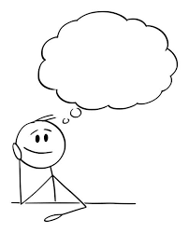
Questions?

Slide 17
Thank you
Jon McEwen, LPC
Student Counseling and Psychological Services
jwm0071@auburn.edu

