Slide 1
Electronic Effort Certification

Slide 2
Effort Certification
Effort Certification is required with receipt of Federal funding.
If any portion of salary/pay comes from a sponsored project, the entire salary/pay must be certified.
Federal Government wants assurance that if they pay an individual, the individual worked on the sponsored project.

Slide 3
Highlights of e~Certs
Increase Efficiency
Increase Compliance (in an increasing audit environment)
Allows Simultaneous Certification
Paper Reduction-Printing will be rare
System developed internally (external costs ~ $1 Million)
Automatic email notification
Implementation to begin with quarter ending 3/31/11
New Online system will be accessed through Banner Self Service
Automatic digital Storage

Slide 4
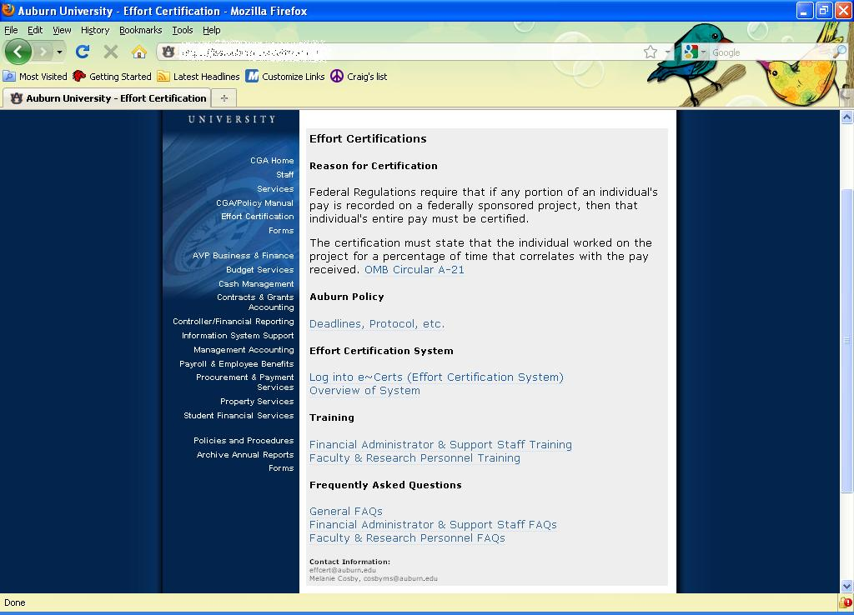
Effort Reporting Webpage
http://www.auburn.edu/administration/business_office/cga/effort-certification.html

Slide 5
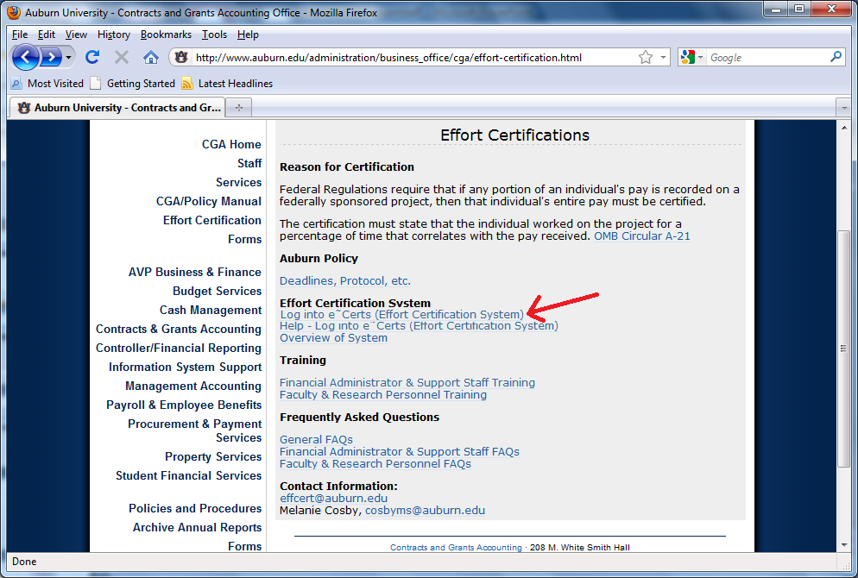
Log into e~Cert System
(via AUACCESS)
Click Here

Slide 6
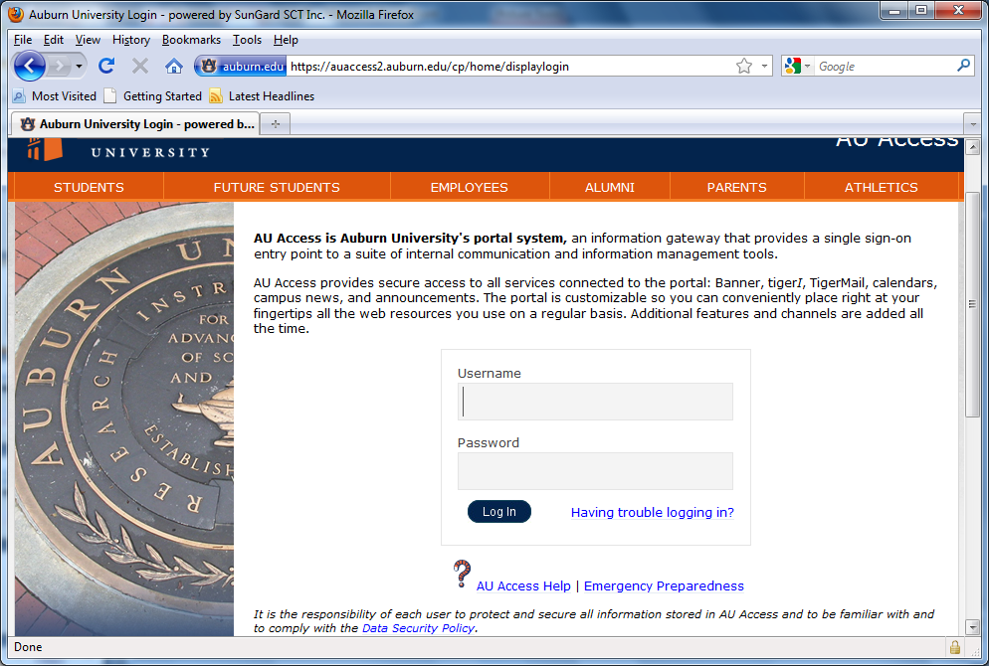
Log into e~Cert System
(via AUACCESS)

Slide 7
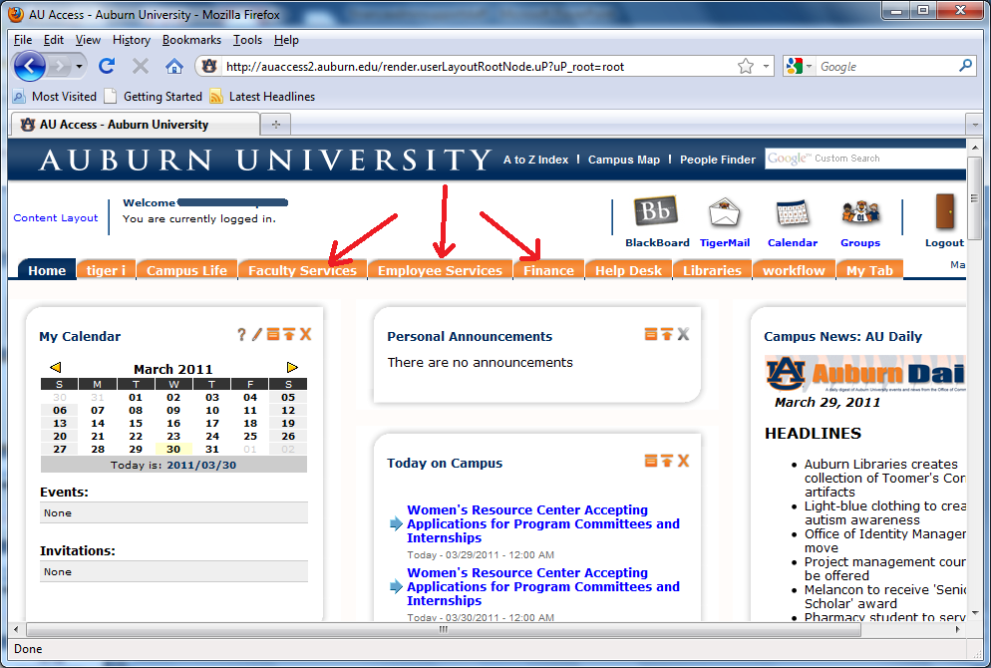
Log into e~Cert System
(via AUACCESS)

Slide 8
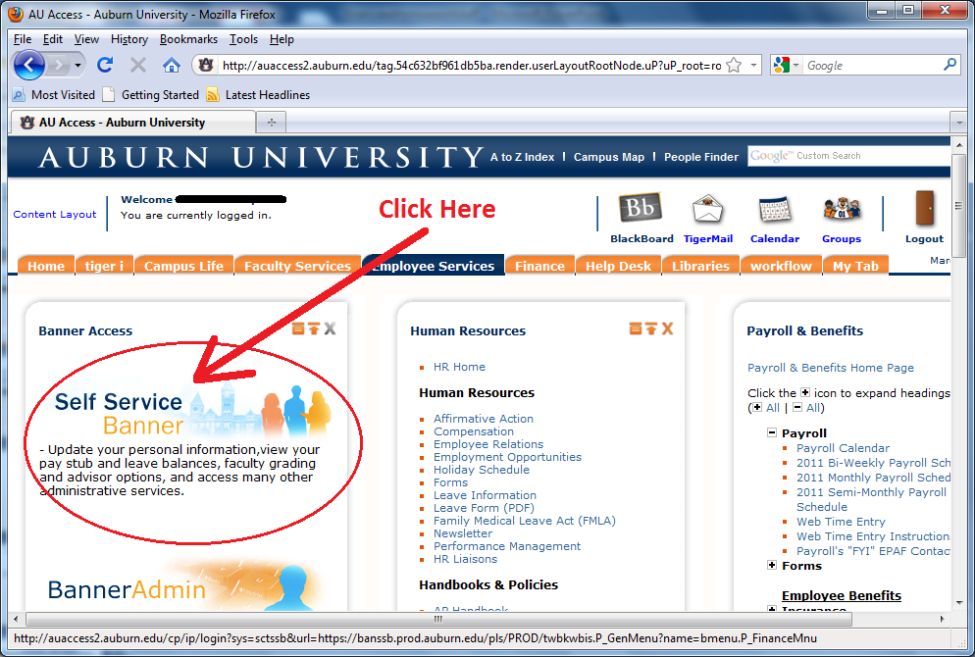
Log into e~Cert System
(via AUACCESS)

Slide 9
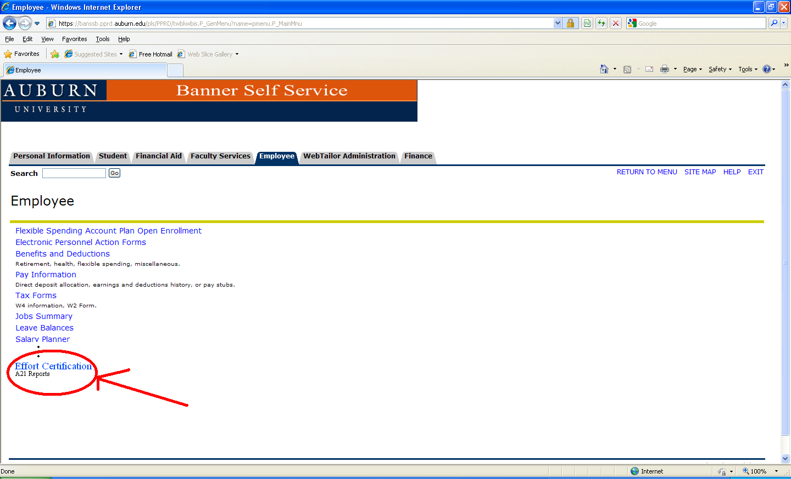
Banner Self Service

Slide 10
Principal Investigators & Co-Principal Investigators
3 Ways to certify effort
a. Individual certification
b. Grant certification
c. Multiple Grant certification

Slide 11
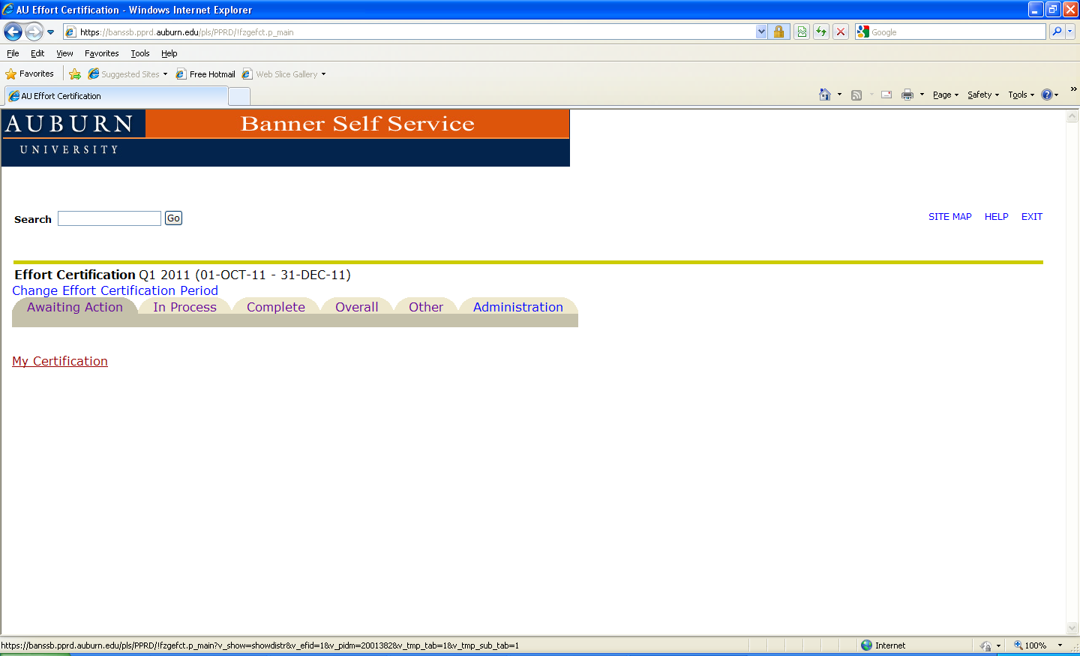
Individual Certification

Slide 12
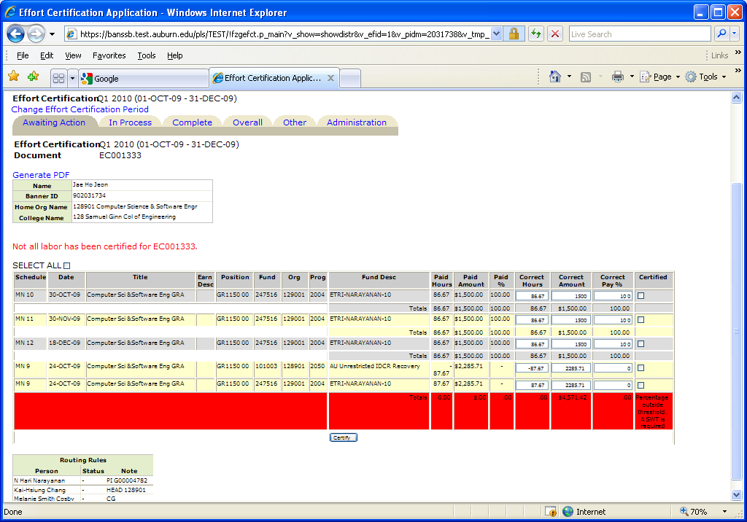
Individual Certification
Line Certification
Person’s Information
Status for Document
Warnings per FOAP line
Routing Queues
Certify

Slide 13
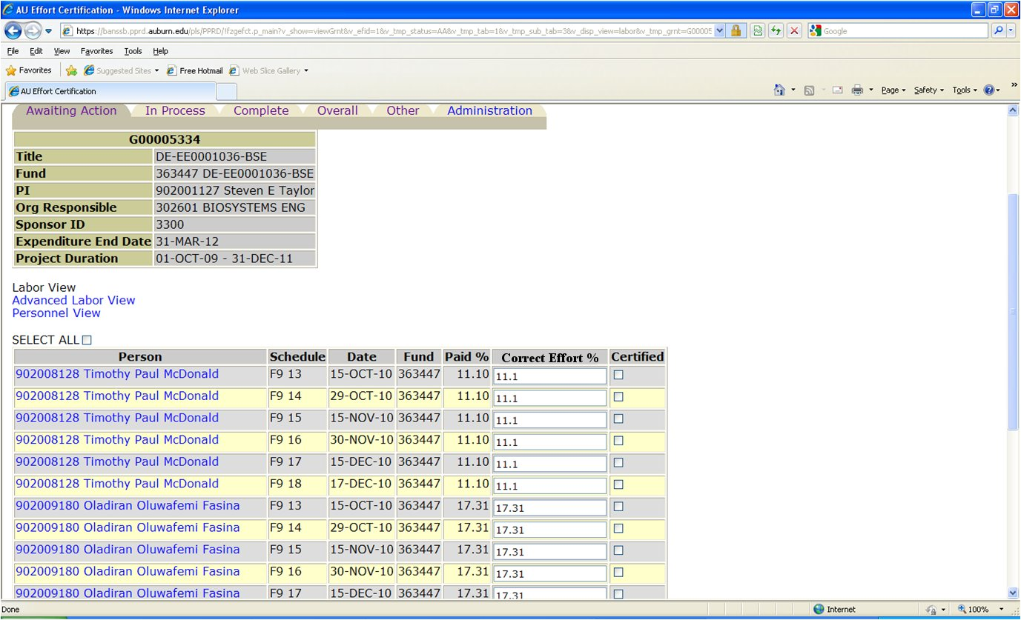

Grant Certification

Slide 14
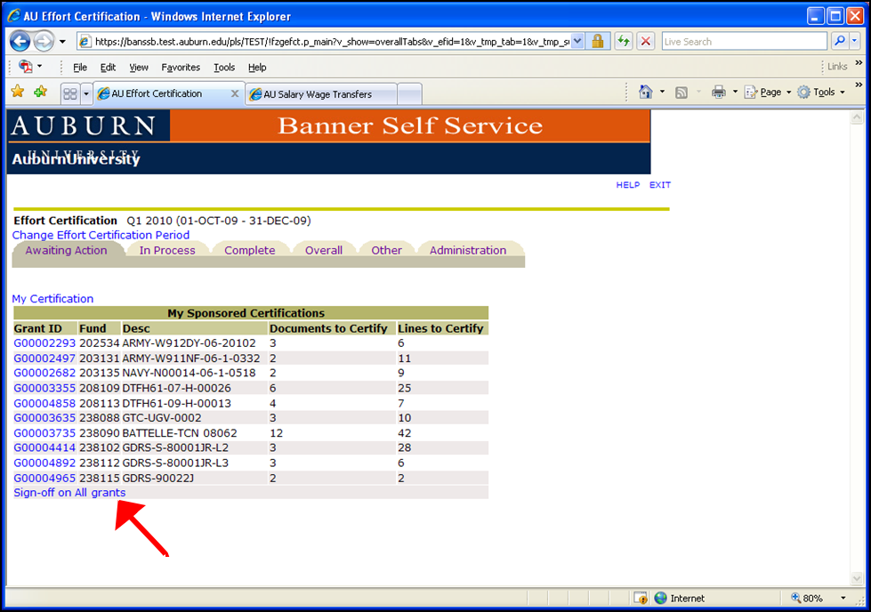
Multiple Grant Certification

Slide 15
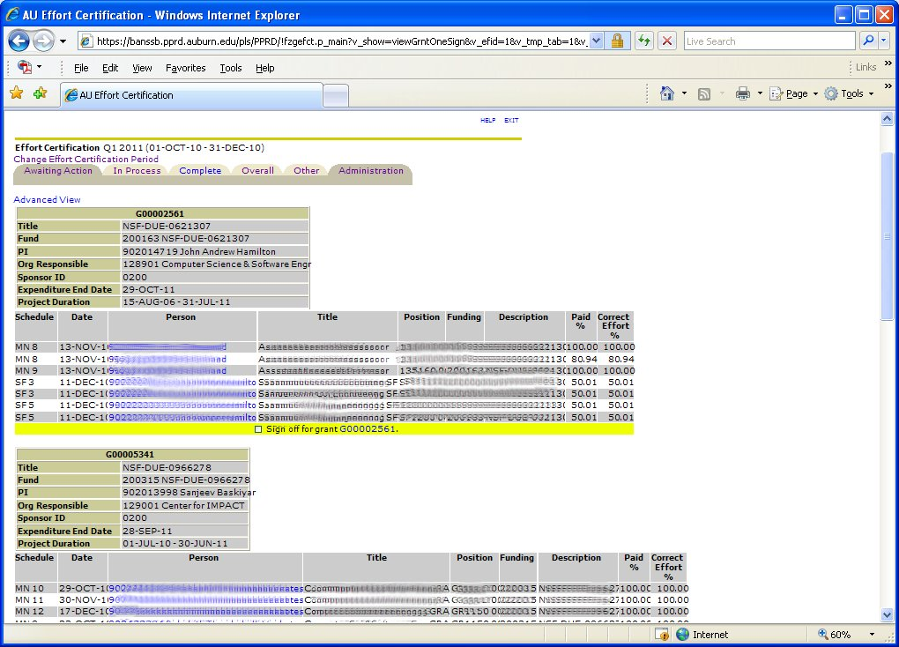
Multiple Grant Certification

Slide 16
End User Benefits of e~Certs
Allow Principal Investigators to certify their funds
Allow Department Heads to certify their employees or organizations
Allow authorized employees/research personnel to certify their own labor distributions
Allow authorized departmental administrators to save or certify unrestricted/non-sponsored FOAPs
Allow FYI contacts to view and save reports

Slide 17
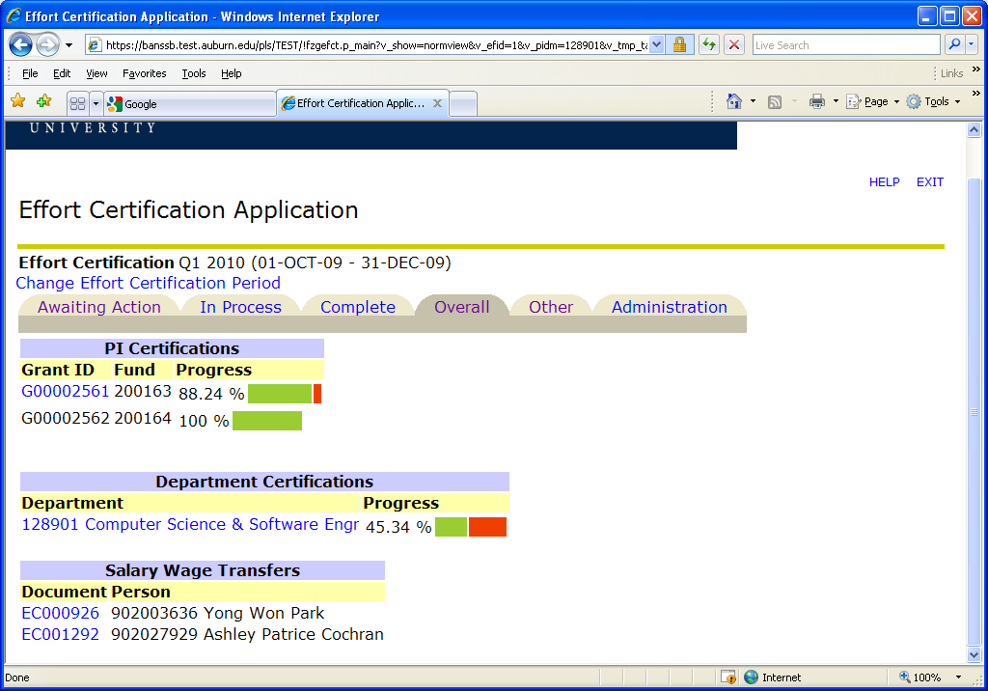
Monitoring Status

Slide 18
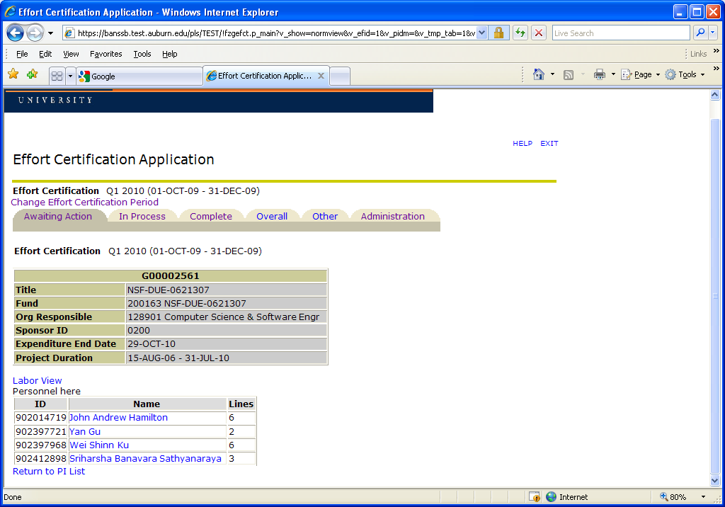
Personnel View

Slide 19
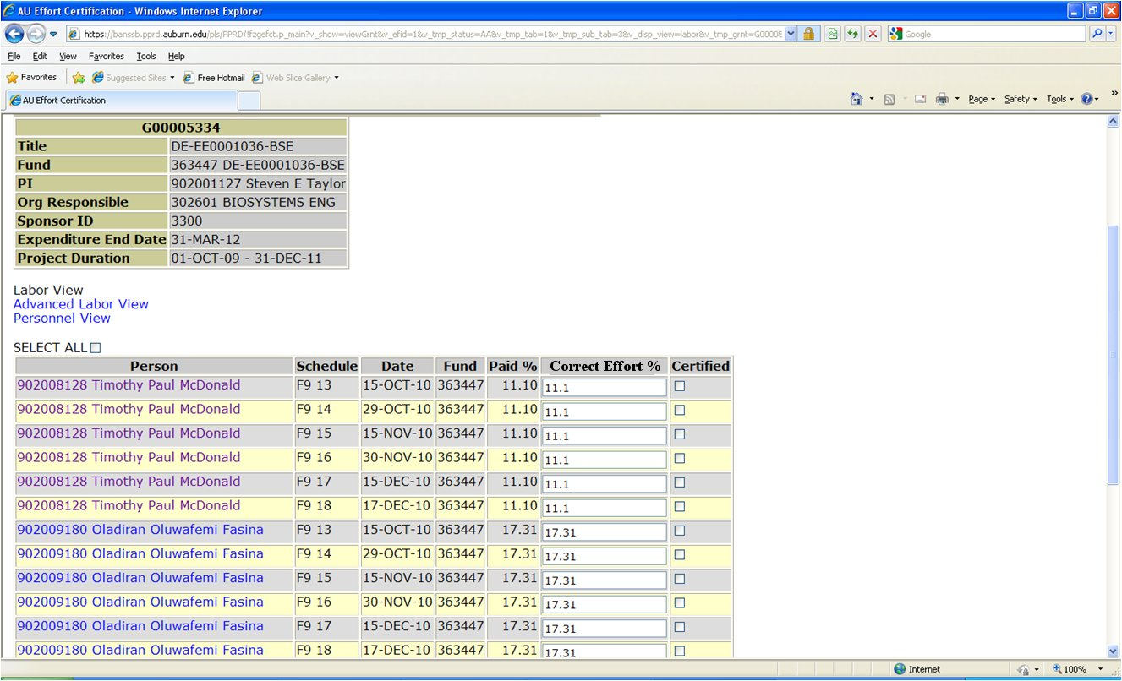
Basic Labor View

Slide 20
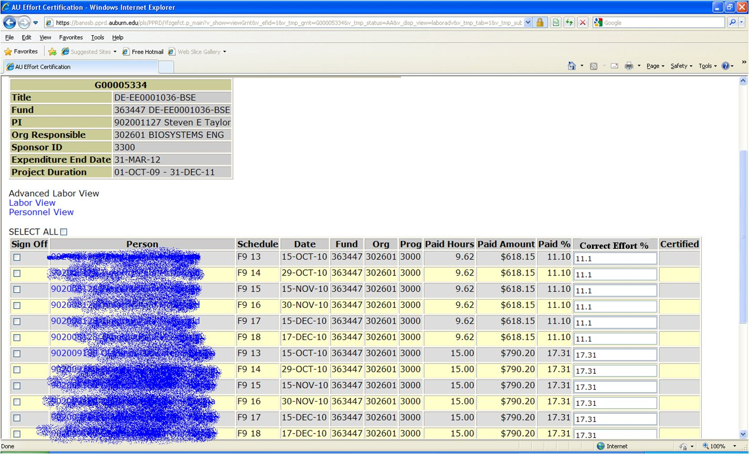
Advanced Labor View By Grant

Slide 21
Departmental Views
Who uses these?
  Department Heads
  Department Financial Administrators
  Department PAR Administrators
What can they see?
  Department Actions
  Department Overview
  Department Personnel Views
  Department Sponsored Programs
  Department Non-Sponsored Programs

Slide 22
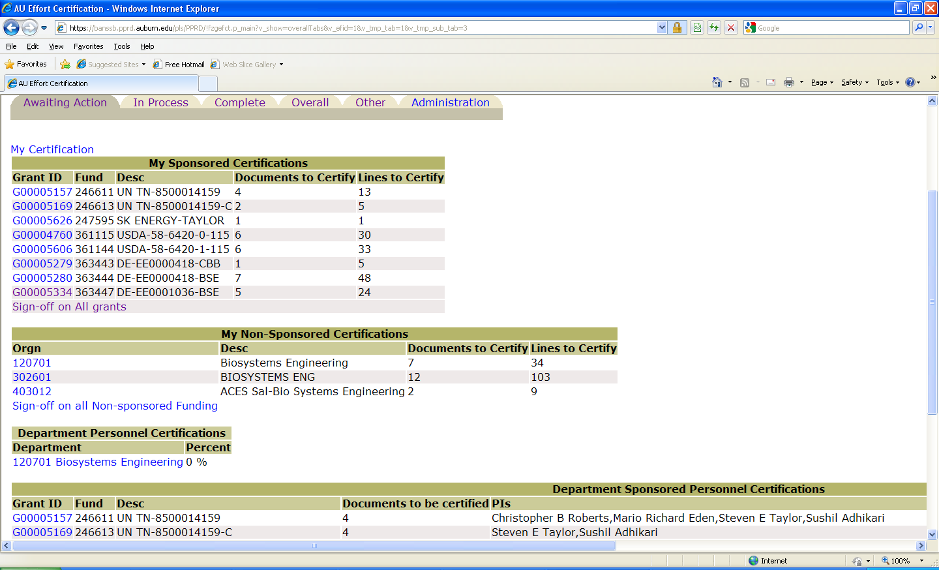
Department Actions

Slide 23
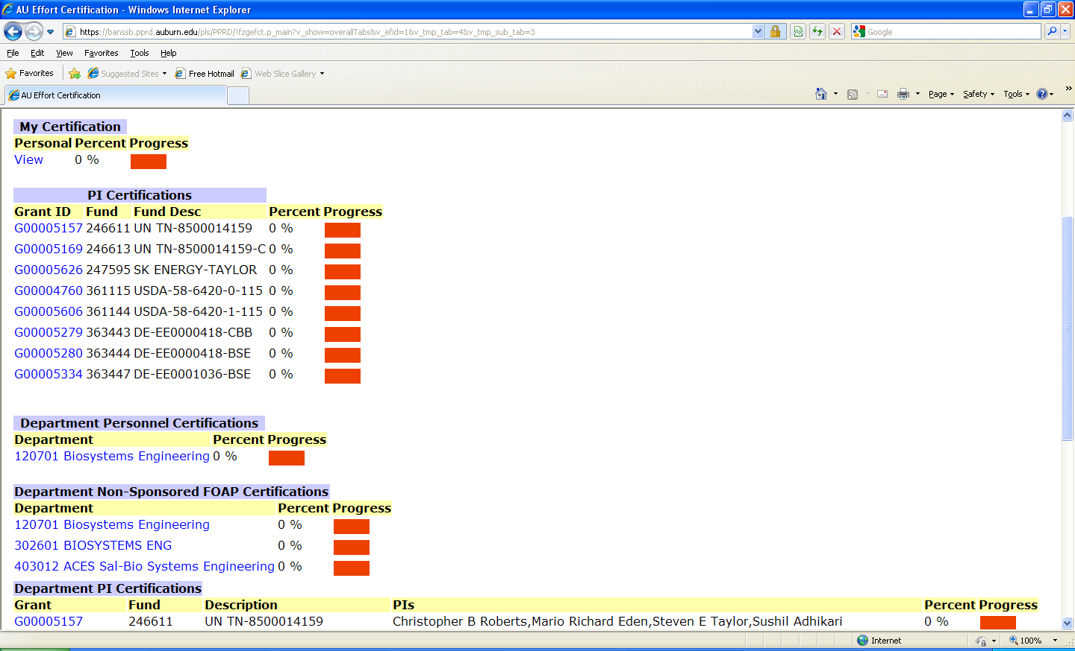
Department Overview

Slide 24
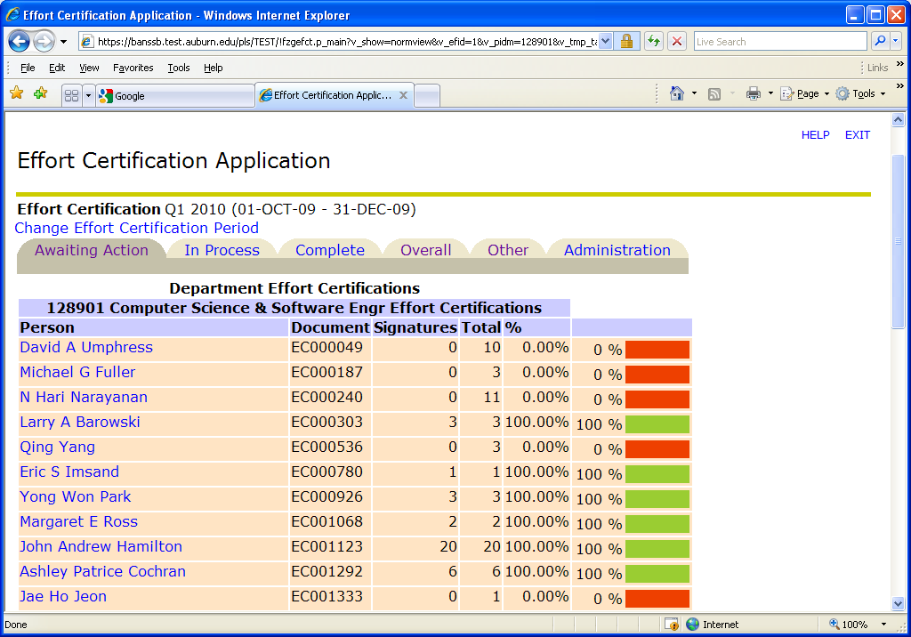
Department Personnel View

Slide 25
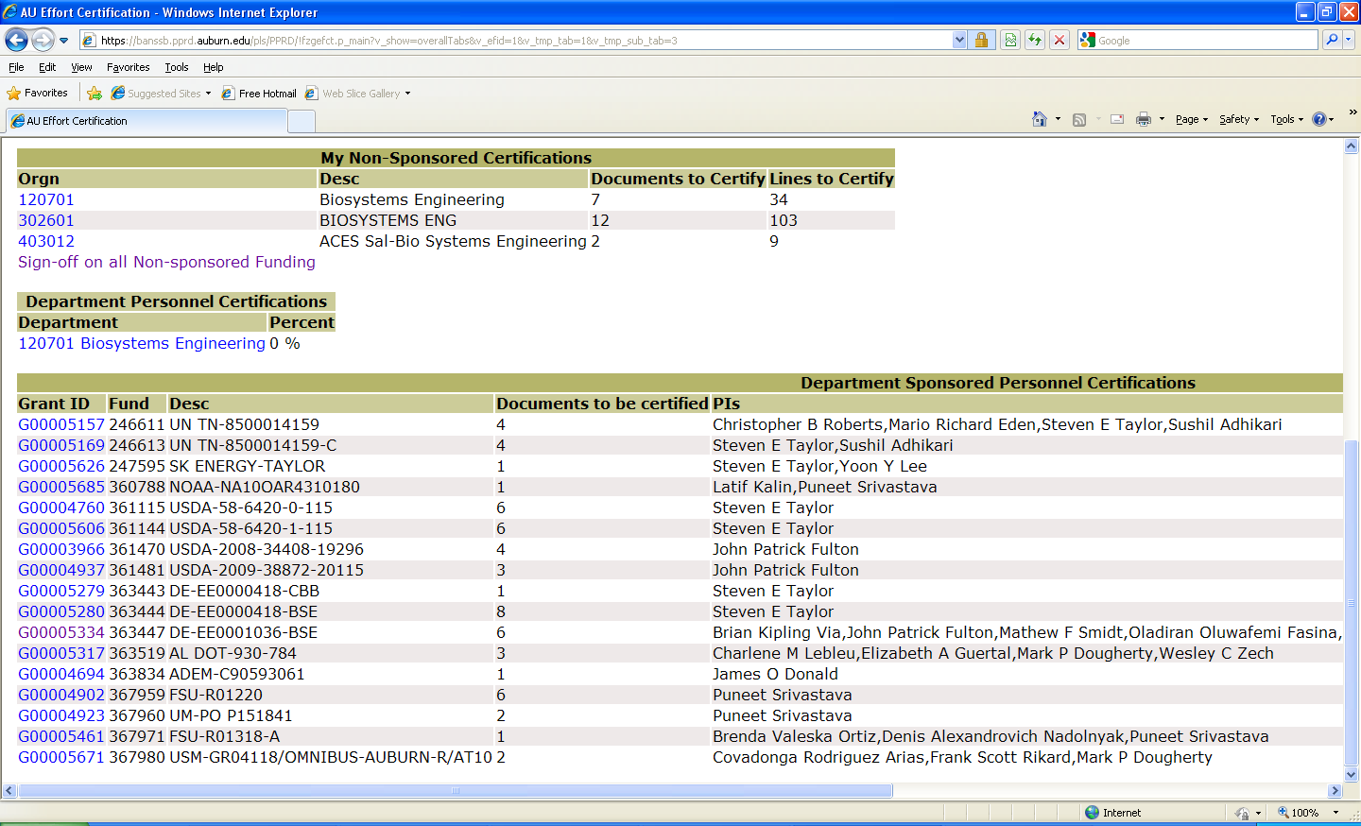
Department Sponsored Programs

Slide 26
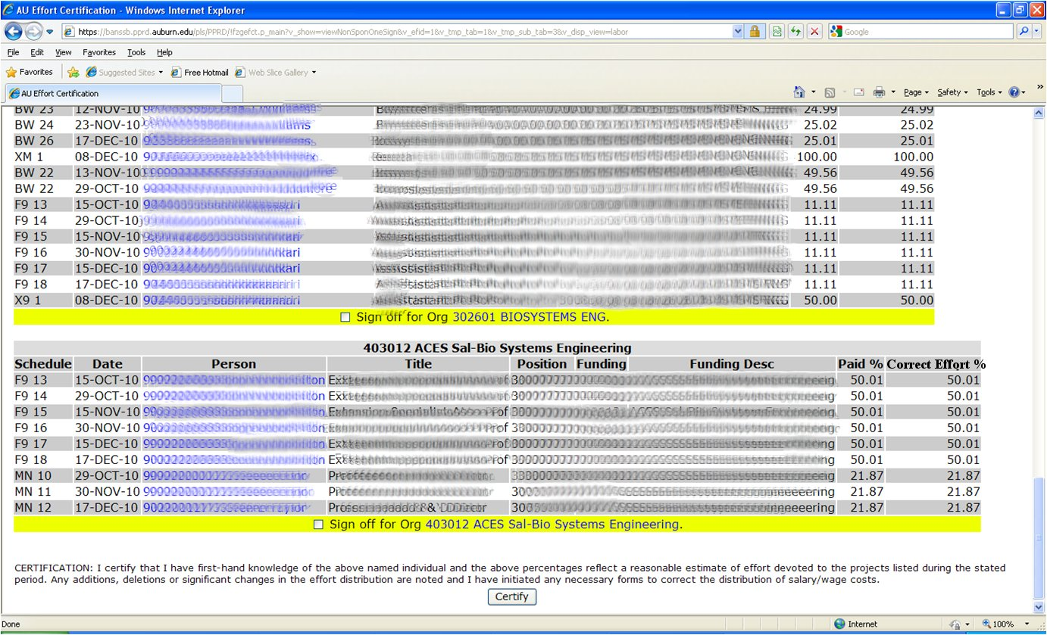
Department Non-Sponsored Programs

Slide 27
Request to Unlock A Row
Only rows which have been certified are available
After selecting which rows in a certification need to be unlocked, give a reason
This now appears under “Awaiting Action”
Contracts and Grants Accounting will have to approve the request

Slide 28
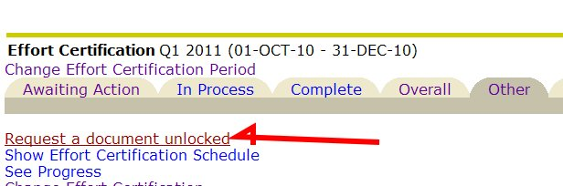
Request to Unlock A Row
Go To Other Tab and select
Request a document unlocked

Slide 29
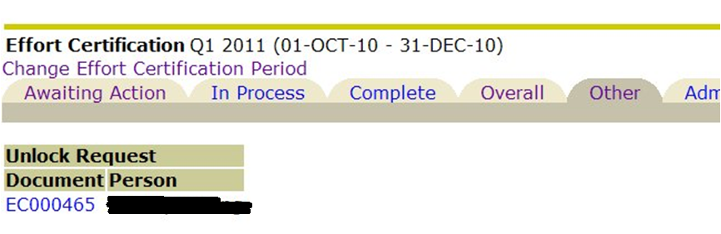
Request to Unlock A Row
Only rows which have been certified are available

Slide 30
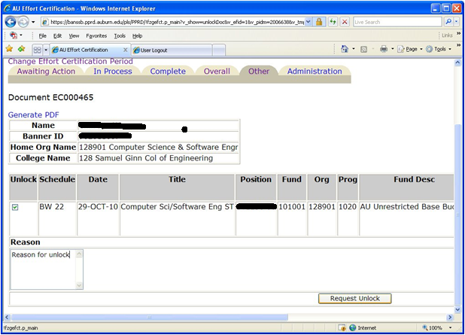
Request to Unlock A Row
After selecting which rows in a certification need to be unlocked, give a reason

Slide 31
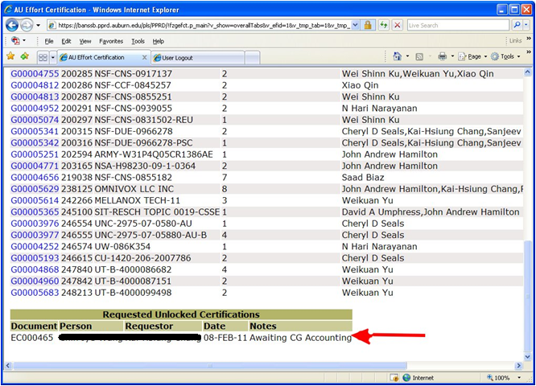
Request to Unlock A Row
This now appears on the Awaiting Action Tab

Slide 32
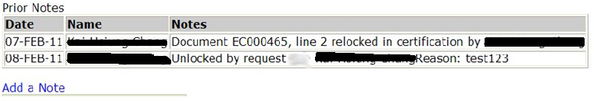
Request to Unlock A Row
Upon Certification, a note is made to the document

Slide 33
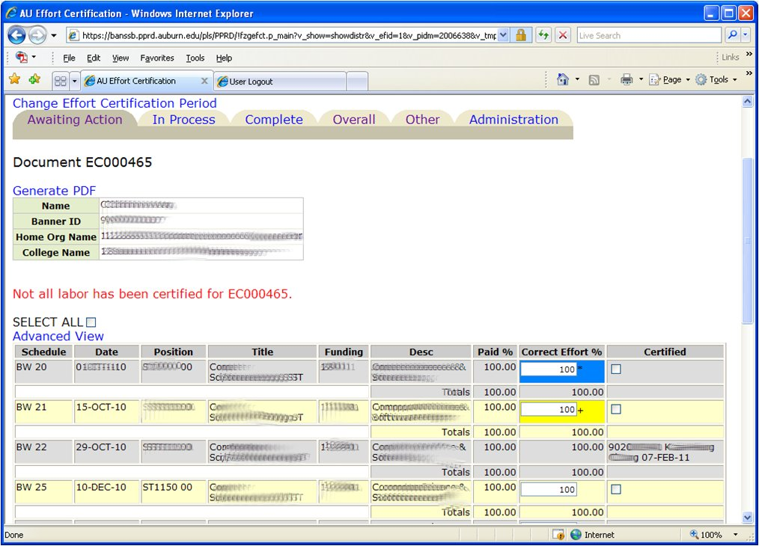
“SAVE” Options
Blue – saved value
Yellow – unlocked row
Certified
Person / Date

Slide 34
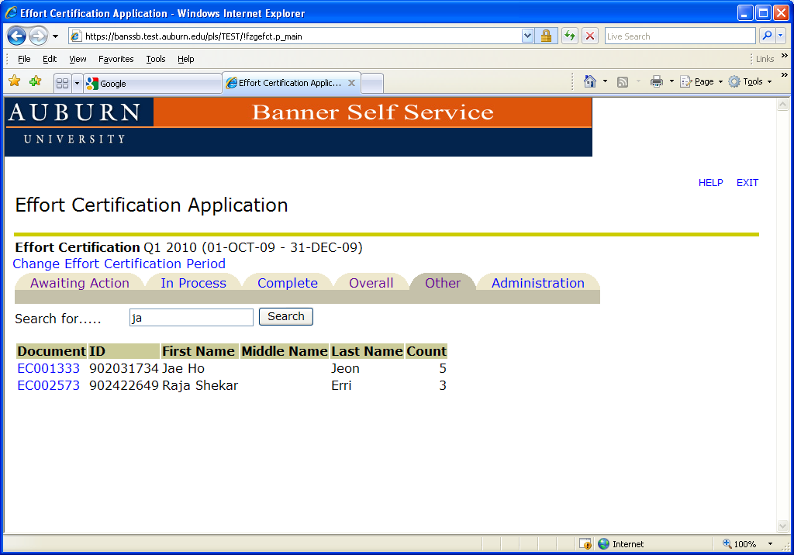
Person Search

Slide 35
Email Notification System
Automatic notifications to be emailed:
1. 5th day after quarter end
-PAR Administrators; Dept. Financial Administrators
2. 10th day after quarter end
-PI, Co-PI, Faculty, Research Personnel, Dept Head, ADR, Dean’s Contact
3. 30th day after quarter end
-PI, Co-PI, Faculty, Research Personnel, PAR Administrator
4. 35th day after quarter end
-PI, Co-PI, Faculty, Research Personnel, PAR Administrator, Dept Financial Administrator, Dept Head, ADR, Dean’s Contact, Dean
5. 40th day after quarter end
-End of business day: System is closed

Slide 36
Consequence of Not Certifying an Effort Report within 40 Days of Quarter End
Expense related to the effort recorded on a sponsored or cost share FOP will be transferred to an unrestricted departmental funding source.

Slide 37
Questions?
Contact information:
Effort Certification effcert@auburn.edu 844-4847

