Slide 1
Electronic Effort Certification

Slide 2
Effort Certification
Effort Certification is required with receipt of Federal funding.
If any portion of salary/pay comes from a sponsored project, the entire salary/pay must be certified.
Federal Government wants assurance that if they pay an individual, the individual worked on the sponsored project.

Slide 3
New Online Effort Certification System
Increase Efficiency
Increase Compliance (in an increasing audit environment)
Allows Simultaneous Certification
Paper Reduction
System developed internally
Automatic email notification
Implementation to begin with quarter ending 3/31/11 (Training of faculty, researchers and personnel in mid- Feb/Early March)
New Online system accessed through Banner Self Service

Slide 4
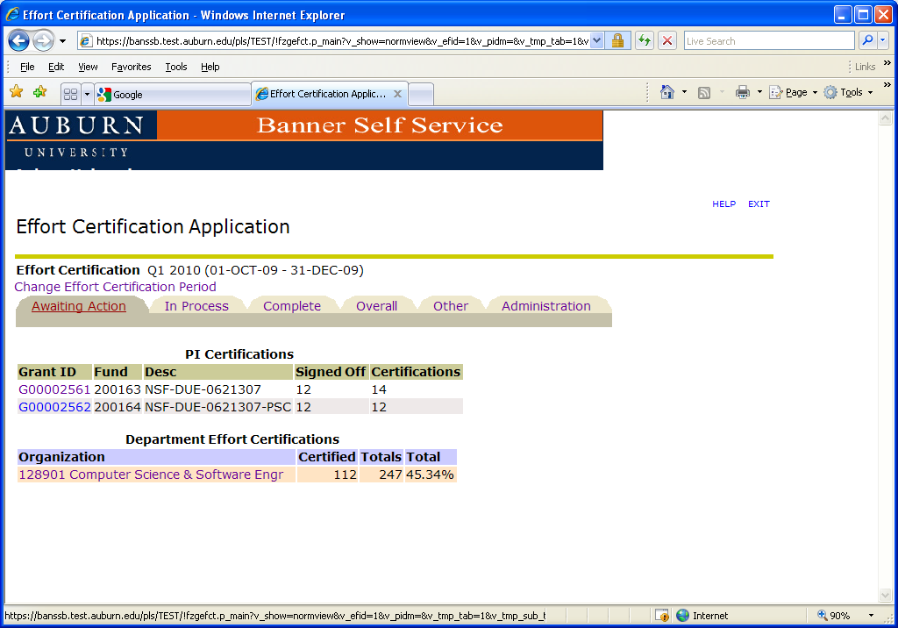
Electronic/Web-based Effort Certification
SSB
Banner Security
Single Sign-on
Menu Item

Slide 5
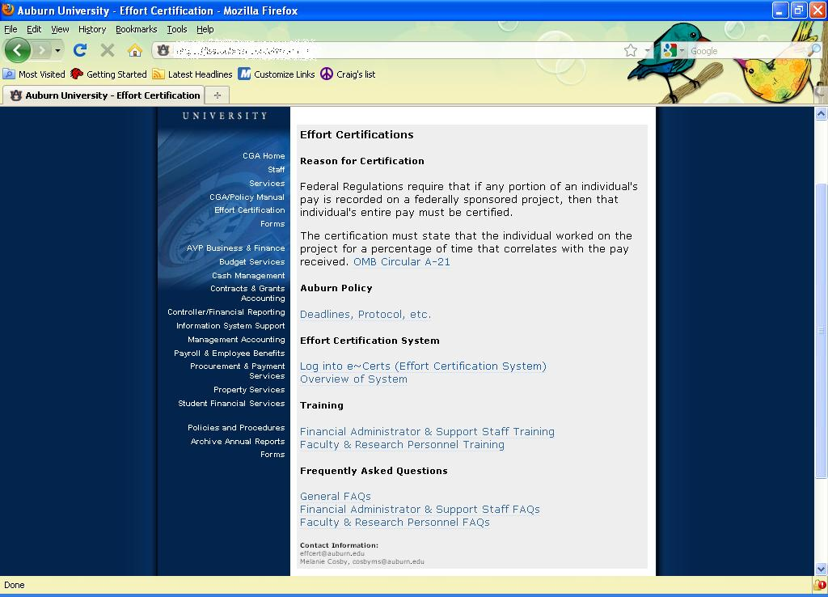
Effort Reporting Webpage
http://www.auburn.edu/administration/business_office/cga/effort-certification.html

Slide 6
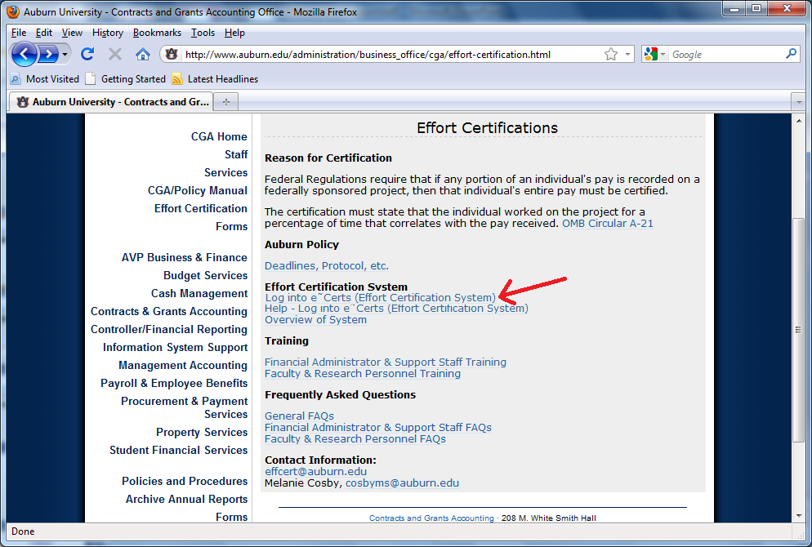
Log into e~Cert System
(via AUACCESS)
Click Here

Slide 7
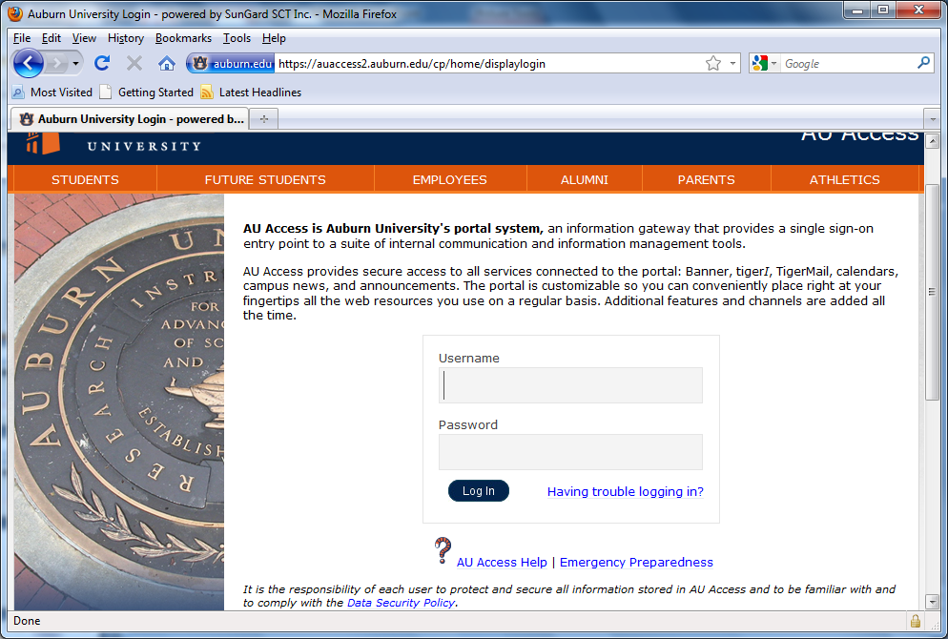
Log into e~Cert System
(via AUACCESS)

Slide 8
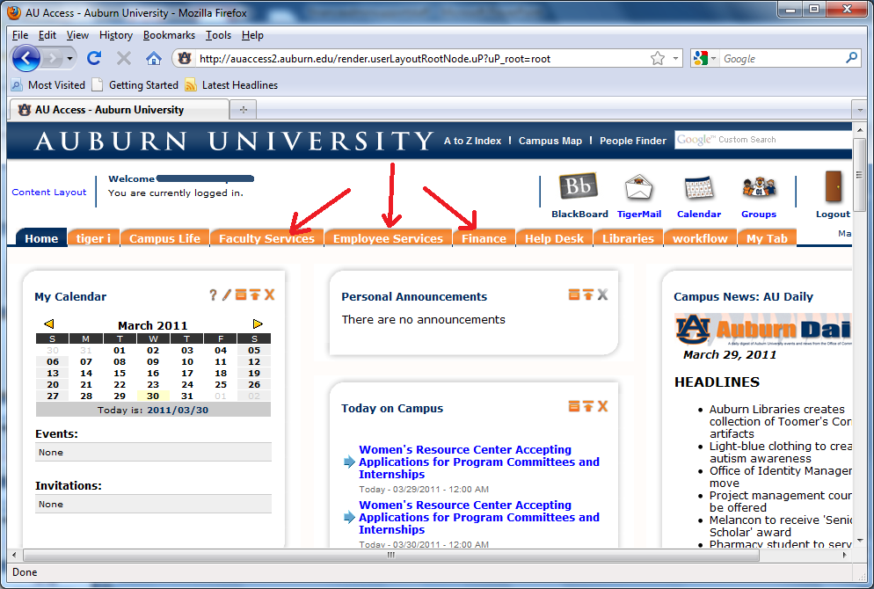
Log into e~Cert System
(via AUACCESS)

Slide 9
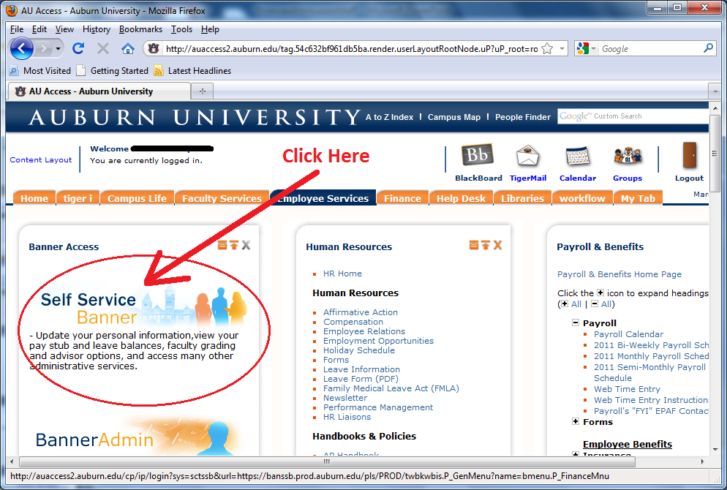
Log into e~Cert System
(via AUACCESS)

Slide 10
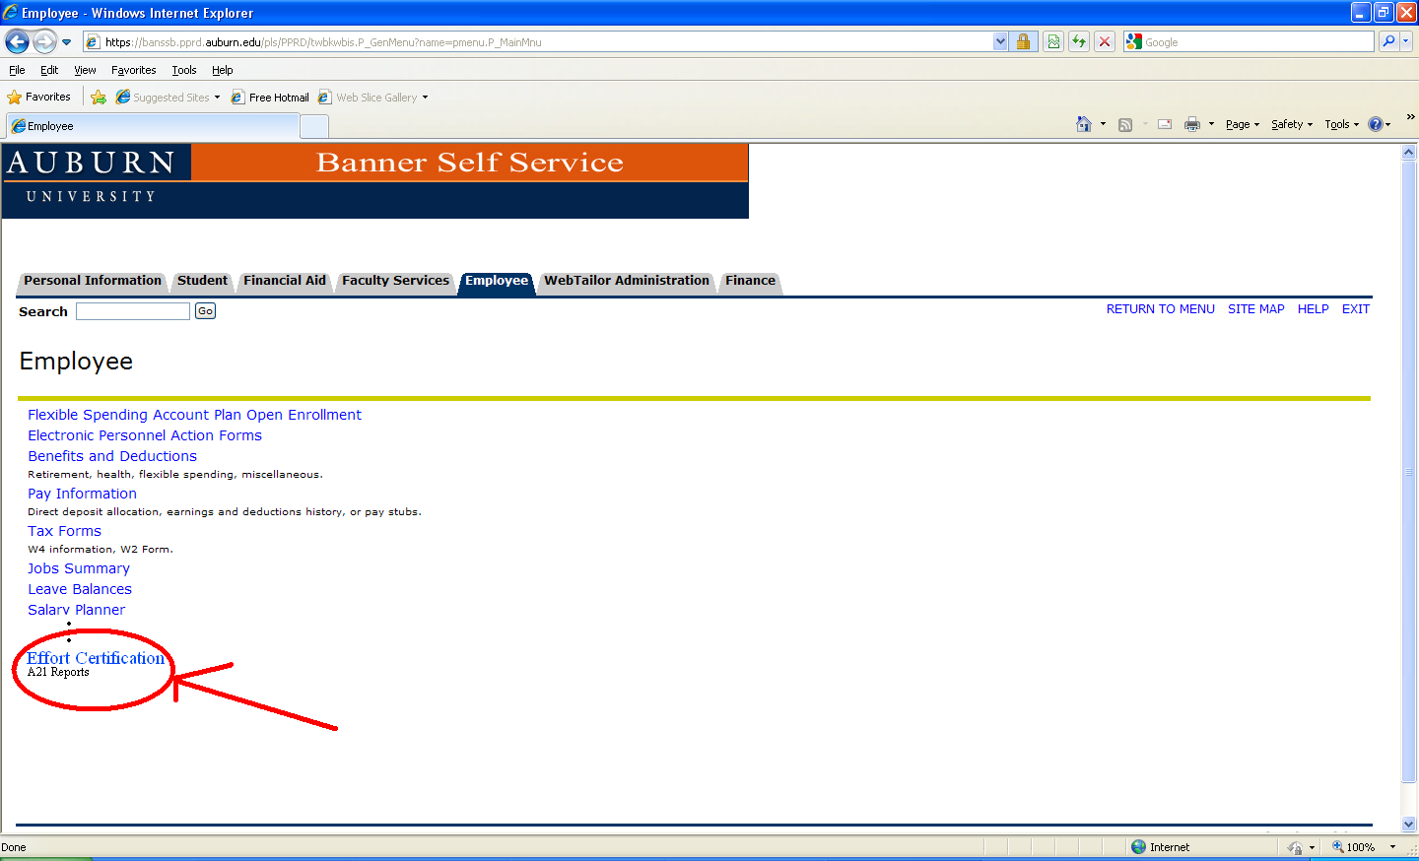
e~Cert System Entry

Slide 11
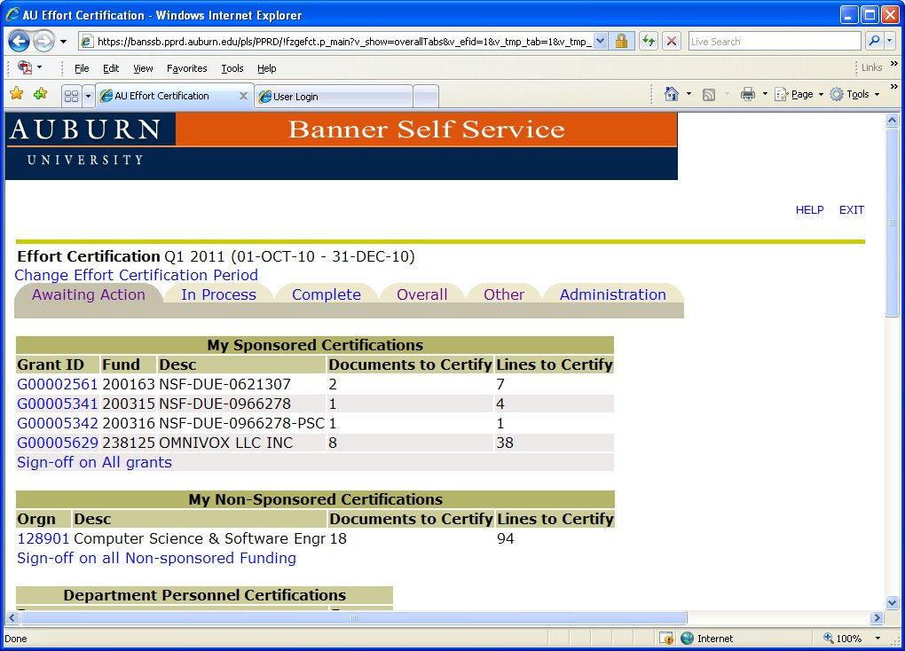
Main Page

Slide 12
Principal Investigators & Co-Principal Investigators
3 Ways to certify effort
a. Individual certification
b. Grant certification
c. Multiple Grant certification

Slide 13
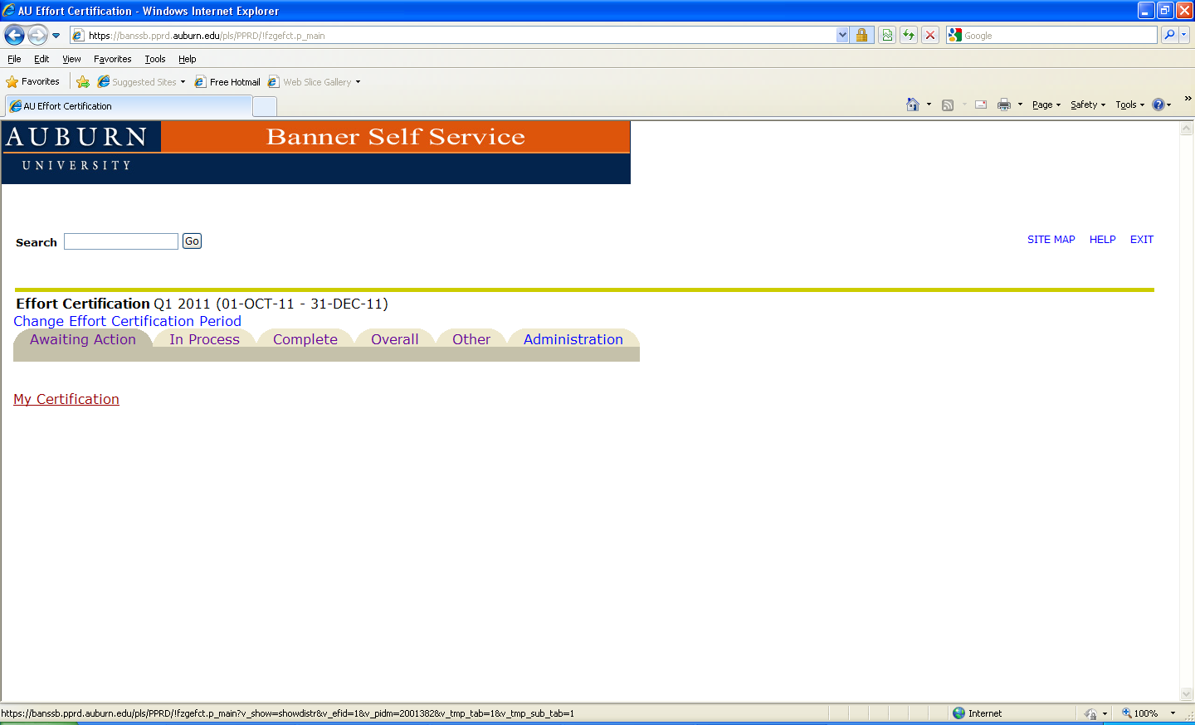
Individual Certification

Slide 14
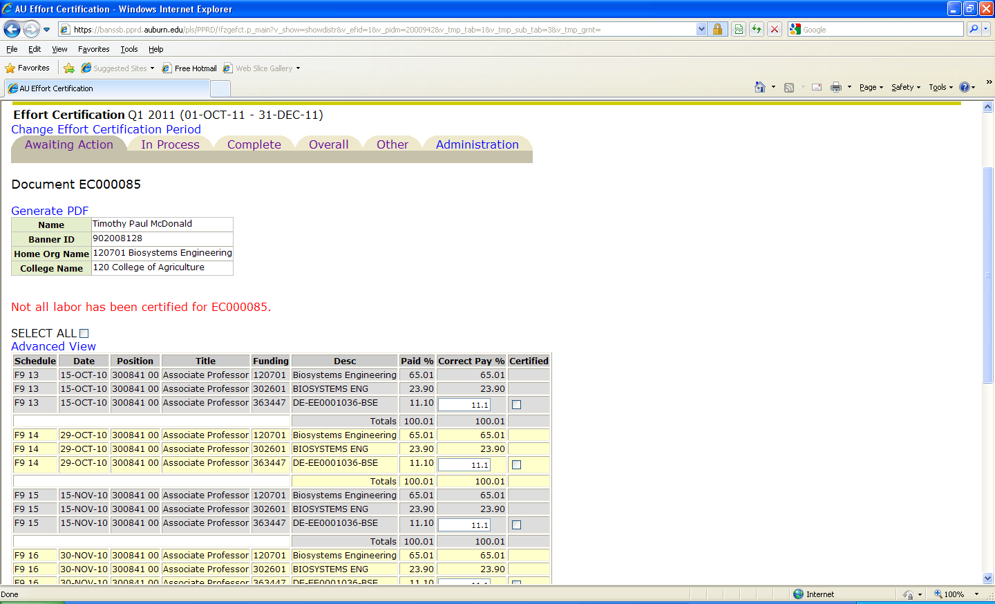

Individual Certification

Slide 15
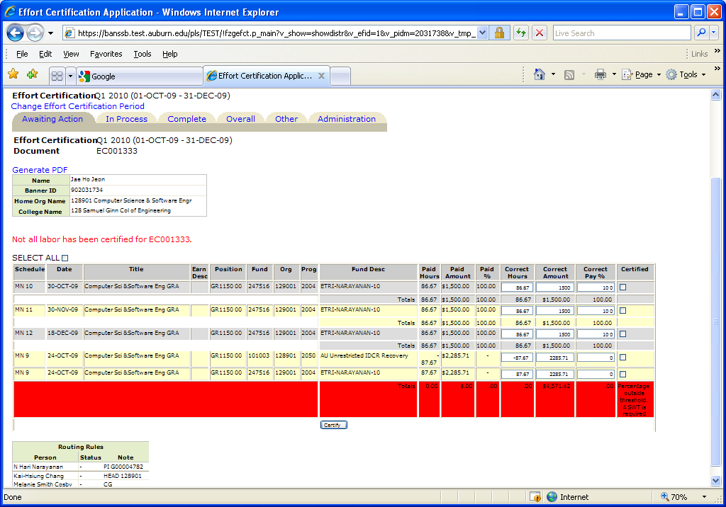
Individual Certification
Line Certification
Person’s Information
Status for Document
Warnings per FOAP line
Routing Queues
Certify

Slide 16
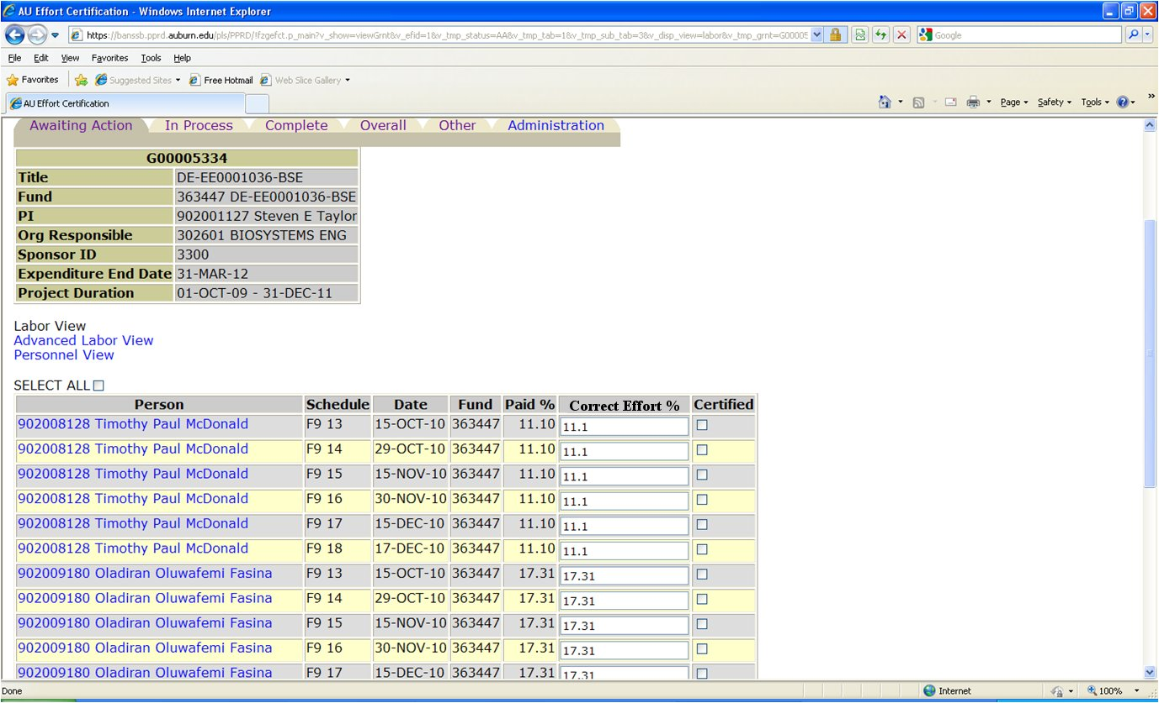
Grant Certification

Slide 17
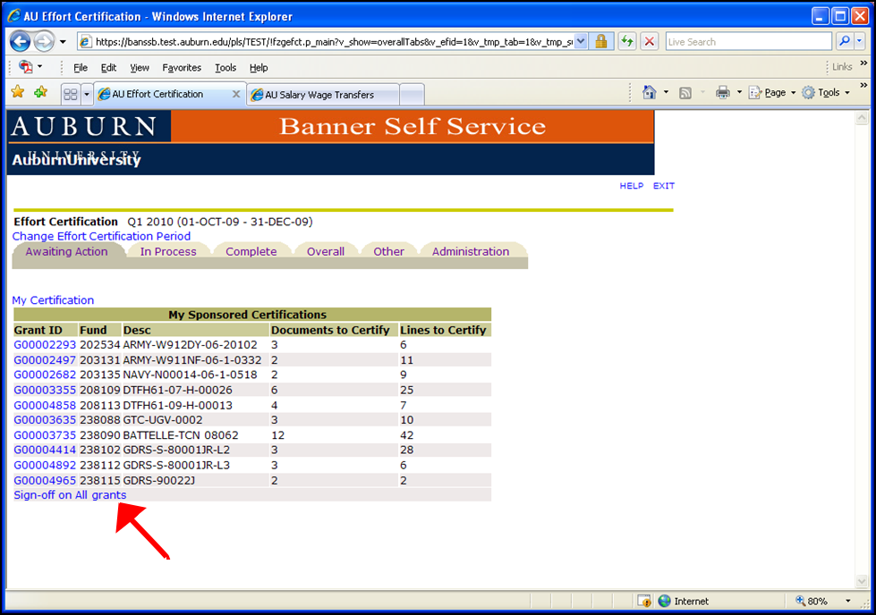
Multiple Grant Certification

Slide 18
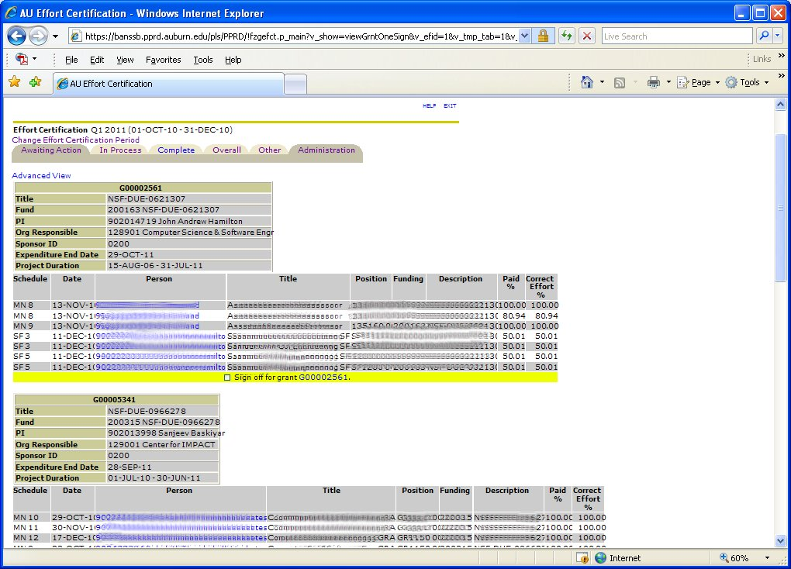
Multiple Grant Certification

Slide 19
eCert Effort Certification System
Allow Principal Investigators to certify their funds
Allow Department Heads to certify their employees or organizations
Allow authorized employees/research personnel to certify their own labor distributions
Allow authorized departmental administrators to save or certify unrestricted/non-sponsored FOAPs
Allow FYI contacts to view and save reports

Slide 20
eCert Effort Certification Outcomes
Increased Rate in Effort Certified
(Goal = 100%)
Ability to Track an Effort Certification Document
Immediate Information to all Stakeholders involved in the Effort Certification
Retrieval of Effort Certification Documents

Slide 21
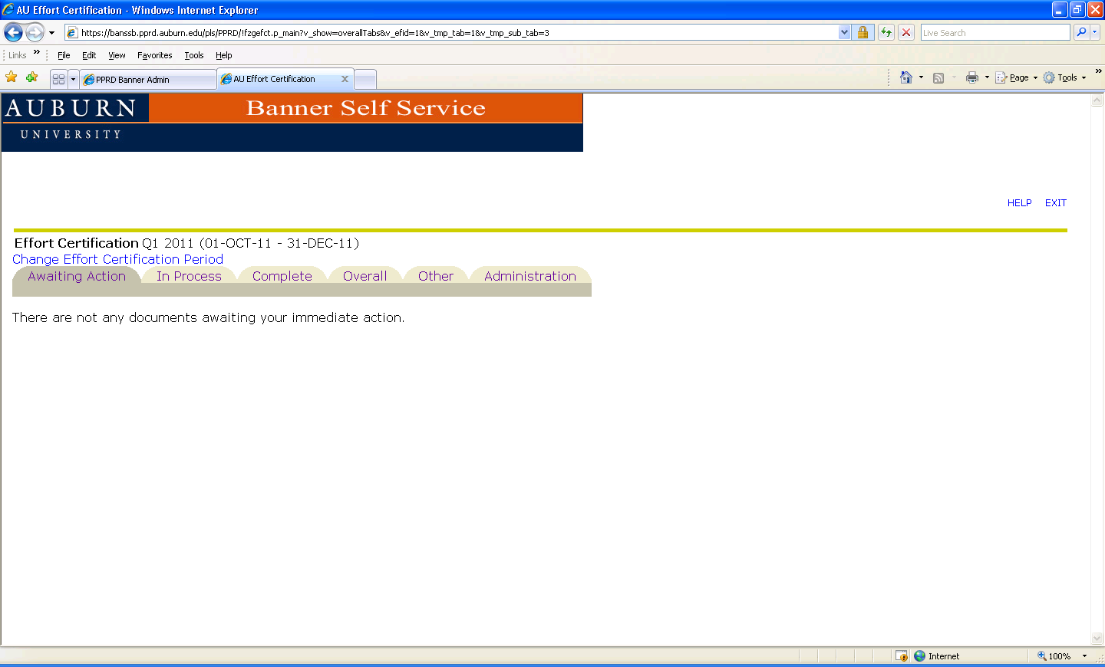
GOAL - Individual

Slide 22
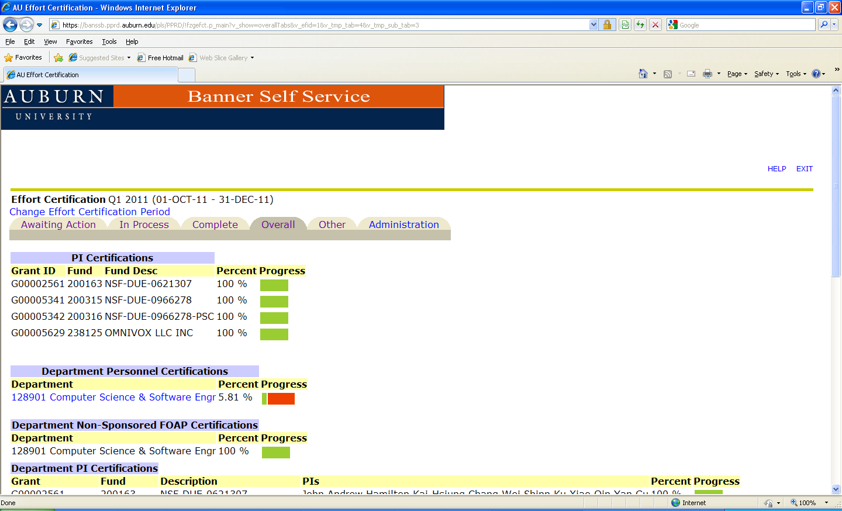
Goal Department(s)

Slide 23
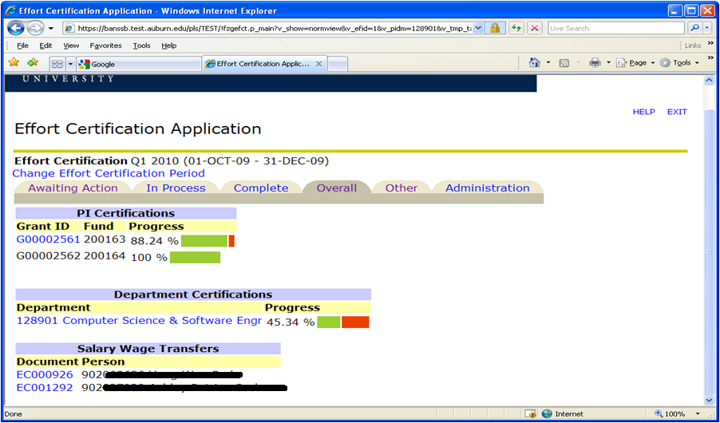
Monitoring the Status of Progress

Slide 24
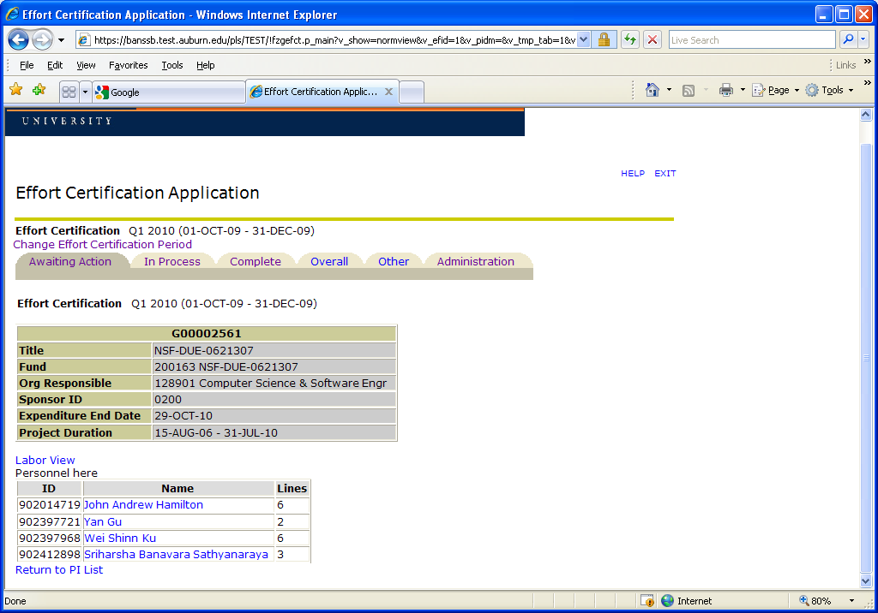
Personnel View

Slide 25
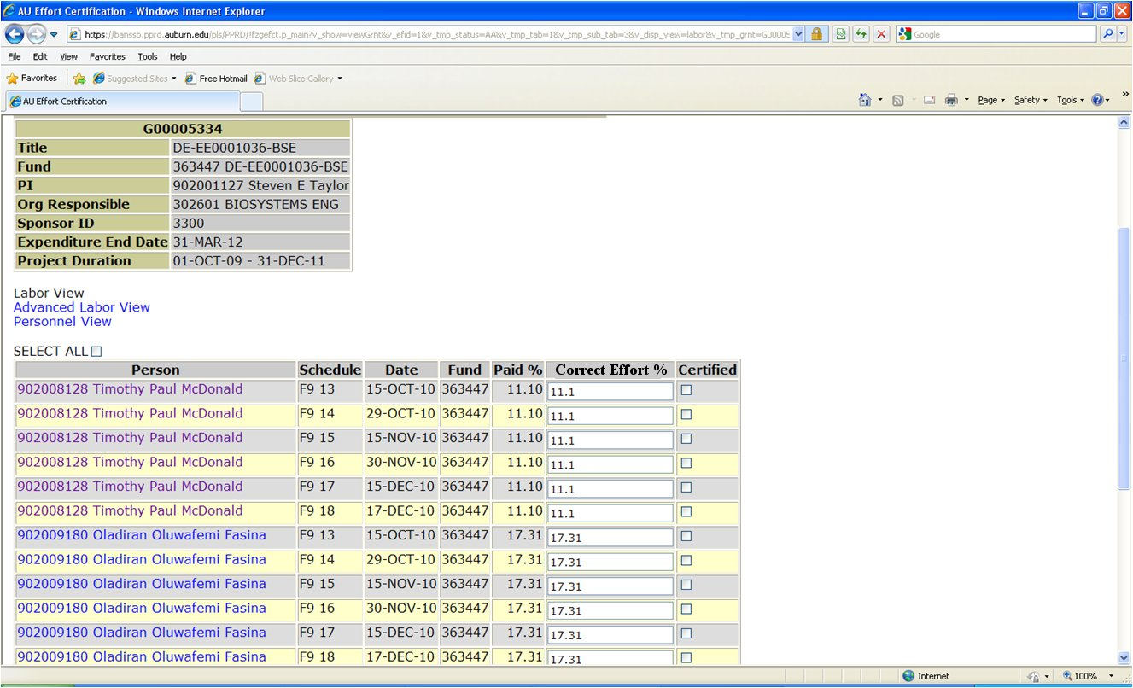
Basic Labor View

Slide 26
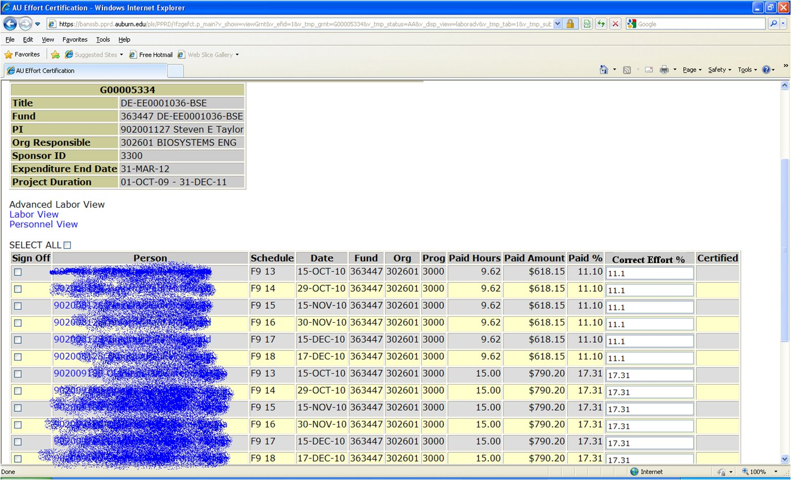
Advanced Labor View

Slide 27
Departmental Views
Department Heads
Department Financial Administrators
Department PAR Administrators
Department Actions
Department Personnel Views
Department Sponsored Programs
Department Non-Sponsored Programs
Department Overview

Slide 28
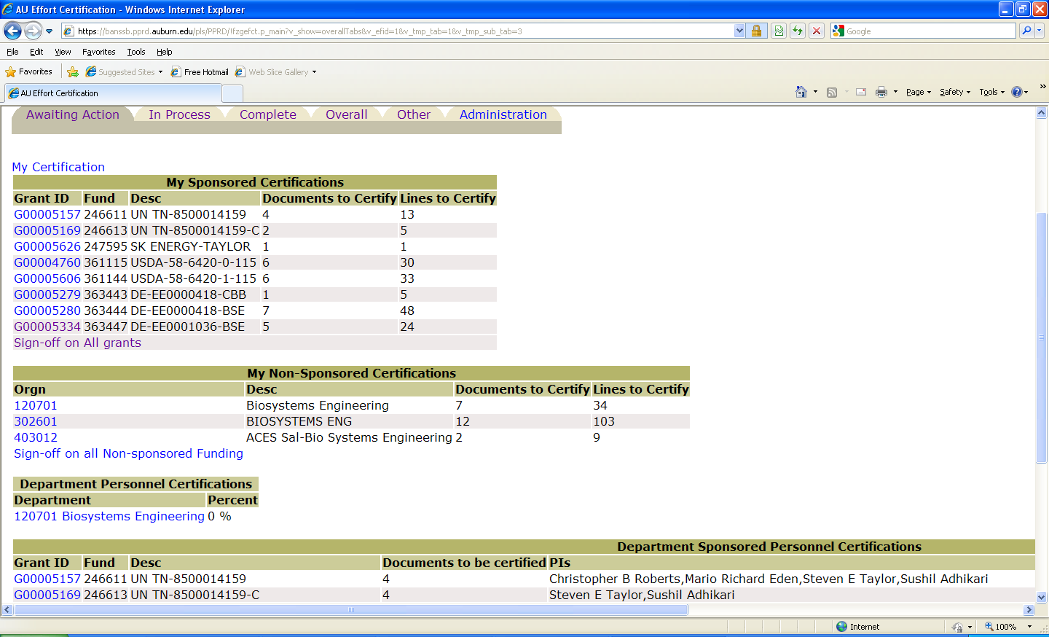
Department Actions

Slide 29
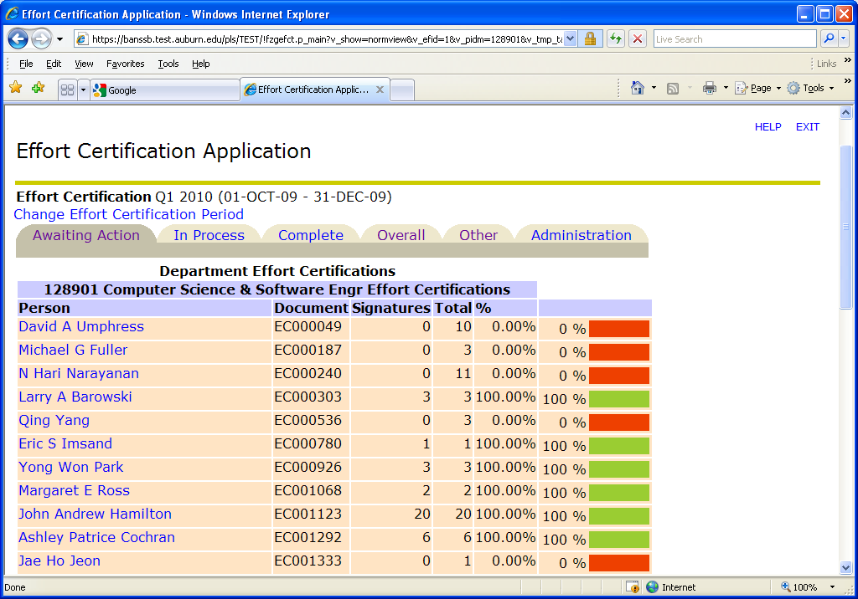
Department Personnel View

Slide 30
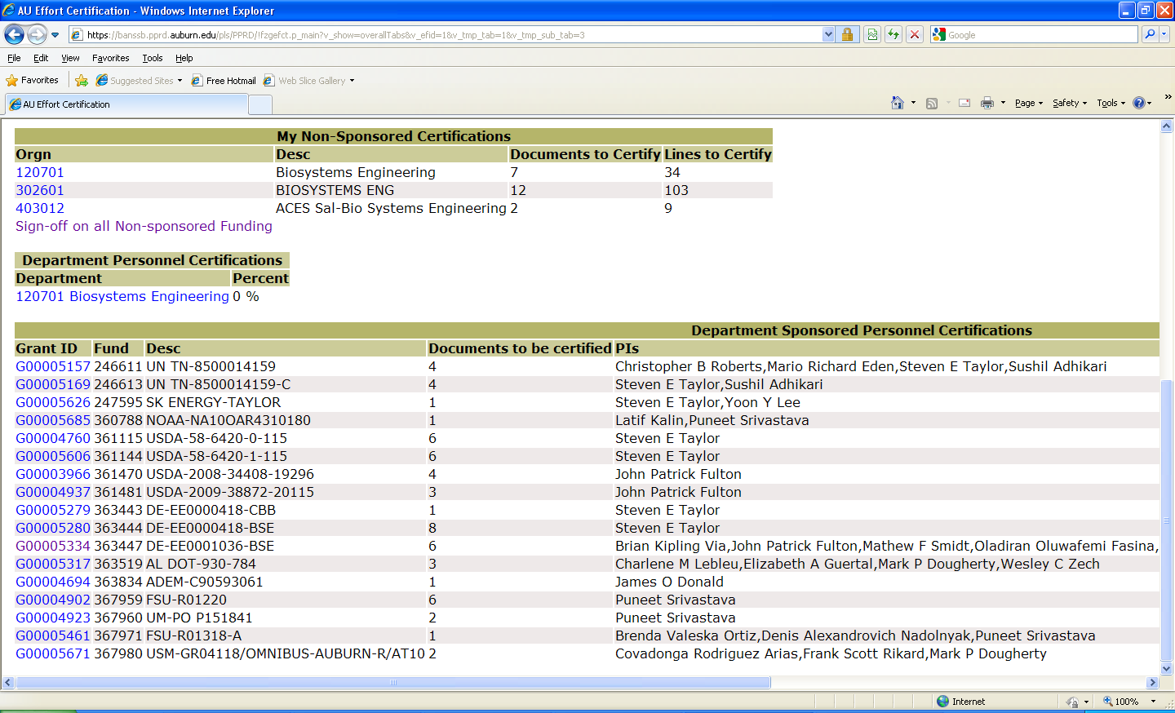
Department Sponsored Programs

Slide 31
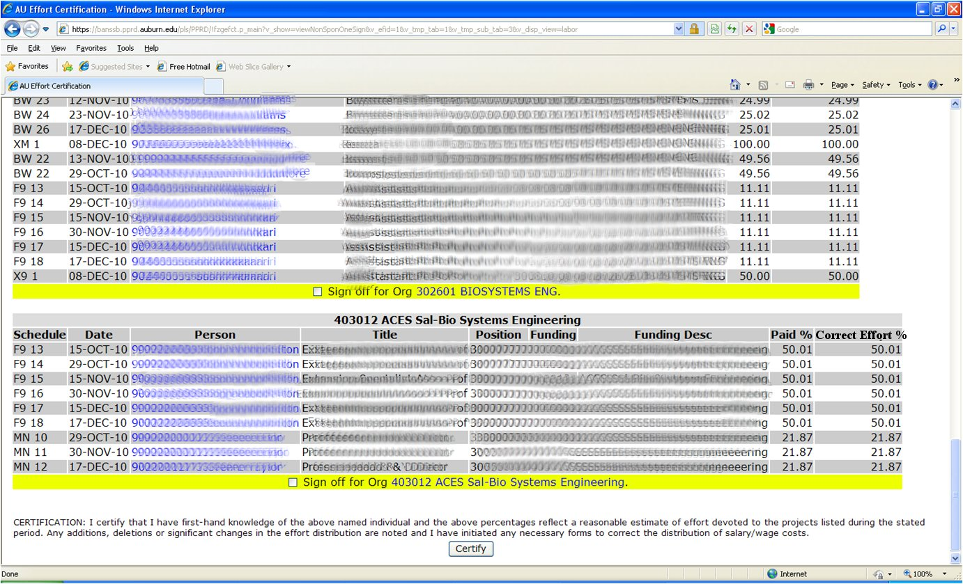
Department Non-Sponsored Programs

Slide 32
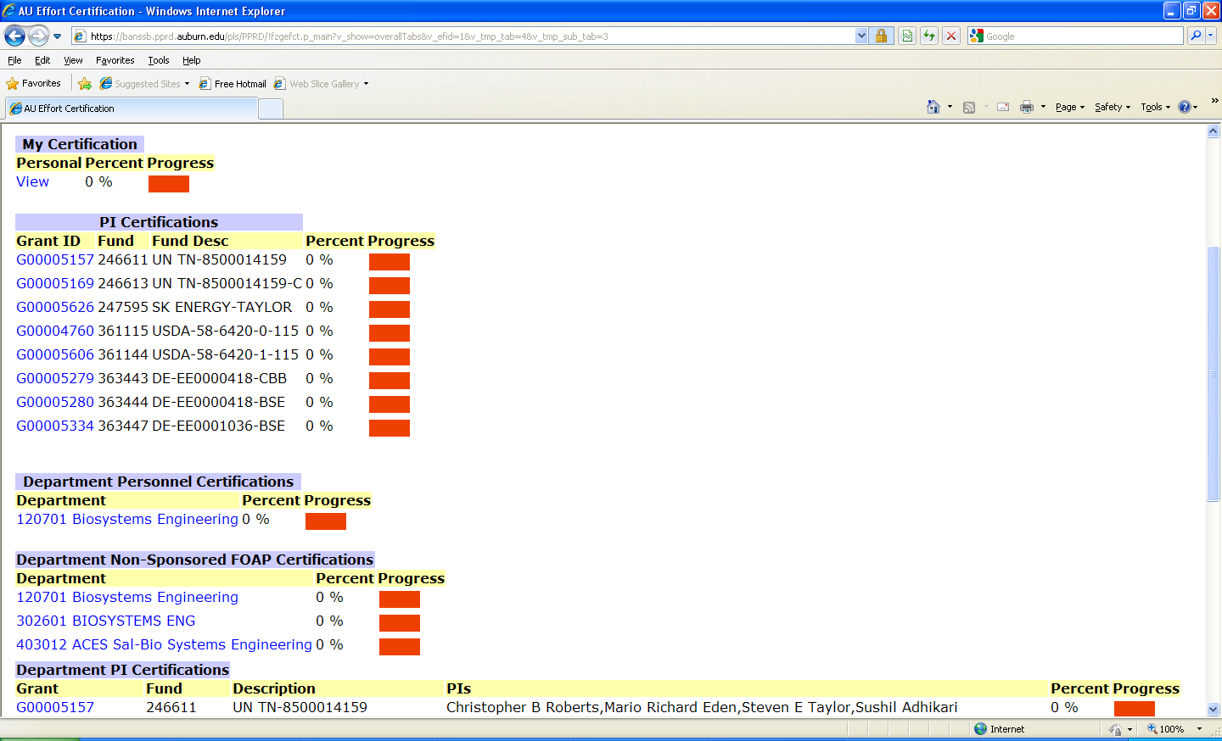
Department Overview

Slide 33
Request to Unlock A Row
Only rows which have been certified are available
After selecting which rows in a certification need to be unlocked, give a reason
This now appears under “Awaiting Action”
Contracts and Grants Accounting will have to approve the request

Slide 34
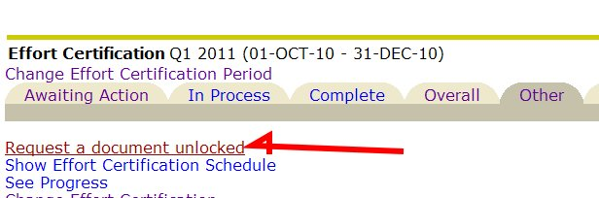
Request to Unlock A Row
Go To Other Tab and select
Request a document unlocked

Slide 35
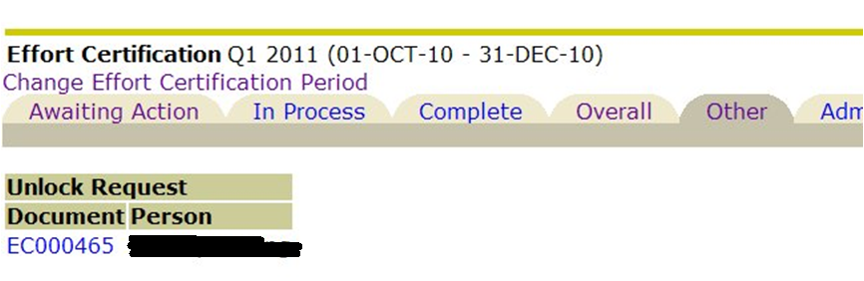
Request to Unlock A Row
Only rows which have been certified are available

Slide 36
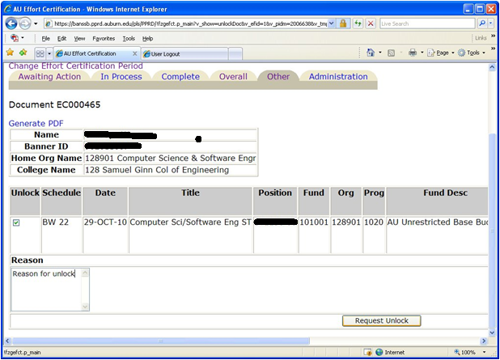
Request to Unlock A Row
After selecting which rows in a certification need to be unlocked, give a reason

Slide 37
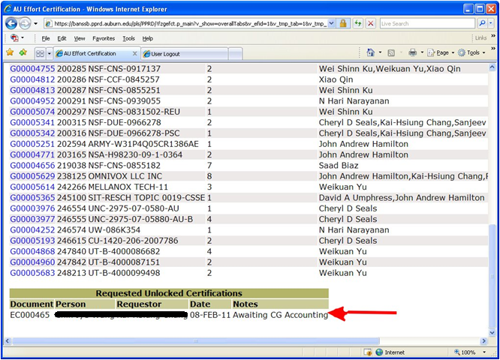
Request to Unlock A Row
This now appears on the Awaiting Action Tab

Slide 38
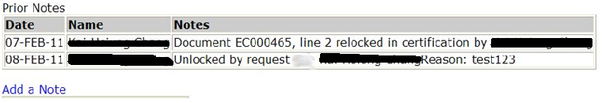
Request to Unlock A Row
Upon Certification, a note is made to the document

Slide 39
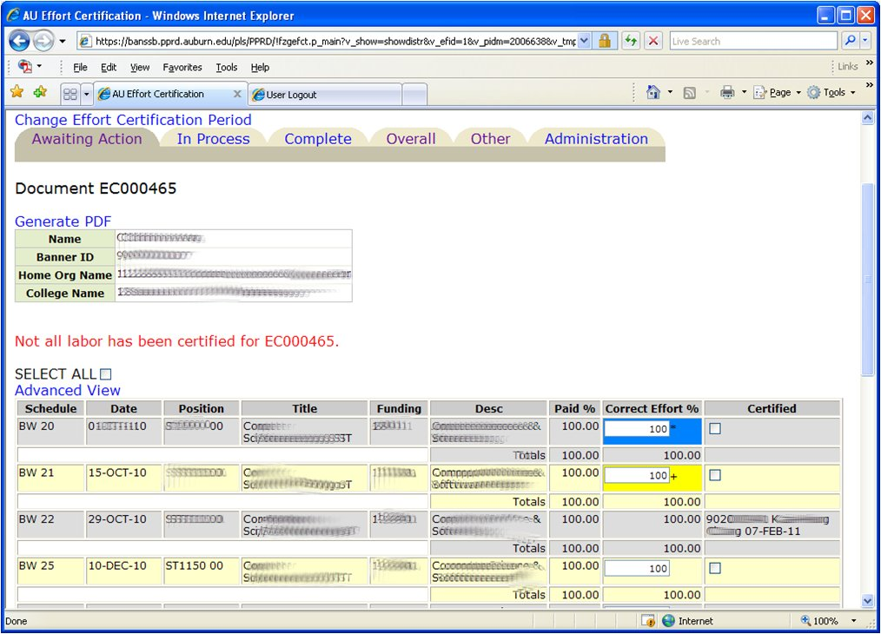
“SAVE” Options
Blue – saved value
Yellow – unlocked row
Certified
Person / Date

Slide 40
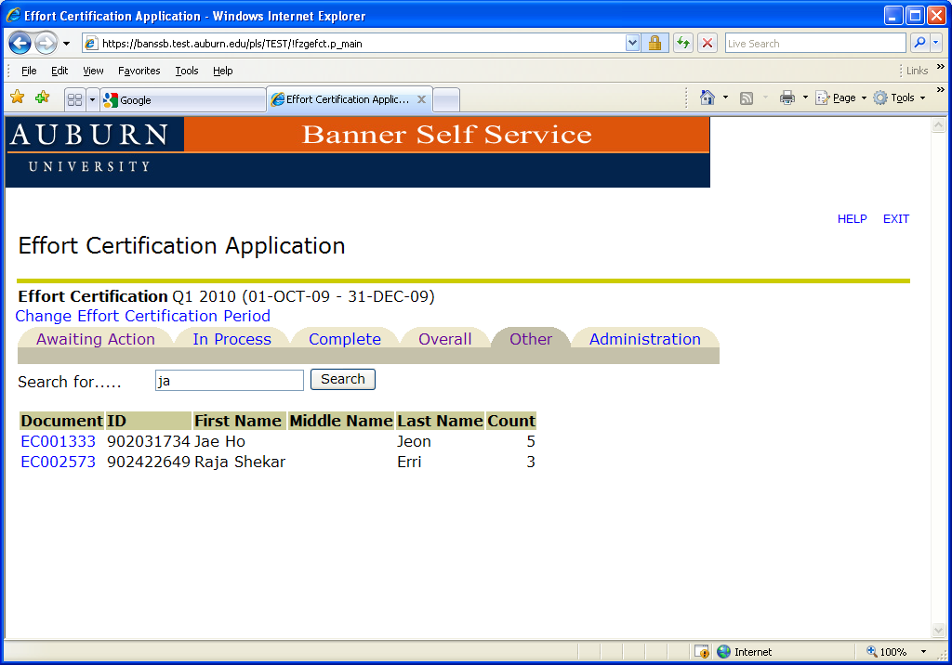
Person Search

Slide 41
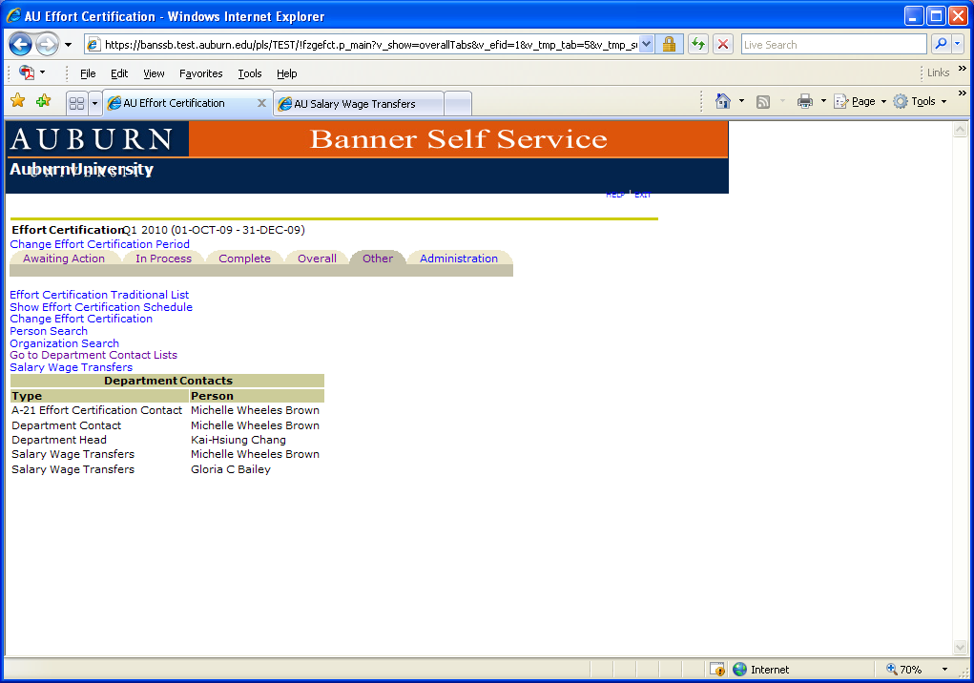
Departmental Contacts

Slide 42
Email Notification System
Automatic notifications to be emailed:
1. 5th day after quarter end
-PAR Administrators; Dept. Financial Administrators
2. 10th day after quarter end
-PI, Co-PI, Faculty, Research Personnel, Dept Head, ADR, Dean’s Contact
3. 30th day after quarter end
-PI, Co-PI, Faculty, Research Personnel PAR Administrator
4. 35th day after quarter end
-PI, Co-PI, Faculty, Research Personnel, PAR Administrator, Dept Financial Administrator, Dept Head, ADR, Dean’s Contact, Dean
5. 40th day after quarter end
-End of business day: System is closed

Slide 43
Consequence of Not Certifying an Effort Report within 40 Days of Quarter End
Expense related to the effort recorded on a sponsored or cost share FOP will be transferred to an unrestricted departmental funding source.

Slide 44
Questions?
Contact information:
Effort Certification effcert@auburn.edu 844-4847

