Slide 1
CIAO Plots
George Rush
Modified by Dr. T

Slide 2
Motivation
Coevolution is hard to visualize & analyze in traditional ways, such as eval-fitness plots; CIAO plots are a way to accomplish this.
This is also fair game for Exam 3 & Final Exam.

Slide 3
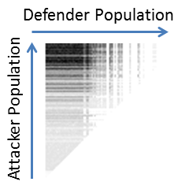
What Are CIAO Plots?
Current Individual vs. Ancestral Opponents
These are used to visually convey the progress of two populations during coevolution.
Note that each CIAO plot should have n by n pixels, where n is the number of generations.

Slide 4
Problems in Coevolution
Cycling
  Both populations circle around to previous solutions over and over again (e.g., rock-paper-scissors).
Disengagement
  One population becomes so powerful that the other is overwhelmed and cannot make progress.
Mediocre Stability
  Neither side evolves. This can happen if both opponents are too weak to provide any incentive to evolve (fitness landscape is basically flat).

Slide 5
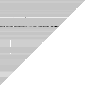


Cycling
Should show striation (stripes), but may not be horizontal. Could be vertical, diagonal, etc.
These plots are actually caused by random survival selection, but illustrate the idea.

Slide 6
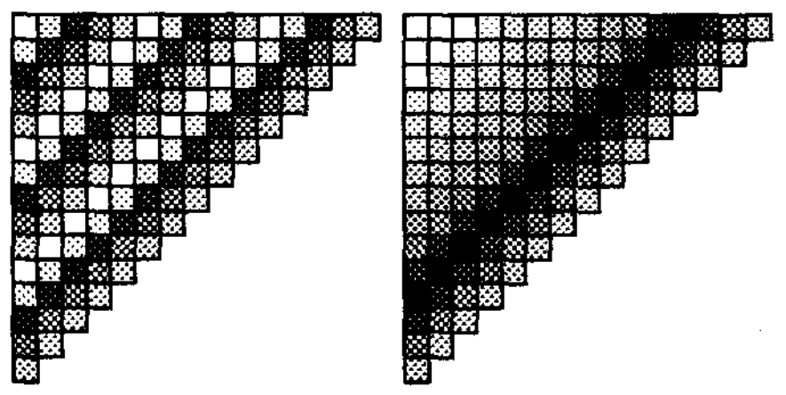
Cycling (continued)

Slide 7
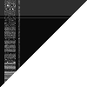
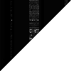


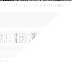

Disengagement
Long periods of inactivity. One side will have consistently high fitness while the other is low.

Slide 8



Mediocre Stability
Neither side changes much, and neither seems to be much stronger.

Slide 9
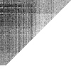
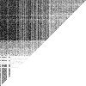
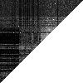
What Do CIAO Plots of Good Evolution Look Like?
Relatively smooth gradients showing evolution on both sides.

Slide 10
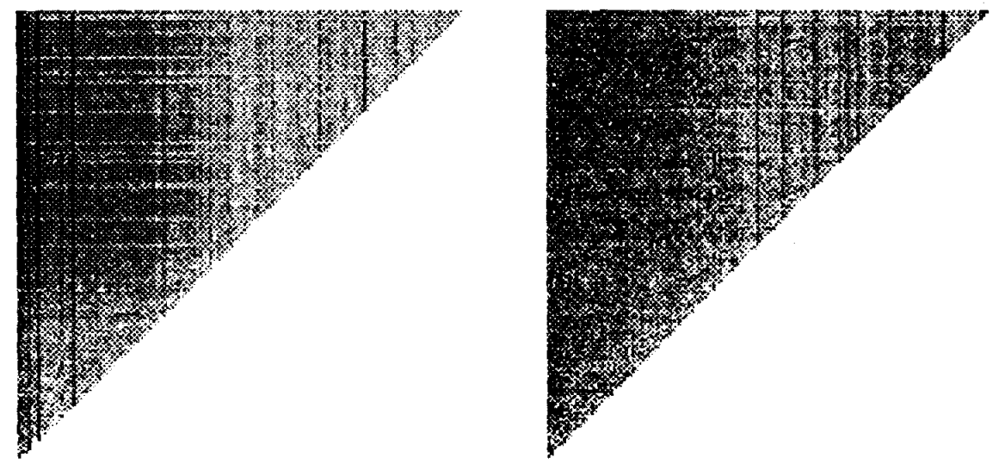
More CIAO Plots of Good Evolution

Slide 11

How to Generate CIAO Plots
Store the best member of each population during each generation.
Population A
Population B

Slide 12


How to Generate CIAO Plots
Choose which population corresponds to the x-axis and y-axis. Each y-axis ancestor must fight the ghosts of their strongest enemies throughout time, so all ancestral opponents (from before that generation). Record fitness each time.

Slide 13
How to Generate CIAO Plots
Normalize the fitness data on a [0, 1] scale. Here is pseudocode to do this:
find minimum recorded fitness value (minFitness)
if minFitness < 0
add |minFitness| to all fitness values
else if minFitness > 0
subtract minFitness from all fitness values
find maximum from current fitness values (maxFitness)
divide all fitness values by maxFitness
[ 1, 3, 5, 9 ]
[ 0, 2, 4, 8 ]
[ 0, 0.25, 0.5, 1 ]

Slide 14
How to Generate CIAO Plots
Create an image pixel by pixel. Darker pixels (lower luminance) are considered to be better for the party on the y-axis. Since CIAO plots are grayscale and the fitness values are normalized on [0, 1], each pixel can be set using luminance. Note that fitness may first need to be subtracted from 1 if higher fitness is considered better.
luminance = fitness * maxLuminance
OR
luminance = (1 – fitness) * maxLuminance

Slide 15
Creating Images
For building images pixel by pixel, I recommend using Pillow (https://python-pillow.github.io/). This is a fork of the Python Imaging Library. I have used it here to output PNG images.
In C++, you might try creating BMP images manually:
  http://stackoverflow.com/questions/1863344/c-creating-image
Alternately, there are C++ libraries for this as well, but I have not tried them. For instance:
  http://pngwriter.sourceforge.net/
  http://stackoverflow.com/questions/3544359/is-it-possible-to-create-an-image-with-c

Slide 16
References
Dave Cliff and Geoffrey F. Miller, Tracking the red Queen: Measurements of Adaptive Progress in CoEvolutionary Simulations. In Advances in Artificial Life, Lecture Notes in Computer Science, Volume 929, Pages 200-218, Springer-Verlag, Berlin Heidelberg, 1995, ISBN 978-3-540-59496-3. http://www. cs.uu.nl/docs/vakken/ias/stuff/cm95.pdf
George Rush, Daniel R. Tauritz, and Alexander D. Kent. Coevolutionary Agent-based Network Defense Lightweight Event System (CANDLES). In Proceedings of the 17th Annual Conference Companion on Genetic and Evolutionary Computation (GECCO Comp '15), ACM, pages 859 – 866, Madrid, Spain, July 11-15, 2015.

